Slide 1
Say Sounds (A–B)
Say Sounds
Phonemic Awareness Listen to the sounds as your teacher says
a word slowly. Then say the word.
Letter/Sound Associations Look at the letters. Say the sounds.
  ai ee ck ea
  ch ay u ea
  ee o e ai
  ea a ee sh
  ay ea i th

Slide 2
Read Words (C)
Read Words
New Words Say the sound. Sound out the word. Read the word.
  deep keep team
  fail feel real
  raid beep weed
  peel pail seal
  clean meet treat
  trait hail cream

Slide 3
Read Words (D)
Word Families Read down. Read rapidly.
deep
keep
sheep
sleep
creep
feel
heel
peel
steel
wheel
each
beach
peach
reach
teach
10 Second Challenge
Cold Timing words read
Practice words read
Hot Timing words read

Slide 4
Read Words (E–F)
Review Words Read a line of words. When your teacher
gives a meaning, circle the correct word.
  main man than trip
  raid Ray pray spray
  paint rain sat thin
  plan play pay train
Words with Endings Sound out the underlined base word.
Read the base word with the ending.
  1. peeled 2. weeded 3. helped 4. cleaned 5. healed

Slide 5
Read Words (G–H)
Multisyllabic Challenge Words Sound out the syllables.
Read the whole word.
  freeway indeed seasick reason
  freedom cleanup plastic problems
High-Frequency Words Say. Spell. Read.
  into come some things after
  water little you people they

Slide 6
Read Sentences (I)
Read Sentences
Sentences Read the sentences with phrasing.
  They will keep working until ten.
  Please come and help clean some things in the sink.
  Let’s pick the best spot for you and me to meet after lunch.
  The sheep will step into the water where it is not deep.
  Kevin will leave the bags next to the tree after
  the cleanup.

Slide 7
Spell Words (J)
Spell Words
Spelling Journal Turn to the Spelling Journal on page 196.

Slide 8
Decodable Informative Text (Part 1)
Decodable Informative Text Read each part. Answer your
teacher’s questions and select the picture that goes with each part.
Ways to Help Seas
Part 1
Teacher Reads People can make a big difference when it comes to
protecting our oceans. There are things everyone can do to help seas.
11
21
31
43
55
People have to work to help seas. There are lots of
ways people can help. People need to keep the beach
clean. Trash on the beach can reach seawater. If the
water is not clean, the fish that people eat may not be
clean. In fact, if seawater is not clean, it may kill fish.
People can have a beach cleanup to pick up trash.

Slide 9
Decodable Informative Text (Part 1) — cont’d
65
76
85
96
They may get a little help from sea gulls. Sea gulls
come on the beach after people leave things there.
People drop some of the things they eat. Sea gulls eat
the things people leave.

Slide 10
Comprehension Questions Part 1
What can happen to fish if trash gets into seas?
If trash gets into seas, fish might ________________.
What can people do to keep beaches clean?
To keep beaches clean, people can ________________.

Slide 11
Decodable Informative Text (Part 2)
Part 2
Teacher Reads Plastic that gets in seas is particularly damaging and may
cause problems for sea animals.
100
111
122
134
145
154
When plastic is put in the trash, it can crack into
little bits. Each little bit can get into seawater. Fish may
think the plastic bits are things to eat. If fish eat the
plastic, they can get sick. The plastic may kill the fish.
To help with the problems, people can use less
plastic. They may aim to go plastic free.

Slide 12
Comprehension Questions Part 2
What item is harmful if it gets into seawater?
One item that is harmful if it gets into seawater is ________________.
If fish eat plastic, how might they be harmed?
If fish eat plastic, they might ________________.
In regard to plastic, how might people help seas?
People can help seas if they ________________.

Slide 13
Decodable Informative Text (Part 3)
Part 3
Teacher Reads Some kinds of fish in seas are endangered (at risk of
dying out forever) and need our help. Read on to find out what we
can do.
162
173
183
193
204
206
216
228
239
248
258
260
Seas are full of fish. But there are less and less
of some fish because people eat a lot of them.
Plus, some fish are killed when they eat trash and
plastic. Thus, there are less of some fish in seas; they
are endangered.
We can help with the loss of endangered fish in
seas. When we plan a meal, we can pick fish that are
not endangered, that still have a lot in seas. That’s a
way to keep seas full of lots of fish.
Each little act from people can help seas in a
big way!

Slide 14
Comprehension Questions Part 3
Why are there less of some fish?
There are less of some fish because ________________.
How can people help with the loss of fish in seas?
People can help with the loss of fish in seas by ________________.

Slide 15
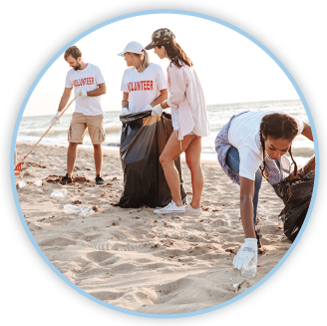
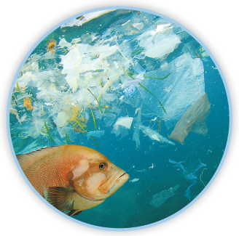
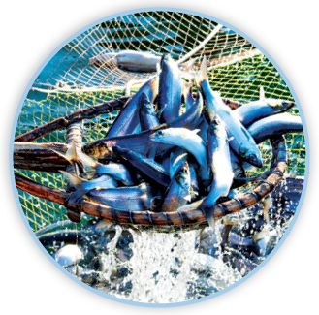
Picture Match
Part ______
Part ______
Part ______

Slide 16
Independent Practice (L) Part 1
Independent Practice
Text Comprehension Read each question. Think of the answer or look back
at the text. Fill in the blank. Be sure the sentence makes sense.
Part 1
  1. WHAT can happen to trash on the beach?
  Trash on the beach can ____________________________________________.
  2. WHAT can happen if seawater is not clean?
  If seawater is not clean, the fish people eat _____________________________.
  3. HOW can people keep the beach clean?
  People can keep the beach clean when ________________________________.

Slide 17
Independent Practice (L) Part 2
Part 2
  4. WHAT thing in the trash can get into seas?
  The thing in the trash that can get into seas is ___________________________.
  5. WHAT can happen if fish eat plastic?
  If fish eat plastic, it can _____________________________________________.
  6. HOW can people help seas?
  People can help seas when they _____________________________________.

Slide 18
Independent Practice (L) Part 3
Part 3
  7. WHAT happens when people eat a lot of some fish?
  When people eat a lot of some fish, the fish will be _______________________.
  8. HOW can we plan a meal to help with endangered fish?
  We can plan to pick fish that are _____________________________________.

Slide 19
Independent Practice (M)
More Practice Read each group of words. Change the order of the groups
to make a sentence. Write each sentence on the line.
  in the tree had a nest The jay
  2. will sleep The seal on the rock
  3. The swim team a treat will get

Slide 20
Independent Practice (M) — cont’d
  4. will clean the mess Lee
  5. in the deep water Dad can swim
  6. off the peach the skin Mom will peel
  7. to see me Please come act in the play
  8. pay a lot for the sheets Gwen may

