Slide 1
Say Sounds (A–B)
Say Sounds
Phonemic Awareness Listen to the word your teacher says. Then say the sounds in the word.
Letter/Sound Associations Look at the letters. Say the sounds.
light
igh ee oa u
ai ay e ea
ee ow igh i
ai igh oa a
ow o ea ay

Slide 2
Read Words (C)
Read Words
New Words Say the sound. Sound out the word. Read the word.
high night fight
flown sight rain
blown bright teeth
cheat coast right
sigh see say
hay bleach blow

Slide 3
Read Words (D)
Word Families Read down. Read rapidly.
fight
sight
might
light
flight
pain
main
rain
train
strain
eat
meat
seat
wheat
treat
10 Second Challenge
Cold Timing words read
Practice words read
Hot Timing words read

Slide 4
Read Words (E–F)
Review Words Read a line of words. When your teacher gives a meaning, circle the correct word.
clamp clasp lamp stamp
twist west thick clap
fresh rush plush list
stand bench lunch brunch
Words with Endings Sound out the underlined base word. Read the base word with the endings.
1. wished 2. bleached 3. twisted 4. rushed 5. clamped
wishing bleaching twisting rushing clamping

Slide 5
Read Words (G–H)
Multisyllabic Challenge Words Sound out the syllables. Read the whole word.
highway tonight upright lightning
brighten railroad speedboat splendid
High-Frequency Words Say. Spell. Read.
do use been who of
school were after all there

Slide 6
Read Sentences (I)
Read Sentences
Sentences Read the sentences with phrasing.
It had been a hot night, so Sal needed to use a fan.
Who were the people you met right after class?
Ms. Hill saw lightning so we went into the school.
Crow sat high in a tree with the chunk of cheese.
Please brighten the screen so we can see it from the back.

Slide 7
Spell Words (J)
Spell Words
Spelling Journal Turn to the Spelling Journal on page 197.

Slide 8
Decodable Narrative Text (Part 1)
Decodable Narrative Text Read each part. Answer your teacher’s questions and select the picture that goes with each part.
The Fox and
the Crow
Part 1
Teacher Reads A fable is a short story that uses animal characters to teach a lesson about human behavior. In this fable about Fox and Crow, one of the animal characters learns a valuable lesson about trusting those who give too many compliments, comments that say something good about someone.
10
22
32
43
55
On a bright, sunlit day, Crow just had to have something to eat. All of a sudden, he saw a chunk of cheese in the grass. “Such luck!” he said to himself. “I will have such a grand meal!” Crow picked up the cheese in his beak. Then he went up to a high branch of a tree to eat it.

Slide 9
Decodable Narrative Text (Part 1) — cont’d
61
71
82
A passing Fox saw Crow with the cheese, and he began to think of a plan. “I must have that cheese!” said Fox to himself, with a grin.

Slide 10
Comprehension Questions Part 1
Who are the main characters in the fable?
The main characters in the fable are ________________.
What did we learn about the setting?
We learned that the setting contains ________________.
What problem did Fox have?
The problem Fox had was ________________.

Slide 11
Decodable Narrative Text (Part 2)
Part 2
Teacher Reads Fox has a plan in mind. Read on to find out what it is.
89
97
108
110
119
131
140
153
“Greetings, Crow!” said Fox, looking up at him. Crow sat on the high branch and held the cheese in his beak.
“You are looking well today!” said Fox. Fox waited for Crow to speak. As Fox looked up at Crow, he was thinking, “If Crow speaks, the cheese will drop from his beak.” But Crow did not say a thing. He held on to the cheese.

Slide 12
Decodable Narrative Text (Part 2) — cont’d
155
164
175
184
193
203
214
Fox went on. “You are such a handsome sight! In fact, you are the best-looking crow in the land!” Crow looked down at Fox. He was thrilled with Fox’s praise, but he did not say a thing.
Fox kept on with the praise. “You have wings of black silk and a beak that is splendid!” Crow puffed up his chest, but he still did not speak.

Slide 13
Comprehension Questions Part 2
What was Fox trying to do?
Fox was trying to ________________.
What compliments did Fox give to Crow?
One compliment that Fox gave to Crow was ________________.

Slide 14
Decodable Narrative Text (Part 3)
Part 3
Teacher Reads So far, Crow has not let go of the cheese. Keep reading to see if Crow responds, or says something, to Fox.
222
233
244
257
267
269
280
291
301
311
322
330
“I bet that you can sing,” said Fox. “Am I right? Please, Crow, will you sing a song?” he asked. “I may weep if I do not get a sweet song from you!” he added with a sigh. “Indeed, I will not sleep tonight unless you sing.”
Crow wished to show off to Fox, and he sang a song. When he did, the cheese fell from his beak and landed right next to Fox’s feet. Fox picked up the cheese and ran off with it. “Thank you, Crow!” Fox yelled with glee. Crow saw Fox’s trick, and he was mad at himself for thinking the praise was real.

Slide 15
Comprehension Questions Part 3
Why did Fox try to make Crow sing?
Fox tried to make Crow sing so that ________________.
What happened in the end when Crow sang?
When Crow sang, ________________.
In the fable, what lesson did Crow learn?
In the fable, Crow learned ________________.

Slide 16
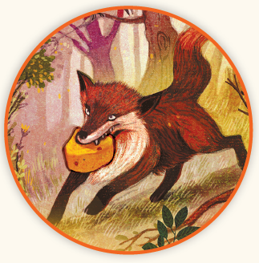
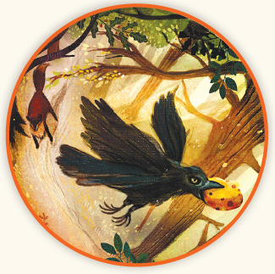
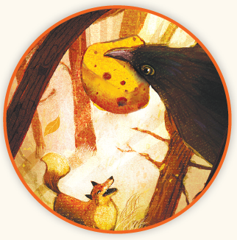
Picture Match
Part ______
Part ______
Part ______

Slide 17
Independent Practice (L) Part 1
Independent Practice
Text Comprehension Read each question. Think of the answer or look back at the text. Fill in the blank. Be sure the sentence makes sense.
Part 1
1. WHO is in the story? ____________________________________________ are in the story.
2. WHERE did Crow go to eat the cheese? To eat the cheese, Crow went _______________________________.
3. WHAT problem did Fox have? Fox’s problem was he _____________________________________.

Slide 18
Independent Practice (L) Part 2
Part 2
4. WHAT plan did Fox have? Fox’s plan was to get Crow to ____________________________________.
5. WHAT did Fox say to Crow? Fox said to Crow _______________________________________________ _____________________________________________________________.

Slide 19
Independent Practice (L) Part 3
Part 3
6. WHY did Fox want Crow to sing? Fox wanted Crow to sing so ___________________________________.
7. WHAT happened when Crow sang? When Crow sang, ___________________________________________.
8. WHY was Crow mad at himself at the end of the story? Crow was mad at himself because ______________________________.

Slide 20
Independent Practice (M) Story 1
More Practice Read each story. Fill in each blank with the best word.
Story 1: It had been snowing all day and night. The wind had blown the trees so that lots of sticks fell down. Sam saw that the snow was high and deep on the road.
“Do you see that? It is a sight to see!” he said to Mel. “We may have to stay in all day. We can use a day off from school!”
1. The snow fell all day and ________.
need night not
2. The wind had ________ the trees so that sticks fell down.
float blown green
3. The snow was ________ on the road.
heap hill high
4. The snow was a ________ to see.
sight shame white

Slide 21
Independent Practice (M) Story 2
Story 2: “Mom will be upset when she sees that I got paint on her light green coat,” Liz said to Jess. “Get the bleach off the high shelf there. It’s the bright red box. Bleaching may not be right. But it is all I can think of to do with the coat. So I will have to use the bleach.”
1. Liz got ________ on Mom’s coat.
paint sight faint
2. Liz asked Jess to get the ________.
beet light bleach
3. The bleach is on the ________ shelf.
high hay heat
4. The bleach box is ________ red.
little bright spots

