Slide 1
Say Sounds (A–B)
Say Sounds
Phonemic Awareness Listen to the word your teacher says.
Then say the sounds in the word.
Letter/Sound Associations Look at the letters. Say the sounds.
  oa ay ee ow
  ea o oa a
  ay ow ea ai
  ee oa i u
  ow ea ai oa

Slide 2
Read Words (C)
Read Words
New Words Say the sound. Sound out the word. Read the word.
  tow goat loan
  lean glow rail
  roast bay bow
  blown mean float
  tea toast coast
  coach fleet throw

Slide 3
Read Words (D)
Word Families Read down. Read rapidly.
mow
tow
snow
flow
crow
oat
moat
goat
float
throat
main
rain
stain
train
sprain
10 Second Challenge
Cold Timing words read
Practice words read
Hot Timing words read

Slide 4
Read Words (E–F)
Review Words Read a line of words. When your teacher
gives a meaning, circle the correct word.
  sweet wed weed plan
  stem stream stray cream
  sprain rain hill thrill
  pill peel plant team
Words with Endings Sound out the underlined base word.
Read the base word with the endings.
  1. loaned 2. glowed 3. planted 4. peeled 5. toasted
  loaning glowing planting peeling toasting

Slide 5
Read Words (G–H)
Multisyllabic Challenge Words Sound out the syllables.
Read the whole word.
  pillow boatload snowman rainbow
  fellow roadway hollow windowsill
High-Frequency Words Say. Spell. Read.
  school some all work are
  said little you saw look

Slide 6
Read Sentences (I)
Read Sentences
Sentences Read the sentences with phrasing.
  All the pillows on the bed are soft.
  There are three boats floating in the water.
  Dad said that we can roast hot dogs for lunch.
  The coach at school did a lot to help the team win.
  The toast is plain, so you can put a little jam on it.

Slide 7
Spell Words (J)
Spell Words
Spelling Journal Turn to the Spelling Journal on page 196.

Slide 8
Decodable Narrative Text (Part 1)
Decodable Narrative Text Read each part. Answer your teacher’s
questions and select the picture that goes with each part.
Sinking Fast!
Part 1
Teacher Reads In the first part of this story, Emma and Nic realized the
boat had a slow leak, and they needed to stop it from sinking. Let’s find
out what they do next.
10
22
33
41
53
64
The rowboat floated with a tilt. “Bail the water as
fast as you can, Emma! I will throw the fish and the
bait off the boat. That will help us to keep floating.
I wish I had not slept,” Nic said.
“It looks as if we are still a long way from land,”
Emma said. “Can we get back to land with all this
water in the rowboat?”

Slide 9
Comprehension Questions Part 1
While Emma bailed water, what did Nic do to try to solve the problem?
While Emma bailed water, Nic tried to solve the problem by
________________.

Slide 10
Decodable Narrative Text (Part 2)
Part 2
Teacher Reads The land seems far away. Emma and Nic are in a race
against time—and water!
68
78
90
102
104
114
126
“Let’s wait and see,” said Nic. “I think we can.
The wind has blown us a little. We seem to be floating
OK. The dock where we got the boat is just past the
next bend.”
At last, they saw the boats at the dock. “There
it is!” Emma said. “Let’s get to the dock and get off
this boat!”

Slide 11
Comprehension Questions Part 2
Was the boat sinking or floating?
The boat was ________________.
Were Nic and Emma close to or far away from the dock?
Nic and Emma were ________________.

Slide 12
Decodable Narrative Text (Part 3)
Part 3
Teacher Reads Nic and Emma kept the rowboat from sinking and
made it to the dock. As for the leaky boat, the man at the dock has some
explaining to do.
128
140
153
163
174
182
194
205
“There was a big mix-up,” said the man at the dock.
“You got the boat with the leak. This is the day I had
plans to fix that leak. Are you OK?” he said.
“Yes, we are,” Emma said. “But it was not the best
day for us!” she said, a bit upset.
Nic said, “I will not be sleeping on a boat. The water
is not fun when you are in a boat that leaks!”

Slide 13
Comprehension Questions Part 3
What did the man at the dock need to explain?
The man at the dock needed to explain ________________.
What did Nic learn from their boat trip?
Nic learned from their boat trip that ________________.

Slide 14
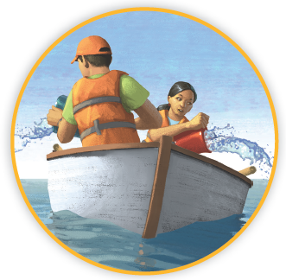
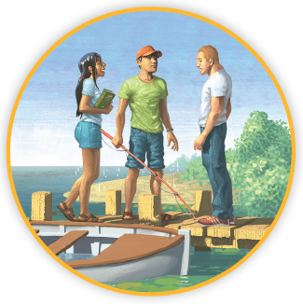
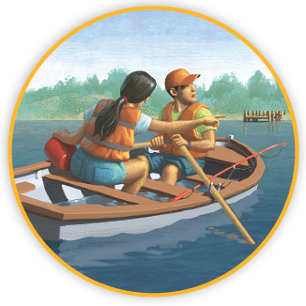
Picture Match
Part ______
Part ______
Part ______

Slide 15
Independent Practice (L) Part 1
Independent Practice
Text Comprehension Read each question. Think of the answer or look back
at the text. Fill in the blank. Be sure the sentence makes sense.
Part 1
  1. WHAT did Nic say to Emma?
  Nic said Emma must _________________________________________.
  2. HOW did Nic help with the problem?
  Nic helped when he _________________________________________.

Slide 16
Independent Practice (L) Part 1 — cont’d
  3. WHAT did Nic say can happen if each of them helped?
  Nic said if each of them helped, they would _______________________.
  4. WHAT did Emma say as she bailed water?
  Emma said that _____________________________________________.

Slide 17
Independent Practice (L) Part 2
Part 2
  5. HOW did the wind help?
  The wind began to _________________________________________.
  6. WHAT did Nic and Emma see at last?
  At last Nic and Emma saw the ________________________________.

Slide 18
Independent Practice (L) Part 3
Part 3
  7. WHAT did the man at the dock say to Emma and Nic?
  He said there was a __________________________________________.
  8. WHAT were the man’s plans?
  The man had plans to _________________________________________.

Slide 19
Independent Practice (M) Story 1
More Practice Read each story. Fill in each blank with the best word.
  Story 1: Liz was sick with a pain in her throat. She missed school three days
  in a row. Dad said, “Please eat the toast and drink all the tea, Liz. You need
  to eat a little so you can get well. After you get well, you can eat roast beef!
  But toast and tea are best when you feel sick.” Liz just groaned as she lay in
  her own bed.
  1. Liz was ________.
sock soak sick
  2. Dad got Liz tea and ________.
rash toast coast
  3. When she is well, Liz can eat ________ beef.
rest roast toad
  4. Liz just ________.
groaned loaned mailed

Slide 20
Independent Practice (M) Story 2
  Story 2: The class is on a school trip. They go to see boats and ships at the
  coast. The ships are so big! The class stands on a dock that floats. They see a
  little boat chug in a slow way up to a big ship. People in gray coats work on
  the little boat. The little boat will tow the big ship to the dock.
  1. The class is on a trip to the ________.
coast cast coach
  2. They see ________ and ships.
roads roasts boats
  3. The people on the little boat have on
  gray ________.
coats crows goats
  4. The little boat will ________
  the big ship to the dock.
rot tow blow

