Slide 1
Say Sounds (A–B)
Say Sounds
Phonemic Awareness Listen to the sounds as your teacher says a word slowly. Then say the word.
Letter/Sound Associations Look at the letters. Say the sounds.
ee ai a ea
i ea th u
sh ai ee ay
ee ay ea e
ai o ch ee

Slide 2
Read Words (C)
Read Words
New Words Say the sound. Sound out the word. Read the word.
reach three sheep
tree tray leak
heel hail wheel
sleep green grain
speak steal teeth
dream scream spray
Irregular Word: been

Slide 3
Read Words (D)
Word Families Read down. Read rapidly.
feet
meet
sheet
greet
street
team
beam
steam
dream
cream
leak
beak
weak
speak
streak
10 Second Challenge
Cold Timing words read
Practice words read
Hot Timing words read

Slide 4
Read Words (E–F)
Review Words Read a line of words. When your teacher gives a meaning, circle the correct word.
braid rain thin mitt
step stay ship spend
raid rid mist mail
press raise wait wit
Words with Endings Sound out the underlined base word. Read the base word with the ending.
1. screamed 2. drained 3. sprayed 4. reached 5. stepped

Slide 5
Read Words (G–H)
Multisyllabic Challenge Words Sound out the syllables. Read the whole word.
teapot steamship sleepless treetop
speedway absentee exclaim maybe
High-Frequency Words Say. Spell. Read.
down into come there saw
said have was were little

Slide 6
Read Sentences (I)
Read Sentences
Sentences Read the sentences with phrasing.
In my dream, people were set to have a grand feast.
Mom said, “Please come get the green teapot.”
My little cat will leap down from the tree branch.
There is a fast way to reach the end of the path.
Laila got into the truck, then she spun the wheels to go.

Slide 7
Spell Words (J)
Spell Words
Spelling Journal Turn to the Spelling Journal on page 196.

Slide 8
Decodable Narrative Text (Part 1)
Decodable Narrative Text Read each part. Answer your teacher’s questions and select the picture that goes with each part.
Stop Feeding the Sheep!
Part 1
Teacher Reads Laila and Colleen work on a farm taking care of sheep. They recently changed the kind of grain they feed the sheep. One day, Laila receives a letter with a warning about the grain. Laila panics: she feels scared and nervous. Let’s learn about the warning.
10
21
Laila looked at the mail. She saw this: “You must NOT feed the grain to the sheep. The grain is bad. The sheep will get sick!”

Slide 9
Decodable Narrative Text (Part 1) — cont’d
26
35
46
58
69
The sheep were at the creek with Colleen. Laila needed to get there—and fast! She had to tell Colleen not to feed the grain to the sheep. Laila ran to the truck and jumped in. The wheels spun, and she was off in a flash!

Slide 10
Comprehension Questions Part 1
Who are the main characters in this story?
The main characters in this story are ________________.
What warning came in the mail?
The warning that came in the mail was ________________.
What problem did Laila have?
The problem that Laila had was ________________.
What action did Laila take to solve the problem?
To solve the problem, Laila ________________.

Slide 11
Decodable Narrative Text (Part 2)
Part 2
Teacher Reads Read on to find out what Laila must do to find Colleen and the sheep.
72
82
92
103
105
115
125
135
“The best way to get to the creek is Green Leaf Trail,” Laila said. “After I get there and speak to Colleen, I can rest. Maybe she has not fed the sheep yet!”
Laila did not go fast because the mist was thick. The truck went down the trail, which had lots of bumps. Then Laila saw the creek. She left the truck next to a tree and ran down the steep trail.

Slide 12
Comprehension Questions Part 2
Why was the drive to the creek difficult?
The drive to the creek was difficult because ________________.

Slide 13
Decodable Narrative Text (Part 3)
Part 3
Teacher Reads Keep reading to find out if Laila will get to the creek in time to help the sheep.
145
154
163
172
184
196
201
211
222
233
243
247
When Laila reached the creek, she did not see Colleen. She ran in the mist and screamed, “Colleen! Colleen! Are you there?” At last, she saw Colleen. “Look at this,” said Laila. “It was in the mail. You must not feed the grain to the sheep. The grain is bad, and the sheep will get sick!”
Colleen did not speak. She ran to the sheep, picked up the pail of grain, and yelled, “Go, sheep! Go!” Then Colleen ran back to Laila with the pail of grain. “The sheep did not eat the grain!” she exclaimed. “They are OK! Thank you, Laila!”

Slide 14
Comprehension Questions Part 3
What action did Colleen take to solve the problem of the bad grain?
To solve the problem of the bad grain, Colleen ________________.

Slide 15
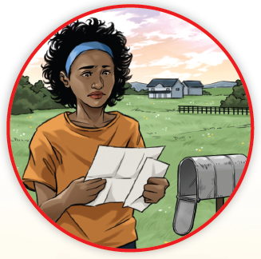

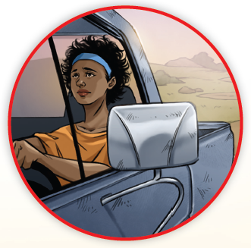
Picture Match
Part ______
Part ______
Part ______

Slide 16
Independent Practice (L) Part 1
Independent Practice
Text Comprehension Read each question. Think of the answer or look back at the text. Fill in the blank. Be sure the sentence makes sense.
Part 1
1. WHO are the people in the story? The people in the story are _________________________________________.
2. WHAT did Laila see when she looked at the mail? The mail said ____________________________________________________ _______________________________________________________________.

Slide 17
Independent Practice (L) Part 1 — cont’d
3. WHAT problem did Laila have? Laila’s problem was she had to ______________________________________.
4. HOW did Laila go to the creek? To go to the creek, Laila ____________________________________________.

Slide 18
Independent Practice (L) Part 2
Part 2
5. WHY did Laila not go fast on the trail? Laila did not go fast because ________________________________________.

Slide 19
Independent Practice (L) Part 3
Part 3
6. HOW did Laila act when she got to the creek? When Laila got to the creek, she _____________________________________.
7. HOW did Colleen act after she saw the mail? After Colleen saw the mail, she ______________________________________.
8. HOW were the sheep after Colleen got the grain from them? After Colleen got the grain from the sheep, the sheep were ________________.

Slide 20
Independent Practice (M)
More Practice Read each group of words. Change the order of the groups to make a sentence. Write each sentence on the line.
1. will fix That shop Mom’s jeans
2. the street ran down Cal
3. Jen sprayed with water the wheels

Slide 21
Independent Practice (M) — cont’d
4. The truck three trees is next to
5. can reach Will the gray tray
6. dreams in his sleep Sam
7. Clean teeth slick feel

Slide 22
Independent Practice (M) — cont’d
8. in the mist were lost The little sheep
9. Mel said a big leak the tub had
10. at the train us Ben will meet

