Slide 1
Say Sounds (A–B)
Say Sounds
Phonemic Awareness Listen to the word your teacher says. Then say the sounds in the word.
Letter/Sound Associations Look at the letters. Say the sounds.
igh i oa ee
ow ea a ai
ay igh e ow
u oa igh ea
ai ee ay igh

Slide 2
Read Words (C)
Read Words
New Words Say the sound. Sound out the word. Read the word.
light slight high
trail right screen
snail sight street
throat sheet thigh
flight tray spray
bright speech might

Slide 3
Read Words (D)
Word Families Read down. Read rapidly.
sigh
high
thigh
high
sigh
oat
boat
goat
float
throat
rain
main
chain
plain
brain
10 Second Challenge
Cold Timing words read
Practice words read
Hot Timing words read

Slide 4
Read Words (E–F)
Review Words Read a line of words. When your teacher gives a meaning, circle the correct word.
class camp cramp shift
thick chick crack spend
swept which when land
plant plan path wept
Words with Endings Sound out the underlined base word. Read the base word with the endings.
1. stayed 2. trailed 3. crossed 4. planted 5. vanished
staying trailing crossing planting vanishing

Slide 5
Read Words (G–H)
Multisyllabic Challenge Words Sound out the syllables. Read the whole word.
lighten stoplight weeknight daydream
trainload invent streetlights electric
High-Frequency Words Say. Spell. Read.
what where do use work
things into all said they

Slide 6
Read Sentences (I)
Read Sentences
Sentences Read the sentences with phrasing.
Where can they get a light bulb for a lamp?
Tam said, “A slight breeze will help all of us feel less hot.”
Bright lights help us see what is on the street at night.
The jet was so fast and up so high that I lost sight of it.
The stoplight was red, so Aimee had to stop until it was green.

Slide 7
Spell Words (J)
Spell Words
Spelling Journal Turn to the Spelling Journal on page 197.

Slide 8
Decodable Informative Text (Part 1)
Decodable Informative Text Read each part. Answer your teacher’s questions and select the picture that goes with each part.
Jobs Come and Go
Part 1
Teacher Reads Jobs in the United States have changed as people developed new ways to meet different needs. Some jobs are no longer needed.
10
19
24
34
44
In the U.S., some jobs from the past have vanished from sight. They are not needed. People have invented fresh ways to do things.
In the past, there were no electric streetlights as we have today. The lights on the streets worked with gas. They were gas lamps.

Slide 9
Decodable Informative Text (Part 1) — cont’d
48
60
70
80
Each gas lamp had to be lit as night fell. The people doing this job went up and down the streets lighting each lamp. At daylight, the same people went back and snuffed each lamp, and the light went off.

Slide 10
Comprehension Questions Part 1
Why do some jobs change over time?
Some jobs change over time because ________________.
What is one example of a job that is no longer needed?
One example of a job that is no longer needed is ________________.

Slide 11
Decodable Informative Text (Part 2)
Part 2
Teacher Reads We don’t always appreciate the things that make life easier today. Learn about jobs that were necessary in the past.
88
98
109
121
131
141
152
161
171
Today people can set clocks that will get them up after a night’s rest. But in the past, workmen might not have had clocks. They needed a way to get up at sunup. They had to go to work at mills and plants.
In some places, people were paid to show up and get workmen up. For this job, people had big sticks to tap on the workmen’s windows. Some of the people tossed little rocks at the windows. That got the sleeping workmen up right away.

Slide 12
Decodable Informative Text (Part 2) — cont’d
175
184
194
204
In the past, streets were dirty. In some places, people paid kids to sweep up the filth at street crossings. The kids swept a path in front of people. The people stayed clean as they crossed the street.

Slide 13
Comprehension Questions Part 2
What is another example of a job that is no longer needed?
Another example of a job that is no longer needed is ________________.
Instead of paying people to tap on windows to get them up, what do people do now?
Instead of paying people to tap on windows to get them up, now people ________________.

Slide 14
Decodable Informative Text (Part 3)
Part 3
Teacher Reads As technology moves forward, it affects every part
of people’s lives. Just as the development of computers, cars, and
telephones have changed our lives, technology has greatly changed the
work people do.
213
222
233
243
246
256
265
279
284
Thanks to technology, some jobs in the U.S. have not stayed as they were in the past, such as sweeping streets. Today in the U.S., people have trucks to help them sweep streets.
Some jobs in the U.S. have not stayed at all. Lighting lamps and tapping on windows to get people up are jobs of the past. The jobs are fun to think of, but they are not needed today.

Slide 15
Comprehension Questions Part 3
Instead of kids sweeping streets, what do people use now?
Instead of kids sweeping streets, now people use ________________.

Slide 16
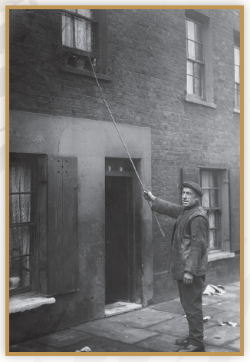
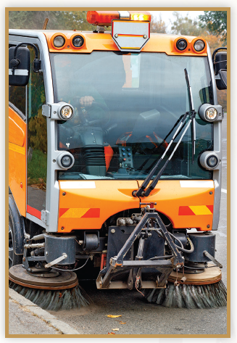
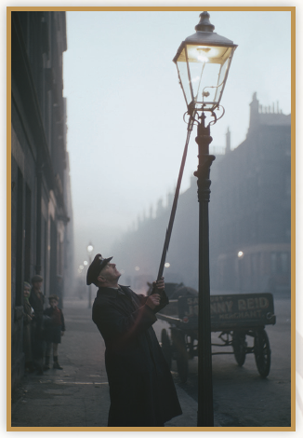
Picture Match
Part ______
Part ______
Part ______

Slide 17
Independent Practice (L) Part 1
Independent Practice
Text Comprehension Read each question. Think of the answer or look back at the text. Fill in the blank. Be sure the sentence makes sense.
Part 1
1. WHY do some jobs vanish? Some jobs vanish because _______________________________________.
2. WHAT job did people do in the past that they do not do today? Today, people do not ____________________________________________.
3. HOW are streets lit today? Today, streets are lit with _________________________________________.

Slide 18
Independent Practice (L) Part 2
Part 2
4. WHAT got workmen up at sunup in the past? Workmen got up when ___________________________________________.
5. WHAT can people do today when they need to get up? Today, when people need to get up they can __________________________.
6. HOW did people keep clean when crossing the street in the past?
People kept clean crossing the street when they _______________________
______________________________________________________________.

Slide 19
Independent Practice (L) Part 3
Part 3
7. WHY are some jobs not as they were in the past? Some jobs are not as they were because of _________________________.
8. HOW do people sweep streets today? Today, people sweep streets with _________________________________.

Slide 20
Independent Practice (M) Story 1
More Practice Read each story. Answer the questions.
Story 1: Ray and Nat went into a shop. Ray needed a light to use at his desk. Nat needed a lock to keep a box shut tight. After the shop, they went to get a snack. When they got back at night, Ray had a bright light. Nat had a lock for the box.
1. WHY did Ray need a light? Ray needed a light to use __________________________.
2. WHY did Nat need a lock? Nat needed a lock to ______________________________.
3. WHEN did Ray and Nat get back? Ray and Nat got back _____________________________.

Slide 21
Independent Practice (M) Story 2
Story 2: At the end of the trail, Nell said, “Where are we? I think we might be lost. Let’s use the map.” Sloan got the map, and Nell got a bright light. “Look! There is a road on the map!” said Nell. They went right to get to the road, so they were not lost after all!
1. WHEN did Nell say, “Where are we?” Nell said this when they reached __________________________.
2. WHO got the map? __________________________ got the map.

Slide 22
Independent Practice (M) Story 2 — cont’d
3. WHY did Nell need a bright light? Nell needed a bright light ____________________________.
4. WHY did Nell and Sloan go right? Nell and Sloan went right to __________________________.

