Slide 1
Say Sounds (A–B)
Say Sounds
Phonemic Awareness Listen to the sounds or word parts as your teacher says a word slowly. Then say the word.
Letter/Sound Associations Look at the letter. Say the sound.
mop
o t i o a
i r o b a
a d p m o
n o i f x
s a j v c

Slide 2
Read Words (C)
Read Words
New Words Say the sound. Sound out the word. Read the word.
on ox mob
mop map rat
rot fox rod
rid not Nat
Bob rip nod

Slide 3
Read Words (D)
Word Families Read down. Read rapidly.
mob
Bob
job
sob
rob
not
rot
cot
dot
got
top
pop
mop
hop
sop
10 Second Challenge
Cold Timing words read
Practice words read
Hot Timing words read

Slide 4
Read Words (E–F)
Multisyllabic Challenge Words Sound out the syllables. Read the whole word.
cannot fossil hatbox topic bandit
High-Frequency Words Say. Spell. Read.
after from to was with
my her see no water

Slide 5
Spell Words (G)
Spell Words
Spelling Journal Turn to the Spelling Journal on page 151.

Slide 6
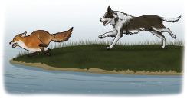
Read Text (H)
Read Text
Decodable Sentence Expansion Read each set of sentences. Then expand the last sentence by telling when. Select the picture that goes with each set.
A mom and a kid go. A mom and a kid go to the school. A mom and a kid go to the school in a cab. . . . , a mom and a kid go to the school in _____ a cab.

Slide 7
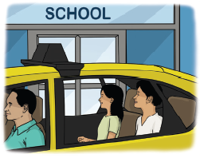
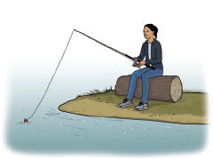
Read Text (H) — cont’d
A dog ran. A dog ran after the fox. A dog ran after the fox to the water. . . . , a dog ran after the fox to the water. _____
I see her. I see her on the log. I see her on the log with her rod. . . . , I see her on the log with her rod. _____

Slide 8
Independent Practice (I)
Independent Practice
More Practice 1 Fill in each blank with the best word.
1. The fox ________ from the dog.
hid sat cat
2. Bob ________ hot water.
top got pot
3. Gas can go in the ________.
six van mob
4. The dog ________.
ran rid not
5. The cat is ________ in the cabin.
Nan not nod

Slide 9
Independent Practice (I) — cont’d
6. The ________ is in the cabin.
rod did not
7. The rat is ________.
fin fat nod
8. The ________ was in the attic.
not box got
9. The pans cannot ________ in the bag.
rid hop fit
10. Bob has the ________.
ran rid map

Slide 10


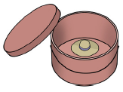
Independent Practice (J)
More Practice 2 Draw a line under the sentence that goes best with each picture.
1. The ox is on a hat.
The cat is on a hat.
2. Nan can mop the water.
Nan can sip the water.
3. The little hat is in the hatbox.
The little pin is on the hatbox.

Slide 11



Independent Practice (J) — cont’d
4. Bob ran after my dog.
The dog ran after the fox.
5. Nat is mad.
Nat is not mad.
6. The man has a can with a lid.
Bob has a mop.

Slide 12

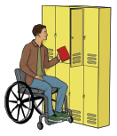
Independent Practice (J) — cont’d
7. The ham can rot in a bag.
The ham cannot rot in a tin.
8. Bob hid in the van.
Bob was at school.

