Slide 1
Say Sounds (A–B)
Say Sounds
Phonemic Awareness Listen to the word your teacher says. Then say the sounds or word parts in the word.
Letter/Sound Associations Look at the letters. Say the sounds.
u g i s ch
b wh th k e
r t l p k
c a f sh o

Slide 2
Read Words (C)
Read Words
New Words Say the sound. Sound out the word. Read the word.
grab plum grin
flat grip drum
club Glen slid
twin glad spot
skit drag spin

Slide 3
Read Words (D)
Word Families Read down. Read rapidly.
thin
grin
twin
skin
spin
grip
flip
trip
slip
clip
chum
glum
drum
plum
strum
10 Second Challenge
Cold Timing words read
Practice words read
Hot Timing words read

Slide 4
Read Words (E–F)
Review Words Read a line of words. When your teacher gives a meaning, circle the correct word.
stem shop hop trap
skip flip skin went
rug plug such frog
kid skid slip wind
Multisyllabic Challenge Words Sound out the syllables. Read the whole word. clinic unpack frantic backdrop gladness

Slide 5
Read Words (G)
High-Frequency Words Say. Spell. Read.
was said school into you
my people after very for

Slide 6
Read Sentences (H)
Read Sentences
Sentences Read the sentences with phrasing.
Glen was sick and went to the clinic.
Kip put red plums into a glass dish.
When Kevin is glad, he has a very big grin.
If you grip the bucket, I can fill it with water.
Viv said she will play the drums in a band after school.

Slide 7
Spell Words (I)
Spell Words
Spelling Journal Turn to the Spelling Journal on page 157.

Slide 8
Decodable Text (Part 1)
Decodable Text Read each part. Answer your teacher’s questions and select the picture that goes with each part.
Cass Is Glum
Part 1
Teacher Reads In this lesson and the next, a family has a disagreement. Dad has to go out of town overnight for a work trip. Eleven-year-old Cass, who watches her little brother, Greg, after school, cannot understand why her father will not trust her to look after her little brother while he is gone. Instead, her grandmother, Gram, is coming to stay.
Dad had to pack for his trip, and Cass sat on his bed as he did. “Are you glum, Cass?” Dad said to her. “It will not be that bad. I will be back.”

Slide 9
Decodable Text (Part 1) — cont’d
Part 1 continued
Cass said, “I will miss you, Dad, but I am sad that you said I cannot look after Greg myself. I can, Dad.”
Dad sat and held her hand. “You are a big help with Greg, Cass, but that is after school. This will not be a fast trip. Gram will have to help.”

Slide 10
Comprehension Questions Part 1
Why was Cass upset?
Cass was upset because ________________.

Slide 11
Decodable Text (Part 2)
Part 2
Teacher Reads Cass is feeling sad and stays in her bad mood when Gram comes. But Greg is thrilled to see Gram.
When Greg saw Gram, he ran to hug her. “Gram! I am glad to see you!” His grin was big as he held her.
With a grin and a hug, Gram said, “You have gotten big, Greg. I am glad to see you. Where is Cass? Is she in back?”
Dad had Greg go and get Cass. “She is a little glum,” Dad said to Gram. “But I am glad you can help with the kids.”

Slide 12
Comprehension Questions Part 2
How do we know that Greg is thrilled to see Gram?
We know that Greg is thrilled to see Gram because ________________.
What did Dad say about how Cass feels?
Dad said Cass was ________________.

Slide 13
Decodable Text (Part 3)
Part 3
Teacher Reads Cass politely greets Gram but refuses to play a game with Gram and Greg.
After Dad left, Gram had fun with Greg, but Cass did not play. She just sat still and was glum. She was still upset that Dad did not trust her to look after Greg. “Gram can be fun,” said Cass. “But Greg and I can have fun, just us.”

Slide 14
Comprehension Questions Part 3
Why was Cass still upset?
Cass was still upset because ________________.

Slide 15
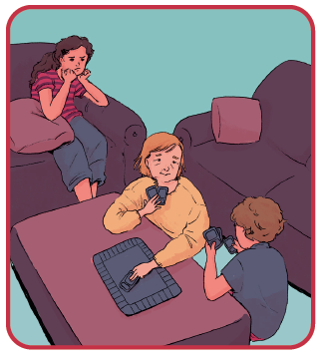
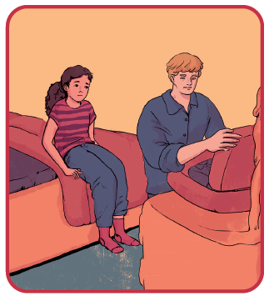
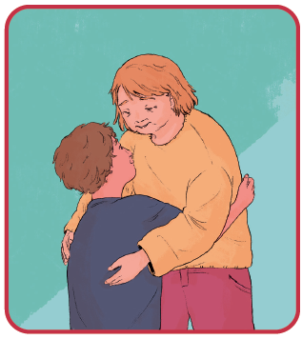
Picture Match
Passage ______
Passage ______
Passage ______

Slide 16
Independent Practice (K)
Independent Practice
More Practice 1 Fill in each blank with the best word.
spin flat plum twig grin
1. Did you snap the ________?
2. The top of the shed was ________.
3. Pat had a red ________ for a snack.
4. Tom can ________ a top.
5. I had to ________ after the fun play.

Slide 17
Independent Practice (K) — cont’d
slid stem drum trip skit
1. Dad and the twins will go on a ________.
2. The sled ________ down the hill.
3. Kim hit the ________ with a stick.
4. Jeff is in a ________ at school.
5. The ________ of the plant is thick.

Slide 18
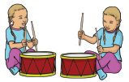
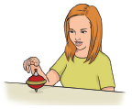
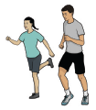
Independent Practice (L)
More Practice 2 Draw a line under the sentence that goes best with each picture.
1. The twins skip to school.
The twins play drums.
2. Kat can get the top to spin.
Kat can grab the bag.
3. Nat and Pat are in a skit.
Nat and Pat run in a club.

Slide 19
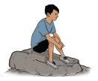


Independent Practice (L) — cont’d
4. Bob went to the clinic.
The lad sat on a flat rock.
5. The flag flaps in the wind.
Nick grins with gladness.
6. Nan was glad to win the contest.
Nan had a bucket of fat plums.

Slide 20
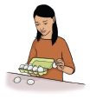

Independent Practice (L) — cont’d
7. The van slid down the hill in the mud.
Min will unpack the eggs.
8. The frantic pup fled.
The cab sped into traffic.

