Slide 1
Say Sounds (A–B)
Say Sounds
Phonemic Awareness Listen to the sounds or word parts as your teacher says a word slowly. Then say the word.
Letter/Sound Associations Look at the letter. Listen to your teacher say the sound. Then say the sound.
d i n c a
a p s b i
a i h p a
i t a m i
f d l v a

Slide 2
Read Words (C)
Read Words
New Words Say the sound. Sound out the word. Read the word.
bat cat his
him can bit
had hid pat
pit hit tan
tin tap tip

Slide 3
Read Words (D)
Word Families Read down. Read rapidly.
map
sap
tap
lap
nap
tan
fan
van
Dan
pan
lip
sip
tip
rip
dip
10 Second Challenge
Cold Timing words read
Practice words read
Hot Timing words read

Slide 4
Read Words (E–F)
Multisyllabic Challenge Words Sound out the syllables. Read the whole word.
cabin visit mishap atlas panic
High-Frequency Words Say. Spell. Read.
her are have my with
see school little water people

Slide 5
Spell Words (G)
Spell Words
Spelling Journal Turn to the Spelling Journal on page 150.

Slide 6
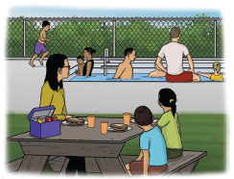
Read Text (H)
Read Text
Decodable Sentence Expansion Read each set of sentences. Then expand the last sentence by telling where. Select the picture that goes with each set.
We have a map. We have a little map. We have a little map and an atlas. . . . , we have a little map and an atlas. _____

Slide 7
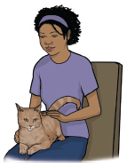
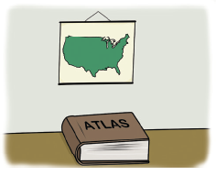
Read Text (H) — cont’d
Nan can pat the cat. Nan can pat the tan cat. Nan can pat the tan cat on her lap. . . . , Nan can pat the tan cat on her lap. _____
We see people. We see people in the water. We can see people in the water. . . . , we can see people in the water. _____

Slide 8
Independent Practice (I)
Independent Practice
More Practice 1 Fill in each blank with the best word.
1. Sam has a fat ________.
hit sat cat
2. His cat is ________.
can tan ran
3. Sam can ________ the tan cat.
pat pit wax
4. The cat sees ________.
bat his him
5. The cat ran and ________.
mix hid lid

Slide 9
Independent Practice (I) — cont’d
6. Nan has a ________ bat.
tan tap fix
7. The ________ is big.
mat his sad
8. The man hid the fan in a ________.
had tap can
9. Nan hit the ________ can.
rip tip tin
10. The lid is on the ________.
cat can cap

Slide 10

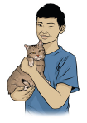
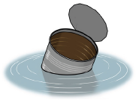
Independent Practice (J)
More Practice 2 Draw a line under the sentence that goes best with each picture.
1. Sam can pat the cat.
Sam hid the can.
2. He has a tan cat.
He has a tan tin.
3. The tin can is in the water.
The tin can is in the pit.

Slide 11
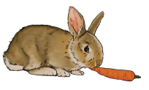
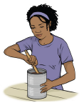
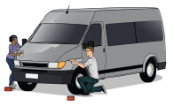
Independent Practice (J) — cont’d
4. The rabbit is in the cabin.
The rabbit bit the tip.
5. Nan can mix in the can.
Nan can tap on the lid.
6. Sam and Nan mix wax.
Sam and Nan wax the van.

Slide 12

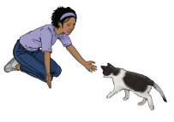
Independent Practice (J) — cont’d
7. Six people fix the map.
Sam and Nan fit in the van.
8. The sad cat ran to Nan.
The sad cat is in the cabin.

