Slide 1
Say Sounds (A–B)
Say Sounds
Phonemic Awareness Listen to the sounds as your teacher says a word slowly. Then say the word.
Letter/Sound Associations Look at the letters. Say the sounds.
ai ch e th
a u ay o
wh ch o sh
ay i ck u
a sh ai e

Slide 2
Read Words (C)
Read Words
New Words Say the sound. Sound out the word. Read the word.
bay main man
Gail bat bait
bit pray pay
stay plan plain
drain grain raid
Ray spray raise
Irregular Word: said

Slide 3
Read Words (D)
Word Families Read down. Read rapidly.
gain
grain
Spain
sprain
strain
bay
pay
Ray
tray
spray
nail
hail
fail
tail
trail
10 Second Challenge
Cold Timing words read
Practice words read
Hot Timing words read

Slide 4
Read Words (E–F)
Review Words Read a line of words. When your teacher gives a meaning, circle the correct word.
less rash trash tip
branch ranch when hen
chip check chick which
stack stick ran run
Words with Endings Sound out the underlined base word. Read the base word with the ending.
1. nailed 2. stacked 3. braided 4. planned 5. happened

Slide 5
Read Words (G–H)
Multisyllabic Challenge Words Sound out the syllables. Read the whole word.
explain paycheck mainland subway
waistband essay raisin picnic
High-Frequency Words Say. Spell. Read.
put saw there people of
some was are look from

Slide 6
Read Sentences (I)
Read Sentences
Sentences Read the sentences with phrasing.
Gail was on the deck to spray the plants.
Todd will explain the map of Spain.
We can get on the subway to go to the play.
Fay said that some people got sick from the fish.
There are six days left until the picnic.

Slide 7
Spell Words (J)
Spell Words
Spelling Journal Turn to the Spelling Journal on page 195.

Slide 8
Decodable Narrative Text (Part 1)
Decodable Narrative Text Read each part. Answer your teacher’s questions and select the picture that goes with each part.
At the Ranch
Part 1
Teacher Reads You could take a class field trip to many different places. You might visit a ranch, which is a large farm where animals are raised. Farm animals are fed grain, which are seeds, and hay, a kind of grass. Let’s learn what it would be like to visit a ranch.
11
23
36
47
50
61
“Mom, this is the day my class will visit Bay Ranch,” Fay said. “Mr. Ross said that we will see grain and hay. We may get to see pigs. After we see the ranch, we will stay and have a picnic lunch. The bus will bring us back at 3:00.”
“Have fun at the ranch, Fay,” Mom said. “I will see you when you get back.”

Slide 9
Comprehension Questions Part 1
Where is the class going to on the field trip?
The class is going to ________________.
What might they see on the ranch?
On the ranch, they might see ________________.

Slide 10
Decodable Narrative Text (Part 2)
Part 2
Teacher Reads Let’s read on to find out what the students learn about the crops (plants) and the stock (animals) raised on the ranch.
66
78
89
101
103
114
124
133
144
On the bus trip, Fay sat with Ray. On the way, they went past a plain, which is flat land with no trees. Stacks of hay sat on the plain. They saw a train filled with grain.
The bus got to Bay Ranch, and the class got off. Chuck met the class. He worked on the ranch. “Can you explain the ranch to us?” the class asked. Chuck said, “Yes! Get up in that truck. You can sit on the hay.”

Slide 11
Decodable Narrative Text (Part 2) — cont’d
147
157
168
180
192
205
215
As the truck went down the trail, Chuck said, “The main crops on this ranch are grain and hay. We plant in May. We spray water on the land, and then we plant the grain and hay. Next, we wait until it rains. We will put the grain in sacks and the hay in big stacks. As you can see, we raise stock—pigs, chickens, and ducks—on this ranch.”

Slide 12
Comprehension Questions Part 2
What kind of land did the class pass on the way to the ranch?
On the way to the ranch, the class went past ________________.
What did we learn about a plain?
A plain is ________________.
What were the main crops grown on the ranch?
The main crops grown on the ranch were ________________.
What stock were raised on the ranch?
The stock raised on the ranch were ________________.

Slide 13
Decodable Narrative Text (Part 3)
Part 3
Teacher Reads Read on to find out what happens at the end.
217
228
239
250
256
266
After the truck trip, the class sat on the grass and had a picnic lunch until they saw the bus. “Let’s go,” said Mr. Ross. “The bus will not wait. Say ‘Thanks’ to Chuck and get on the bus.”
“This was a fun day at the ranch,” said Fay.

Slide 14
Comprehension Questions Part 3
What did the students do after the truck trip?
After the truck trip, the students ________________.

Slide 15
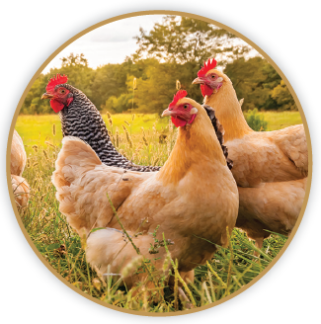

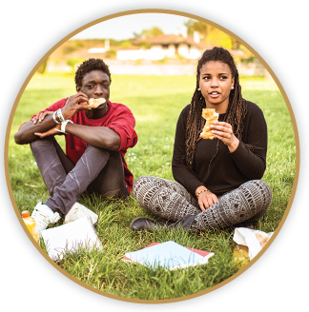
Picture Match
Part ______
Part ______
Part ______

Slide 16
Independent Practice (L) Part 1
Independent Practice
Text Comprehension Read each question. Think of the answer or look back at the text. Fill in the blank. Be sure the sentence makes sense.
Part 1
1. WHERE will the class go on the trip? On the trip, the class will go _________________________________________.
2. WHAT may they see when they get there? When they get there, they may see ___________________________________.

Slide 17
Independent Practice (L) Part 2
Part 2
3. WHAT did they go past on the way to the ranch? On the way to the ranch, they went past _______________________________.
4. WHAT is a plain? A plain is ________________________________________________________.
5. WHAT were the main crops on the ranch? The main crops on the ranch were ____________________________________.
6. WHAT stock did the class see on the ranch? On the ranch, the class saw _________________________________________.

Slide 18
Independent Practice (L) Part 3
Part 3
7. WHAT did the class do after the truck trip? After the truck trip, the class _________________________________________.
8. WHAT did the class say to Chuck at the end of the trip? At the end of the trip, the class said ___________________________________.

Slide 19
Independent Practice (M)
More Practice Fill in each blank with the best word.
1. People ________ go on the bus trip.
main may way
2. It may ________ at the end of the day.
raid grain rain
3. Ray put the dish on the ________.
tray trip play
4. Fish will grab the ________.
bay bait jail
5. Alex will fill the pail with some ________.
grain plain pray

Slide 20
Independent Practice (M) — cont’d
6. Dom got the ________ from the box.
main pain mail
7. The pup will ________ in its bed.
way stay may
8. I will pay Shan to ________ the shed.
paint plain grain
9. Kim has a long, black ________.
bay rain braid
10. Jed saw Mom fix the ________.
drain wait may

