Slide 1
Say Sounds (A–B)
Say Sounds
Phonemic Awareness Listen to the word your teacher says.
Then say the sounds or word parts in the word.
Letter/Sound Associations Look at the letters. Say the sounds.
  k b t ck m
  o th f r p
  sh i n s a
  g l e j d

Slide 2
Read Words (C)
Read Words
New Words Say the sound. Sound out the word. Read the word.
    nest task send sent lamp
  rust fast bump
  lend lent mask
  list rest lump
  lost mend lamp
  hand hint ask

Slide 3
Read Words (D)
Word Families Read down. Read rapidly.
rust
must
dust
just
gust
lend
mend
send
bend
tend
bump
lump
jump
dump
pump
10 Second Challenge
Cold Timing words read
Practice words read
Hot Timing words read

Slide 4
Read Words (E–F)
Review Words Read a line of words. When your teacher gives a meaning,
circle the correct word.
  wish win cash cap
  sack sock set toss
  with yet sad dash
  fizz fish bath bat
Multisyllabic Challenge Words Sound out the syllables. Read the whole word.
insist absent fastness backrest intend

Slide 5
Read Words (G)
High-Frequency Words Say. Spell. Read.
  was from put for very
  work her where said people

Slide 6
Read Sentences (H)
Read Sentences
Sentences Read the sentences with phrasing.
  Jenn put the list on the desk.
  Meg was absent from school.
  Where did the fox sit down to rest?
  Viv will ask her dad to work on a map with her.
  Jeff said he lost his hat when he was at the picnic.

Slide 7
Spell Words (I)
Spell Words
Spelling Journal Turn to the Spelling Journal on page 154.

Slide 8
Decodable Text (Passage 1)
Decodable Text Read each passage. Answer your teacher’s questions
and select the picture that goes with each passage.
Passage 1
The Big Bump
Teacher Reads Max and Gus were on their way to the campground
for a weekend adventure when an accident occurred. Let’s find out
what happened.
Max and Gus sat in a van. “I am lost,” Max said.
“Where will we camp?”
Gus said, “Let’s go west. We will pass a big tent.”
Max went west in the van. He saw the big tent, but
he did not see the big bump. Max went fast and hit the
bump. He put a big dent in a hubcap.

Slide 9
Comprehension Questions Passage 1
Why did Max have an accident on the way to the campground?
Max had an accident because ________________.
What happened to the van’s hubcap?
The van’s hubcap ________________.

Slide 10
Decodable Text (Passage 2)
Passage 2
A Big Help
Teacher Reads A girl intends to help her mother with many tasks. Let’s
find out why her mother needs assistance.
My mom’s job is to mend the fabric on lamps. She is
very fast and is the best at her job. But she cannot work
if her hand is in a cast. My mom must get a lot of rest.
I intend to help her get well. She will not have to ask
me for help. I will insist that my mom get rest. I will
help her with tasks.

Slide 11
Comprehension Questions Passage 2
Why did the girl need to help her mom?
The girl needed to help her mom because ________________.
How will the girl help her mom?
The girl will help her mom ________________.

Slide 12
Decodable Text (Passage 3)
Passage 3
The Lost Mask
Teacher Reads Rick has lost the mask he needs for his part in the school play. Let’s see if he locates the mask.
“My mask is lost! Where did I put my mask?” Rick
asks. “I cannot see where I put it last.”
Rick did not panic. He went on a hunt for the mask.
He did not see the mask in the cabin.
At last, he bent down to look in his cat’s basket.
The mask was in the cat’s basket. The cat had sat on it!

Slide 13
Comprehension Questions Passage 3
What was Rick’s problem?
Rick’s problem was that ________________.
Where was Rick’s lost mask?
Rick’s lost mask was in ________________.

Slide 14
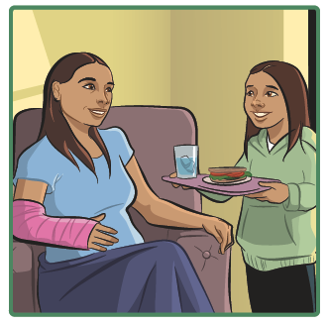
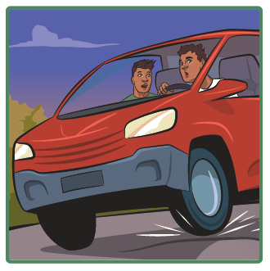
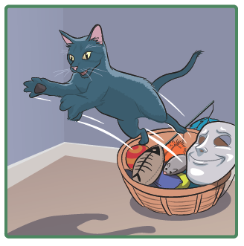
Picture Match
Passage ______
Passage ______
Passage ______

Slide 15
Independent Practice (K)
Independent Practice
More Practice 1 Fill in each blank with the best word.
lamp mend lent ask rust
  1. Ed will ________ the rip in the tent.
  2. Mom lit the gas ________.
  3. The old tin can has ________.
  4. I will ________ Pam if I can sit on her hammock.
  5. Anton ________ Jon his backpack.

Slide 16
Independent Practice (K) — cont’d
rest list mask lost fast
  6. Meg has a big red ________.
  7. The bus will not go ________.
  8. Jeff was sad when he ________ his mitt.
  9. The children sat down to ________.
  10. Beth has a ________ of the people in her school.

Slide 17

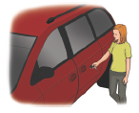
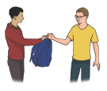
Independent Practice (L)
More Practice 2 Draw a line under the sentence that goes best
with each picture.
1. The hammock had a backrest.
I can polish the lamp.
2. The red van went down the hill.
Kat can lock the red van.
3. Bill will rest on the cot.
Bill will lend Sam his backpack.

Slide 18

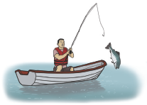

Independent Practice (L) — cont’d
  4. Jill had on a mask.
Jill can run fast.
  5. Nick lent Jen a tennis racket.
Nick lost the fish.
6. Mom will mend the sack.
Kim will get her neck wet.

Slide 19


Independent Practice (L) — cont’d
7. The can has rust.
The mat has a lump.
8. Dad had a very big list.
Dad had a bucket of fish.

