Slide 1
Say Sounds (A)
Say Sounds
Letter/Sound Associations Look at the letters. Say the sounds.
igh ir kn ai
qu or au tch
aw ow ee oi
ew dge oo ar

Slide 2
Read Words (B)
Read Words
New Words Look at the letter that follows g. Say the sound for g. Sound out the word. Then read the word.
cage urge gate
cringe cage gee
gent glee merge
gust page strange
change gate gist

Slide 3
Read Words (C)
Word Families Read down. Read rapidly.
age
page
rage
wage
stage
range
change
mange
strange
grange
ice
rice
nice
slice
price
10 Second Challenge
Cold Timing words read
Practice words read
Hot Timing words read

Slide 4
Read Words (D–E)
Multisyllabic Challenge Words Sound out the syllables. Read the whole word.
margin gently cabbage percent
teenage sausage German grapevine
Prefixes and Suffixes Say the word. Then say the prefix or suffix.
PREFIXES | SUFFIXES
1. misled | reddish
2. a- ex- pro- pre- | -ment -sion -ly -y
Expert Tip: The prefix mis- means wrongly in these words: miscount (count wrongly), misspell (spell wrongly), mistreat (treat wrongly).

Slide 5
Read Words (F–G)
Words with Prefixes and Suffixes Say the underlined affix. Read the whole word.
atomic misprint replace excel misspell increase
punish successful settlement homeless education publish
repayment recently distraction completeness
High-Frequency Words Say. Spell. Read.
find mind kind by why my try
father from
friend years almost even heard through every

Slide 6
Read Sentences (H)
Read Sentences
Sentences Read the sentences with phrasing.
My best friend is a teenager.
I could eat cabbage and sausage almost every day.
Fatima’s father had to change the date of the meeting.
Martin’s bird does not mind taking long rides in her cage.
Have you heard about the strange thing that happened at the park years ago?

Slide 7
Spell Words (I)
Spell Words
Spelling Journal Turn to the Spelling Journal on page 247.

Slide 8
Decodable Informative Text (Part 1)
Decodable Informative Text Read each part. Answer your teacher’s questions and select the picture that goes with each part.
Making a Difference
Part 1
Teacher Reads Jane Addams always had great compassion for how others felt. In particular, she always tried to understand those who had far less than she had. That compassion would influence the course of her life, a life of service to others.
10
22
34
46
Even as a little girl, Jane Addams could not understand why some people had so much and others had so little. Jane was lucky. Her father was a rich man, so her family made their home in a nice, large house. When Jane and her father went down the street in the 1860s, she would see children

Slide 9
Decodable Informative Text (Part 1) — cont’d
Part 1 continued
57
69
77
88
100
110
playing in the road. These children did not have a yard or lawn where they could play, like she did.
Seeing these children, who did not have as much as she did, upset Jane. She made up her mind that she would try to change things and make people’s lives better. When Jane grew up, she did just that!

Slide 10
Comprehension Questions Part 1
Why was Jane Addams lucky as a child?
Jane Addams was lucky as a child because ________________.
What upset Jane as a child?
Jane was upset when ________________.
What did Jane decide she would do when she grew up?
Jane decided she would ________________.

Slide 11
Decodable Informative Text (Part 2)
Part 2
Teacher Reads Although Jane was born into a wealthy family, there were other hardships that she had to overcome.
116
126
137
148
159
165
174
185
199
Jane’s mother had passed away when Jane was just two. Six years later, her father wed another woman and Jane got a new stepmother and two stepbrothers all at the same time. She became close to one of her stepbrothers who was about the same age as she was.
Later on, Jane went to college, something that few women did in those days. She wanted to become a doctor. It would be a good way to help people. Jane did get a college education. But she did not become a doctor. Why? She had

Slide 12
Decodable Informative Text (Part 2) — cont’d
Part 2 continued
210
224
233
245
258
very bad problems with her back and had to stay in bed for a long time. That prevented her from getting more schooling. However, even if her dream of being a doctor was out of reach, Jane still had the urge to help people. She only had to decide how.

Slide 13
Comprehension Questions Part 2
What did Jane do that most women did not do in those days?
Unlike most women in those days, Jane ________________.
Why did Jane have to change her plan to be a doctor?
Jane had to change her plan to be a doctor because of ________________.
What problem did Jane have when she changed her plan?
The problem Jane had was that she ________________.

Slide 14
Decodable Informative Text (Part 3)
Part 3
Teacher Reads Read on to discover how a trip to London, England, helped Addams decide what to do.
260
270
280
290
299
310
322
324
332
345
355
365
372
When Addams was feeling better, she made a trip to London with Ellen Starr, a college friend. While the two women were there, they went to visit Toynbee Hall, a settlement house where homeless or hungry people could go for help. Addams saw many good things going on at Toynbee Hall. At last, she saw how she could help people who had hard lives.
Addams wanted to start her own settlement house in the U.S. Starr said she would like to help. So when the two women returned home, they began to plan their own settlement house, a place for people who needed a helping hand. Addams wanted to help change lives.

Slide 15
Comprehension Questions Part 3
What did Addams and Starr learn about Toynbee Hall?
They learned that Toynbee Hall was ________________.
What did the visit to Toynbee Hall show Addams?
The visit to Toynbee Hall showed Addams that ________________.

Slide 16
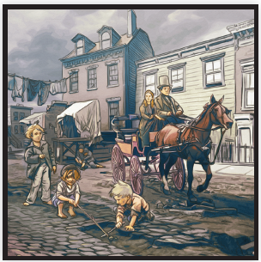
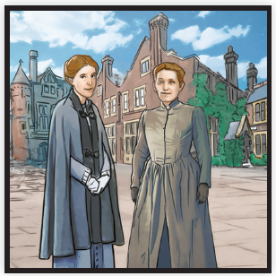
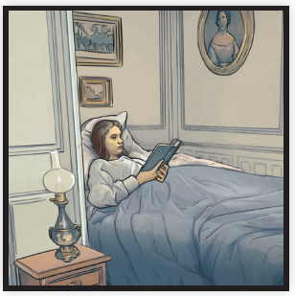
Picture Match
Part ______
Part ______
Part ______

Slide 17
Independent Practice (K) Part 1
Independent Practice
Text Comprehension Read each question. Think of the answer or look back at the text. Fill in the blank. Be sure the sentence makes sense.
Part 1
1. WHY was Jane Addams lucky as a child? Jane Addams was lucky as a child because __________________________ _____________________________________________________________.
2. WHAT upset Jane as a child? As a child, Jane was upset when she _______________________________ _____________________________________________________________.

Slide 18
Independent Practice (K) Part 1 — cont’d
3. WHAT did Jane decide she would do when she grew up? Jane decided she would _________________________________________.

Slide 19
Independent Practice (K) Part 2
Part 2
4. WHAT did Jane do that most women did not do in those days? Unlike most women in those days, Jane ______________________________.
5. WHY did Jane have to change her plan to be a doctor? Jane had to change her plan because of ______________________________.
6. WHAT problem did Jane have when she changed her plan? The problem Jane had was that she __________________________________.

Slide 20
Independent Practice (K) Part 3
Part 3
7. WHAT did Addams and Starr learn about Toynbee Hall? Addams and Starr learned that Toynbee Hall __________________________ ______________________________________________________________.
8. WHAT did the visit to Toynbee Hall show Addams?
The visit to Toynbee Hall showed Addams that ________________________ _____________________________________________________________.

Slide 21
Independent Practice (L)
More Practice • Activity 1 Read each question. Underline the best words for each question.
1. Which words name animals? gopher rabbit
challenge squirrel
pencil raccoon
4. Which words name foods? cabbage oysters
margin sausage
coleslaw percent
2. Which words name ways to travel?
subway census
pencil scooter
rocket seaplane
5. Which words name body parts?
elbow teeth
kneecap cabbage
kitchen cheekbone
3. Which words name things that have to do with school?
pencil sausage
gaslight classroom
alphabet homeroom
6. Which words name tools? second legend
screwdriver sketchpad
hatchet hammer

Slide 22
Independent Practice (M)
More Practice • Activity 2 Fill in each blank with the best word.
1. Ling and Sheldon will clean every dish. First, they will fill the sink with water and ________.
decrease
detergent
2. Branden wrote to the newspaper editor. He had found a
________ in a newspaper article.
misstep
misprint
3. My father put the dish on the shelf next to the plant. He put the
dish ________ the plant.
beside
belong
4. The children go to school. They will get an ________
in school.
education
operation
5. The number of kids in each class will get larger this year. The number of kids will ________.
indeed
increase

