Slide 1
Say Sounds (A)
Say Sounds
Letter/Sound Associations Look at the letters. Say the sounds.
  tch oi wr oo
  aw ph au qu
  dge ur tch er
  oi ow oy ou

Slide 2
Read Words (B)
Read Words
New Words Look at the letter that follows g. Say the sound for g.
Sound out the word. Then read the word.
  surge grown gist
  green page gash
  bulge glee rage
  stage merge hinge

Slide 3
Read Words (C)
Word Families Read down. Read rapidly.
large
Marge
barge
sarge
charge
age
rage
wage
page
stage
face
pace
place
space
trace
10 Second Challenge
Cold Timing words read
Practice words read
Hot Timing words read

Slide 4
Read Words (D–E)
Multisyllabic Challenge Words Sound out the syllables. Read the whole word.
  drugstore danger gateway carpool
  giraffe urgent Congress autograph
Prefixes and Suffixes Say the word. Then say the prefix or suffix.
PREFIXES | SUFFIXES
1. misled | reddish
2. in- con- com- a- | -ful -er -est -sion

Slide 5
Read Words (F–G)
Words with Prefixes and Suffixes Say the underlined affix. Read the whole word.
  misuse income excellent precede mistime adopt
  shipment rubbish thirty uncle tarnish nicest
  instrument reflection un afraid incorrectly
High-Frequency Words Say. Spell. Read.
  give live now how other mother brother
  almost mind years thought who many friend through

Slide 6
Read Sentences (H)
Read Sentences
Sentences Read the sentences with phrasing.
  First, I thought you could read through those pages.
  It is urgent that I find my backpack and planner now!
  Would you mind telling me how many giraffes are in this park?
  The hinge on the back gate has now worn out.
  The surge of strong waves almost put us in danger.

Slide 7
Spell Words (I)
Spell Words
Spelling Journal Turn to the Spelling Journal on page 247.

Slide 8
Decodable Informative Text (Part 1)
Decodable Informative Text Read each part. Answer your teacher’s
questions and select the picture that goes with each part.
Amazing Dolphins
Part 1
Teacher Reads People find dolphins fascinating. So do the scientists
who study them. Dolphins live in water like fish, but they breathe air like
animals on land. The more we learn about dolphins, the more we realize
how awesome they are!
10
23
34
Many people have seen dolphins on TV or in films.
People have seen them leap out of the surging sea or from a
large pool. We know many things about dolphins, but we are
trying to discover more about these smart animals.

Slide 9
Decodable Informative Text (Part 1) — cont’d
Part 1 continued
42
50
62
71
82
94
106
118
126
130
139
152
Some people think dolphins look like sharks because
they are both gray and live in water. But there are many
differences between the two animals. For one thing, a
dolphin is a mammal, an animal that breathes air and feeds
milk to its young. Sharks are fish and do not breathe air
or feed milk to their young. Also, a shark’s tail sweeps side
to side, and a dolphin’s tail goes up and down. In addition,
dolphins like being around other dolphins, while many
sharks prefer swimming alone.
How smart are dolphins? Experts have found that they
are very smart! In fact, dolphins are one of the few kinds of
animals that can recognize their own reflections.

Slide 10
Comprehension Questions Part 1
What is the topic of the passage?
The topic of the passage is ________________.
Why do some people think dolphins and sharks are alike?
Some people think dolphins and sharks are alike because
________________.

Slide 11
Comprehension Questions Part 1 — cont’d
What is one way dolphins and sharks are different?
One way dolphins and sharks are different is ________________.
What have experts learned about dolphins?
Experts have learned that dolphins are ________________.

Slide 12
Decodable Informative Text (Part 2)
Part 2
Teacher Reads Read on to find out how dolphins learn to perform tricks.
159
167
178
190
203
213
226
239
Dolphins are playful and lively, so dolphin trainers
teach them tricks that seem like play. Each time the dolphin
performs a trick like leaping high out of the water, the trainer
gives the dolphin a treat as a reward. That treat is a fish!
That’s how trainers teach dolphins to do new things. Soon,
the dolphin knows what to do to get fish. But there may be
times when a dolphin does not want to do a trick. A trainer
will try different things to get the dolphin to change its mind.

Slide 13
Comprehension Questions Part 2
Why do trainers teach dolphins tricks that seem like play?
Trainers teach dolphins tricks that seem like play because
________________.
What do trainers give dolphins for performing tricks?
Trainers give dolphins ________________.

Slide 14
Decodable Informative Text (Part 3)
Part 3
Teacher Reads Technology is also being used to teach dolphins.
251
259
269
279
289
300
312
319
329
340
351
There is another excellent way to teach dolphins—
through the use of computers. Dolphins talk to each other
by making clicks and other sounds that travel through the
water. A computer can change a trainer’s voice into dolphin
clicks and sounds. The trainer can then use the computer to
talk to the dolphins and tell them what to do. The sounds
travel through the water to the dolphins.
Dolphins also have a strong sense of hearing. They can
detect sounds at a long range. If a trainer drops something
small into the water that the dolphin cannot see, the dolphin
can swim right over to it.

Slide 15
Decodable Informative Text (Part 3) — cont’d
Part 3 continued
357
367
378
392
403
410
Some of the best things about dolphins are how much
they like to meet people and how gentle they are. Sometimes
a dolphin will even let a swimmer hold on to its fin and give
the swimmer a ride. But the swimmer should first make sure
it’s a dolphin and not a shark!

Slide 16
Comprehension Questions Part 3
How can computers help a trainer talk to dolphins?
Computers change the trainer’s voice into ________________.
Why can a dolphin find something too small to see in water?
A dolphin can find something too small to see because ________________.
What is one of the best things people have learned about dolphins?
One of the best things people have learned about dolphins is
________________.

Slide 17
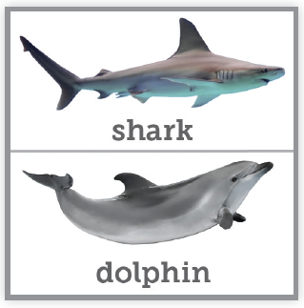
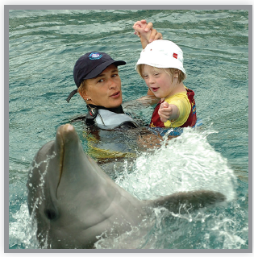
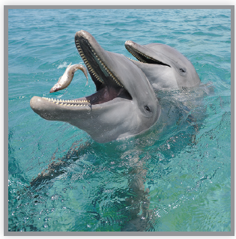
Picture Match
Part ______
Part ______
Part ______

Slide 18
Independent Practice (K) Part 1
Independent Practice
Text Comprehension Read each question. Think of the answer or look back
at the text. Fill in the blank. Be sure the sentence makes sense.
Part 1
  1. WHY do some people think dolphins and sharks are alike?
  Some people think they are alike because ___________________________.
  2. HOW are dolphins and sharks different?
  One way dolphins and sharks are different is _________________________
  _____________________________________________________________
  _____________________________________________________________.

Slide 19
Independent Practice (K) Part 1 — cont’d
  3. WHAT have experts found out about dolphins?
  Experts have found out that dolphins are ____________________________.

Slide 20
Independent Practice (K) Part 2
Part 2
  4. WHY do trainers teach dolphins tricks that seem like play?
  Trainers teach tricks that seem like play because ________________________.
  5. WHAT do trainers give dolphins for performing tricks?
  For performing tricks, trainers give dolphins ____________________________.

Slide 21
Independent Practice (K) Part 3
Part 3
  6. HOW can computers help trainers talk to dolphins?
  Computers change the trainer’s voice into ____________________________
  ______________________________________________________________.
  7. WHY can a dolphin find something that is too small to see in water?
  A dolphin can find something that is too small to see because _____________
  ______________________________________________________________.
  8. WHAT is one of the best things about dolphins?
  One of the best things about dolphins is ______________________________
  ______________________________________________________________.

Slide 22
Independent Practice (L)
More Practice • Activity 1 Read each story. Underline all the endings that make sense.
1. Liz and Trish plan to put on a play for their class.
On Thursday, Liz and Trish ________.
a. got up on the stage
b. changed into their costumes
c. put a goose into a cage
2. Stefan likes to keep his house very clean.
This morning, he ________.
a. turned the pages of his
newspaper
b. cleaned the sink with a
sponge
c. killed the germs in the toilet

Slide 23
Independent Practice (L) — cont’d
  3. Mr. Perez went to the garden shop. At the
  garden shop, Mr. Perez ________.
a. chose a large plant for his
porch
b. got a new hose for the yard
c. paid for an ice cream cone
4. The zoo has many animals. At the zoo, you
can ________.
a. see some giraffes
b. point out large birds
c. live in a spacecraft

Slide 24
Independent Practice (M)
More Practice • Activity 2 Fill in each blank with the best word.
afraid rubbish uncle detect adopt
  1. Oren did not like the gusty wind blowing through the trees.
  He was ________ of the loud noise.
  2. I thought I could ________ a tone of sadness. What is wrong?
  3. Jordan likes when people come to visit. His aunt and ________
  visit each summer.

Slide 25
Independent Practice (M) — cont’d
  4. Ralph and Ginny plan to ________ a girl and a boy. They do not
  mind if it takes some time.
  5. The attic is filled with ________. We need to throw it all in
  the trash.

