Slide 1
Say Sounds (A–B)
Say Sounds
Phonemic Awareness You will blend and segment sounds as
you read and spell words.
Letter/Sound Associations Look at the letters. Say the sounds.
  ea ar a_e oa
  ar a i_e igh
  o ai ar ea
  o_e ow ee o
  e ar ow i

Slide 2
Read Words (C)
Read Words
New Words Say the sound. Sound out the word. Read the word.
  dart yarn tar
  tow Mars hark
  bar bow charm
  cheat chart harp
  cart coat day
  sharp sheep shark
Irregular Word: warm

Slide 3
Read Words (D)
Word Families Read down. Read rapidly.
park
dark
mark
shark
Clark
dart
tart
cart
chart
start
woke
poke
joke
choke
broke
10 Second Challenge
Cold Timing words read
Practice words read
Hot Timing words read

Slide 4
Read Words (E–F)
Review Words Read a line of words. When your teacher
gives a meaning, circle the correct word.
  cane can crane mane
  plane plan stove man
  shine tribe trip brave
  drove stroke strip stripe
Words with Endings Read words with endings.
1. filing 2. smiling 3. plotting 4. hummed 5. striped
6. darted 7. sneaking 8. charming 9. charted 10. sighed

Slide 5
Read Words (G–H)
Multisyllabic Challenge Words Sound out the syllables.
Read the whole word.
  artist tarnish discard barnyard sharpen
  apartment inartistic problem replicate update
High-Frequency Words Say. Spell. Read.
  should could would after saw
  were from there said who

Slide 6
Read Sentences (I)
Read Sentences
Sentences Read the sentences with phrasing.
  What would you do if you saw a shark swimming in the water?
  There were trucks dumping tar on the road to fix the holes.
  Who could get some red yarn for each of us to make a scarf?
  At dusk, I saw a fox dart past the shed in the yard.
  Something sharp poked my arm as I went past the desk.

Slide 7
Spell Words (J)
Spell Words
Spelling Journal Turn to the Spelling Journal on page 200.

Slide 8
Decodable Narrative Text (Part 1)
Decodable Narrative Text Read each part. Answer your teacher’s
questions and select the picture that goes with each part.
Can the Nanobots
Be Stopped?
Part 1
Teacher Reads After the nanobots escape in the lab, Jayda has to find
a way to capture these tiny robots and keep them from replicating
(producing exact copies of themselves) and growing in number.
10
22
30
Jayda’s plan had been to look for the lab’s secret
and check that the lab was safe for Mom. But with all
these replicating nanobots, Jayda had just made the
lab unsafe.

Slide 9
Decodable Narrative Text (Part 1) — cont’d
32
40
48
59
67
75
84
Jayda’s brain was working in slow mode. Where
were her problem-solving skills when she needed
them? There had to be some way to get the nanobots
back in the plastic boxes. Jayda looked down.
Nanobots were eating the charms on her boots.
When the nanobots finished all the charms, they ran
up and down in the lab.

Slide 10
Comprehension Questions Part 1
Why is the lab unsafe now?
Now the lab is unsafe because ________________.
What talent did Jayda usually have?
The talent that Jayda usually had was ________________.
What problem did Jayda need to solve?
The problem that Jayda needed to solve was ________________.

Slide 11
Decodable Narrative Text (Part 2)
Part 2
Teacher Reads Keep reading to see if Jayda has an idea for stopping the
nanobots from replicating.
90
101
109
117
126
137
147
153
163
171
183
195
All of a sudden Jayda had a brain flash. The boot
charms were made from stardust. It seemed the
nanobots liked stardust. Jayda broke her locket and
dumped the stardust at her feet. The nanobots rushed
to her feet. As they came close, Jayda put them into
the plastic boxes. After some hard work, she had all
the nanobots back in the boxes.
Jayda was feeling very smart for having put all the
nanobots back. And she had stopped the replicating.
It was time to go home. Jayda flicked off her light ray
and left the lab. Maybe she would not have to tell Mom
that she had sneaked into the lab after all.

Slide 12
Comprehension Questions Part 2
How did Jayda get the nanobots back into the boxes?
Jayda got the nanobots back into the boxes by ________________.
Why was Jayda feeling smart?
Jayda was feeling smart because ________________.

Slide 13
Decodable Narrative Text (Part 3)
Part 3
Teacher Reads Jayda has discovered Mom’s secret, but now she has a
secret of her own. Keep reading to see if Jayda plans to tell Mom what
she did or keep it to herself.
204
214
223
234
247
258
267
276
But on the way home, Jayda started to think back
to what had happened. There was a slight problem.
Well, it was a big problem. There were lots of nanobots
in the lab that had not been there at the start of the
night. There was no way to explain that to Mom. Jayda
sighed. She would have to tell Mom the tale.
Jayda slipped inside when she got home. And there
was Mom, waiting.

Slide 14
Decodable Narrative Text (Part 3) — cont’d
279
289
300
309
315
323
335
343
Jayda gave Mom a full update. “I was checking to
see if the lab was safe for you, Mom,” said Jayda.
“Thank you,” said Mom. “But this means no drone
trips for you for three weeks.”
Then Mom went on. “Jayda, your problem-solving
skills were right on the mark. It may be that I need
some help in the lab. Are you free?”

Slide 15
Comprehension Questions Part 3
Why did Jayda have to tell her mother what happened?
Jayda had to tell her mother what happened because ________________.
What was Jayda’s punishment?
Jayda’s punishment was ________________.
Why did Mom ask Jayda to help her in the lab?
Mom asked Jayda to help her in the lab because ________________.

Slide 16
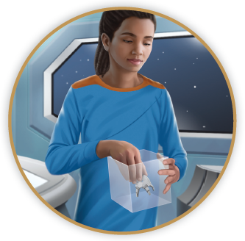
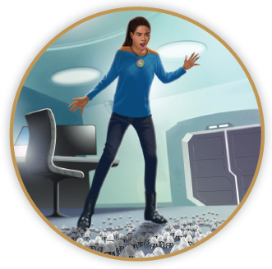
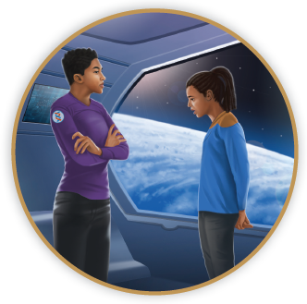
Picture Match
Part ______
Part ______
Part ______

Slide 17
Independent Practice (L) Part 1
Independent Practice
Text Comprehension Read each question. Think of the answer or look back
at the text. Fill in the blank. Be sure the sentence makes sense.
Part 1
  1. WHY is the lab unsafe?
  The lab is unsafe because ______________________________________.
  2. WHAT problem must Jayda solve?
  The problem Jayda must solve is _________________________________
  ____________________________________________________________.

Slide 18
Independent Practice (L) Part 2
Part 2
  3. WHY did the nanobots eat the charms on Jayda’s boots?
  They ate the charms because ____________________________________.
  4. HOW did Jayda get the nanobots back into boxes?
  Jayda got them back into boxes with _______________________________.
  5. HOW was Jayda feeling after she put the nanobots back?
  Jayda was feeling ______________________________________________.

Slide 19
Independent Practice (L) Part 3
Part 3
  6. WHY must Jayda tell Mom what happened in the lab?
  Jayda must tell Mom because ______________________________________.
  7. WHAT did Mom tell Jayda she cannot do?
  Mom said Jayda cannot ___________________________________________.
  8. WHAT made Mom ask Jayda to help in the lab?
  Mom asked Jayda to help in the lab because of ________________________.

Slide 20
Independent Practice (M) Story 1
More Practice Read each story. Answer the questions.
  Story 1: James looked for his cat, Jax. “Could you be hiding from me? I do
  not think you went far,” he said. James made a plan to put some yarn on the
  rug and wait. Jax should come, as she liked yarn. James put the yarn down.
  After a while, he saw Jax dart in and start to play with the yarn. “There you
  are,” said James. “What a smart cat you are!”
  1. WHAT was James looking for?
  James was looking for ___________________________________________.
  2. WHAT plan did James make?
  James made a plan to ___________________________________________.
  3. WHAT happened after James put his plan to work?
  After James put his plan to work, James _____________________________.

Slide 21
Independent Practice (M) Story 2
  Story 2: Saree had a dream last night. In her dream, she started off on a trip
  to Mars. She passed by stars. On Mars, it was dark and dull. All she saw were
  sharp red rocks. After Saree woke up, she looked next to her bed. There was
  a sharp red rock! This was not part of her dream. Could it be a rock from
  Mars? What would she do with it?
  1. WHAT was Saree’s dream?
  Saree’s dream was that _________________________________________.
  2. WHAT was it like on Mars?
  On Mars, it was _______________________________________________.
  3. WHAT did Saree see next to her bed when she woke up?
  When Saree woke up, she saw a _________________________________.

