Slide 1
Say Sounds (A)
Say Sounds
Letter/Sound Associations Look at the letters. Say the sounds.
oo tch aw ou
oa qu oi ee
ar a_e dge ur
oy kn ph ew

Slide 2
Read Words (B)
Read Words
New Words Look at the letter that follows g. Say the sound for g. Sound out the word. Then read the word.
germ stage gem
age glad urge
large goose grew
drug Gene sponge

Slide 3
Read Words (C)
Word Families Read down. Read rapidly.
age
page
cage
wage
stage
barge
large
sarge
charge
Marge
dance
chance
glance
France
trance
10 Second Challenge
Cold Timing words read
Practice words read
Hot Timing words read

Slide 4
Read Words (D–E)
Multisyllabic Challenge Words Sound out the syllables. Read the whole word.
ginger disgust target gentleman
greenhouse stagecoach Pacific gingersnap
Prefixes and Suffixes Say the word. Then say the prefix or suffix.
PREFIXES | SUFFIXES
1. misled | reddish
2. a- ex- dis- com- | -ment -sion -ful -le
Expert Tip: The suffix -ish means somewhat like in these words: purplish (somewhat purple), childish (somewhat like a child),
roundish (somewhat round).

Slide 5
Read Words (F–G)
Words with Prefixes and Suffixes Say the underlined affix. Read the whole word.
exercise confirm complete agreed proceed mistake
furnish wisest torment circle attention finish
amendment helpless ly reduction dis respectful
High-Frequency Words Say. Spell. Read.
walk talk there where should could would
thought heard almost any care friend years over

Slide 6
Read Sentences (H)
Read Sentences
Sentences Read the sentences with phrasing.
Tarik thought the gingersnaps over there were good.
There are almost no large sponges left.
Kelvin takes good care of his cat, Ginger.
It could start raining while Gene is out running.
My friend is my age, and he acts on stage in many plays.

Slide 7
Spell Words (I)
Spell Words
Spelling Journal Turn to the Spelling Journal on page 247.

Slide 8
Decodable Informative Text (Part 1)
Decodable Informative Text Read each part. Answer your teacher’s questions and select the picture that goes with each part.
A Life Helping Others
Part 1
Teacher Reads In 1889, Jane Addams and Ellen Starr rented a large, vacant (empty) house called Hull-House in Chicago. At the time, the Hull-House neighborhood was home to many working-class and immigrant people from countries in Europe.
9
18
28
Jane Addams and Ellen Starr began working on Hull- House right away. They cleaned, painted, and furnished the house. When they finished, they urged people to come to Hull-House to make their lives better.

Slide 9
Decodable Informative Text (Part 1) — cont’d
Part 1 continued
35
45
55
65
76
87
At Hull-House, there was a daycare center for children of working mothers and fathers. There were also clubs after school for school-age children. There were classes for adults, too. At night, Hull-House had concerts and plays for all to enjoy. Hull-House helped a lot of people. But Addams wanted to do even more.

Slide 10
Comprehension Questions Part 1
What did Jane Addams and Ellen Starr start working on right away?
They started working on ________________.
Why did Addams and Starr want people to come to Hull-House?
They wanted people to come to Hull-House to ________________.
What did Hull-House provide?
Hull-House provided ________________.

Slide 11
Decodable Informative Text (Part 2)
Part 2
Teacher Reads Addams always had new goals that she wanted to achieve. Read on to find out what they were.
92
102
113
126
135
144
154
163
167
178
188
200
210
Addams discovered a lot about the people who came to Hull-House and their lives. She knew that many changes still needed to be made so that life could be even better for them.
One thing Addams saw was that working conditions were awful. Many children and adults worked long, hard hours. Addams worked to get laws changed to limit the number of hours children could work. She helped make working conditions better for everyone.
During the next stage of her life, Addams began to take on bigger projects. For example, a huge concern of hers was that women did not have the right to vote. So, Addams joined with other activist women to get the voting laws changed.

Slide 12
Comprehension Questions Part 2
What did Addams learn at Hull-House about people’s lives?
Addams learned that ________________.
What did Addams do about these conditions?
Addams worked to ________________.
What was another problem that concerned Addams?
Another problem that concerned Addams was ________________.

Slide 13
Decodable Informative Text (Part 3)
Part 3
Teacher Reads Addams accomplished many things in her life. Keep reading to find out how she was honored, or praised publicly, for her efforts.
211
219
230
240
250
260
269
278
Addams worked to get the 19th Amendment passed. This law allowed many women to vote in 1920. Addams was also the leader of the Women’s Peace Party. This organization urged people to talk about their problems rather than fight.
At the same time, Hull-House kept expanding. It became quite well known. People from around the globe came to visit. When those people returned home, they began settlement houses like Hull-House.

Slide 14
Decodable Informative Text (Part 3) — cont’d
Part 3 continued
283
293
304
315
325
332
In addition to helping others, Addams was also an author. In 1910, she published a book called Twenty Years at Hull- House. Addams spent most of her life trying to make life better for others. In 1931, her efforts were recognized when she was given the Nobel Peace Prize.

Slide 15
Comprehension Questions Part 3
What happened in 1920 when the 19th Amendment was passed?
In 1920, when the 19th Amendment was passed, ________________.
How was Addams’s hard work recognized by others?
Addams was given the ________________.

Slide 16
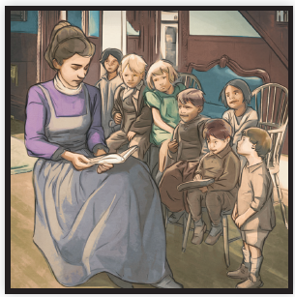
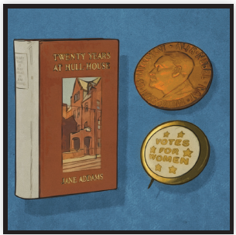
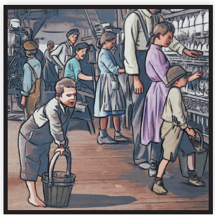
Picture Match
Part ______
Part ______
Part ______

Slide 17
Independent Practice (K) Part 1
Independent Practice
Text Comprehension Read each question. Think of the answer or look back at the text. Fill in the blank. Be sure the sentence makes sense.
Part 1
1. WHAT did Jane Addams and Ellen Starr start working on right away? Right away, they started working on ________________________________.
2. WHY did Addams and Starr want people to come to Hull-House? They wanted people to come to Hull-House to ________________________.

Slide 18
Independent Practice (K) Part 1 — cont’d
3. WHAT did Hull-House provide? Hull-House provided ____________________________________________ _____________________________________________________________.

Slide 19
Independent Practice (K) Part 2
Part 2
4. WHAT did Addams learn at Hull-House about people’s lives? At Hull-House, Addams learned that __________________________________ _______________________________________________________________.
5. WHAT did Addams do about working conditions? Addams worked to ________________________________________________
_______________________________________________________________.
6. WHAT was another problem that concerned Addams? Another problem that concerned Addams was __________________________.

Slide 20
Independent Practice (K) Part 3
Part 3
7. WHAT happened in 1920 when the 19th Amendment passed? When the 19th Amendment passed _________________________________ ______________________________________________________________.
8. HOW was Addams’s hard work recognized by others?
Addams was given the ____________________________________________.

Slide 21
Independent Practice (L)
More Practice • Activity 1 Read each story. Underline all the endings that make sense.
1. The jeweler had a large display case in his store. In the display case were ________.
a. large jewels
b. lace dresses
c. strange gems
2. Gemma likes to ride her horse in the summer.
One day Gemma ________.
a. rode almost as far as the river
b. stopped on a ridge to look over the land
c. put a sponge in the bathtub
3. Gage does chores at his house. One day Gage ________.
a. went for a walk with a friend
b. put a new hinge on a gate
c. changed the oil in his car

Slide 22
Independent Practice (M)
More Practice • Activity 2 Read each question. Underline the best words for each question.
1. Which words name people? teenager circle
sponge pitchers
astronauts catchers
4. Which words name foods? gingersnaps radish
sausage cabbage
stagehand gaslight
2. Which words name numbers?
seventeen thousands
hundreds thirteen
fifteen center
5. Which words name games?
hopscotch ginger
finish baseball
basketball grapevines
3. Which words name things related
to the sea?
harbor saddle
cement seacoast
census seashore
6. Which words name plants? citrus trees lime trees
cartwheels greenhouse
oak trees grapevines

