Slide 1
Say Sounds (A–B)
Say Sounds
Phonemic Awareness Listen to the word your teacher says. Then say the sounds or word parts in the word.
Letter/Sound Associations Look at the letters. Say the sounds.
w u s m sh
n l ch o p
b e f t ck
th a d i r

Slide 2
Read Words (C)
Read Words
New Words Say the sound. Sound out the word. Read the word.
risk test west
desk land best
bend damp ramp
bump fast pest
past lump pond

Slide 3
Read Words (D)
Word Families Read down. Read rapidly.
pest
nest
vest
rest
west
end
bend
mend
lend
send
hint
lint
mint
tint
lint
10 Second Challenge
Cold Timing words read
Practice words read
Hot Timing words read

Slide 4
Read Words (E–F)
Review Words Read a line of words. When your teacher gives a meaning, circle the correct word.
fin will path wet
neck rim rock not
Jess leg gill rack
duck gush hug rag
Multisyllabic Challenge Words Sound out the syllables. Read the whole word. unjust extend husband indent socket

Slide 5
Read Words (G)
High-Frequency Words Say. Spell. Read.
be he she we after
go long the where no

Slide 6
Read Sentences (H)
Read Sentences
Sentences Read the sentences with phrasing.
Where is the bump on the cat’s leg?
Kat and her husband will go to the pond after work.
Max will see if the tent is damp.
Nick said he will fix the ramp that got bent.
Tish did not look at the dog as she ran past it.

Slide 7
Spell Words (I)
Spell Words
Spelling Journal Turn to the Spelling Journal on page 155.

Slide 8
Decodable Text (Passage 1)
Decodable Text Read each passage. Answer the questions and select the picture that goes with each passage.
Passage 1
Mist the Cat
Teacher Reads In this story, Ann is having a conversation with her friend, Jeff. Ann is complaining about her sister, Bess, who doesn’t like Ann’s pet cat. Let’s find out how Jeff responds.
Ann sat with Mist, her cat, on her lap. She was upset with Bess.
“Jeff,” Ann said. “Bess said that Mist is a pest. Is Mist a pest?”
Jeff put a hand on Mist to pet the cat. “No, Ann,” said Jeff. “No pet is a pest. Bess is just mad at Mist.”

Slide 9
Comprehension Questions Passage 1
Why was Ann upset?
Ann was upset because ________________.
How did Jeff respond to Ann?
Jeff responded to Ann by saying ________________.

Slide 10
Decodable Text (Passage 2)
Passage 2
Sunset at the Pond
Teacher Reads Ben and Kim are at a camp where they are having a lot of fun. They chat as they take a walk around a pond.
“At dusk, I ran to the pond,” Ben said to Kim. “I saw the best sunset! It was very red.”
Kim bent down to pick up a rock to toss into the water. “I will not miss a sunset at the pond. I will go to the pond at dusk just to see the red sunset,” she said.

Slide 11
Comprehension Questions Passage 2
What did Ben tell Kim?
Ben told Kim that ________________.
Why did Kim want to go back to the pond at dusk?
Kim wanted to go back to the pond at dusk to ________________.

Slide 12
Decodable Text (Passage 3)
Passage 3
The List
Teacher Reads Justin wants to try fishing, but he is impatient, meaning he doesn’t like waiting for things to happen. His mom knows fishing takes patience, so she gives him something to do to teach him how to be patient.
Justin got a list from his mom.
“This list is a test for you,” his mom said. “If you pass, you can fish at the pond. You have until sunset to hunt for a red vest, a big ant, a rock with a dent, and a nest in a tree.”
Justin said, “I can pass the test. I will look until the end. It will be fun.”
At sunset, Justin wins! He gets to fish at the pond.

Slide 13
Comprehension Questions Passage 3
When did Justin have to be done with the list?
Justin had to be done with the list by ________________.
Why did Justin get to fish at the pond?
Justin got to fish at the pond because ________________.

Slide 14
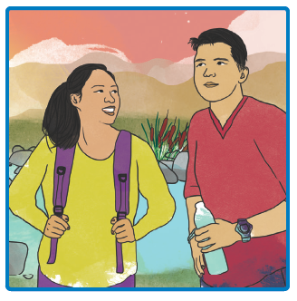
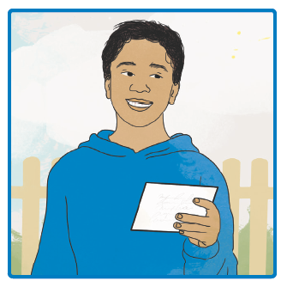
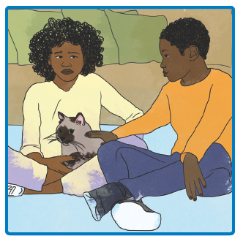
Picture Match
Passage ______
Passage ______
Passage ______

Slide 15
Independent Practice (K)
Independent Practice
More Practice 1 Fill in each blank with the best word.
1. Nick’s land was in the ________.
west test pest
2. Tess was the ________ in the contest.
bump best past
3. This little bug is such a ________.
bent pest past
4. The ship will ________ at the dock.
land lump west
5. Nan ran ________ Lil on the path.
west pet past

Slide 16
Independent Practice (K) — cont’d
6. The red van went up the ________.
ram ramp pet
7. Ants can be a ________ to a picnic.
ramp risk bet
8. Sam had a ________ in school.
test west bent
9. The children ran very ________.
jump fast last
10. Can he dust off his ________?
land damp desk

Slide 17
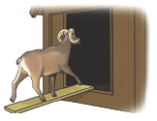


Independent Practice (L)
More Practice 2 Draw a line under the sentence that goes best with each picture.
1. The ram ran past Lin on the path.
The ram ran up the ramp.
2. My pet was the best pup in the contest.
The man bent down to pet the pup.
3. At dusk, the sun sets in the west.
The children had a test.

Slide 18

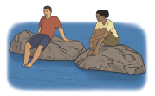
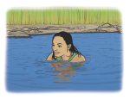
Independent Practice (L) — cont’d
4. The mat has a lump.
The log has a bump.
5. Beth put a mint in her pocket.
The people sat on rocks in the water.
6. Pam got wet in the pond.
Pam will run at the pond.

Slide 19
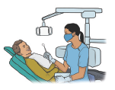

Independent Practice (L) — cont’d
7. The man can fix his hat.
The dentist is at work.
8. The little egg will fit in his hand.
The man will extend his leg.

