Slide 1
Say Sounds (A–B)
Say Sounds
Phonemic Awareness Listen to the sounds or word parts as your teacher says a word slowly. Then say the word.
Letter/Sound Associations Look at the letter. Say the sound.
h e s l o
i o p a b
y m g u d
e w t i n
f r e g a

Slide 2
Read Words (C)
Read Words
New Words Say the sound. Sound out the word. Read the word.
beg yet pat
yes Don den
wed pet pot
pit pop Mom
hen him leg

Slide 3
Read Words (D)
Word Families Read down. Read rapidly.
pen
den
Jen
men
hen
bed
Ted
Ned
wed
red
set
wet
let
pet
net
10 Second Challenge
Cold Timing words read
Practice words read
Hot Timing words read

Slide 4
Read Words (E–F)
Multisyllabic Challenge Words Sound out the syllables. Read the whole word. rotten comet fatten inlet happen
High-Frequency Words Say. Spell. Read.
said to where of from
some look down we children

Slide 5
Spell Words (G)
Spell Words
Spelling Journal Turn to the Spelling Journal on page 153.

Slide 6
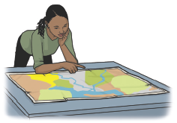
Read Text (H)
Read Text
Decodable Sentence Expansion Read each set of sentences. Then expand the last sentence by telling where. Select the picture that goes with each set.
I let the dog in. I let the dog in at ten. I let the dog in at ten and got him water. I let the dog in . . . at ten and got him water. _____

Slide 7
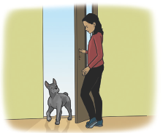
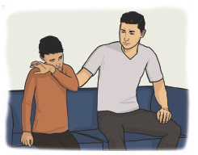
Read Text (H) — cont’d
Don got upset. Don got upset, and his dad sat with him. Don got upset, and his dad sat with him until he was not sad. Don got upset . . . , and his dad sat with him _____ until he was not sad.
Jen looks. Jen looks at an inlet. On the map, Jen looks at an inlet. On the map, Jen looks at an inlet . . . _____

Slide 8
Independent Practice (I)
Independent Practice
More Practice 1 Fill in each blank with the best word.
1. Mom said ________ to Ed.
yes yet net
2. The ________ ran.
met pet let
3. Ed can ________ Nan.
set den wed
4. Don hit his ________.
leg beg hem
5. Did Meg get to school ________?
den hen yet

Slide 9
Independent Practice (I) — cont’d
6. Sam is in the ________ with Ben.
beg den rot
7. Ted can see a ________.
met set jet
8. I have ________ pens.
beg ten yet
9. My dog can ________ to get fed.
yes beg met
10. Mom ________ us go.
let wed leg

Slide 10
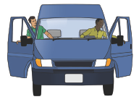
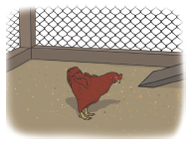

Independent Practice (J)
More Practice 2 Draw a line under the sentence that goes best with each picture.
1. The men get on a jet.
The men get in a van.
2. The red hen is in a pen.
The red hen is in a pit.
3. He has a pan of water.
He has a mug of water.

Slide 11
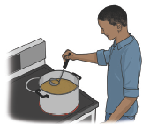
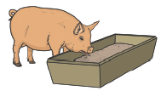
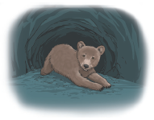
Independent Practice (J) — cont’d
4. Ed sips from the pot.
Ed dips in the pot.
5. Can Jen fatten her pig?
Where can Don see the
comet?
6. The cub is in a den.
The cub is in a pen.

Slide 12
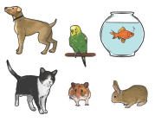
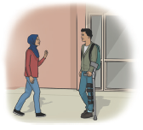
Independent Practice (J) — cont’d
7. They have six pens.
They have six pets.
8. Meg met him at school.
Meg met him at the inlet.

