Slide 1
Say Sounds (A–B)
Say Sounds
Phonemic Awareness Listen to the sounds as your teacher says
a word slowly. Then say the word.
Letter/Sound Associations Look at the letters. Say the sounds.
    tree leaf
  ee ai ea ay
  ch o th ck
  sh ee ai wh
  ea e ay i
  ai a ea u

Slide 2
Read Words (C)
Read Words
New Words Say the sound. Sound out the word. Read the word.
  beef eat sea
  say week tea
  meat beach need
  see lean feed
  each deep trail
  beat bait beets

Slide 3
Read Words (D)
Word Families Read down. Read rapidly.
see
bee
flee
free
tree
need
feed
seed
speed
bleed
eat
meat
seat
wheat
treat
10 Second Challenge
Cold Timing words read
Practice words read
Hot Timing words read

Slide 4
Read Words (E–F)
Review Words Read a line of words. When your teacher
gives a meaning, circle the correct word.
  paint pant plan stay
  Spain pain brain brass
  tray trip rip step
  man main train trap
Words with Endings Sound out the underlined base word.
Read the base word with the ending.
  1. claimed 2. fainted 3. hailed 4. needed 5. speeded

Slide 5
Read Words (G–H)
Multisyllabic Challenge Words Sound out the syllables.
Read the whole word.
  seashell peanut seaweed sunbeam
  payment coffee weekend season
High-Frequency Words Say. Spell. Read.
  things little water there people
  they after put saw from

Slide 6
Read Sentences (I)
Read Sentences
Sentences Read the sentences with phrasing.
  Can fish freeze in seawater?
  There is a little breeze from the sea.
  They need to put the crayons in the box.
  After my dog did a trick, I fed him a treat from the bag.
  Some people have a plan to stay in Spain for a week.

Slide 7
Spell Words (J)
Spell Words
Spelling Journal Turn to the Spelling Journal on page 195.

Slide 8
Decodable Informative Text (Part 1)
Decodable Informative Text Read each part. Answer your
teacher’s questions and select the picture that goes with each part.
People Need Seas
Part 1
Teacher Reads About 70% of planet Earth’s surface is covered by water,
including oceans and seas. So, it’s not surprising that people use seas in
many ways.
9
19
29
40
People need seas. They sail ships on seas. Some
people work on ships. They fill up ships with things
people need, such as beans, tea, and wheat. Then the
ships sail from land to land. Each day of the week,
ships go east and west to get things to people.

Slide 9
Comprehension Questions Part 1
Why is it important that ships sail from one place to another?
It is important that ships sail from one place to another because
________________.

Slide 10
Decodable Informative Text (Part 2)
Part 2
Teacher Reads Food from seas is an important part of many people’s
diet (what they eat).
50
59
72
83
93
103
People eat things from seas. The main thing people
eat is fish. Some fish is fresh. But to get fish from seas
to shops, people may freeze the fish to keep it fresh.
People can feast on clams, crabs, and bass from seas.
Some people eat fish eggs and seaweed. Seaweed is a
plant from seas.

Slide 11
Comprehension Questions Part 2
What is the main thing people eat from seas?
The main thing people eat from seas is ________________.
What other sea animals do people eat?
Other sea animals that people eat are ________________.
What is one sea plant people eat?
One sea plant people eat is ________________.

Slide 12
Decodable Informative Text (Part 3)
Part 3
Teacher Reads People need seas for serious reasons, but spending time
by seas can be enjoyable, too.
106
116
127
139
150
162
175
179
At beaches, seas meet land. People can have a fun
day at the beach. On land, people can pick up seashells
and fill a pail with sand. They can swim in the deep
seawater. People can get on ships with sails and go with
the wind. In a big breeze, ships pick up speed and go
fast. Seas are spots for work and play. It is plain to see
that people need seas.

Slide 13
Comprehension Questions Part 3
What can people do at the beach?
At the beach, people can ________________.
What would you do at the beach?
At the beach, I would ________________.

Slide 14
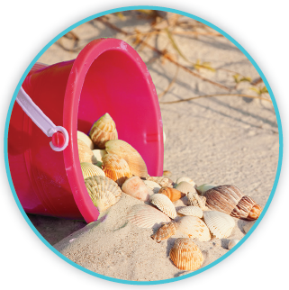
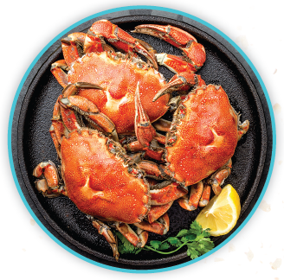
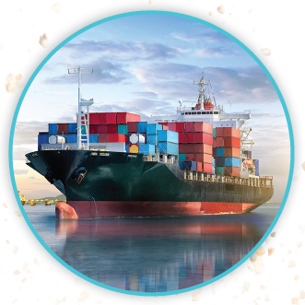
Picture Match
Part ______
Part ______
Part ______

Slide 15
Independent Practice (L) Part 1
Independent Practice
Text Comprehension Read each question. Think of the answer or look back
at the text. Fill in the blank. Be sure the sentence makes sense.
Part 1
  1. WHY are there ships that sail from east to west?
  There are ships that sail from east to west to ____________________________.
  2. WHAT are some things people fill ships with?
  People fill ships with _______________________________________________.

Slide 16
Independent Practice (L) Part 2
Part 2
  3. WHAT is the main thing people eat from seas?
  The main thing people eat from seas is ________________________________.
  4. WHAT can people feast on from seas?
  People can feast on _______________________________________________.
  5. WHAT is a sea plant that people eat?
  A sea plant that people eat is ________________________________________.

Slide 17
Independent Practice (L) Part 3
Part 3
  6. HOW can people have fun on land at the beach?
  On land at the beach, people can ____________________________________
  _______________________________________________________________.
  7. HOW can people have fun in the sea at the beach?
  In the sea at the beach, people can ___________________________________.
  8. WHAT are seas spots for?
  Seas are spots for ________________________________________________.

Slide 18
Independent Practice (M)
More Practice Fill in each blank with the best word.
  1. Edwin saw a ________ on the leaf.
meat bee sea
  2. Alec will ________ Viv after class.
tea beef meet
  3. I will ________ my cat when I eat.
feed leaf beach
  4. I have a math test this ________.
eat week beat
  5. The man gets water for a cup of ________.
tea need see

Slide 19
Independent Practice (M) — cont’d
  6. We get fish from the ________.
beets sea eat
  7. Will ________ kid get a peach for snack?
deep beef each
  8. Some people ________ seaweed.
see eat need
  9. What can you see in water that is not ________?
beat deep meat
  10. Abbee will ________ the class to the bus.
lead beef see

