Slide 1
Say Sounds (A)
Say Sounds
Letter/Sound Associations Look at the letters. Say the sounds.
oo
moon book
oo ee kn aw
qu oo igh oa
dge ai oo ew
oo oy ar ou

Slide 2
Read Words (B)
Read Words
New Words Say the usual sound. Read the word. If it isn’t a real word, try the other sound.
foot shook spoon
bloom fool hook
look spool mood
cook soot room

Slide 3
Read Words (C)
Word Families Read down. Read rapidly.
book
cook
look
hook
shook
good
hood
wood
stood
hood
fool
cool
pool
spool
stool
10 Second Challenge
Cold Timing words read
Practice words read
Hot Timing words read

Slide 4
Read Words (D–E)
Multisyllabic Challenge Words Sound out the syllables. Read the whole word.
woodpile football scooter wooden teaspoon
moonlight fishhook mushroom bookkeeper woodpecker
Prefixes and Suffixes Say the word. Then say the prefix or suffix.
PREFIXES | SUFFIXES
1. | active
2. a- re- pre- de- | -al -ment -ful -able
Expert Tip: The suffix -ive creates adjectives, words that describe something: support ➝ supportive, act ➝ active, disrupt ➝ disruptive.

Slide 5
Read Words (F–G)
Words with Prefixes and Suffixes Say the underlined affix. Read the whole word.
adult resale predate concept
negative shameful punishable attractive
compliment regretful expertness incentive
retirement aggressive exception al insuffer able
High-Frequency Words Say. Spell. Read.
any anything anyone anyhow anywhere
thought only enough other does from who warm

Slide 6
Read Sentences (H)
Read Sentences
Sentences Read the sentences with phrasing.
I cannot find my fishhooks anywhere.
Does anyone know a good bookkeeper?
Dad has enough time to help us look for the missing boots.
I thought I could fit all my books in a trunk at the foot of my bed.
It was so dark that Fareed could not see anything by the woodpile.

Slide 7
Spell Words (I)
Spell Words
Spelling Journal Turn to the Spelling Journal on page 249.

Slide 8
Decodable Narrative Text (Part 1)
Decodable Narrative Text Read each part. Answer your teacher’s questions and select the picture that goes with each part.
The Camping Trip
Part 1
Teacher Reads Some people enjoy camping as an activity to do in their free time. It’s a chance to get close to nature. Not everyone experiences camping in the same way, though. Let’s see how this father and son have different camping experiences.
11
21
34
46
57
Dad drove the car into the driveway and said to Gaspar, “Don’t forget to take your sleeping bag and backpack into the house. Tell Mom I will be there in a few minutes.” Gaspar took his things and went in while Dad put the car away. When Dad went in, Gaspar was telling his mother all about their weekend camping trip.

Slide 9
Decodable Narrative Text (Part 1) — cont’d
Part 1 continued
61
69
84
96
109
Mom glanced at Dad, who looked exhausted. “Dinner will be at six,” she said. “Why don’t you rest a little? I can get all the details from Gaspar,” she said, trying to hide a smile.
“I think I could sleep for a week,” Dad agreed as he sat down on the couch. “Call me if you need any help.”

Slide 10
Comprehension Questions Part 1
Who are the main characters in the story?
The main characters are ________________.
How did Gaspar and Dad spend their weekend?
Gaspar and Dad spent their weekend ________________.
How did Dad look after the camping trip?
After the camping trip, Dad looked ________________.

Slide 11
Decodable Narrative Text (Part 2)
Part 2
Teacher Reads Gaspar’s and Dad’s camping experiences were completely different. First, find out what Gaspar had to say about the camping trip.
120
130
141
154
165
176
186
188
197
209
222
224
Later at the dinner table, Gaspar told his mother more about what he and the other kids had discovered in the woods. “We got to brush our teeth by the brook, and we even saw a woodpecker,” Gaspar said. “We also went for a long hike on the footpath around the lake. At night, we cooked hot dogs and beans over a campfire. It was awesome!” Gaspar exclaimed.
When they finished eating dinner, Gaspar said, “All the kids in the camping club said to thank you, Dad. They said you were a good sport, too. I hope we can return next year. Can we?”
“Let’s wait and see, Gaspar,” Dad said.

Slide 12
Comprehension Questions Part 2
What is one thing Gaspar said about the camping trip?
One thing Gaspar said about the camping trip was ________________.
What did Dad say when Gaspar asked if they could go back next year?
When Gaspar asked if they could go back next year, Dad said, ________________.

Slide 13
Decodable Narrative Text (Part 3)
Part 3
Teacher Reads Now find out how Dad’s camping experience differed from Gaspar’s experience. Do you think Dad will go camping with the camping club next year?
231
242
253
264
266
276
288
300
314
327
340
After Gaspar was in bed, Mom said to Dad, “You look awful! I thought you told Gaspar you were the best camper of all your friends when you were a boy. What happened to you?”
“Don’t make me remember it all,” Dad groaned. “To start with, no one told me the tents had detachable flaps. I was the only camping leader who needed a kid to help him put up his tent! The next day we went on a hike. I thought hikes were short. By the time we got back to the campsite, my feet felt like they were on fire. I have blisters on every inch of each foot. Then we discovered a big mistake. My tent must

Slide 14
Decodable Narrative Text (Part 3) — cont’d
Part 3 continued
351
364
377
388
400
403
have been pitched right on top of an anthill. The ants were in full attack mode by the time we got to my tent.” Dad looked at Mom, who was grinning widely. “It’s not that funny. Did I tell you about the woodpecker that woke me up at sunrise with its drumming?”

Slide 15
Comprehension Questions Part 3
Why did Dad feel differently than Gaspar about the trip?
One reason Dad felt differently than Gaspar about the trip was ________________.
Why did the other kids tell Gaspar in Part 2 that his dad was a good sport?
The kids told Gaspar that his dad was a good sport because ________________.
Why might Dad have said “Let’s wait and see” about next year?
Dad might have said “Let’s wait and see” about next year because ________________.

Slide 16
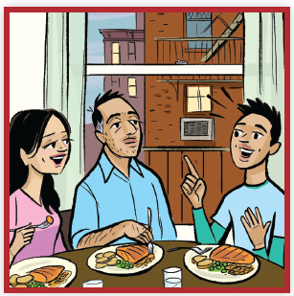
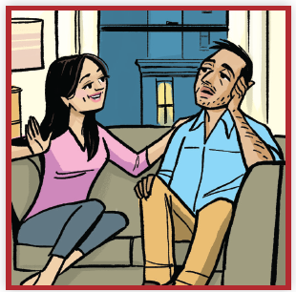
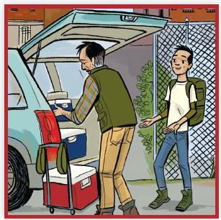
Picture Match
Part ______
Part ______
Part ______

Slide 17
Independent Practice (K) Part 1
Independent Practice
Text Comprehension Read each question. Think of the answer or look back at the text. Fill in the blank. Be sure the sentence makes sense.
Part 1
1. WHO is this story about? This story is about _____________________________________________.
2. HOW did Gaspar and Dad spend their weekend? Gaspar and Dad spent their weekend _______________________________.
3. HOW did Dad look after the camping trip? After the camping trip, Dad looked __________________________________.

Slide 18
Independent Practice (K) Part 2
Part 2
4. WHAT is one thing Gaspar said about the camping trip? One thing Gaspar said was: _______________________________________ _____________________________________________________________.
5. WHAT did Dad say when Gaspar asked to go back next year? When asked about going back next year, Dad said, _____________________.

Slide 19
Independent Practice (K) Part 3
Part 3
6. WHAT is one reason Dad felt differently than Gaspar about the trip?
Dad felt differently than Gaspar because ____________________________ _____________________________________________________________.
7. WHY did the other kids tell Gaspar in Part 2 that his dad was a good sport?
The kids told Gaspar that his dad was a good sport because _____________ _____________________________________________________________.
8. WHY might Dad have said “Let’s wait and see” about next year?
Dad might have said “Let’s wait and see” because _____________________ _____________________________________________________________.

Slide 20
Independent Practice (L)
More Practice • Activity 1 Read each list. Cross out the word that does not belong in each list.
1. woodpile
sausage
cabbage
mushrooms
4. bookkeeper
snowplow
landlord
homeowner
7. football
thought
basketball
soccer
2. sunflower
anyone
cactus
grapevines
5. rowboat
boathouse
sailboat
motorboat
8. nightgown
jacket
raincoat
wooden
3. penthouse
playhouse
stagecoach
doghouse
6. scooter
snowplow
rowboat
bookstore
9. blowtorch
crowbar
mushroom
hammer

Slide 21
Independent Practice (M)
More Practice • Activity 2 Fill in each blank with the best word.
1. If you are a grown-up, you are an ________.
adopt
adult
2. If you could stop something from happening, you could ________ it.
prepay
prevent
3. If you did something that was fun, you might feel ________.
joyful
tearful
4. If you are at the last track meet of the season, you are at the
track meet.
final
central

Slide 22
Independent Practice (M) — cont’d
5. If something is very hard for you to do, you might
to do it.
gentle
struggle
6. If you did something very fast, you did it .
swiftly
nightly

