Slide 1
Say Sounds (A–B)
Say Sounds
Phonemic Awareness You will blend and segment sounds as you read and spell words.
Letter/Sound Associations Look at the letters. Say the sounds.
ai a_e a ar
ow ar ea ay
i ee igh ar
ar oa o ea
o_e i_e e ar

Slide 2
Read Words (C)
Read Words
New Words Say the sound. Sound out the word. Read the word.
Jar arm hard
scar Jay speed
aim spark art
eat mark card
march meek might
yard oats scarf

Slide 3
Read Words (D)
Word Families Read down. Read rapidly.
dart
Bart
cart
chart
smart
far
jar
tar
scar
star
fine
dine
shine
whine
spine
10 Second Challenge
Cold Timing words read
Practice words read
Hot Timing words read

Slide 4
Read Words (E–F)
Review Words Read a line of words. When your teacher gives a meaning, circle the correct word.
mope mop tape tap
prize fill file tome
choke graze blade drive
bad fin fine froze
Words with Endings Read words with endings. 1. filed 2. hoped 3. snapped 4. taping 5. begged 6. marked 7. staying 8. steaming 9. parting 10. marched

Slide 5
Read Words (G–H)
Multisyllabic Challenge Words Sound out the syllables. Read the whole word.
stardust market arctic garlic locket
problem rocket handprint nanobot replicate
High-Frequency Words Say. Spell. Read.
could should would to was
been work are you water

Slide 6
Read Sentences (I)
Read Sentences
Sentences Read the sentences with phrasing.
Could you help me rake all of the leaves in the yard?
At the end of lunch, Dev spilled water on his scarf.
There are marks on the tree where a truck hit it.
I should have sent Neal a get-well card while he was sick.
It would be smart for Jayda to stay home and not go to the lab.

Slide 7
Spell Words (J)
Spell Words
Spelling Journal Turn to the Spelling Journal on page 200.

Slide 8
Decodable Narrative Text (Part 1)
Decodable Narrative Text Read each part. Answer your teacher’s questions and select the picture that goes with each part.
A Problem at the Lab
Part 1
Teacher Reads It’s the year 2320, far in the future. Jayda’s mother does secret work in a space lab orbiting (circling) a faraway planet. Jayda’s mother does not talk about her work with anyone, not even Jayda. Jayda wants to find out what goes on in the lab and make sure her mother is safe.
9
20
26
37
45
Starting when Jayda was little, she wanted to see the way all things worked. This has made her skilled at solving problems as she has grown.
Jayda hoped Mom would let her go to the lab where Mom worked. Jayda begged her each day. “Mom, please may I go to the lab with you?”

Slide 9
Decodable Narrative Text (Part 1) — cont’d
54
64
69
79
Mom explained “I wish you could go. But my work is secret, so you can’t.”
The secret part made it hard on Jayda. Was Mom safe working on secret stuff in the lab?

Slide 10
Comprehension Questions Part 1
Who is the main character?
The main character is ________________.
What did Jayda want to do?
Jayda wanted to find out what her mother was doing in her ________________.
Why was Jayda not supposed to visit her mother’s lab?
Jayda was not supposed to visit her mother’s lab because ________________.

Slide 11
Decodable Narrative Text (Part 2)
Part 2
Teacher Reads Jayda had a plan to find out what Mom did in her lab. Read on to find out what Jayda discovers.
87
97
107
116
127
135
142
152
164
176
Jayda planned to sneak into the lab to check on Mom’s work. Jayda had on her glass locket filled with stardust. Mom got the stardust on her first rocket trip to planet Spartan, and it was the best thing Jayda owned. Jayda had Mom’s smart-mitts, which were marked with Mom’s handprints. Jayda needed Mom’s handprint to get into the lab. When Jayda pressed a smart-mitt on the code pad at the lab gate, the gate went up. Jayda was in! She was glad she hadn’t set off the lab code with red lights.

Slide 12
Decodable Narrative Text (Part 2) — cont’d
182
193
203
214
223
Jayda could not see in the dark lab, so she switched on her light ray. Then she gasped. There were little plastic boxes lined up on a shelf. And in each box, there was a nanobot. The nanobots were looking right at Jayda.

Slide 13
Comprehension Questions Part 2
What was Jayda’s plan?
Jayda’s plan was to ________________.
Why were the smart-mitts important to Jayda’s plan?
The smart-mitts were important to Jayda’s plan because ________________.
What did Jayda discover in the lab?
In the lab, Jayda discovered ________________.

Slide 14
Decodable Narrative Text (Part 3)
Part 3
Teacher Reads When the nanobots start replicating, or producing exact copies of themselves, Jayda faces a serious problem.
225
235
245
256
266
274
281
291
299
308
319
332
Just then, something shifted at the far end of the lab. The soft thud made Jayda jump and then bump into a shelf. Crash! Some of the plastic boxes fell down and the tops came off. The nanobots hopped from the boxes and started darting this way and that.
The nanobots seemed harmless, at least when there were just ten of them. But as Jayda looked on, the nanobots began to replicate with shocking speed. Ten nanobots became 20. Then 20 became 40. Jayda could not keep track of them all! What was she going to do? She should not have been in the lab at all.

Slide 15
Comprehension Questions Part 3
What happened when Jayda bumped into the shelf?
When Jayda bumped into the shelf, ________________.
What was Jayda’s problem?
Jayda’s problem was ________________.

Slide 16
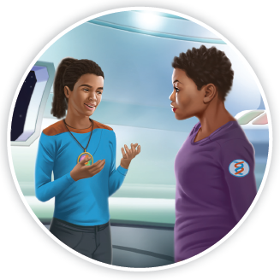
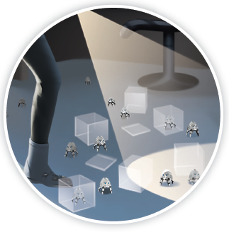
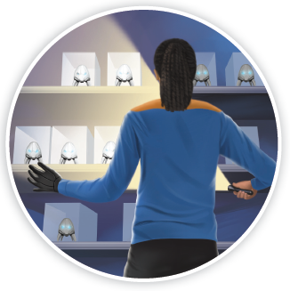
Picture Match
Part ______
Part ______
Part ______

Slide 17
Independent Practice (L) Part 1
Independent Practice
Text Comprehension Read each question. Think of the answer or look back at the text. Fill in the blank. Be sure the sentence makes sense.
Part 1
1. WHO are the people in the story? The people in the story are ______________________________________.
2. WHAT did Jayda hope to do? Jayda hoped to _______________________________________________.
3. WHY can’t Jayda go to the lab? Jayda can’t go to the lab because _________________________________.

Slide 18
Independent Practice (L) Part 2
Part 2
4. WHAT was Jayda’s plan? Jayda’s plan was to ____________________________________________.
5. WHY did Jayda need Mom’s smart-mitts? Jayda needed Mom’s smart-mitts to _______________________________.
6. WHAT did Jayda see in the lab? In the lab, Jayda saw __________________________________________.

Slide 19
Independent Practice (L) Part 3
Part 3
7. WHAT happened when Jayda bumped into the shelf? When Jayda bumped into the shelf, _________________________________ ______________________________________________________________.
8. WHAT did the nanobots do? The nanobots began to ___________________________________________.

Slide 20
Independent Practice (M) Story 1
More Practice Read each story. Answer the questions.
Story 1: Dad handed Rick a list of things to get at the market. At the market, Rick filled a big cart with things from Dad’s list. Rick was in a rush. He did not take a close look at the list, but he should have. It would have been a smart thing to do.
After Rick got home, Dad asked, “Where is the garlic?” Rick started back to the market.
1. WHERE did Rick go? Rick went to _______________________________________________.

Slide 21
Independent Practice (M) Story 1 — cont’d
2. WHERE did Rick put the things from the list? Rick put the things __________________________________________.
3. WHY did Rick have to go back to the market? Rick had to go back _________________________________________.

Slide 22
Independent Practice (M) Story 2
Story 2: Pilar had a yard sale to sell things she could not keep. She had some big things for sale, like bikes. She had glass jars in all sizes and shapes. There was a red scarf and a dark gray coat. Lots of people came to shop in her yard. After each sale, Pilar’s dog would jump and bark. That made all the people smile. At the end of the day, Pilar’s yard was clean.
1. WHERE did Pilar have a sale? Pilar had a sale ________________________________________________.
2. WHAT glass things did Pilar have for sale? Pilar had _____________________________________________________.
3. WHAT would Pilar’s dog do after each sale? Pilar’s dog would ______________________________________________.

