Slide 1
Say Sounds (A–B)
Say Sounds
Phonemic Awareness You will blend and segment sounds as you read and spell words.
Letter/Sound Associations Look at the letters. Say the sounds.
or wh ir a
th i igh i_e
ur ck oa e
ow o_e u ur
ar o er ea

Slide 2
Read Words (C)
Read Words
New Words Say the sound. Sound out the word. Read the word.
firm burp farm
curl Barb Carl
burst blurt bleed
nurse birth nerve
birch Kirk whirl
curve twirl carve
Irregular Word: work

Slide 3
Read Words (D)
Word Families Read down. Read rapidly.
hurt
curt
yurt
spurt
blurt
art
tart
dart
chart
start
fort
sort
port
short
sport
10 Second Challenge
Cold Timing words read
Practice words read
Hot Timing words read

Slide 4
Read Words (E–F)
Review Words Read a line of words. When your teacher gives a meaning, circle the correct word.
spine spin flame braid
flap blond broke keep
groan beast float steal
best flight grime grin
Words with Endings Read words with endings. 1. spinning 2. flaming 3. grinning 4. spinner 5. voter 6. farmer 7. firmer 8. bleeding 9. whirling 10. twirled

Slide 5
Read Words (G–H)
Multisyllabic Challenge Words Sound out the syllables. Read the whole word.
surplus northern arcade murmur furnish
birthmark veteran surrender misinterpret suburbs
High-Frequency Words Say. Spell. Read.
other mother another use they
of were work from look

Slide 6
Read Sentences (I)
Read Sentences
Sentences Read the sentences with phrasing.
There were lots of bows to curl for the art bin.
When you are training your pet, you should use a firm tone.
The mother dog gave birth to five pups, and they are very sweet.
The school nurse looked at my arm after I fell on the way to class.
Make another left turn after the road curves and you will come to Kirk’s farm.

Slide 7
Spell Words (J)
Spell Words
Spelling Journal Turn to the Spelling Journal on page 202.

Slide 8
Decodable Informative Text (Part 1)
Decodable Informative Text Read each part. Answer your teacher’s questions and select the picture that goes with each part.
Urban Artists at Work
Part 1
Teacher Reads Philadelphia, Pennsylvania, has 4,000 murals, which are large pictures that are painted on the walls of buildings. The murals are part of the Mural Arts project, which was started in 1984 by an artist named Jane Golden.
10
17
27
38
48
The goal of the Mural Arts project was to have young people from Philadelphia help artists paint murals. At first, Mural Arts was a little project, but it did not stay that way! As time passed, Mural Arts has grown and turned into an important part of life in Philadelphia.

Slide 9
Decodable Informative Text (Part 1) — cont’d
50
59
68
79
90
99
107
Why has the project worked so well? Artists and people in the community work together on art that means a lot to them. They take pride in the work they do. Each mural seems to burst from the side of a building and “speak” to the people of Philadelphia. That’s because each mural shows things that people think are important.

Slide 10
Comprehension Questions Part 1
What was the goal of the Mural Arts project?
The goal of the Mural Arts project was to ________________.
What has happened to the Mural Arts project as time passed?
As time passed, the Mural Arts project has ________________.
Why has the Mural Arts project worked so well?
The Mural Arts project has worked so well because ________________.

Slide 11
Decodable Informative Text (Part 2)
Part 2
Teacher Reads The murals in Philadelphia cover a wide range of topics and subjects. Keep reading to find out what some of them are.
110
119
128
137
148
158
164
174
186
197
209
The murals show people from the past and present who grew up in Philadelphia. There are leaders, sports stars, singers, and other people in the murals. Lots of murals use swirls of bright paint to show people at work and at play. There are murals of gardens filled with plants and murals of birds.
Lots of people stop and look at a mural named Reach High and You Will Go Far. It shows a girl with a tree held high in her hands. What is this mural saying? It is telling kids to set big goals and reach for big dreams.

Slide 12
Comprehension Questions Part 2
What kinds of topics do the murals show?
The murals show ________________.
What is the mural named Reach High and You Will Go Far telling kids to do?
The mural named Reach High and You Will Go Far is telling kids to ________________.

Slide 13
Decodable Informative Text (Part 3)
Part 3
Teacher Reads Philadelphia offers different kinds of tours, which are trips around the city, so visitors can learn about its amazing murals. There are walking tours, train tours, and trolley bus tours.
211
220
229
239
250
259
268
280
290
297
On weekends, you might see lots of people getting on a bus to see Philadelphia’s murals. People come from the suburbs of Philadelphia, as well as from other parts of the U.S. The trip leader tells them when the murals were painted, who the artists are, and other interesting facts. People may come back lots of times to see the murals they like best. That is not a surprise to the people of Philadelphia, who take pride in the murals. The murals show who they are.

Slide 14
Comprehension Questions Part 3
What is one way to see the murals in Philadelphia?
One way to see the murals in Philadelphia is to ________________.
Where do people come from to see the murals?
People come from ________________.
What kinds of facts might people learn about the murals from the trip leader?
People might learn ________________.

Slide 15
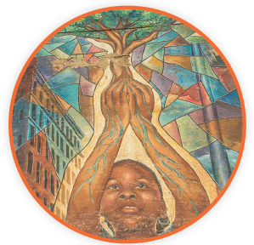
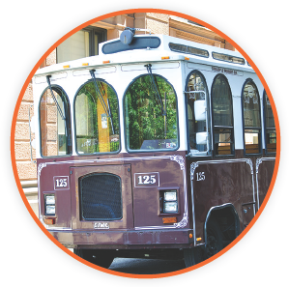
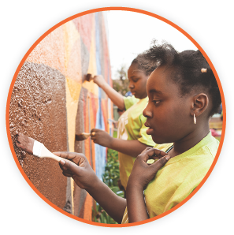
Picture Match
Part ______
Part ______
Part ______

Slide 16
Independent Practice (L) Part 1
Independent Practice
Text Comprehension Read each question. Think of the answer or look back at the text. Fill in the blank. Be sure the sentence makes sense.
Part 1
1. WHAT was the goal of the Mural Arts project? The goal was to _______________________________________________.
2. WHAT has happened to the Mural Arts project as time passed? As time passed, the project _______________________________________. _____________________________________________________________.
3. WHY has the Mural Arts project worked so well? It has worked so well because ____________________________________.

Slide 17
Independent Practice (L) Part 2
Part 2
4. WHAT is a topic the murals show? A topic shown is ______________________________________________.
5. WHAT is the mural Reach High and You Will Go Far telling kids to do? This mural is telling kids to _____________________________________.

Slide 18
Independent Practice (L) Part 3
Part 3
6. HOW do some people visit the murals in Philadelphia? Some people get on __________________________________________.
7. WHERE do people come from to see the murals? People come from ___________________________________________.
8. WHAT facts might a trip leader tell the people on a bus trip? A trip leader might tell people ___________________________________.

Slide 19
Independent Practice (M) Story 1
More Practice Read each story. Answer the questions.
Story 1: Kirsten could feel the firm dirt under her feet as she ran. Kirsten liked running on the curves of the farm road. They made running fun. As she ran, she turned so she could look at a bird. At the same time, she came to another curve. Kirsten fell in the dirt. Thud! Kirsten hurt her arm. It was bleeding. She ran back home, where her mother cleaned up her arm.
1. WHERE did Kirsten like to run? Kirsten liked to run _______________________________________________.
2. WHAT did Kirsten look at while she was running? While she was running, Kirsten looked at ____________________________.
3. WHAT happened to Kirsten when she was running? When she was running, Kirsten ____________________________________.

Slide 20
Independent Practice (M) Story 2
Story 2: It is Bert’s first day of work as a nurse. He has on his green shirt and pants. He wishes to help people when they are sick or hurt. The other nurses show Bert what to do. When Bert helps people, he smiles so they smile back. At the end of the day, Bert gets home. He turns on the light at his desk. He will be glad to get back to work the next day.
1. WHAT is Bert’s job? Bert is a ____________________________________________________.
2. WHO shows Bert what to do? __________________________________________ show Bert what to do.
3. WHY do people smile at Bert? People smile at Bert because ____________________________________.

