Slide 1
Say Sounds (A–B)
Say Sounds
Phonemic Awareness Listen to the word your teacher says. Then say the sounds or word parts in the word.
Letter/Sound Associations Look at the letters. Say the sounds.
chin when that shop
th a wh p t
sh th e d s
u wh ch n o
z ch i th sh

Slide 2
Read Words (C)
Read Words
New Words Say the sound. Sound out the word. Read the word.
when ship chip
chat that shed
this thus chop
whip shop then
whiz chin thud

Slide 3
Read Words (D)
Word Families Read down. Read rapidly.
zip
hip
chip
ship
whip
sat
hat
cat
chat
that
hop
top
mop
chop
shop
10 Second Challenge
Cold Timing words read
Practice words read
Hot Timing words read

Slide 4
Read Words (E–F)
Review Words Read a line of words. When your teacher gives a meaning, circle the correct word.
fish fist fit fast
mend men end mat
sick pick sip sun
task ask math mash
Multisyllabic Challenge Words Sound out the syllables. Read the whole word. chipmunk nutshell shamrock chitchat banish

Slide 5
Read Words (G)
High-Frequency Words Say. Spell. Read.
saw into was to said
work put down children and

Slide 6
Read Sentences (H)
Read Sentences
Sentences Read the sentences with phrasing.
Al will run down to the shop.
Jon and Beth can chop the log.
I saw a little chipmunk dash into the shed.
Can you put this lamp into a box for my mom?
When Rick got a chess set, he said it was the best gift.

Slide 7
Spell Words (I)
Spell Words
Spelling Journal Turn to the Spelling Journal on page 155.

Slide 8
Decodable Text (Part 1)
Decodable Text Read each part. Answer your teacher’s questions and select the picture that goes with each part.
Chuck’s Chipmunk
Part 1
Teacher Reads Chipmunks are the smallest animals in the squirrel family. Most chipmunks live in long, underground burrows, or tunnels. Chipmunks eat many kinds of foods, including nuts. This story is about a man and a chipmunk that want the same nuts.
The little chipmunk sat next to a big rock. It saw a shed at the end of the path. It saw a man put some nuts in the shed. The chipmunk had a wish. Its wish was to get to the nuts in the shed. The chipmunk ran down the path to the shed. The shed was shut, but the chipmunk got in and saw a box on a shelf. The chipmunk went up to the box and saw them. Nuts! When the chipmunk had its fill, it ran back to the rock.

Slide 9
Comprehension Questions Part 1
What did the chipmunk want?
The chipmunk wanted ________________.
What did the chipmunk do to get the nuts?
To get the nuts, the chipmunk ________________.

Slide 10
Decodable Text (Part 2)
Part 2
Teacher Reads The shed belongs to Chuck, who stores his nuts there. Will the chipmunk return to the shed? Will Chuck and the chipmunk meet? Let’s find out.
After work, Chuck went to the shed to check on the box of nuts. Chuck did not see the chipmunk, but the nut box was a mess! “Look at this!” Chuck said when he saw the nutshells.
Just then, Chuck saw the chipmunk in the shed. He saw the chipmunk chomp on a nut! Chuck went after the chipmunk, but it ran off.

Slide 11
Comprehension Questions Part 2
What happened when Chuck saw the chipmunk eating a nut?
When Chuck saw the chipmunk eating a nut, he ________________.

Slide 12
Decodable Text (Part 3)
Part 3
Teacher Reads Chuck is annoyed that the chipmunk got into his box of nuts. He needs to figure out how to keep the box of nuts safe from this hungry little creature.
Chuck said, “Did that chipmunk get into my box of nuts? I must check. Yes! That chipmunk did get into the box. It left this mess. That chipmunk is little, but it can be a pest!”
Then Chuck said, “I cannot let the chipmunk have some nuts from my box. I will put some nuts at the big rock.” Then Chuck got some nuts and went down the path. He set down a box of nuts at the big rock for the chipmunk.

Slide 13
Comprehension Questions Part 3
How did Chuck stop the chipmunk from eating the nuts in the shed?
To stop the chipmunk, Chuck ________________.

Slide 14
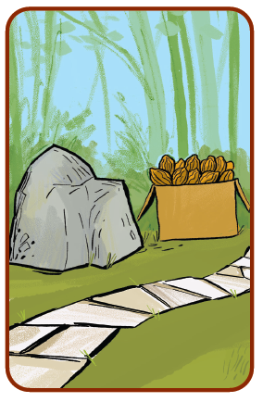
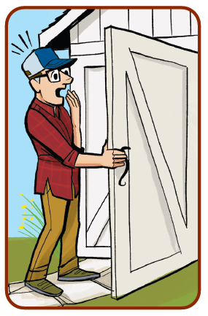
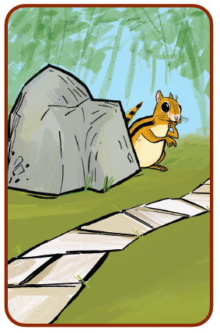
Picture Match
Passage ______
Passage ______
Passage ______

Slide 15
Independent Practice (K)
Independent Practice
More Practice 1 Read each group of words. The groups of words are not in the correct order. Change the order of the words to make a sentence. Write each sentence on the line. Read each sentence.
1. will not get into the shed That chipmunk
2. of the ship on the deck People sit

Slide 16
Independent Practice (K) — cont’d
3. set the fish on this dish You can
4. will whip Jeff the eggs
5. Mom got from the dentist this bill
6. on the rock hit his chin Tim

Slide 17
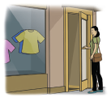

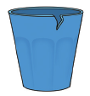
Independent Practice (L)
More Practice 2 Draw a line under the sentence that goes best with each picture.
1. Lin went in the shop.
Lin is in the shed.
2. This duck is in the sandbox.
This tot will sit in the sandbox.
3. The dish has a big chip.
The cup has a little chip.

Slide 18
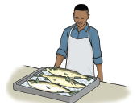
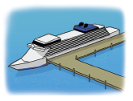

Independent Practice (L) — cont’d
4. Ed sells the best fish.
Ed picks up a nutshell.
5. That ship is at the dock.
That chip is on a dish.
6. The dog will whiz past the children.
The chipmunk can dash up fast.

Slide 19
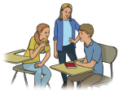
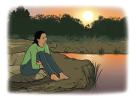
Independent Practice (L) — cont’d
7. They will get wet on the deck.
They will chat at school.
8. When it was dusk, Pam went to the pond.
When the sun set, Pam went to the shop.

