Slide 1
Say Sounds (A–B)
Say Sounds
Phonemic Awareness Listen to the word your teacher says.
Then say the sounds or word parts in the word.
Letter/Sound Associations Look at the letters. Say the sounds.
  p d o ch v
  ck a t r f
  e s n c th
  u sh i m l

Slide 2
Read Words (C)
Read Words
New Words Say the sound. Sound out the word. Read the word.
  jump pump band
  hand tent ramp
  mend dust dusk
  vast tusk task
  wind pond husk

Slide 3
Read Words (D)
Word Families Read down. Read rapidly.
fast
last
past
cast
vast
lamp
ramp
damp
camp
ramp
tent
dent
lent
Kent
vent
10 Second Challenge
Cold Timing words read
Practice words read
Hot Timing words read

Slide 4
Read Words (E–F)
Review Words Read a line of words. When your teacher gives a meaning,
circle the correct word.
  pack nap pad rush
  dish hush had sun
  bat bath back Nick
  mash tack rim putt
Multisyllabic Challenge Words Sound out the syllables. Read the whole word.
dentist invest locket sandbox invent

Slide 5
Read Words (G)
High-Frequency Words Say. Spell. Read.
  some my are down work
  and school see play the

Slide 6
Read Sentences (H)
Read Sentences
Sentences Read the sentences with phrasing.
  There are some nets to fish with on the ramp.
  I can work on the last task with Dad.
  Mom and Ken will set up the tent at camp.
  Will you go to the pond with us at dusk?
  My dog will jump off the bed for us to pet him.

Slide 7
Spell Words (I)
Spell Words
Spelling Journal Turn to the Spelling Journal on page 155.

Slide 8
Decodable Text (Passage 1)
Decodable Text Read each passage. Answer your teacher’s questions
and select the picture that goes with each passage.
Passage 1
The Lost Test
Teacher Reads Mel, the girl in this story, is afraid to look at her last
spelling test. When she finally decides to look at it, something unexpected
happens.
Mel went to the pond after school with the test in
her hand. She sat down by the water, but did not look at
the test yet.
“I did my best,” Mel said, “but did I pass the test?”
When Mel went to look at her test, a gust of wind got
the test.
“No!” said Mel and she ran after it. But the test fell
into the pond and was lost. Mel was upset!

Slide 9
Comprehension Questions Passage 1
What did Mel take to the pond?
Mel took her ________________.
Why didn’t Mel get to see how she did on the test?
Mel didn’t get to see how she did on the test because ________________.

Slide 10
Decodable Text (Passage 2)
Passage 2
To Mend a Desk
Teacher Reads When Alex sits down to work at his desk, he notices that
the desk has a broken leg. He goes to find his dad and ask for help to fix
the leg of the desk.
Alex went to get his dad. “Dad?” Alex said. “The
leg on my desk is bent, and I cannot fix it. Can you
mend it?”
Dad went to look at the desk. “It is a bad bend, Alex,”
Dad said. “I can mend it. But you must lend a hand
and help.”
Alex said, “I can lend a hand, Dad.”

Slide 11
Comprehension Questions Passage 2
Why did Alex need to fix the desk?
Alex needed to fix the desk because ________________.
How did Alex solve this problem?
Alex solved this problem by ________________.

Slide 12
Decodable Text (Passage 3)
Passage 3
The Band
Teacher Reads Parents, students, teachers, and members of the
community have all come together to hear the school band play.
People sit in the big tent. The band will play at dusk.
Lots of children play in the school band.
Some children do tasks to help the band. Kim sells
tickets. Jon pumps water into cups for people to sip.
Then a man tells the band to play. People hush.

Slide 13
Comprehension Questions Passage 3
What was Jon’s task?
Jon’s task was to ________________.
Why did people hush (become quiet)?
People hushed because ________________.

Slide 14
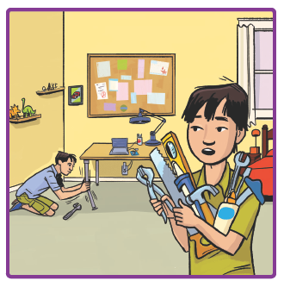
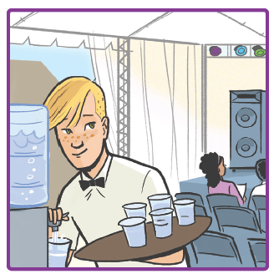
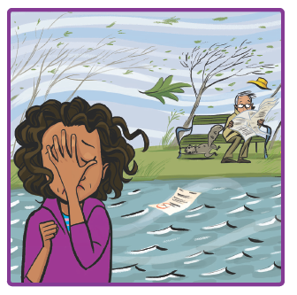
Picture Match
Passage ______
Passage ______
Passage ______

Slide 15
Independent Practice (K)
Independent Practice
More Practice 1 Fill in each blank with the best word.
  1. Dad will ________ his tan socks.
dust mend dent
  2. Jaz will finish the big ________.
fist tent task
  3. Tavis and I play in a ________.
band nest bump
  4. I put the ________ on my desk.
wind pond lamp
  5. Pam had a math ________.
nest test west

Slide 16
Independent Practice (K) — cont’d
  6. Sal ran ________ the pond.
past last fist
  7. The van hit a big ________.
tusk mint bump
  8. The sun sets in the ________.
sand west tent
  9. The eggs are in the ________.
lamp fund nest
  10. It is fun to dig in the ________.
sand lump pest

Slide 17
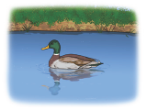
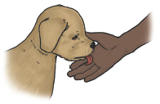
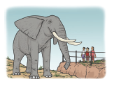
Independent Practice (L)
More Practice 2 Draw a line under the sentence that goes best
with each picture.
1. Don pumps gas into the van.
The duck is in the pond.
2. The pup can lick my hand.
The pup will jump into the sandbox.
3. The children look at the tusks.
The children went to bed at dusk.

Slide 18
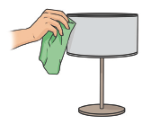
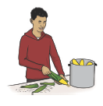
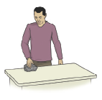
Independent Practice (L) — cont’d
  4. We cannot see the sun at dusk.
I must dust the lamp.
  5. Jill has a mask on her desk.
Bill will rip the husks off.
6. Rick put a rock on his desk.
An egg is in the nest.

Slide 19
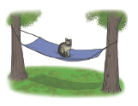
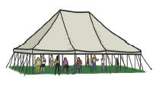
Independent Practice (L) — cont’d
7. Jeff sent Nan a locket.
Jess must sit in the hammock.
8. The people sit in the vast tent.
Kat sat in the red sandbox.

