Slide 1


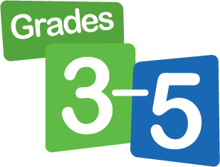
Get Ready for Fluency Flight!
Click your students’ grade level to access a presentation that will help them navigate their student dashboard:
Tips:
Review the presentation ahead of time to internalize the slides, and note any additional guidance you want to provide.
Show the presentation to your class the day students initially log in to their student dashboards.
Feel free to adjust the presentation for your students. Skip slides when needed.
Visit the Fluency Flight Program Preview page to download additional resources!

Slide 2

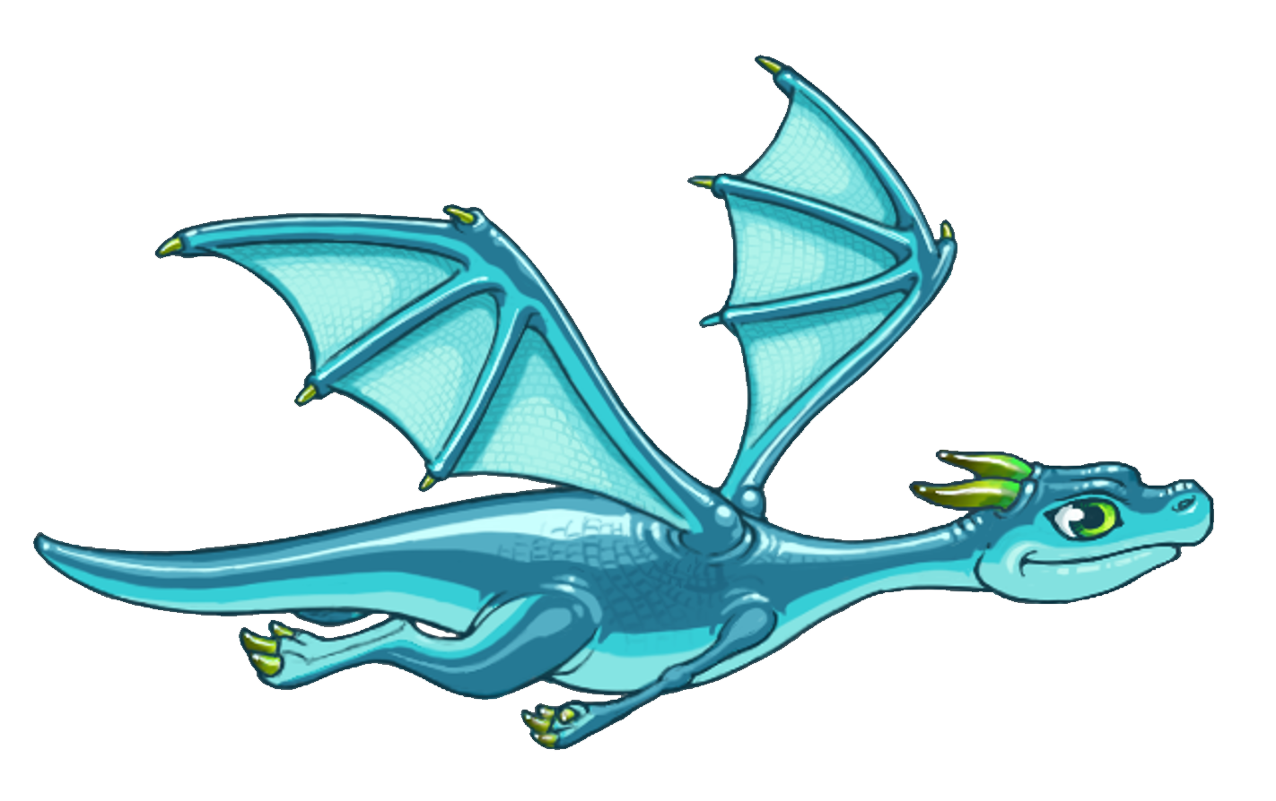
Get Ready for
Fluency Flight!

Slide 3
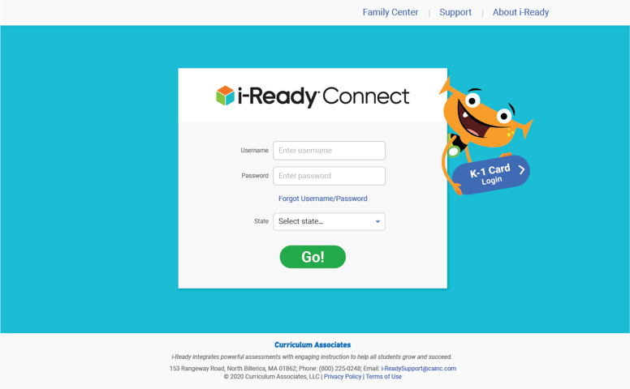
How to Log In
Optional
Enter your username.
Enter your password.
Select your state.
Click Go!

Slide 4
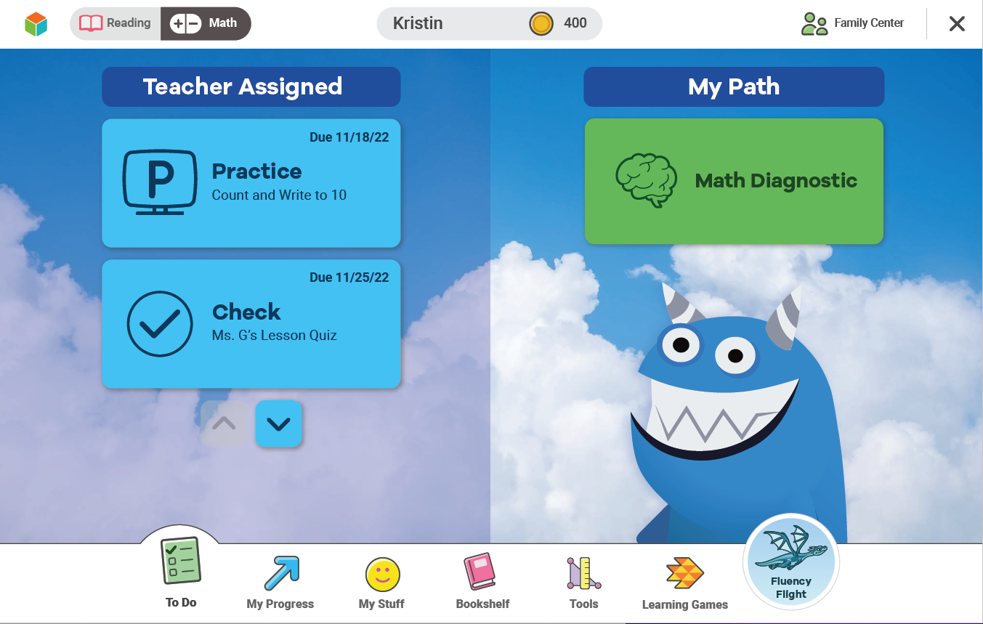



Your Dashboard
The light blue circle with the dragon on it leads to Fluency Flight.

Slide 5
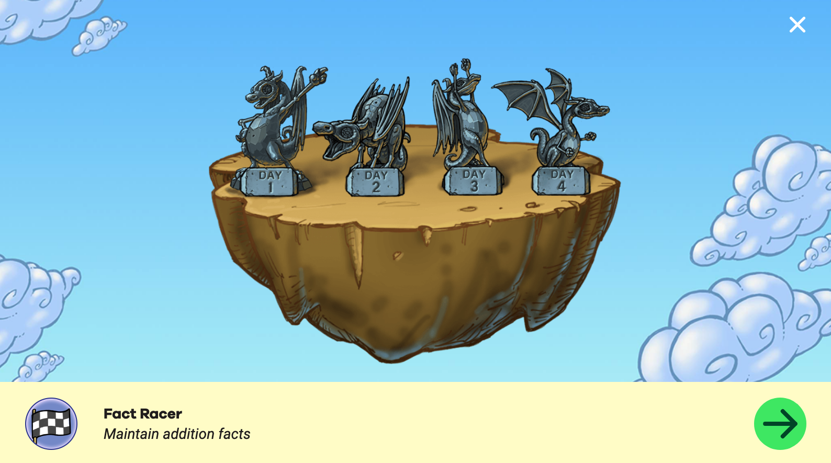
Fluency Flight
Fluency Flight helps increase your math fluency.
Try to earn four dragons every week.
You can earn a dragon by completing the day’s activities.

Slide 6
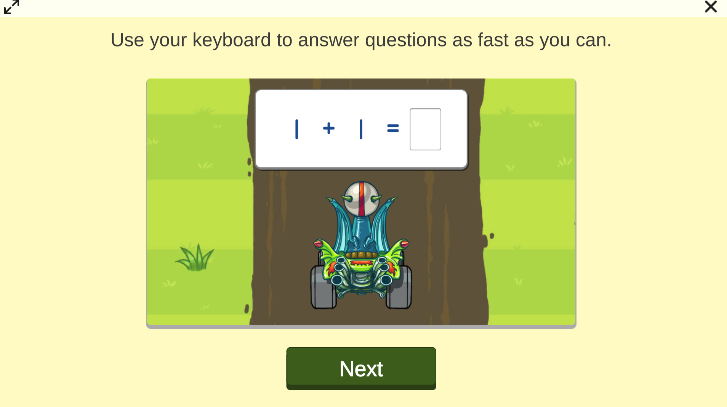
Fluency Flight: First Activity
Your first activity in Fluency Flight starts automatically.
The activity you see might be different from what someone else sees.

Slide 7
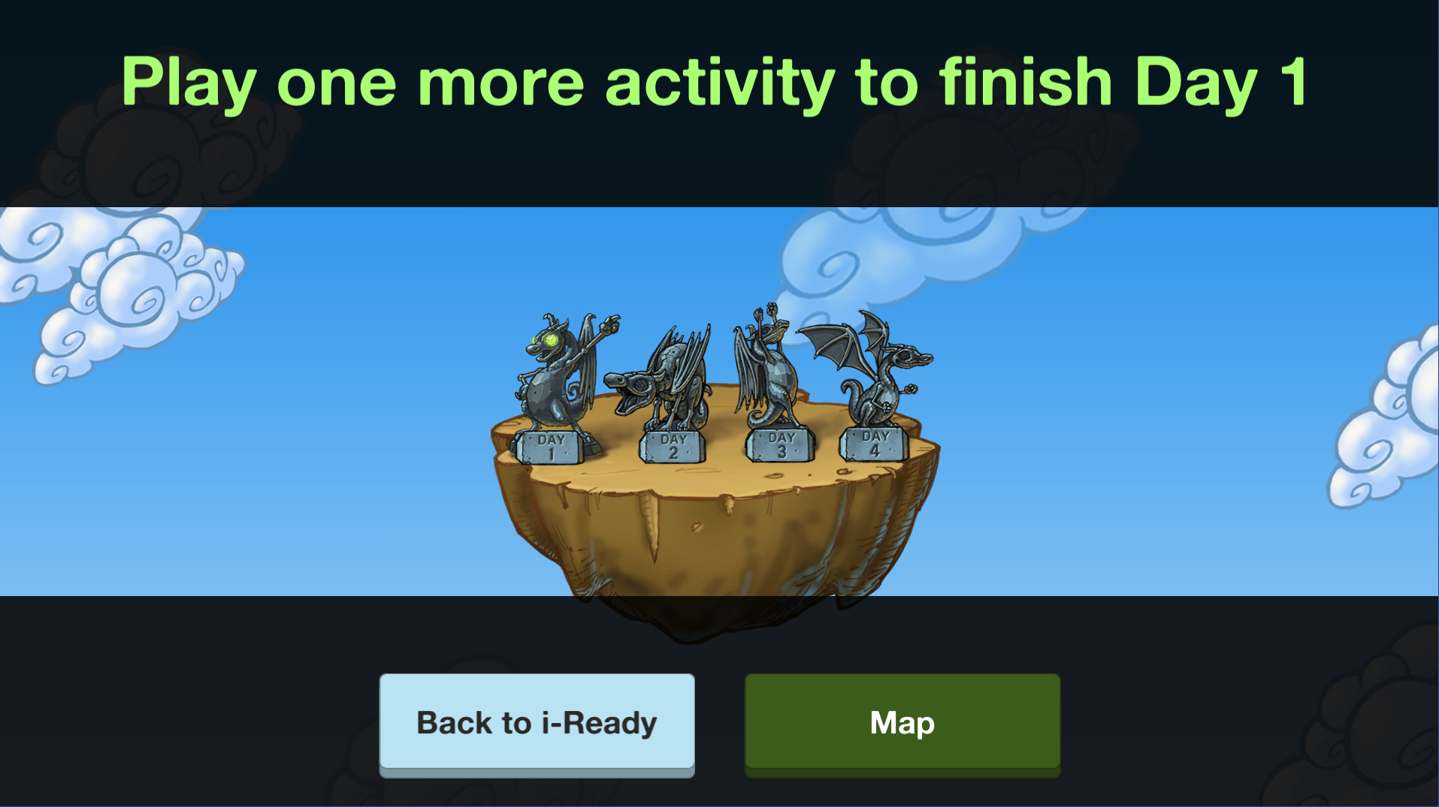
Fluency Flight: First Activity
When you finish the first activity, the dragon’s eyes will glow.
Keep going to earn your dragon for the day!

Slide 8
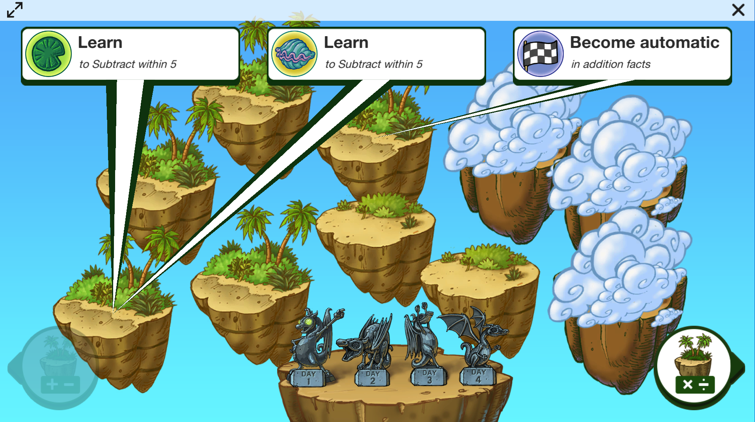
Fluency Flight: Your Choice
You choose your second activity!
Click on the speech bubble at the top to choose.
Your activities will change as you learn.

Slide 9
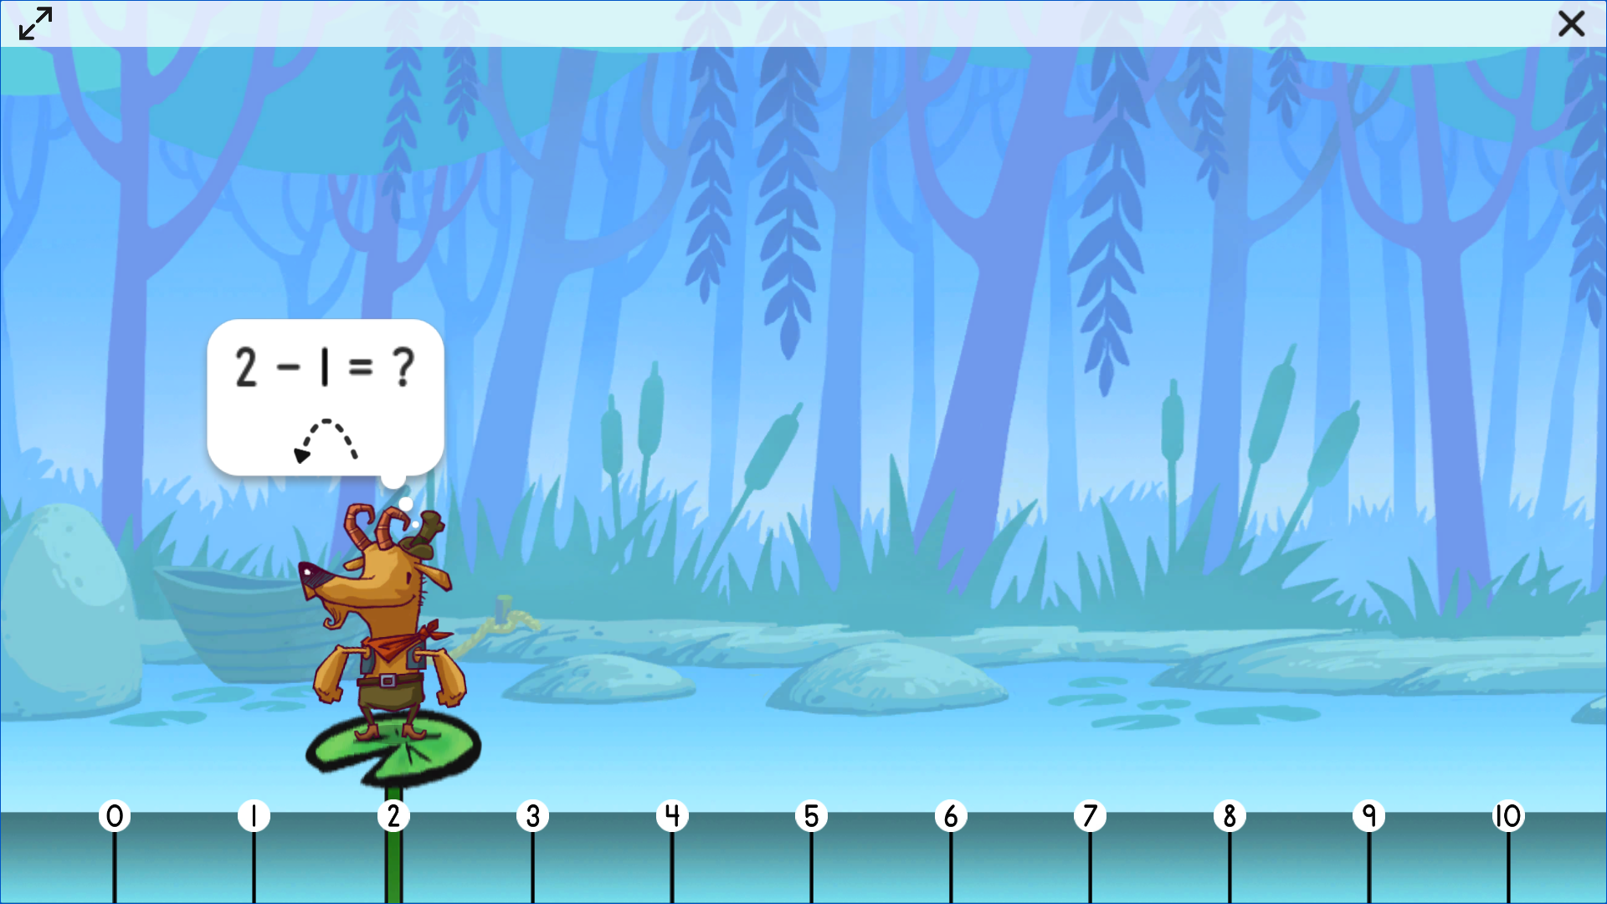
Fluency Flight: Second Activity
Follow the directions
in the activity.
It’s okay to make mistakes!
When you complete your second activity . . .

Slide 10
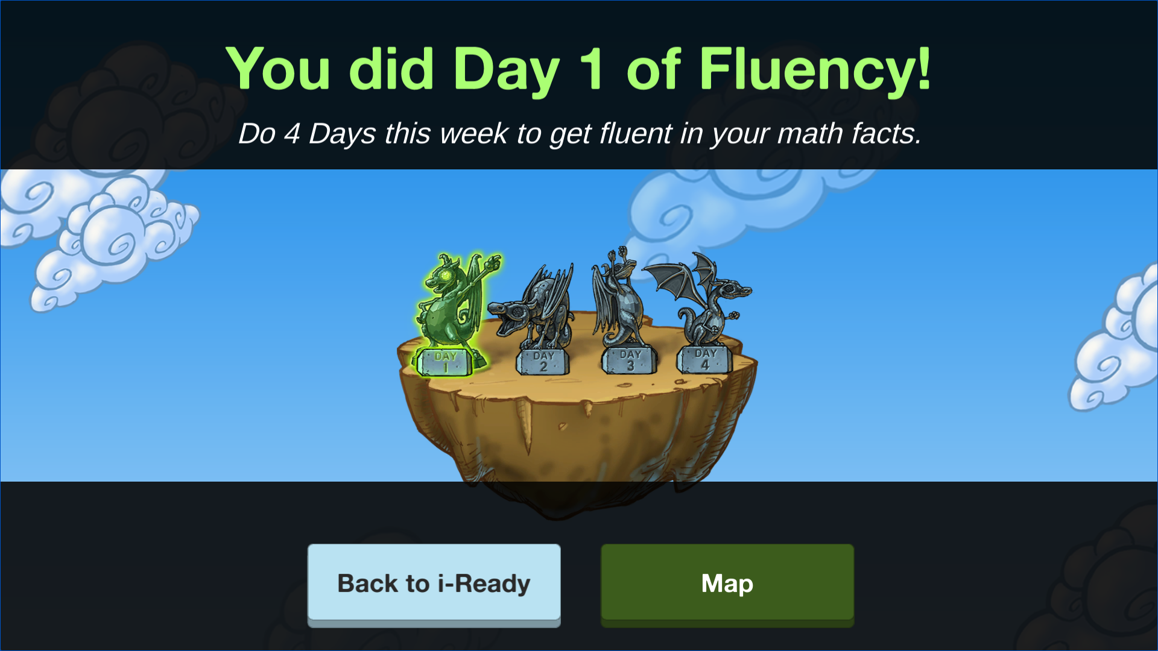
Fluency Flight
You get your dragon for the day!
You can only get
one dragon per day.
Try to get four dragons every week!

Slide 11
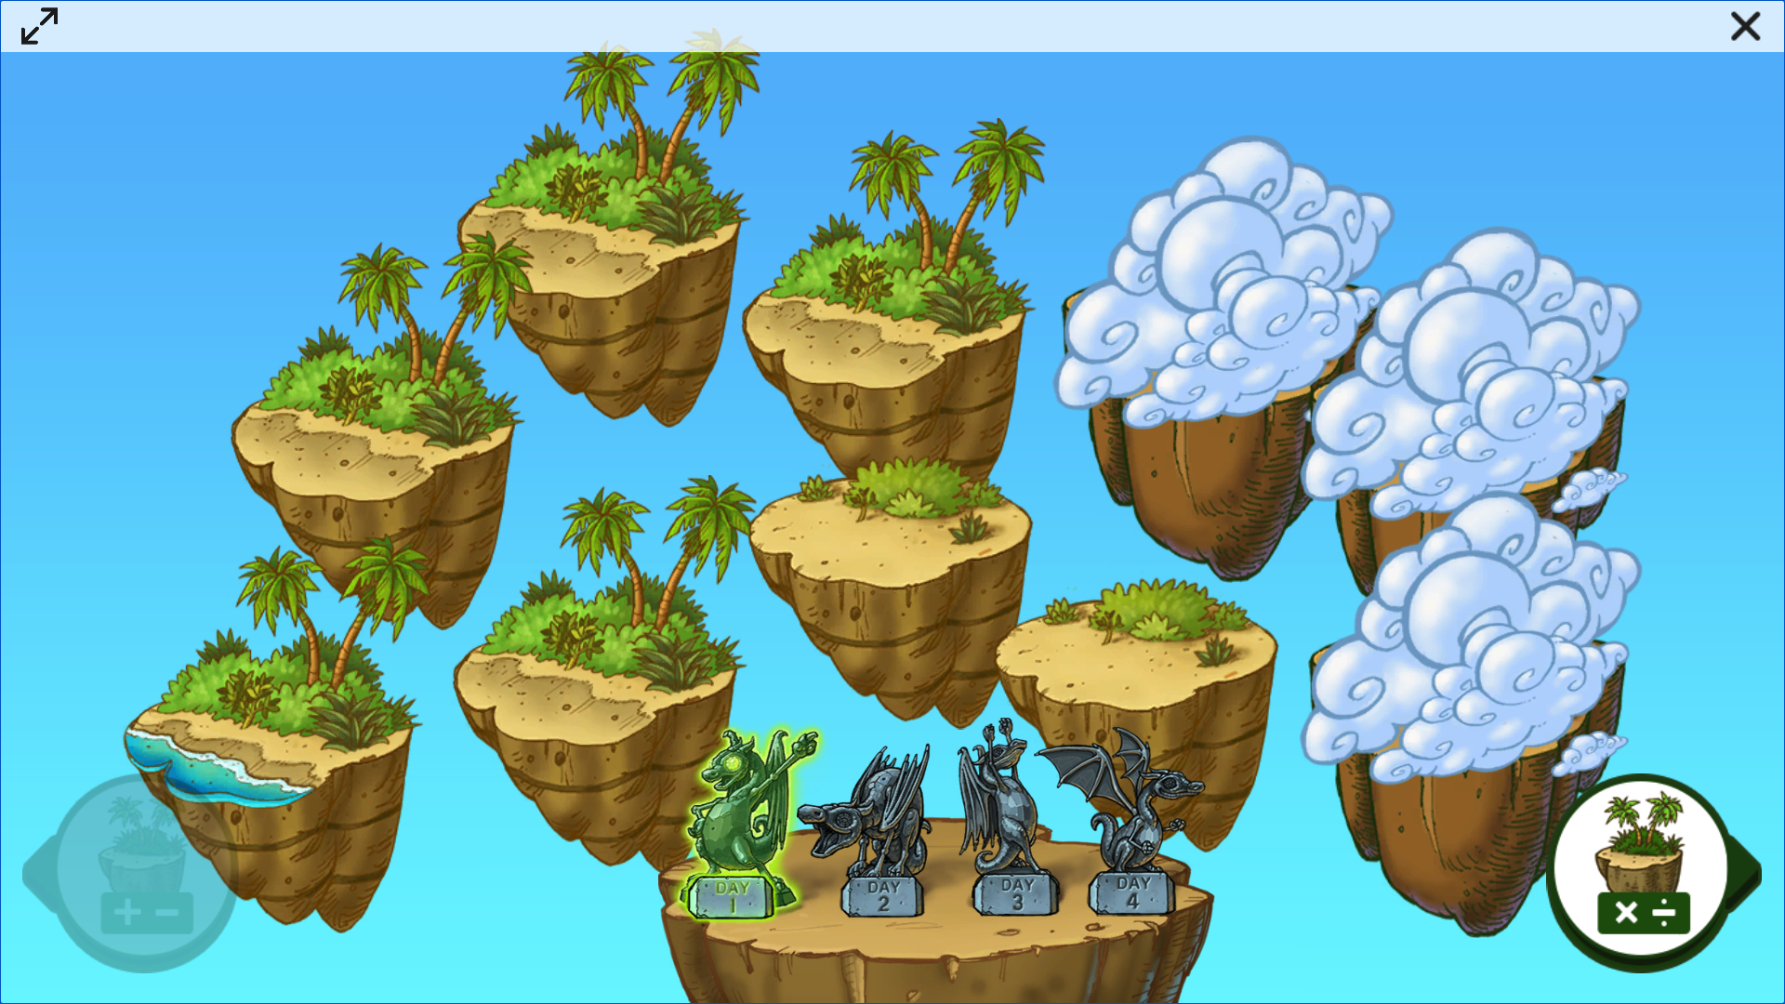
Fluency Flight
Watch the islands change as you complete more activities.
In time, the clouds will move, revealing more islands, and more water and trees will appear on your islands.
You can click on an island to learn more.
Image of islands

Slide 12
Let your math facts fluency take flight!

Slide 13
Get Ready for
Fluency Flight!

Slide 14
How to Log In
Optional
Enter your username.
Enter your password.
Select your state.
Click Go!

Slide 15
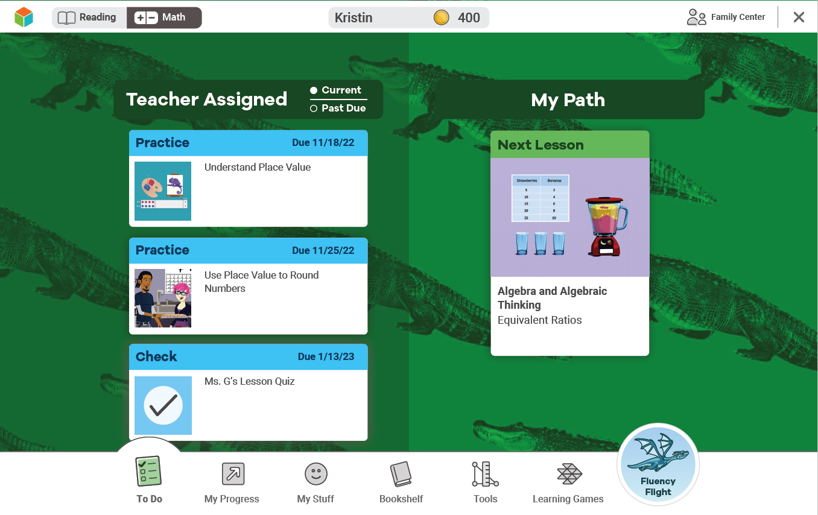
Your Dashboard
The light blue circle with the dragon on it leads to Fluency Flight.

Slide 16
Fluency Flight
Optional
Fluency Flight helps increase your math fluency.
If you complete two activities, you’ll earn a dragon for the day.
Try to earn four dragons every week!

Slide 17
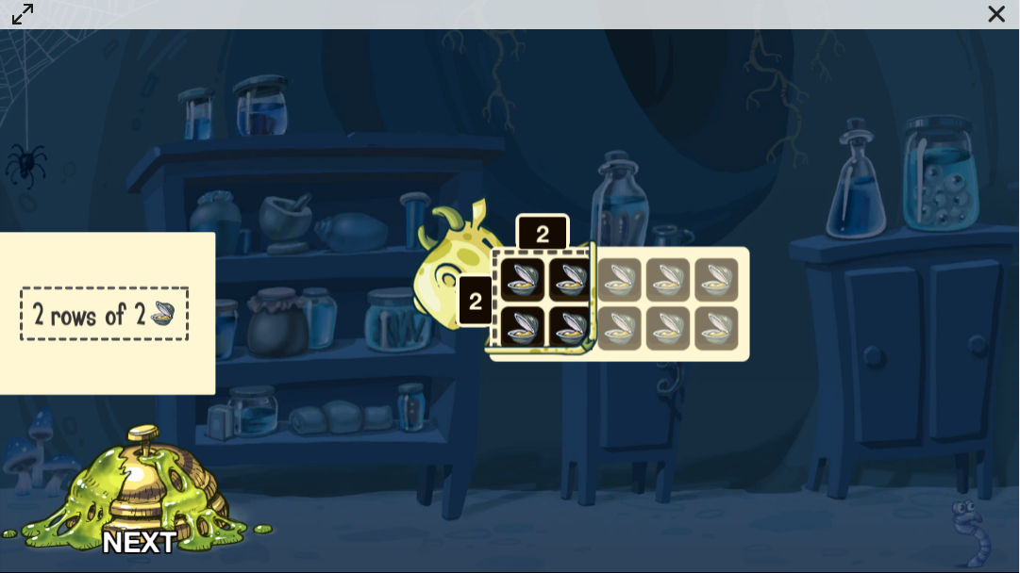
Fluency Flight: First Activity
Optional
Your first activity in Fluency Flight starts automatically.
The activity you see might be different from what someone else sees.

Slide 18
Fluency Flight: First Activity
Optional
When you finish the first activity, the dragon’s eyes will glow.
Keep going to earn your dragon for the day!

Slide 19
Fluency Flight: Your Choice
Optional
You choose your second activity!
Click on the speech bubble at the top to choose.
Your activities will change as you learn.

Slide 20
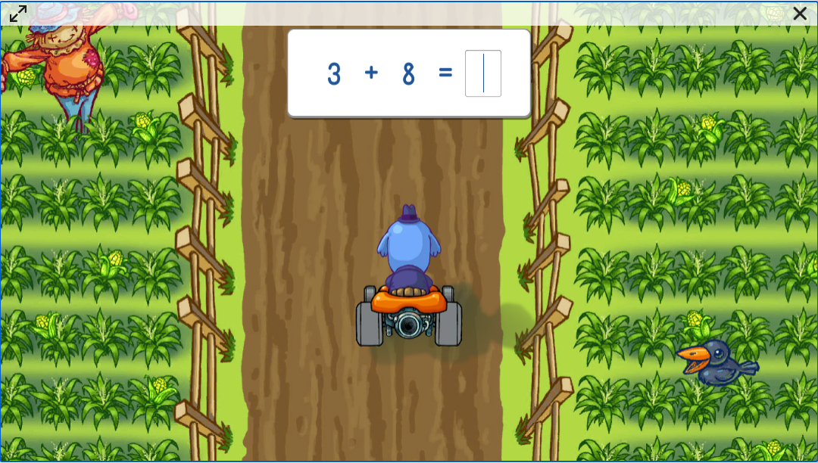
Fluency Flight: Second Activity
Optional
Follow the directions in the activity.
It’s okay to make mistakes!
When you finish the second activity . . .

Slide 21
Fluency Flight
Optional
You get your dragon for the day!
You can only get
one dragon per day.
Try to get four dragons every week!

Slide 22
Fluency Flight
Optional
Watch the islands change as you complete more activities.​
In time, the clouds will move, revealing more islands, and more water and trees will appear on your islands.
You can click on an island to learn more.

Slide 23
You can do it!

