Slide 1

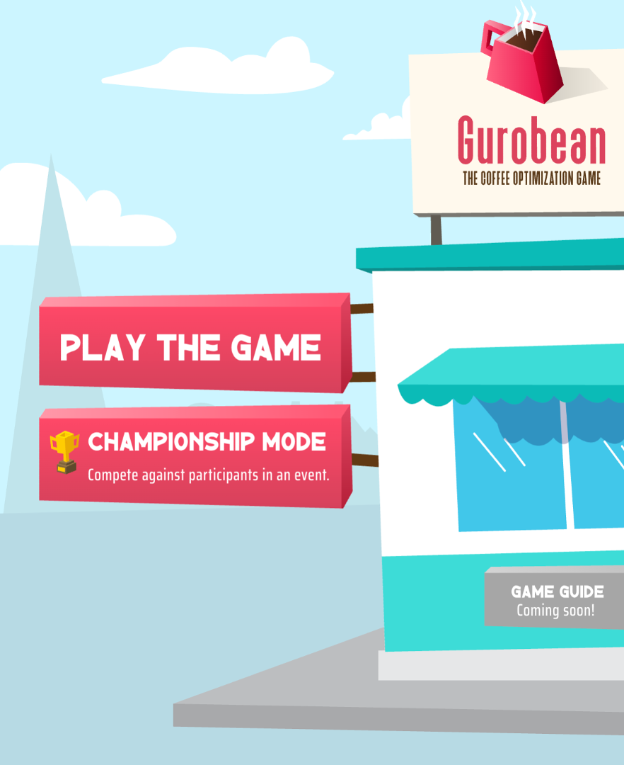

Teaching Deck

Slide 2
How to Use This Deck (for TAs)
One deck, two teaching paths. Every content slide is tagged in the top-right corner, hide the slides that don't fit your audience.
CORE: Everyone
TECHNICAL: OR / ENG / CS
BUSINESS: MBA / Analytics
Technical Track · 45–75 min
Show: CORE slides + all TECHNICAL slides.
Hide: BUSINESS slides.
Emphasis: formulation, classification, why enumeration fails, deterministic vs. stochastic vs. robust.
Good lead-in to integer/nonlinear programming, simulation, queueing.
Business & Analytics Track · 45–60 min
Show: CORE slides + all BUSINESS slides.
Hide: TECHNICAL math slides.
Emphasis: decision quality, trade-offs, why feasible plans differ, the moving sweet spot.
No math background needed, focus on insight and strategy.

Slide 3
Game Essentials
Core

Slide 4
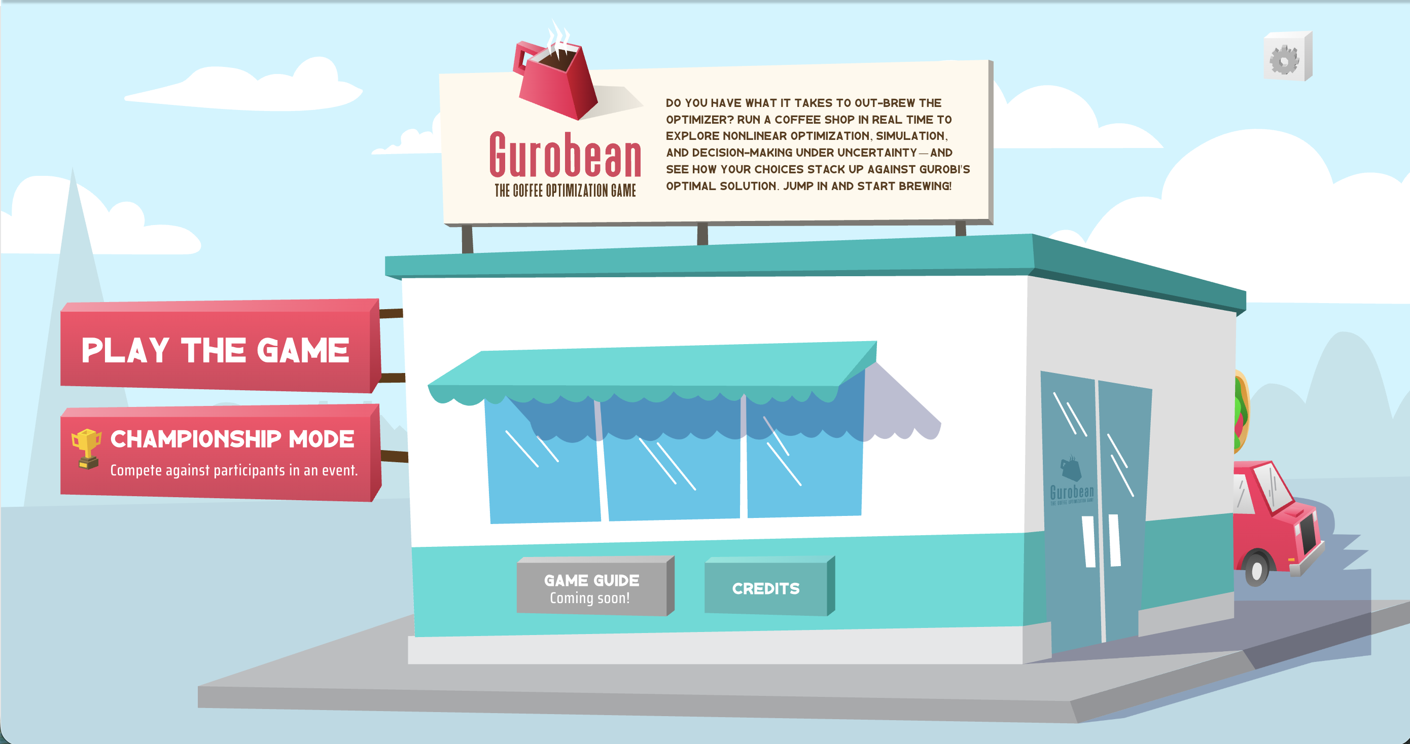
Gurobean needs your help!
CORE
Gurobi just opened a coffee shop
Business is already picking up!
How much coffee should you brew each hour?
How should you balance hot and cold drinks?
What price should you charge, and how fast should the barista serve?
Your goal: run the shop to maximize 5-day profit.

Slide 5
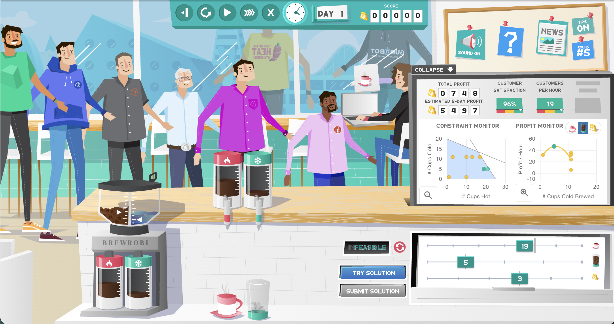
The Coffee Shop
CORE
You run Gurobean in real time and watch the shop respond to your decisions as the day unfolds.
On the shop floor: customers arrive and queue for hot or cold coffee, the barista serves one at a time, and BREWROBI brews to the rates you set.
Around it: the top bar, live dashboard, and monitors track what's happening and how your plan is performing.
The next few slides tour each part of the screen.

Slide 6
Game controls
Play, pause, step, fast-forward, and restart the simulation here. The day counter and your running score sit alongside.

Slide 7
The shop in action
Customers arrive at random, line up, and a single barista serves them one at a time. Watch the queue grow when demand outpaces service.

Slide 8
BREWROBI
The brewing station. Your brew-rate sliders decide how much hot and cold coffee is ready.

Slide 9
The slider panel
Each slider is a decision you control, cups of hot and cold coffee per hour, the price markup, and the barista's speed. Set them, then click Try Solution to run the shop with your choices.

Slide 10
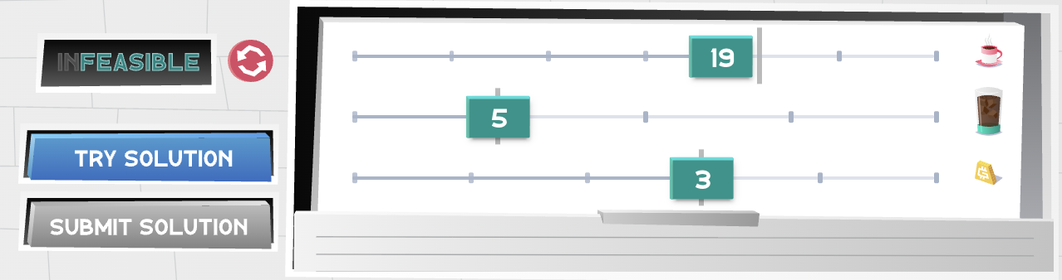
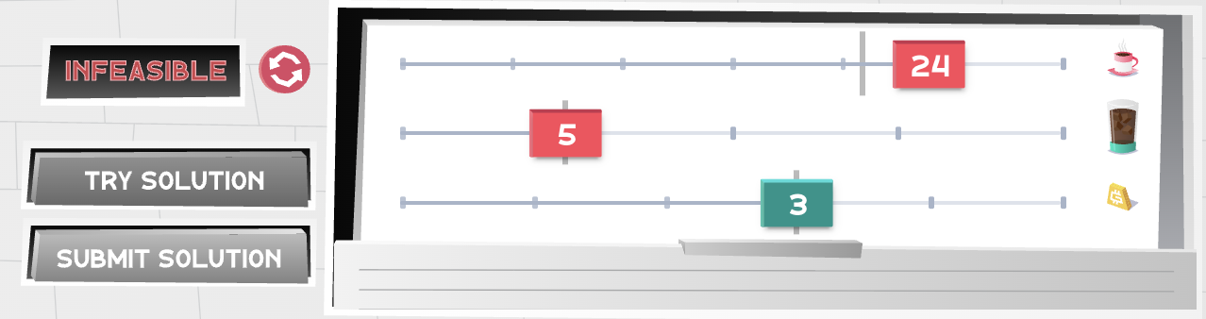
Making Your Decisions
CORE
Feasible, values are green
Each slider is a decision variable you control, here, cups of hot and cold coffee to brew per hour, plus the price markup. Later rounds add barista service rate.
Adjust the sliders to set a candidate solution, nothing changes until you act on it.
Click TRY SOLUTION to restart the simulation with your new choices and watch it play out.
If a setting needs more beans or water than the shop has, the panel reads INFEASIBLE and the values turn red, adjust until it's feasible (green).
When you're happy, click SUBMIT SOLUTION to lock in your decisions and score the round.
Infeasible, values turn red

Slide 11
Your live dashboard
Track total profit, your estimated 5-day profit, customer satisfaction, and customers per hour as the simulation runs, your scoreboard for how the shop is doing.

Slide 12
The two monitors
The Constraint Monitor shows whether your plan fits the beans and water on hand; the Profit Monitor shows how profit changes with your decisions, and where it peaks.

Slide 13
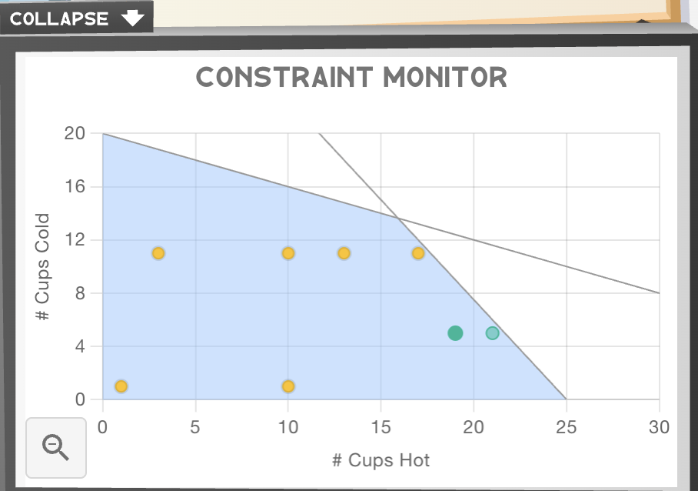
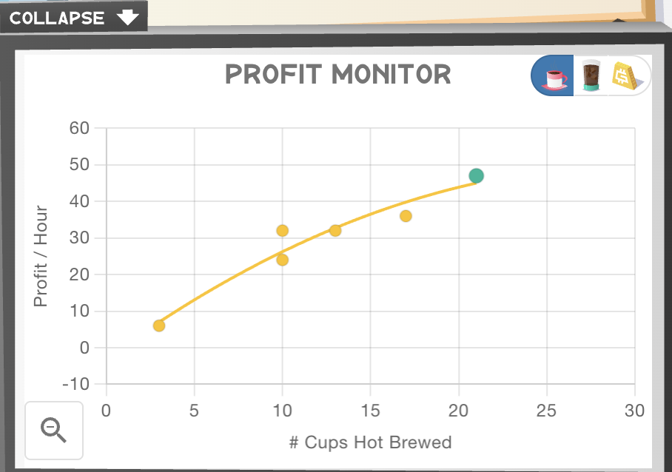
Reading the Monitors
CORE
Two dashboards turn the running simulation into decisions you can reason about.
Constraint Monitor
Shows whether a decision fits the shop's beans & water.
Shaded area = the feasible region; markers outside it turn the sliders red.
Answers: is this decision allowed?
Profit Monitor
Plots profit against a decision (hot, cold, or price).
The curve rises to a peak, then falls, brewing more isn't always better.
Answers: is this decision good?

Slide 14
The bulletin board
Sound, help, the newsfeed, tips, and the round marker live here. At the start of each round, the newsfeed pops up to explain what’s new.

Slide 15
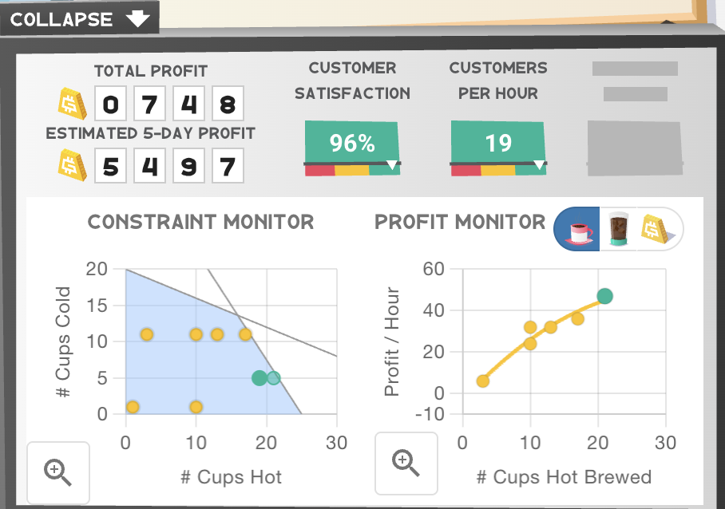
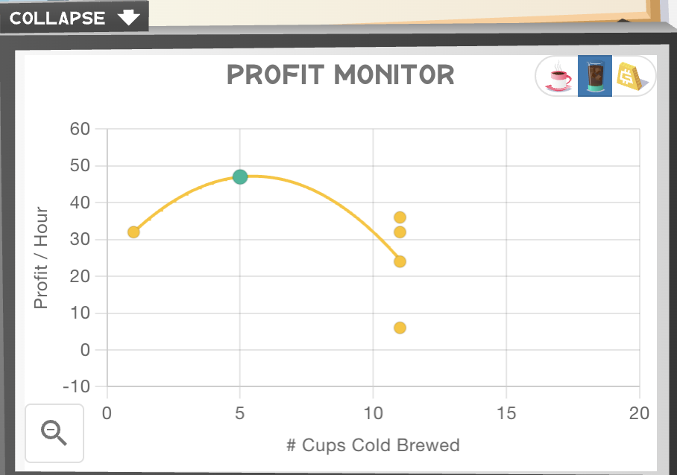
Tips for Testing
CORE
Treat each round as an experiment: try several scenarios before you submit, and give each one time to play out.
Try, run, repeat. Move the sliders, click Try Solution, and let each run play for at least 12 hours of sim time so its dot appears on the Profit Monitor.
Give it time to settle. It starts empty and early numbers swing wildly; only once the shop reaches steady state do the metrics reflect your decision.
Enlarge the Profit Monitor. As rounds get more complex, click the magnifier to expand it and read the curve clearly (shown right).
Cycle the x-axis. Switch the Profit Monitor's x-axis between decision variables (hot, cold, price) to see how profit responds to each (shown right).

Slide 16
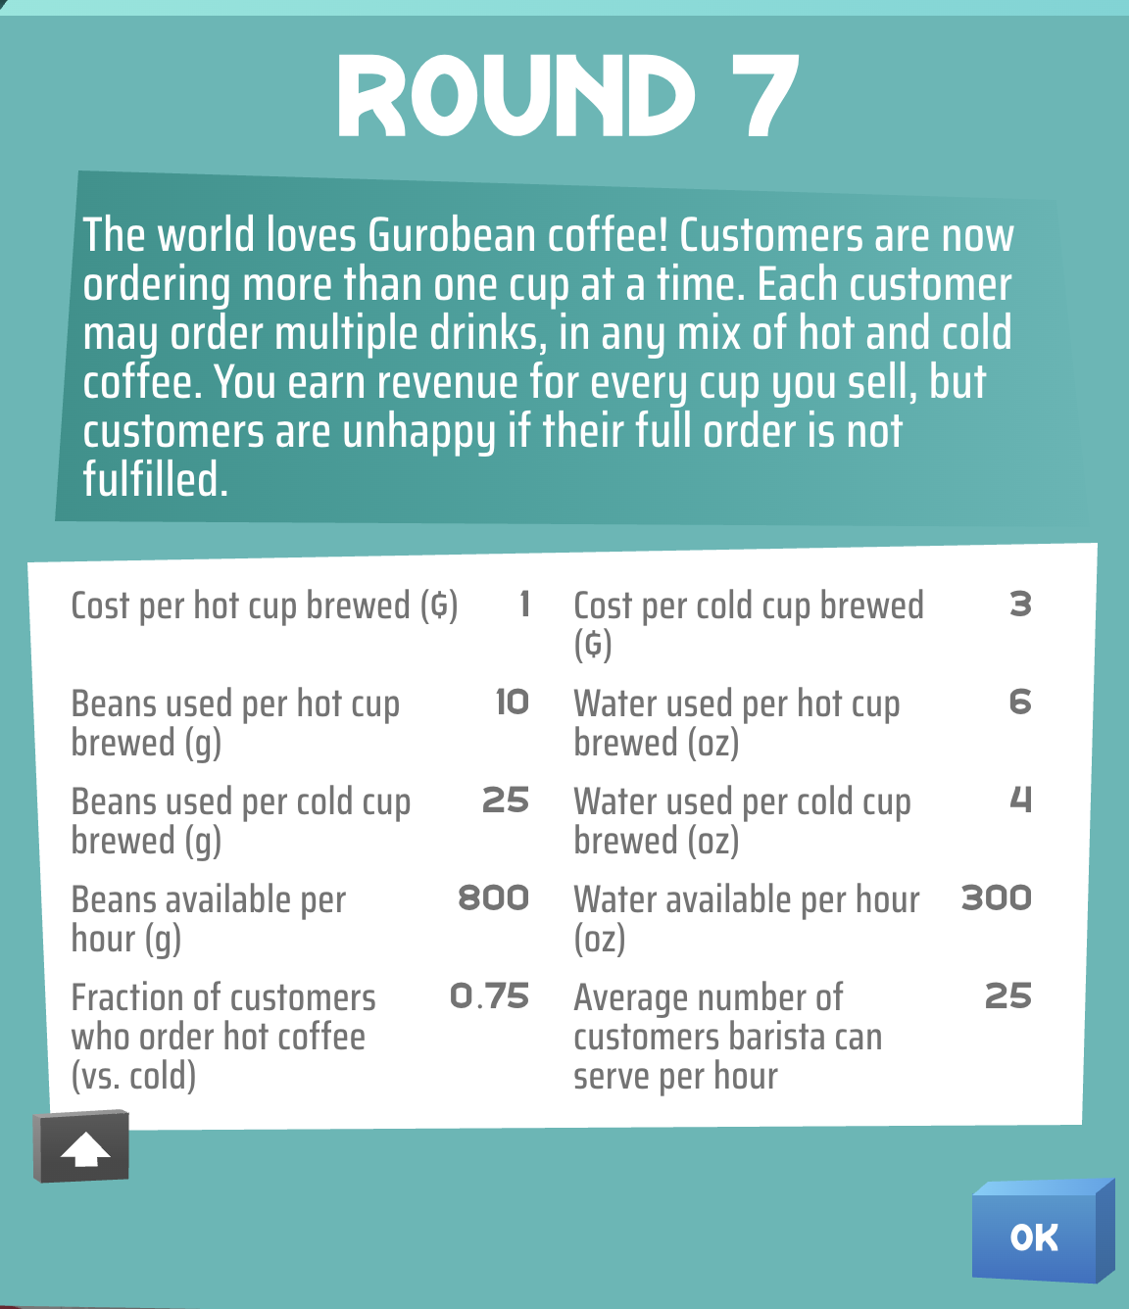
How the Rounds Work
CORE
Eight rounds, each adding one new wrinkle
The game has eight rounds of rising complexity. Each one starts with a newsfeed pop-up (right) where Alinea introduces the new twist and shows that round's parameters.
Rounds 1–2: brew hot, then hot + cold
Rounds 3–4: brewing now costs money
Round 5: set the price (markup)
Round 6: crowds balk and leave
Round 7: customers order multiple cups
Round 8: choose the barista’s speed

Slide 17
You Decide Before You Know Demand
CORE
When you decide
You set brew rates, price, and service before the day starts.
All you have is the average arrival rate, the forecast.
Brew too little and you miss sales; too much and cups go to waste.
What you're graded on
Customers actually arrive at random (a Poisson process).
Your 5-day profit is scored on what really happened, not the forecast.
So the same decision yields a different result every run.
The newsvendor setup at the heart of the game
This gap between planning on forecasts and being judged on reality is what makes a good decision hard to recognize.
Demand splits two ways, too: the newsfeed gives the fraction of customers who want hot vs. cold (e.g. 0.75 hot), so you must forecast, and commit to brewing, each type separately.

Slide 18
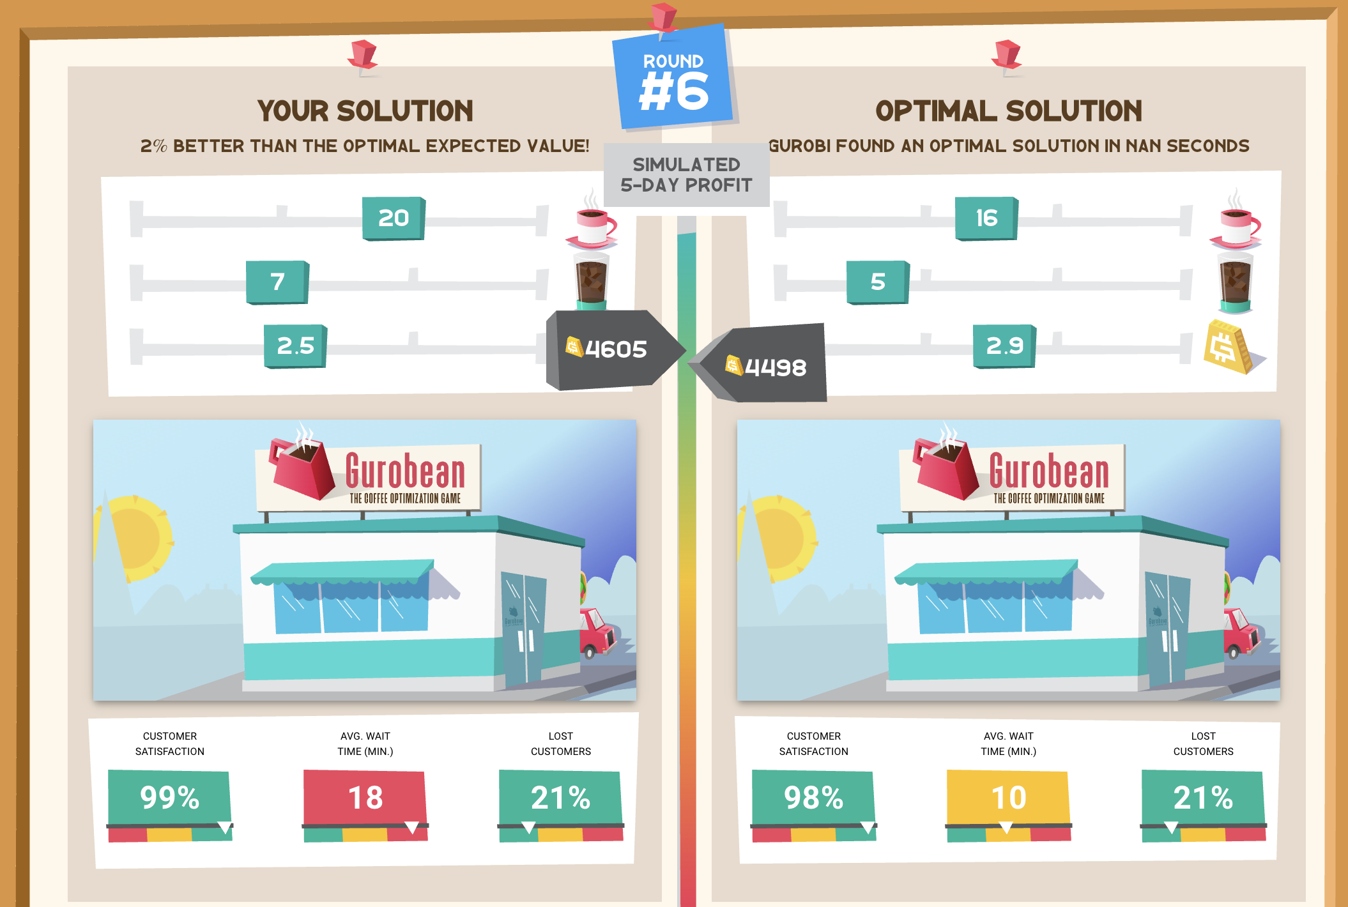
You vs. Gurobi
CORE
When you Submit, the game scores your decision with a full five-day simulation, then Gurobi solves the round and the two are compared side by side:
You see your slider settings and resulting metrics next to Gurobi's optimal settings.
Each solution is plotted on the expected-profit curve, filled markers show expected profit, hollow markers show what actually happened in this run.
Read the two markers together: because this run is random, your hollow marker can land above or below Gurobi's, the outcome alone doesn't tell you whose decision was better.

Slide 19
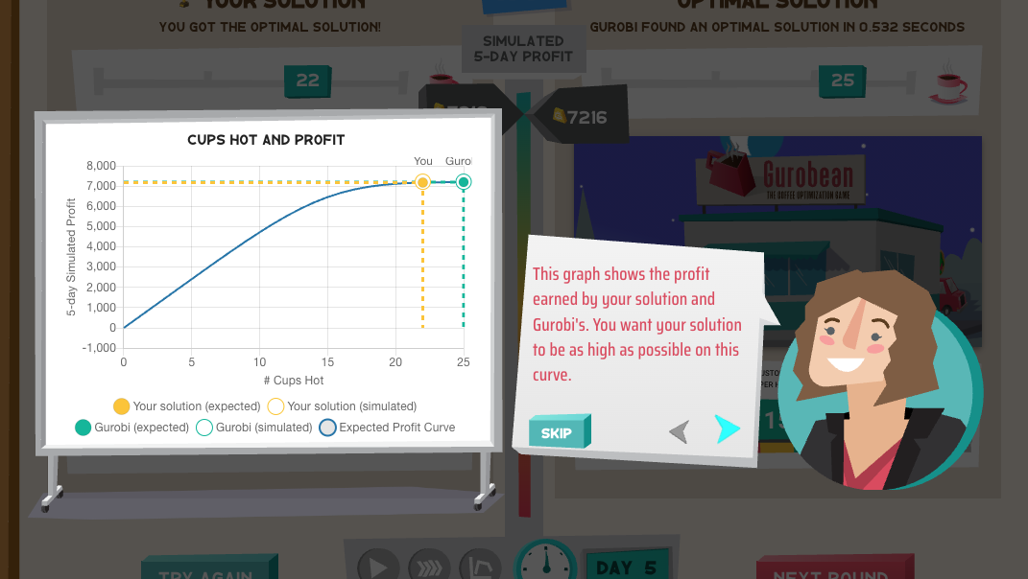
Expected vs. Realized
CORE
The central lesson of the comparison screen
A single five-day simulation is just one realization of a random system.
Gurobi optimizes expected profit, the decision that performs best on average across many possible futures.
So you can beat Gurobi on one run and Gurobi's decision is still the better one.
The real question isn't “who got lucky this time?” but “which decision would you trust before knowing what randomness will occur?”

Slide 20
Activity: Predict, Then Run
CORE
Before you touch Try Solution, make a prediction.
Pick one slider, say, raise the price (markup).
Ask the room: what happens to profit? To the queue? To lost customers? Have students commit to an answer.
Now run it. Did the system behave the way you predicted, and did it play out the same way twice?
Why it works
Committing to a prediction first makes the surprise stick, and sets up the lesson that nonlinear, random systems don’t move the way intuition expects.

Slide 21
Championship Mode
CORE
Two ways to compete on decision quality, not luck
Two ways to compete
Class Championship, private, via a match code you share
Global Championship, public, a fresh scenario each week
Why it’s fair
Everyone plays the same scenario, so nobody wins on a lucky day
Rewards consistent, well-reasoned decisions

Slide 22
Technical Deep-Dive
Technical Track · OR / Engineering / CS

Slide 23
What Students Should Take Away
TECHNICAL
Technical learning outcomes, the lasting points behind the modeling and simulation
Models define decisions, objectives, and constraints, but evaluation may need simulation. A formulation says what is optimal in theory; simulation shows how it behaves in practice.
An expected-value-optimal solution will not win every run. The decision that is best on average can still lose on any single realization.
Nonlinearity and congestion create feedback that breaks simple reasoning. Small changes ripple through queues and prices in ways intuition misses.
Simulation output is statistical, not deterministic. Read outcomes as distributions, and let the system reach steady state before judging.
Feasibility defines the solution space; performance defines its quality. Meeting every constraint is the entry ticket, not the goal.

Slide 24
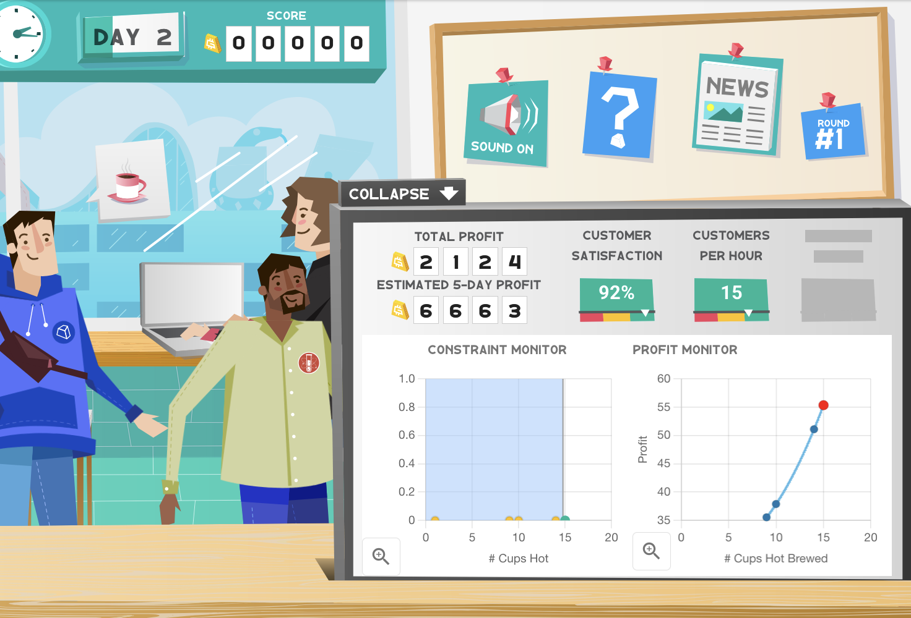
Under the Hood
TECHNICAL
The Models Behind the Game
Newsvendor-style inventory decisions
Stochastic demand (random arrivals)
Resource constraints (beans, water, capacity)
Queueing theory
Nonlinear profit functions
Simulation-based evaluation

Slide 25
Activity: Formulate Round 1
TECHNICAL
Round 1: brew hot coffee only, limited beans and water
One answer
maximize expected profit from hot coffee
subject to beans used ≤ beans available; water used ≤ water available
by choosing Qₕ = cups of hot coffee to brew per hour
Same three pieces as every optimization model.
Write the three pieces:
Objective, what are we maximizing?
Constraints, what limits us?
Decision variable, what do we choose?
Give students 2 minutes in pairs, then reveal →

Slide 26
Notation
TECHNICAL
What each symbol in the model means
Decisions · what you and Gurobi choose
Q_{h}, Q_{c}: cups of hot and cold coffee brewed per hour
m: markup added to cost (a decision in later rounds)
μ: barista service rate (a decision in later rounds)
Demand
λ: customer arrival rate per hour
ψ_{h}, ψ_{c}: share of customers wanting hot / cold
D_{h}, D_{c}: random hourly demand (mean λ_{i}, Normal approx.)
Prices and costs
r_{h}, r_{c}: revenue per cup sold (hot / cold)
c_{h}, c_{c}: cost per cup brewed (hot / cold)
Resources
a_{b}, a_{w}: beans and water available
u_{hb}, u_{hw}, u_{cb}, u_{cw}: ingredient used per cup
Profit-curve terms
φ, Φ: standard normal density and CDF
z_{i} = (Q_{i} − λ_{i}) / √λ_{i}: standardized brew quantity

Slide 27
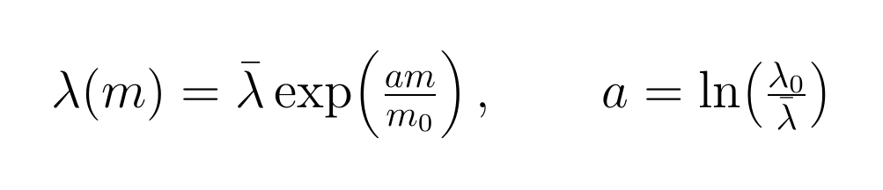
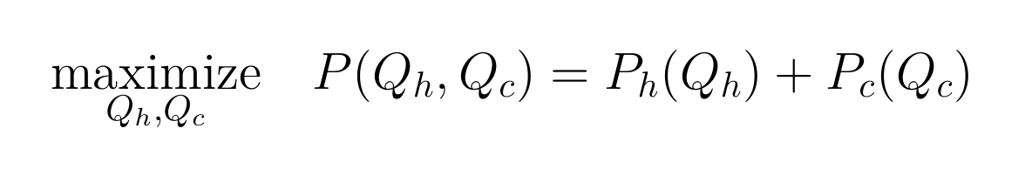
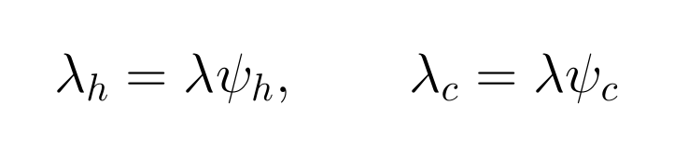
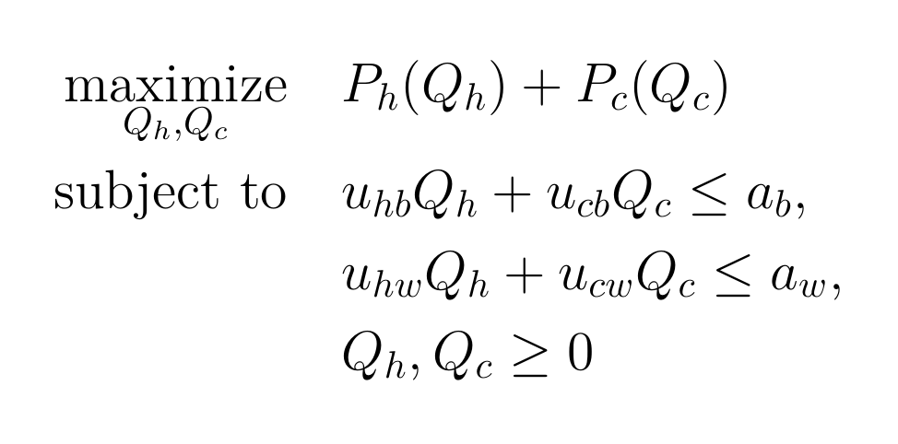
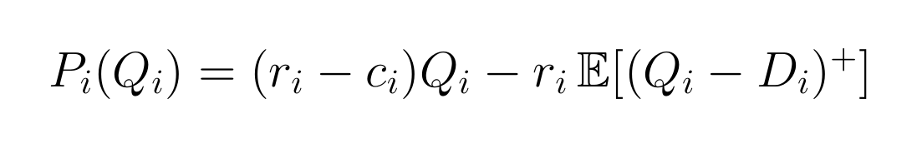
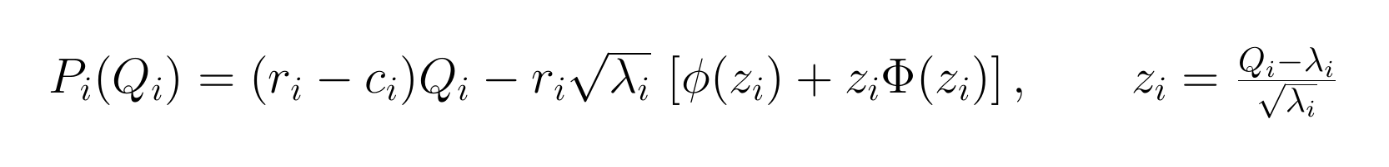
Nonlinear Model
TECHNICAL
Here’s the base model Gurobi solves in the early rounds; you don’t need to follow the math to play.
1 · Demand responds to markup
3 · The base model
2 · Expected profit per drink

Slide 28
The Shape of the Objective
TECHNICAL
Where the peak sits, how high, and how sharp
Flat peak: forgiving, so roughly right is good enough. Sharp peak: unforgiving, so a small miss is costly.
The best choice moves with each scenario, and a binding resource limit can pin it to the constraint, not the curve's natural peak.

Slide 29
Why We Simulate
TECHNICAL
The formula is only one piece; simulation scores the real shop
A formula covers only one piece. The closed form approximates a single drink's profit; the real shop (queues, balking, congestion, randomness) is dynamic, so its true performance has no formula.
We estimate by running it. Simulate the shop many times and average, the way call centers, hospitals, and traffic networks are analyzed.
The output is a distribution. Read results statistically; any single run is just one draw, not the verdict.
Let it reach steady state. Early numbers swing while the shop fills, so wait for burn-in before judging a decision.

Slide 30
How Do You Actually Solve It?
TECHNICAL
By hand / trial-and-error: What you did playing Gurobean. Fun for a while, but slow and rarely optimal.
Try every combination (enumeration): Conceptually simple, but the combinations explode into the trillions, hopeless.
Heuristics, smart rules of thumb: Break the problem up, decide one slider at a time, or simplify it. Useful and fast, but approximate.
Optimization solvers: Software like Gurobi uses math and algorithms to find the optimal decision in a fraction of a second.

Slide 31
Business & Strategy
Business & Analytics Track · MBA / Exec Ed

Slide 32
What Students Should Take Away
BUSINESS
Business & analytics learning outcomes, the lasting points, no math required
A single outcome doesn’t measure a decision. Because demand is random, the same choice gives different results.
Uncertainty makes performance inherently variable. Two “good” days can follow the very same decision.
Feasible plans can perform very differently. Meeting every constraint doesn’t make a plan good.
Systems with people and queues behave non-intuitively. Small changes can overwhelm gut instinct.
Analytics supports decisions, it doesn’t eliminate risk. Good decision-making is about managing uncertainty, not removing it.

Slide 33
Mathematical Optimization
BUSINESS
Every round of Gurobean is secretly one of these
maximize / minimize
a performance metric
“objective function”
subject to
restrictions on decisions
“constraints”
by choosing
quantities we control
“decision variables”
For the Gurobean coffee shop:
maximize
5-day profit
subject to
beans, water, and queue/service capacity
by choosing
brew rates, markup, and barista service rate

Slide 34
Feasibility ≠ Success
BUSINESS
Meeting every constraint is only the entry ticket.
When the sliders turn red, the plan is infeasible, it breaks a resource or capacity limit. Students quickly learn to get back into the green.
But among all the feasible plans, performance still varies enormously.
“Is this allowed?” and “Is this good?” are different questions.
Ask the room: two feasible plans, wildly different profit, what separates a good decision from a merely allowed one?

Slide 35
Trade-offs & Diminishing Returns
BUSINESS
Every decision pulls in more than one direction, and more is not always better.
Brew too little and customers leave empty-handed; brew too much and coffee becomes waste.
Serve too slowly and the queue grows; raise prices and margins improve but demand falls.
The first extra unit of brewing or capacity helps a lot; later ones help less as the system saturates.
Good decisions balance competing effects, there is rarely a single dial to turn.
Activity: have students find the point where pushing a slider further stops helping, or starts hurting.

Slide 36
The Best Choice Is a Moving Target
BUSINESS
The shape of the profit curve changes from round to round and scenario to scenario.
As the round, the ingredients on hand, and the prices change, the profit curve reshapes.
Three things move: where the peak sits (the best decision), how high it reaches (the best 5-day profit), and how sharp it is.
A flat peak is forgiving, roughly right is good enough. A sharp peak is unforgiving, small misses cost real money.
A binding resource limit can cut the curve short, putting the best choice at the constraint, not the natural peak.
So the best decision must be re-found as conditions change, not memorized.
Activity: put two Profit Monitor curves side by side and ask where the sweet spot is now, and how costly a small miss would be.

Slide 37
Common Misconceptions to Address
BUSINESS
Myth: “The best decision should always win.”
Reality: Not in a random system, a strong plan can lose on a single run and still be right on average.
Use these moments to reshape decision intuition, surface the myth, then correct it.
Myth: “More production always means more profit.”
Reality: Over-brewing wastes money; profit peaks and then falls. More is not always better.
Myth: “If it worked once, it’s a good policy.”
Reality: One good day is one lucky draw. Judge a decision by its distribution of outcomes, not one result.

Slide 38

Play Gurobean
www.gurobean.com​

