Slide 1
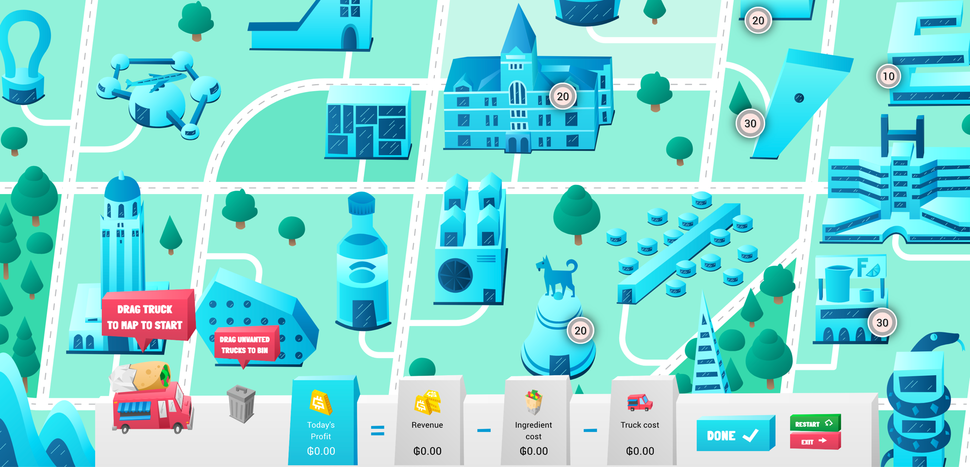

The Burrito Optimization Game
Game and slides by Gurobi Optimization, in
collaboration with Prof. Larry Snyder,
Lehigh University

Slide 2


Outline
Introduction
Coping with Uncertainty
Optimization 101

Slide 3
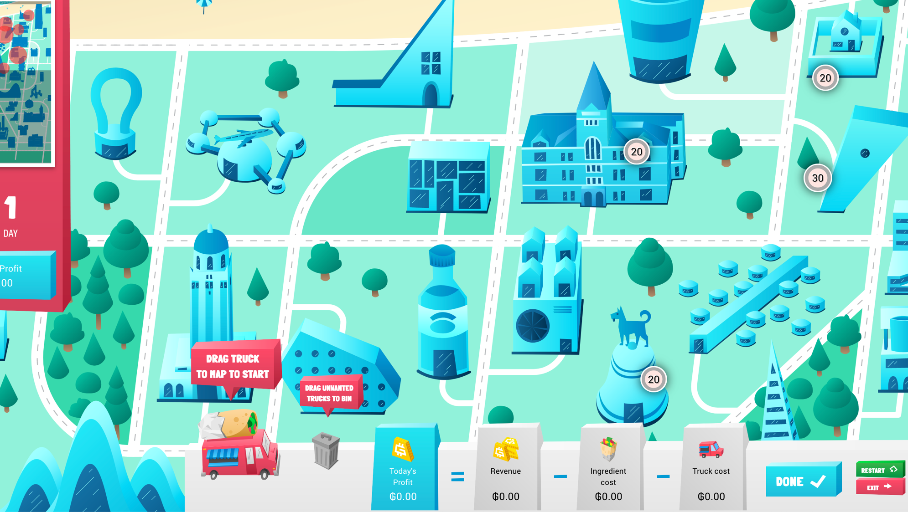
Introduction
© 2022 Gurobi Optimization, LLC. Confidential, All Rights Reserved | 3

Slide 4
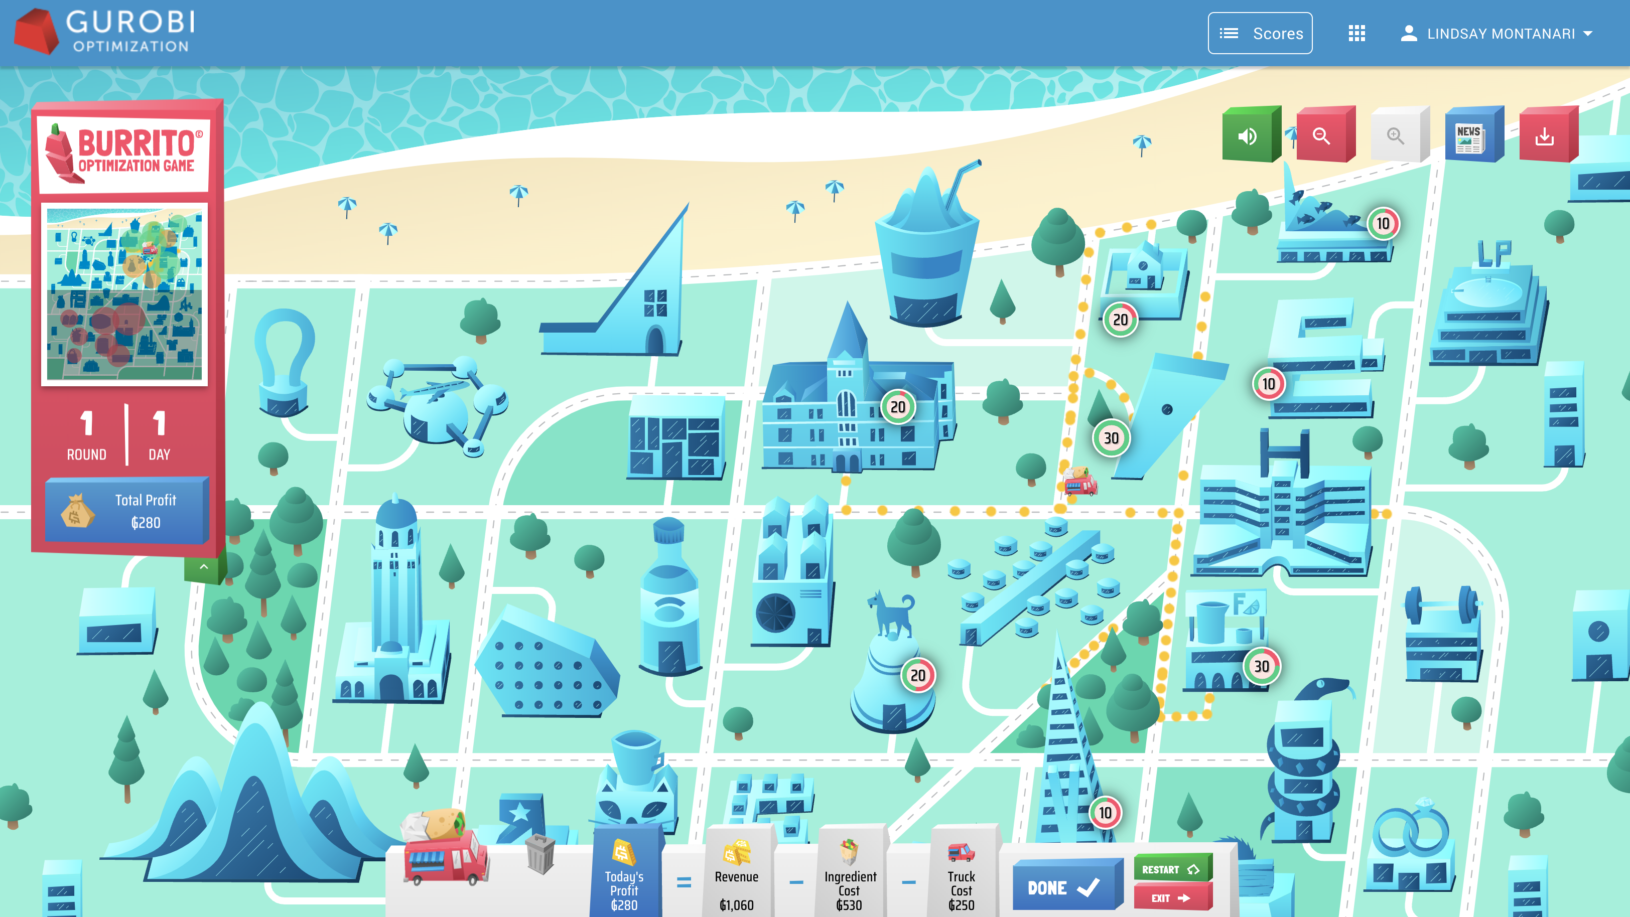
Guroble needs your help!
Guroble has just launched its business in Burritoville
Where to place burrito trucks to serve customers and maximize profit?
Plan carefully:
  Every truck has a cost
  Revenue depends on how close to customers
Each day brings new challenges

Slide 5
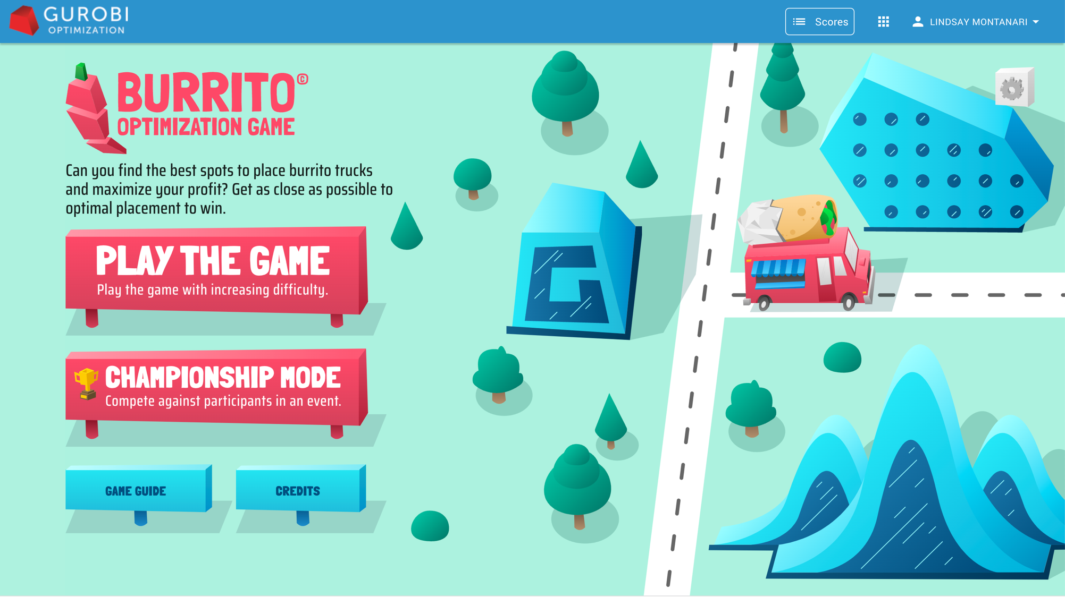
Click here!

Slide 6
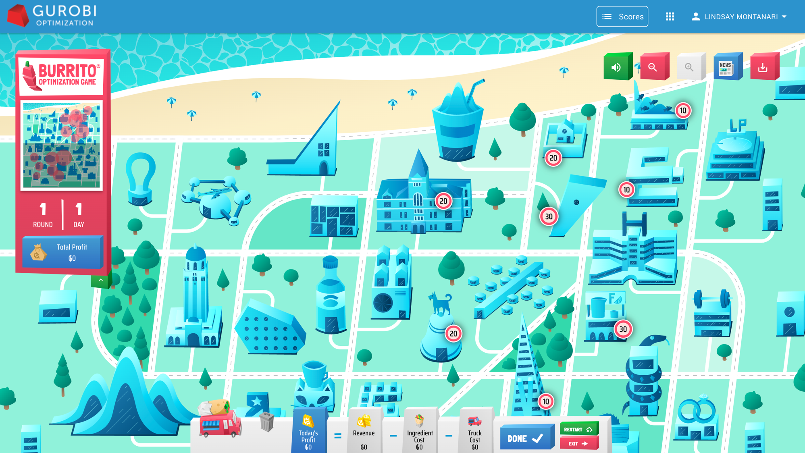
…onto the map
Drag a truck from here…

Slide 7
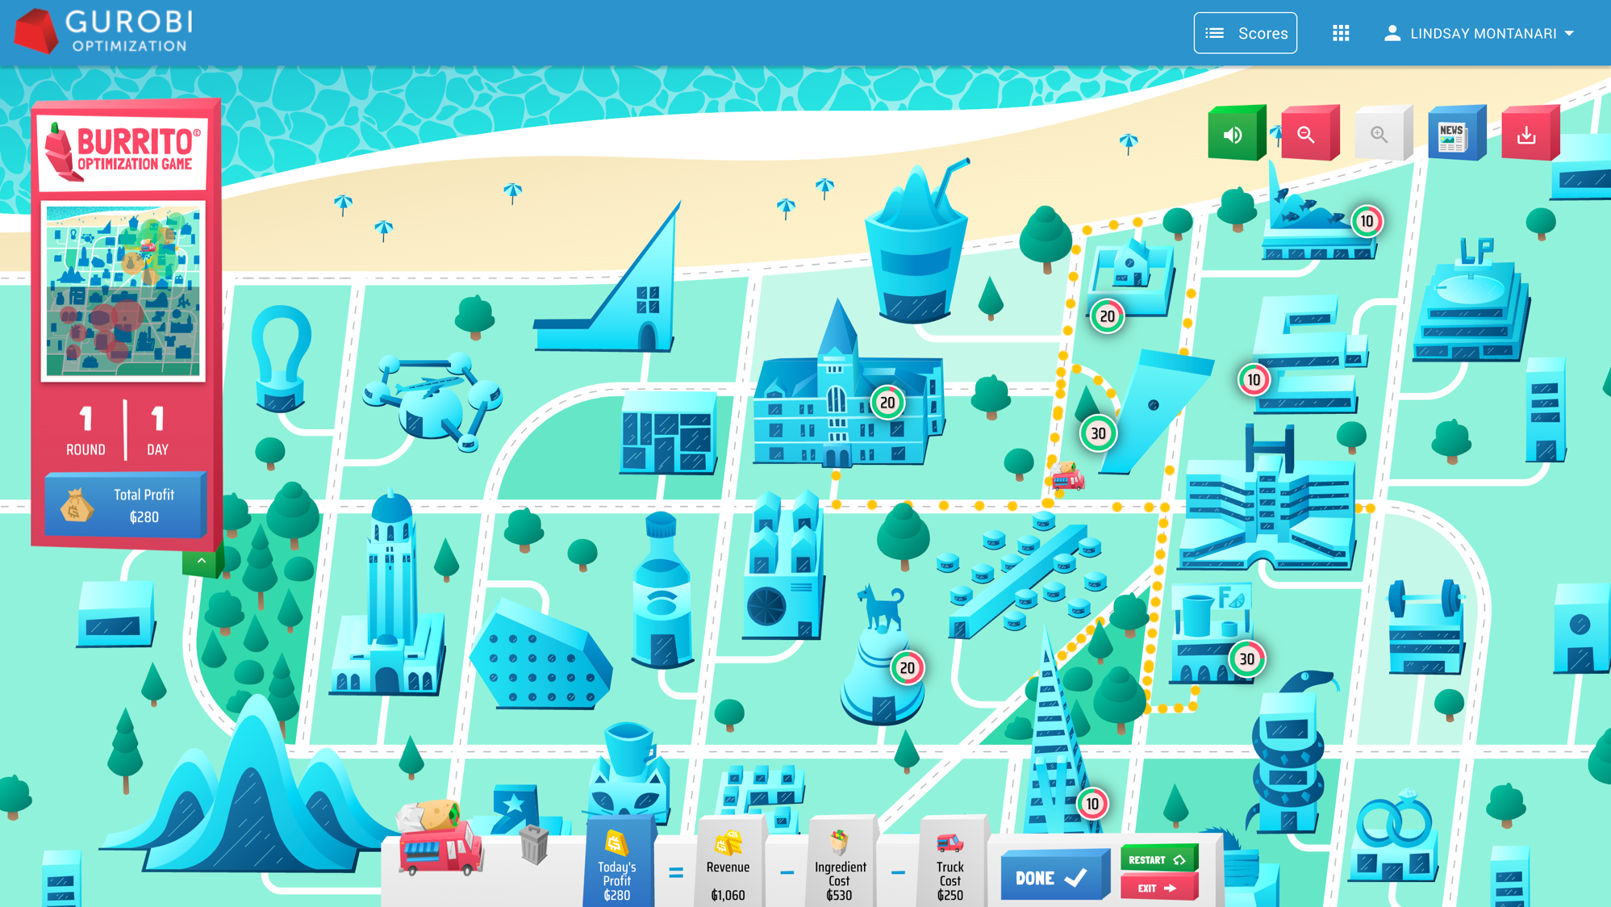
Now customers are buying burritos

Slide 8
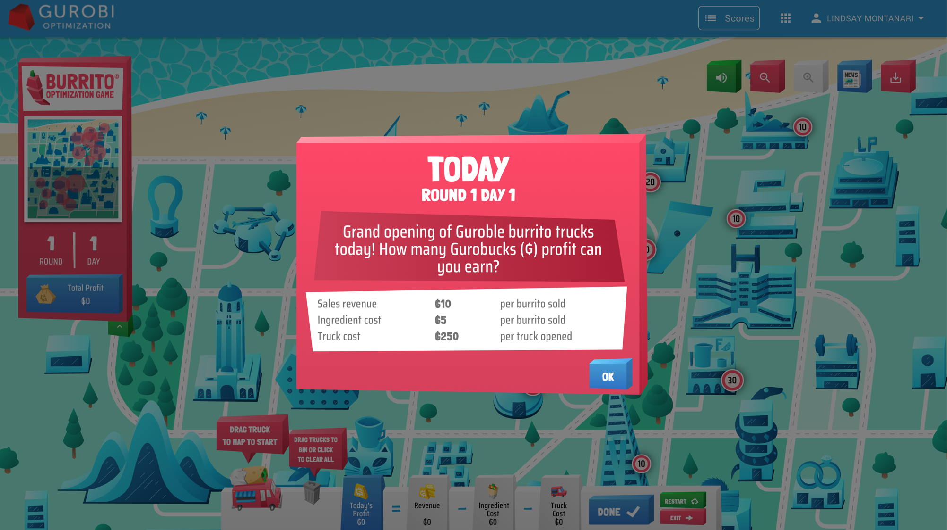
The “newsfeed”
Pay attention to today’s costs and revenue

Slide 9
Your costs, revenues, and profit for today

Slide 10
There’s more map this way! (Scroll or zoom to see it)

Slide 11
Maximum number of customers at this building today
Fraction you haven’t
Fraction you’ve “captured”
(Capture more by placing trucks closer to buildings)

Slide 12
Drag truck to new spot to move it
Or to trash to remove it

Slide 13
Satisfied with your solution? Click DONE

Slide 14
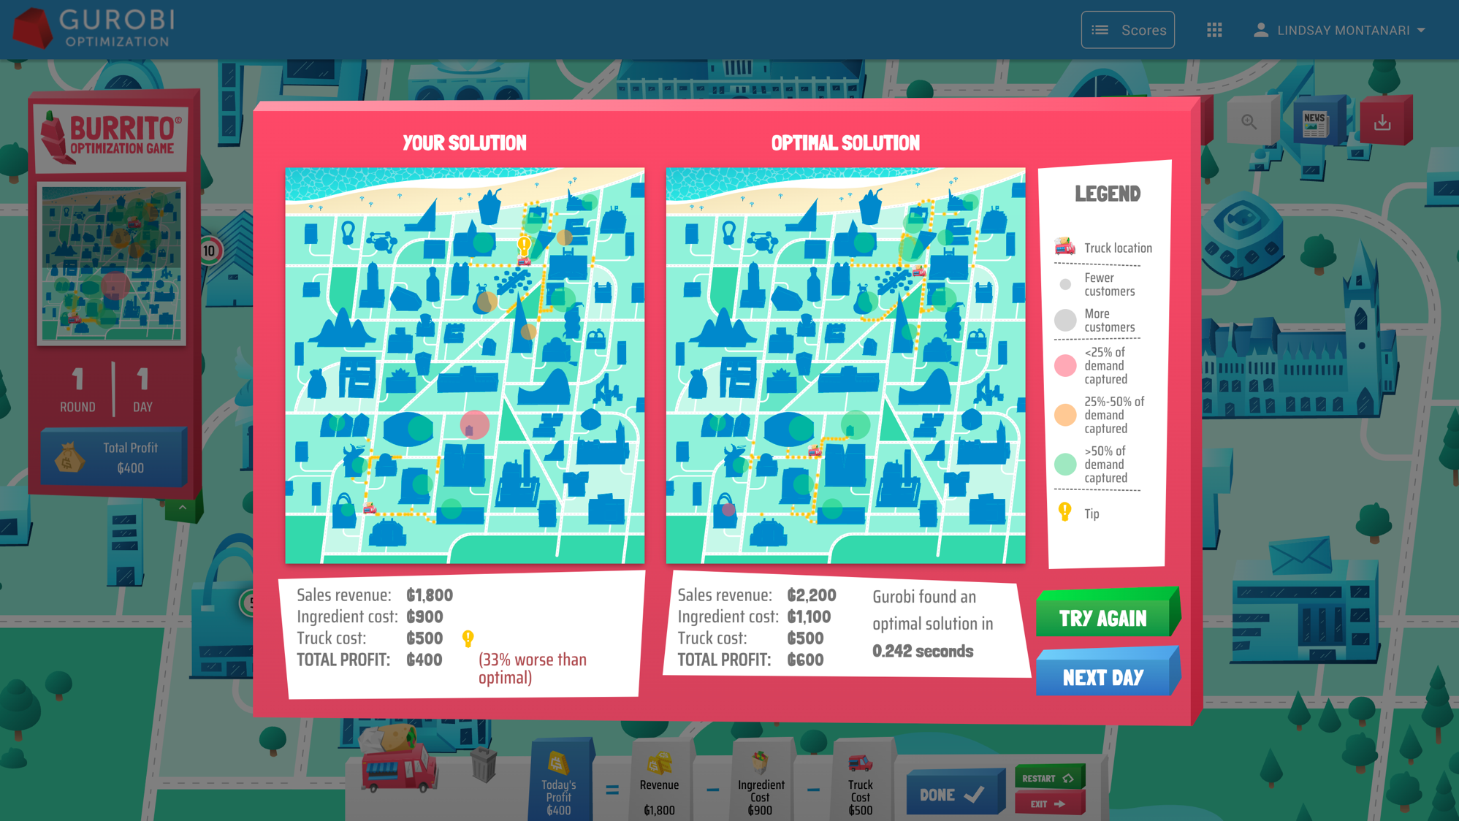

Slide 15
Sounds on/off
Zoom in/out
View newsfeed

Slide 16
“Minimap”
Dots represent customers:
Size indicates demand
Color indicates % capture
Total profit over all rounds/days
Collapse sidebar

Slide 17
Coping with Uncertainty
© 2022 Gurobi Optimization, LLC. Confidential, All Rights Reserved | 17

Slide 18
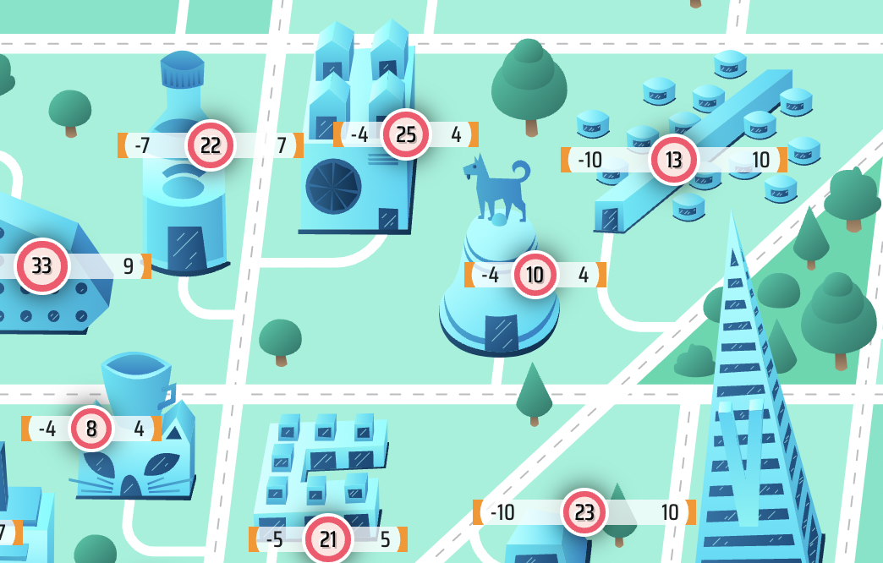
Round 2
The numbers on the buildings represent demand forecasts.
Error bars indicate the range of possible values.

Slide 19
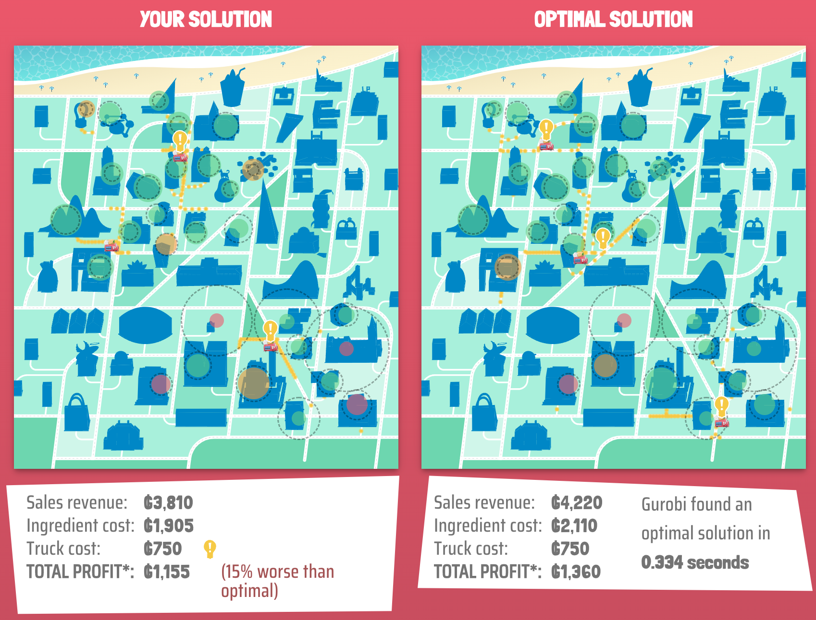
Round 2
Your solution (and Gurobi’s) are evaluated based on actual demands
Even though you (and Gurobi) only have forecasts when planning.
Actual
Forecast

Slide 20
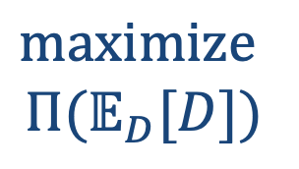
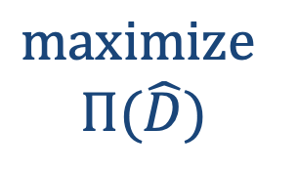

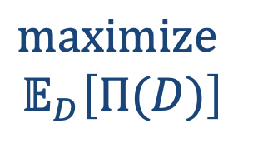

How should we optimize when demands are random?
Optimize performance under the forecasts
Optimize the mean performance
Optimize the worst-case performance
Optimize performance under the means
$$maximize$$
$$Π(\hat{D})$$
$$maximize$$
$$Π(𝔼_{D}[D])$$
$$maximize$$
$$𝔼_{D}\left[Π(D)\right]$$
$$maximize$$
$$\min_{D}\left[Π(D)\right]$$
$Π(D)$=profit if demands=$D$
These are equivalent, given the structure of the Burrito optimization problem.
This is how Gurobi optimizes in the game.

Slide 21
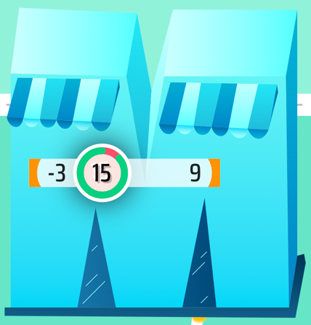


Into the Weeds
The random demands follow a triangular distribution:
min
mode
max
$$f(d)$$
mean
$$d$$

Slide 22
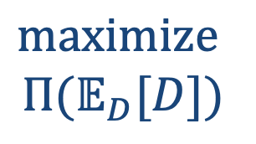
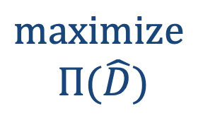
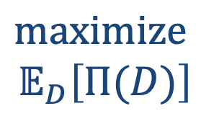

How should we optimize when demands are random?
Optimize performance under the forecasts
Optimize the mean performance
Optimize the worst-case performance
Optimize performance under the means
$$maximize$$
$$Π(\hat{D})$$
$$maximize$$
$$Π(𝔼_{D}[D])$$
$$maximize$$
$$𝔼_{D}\left[Π(D)\right]$$
$$maximize$$
$$\min_{D}\left[Π(D)\right]$$

Slide 23
Optimization terminology
Optimize performance under the forecasts
Optimize the mean performance
Optimize the worst-case performance
Optimize performance under the means
$$maximize$$
$$Π(\hat{D})$$
$$maximize$$
$$Π(𝔼_{D}[D])$$
$$maximize$$
$$𝔼_{D}\left[Π(D)\right]$$
$$maximize$$
$$\min_{D}\left[Π(D)\right]$$
Deterministic Optimization
Stochastic Optimization
Robust Optimization

Slide 24
Optimization 101
© 2022 Gurobi Optimization, LLC. Confidential, All Rights Reserved | 24

Slide 25
Mathematical Optimization
In mathematical optimization, the goal is to
minimize/maximize
some performance metric
“objective function”
by choosing
some quantities
“decision variables”
subject to
some restrictions on our decisions
“constraints”
For example:
minimize
manufacturing cost
by choosing
production quantities at each factory
subject to
produce enough to meet demand

Slide 26
Mathematical Optimization
In mathematical optimization, the goal is to
minimize/maximize
some performance metric
by choosing
some quantities
subject to
some restrictions on our decisions
For example:
maximize
operating room (OR) utilization
by choosing
sequence of surgeries in each OR
subject to
higher-priority patients scheduled first
setup time between surgeries

Slide 27
Mathematical Optimization
In mathematical optimization, the goal is to
minimize/maximize
some performance metric
by choosing
some quantities
subject to
some restrictions on our decisions
For example:
maximize
profit
by choosing
burrito truck locations
subject to
each customer visits ≤1 truck

Slide 28
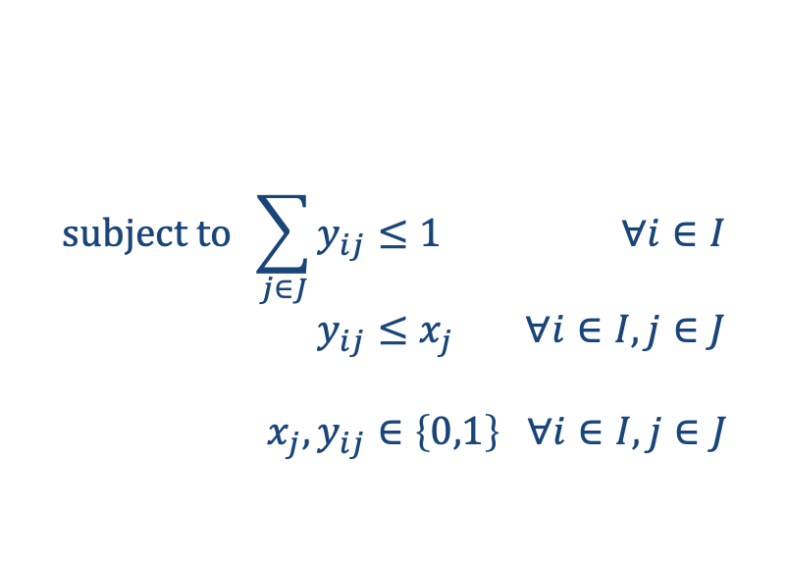
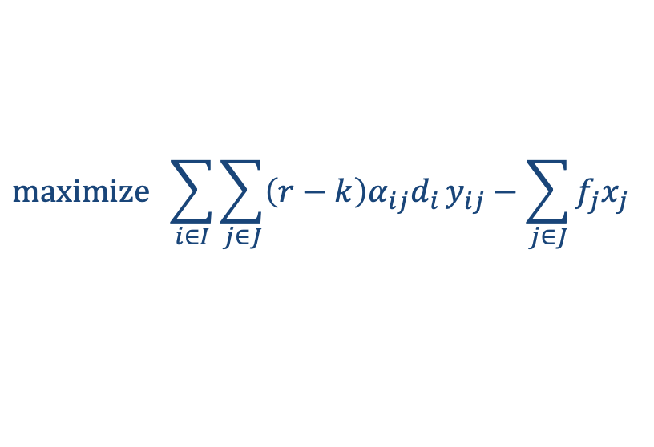
Formulating Problems Mathematically
We can’t write these quantities in words. We need to write them mathematically.
Here’s the Burrito Optimization Game problem, formulated mathematically:
$$maximize \sum_{i∈I}{\sum_{j∈J}{\left(r−k\right)α_{ij}d_{i}}y_{ij}}−\sum_{j∈J}{f_{j}x_{j}}$$
$$subject to \sum_{j∈J}{y_{ij}}≤1 ∀i∈I \\ y_{ij}≤x_{j} ∀i∈I,j∈J \\ x_{j},y_{ij}∈\left\{0,1\right\} ∀i∈I,j∈J$$
(You don’t need to understand this formulation!)

Slide 29
Classifying Mathematical Optimization Problems
Mathematical optimization problems are classified using terms like
linear programming (LP)
nonlinear programming (NLP)
integer programming (IP)
constraint programming (CP)
mixed-integer programming (MIP)
stochastic programming (SP)
based on the types of objective function, decision variables, and constraints.

Slide 30
Solving Mathematical Optimization Problems
Once you have formulated an optimization problem, how do you solve it?
That is, how do you find the optimal solution?
Some possible approaches:
By hand/trial-and-error
This is essentially what you did when you played the Burrito Optimization Game.
It might be fun (for a while), but it is time-consuming and usually does not find optimal solutions.
Try all solutions
Computers are fast. Why not program the computer to check every possible solution? Then just pick the best one.
This approach is called total enumeration. But it’s a bad idea. Let’s see why…

Slide 31
# Nodes | # Solutions | Time | What You Could Do in that Time
10 | 1,024 | 0.000001 sec | nothing
20 | 1,048,576 | 0.001 sec | start to blink
30 | 1,073,741,824 | 1.1 sec | smile
35 | 34,359,738,368 | 34.4 sec | listen to 1/3 of "Baby Shark"
Don’t Use Enumeration!
40 | 1 trillion | 18.3 min | watch most of one episode of The Office
45 | 35 trillion | 9.8 hours | watch first 2.5 Lord of the Rings movies
Suppose the computer can evaluate
1,000,000,000
solutions per second.
50 | 1 quadrillion | 13.0 days | watch every episode of The Office 4.2x
55 | 36 quadrillion | 1.1 years | get a Master’s degree
60 | 1 quintillion | 36.6 years | pay off your mortgage
70 | 1 sextillion | 37,436 years | travel to Alpha Centauri and back 3x
80 | 1 septillion | 38 million years | almost travel to the nearest black hole

Slide 32
Solving Mathematical Optimization Problems
Some other approaches:
Common-sense
rules of thumb
Divide the problem (e.g., the Burritoville map) into smaller problems and solve those.
Make decisions (e.g., truck locations) one at a time.
Simplify the problem (e.g., ignore demand numbers).
Approximate approaches like these are called heuristics.
They are useful and important in practice.

Slide 33

Solving Mathematical Optimization Problems
Other approaches:
These software packages use math and algorithms to find optimal solutions. Gurobi offers a free license to all academics along with resources to help you get started. To download your license, please visit: gurobi.com/academic
Optimization “solvers”
ALWAYS FREE FOR ACADEMICS

Slide 34
www.BurritoOptimizationGame.com
© 2022 Gurobi Optimization, LLC. Confidential, All Rights Reserved | 34

