Slide 1
A Sustainable and Innovative Approach to Optimizing Pharmacy Benefits.
May 16, 2023

Slide 2
What We Believe: Protecting Self-Funded Plans Requires a Multi-Faceted Approach
Spend Control
Risk Mitigation
Catastrophic
Claims Coverage
Catastrophic Specialty
Claims Protection
Manufacturer Assistance & Alternative Funding
Independent Clinical
Oversight &
Intervention
Client-Aligned Contract & Service
Payer Owned
Comprehensiveness of Coverage
An array of solutions are required that can flex to meet each client's unique and evolving needs.
Notes:
We believe that there is no program that can singlehandedly and effectively manage specialty drug spend and risk. Plans need to deploy an array of programs that combine to provide the level of protection required to fully protect themselves. The optimal approach is multi-faceted and deploys an array of programs that collectively provide comprehensive, holistic, layered protection.
It begins with a scaled contract, supported with quality client and member service.
Next, comes an array of quality clinical programs that ensure the plan is only paying for the medications that its members need – and that the plan pays for a low-cost, effective therapy option.
Manufacturer co-pay assistance programs, which typically fully cover the member’s portion of the cost of the drug and help defray the employer’s cost, can shift spend in many circumstances. In addition, alternative funding programs, including patient assistance solutions, can also defray member and plan costs.
Any well-conceived carved-out, self-funded plan needs to include quality stop-loss coverage to serve as a backstop for catastrophic claims. Traditional stop-loss coverage extends to both medical and pharmacy claims.
Finally, we do not believe that traditional stop-loss coverage sufficiently protects the plan from high-cost, multi-year pharmacy claims. For this, we believe the plan needs catastrophic specialty claims protection to provide an additional backstop.

Slide 3
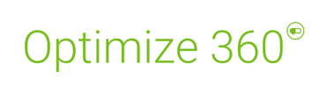



RxBenefits Delivers
Spend Control
Risk Mitigation
Catastrophic
Claims Coverage
Catastrophic Specialty
Claims Protection
Preferred Financial Assistance Solutions
RxBenefits’ Client-Aligned Contract & Service
Clinical
Oversight &
Intervention
Payer Owned
Preferred Traditional
Stop-Loss Coverage
Comprehensiveness of Coverage
~20% First
Year Savings
5-10% Annual Savings Potential
Offsets Member
& Plan Costs
Limits Liability on High-Cost Rx & Medical Claims
Limits Rx Liability with Multi-Year, Laser-Free Protection
Notes:
At RxBenefits, we deliver carved-out, self-funded plans that combine to provide a comprehensive offerering that effectively protects the plan. Here is a snapshot of our comprehensive offering for self-funded, carved-out employers. The plan addresses both of the big concerns that we hear from brokers, prospects, and clients – the need to manage overall spend/plan cost, while also mitigating the risk of large, catastrophic claims. Our solutions help drive plan savings and mitigate risk, with particular focus on the high-cost specialty drugs that keep employers up at night.
We begin with a scaled, transparent contract negotiated by RxBenefits with the leading PBMs. Our pharmacy experts, many of whom bring PBM experience, are knowledgeable about the questions to ask to negotiate the best discounts and rebates – which we then pass on to your clients. We generally find that when we analyze an existing arrangement, that the plan sponsor would have saved 20% or more had RxBenefits been managing the plan. We also take over the entire servicing of all aspects of the program for brokers, clients, and their members and provide an elevated service experience on a par with the best of retail and entertainment.
We then layer in our Protect suite of clinical solutions, designed to minimize wasteful spending and ensure your clients’ members get the medications they need at the lowest possible cost. Our programs focus first on removing high-cost drugs from the formulary when lower-cost alternatives are available. Then we take over the prior authorization process and provide independent, client-aligned oversight – we obtain prescriber chart notes so we can make data-driven decisions and, unlike the PBM’s algorithm-driven processes, every Prior Authorization we receive is reviewed by a member of our clinical team. While focused on ensuring the health and safety of your clients’ members, we also typically see an additional 5-10% in plan savings when employers adopt our clinical programs – which are backed by ROI guarantees.
We work with the PBMs to provide clients with access to co-pay assistance programs, which typically fully cover the member’s portion of the cost of the drug and help defray the employer’s cost. We also work with several patient assistance program providers. Under these types of programs, the employer carves out/excludes all/some specialty drugs from plan coverage and engages a vendor to help qualifying members obtain funding for their specialty medications from drug manufacturers and/or charitable foundations. The vendor then charges the employer a fee for their services, typically 25% of the savings achieved. Under the right circumstances, these programs can generate strong plan savings, but their success is tied closely to both drug and patient mix. Current earned rebates on the drugs that would be managed through PAP can also be an important element in evaluating the impact of a patient assistance program, as loss of rebates needs to be factored into the decision. An important first step when any of your clients are considering adopting a patient assistance program is to conduct a financial analysis to determine the level of savings that can be achieved. We can perform these analyses for you and your clients.
Any well-conceived carved-out, self-funded plan needs to include quality stop-loss coverage to serve as a backstop for catastrophic claims. Traditional stop-loss coverage extends to both medical and pharmacy claims. We are working with a number of stop-loss carriers including Berkeley Accident and Health, Crum & Forster, Optum, Symetra, and Voya Financial, will aggressively consider lowering traditional stop-loss premiums when your clients choose to purchase RxPharmacy Assurance supplemental .stop-loss coverage.
Speaking of RxPharmacy Assurance, traditional stop-loss does not go far enough, so we also offer supplemental stop loss insurance through our sister company that provides additional protection where traditional stop loss coverage ends. Unlike traditional stop-loss coverage, RxPharmacy assurance provides multi-year protection for covered specialty drugs. It covers claims from $250K up to $1.25M, per year/condition/claimant and provides $3M lifetime coverage, per condition and claimant. RxPharmacy Assurance protects employers from unexpected (and potentially catastrophic) specialty claims for a specific set of conditions and respective drug therapies. The program covers all new-starts with qualified conditions and approved medications. There are no specific employer size requirements. However, the employer must meet the pre-requisites to join the RxPharmacy Assurance captive: they must be an RxBenefits client and be enrolled in the RxBenefits Protect program.

Slide 4

Lowest Net Cost Contracting…
Delivering substantial contractual savings and an exceptional client and member service experience.
RxBenefits Client-Aligned Contracts
NEW
23-24
Larger Group Pricing
Competitive options with top 3 PBMS:
1-year scaled contracts
100% rebate pass-through
Automatic pricing improvements
Annual reconciliation
20%
Average first-year contract savings
with guaranteed rates and rebates
Notes:
Optimize 360 is our flagship contracting and service offering. Let me dive deeper on our Optimize 360 solution… managing to the lowest net cost starts with securing a high-performing pharmacy contract, without a major hassle!
By tapping into RxBenefits' size-and-scale, your client immediately gains purchasing power equal to that of a Fortune 10 company.
Your clients contract directly with RxBenefits, not the PBM. This 12-month, client-aligned contract contract offers guaranteed rates and rebates.
At year end, we reconcile performance against our guarantees to ensure we have lived up to our commitments.
At renewal, clients automatically receive the benefit of all pricing improvements we negotiate with the PBMs on their behalf.
We are constantly working to provide ongoing independent oversight and act in the best interests of our clients.
This year, we are pleased to offer larger groups of 7,500 members or more competitive and customized pricing from any of our PBM partners.
Our typical new client experiences a pricing improvement or roughly 20% when they move to RxBenefits. For a typical 1,000- member life group with $1.2 million in pharmacy spend, this amounts to nearly a quarter of a million dollars I contract savings. In addition, clients typically see 10% pricing improvements from year to year.
If you provide us with a claims file, we can run a complementary financial analysis and show you where your clients might be missing opportunities to save with their current pharmacy plan.

Slide 5

…With Award Winning Services
RxBenefits’ exceptional service is on par with the best in retail and travel — leading to high member satisfaction and mutual client loyalty.
NEW
23-24
#1 in Client & Member Satisfaction
50% more agents to meet unprecedented demand
New agent software to expedite call handling
Broker & member digital
self-service experiences
Client Onboarding
Client Services
Account Management
Member Services
4 Consecutive Years
Stevies Customer Service Department of the Year in the
Healthcare, Pharmaceuticals, and Related Industries category
Notes:
From onboarding to account management to servicing members, we deliver an exceptional, world-class service experience. It is one of the things that sets RxBenefits apart from others in healthcare.
Unique to RxBenefits is the DIRECT CONNECTIVITY between our platform and the PBM backend systems. This connectivity allows us to access plan, member, and claims data in real-time so we can take over the entire client and member experience and ensure it is best in class.
In 2023, we are adding substantial member service capacity to meet the unprecedented demand we’ve seen this year
We are also arming our member service agents with new technology to put more information at their fingertips to expedite call handling and provide members with an even better service experience.
In 2024, we will be rolling out digital self service programs for brokers and members, to complement the current client self-service portal.
Great service is a cornerstone of our offering and an important part of our heritage. We’re proud to say that we were recently awarded a Stevie Award for providing superior customer service for the fourth straight year.

Slide 6
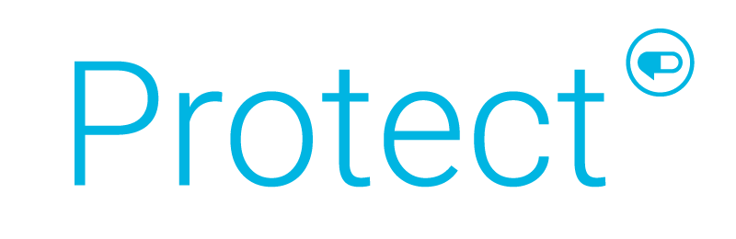

Unrivaled Clinical Oversight and Active Intervention
Client-aligned clinical programs that work in the best interest of your clients and their members to achieve better health outcomes at a lower net cost
5-7%
Annual Plan Savings
7:1
Average Program ROI
Money Back Guaranteed Savings
Notes:
Protect is our comprehensive clinical solution designed to improve health outcomes, lower net cost, and improve member experienced
In 2022, across our book of business, we delivered 5-7% annual plan savings with a 7:1 average program ROI
And expect to increase this to 7-10% annual plan savings and 5:1 average program ROI

Slide 7
Client-Aligned Clinical Solutions You’ve Come to Trust
Low Clinical Value Formulary Exclusions
Independent Prior
Authorization Reviews
Removes high-cost, low value drugs from PBM formularies when equally effective, lower cost alternatives are available
Foundational PAs
Independent review of chart notes results in clinically sound decisions
and fewer approved PAs
High Dollar Claim Review
Reliable PharmD-led review of scripts that cost $1,000 or more
for a 30-day supply
Complex Condition
Intervention
Provides additional clinical oversight for patients newly prescribed or already taking specialty drugs projected to cost $250k annually or more, including reviews by a condition specialist (M.D.)
NEW
2023
Protect Savings Validation: Transparent and Easy to Understand ROI Report
Notes:
As mentioned, we have delivered results and plan to continue to deliver, will now take you through what Protect is today as a refresher, insights that drove our enhancements, what are the enhancements
Let’s start by discussing the base elements of Protect, solutions you've come to trust.
Formulary Management – we have the LCV formulary exclusions that provides an additional layer of formulary management that goes above and beyond what our PBM offers …these add’l formulary exclusions deliver about $1.00 PMPM
Independent Prior Authorization review - - Our recommended tailored UM components under Protect are reviewed independently of the PBM. This is where a client decides to delegate the UM to us rather than have the PBM perform. We use PBMs criteria and generate an approval rate in line with more detailed chart reviews. We operate at 78% rather than industry standard of over 90% for ePA. Note: the approval rates are consistent across both specialty and non-specialty whereas PBM reviewed claims are approved at a higher rate.
Within independent PA reviews, we start with foundational PAs that cover both traditional drugs and nearly all specialty medications under PBM criteria; HDCR is for meds over 1000 or more for a 30 days supply; and Complex Condition Intervention, which covers expensive specialty medications, typically with a pricetag of $250K per year and up.
In 2023, we introduced the Protect Savings Validation report to compare plan savings against the expenses paid by the plan for the Protect program. We will talk more about this report in just a few moments.

Slide 8
Looking Ahead: Three Drug Classes Present Significant Opportunity
Anti-Inflammatory
& Dermatology (Specialty)
27%
2022 RxBenefits book of business data substantiates disproportionately high spend in three drug classes.
45%
18%
Diabetes (Non-Specialty)
2022 Total Gross Cost
55%
All
Others
Notes:
NOTE: data is from 2022 BOB and represents total gross cost
So what next…
- As part of any customer centric process, we looked carefully at the data…as you can see on this slide, our BOB data demonstrates that: 45% of drug spend resides with 3 drug classes, 27% with anti-inflammatory conditions and dermatological agents in the specialty space and in the non-specialty space, 18% is driven by diabetes alone, GLP-1s a driving force behind this. And spend in these classes continues to grow disproportionately.

Slide 9
Now Enhanced to Drive Deeper Savings & Satisfaction
NEW
2023
NEW
2024
June
January
Explore Switching High-Cost Specialty Treatments with Lower Cost Alternatives
Remove Low Clinical Value Drugs from the Formulary
Reduce Off-Label Prescribing of Next Generation Diabetes Medications (GLP-1s)
+
+
Member-Friendly Approach to Therapy Optimization
Deliver Clinically Sound Prior Authorization Decisions
Enhanced ROI Guarantee for Groups >1,000 Members
Total Projected Program Savings: $7.00-11.00 PMPM
Notes:
So now let’s talk about what’s new
•Protect is still grounded in utilization mgmt., but what makes Protect different is the evolving and comprehensive approach to clinical mgmt. here at RxB.
•UM programs are historically watered down by ePA and channel conflict…we don’t leverage ePA nor own a pharmacy – aligned interests of our clients.
•Our program interventions are led by registered pharmacists who not only perform reviews for medical necessity through UM ( ST, QL, and PA) yet also tackle utilization management from multiple angles…that is the difference in the ‘sea of the same’, we not only have standard UM but also interventions and consultations that are both prospective, before claims adjudication and retrospective after claims adjudication. Examples of this include: dose optimization, drug-drug interactions and ongoing monitoring as part of the therapeutic interventions for specialty medications.
•Moving left to right, as noted earlier, we still have LCV, and foundational PA, which includes traditional and specialty PAs from the PBM, HDCR, and CCI, and layer in 4 new key components:
Officially in June, the go-live for the expansion of GLP-1s drug class UM reviews is the Next generation diabetes UM program for GLP-1s – reduce off-label use for drugs used to treat Type 2 diabetes, this ties back to the ever-increasing diabetes issue
Additionally, for January 2024 go-live:
2. Therapeutic interchange for specialty meds – AF and derm
3. Whole product is wrapped in digital engagement and an improved experience for the member
4. Lastly, we are extending and enhanced ROI guarantee to clients over 1000 lives, 2:1
-Full value of the program from a financial perspective is sitting at $7-11 plan savings PMPM
We now offer the entire Protect offering as a single offering; we are no longer offering this set of complimentary solutions on an a la carte basis. Any clients who only took LCV in the past and only wants to continue with LCV will be grandfathered. That said, we strongly recommend that they consider moving to the full suite of solutions. Those who’ve only taken our PA offerings in the past will be asked to move to the full suite of solutions.

Slide 10
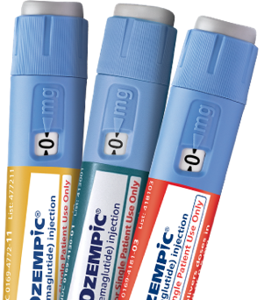
Further Reduce Spend by Combatting Off-Label Prescribing of GLP-1s
NEW
2023
Addresses increase in
off-label prescribing of expensive next-generation, Type 2 Diabetes medications like Ozempic® and Mounjaro™
Utilization Management for Next Generation Diabetes Drugs
Expanded UM edits to confirm medical necessity and FDA-approved dosing prior to prescription being filled
Pharmacist-led PA process that approves prescriptions that meet established criteria
More extensive infrastructure to manage the influx of member calls and ensure timely turnaround of prior authorizations
Reversing a Troubling Trend
RxBenefits’ BOB GLP-1 Spend
*
^{$160M}
^{$107M}
^{$55M}
2021 2022 2023
^{40% YoY Increase}
*Projected without expanded edits. Data as of 3/23
Notes:
GLP-1s like Ozempic® and Mounjaro™ are increasing being prescribed “off-label” for weight loss
Rxs not typically subject to additional review in the PA process
Total plan costs for this class of drugs has grown drastically and is only expected to increase
Has created unwanted consequences:
Higher plan spending
Product scarcity
Negative member outcomes (increased PA turnaround times leading to high call volumes
Our solution involves placing prior authorizations on all GLP-1 scripts and putting them through another level of scrutiny to ensure that they are specifically being written as a treatment option for diabetes. If we do not see diabetes as a diagnosis in the chart notes, we will not approve the script.

Slide 11
Extract Additional Economic & Clinical Value
NEW
2024
High-Touch Therapeutic Interchange
for Anti-Inflammatory Medications & Dermatologic Agents
Projected Success Rates
²
Clinical Prioritization Engine identifies greatest opportunities for intervention
Expert Specialty Pharmacists guide providers to lower cost, therapeutically equivalent alternatives with minimal dispensing delay to members
Transparent & empowering PA process keeps members informed and engaged at every step
Therapeutic response monitoring ensures patients benefit from therapy over time
10%
Point-of-Sale Conversions
3%
Retrospective
Conversions
A therapeutically equivalent, lower-cost alternative may include a non-specialty medication or a biosimilar
Notes:
Problem
As mentioned earlier, specialty spend on the rise, greatest area of opportunity both clinical and financially reside with lower cost alternatives for AF medications and dermatological agents.
Solution
As part of the expanded solution the Therapeutic Interchange will include:
Clinical rules engine will be set-up to ID the most critical opportunities for intervention
Centralized and expert specialty pharmacists to guide providers and members to lower cost and clinically appropriate therapeutic alternatives
PA process will be digitized in the member portal to keep members up to speed on where their approval is at
Process will be built out to include a prospective and retrospective approach, pre and post, leverage the trusted PA process for prospective. Note: focus on the member monitoring piece - identifying treatment failure EARLY pays dividends; avoids potential medical channel costs (more so with RA and Crohn's/UC than psoriasis.
Examples:
Retrospective --->Katie, who has been battling ulcerative colitis and using Humira with no visible improvement, can have better outcome by switching to Otezla.
A switch from Humira to Otzela can save a total of $126 per day for the member and their plan (note: when biosimilars are approved, recommendations may be updated to reflect those changes). Member health is always blanced w/ cost containment as #1 peioeity.
Prospective ---> When Eduardo's prescriber put in a new PA request for Humira, she was given a list of available proven alternatives that could work for Eduardo's newly prescribed condition - psoriasis. After detail conversation with RxB's pharmacists, the prescriber decide to go with Otezla
A switch from Humira to Otzela can save a total of $126 per day for the member and their plan
Supporting data, not talking points (unless requested)
Clinical literature/studies and BOB informs that we expect to see 10% POS conversions and 3% retrospective conversions
Sources, details below
Prospective 3, 4, 5, 6
Retrospective 1, 2, 6
1 Palak V. Patel, Caitlin G. Purvis, Ramiz N. Hamid & Steven R. Feldman (2022) Non-medical switching in dermatology: cost-conscious policy or an affront to patient safety?, Journal of Dermatological Treatment, 33:6, 2707-2710, DOI: 10.1080/09546634.2022.2110360
2 Olivia S. Costa, Tabassum Salam, Amy Duhig, Aarti A. Patel, Ann Cameron, Jennifer Voelker, Brahim Bookhart & Craig I. Coleman (2020) Specialist physician perspectives on non-medical switching of prescription medications, Journal of Market Access & Health Policy, 8:1, DOI: 10.1080/20016689.2020.1738637
3 Papp K;Reich K;Leonardi CL;Kircik L;Chimenti S;Langley RG;Hu C;Stevens RM;Day RM;Gordon KB;Korman NJ;Griffiths CE; “Apremilast, an Oral Phosphodiesterase 4 (PDE4) Inhibitor, in Patients with Moderate to Severe Plaque Psoriasis: Results of a Phase III, Randomized, Controlled Trial (Efficacy and Safety Trial Evaluating the Effects of Apremilast in Psoriasis [Esteem] 1).” Journal of the American Academy of Dermatology, pubmed.ncbi.nlm.nih.gov/26089047/. Accessed 15 May 2023.
4 Reich K;Gooderham M;Green L;Bewley A;Zhang Z;Khanskaya I;Day RM;Goncalves J;Shah K;Piguet V;Soung J; “The Efficacy and Safety of Apremilast, Etanercept and Placebo in Patients with Moderate-to-Severe Plaque Psoriasis: 52-Week Results from a Phase Iiib, Randomized, Placebo-Controlled Trial (Liberate).” Journal of the European Academy of Dermatology and Venereology : JEADV, pubmed.ncbi.nlm.nih.gov/27768242/. Accessed 15 May 2023.
5 Joint American Academy of Dermatology-National Psoriasis Foundation guidelines of care for the management of psoriasis with systemic nonbiologic therapies
Menter A;Gelfand JM;Connor C;Armstrong AW;Cordoro KM;Davis DMR;Elewski BE;Gordon KB;Gottlieb AB;Kaplan DH;Kavanaugh A;Kiselica M;Kivelevitch D;Korman NJ;Kroshinsky D;Lebwohl M;Leonardi CL;Lichten J;Lim HW;Mehta NN;Paller AS;Parra SL;Pathy AL;Prater EF;Rahimi RS;Rupani RN;Siegel M;Stoff B;Strober BE;Tapper EB;Wong EB;Wu JJ;Hariharan V;Elmets CA;

Slide 12
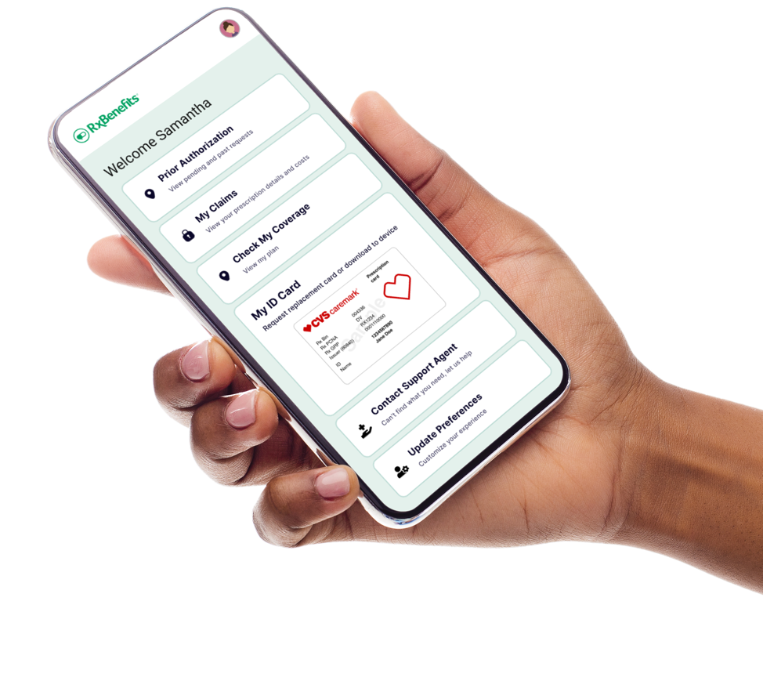
Enhance Member Experiences With Tailored Engagement
NEW
2024
Modernized Member Digital
Communication Platform
Offer real-time access to current prescription status along with ability to review past medications/claims
Boost member engagement and drive higher satisfaction by sending personalized updates to members through their preferred communication channel
Notes:
Problem
Modernizing the member experience and better meeting members where they are is another enhancement within scope of Protect.
Solution
Wrapping the whole product in a digital upgrade, meeting members where they are
As mentioned previously members will be able to access real time status updates on their PA

Slide 13
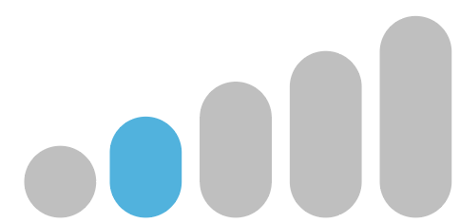
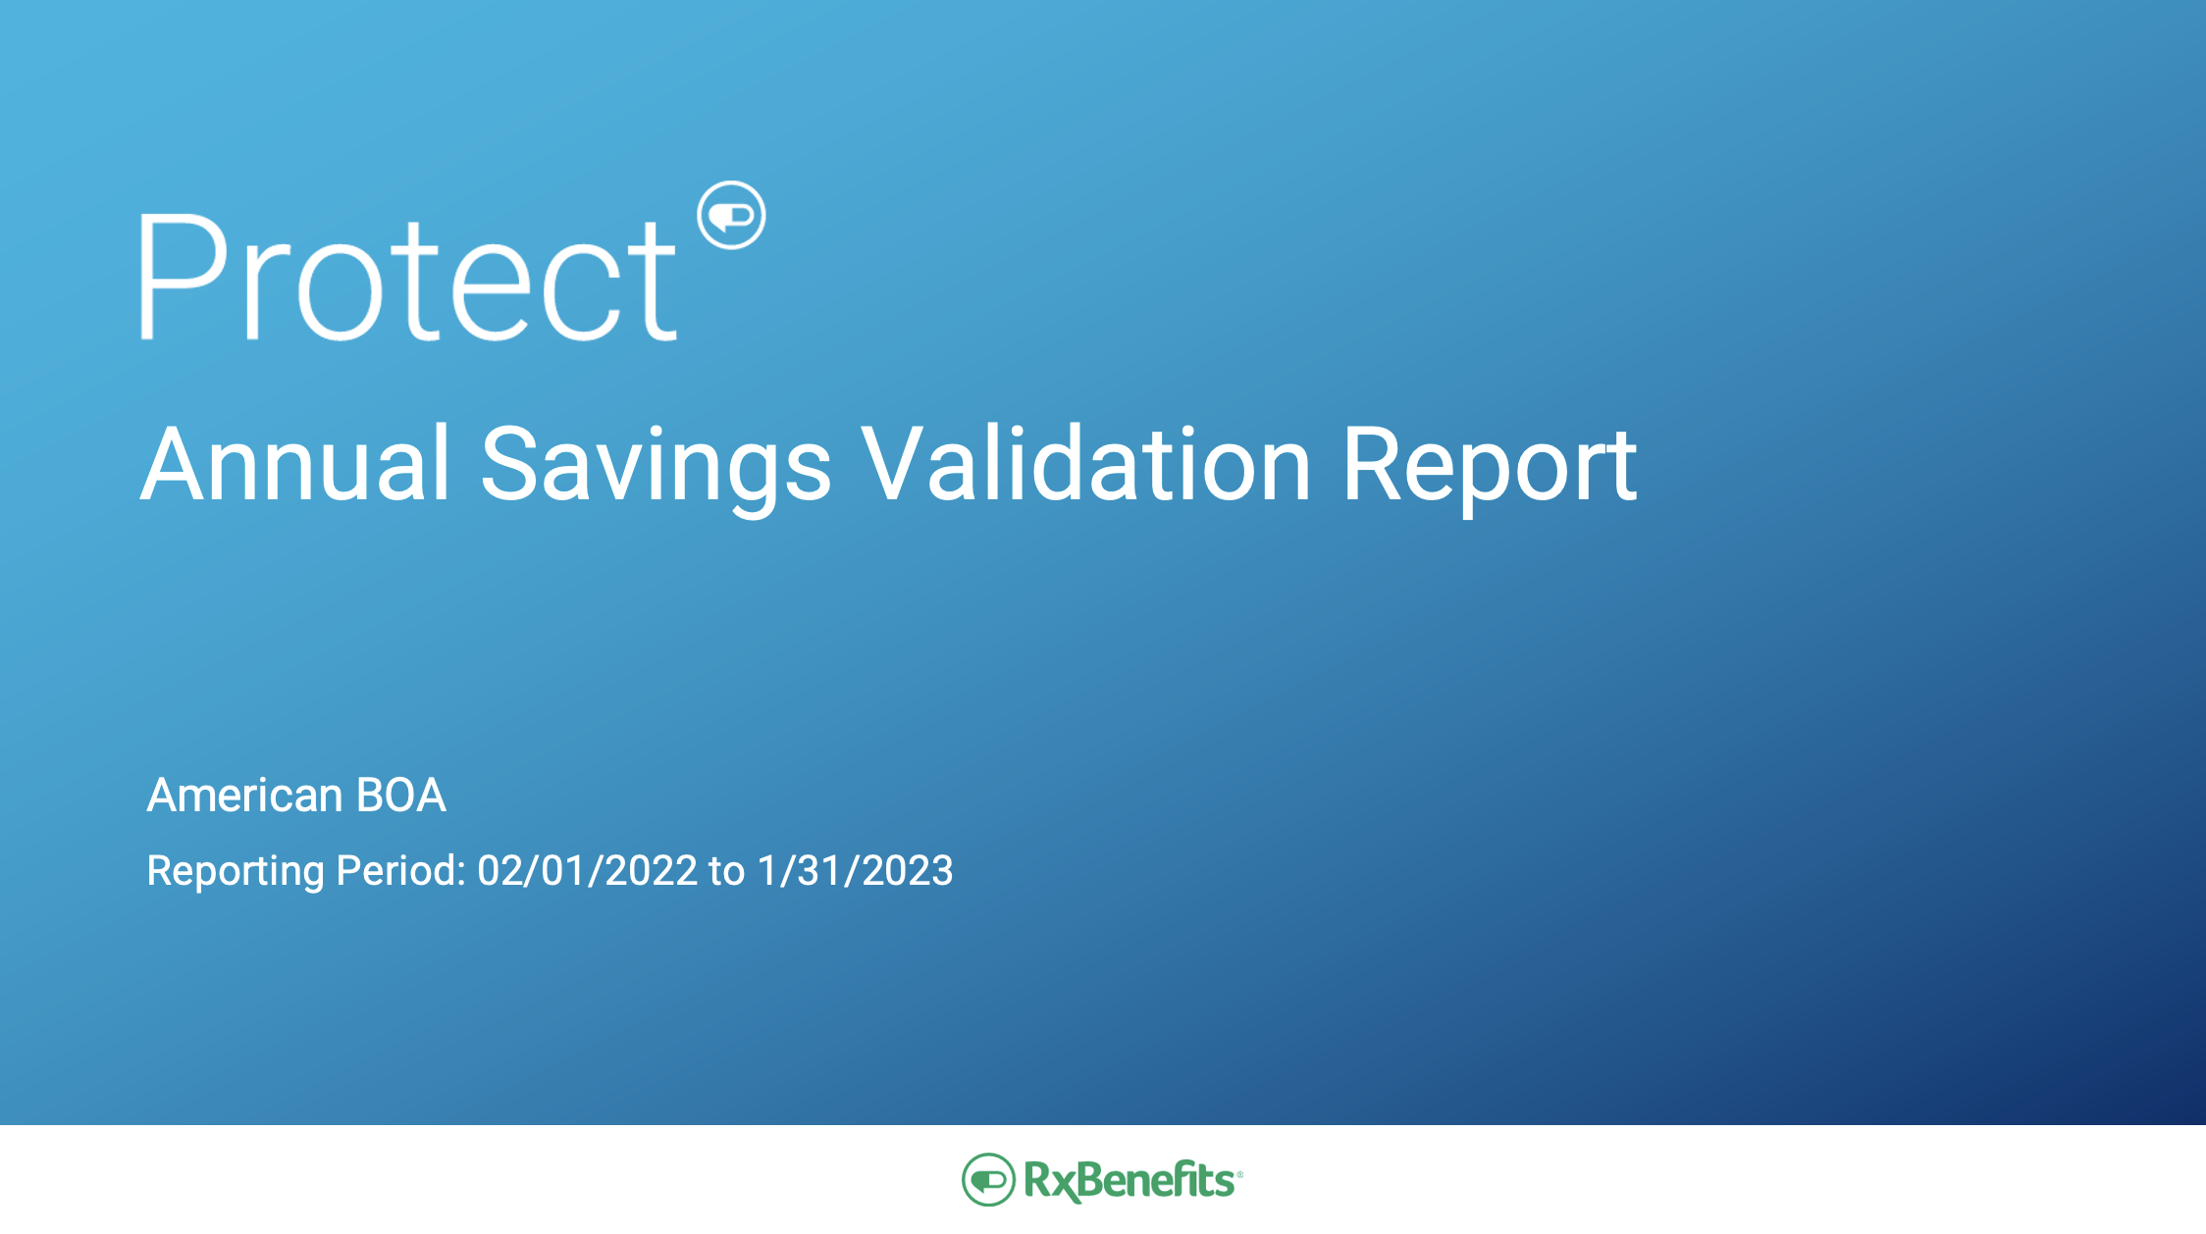
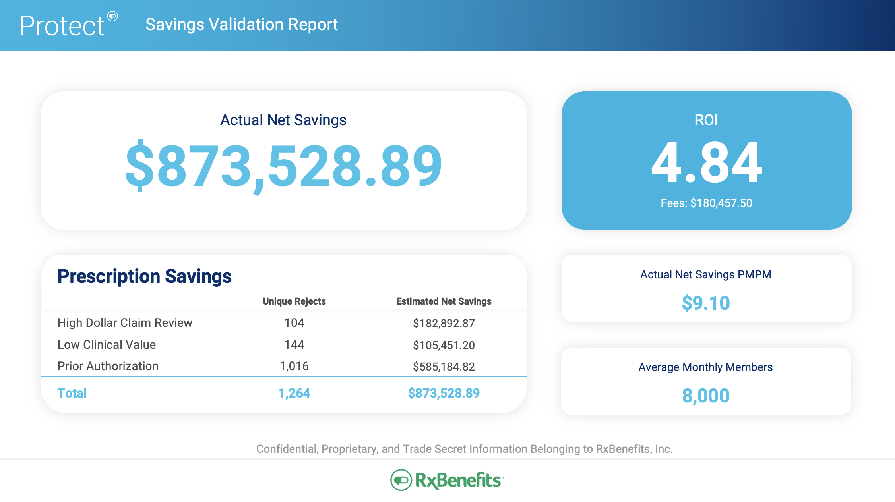
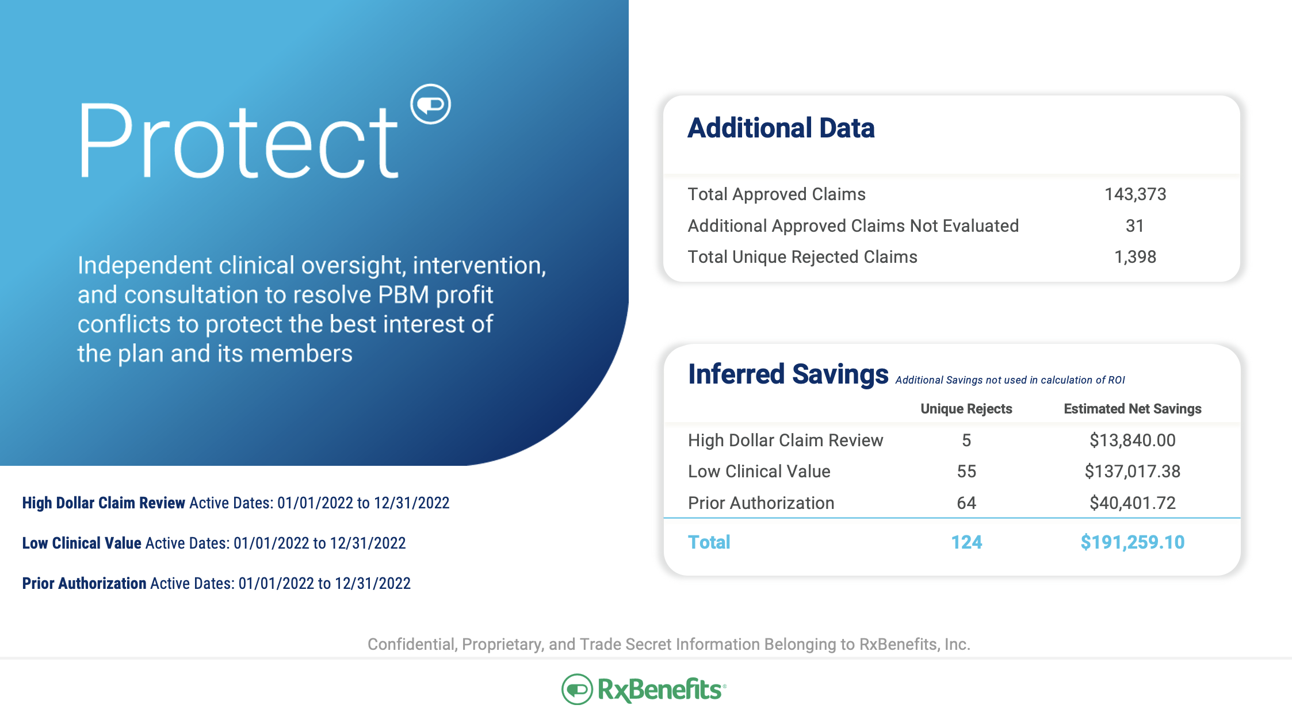
Assessing and Guaranteeing Clinical Program Savings
Savings Validation Report
ROI based on actual, hard-dollar savings
Methodology validated by third-party consultant firm
Produced on an annual basis
NEW
2024
2:1 ROI Guarantee for groups over 1,000 members
(1:1 guarantee applies for groups under 1,000 members)
Notes:
The Protect program now includes guaranteed savings, calculated utilizing reporting that is transparent, mathematically sound, utilizing an auditable methodology that is capable of calculating hard-dollar savings.
Using the full-paid and rejected-claims files, we identify individual rejected claims associated with a Protect component, and then follow the claim reject from the initial date to any subsequent pathways after the rejection – subsequently approved, alternative medication filled, or alternative recommended but not filled.
The Enhanced Protect Savings Analysis is based on actual, auditable dollars saved! Our methodology has been vetted and validated by the pharmaceutical consulting firm, Excelsior Solutions (Note: potential sensitivity as Excelsior is owned by Lockton)
In 2024, we are doubling our ROI guarantee for groups with 1,000 or more members. For groups with under 1,000 members, we will continue to offer a 1:1 ROI guarantee.

Slide 14
Deliver Client-Aligned Solutions Far Superior to PBM Programs
PBMs
vs.
Final formulary placement is influenced by PBM economics
Automatically remove low clinical value drugs from the formulary without impact to rebates
Simply the best way for you to protect your clients from the harmful effects of misaligned PBM incentives
Automated Prior Authorization process programmed to approve based on simple Yes/No inputs, resulting in approval rates of 90%
Financially-independent pharmacy personnel leverage chart notes and lab results to approve, on avg., 68% of review requests
PBM-owned distribution channels encourage fast approval
PA decisions rooted in clinical best practice with no bias to dispense
Notes:
Please do not confuse our client-aligned programs with those you might be able to obtain directly from the large PBMs. There are significant differences

Slide 15
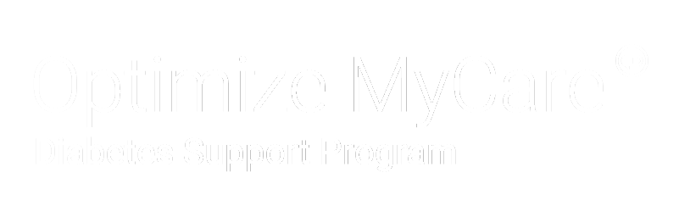


Better Manage Diabetes Costs and Outcomes
Assist members in better managing diabetes-related risks to optimize health and reduce costs
Pharmacist-led, ”human to human” interactions designed to:
With Validated Results:
Optimize drug regimens and adherence leveraging medication experts
Manage all aspects of a person’s health, not just diabetes
Address health literacy, gaps in care, and lifestyle/behaviors
Drive fewer serious complications and lower overall healthcare costs
2.3:1
Average ROI
48%
Care Gap Closure for members with Diabetes
$2,555
Average savings per engaged member
1.3
Average A1C Reduction
Notes:
Pharmacist led, human to human interactions. This is an proactive program – Tria not wait for the member to call – its pharmacists actively outreach to members and attempt to engage them in a discussion about medication therapy, broader health conditions, and the potential for behavior change to lead healther lifestyles. The program aims to achieve both medication AND overall health savings dollars.
Avg patient profile – 55 years old, 7 total conditions, 4 chronic conditions, taking 9 Rxs and 2 additional OTC medications. On initial consult, Tria pharmacists find nearly 2 drug therapy problems on average.

Slide 16


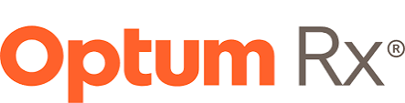
Make Specialty Medications More Affordable for Members and Plans
RxBenefits’ Manufacturer Assistance Solutions
Mitigating the cost of pricey specialty drugs to help patients get the medication they need
Reduces patient copay to $0 at pharmacy counter
Offers seamless member experience
Lower plan spend on many specialty medications
Available through
the Big Three PBMs
Notes:
Bridge is a new way of branding the combination of our manufacturer assistance solutions and our patient assistance solutions. They are literally meant to bridge Optimize 360 and Protect on one end of the spectrum with RxPharmacy Assurance on the other.
The first half of our Bridge solution are our manufacturer assistance solutions, which we have had in place for quite some time. Our self-insured clients need protection, and with Bridge we're targeting high-cost specialty medications in another way. These programs reduce patient pay, offer a great member experience, and lower plan spend as well.
We have SOSP with ESI, PrudentRx with CVS, and Optum's variable copay. These solutions can be paired with our patient assistance solutions, which we'll touch on next

Slide 17
Help Plans and Members Offset High-Cost Specialty Medications
NEW
2023
RxBenefits’ Preferred Patient Assistance Solutions
A solution that addresses identified gaps of most traditional programs.
RxBenefits’ Integrated & Vetted Patient Assistance Solutions
Uniquely balanced focus on pharmacy plan savings and member health
Clinical oversight to ensure appropriateness and safety of medications
Compassionate, quality member experience with no therapy interruptions
Retrospective outcomes reporting to determine true program savings
We do not accept any patient
assistance commissions.
Notes:
The other half of Bridge are our preferred patient assistance solutions, including SaveOnSP Advantage with SOSP and ESI, and Amwins Rx, which can be paired with any of our three PBMs. As you recall, we added these in earlier 2023.
After vetting various solutions in the marketplace, our solution has a more balanced focus on pharmacy plan savings and member health.
Protect is required, and therefore we can ensure clinical oversight, including the appropriateness and safety of medications. A quality member experience is key, and we are working now on outcomes reporting.
We do not accept any commissions on patient assistance solutions, which is unique in the marketplace.
Our partnership with Amwins Rx targets specialty medications over $9,000 per 30 day supply excluding anti-inflammatory and dermatological agents. We established this criteria to really zero in on costly medications that would not trigger specialty carve-out fees nor impact our aggressive contracted PBM pricing. Also, we're targeting these therapeutic classes with Protect.

Slide 18

Mitigate Risk with Supplemental Stop-Loss for Catastrophic Claims
Flexible, accessible specialty pharmacy supplemental stop-loss coverage provides long-term protection against the unexpected and potentially damaging effects that can result from catastrophic specialty claims.
RxBenefits’ Sister Company
Delivers multi-year, laser free protection
Pays up to $1M per year, per condition, per claimant, and up to $3M per condition, per claimant lifetime
Limits stop-loss carrier risk and provides
a mechanism for brokers and self-funded plans to negotiate reduced stop-loss rates
NEW
2024
Expanded to cover
most specialty conditions and medications
Attachment points as low as $100K up to $250K so plans can choose the coverage that is right for them
May replace traditional stop-loss for pharmacy claims, depending on attachment point selected
RxPharmacy Assurance, Inc. is a Vermont domiciled Sponsored Captive managed by Marsh Captive Management. Upon meeting membership eligibility requirements, self-funded plans of all sizes can access affordable supplemental stop-loss insurance designed specifically to manage pharmacy risk by forming a cell within RxPharmacy Assurance.
Notes:
RxPharmacy Assurance is wholly owned subsidiary of RxBenefits that offers supplemental stop-loss coverage to help self funded employers manage the risk of high-cost specialty claims.
Generally, all small to mid-market self-funded clients purchase stop-loss to help manage the risk associated with large claims
In the past, the largest claims tended to be one-time medical situations like premature births or expensive hospitalizations and surgeries; but advances in pharmacy have now made it necessary to address chronic, long-term situations that are primarily driven by medications. Traditional stop-loss doesn’t service this need very well because the stop-loss carrier will often limit its payouts by lasering claims or significantly raising premiums at renewal. Lasering = when a stop-loss carrier sets an individual deductible for the high-cost claimant at a level where the carrier is not expected to have to payout; leaving the employer exposed to 100% of the liability.
A requirement for RxPharmacy Assurance coverage is enrollment in RxBenefits’ Protect program. That’s because the primary goal of RxBenefits’ independent clinical review is to ensure clinically appropriate and cost-effective treatments are prescribed. But there will always be large claims that are unavoidable, despite our best efforts. That’s where our supplemental stop-loss coverage brings value: by removing the sting of a large claim.
New for 2024:
As we head into 2024, we are making two major enhancements as a result of feedback from the broker community who wanted more comprehensive coverage and more deductible options than just $250,000, which is our current offering. Our response: we’ll start covering virtually all specialty conditions (which increases our coverage from 400+ to 1,000+ medications) and we’ll offer flexible attachment points (from 100K up to 250K in 25k increments).
That means, if a client were to choose a deductible that matches the one they selected with their traditional stop-loss carrier, it enables RxPharmacy Assurance to be the primary stop-loss payer for specialty conditions. This can translate into additional value for the client in the form of lower premium rates from their traditional stop-loss carrier while securing multi-year protection with us.
We expect to have preliminary rates available in June.
Until then, if you would like to learn more about stop-loss coverage in general, there is a series of short, animated videos on RxBU that cover the basics. Also, we will be hosting a webinar in mid June diving deeper into the S/L market and how to maximize client opportunities.

Slide 19


You Asked, We Delivered: New Layers of Protection and Enhanced Services
Preferred Traditional
Stop-Loss Coverage
Larger Group Pricing
50% More Agents
New Agent
Software
Broker & Member Digital Self-Service Experiences
Type 2 Diabetes UM Program
High-Touch Therapeutic Interchange
Digital PA Tracking for Members
2:1 ROI Guarantee for Groups >1,000 Members
Patient Assistance Solutions
Favorable Underwriting When Coupled With Protect and RxPharmacy Assurance
Broad Specialty Drug Coverage
Multiple Attachment Points Starting at $100K
Notes:
I wanted to summarize all of the enhancements we’ve made to our offering in 2023 and for the 2024 plan year. We’ve been focused on providing the best specialty management solution for self-funded employers anywhere. And we’ve also been focused on making our service experience, already acknowledged as one of the best in pharmacy benefits, even better.
Optimize 360: Competitive, custom pricing for larger groups; a dramatically larger member service team; new software to make it easier for our member service representatives to quickly access information and better serve members; coming soon: new broker and member digital self-service experiences
Protect: In June, a new program to effectively address the wave of off-label prescribing of new generation diabetes medications; Coming in 2024: a new high-touch therapeutic interchange program targeting two classes of drugs – anti inflammtory and dermatological agents that comprise 1/3 of most plans’ total spend; a new member portal that enables them to set communications preferences and check the real-time status of prior authorizations, among other things; all backed by an even stronger ROI guarantee of 2:1 for groups over 1,000 member lives
Bridge: New patient assistance solutions that provide strong clinical oversight, a quality member experience, and a savings analysis that provides a realistic sense of potential client savings
Preferred Traditional Stop-Loss Coverage: Partnerships with 5 traditional stop-loss carriers including Optum, Voya, Symetra, Berkeley, and Crum & Forster, that provide for opportunities for beneficial underwriting (including reduced stop-loss premiums) when the client also obtains RxPharmacy Assurance coverage, subject to individual client underwriting
RxPharmacy Assurance: Expanded coverage of most specialty conditions and medications; new attachment points in $25k increments, starting at $100k and going up to $250k

