Slide 1
Next Generation Diabetes Utilization Management Preventing the dispensing of Type 2 diabetes drugs (GLP-1s) being prescribed off-label for weight loss
Date

Slide 2
Popular Culture is Creating a Wave of Demand
Next generation treatments, including Ozempic® and Mounjaro™, are FDA-Approved to treat Type 2 Diabetes
These drugs have weight loss as a “side effect”
Highly sought-after for weight loss after being widely popularized
Social media/celebrities
Direct-to-consumer advertising
Ease of access through telehealth platforms

Slide 3
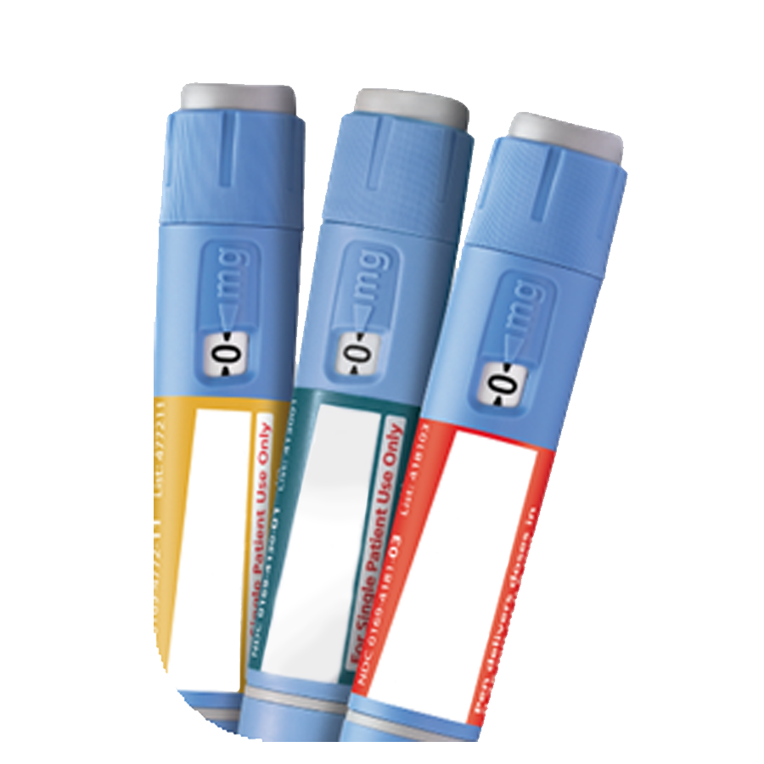
Negative Impacts Experienced As a Result of Off-label Prescribing
Inappropriate use leads to unwanted consequences
Total plan costs for this class of drugs have grown drastically and are only expected to increase
Employer
Plan spend and trending increases
Off-label coverage often unaligned with plan goals
RxBenefits’ BOB Category Spend
Members
Product scarcity for patients with Type 2 Diabetes
Customer Service challenges due to high call volumes
Off-label prescribing could result in harmful side effects and negative health outcomes
*
^{$160M}
^{$107M}
^{$55M}
2021 2022 2023
40% spend potentially due to off-label use
*Projected without expansion of edits

Slide 4
Innovating to Solve Real-World Concerns
Uncovering market trends through RxBenefits’ Proactive Utilization Surveillance
Creating a client-aligned solution to drive immediate impact
NEW
June 2023
Next Generation Diabetes Utilization Management

Slide 5
Reducing Spend by Combatting Off-Label Prescribing of Diabetes Drugs
Expanded UM edits
Detailed chart review confirms medical necessity (Type 2 Diabetes diagnosis) and FDA-approved dosing prior to prescription being filled
Deny applicable prescriptions that do not meet these criteria
NEW
June 2023
Next Generation Diabetes Utilization Management
Enhanced member outcomes
Expand infrastructure to manage the influx of member calls and ensure timely turnaround of prior authorizations
Shield members from potential harmful side effects

Slide 6
With New Edits Clients Are Covered Regardless of PBM
As of June 15th
Caremark
GLP-1
UM Rule
Caremark | Adding GLP-1 UM Rule
Basic | Yes
Intermediate | Yes
Custom | Opt-in
Express Scripts
GLP-1 UM Rule
Express Scripts | Adding GLP-1 UM Rule
Basic – Level 1 | Yes
Intermediate – Super Advantage | Yes
Advanced – Super Advantage Plus | Yes
Custom | Opt-in
Optum Rx
GLP-1 UM Rule
Express Scripts | Adding GLP-1 UM Rule
Basic | Yes
Intermediate | Yes
Advanced | Yes
Custom | Opt-in

Slide 7
Next Steps for Implementation
Systematic notification of clients and members prior to program launch leaving time for AM conversations and member questions
RxBenefits infrastructure expansion is underway and will be in place prior to program go live
Program rollout across PBMs for 360 Clients
Currently Live
6/1
6/15
7/15*
Optum Rx Basic, Intermediate & Advanced and ESI Intermediate & Advanced
ESI Intermediate & Advanced (**enhanced rule)
ESI Basic, CVS Basic & Intermediate
ESI Custom, Optum Rx Custom & CVS Custom
*Earliest possible; actual date subject to lead time
New Client timing varies slightly

