Slide 1

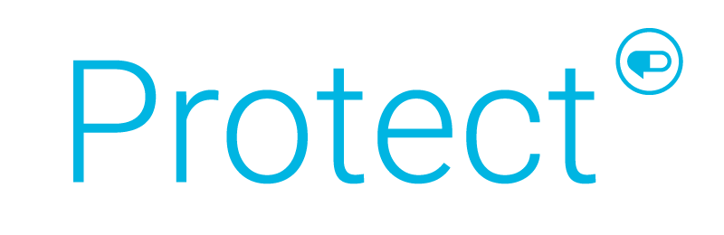
Client-Aligned Clinical Programs
Date

Slide 2

Unrivaled Clinical Oversight and Active Intervention
Client-aligned clinical programs that work in the best interest of your clients and their members to achieve better health outcomes at a lower net cost
5-7%
Annual Plan Savings
7:1
Average Program ROI
Money Back Guaranteed Savings
Notes:
Protect is our comprehensive clinical solution designed to improve health outcomes, lower net cost, and improve member experienced
In 2022, across our book of business, we delivered 5-7% annual plan savings with a 7:1 average program ROI
And expect to increase this to 7-10% annual plan savings and 5:1 average program ROI in 2024

Slide 3
Client-Aligned Clinical Solutions You’ve Come to Trust
Low Clinical Value Formulary Exclusions
Independent Prior
Authorization Reviews
Removes high-cost, low value drugs from PBM formularies when equally effective, lower cost alternatives are available
Foundational PAs
Independent review of chart notes results in clinically sound decisions
and fewer approved PAs
High Dollar Claim Review
Reliable PharmD-led review of scripts that cost $1,000 or more
for a 30-day supply
Complex Condition
Intervention
Provides additional clinical oversight for patients newly prescribed or already taking specialty drugs projected to cost $250k annually or more, including reviews by a condition specialist (M.D.)
NEW
2023
Protect Savings Validation: Transparent and Easy to Understand ROI Report
Notes:
As mentioned, we have delivered results and plan to continue to deliver, will now take you through what Protect is today as a refresher, insights that drove our enhancements, what are the enhancements
Let’s start by discussing the base elements of Protect, solutions you've come to trust.
Formulary Management – we have the LCV formulary exclusions that provides an additional layer of formulary management that goes above and beyond what our PBM offers …these add’l formulary exclusions deliver about $1.00 PMPM
Independent Prior Authorization review - - Our recommended tailored UM components under Protect are reviewed independently of the PBM. This is where a client decides to delegate the UM to us rather than have the PBM perform. We use PBMs criteria and generate an approval rate in line with more detailed chart reviews. We operate at 78% rather than industry standard of over 90% for ePA. Note: the approval rates are consistent across both specialty and non-specialty whereas PBM reviewed claims are approved at a higher rate.
Within independent PA reviews, we start with foundational PAs that cover both traditional drugs and nearly all specialty medications under PBM criteria; HDCR is for meds over 1000 or more for a 30 days supply; and Complex Condition Intervention, which covers expensive specialty medications, typically with a pricetag of $250K per year and up.
In 2023, we introduced the Protect Savings Validation report to compare plan savings against the expenses paid by the plan for the Protect program. We will talk more about this report in just a few moments.

Slide 4
Looking Ahead: Three Drug Classes Present Significant Opportunity
Anti-Inflammatory
& Dermatology (Specialty)
27%
2022 RxBenefits book of business data substantiates disproportionately high spend in three drug classes.
45%
18%
Diabetes (Non-Specialty)
2022 Total Gross Cost
55%
All
Others
Notes:
NOTE: data is from 2022 BOB and represents total gross cost
So what’s next?
- As part of any customer centric process, we looked carefully at the data…as you can see on this slide, our BOB data demonstrates that: 45% of drug spend resides with 3 drug classes, 27% with anti-inflammatory conditions and dermatological agents in the specialty space and in the non-specialty space, 18% is driven by diabetes alone, GLP-1s a driving force behind this. And spend in these classes continues to grow disproportionately.

Slide 5
Now Enhanced to Drive Deeper Savings & Satisfaction
NEW
2023
NEW
2024
June
January
Explore Switching High-Cost Specialty Treatments with Lower Cost Alternatives
Remove Low Clinical Value Drugs from the Formulary
Reduce Off-Label Prescribing of Next Generation Diabetes Medications (GLP-1s)
+
+
Member-Friendly Approach to Therapy Optimization
Deliver Clinically Sound Prior Authorization Decisions
Enhanced ROI Guarantee for Groups >1,000 Members
Total Projected Program Savings: $7.00-11.00 PMPM
Notes:
So now let’s talk about what’s new
•Protect is still grounded in utilization mgmt., but what makes Protect different is the evolving and comprehensive approach to clinical mgmt. here at RxB.
•UM programs are historically watered down by ePA and channel conflict…we don’t leverage ePA nor own a pharmacy – aligned interests of our clients.
•Our program interventions are led by registered pharmacists who not only perform reviews for medical necessity through UM ( ST, QL, and PA) yet also tackle utilization management from multiple angles…that is the difference in the ‘sea of the same’, we not only have standard UM but also interventions and consultations that are both prospective, before claims adjudication and retrospective after claims adjudication. Examples of this include: dose optimization, drug-drug interactions and ongoing monitoring as part of the therapeutic interventions for specialty medications.
•Moving left to right, as noted earlier, we still have LCV, and foundational PA, which includes traditional and specialty PAs from the PBM, HDCR, and CCI, and layer in 4 new key components:
Officially in June, the go-live for the expansion of GLP-1s drug class UM reviews is the Next generation diabetes UM program for GLP-1s – reduce off-label use for drugs used to treat Type 2 diabetes, this ties back to the ever-increasing diabetes issue
Additionally, for January 2024 go-live:
2. Therapeutic interchange for specialty meds – AF and derm
3. Whole product is wrapped in digital engagement and an improved experience for the member
4. Lastly, we are extending and enhanced ROI guarantee to clients over 1000 lives, 2:1
-Full value of the program from a financial perspective is sitting at $7-11 plan savings PMPM
We now offer the entire Protect offering as a single offering; we are no longer offering this set of complimentary solutions on an a la carte basis. Any clients who only took LCV in the past and only wants to continue with LCV will be grandfathered. That said, we strongly recommend that they consider moving to the full suite of solutions. Those who’ve only taken our PA offerings in the past will be asked to move to the full suite of solutions.

Slide 6
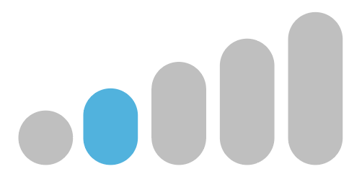

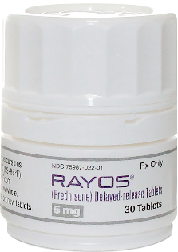
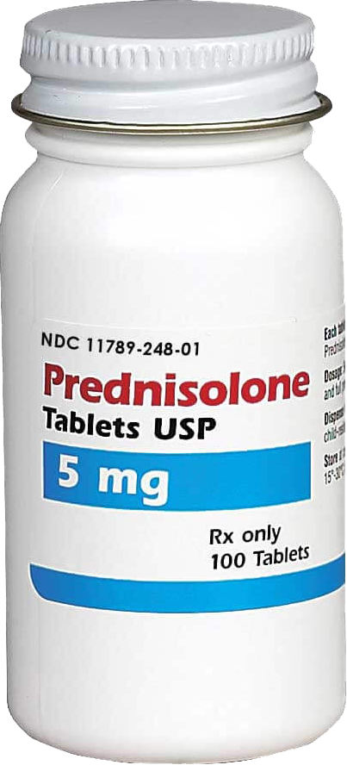
Realize Immediate Savings By Eliminating Low Clinical Value Drugs
Rayos is a delayed release version of Prednisone that costs roughly 280x as much as regular Prednisone
Formulary Exclusions for Low Clinical Value (LCV) Medications
Rayos
$2,370
Ensure scripts for non-essential medications are redirected to equally clinically effective, lower cost alternatives
vs
Prednisone
$8.50
Notes:
Problem
PBM formularies can be biased and may not always be designed to have the most effective soltutions
Examples of low clinical value drugs include compounds, reformations, or drugs that work at a small percent but have a large price tag compared to alternatives.
Many of these are highly couponed, which, as we know, is a marketing technique by the manufacturer – a technique we mitigate
Solution
Our Low Clinical Value program is led by clinicians and helps eliminate wasteful spending within a plan, yielding high savings with minimal disruption, by ensuring prescriptions for non-essential medications are instead filled with lower cost, yet equally effective alternatives.
Our list is updated twice per year as new drugs hit the market and as we see exposure to existing drugs, such as 510k products in other areas of our BoB.
RxBenefits works on behalf of the payer to tweak the formulary without negatively impacting rebate receipts. This is an example of minimizing the manufacturer and PBM influence on formulary development.

Slide 7
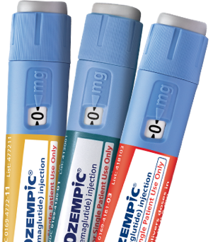
Further Reduce Spend by Combatting Off-Label Prescribing of GLP-1s
NEW
2023
Addresses increase in
off-label prescribing of expensive next-generation, Type 2 Diabetes medications like Ozempic® and Mounjaro™
Utilization Management for Next Generation Diabetes Drugs
Expanded UM edits to confirm medical necessity and FDA-approved dosing prior to prescription being filled
Pharmacist-led PA process that approves prescriptions that meet established criteria
More extensive infrastructure to manage the influx of member calls and ensure timely turnaround of prior authorizations
Reversing a Troubling Trend
RxBenefits’ BOB GLP-1 Spend
*
^{$160M}
^{$107M}
^{$55M}
2021 2022 2023
^{40% YoY Increase}
*Projected without expanded edits. Data as of 3/23
Notes:
GLP-1s like Ozempic® and Mounjaro™ are increasing being prescribed “off-label” for weight loss
Rxs not typically subject to additional review in the PA process
Total plan costs for this class of drugs has grown drastically and is only expected to increase
Has created unwanted consequences:
Higher plan spending
Product scarcity
Negative member outcomes (increased PA turnaround times leading to high call volumes
Our solution involves placing prior authorizations on all GLP-1 scripts and putting them through another level of scrutiny to ensure that they are specifically being written as a treatment option for diabetes. If we do not see diabetes as a diagnosis in the chart notes, we will not approve the script.

Slide 8
Extract Additional Economic & Clinical Value
NEW
2024
High-Touch Therapeutic Interchange
for Anti-Inflammatory Medications & Dermatologic Agents
Projected Success Rates
²
Clinical Prioritization Engine identifies greatest opportunities for intervention
Expert Specialty Pharmacists guide providers to lower cost, therapeutically equivalent alternatives with minimal dispensing delay to members
Transparent & empowering PA process keeps members informed and engaged at every step
Therapeutic response monitoring ensures patients benefit from therapy over time
10%
Point-of-Sale Conversions
3%
Retrospective
Conversions
A therapeutically equivalent, lower-cost alternative may include a non-specialty medication or a biosimilar
Notes:
Problem
As mentioned earlier, specialty spend on the rise, greatest area of opportunity both clinical and financially reside with lower cost alternatives for AF medications and dermatological agents.
Solution
As part of the expanded solution the Therapeutic Interchange will include:
Clinical rules engine will be set-up to ID the most critical opportunities for intervention
Centralized and expert specialty pharmacists to guide providers and members to lower cost and clinically appropriate therapeutic alternatives
PA process will be digitized in the member portal to keep members up to speed on where their approval is at
Process will be built out to include a prospective and retrospective approach, pre and post, leverage the trusted PA process for prospective. Note: focus on the member monitoring piece - identifying treatment failure EARLY pays dividends; avoids potential medical channel costs (more so with RA and Crohn's/UC than psoriasis.
Examples:
Retrospective --->Katie, who has been battling ulcerative colitis and using Humira with no visible improvement, can have better outcome by switching to Otezla.
A switch from Humira to Otzela can save a total of $126 per day for the member and their plan (note: when biosimilars are approved, recommendations may be updated to reflect those changes). Member health is always blanced w/ cost containment as #1 peioeity.
Prospective ---> When Eduardo's prescriber put in a new PA request for Humira, she was given a list of available proven alternatives that could work for Eduardo's newly prescribed condition - psoriasis. After detail conversation with RxB's pharmacists, the prescriber decide to go with Otezla
A switch from Humira to Otzela can save a total of $126 per day for the member and their plan
Supporting data, not talking points (unless requested)
Clinical literature/studies and BOB informs that we expect to see 10% POS conversions and 3% retrospective conversions
Sources, details below
Prospective 3, 4, 5, 6
Retrospective 1, 2, 6
1 Palak V. Patel, Caitlin G. Purvis, Ramiz N. Hamid & Steven R. Feldman (2022) Non-medical switching in dermatology: cost-conscious policy or an affront to patient safety?, Journal of Dermatological Treatment, 33:6, 2707-2710, DOI: 10.1080/09546634.2022.2110360
2 Olivia S. Costa, Tabassum Salam, Amy Duhig, Aarti A. Patel, Ann Cameron, Jennifer Voelker, Brahim Bookhart & Craig I. Coleman (2020) Specialist physician perspectives on non-medical switching of prescription medications, Journal of Market Access & Health Policy, 8:1, DOI: 10.1080/20016689.2020.1738637
3 Papp K;Reich K;Leonardi CL;Kircik L;Chimenti S;Langley RG;Hu C;Stevens RM;Day RM;Gordon KB;Korman NJ;Griffiths CE; “Apremilast, an Oral Phosphodiesterase 4 (PDE4) Inhibitor, in Patients with Moderate to Severe Plaque Psoriasis: Results of a Phase III, Randomized, Controlled Trial (Efficacy and Safety Trial Evaluating the Effects of Apremilast in Psoriasis [Esteem] 1).” Journal of the American Academy of Dermatology, pubmed.ncbi.nlm.nih.gov/26089047/. Accessed 15 May 2023.
4 Reich K;Gooderham M;Green L;Bewley A;Zhang Z;Khanskaya I;Day RM;Goncalves J;Shah K;Piguet V;Soung J; “The Efficacy and Safety of Apremilast, Etanercept and Placebo in Patients with Moderate-to-Severe Plaque Psoriasis: 52-Week Results from a Phase Iiib, Randomized, Placebo-Controlled Trial (Liberate).” Journal of the European Academy of Dermatology and Venereology : JEADV, pubmed.ncbi.nlm.nih.gov/27768242/. Accessed 15 May 2023.
5 Joint American Academy of Dermatology-National Psoriasis Foundation guidelines of care for the management of psoriasis with systemic nonbiologic therapies
Menter A;Gelfand JM;Connor C;Armstrong AW;Cordoro KM;Davis DMR;Elewski BE;Gordon KB;Gottlieb AB;Kaplan DH;Kavanaugh A;Kiselica M;Kivelevitch D;Korman NJ;Kroshinsky D;Lebwohl M;Leonardi CL;Lichten J;Lim HW;Mehta NN;Paller AS;Parra SL;Pathy AL;Prater EF;Rahimi RS;Rupani RN;Siegel M;Stoff B;Strober BE;Tapper EB;Wong EB;Wu JJ;Hariharan V;Elmets CA;

Slide 9
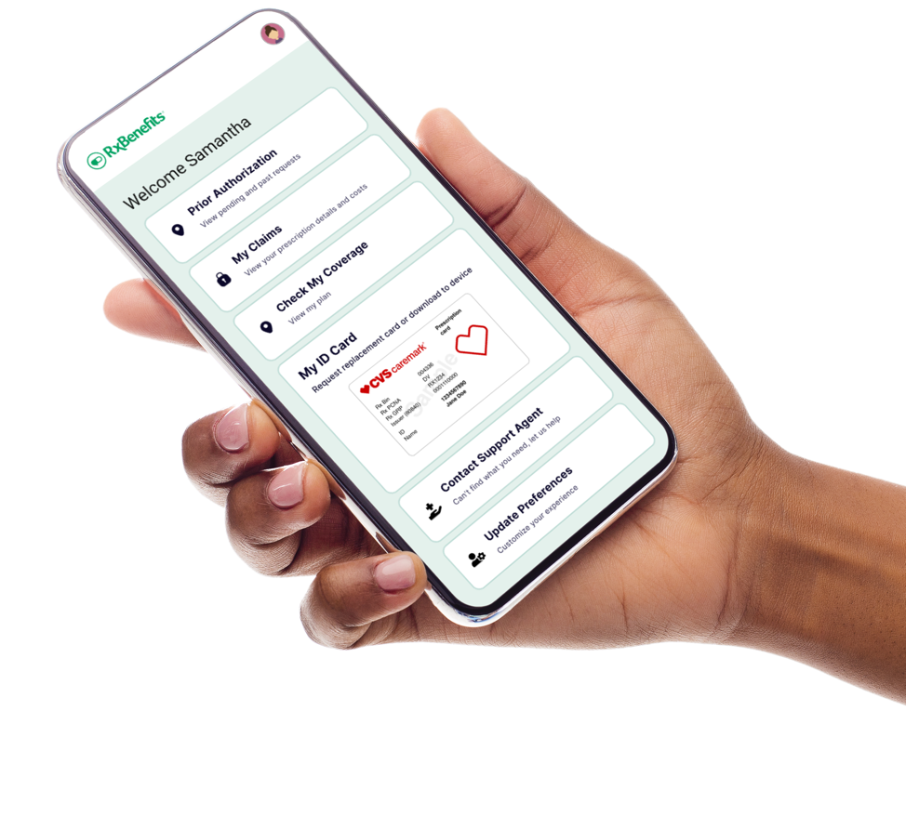
Enhance Member Experiences With Tailored Engagement
NEW
2024
Modernized Member Digital
Communication Platform
Offer real-time access to current prescription status along with ability to review past medications/claims
Boost member engagement and drive higher satisfaction by sending personalized updates to members through their preferred communication channel
Notes:
Modernizing the member experience and better meeting members where they are is another enhancement within scope of Protect
We are wrapping the whole product in a digital upgrade, meeting members where they are
As mentioned previously members will be able to access real time status updates on their PA, access claims history, and set communications preferences to better communicate with RxBenefits staff

Slide 10
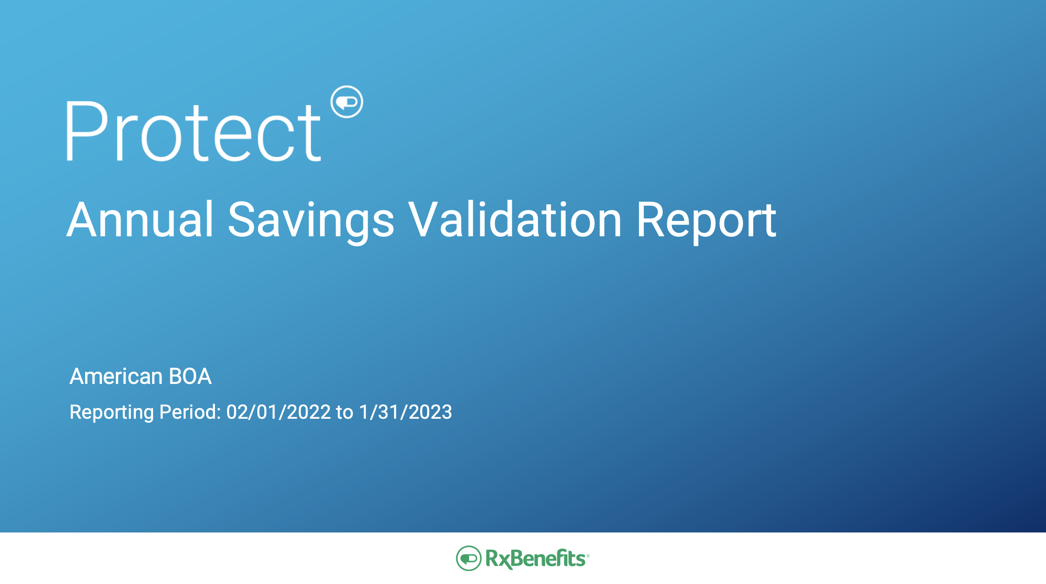
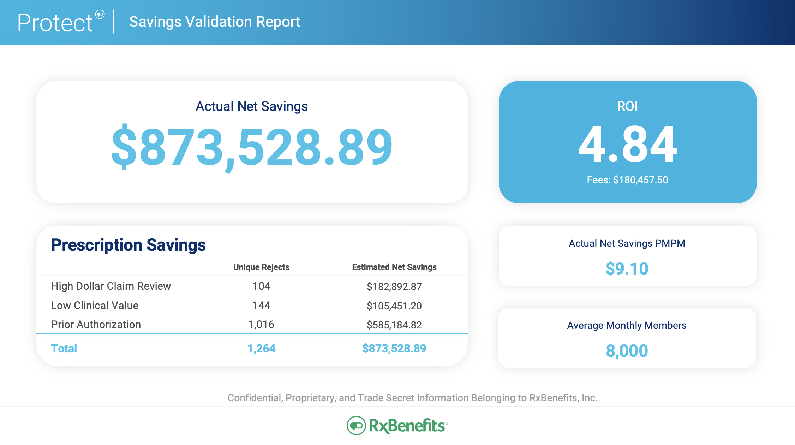
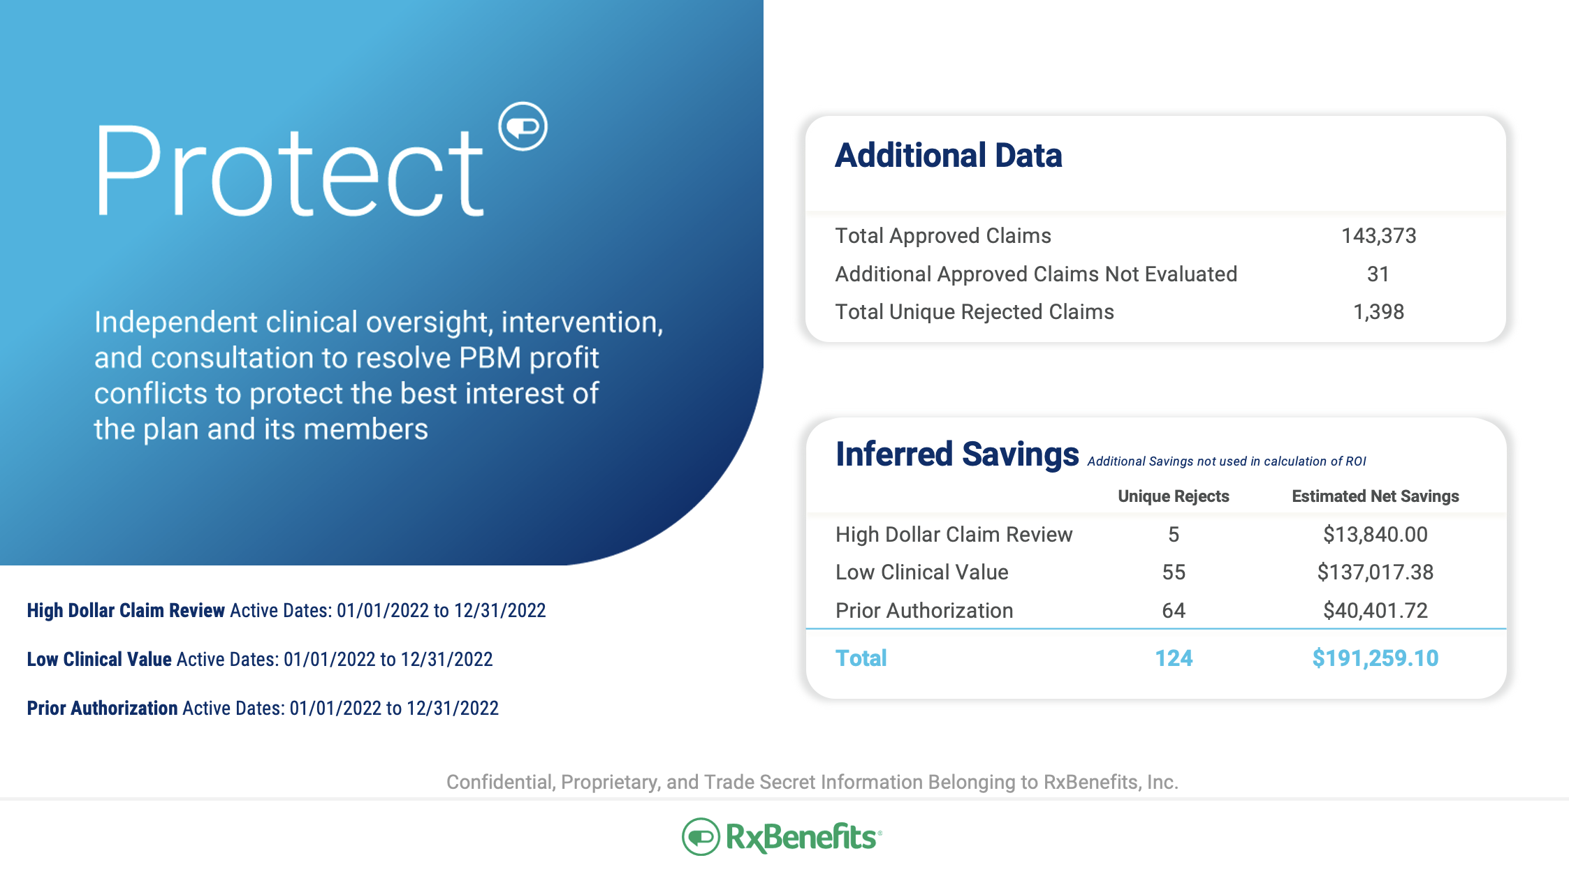
Assessing and Guaranteeing Clinical Program Savings
Savings Validation Report
ROI based on actual, hard-dollar savings
Methodology validated by third-party consultant firm
Produced on an annual basis
NEW
2024
2:1 ROI Guarantee for groups over 1,000 members
(1:1 guarantee applies for groups under 1,000 members)
Notes:
The Protect program now includes guaranteed savings, calculated utilizing reporting that is transparent, mathematically sound, utilizing an auditable methodology that is capable of calculating hard-dollar savings.
Using the full-paid and rejected-claims files, we identify individual rejected claims associated with a Protect component, and then follow the claim reject from the initial date to any subsequent pathways after the rejection – subsequently approved, alternative medication filled, or alternative recommended but not filled.
The Enhanced Protect Savings Analysis is based on actual, auditable dollars saved! Our methodology has been vetted and validated by the pharmaceutical consulting firm, Excelsior Solutions (Note: potential sensitivity as Excelsior is owned by Lockton)
In 2024, we are doubling our ROI guarantee for groups with 1,000 or more members. For groups with under 1,000 members, we will continue to offer a 1:1 ROI guarantee.

Slide 11
Deliver Client-Aligned Solutions Far Superior to PBM Programs
PBMs
vs.
Final formulary placement is influenced by PBM economics
Automatically remove low clinical value drugs from the formulary without impact to rebates
Simply the best way for you to protect your clients from the harmful effects of misaligned PBM incentives
Automated Prior Authorization process programmed to approve based on simple Yes/No inputs, resulting in approval rates of 90%
Financially-independent pharmacy personnel leverage chart notes and lab results to approve, on avg., 78% of review requests
PBM-owned distribution channels encourage fast approval
PA decisions rooted in clinical best practice with no bias to dispense
Notes:
Please do not confuse our client-aligned programs with those you might be able to obtain directly from the large PBMs. There are significant differences:
Which treatments, and where they fall on PBM formularies, is influenced by several factors grounded in how the PBMs make a profit. RxB on the other hand automatically removes low value drugs with no financial benefit to us and no impact to your rebates
An automated PA process oversimplifies approvals and is easily gamed by prescriber, this results in an approval rating of approximately 90%. Our independent pharmacy personnel dive deeper by reviewing chart notes and lab result. On average 78% of PAs get approved.
PBM-owned points in the distribution channel can lead to faster approvals. RxB PA decisions have no bias, and are always rooted in clinical best practices.

Slide 12
Our Focus is on Where the Dollars Are Driving Plan Cost
Member
Utilization
90%
8%
2%
Generics
Brands & High-Cost Generics
Specialty
Independently-Managed Prior Authorization Review
Formulary Exclusions of Low Clinical Value Drugs (LCV)
HDCR
GLP-1
Interchange
CCI
Total Plan
Spend
10%
40%
50%
Notes:
The path to optimized trend involves a clinical strategy.
So where should a payer focus clinically and to what should they pay attention?
Today, 85-90% of prescriptions dispensed are relatively inexpensive generics, which is a great deal for payers. These are typically $100 or less. But unfortunately, this bucket only represents about 10% of the total prescription benefits.
Brands and some high-cost generics may make up 10-14% of prescriptions dispensed, with costs between $100 and $1,000, and take up about 30% of plan costs. This pool of medications is increasing all the time as we mentioned earlier,
In the last bucket we have specialty, high-cost brands and generics, orphan drugs, and potentially devasting catastrophic claims. These medications only make up about 1-2% of dispenses but represent about 60% of all plan costs.
Our goal is to focus any intervention efforts on the 10% of prescriptions that typically represent 90% of the cost, with a strong focus on the 2% that represent 50% of the cost. The goal is to ensure that very expensive drugs, which cost the plan dearly, are written according to guideline and having their desired impact. We want clients’ members to get the medications they need, but at the lowest possible cost that generates a positive clinical outcome.

