Slide 1
Value Analysis Presentation

Slide 2


© EvoEndo Inc. All Rights Reserved.
US: Rx Only. For use by trained physicians only. MKT-3 Rev 7.0

Slide 3

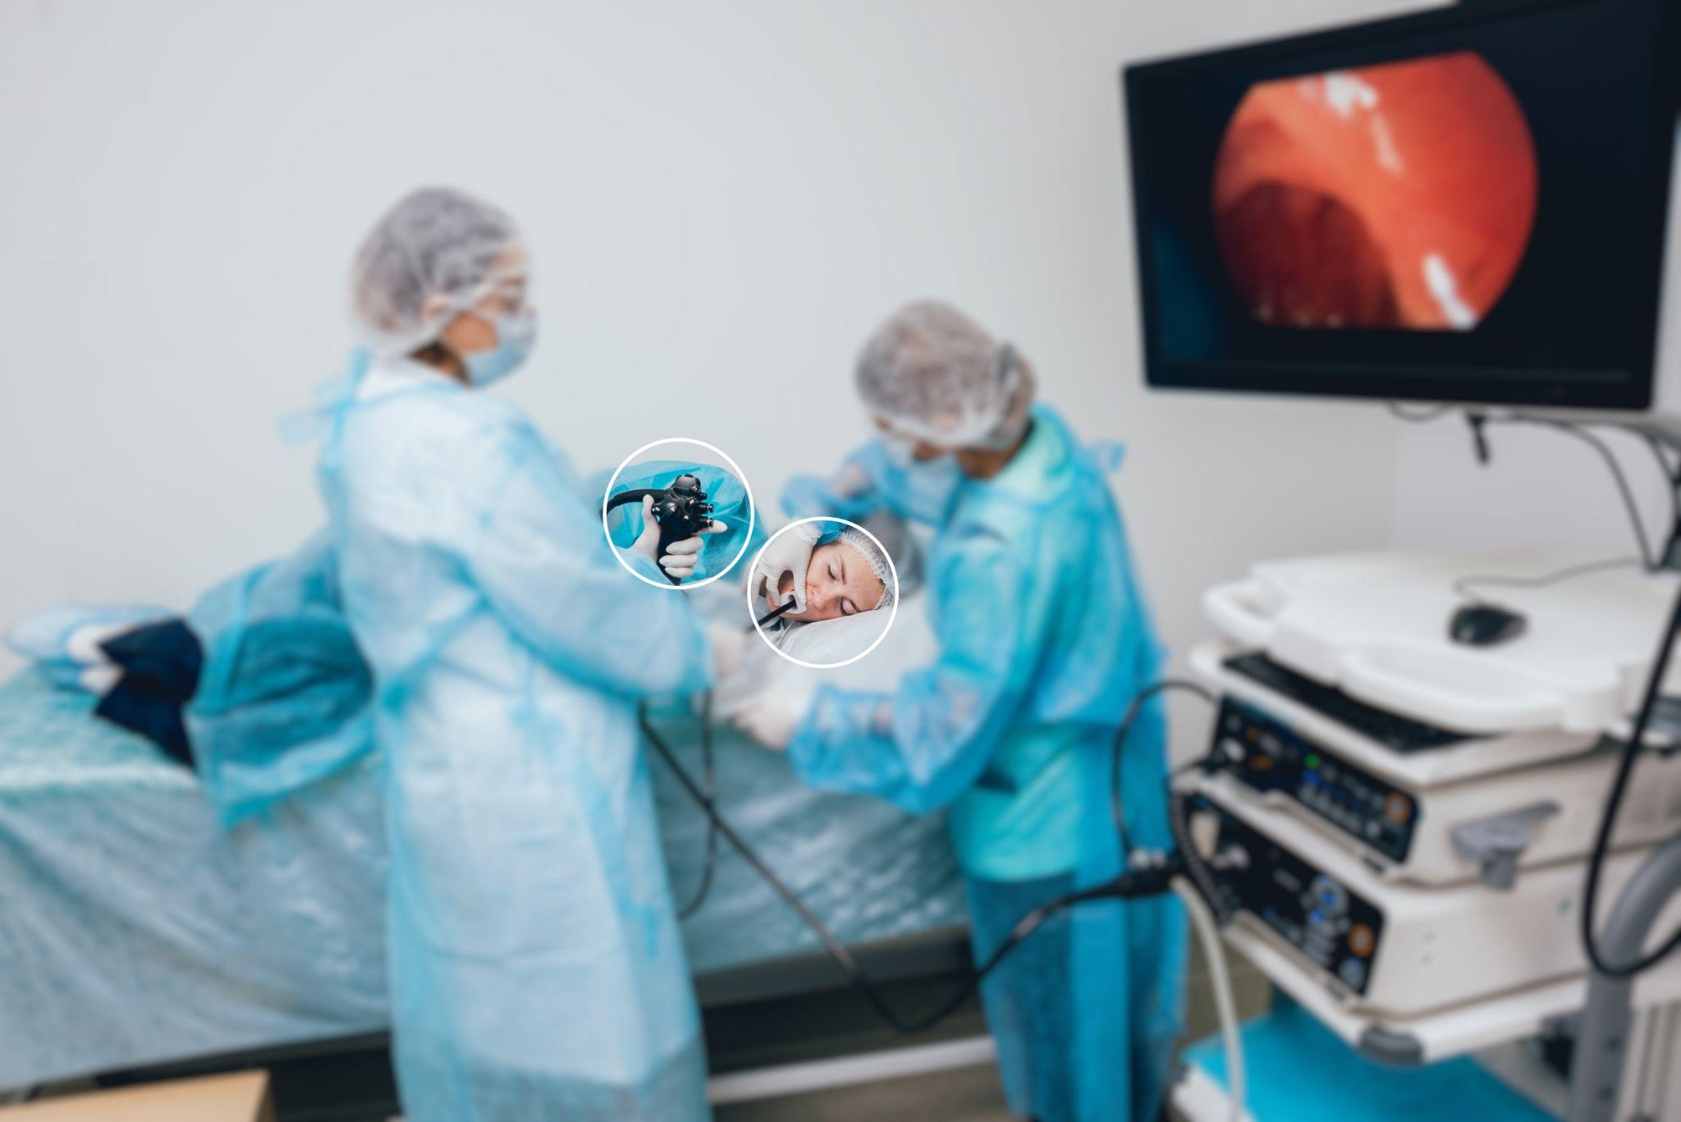
Limitations of Traditional Upper Endoscopy
Need significant infrastructure and resources for cleaning and reprocessing reusable scopes
Reusable scopes are expensive and require frequent repair
Require general
anesthesia and are not optimized for Sedation-Free TNE
Pediatric professionals
are looking for lower-risk,
sedation-free alternatives.
Notes:
Limited steering capabilities
Too wide or too short
Lack integrated air, water, and suction
Too large for patients with narrow nasal passages

Slide 4

Evidence-Based Practice Summary
Sedation-free TNE has been available and reported in the United States and around the world since 1994. Multiple studies document its safety, reliability, and ease of learning.
Studies in the pediatric population have documented reliable biopsies, increased patient safety, improved efficiency, cost/charge savings, high success rate, and high patient satisfaction
300+
Published articles
on TNE
Latest Publications
OFFICE-BASED SEDATION-FREE TRANSNASAL ESOPHAGOGASTRODUODENOSCOPY WITH BIOPSIES USING SINGLE-USE GASTROSCOPES: A PEDIATRIC SINGLE-CENTER EXPERIENCE.
Smadi Y, Thomas J, Bittar K, Norton H, Friedlander JA, Bornstein J
JPGN Reports 2023, 1-6
SAFETY AND EFFICACY OF A NOVEL ULTRATHIN GASTROSCOPE FOR UNSEDATED TRANSNASAL ENDOSCOPY IN CHILDREN AND ADULTS FOR EVALUATION OF UPPER GASTROINTESTINAL DISORDERS
Thavamani A, Ryan M, Leinwand K, Ramraj R, Schroeder A, Menard-Katcher P, Bhardwaj V, Franciosi J, Friedlander J, Sabe R
iGIE (2024)
Click Here for Additional Literature

Slide 5

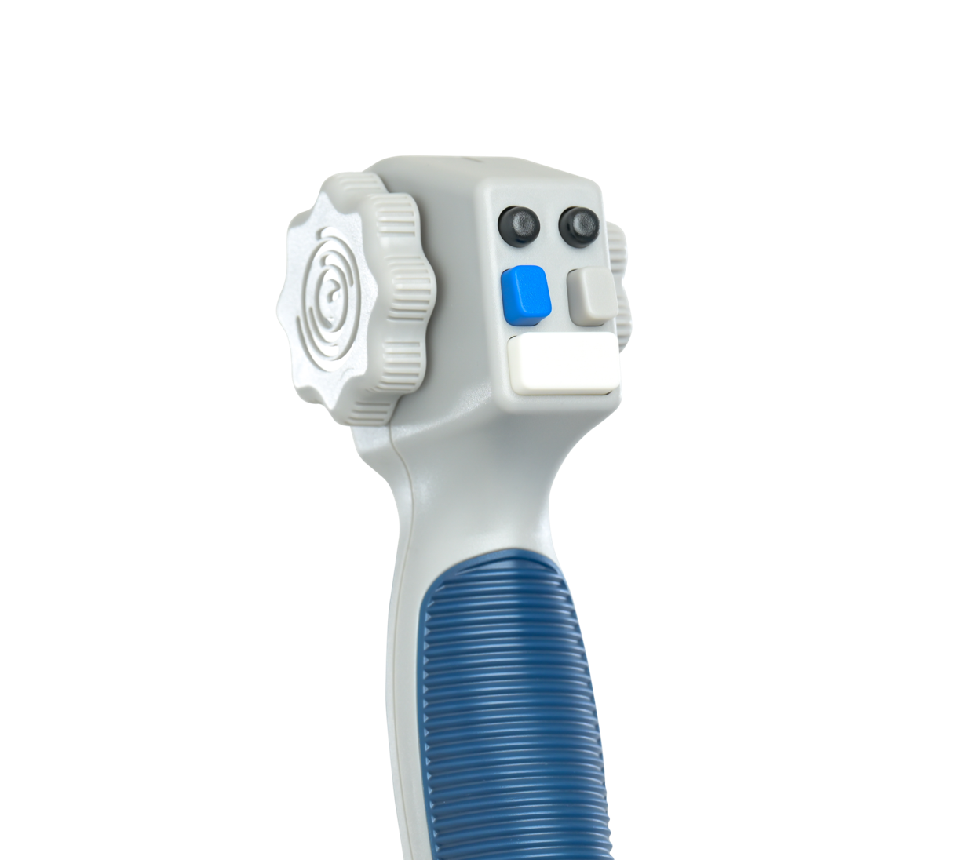
The Future of Endoscopy
Is Here
Safety
Sedation-free TNE eliminates the need for general anesthesia.
Single-use design decreases the risk of cross-contamination.
Efficiency
Reduced NPO time, no pre- or post-procedure recovery time.
A functional scope is always available, no reprocessing time is required.
Affordability
Lower up-front capital expenses.
No scope maintenance, repairs, or reprocessing costs.
The EvoEndo® System is the only FDA-cleared product designed specifically for pediatric patients, introducing a sedation-free, lower-risk, cost-effective alternative to traditional endoscopy.

Slide 6
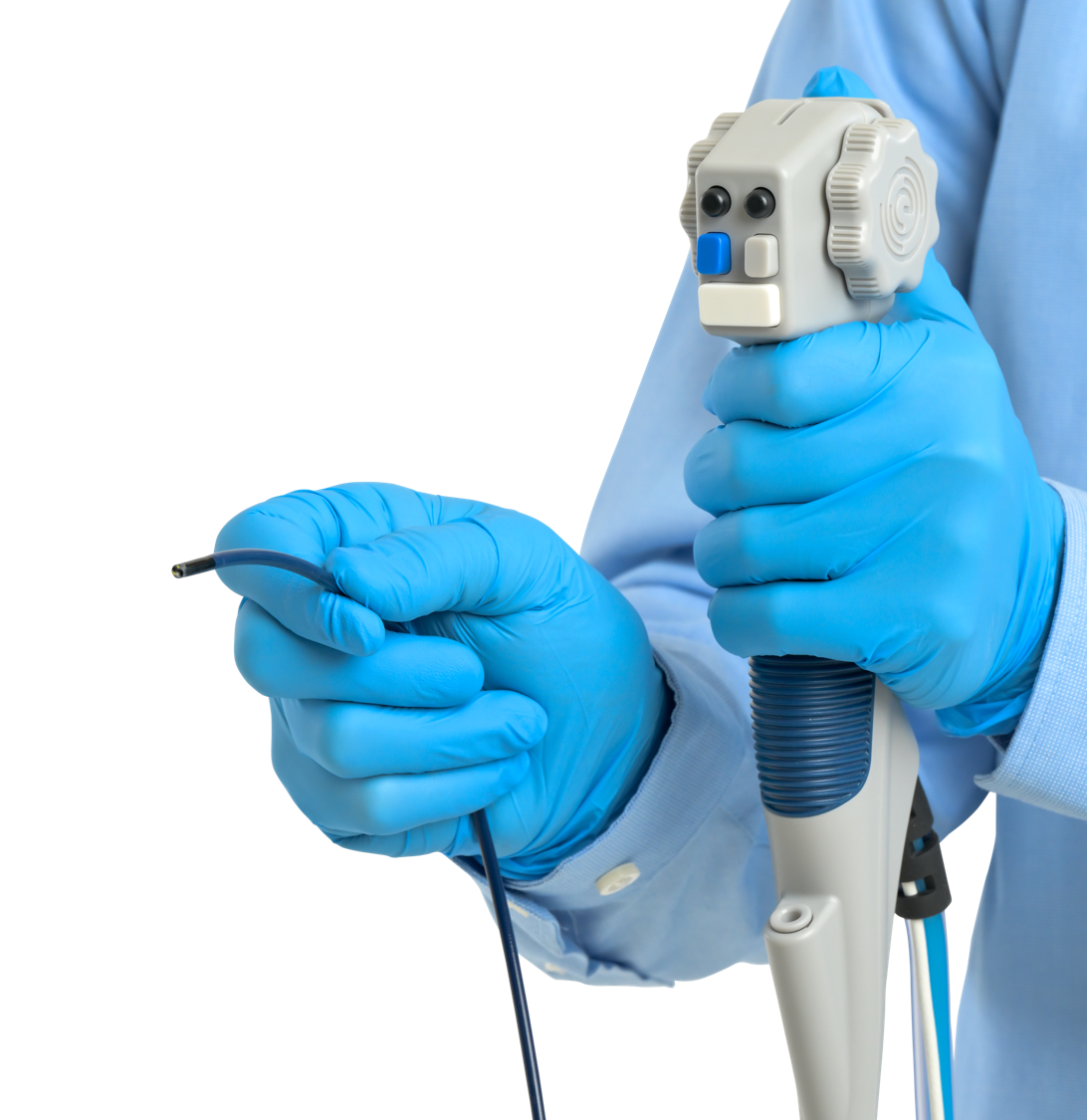
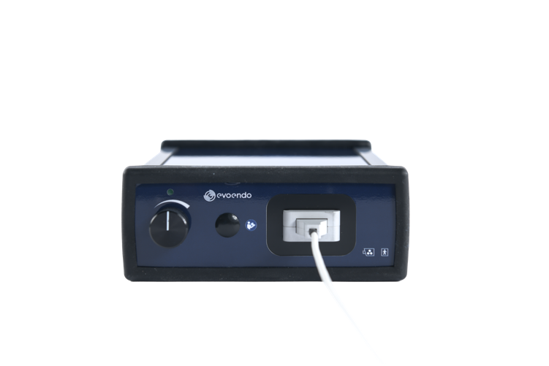
EvoEndo® Single-Use Endoscopy System
Indications for Use
The EvoEndo® Model LE Gastroscope is intended for the visualization of the upper digestive tract in adults and pediatric patients, specifically for the observation, diagnosis, and endoscopic treatment of the esophagus, stomach, and duodenal bulb in patients over the age of five. The gastroscope is a sterile, single-use device and can be inserted orally or transnasally. The EvoEndo® Controller is intended for use with an EvoEndo® Endoscope for endoscopic diagnosis, treatment, and video observation.

Slide 7
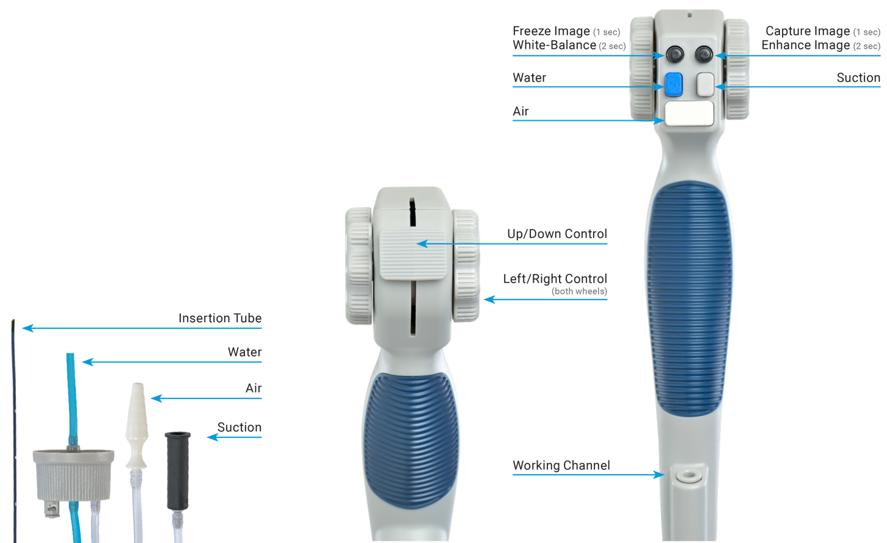
EvoEndo® Model LE Single-Use Gastroscope
Product Specifications
Narrow diameter fits smaller nasal anatomy
Enables full transnasal EGD
Accommodates most standard pediatric accessories
Reduces risk of scope cross-contamination

Slide 8
EvoEndo® Model LE Single-Use Gastroscope
Product Specifications
Optical System
Field of View | 120° Diagonal, 87.5° Horizontal
Depth of Field | 2.5 mm - 25 mm
Illumination method | LED
Insertion Portion | Fits peds/mini endo forceps
Bending section | 210° Up, 90° Down, 100° Left, 100° Right
Maximum diameter of insertion portion | 3.5 mm (0.14”)
Working length | 1.1 M (43.3”)
Channel | Optical System
Average inner diameter | 2.0 mm (0.078”)
Minimum instrument channel width | 2.0 mm (0.078”)
Connections
Air Connector | Connects to 1/4”- 3/8” supply lines
Water Connector | Connects to bottle with 1.25” top
Suction Connector | Connects to standard 6 mm suction device

Slide 9
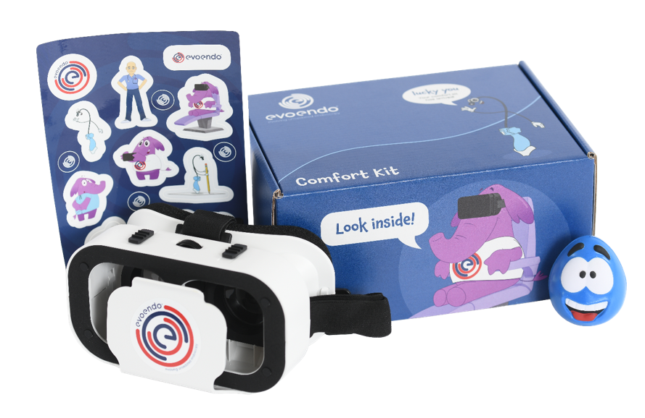
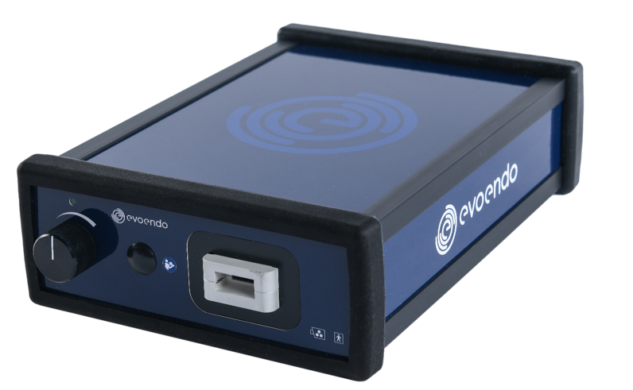
EvoEndo®
Controller
EvoEndo® Patient
Experience Kit
Lightweight and portable at 6” x 8.5”, 2 lbs
Easy to set up – plug and play
Easy to scale to multiple sites
Integrates with some third-party endoscopy reporting software (e.g., Provation)
Virtual reality patient distraction via single-use VR goggles
Stress-relief squeeze ball
Curated, age-appropriate video library at evoendo.com/youtube
© EvoEndo Inc. All Rights Reserved. The EvoEndo® Patient Experience Kit is not part of the cleared EvoEndo® System.
US: Rx Only. For use by trained physicians only. MKT-3 Rev 5.0

Slide 10





Patient Benefits
Safe
No needles, no anesthesia.
No risk of infection from cross-contamination.
Convenient
Quicker recovery.
Less fasting time, less time in clinic, less disruption.
Reduced burden on caregivers.
More frequent scoping.
Patient-Centric
Distraction techniques improve the patient experience.
Family accompanies patient during the procedure.
Visual findings can be discussed immediately.
10
© EvoEndo Inc. All Rights Reserved.
US: Rx Only. For use by trained physicians only. MKT-3 Rev 5.0
Notes:
The safety and convenience benefits of EvoEndo® Sedation-Free TNE lower barriers to care and allow patients and families to spend less time in the procedure room and more time enjoying the activities they love.

Slide 11




Healthcare Professional Benefits
Efficiency
More procedures in less time.
No waiting for scope reprocessing and repairs.
Easy to operate, small footprint, highly portable.
Improved Outcomes
Faster time to diagnosis.
Better access and fewer barriers to care for patients.
Well-tolerated by the majority of patients with a
94% - 98% success rate.^{6,8,10}
Increases patient compliance.
Risk Mitigation
Reduces complication potential related to anesthesia.
Eliminates cross-contamination risk from scope reprocessing.
11
© EvoEndo Inc. All Rights Reserved.
US: Rx Only. For use by trained physicians only. MKT-3 Rev 5.0
Notes:
EvoEndo® Sedation-Free TNE reduces the barriers to care for patients and increases access for a larger proportion of the treatment population, leading to better outcomes while improving clinician efficiency and decreasing risk.

Slide 12
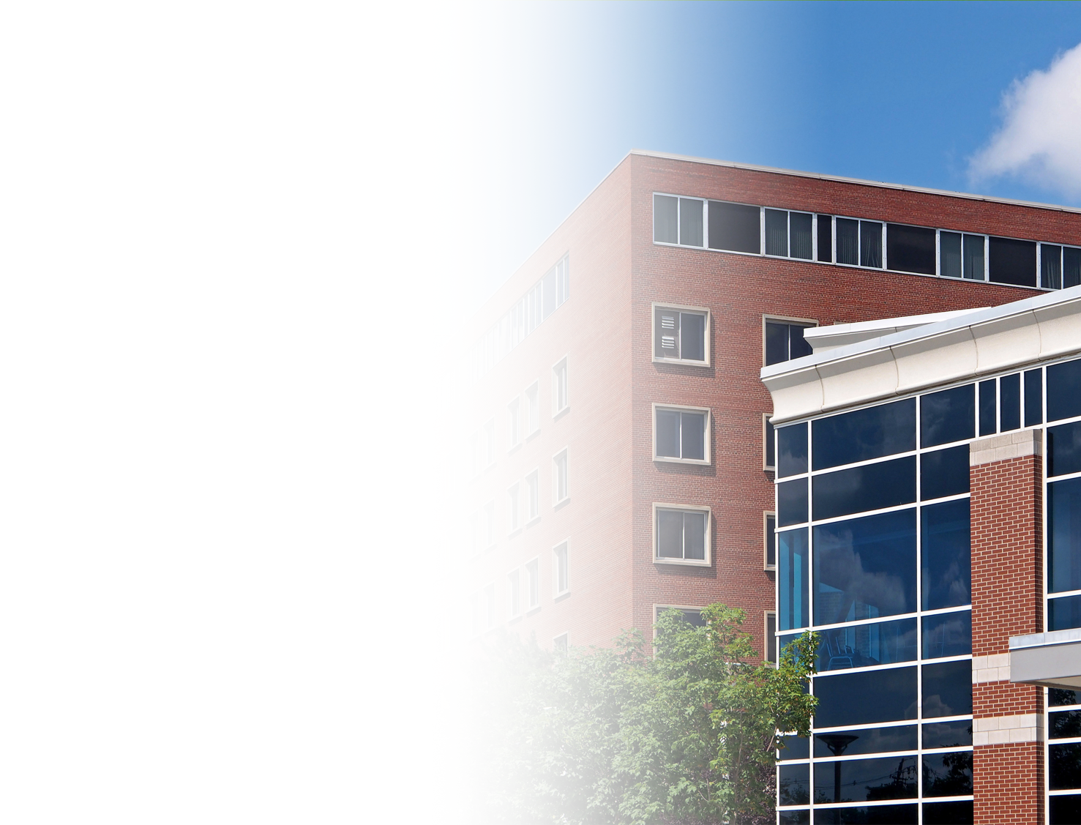



Healthcare System Benefits
Improved Economics
Adds additional revenue stream via increased procedural throughput.
Reduces total cost of ownership.
Stabilizes operational budget expenditures.
Better Resource Management
Frees up OR-based treatment areas for higher-margin procedures.
Reduces procedural backlogs.
Improves patient no-show rates by decreasing wait times.
Eliminates staff downtime for reprocessing or repair of reusable scopes.
Reduces staff required to support the same volume of procedures.
Scalability
Low capital costs and minimal start-up costs enable rapid program expansion.
System portability can transform underutilized spaces into revenue-generating procedure sites.
Notes:
The addition of EvoEndo® Sedation-Free TNE to existing GI service lines will provide new revenue opportunities and potentially make existing lines more efficient and profitable through improved resource allocation and management. These adjustments reduce patient backlogs and improve access to essential services throughout the division.

Slide 13


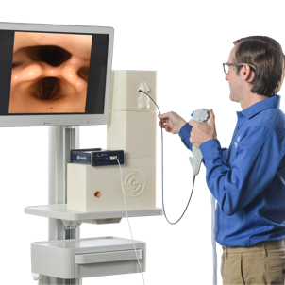
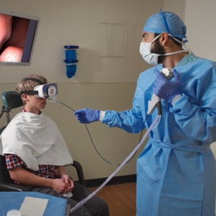
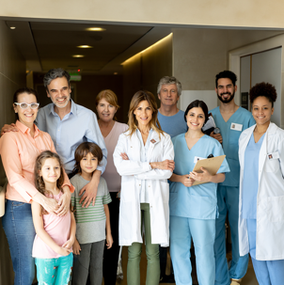
System Implementation Support
Our account management and clinical teams will be with you step by step as you integrate this technology into your practice.
Business
Planning
Implementation Planning
Program
Launch
Program
Expansion
Support Tools include FAQs, Templates, Checklists, Fact Sheets, Best Practices, and Patient Resources.

Slide 14
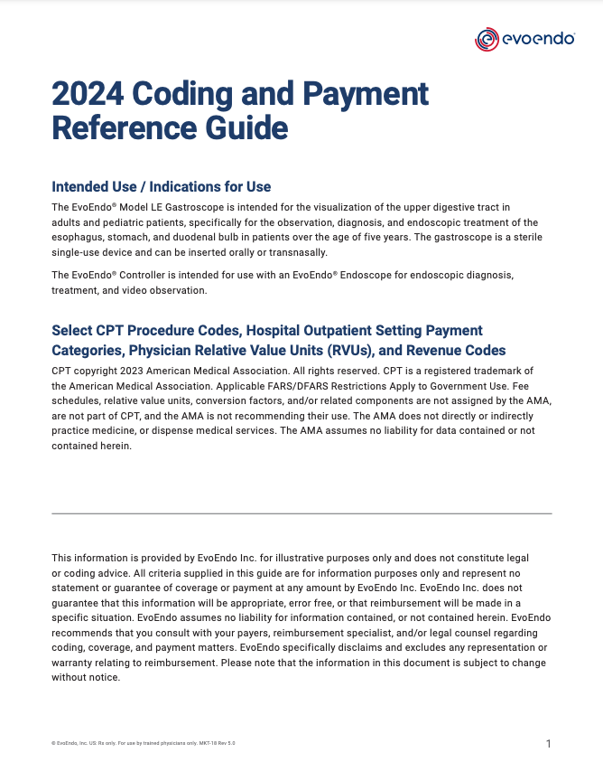
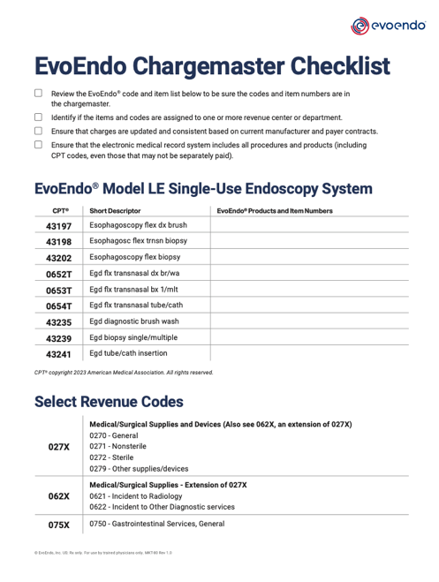
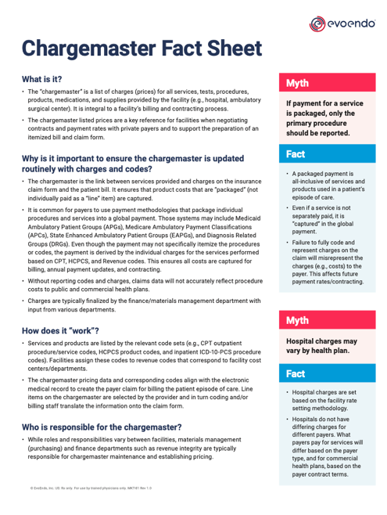
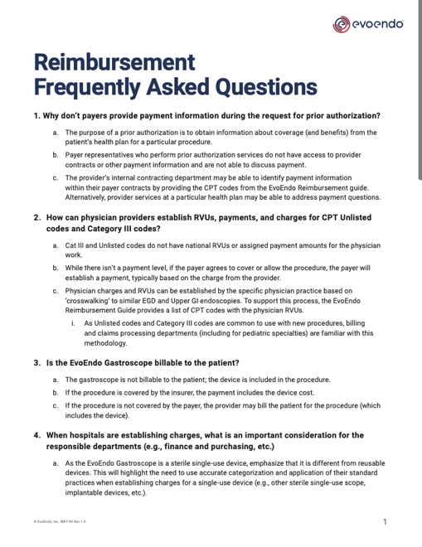
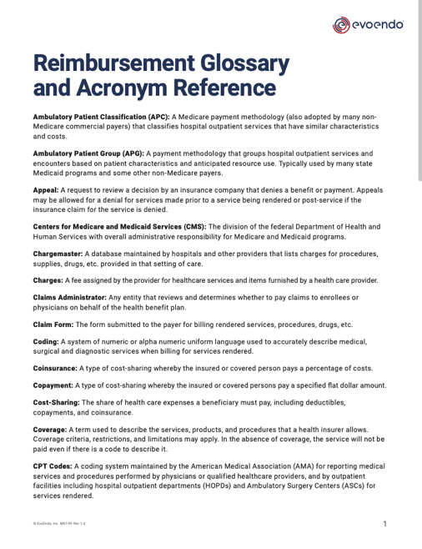
Coding and Reimbursement Support

Slide 15
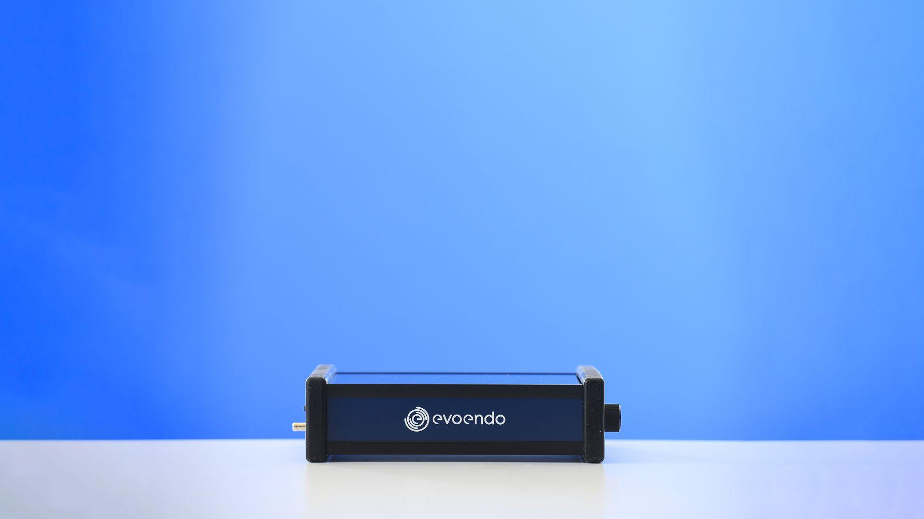



Contact Us for More Information
303.223.7445
sales@evoendo.com
303.265.9381
15
© EvoEndo Inc. All Rights Reserved.
US: Rx Only. For use by trained physicians only. MKT-3 Rev 5.0

Slide 16
Optional Additional Slides

Slide 17
Featured Literature Highlighting EvoEndo
Office-Based Sedation-Free Transnasal Esophagogastroduodenoscopy (TN-EGD) With Biopsies Using Single-Use Gastroscopes: A Pediatric Single-Center Experience
Smadi Y, Bittar K, et al. JPGN Reports, 2023: E-Pub
This study aimed to evaluate the feasibility and efficacy of office-based sedation-free transnasal esophagogastroduodenoscopy (TN-EGD) using single-use gastroscopes in pediatric patients.
https://onlinelibrary.wiley.com/doi/10.1002/jpr3.12025
Safety and Efficacy of a Novel Ultrathin Gastroscope for Unsedated Transnasal Endoscopy in Children and Adults for Evaluation of Upper Gastrointestinal Disorders
Thavamani A, Ryan M, Leinwand K, et al. iGIE, 2024: E-Pub
This study aimed to evaluate the safety and efficacy of a novel ultrathin gastroscope specifically designed for unsedated transnasal endoscopy, with a particular focus on its application in both pediatric and adult populations presenting with various upper GI conditions.
https://www.researchgate.net/publication/376790857_Safety_and_Efficacy_of_a_Novel_Ultrathin_Gastroscope_for_Unsedated_Transnasal_Endoscopy_in_Children_and_Adults_for_Evaluation_of_Upper_Gastrointestinal_Disorders
Proof of Concept Functional Endoscopic Esophageal Evaluation of Swallowing (FEEES) Using Unsedated Transnasal Endoscopy
Friedlander JA, Smith C, Nguyen N, et al. JPGN 2024, E-Pub
This case report investigates the feasibility of Functional Endoscopic Esophageal Evaluation of Swallowing (FEEES) using unsedated TNE, particularly focusing on its application in a 14-year-old male diagnosed with Type 2 Achalasia and Eosinophilic Esophagitis (EoE).
https://onlinelibrary.wiley.com/doi/10.1002/jpn3.12154
A Guide on Transnasal Endoscopy: Setting Up a Pediatric Unsedated Endoscopy Program
Friedlander JA, Leinwand K, Bhardwaj V, Nguyen N
Front Pediatrics. 2024 Jan 16;11:1267148
This study provides a comprehensive guide for establishing a pediatric sedation-free endoscopy program, to address the growing interest in TNE within the pediatric gastroenterology community.
https://www.frontiersin.org/articles/10.3389/fped.2023.1267148/full

Slide 18
Office-Based Sedation-Free Transnasal Esophagogastroduodenoscopy (TN-EGD) With Biopsies Using Single-Use Gastroscopes: A Pediatric Single-Center Experience
Smadi Y, Bittar K, et al. JPGN Reports, 2023: E-Pub.
https://onlinelibrary.wiley.com/doi/10.1002/jpr3.12025
HIGHLIGHTS
CONCLUSION
Office-based sedation-free TN-EGD with VR distraction using single-use gastroscopes proved effective and safe for monitoring EoE, gastritis, and duodenitis in pediatric patients. The procedure had high completion rates, minimal adverse events, and favorable patient preference over sedated EGD. Moreover, it allowed for comprehensive assessment and sampling, enhancing diagnostic capabilities.
This approach offers potential cost savings by reducing the need for sedation and anesthesia, as well as optimizing patient experience by eliminating associated risks and providing a more efficient outpatient experience. The successful implementation of TN-EGD in this study suggests its viability for broader application in pediatric endoscopy and highlights the importance of continued exploration of innovative techniques to improve patient care.
Type of Study | Case Series
Location | Outpatient Clinic Office
Proceduralist | Expert Endoscopist, new to TNE
# of Subjects | 8 with Eosinophilic Esophagitis Undergoing First Time TNE
Ages | 11-20 years, (6 males 2 females)
Procedure Performed | TN-EGD (n=7) TN-EG (n=1) with Brushing, Disaccharidases, Aspirate, and/or Biopsies (All Adequate)
Completion Rate | 100% EG, 87.5% EGD
Adverse Events | All Grade 1 or lower. 25% scant vomiting
Average Duration in Office | 65 min (+/- 7 min)
Patient Preference | 7/8 Preferred TN-EGD over Sedated Procedure

Slide 19
Proof of Concept Functional Endoscopic Esophageal Evaluation of Swallowing (FEEES) Using Unsedated Transnasal Endoscopy
Friedlander JA, Smith C, Nguyen N, et al. JPGN 2024, E-Pub.
https://onlinelibrary.wiley.com/doi/10.1002/jpn3.12154
HIGHLIGHTS
CONCLUSION
This case report serves as compelling evidence for the feasibility and safety of employing unsedated Transnasal Endoscopy (TNE) for Functional Endoscopic Esophageal Evaluation of Swallowing (FEEES). The absence of adverse events confirms the safety profile of this approach, suggesting it as a viable alternative to traditional sedated procedures. While the study underscores the potential utility of TNE in functional assessment of esophageal motility, further research is important to fully comprehend its clinical implications. Future investigations should aim to elucidate the precise diagnostic capabilities of TNE in managing various esophageal disorders, ultimately optimizing its integration into clinical practice for enhanced patient care and improved treatment outcomes.
Type of Study | Case Report
Location | Hospital Outpatient Clinic
Proceduralist | Expert TNE Endoscopist
Subject | 14-year-old male with Type 2 Achalasia and EoE
Procedure | TNE with Functional Motility Evaluation (FEEES)
Adverse Events | None
Results | TNE can be used as tool for functional evaluation of esophageal motility, future research is needed

Slide 20
Safety and Efficacy of a Novel Ultrathin Gastroscope for Unsedated Transnasal Endoscopy in Children and Adults for Evaluation of Upper Gastrointestinal Disorders
Thavamani A, Ryan M, Leinwand K, et al. iGIE, 2024: E-Pub
https://www.researchgate.net/publication/376790857_Safety_and_Efficacy_of_a_Novel_Ultrathin_Gastroscope_for_Unsedated_Transnasal_Endoscopy_in_Children_and_Adults_for_Evaluation_of_Upper_Gastrointestinal_Disorders
HIGHLIGHTS
CONCLUSION
The study emphasizes the safety and efficacy of the novel ultrathin gastroscope for unsedated TNE, positioning it as a valuable alternative for the evaluation of upper GI disorders in both pediatric and adult populations. With a high completion rate and minimal adverse events, this approach offers potential benefits in terms of patient comfort and maintains high diagnostic accuracy. The findings suggest that incorporating this device into clinical practice could enhance patient experience and improve diagnostic outcomes, thereby contributing to more effective management strategies for upper GI disorders.
Type of Study | Multi-Center Retrospective Case Series
Location | 7 Medical Centers (6 Pediatric, 1 Adult)
Proceduralist | Establish TNE proceduralist, new to EvoEndo Device
# of Subjects | 53 Subjects with EoE (n=51) Esophageal Varices (n=2)
Ages | 6-37 years, (45 males 8 females), 18 subjects naïve to TNE, 35 had undergone TNE prior
Procedure Performed | TN-Esophagoscopy (n=3) TN-EG (n=42), or TN-EGD (n=4) with or without Biopsies (All Adequate)
Completion Rate | 94.3% Completion Rate (n=50/53, 1 subject was removed from cohort as procedure was not started)
Adverse Events | All Grade 1 or lower. 9.4% Adverse Events (2 epistaxis, 2 sore nose, 1 gag
Average Duration in Office | 33.5 (+/-=7.2 min, n=18)

Slide 21
A Guide on Transnasal Endoscopy:
Setting Up a Pediatric Unsedated Endoscopy Program
Friedlander JA, Leinwand K, Bhardwaj V, Nguyen N
Front Pediatrics. 2024 Jan 16;11:1267148
https://www.frontiersin.org/articles/10.3389/fped.2023.1267148/full
HIGHLIGHTS
CONCLUSION
Establishing a pediatric unsedated endoscopy program presents a valuable opportunity to enhance patient care, minimize the risks associated with anesthesia, and reduce healthcare costs. The guide provided in this study serves as a comprehensive resource for pediatric gastroenterologists aiming to implement sedation-free TNE into their practice. By addressing key considerations such as unit setup, staffing, equipment selection, financial planning, and training requirements, pediatric healthcare providers can effectively establish and manage successful TNE programs, thereby improving accessibility and quality of care for pediatric patients with gastrointestinal disorders.
Type of Study | Comprehensive Expert Review
Purpose | Review history of TNE, possible layout of TNE units, distraction and analgesia methods, staffing/credentialing needs, supply lists, endoscopy equipment, current and forthcoming technologies, financial and business concepts, coding considerations and training methods.
Discussion and Importance of Manuscript | Pro/cons of various equipment and style of TNE units and Program

