Slide 1
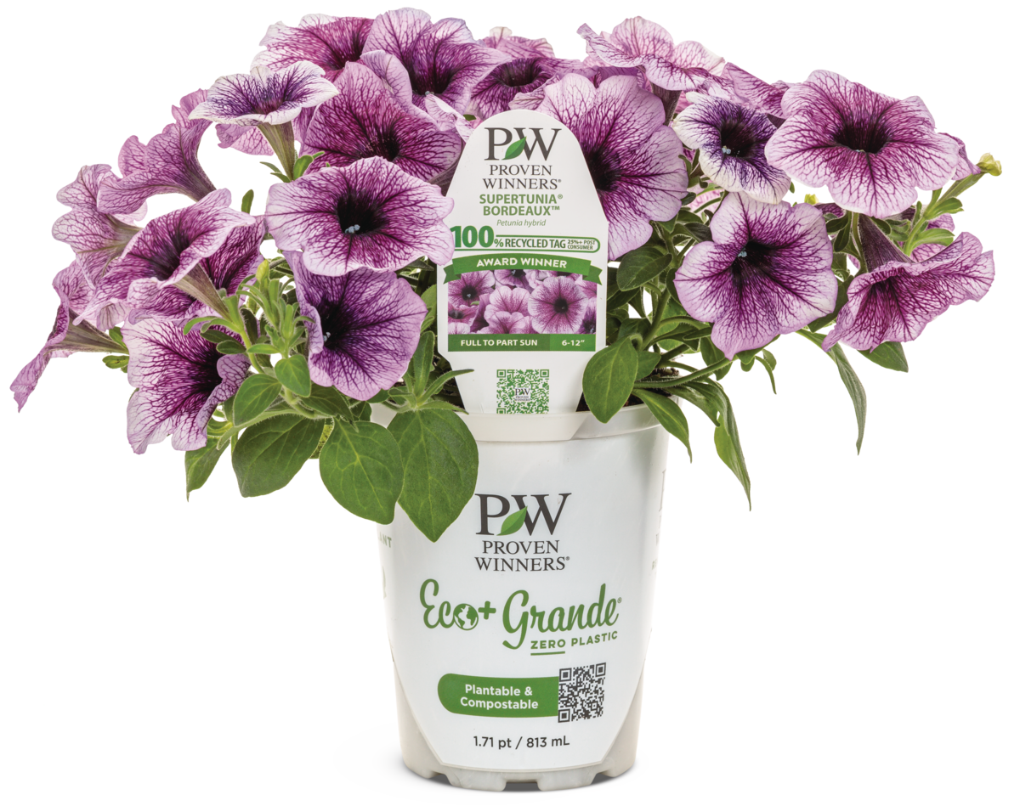
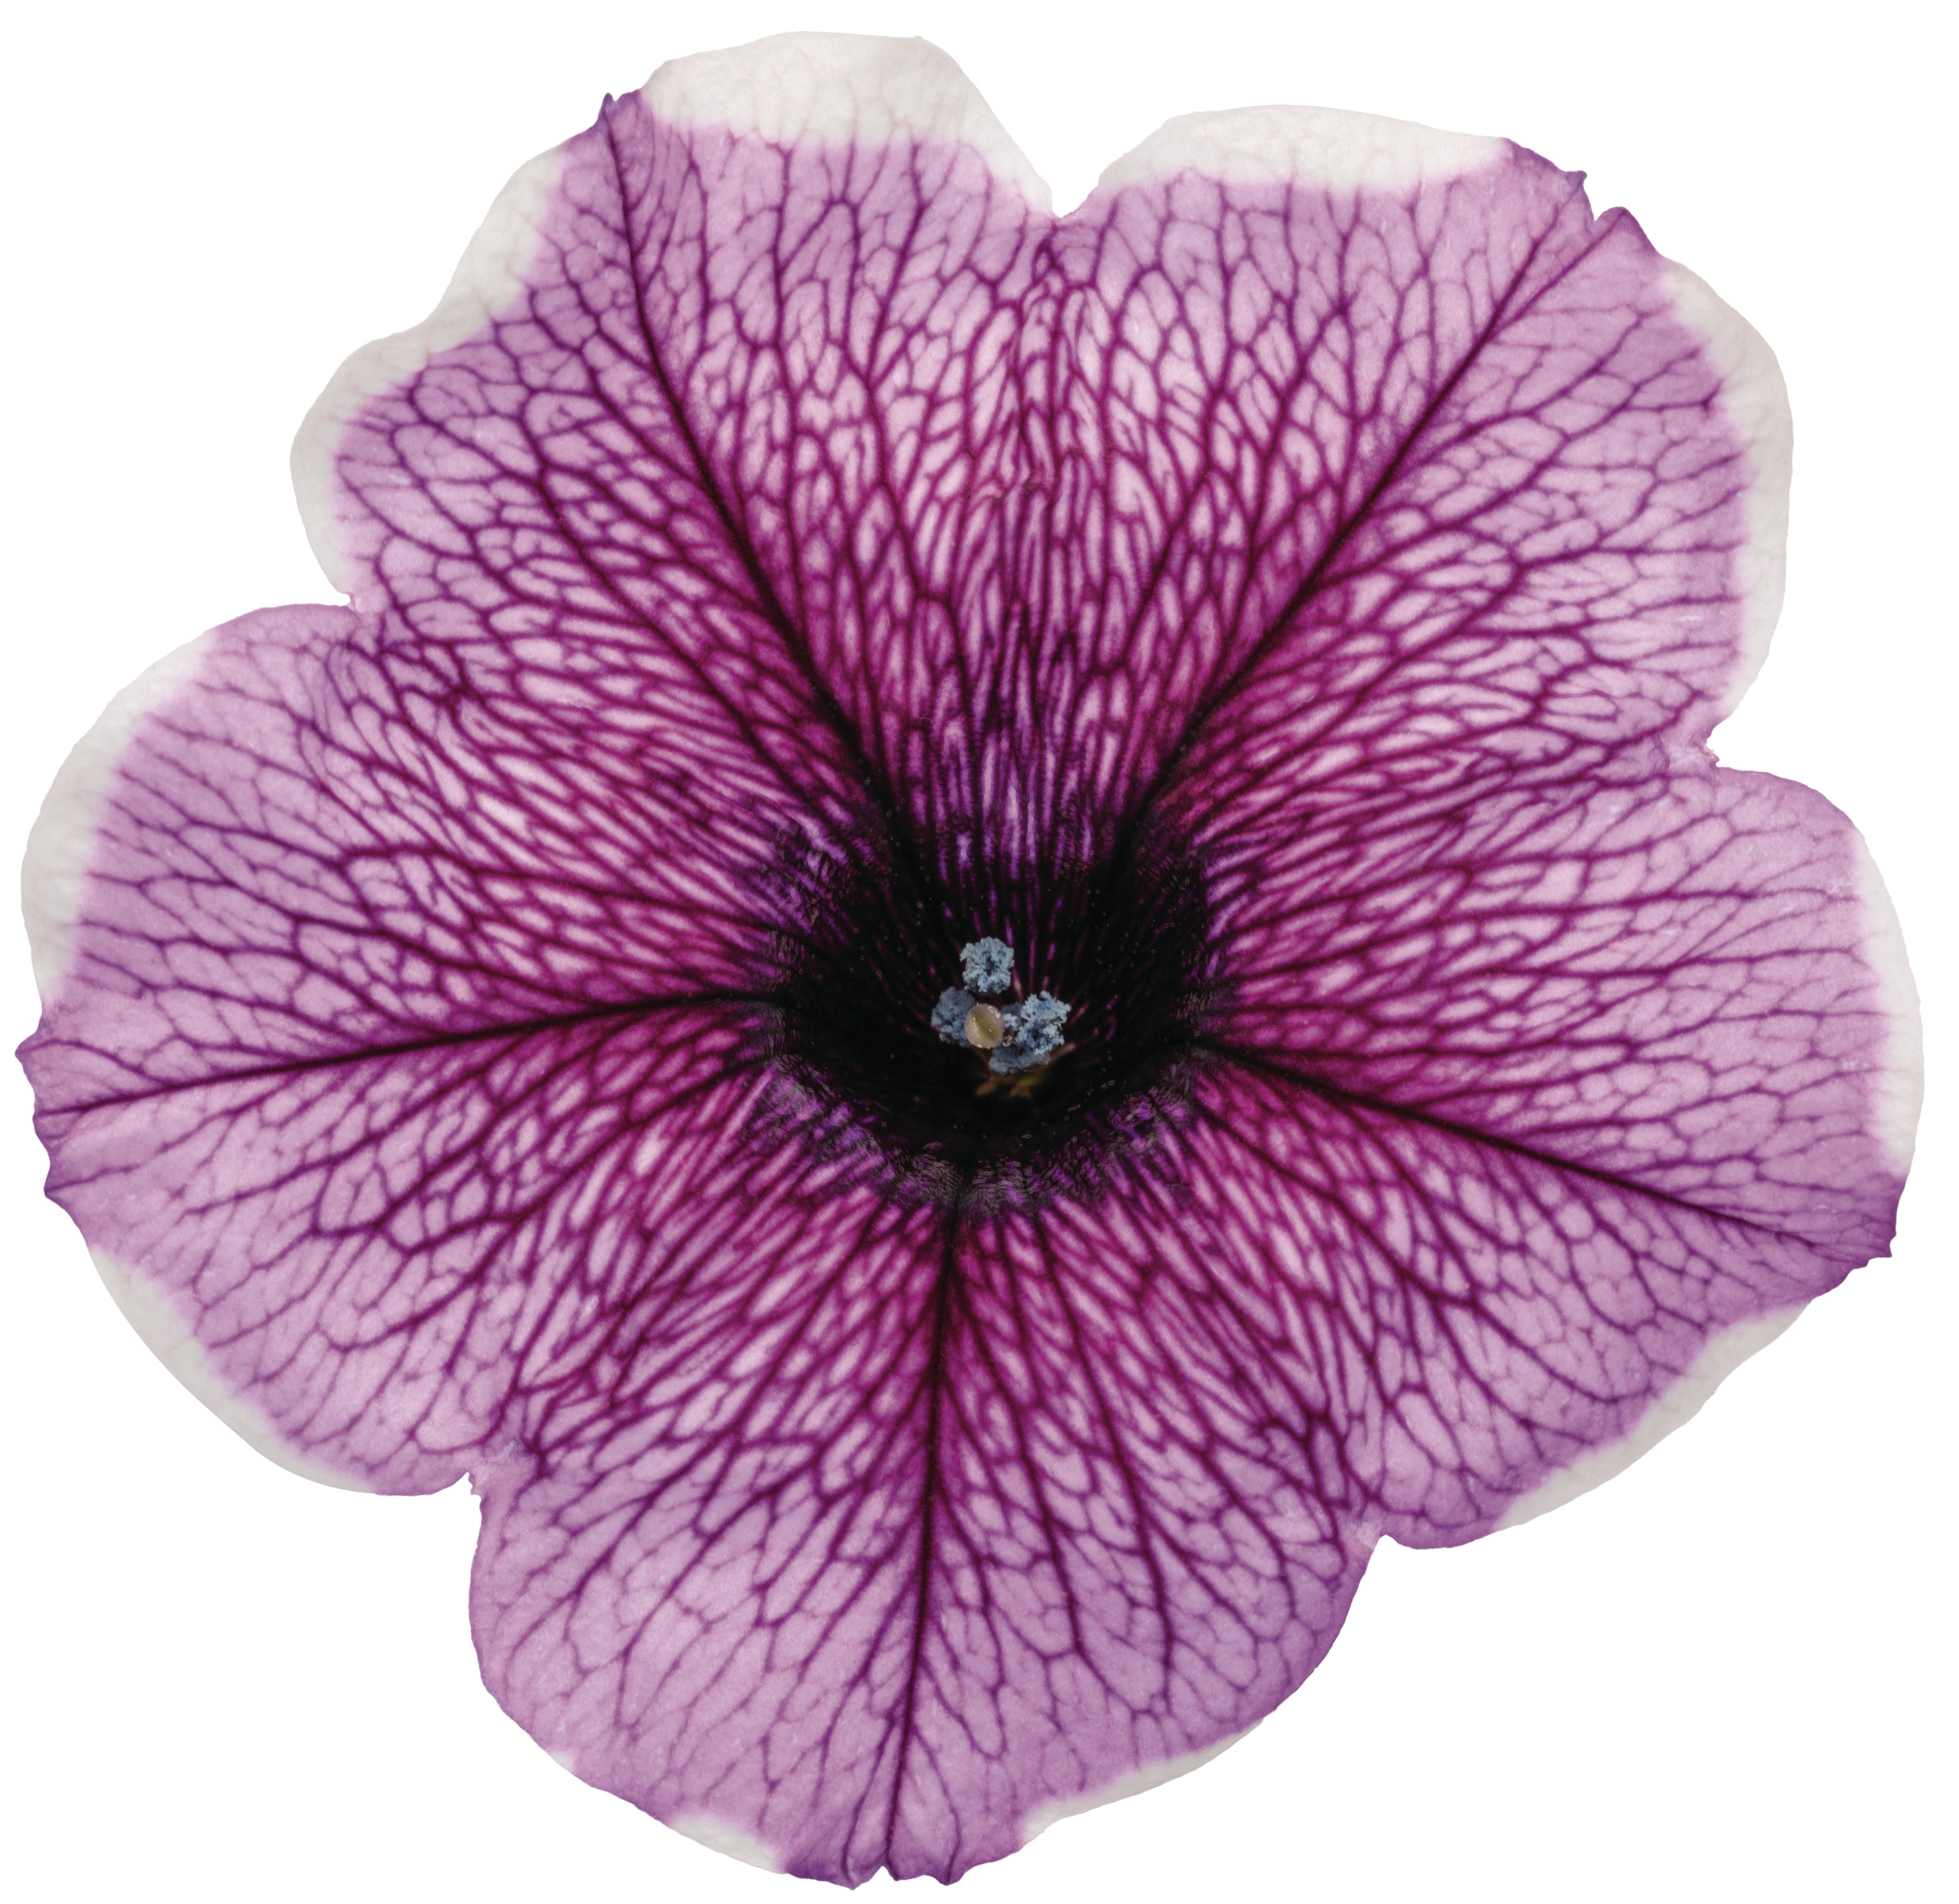

Supertunia® Bordeaux™ Improved
New for the 2025-2026 Season
provenwinners.com

Slide 2
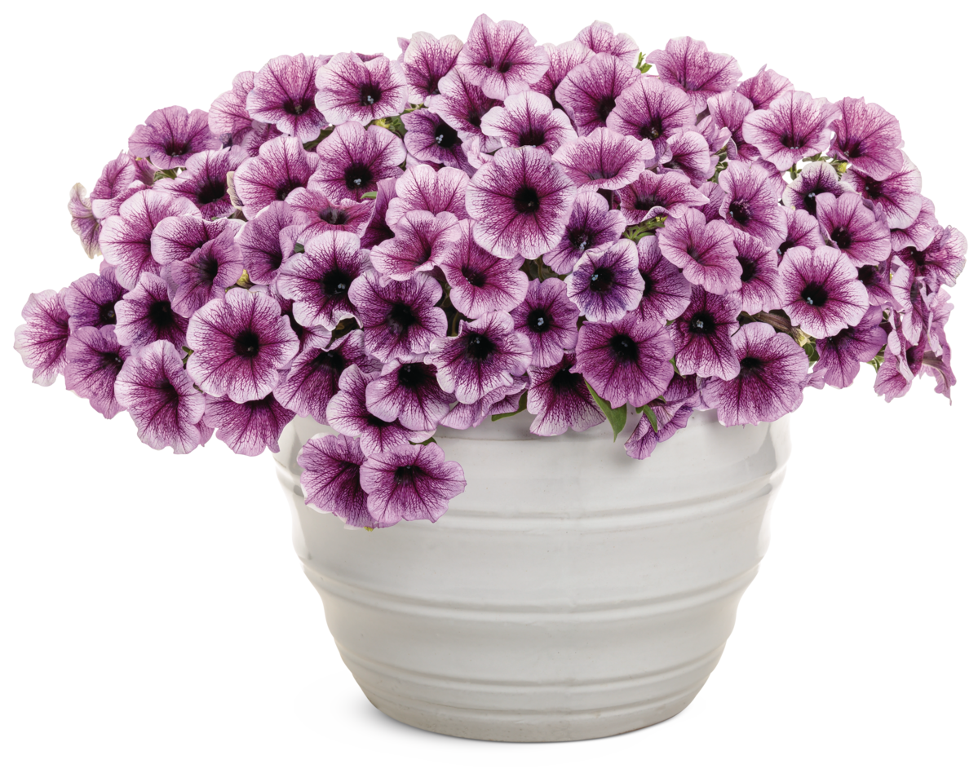
Supertunia® Bordeaux™
Improved Petunia
The Goal of Greater Consistency.
Over the last couple of years, we have seen some variabilities with the performance of Supertunia® Bordeaux™, including foliar distortion and blind shoots as well as funneled flowers.
While we worked diligently to minimize impacts to our grower and retailer customers, given the importance of this variety, we know some were frustrated and have been asking for an improvement.

Slide 3
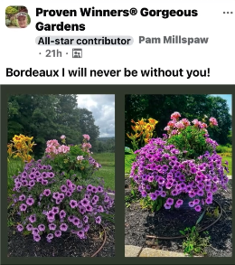
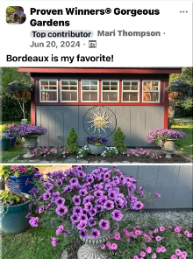
Supertunia® Bordeaux™
Improved Petunia
Supertunia® Bordeaux™
Improved Petunia
Outstanding Garden Performance
Like many Proven Winners® annuals, Supertunia® Bordeaux™ is a variety that consumers request by name and share widely on social media.
Supertunia® Bordeaux™ Improved has been tested over multiple years, confirming strong grower production performance, retail appeal, and most importantly, outstanding garden performance for consumers.
02 / Outstanding Garden Performance

Slide 4
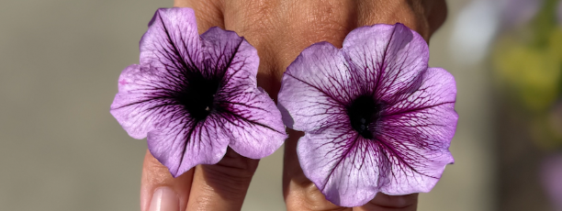
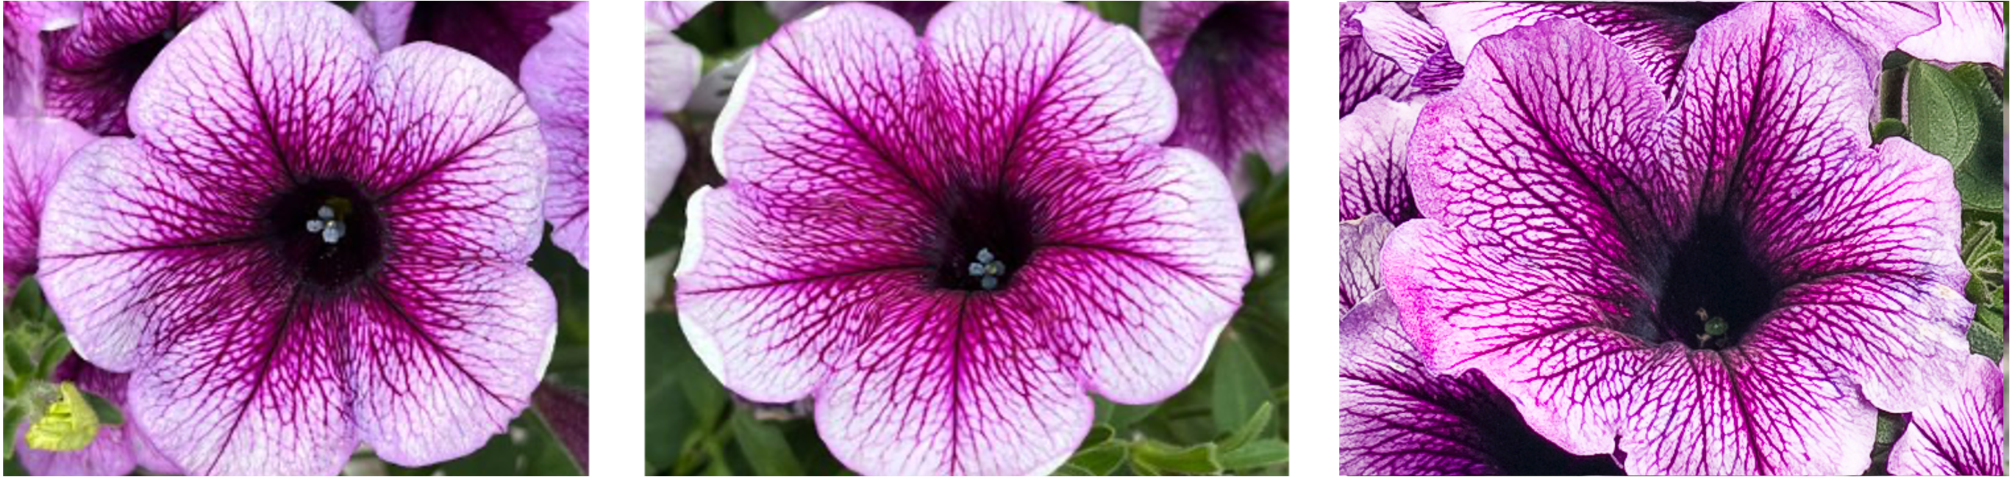
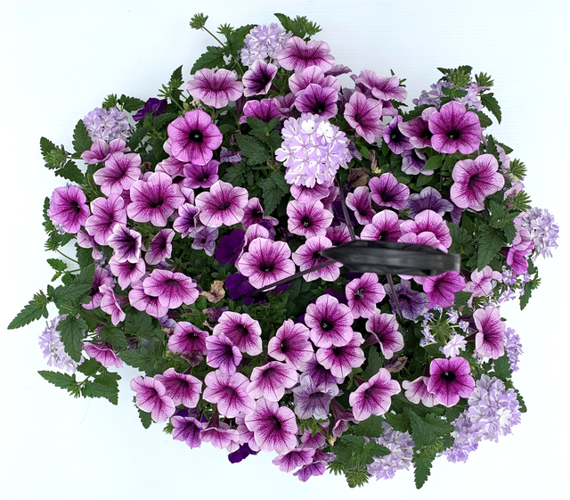
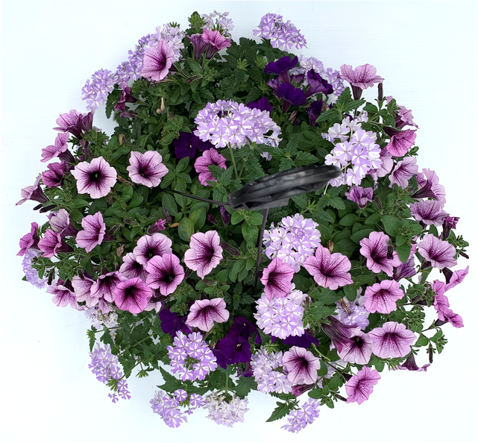
Supertunia® Bordeaux™
Improved Petunia
Better Overall Performance
Left: Supertunia® Bordeaux™ Improved | Right: Supertunia® Bordeaux™
This new introduction has dramatically increased genetic stability, resolving the somaclonal variation issues previously seen in the original variety and allowing for greater consistency across the supply chain.
Supertunia® Bordeaux™ Improved bears slightly lighter lavender blooms than the original variety, but with the same dark throat and veining. Sometimes, the flowers of Supertunia Bordeaux Improved will be accented by a faint white picotee margin.
The similar flower color and pattern, combined with the improved overall plant performance, makes Supertunia® Bordeaux™ Improved an easy swap in existing recipes and single container production.
Left and center: Supertunia® Bordeaux™ Improved | Right: Supertunia® Bordeaux™
Left: Supertunia® Bordeaux™ Improved | Right: Supertunia® Bordeaux™

Slide 5
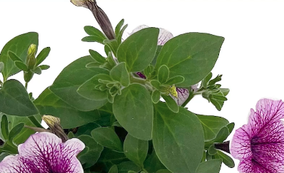
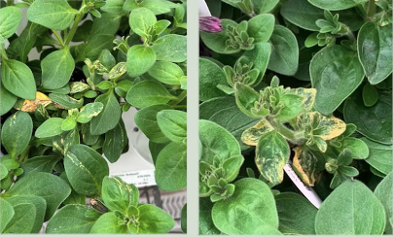
Supertunia® Bordeaux™
Improved Petunia
Key Improvements
  Earlier to flower
  More consistent flowering
  Better branching and habit
  Easier growth control
  Eliminates foliar issues
Top: Supertunia® Bordeaux™ Improved | Bottom: Supertunia® Bordeaux™

Slide 6
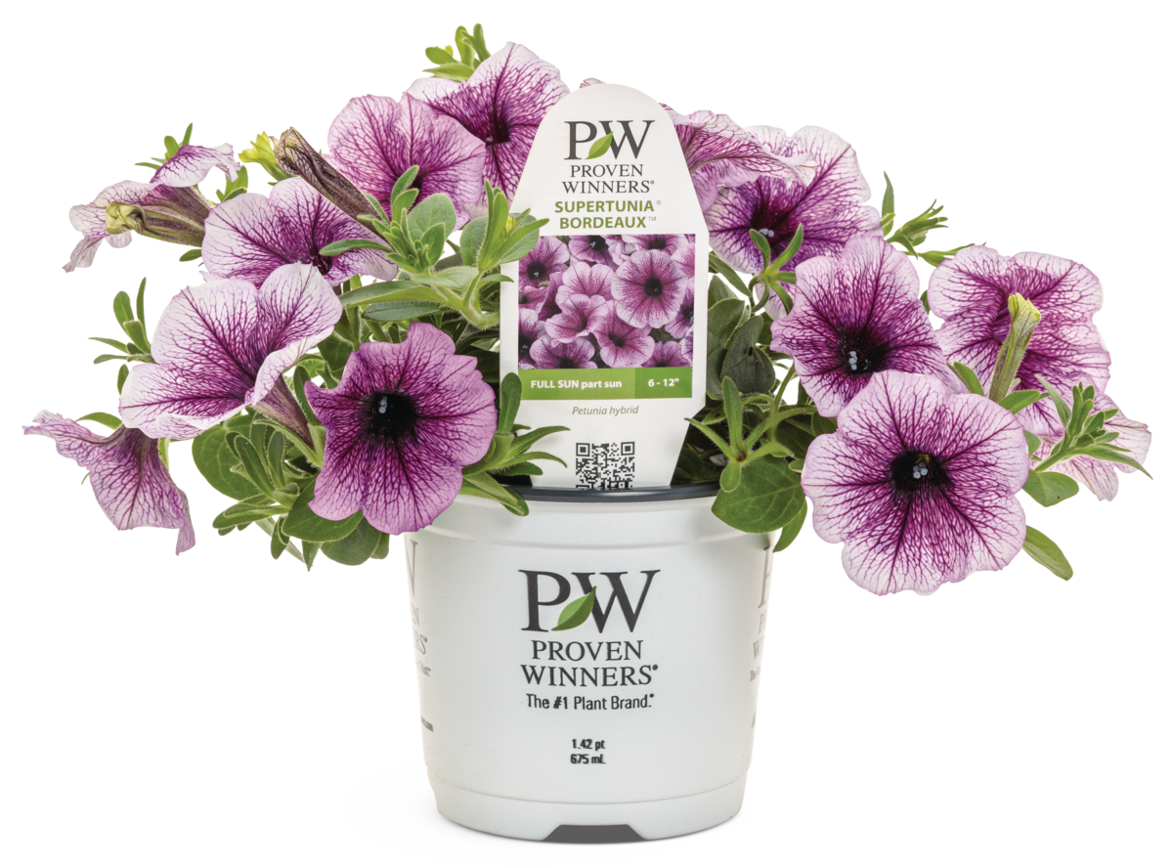
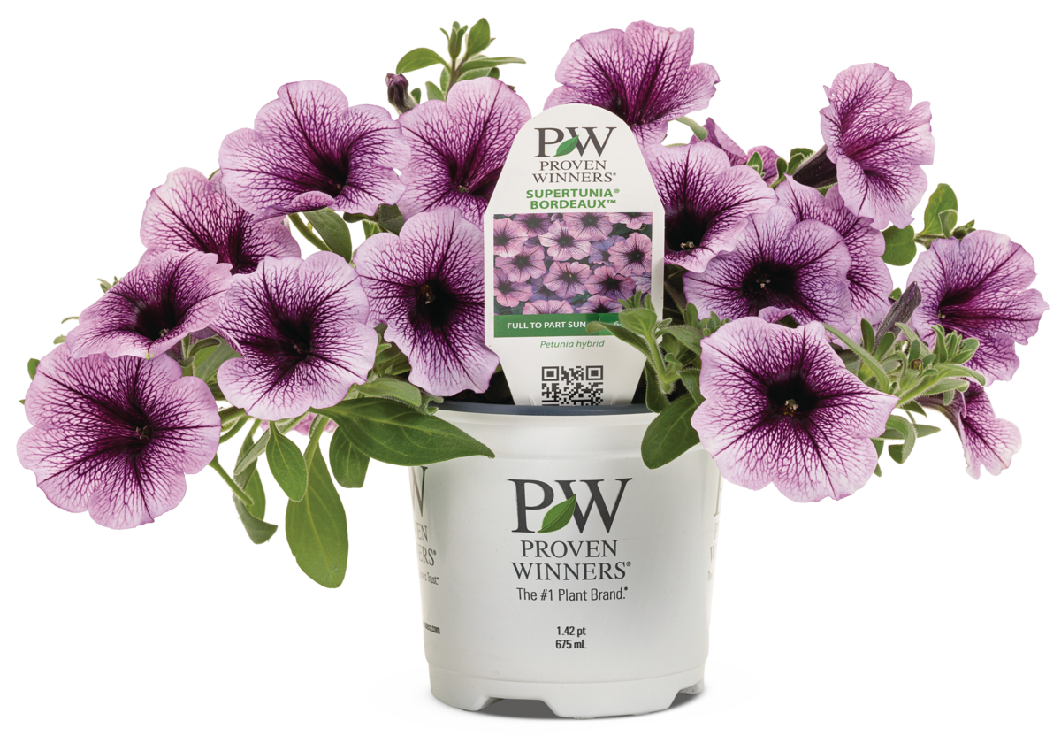
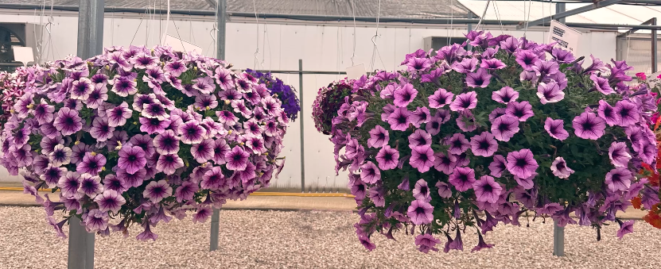
Supertunia® Bordeaux™
Improved Petunia
Improved Flower Coverage
Left: Supertunia® Bordeaux™ Improved | Right: Supertunia® Bordeaux™
Supertunia® Bordeaux™ Improved has enhanced branching and a tighter, more balanced habit, resulting in a fuller plant that looks great in Grande or Classic containers, monoculture plantings and container recipes.
Left: Supertunia® Bordeaux™ Improved | Right: Supertunia® Bordeaux™

Slide 7
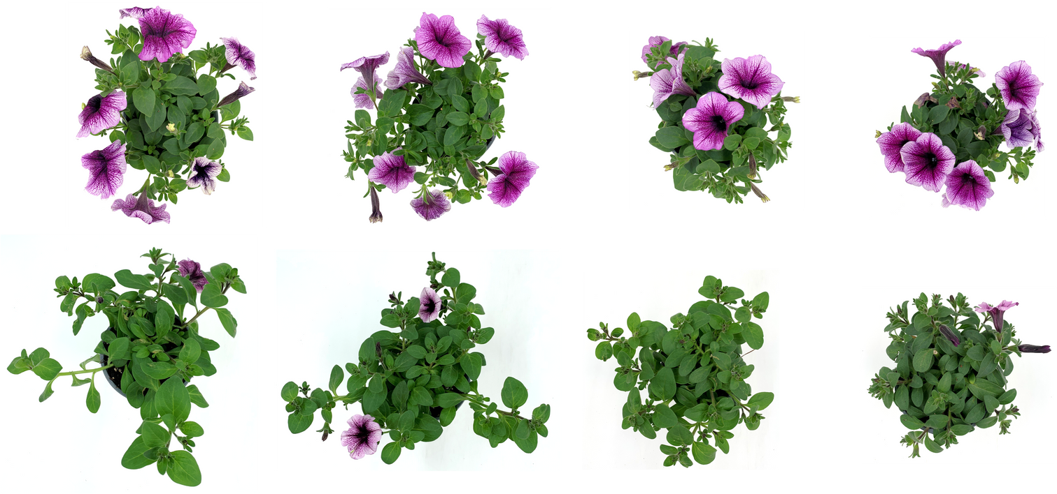
Supertunia® Bordeaux™
Improved Petunia
Easier Growth Control
Supertunia® Bordeaux™ Improved is earlier to flower, better branched, and more heavily flowered than the original, providing strong floral presence during the critical retail sales window.
No PGR
Bonzi 2.5 ppm
Bonzi 5 ppm
Bonzi 10 ppm
Top: Supertunia® Bordeaux™ Improved | Bottom: Supertunia® Bordeaux™
Photos taken week 20 at four weeks old using standard liners.

Slide 8
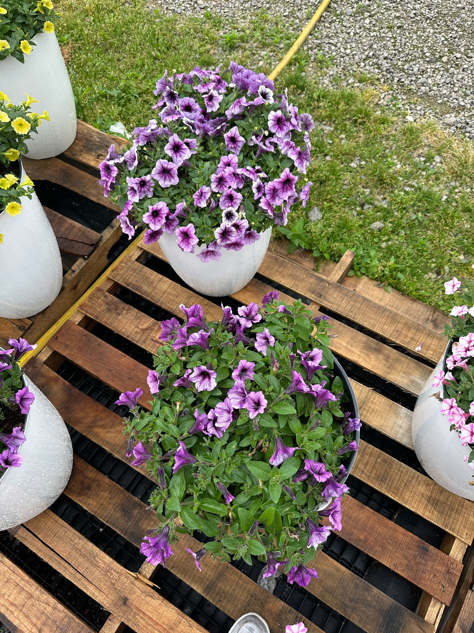
Supertunia® Bordeaux™
Improved Petunia
Weather Tolerance & Durability
Supertunia® Bordeaux™ Improved has superior weather tolerance and improved petal substance.
This ensures that flowers maintain vibrant color and presentation even after heavy rainfall, providing consistent retail appeal and reliable garden performance.
Top: Supertunia® Bordeaux™ Improved | Bottom: Supertunia® Bordeaux™
Image taken immediately after a downpour.

Slide 9
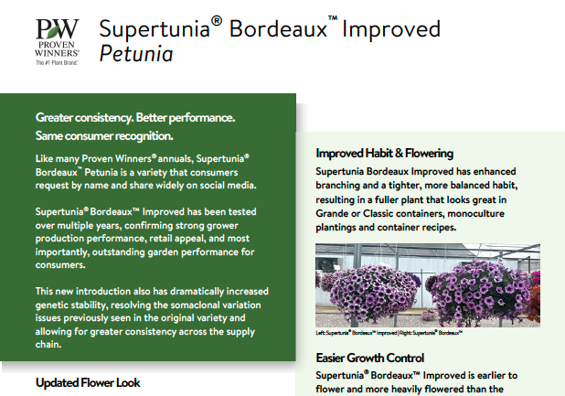
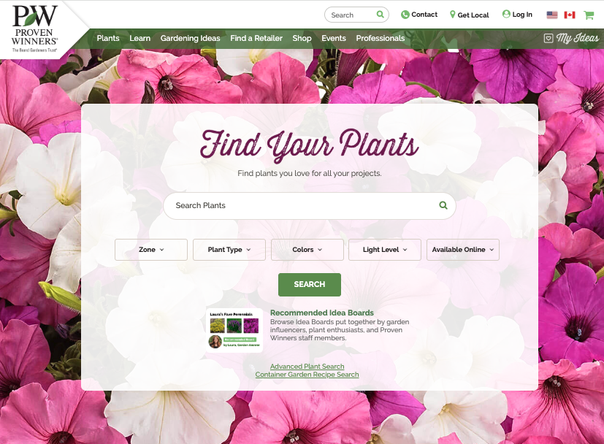

Supertunia® Bordeaux™
Improved Petunia
Additional Resources:
Click to Download PDF
Visit our Website
Click to View Video

