Slide 1
04/23
The Transamerica Final Expense Solutions Portfolio
For Agent Use Only. Not for Use With the Public.
133508R4
Notes:
Welcome to the Transamerica presentation on our Final Expense Solutions Portfolio. All three policies provide fast, easy protection that will be there when your clients’ loved ones need it most.

Slide 2
IMPORTANT INFORMATION FOR PRESENTER
This presentation is the property of Transamerica and its affiliates. By delivering the presentation, you acknowledge that it cannot be altered, edited or reproduced in any way. You further understand you may not misrepresent the information in this presentation or deviate from its approved content.
For Agent Use Only. Not for Use With the Public.
Notes:
You deserve to work with a company that is responsive and strives to inspire the growth of your business in creative and innovative ways. Transamerica is committed to you and your success, and there are a few things that set us apart.
People are living longer lives, and the quality they expect from those years is making a big impact on their financial security. We’ve been helping people feel better about the future for more than 100 years. We’re proud of the trust we’ve earned from the families we’ve helped protect. One generation to the next.
We’re a highly rated carrier.
We also offer a wide portfolio of offerings to meet customers’ needs, including the lifetime permanent protection of the Final Expense Solutions Portfolio. It can help provide clients with a sense of security that comes from knowing their loved ones will have one less thing to worry about.

Slide 3
The Transamerica difference
Meeting client needs
Understanding the opportunity
Competitive product features
Marketing tools to grow your business
For Agent Use Only. Not for Use With the Public.
Notes:
[READ SLIDE]

Slide 4
Built on trust for more than 100 years
A highly rated insurance company
Wide portfolio of products to meet client needs
For Agent Use Only. Not for Use With the Public.
Notes:
You deserve to work with a company that is responsive and strives to inspire the growth of your business in creative and innovative ways. Transamerica is committed to you and your success, and there are a few things that set us apart.
People are living longer lives, and the quality they expect from those years is making a big impact on their financial security. We’ve been helping people feel better about the future for more than 100 years. We’re proud of the trust we’ve earned from the families we’ve helped protect. One generation to the next.
We’re a highly rated carrier.
We also offer a wide portfolio of offerings to meet customers’ needs, including the lifetime permanent protection of the Final Expense Solutions Portfolio. It can help provide clients with a sense of security that comes from knowing their loved ones will have one less thing to worry about.

Slide 5
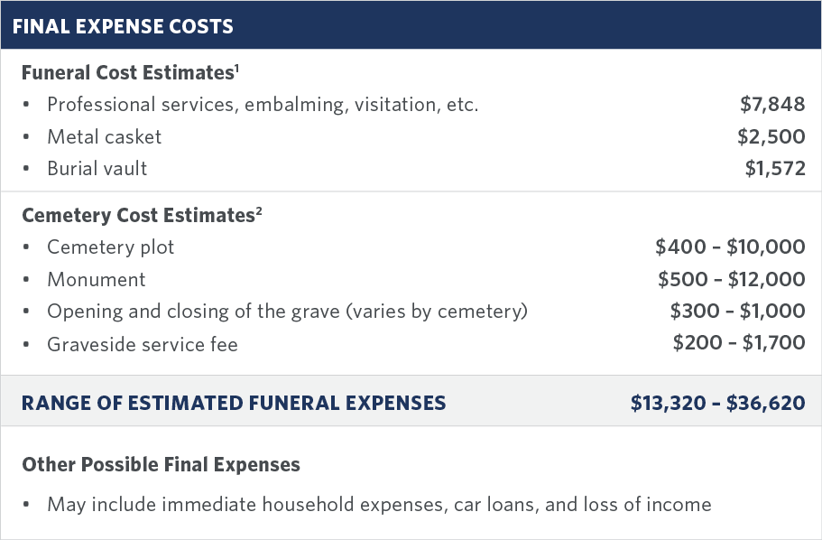
HELPING PROTECT THEIR FAMILIES
An important part of insurance planning is helping protect your client’s family from unexpected financial burdens, especially final expenses.
No one knows what the future may hold, but taking action today can help them ensure that their loved ones are cared for in the event of their passing.
¹ “2021 NFDA General Price List Study Shows Funeral Costs Not Rising as Fast as Rate of Inflation,” NFDA, 2021
² “Cemetery and Gravesite Costs,” funeralresources.com, accessed February 2021
For Agent Use Only. Not for Use With the Public.
Notes:
[READ SLIDE]

Slide 6
ADDRESSING DIFFERENT SEGMENTS
Baby Boomers & seniors
Younger families
Women
Millennials
Mass affluent & middle market
Health-impaired individuals
For Agent Use Only. Not for Use With the Public.
Notes:
Meeting the needs of your clients also means being able to be relevant to different types of clients.
As you know, boomers and seniors continue to be part of a growing aging population. In fact, older Americans are projected to outnumber children for the first time in U.S. history.* By 2030, all Baby Boomers will be older than age 65. As they age, this segment will need to focus on how to manage their final expenses as well as ways to help protect their children and grandchildren.
Younger families with term coverage may be looking for budget-friendly premiums, and the mass affluent and middle market may be looking for a quick way to obtain guaranteed permanent life insurance.
Individuals who would not qualify for standard coverage due to their age, health, height, or weight** and would potentially have to endure extensive, time-consuming underwriting requirements, may be interested in an immediate, simplified issue, permanent coverage policy with the ability to access cash to pay for a nursing home.
* "Older People Projected to Outnumber Children for First Time in U.S. History," U.S. Census Bureau, February 2020
** Note: Transamerica will decline coverage on an application for a proposed insured who has been declined for another life product with any Transamerica insurance company.

Slide 7
Final expense is simple
People need it
Growing target market
Career freedom and flexibility
For Agent Use Only. Not for Use With the Public.
Notes:
Transamerica final expense is truly fast, easy protection now, that will be there when your clients’ loved ones need it most. The new simplified process lets you do more in less time, which can help you grow your business.
In addition, our Final Expense Solutions Portfolio provides some of the simplest coverage available on the market. As a simplified-issue whole life policy with simplified underwriting guidelines, it’s easier to place than fully underwritten products. Plus, it only requires a life insurance license and is easy to explain to your clients.
Moreover, many people need it. Many individuals don’t work with a financial planner and may be unaware of the financial burden of their final expenses. Many Americans believe Social Security will pay for their final expense needs; however, the government only pays a lump sum of $255 for those who qualify.*
As we mentioned earlier, there’s also a growing market for final expense, with roughly 10,000 Americans turning 65 every day.**
Lastly, final expense can provide you with freedom and flexibility. It’s your business, and you should run it to fit your lifestyle. The convenient features of our updated final expense solutions allow you to do just that.
* "If You Are the Survivor," ssa.gov, accessed online April 2023
** "The Baby Boomer Generation," Seniorliving.org, accessed online April 2023

Slide 8
Getting coverage is fast and easy
Includes reliable premiums
Provides flexible benefits through riders
Offers additional benefits in most states
Expedited claims up to $25,000
For Agent Use Only. Not for Use With the Public.
Notes:
Some of the highlights of Transamerica’s Final Expense Solutions Portfolio include:
FAST & EASY
No exams or labs
Less time and effort with iGO e-App®
Reduces cycle time and case requirements
Faster case placement
Potential for same-day notification with real time underwriting
Coverage can begin immediately.
SAFE & PREDICTABLE
Issued by a highly rated carrier
Guaranteed fixed premiums (regardless of insured’s age or health)
Retirees on a fixed budget can conveniently pay with using their Direct Express® card.
CUSTOMIZABLE PROTECTION
Permanent whole life death benefit available for $1,000 to $50,000
People ages 15 days to 85 years of varying health, build, and incomes may qualify.
No federal income tax on death benefit to their heirs
Policy builds a tax-deferred cash value over time that can be borrowed against.
These riders are free to add at onset, but at the time of use there are fees assessed to the policy owner.
Includes standard in policy* Accelerated Death Benefit Rider (ADBR) with Nursing Home Option (NHO) at no extra cost**
Optional rider covering up to 9 children or grandchildren with conversion privilege
EXPEDITED CLAIMS
Transamerica’s expedited claims process can pay up to $25,000 of the total death benefit to cover funeral-related or any other expenses that may arise.***
* This rider is not available if your client needs any assistance in performing daily living activities at the time of application.
** Accelerated Death Benefit Rider with Nursing Home Benefit is not available in New York. In Florida, Accelerated Death Benefit Rider (ADBR) is available. In California, Terminal Illness Accelerated Death Benefit Rider (TIR) is available.
*** Subject to qualifications and two-year contestability period

Slide 9
Apply With iGO® e-App
Write business electronically
Always submit in good order
Access in Agent + Advisor Portal
No “approved other than applied”
Real Time Underwriting
Place business faster
Get paid sooner
Streamlined, consolidated guidelines
Insureds 0-85
For Agent Use Only. Not for Use With the Public.
9
Notes:
Now you can write final expense business electronically with the same iGO® e-App you may already know. When you do, you’ll get the benefits of real time underwriting, which means quicker coverage for your client and quicker commissions payments for you.
Visual cues will guide you through the iGO e-App process, ensuring you’ll always submit in good order, with no delays for illegibility, incomplete field, or wrong forms. The application pre-selects risk class plan based on client information you enter for medical questions.
This new experience is designed so you only apply for coverage that your client has the potential to be approved for, reducing holdups for “approved other than applied.”
Express Protect Underwriting runs in the background on all Final Expense Solutions Portfolio iGO e-Apps. With this automated tool, there’s no more guessing on risk class or premiums. It uses streamlined, consolidated underwriting guidelines for insureds ages 0 to 85. You'll receive an email shortly after submitting the iGO e-App notifying you of case approval or status.

Slide 10
Grow your business with the Final Expense Solutions Portfolio
The new simplified process allows you to do more in less time with our three portfolio options — Immediate Solution, 10-Pay Solution, and Easy Solution.
The client’s medical history determines product eligibility.
For Agent Use Only. Not for Use With the Public.
Notes:
[READ SLIDE]

Slide 11
PRODUCT OVERVIEW
Premium paying period: Level premiums to age 121
Age last birthday issue ages: 0¹–85
Minimum issue amount: $1,000
Maximum issue amount: 0¹–55 $50,000 56–65 $40,000 66–75 $30,000 76–85 $25,000
Benefit period:
This product matures at age 121.
Policy loans: The policy loan rate is variable, not to exceed 8%.
Additional Benefits/Riders:²
Accelerated Death Benefit Rider (ADBR) for Florida only
Accelerated Death Benefit Rider with Nursing Home Benefit (NHB)
Terminal Illness Accelerated Death Benefit Rider (TIR) for California only
Optional Riders:
Accidental Death Benefit Rider (ADR)
Children’s and Grandchildren’s Benefit Rider (CGR)
¹ Minimum insured age is 15 days.
² Neither the Accelerated Death Benefit Rider (ADBR) nor the ADBR with Nursing Home Benefit (NHB) is available in New York.
For Agent Use Only. Not for Use With the Public.
11
Notes:
[READ SLIDE]

Slide 12
PRODUCT OVERVIEW
Premium paying period: Level premiums for 10 years
Age last birthday issue ages: 0¹–85
Minimum issue amount: $1,000
Maximum issue amount: 0¹–55 $50,000 56–65 $40,000 66–75 $30,000 76–85 $25,000
Benefit period:
This product matures at age 121.
Policy loans: The policy loan rate is variable, not to exceed 8%.
Additional Benefits/Riders:²
Accelerated Death Benefit Rider for Florida Only (ADBR)
Accelerated Death Benefit Rider with Nursing Home Benefit (NHB)
Terminal illness Accelerated Death Benefit Rider (TIR) for California only
¹ Minimum insured age is 15 days.
² Neither the Accelerated Death Benefit Rider (ADBR) nor the Accelerated Death Benefit Rider with Nursing Home Benefit (NHB) is available in New York.
For Agent Use Only. Not for Use With the Public.
12
Notes:
[READ SLIDE]

Slide 13
PRODUCT OVERVIEW
Premium paying period: Level premiums to age 121
Age last birthday issue ages: 18-80; In New York, 50-75
Minimum issue amount: $1,000
Maximum issue amount: $25,000
Benefit period:
This product matures at age 121.
Death benefit: The death benefit during the first two policy years is based on the face amount for accidental death of the insured, or will be limited to 110% of the sum of premiums paid (minus the loan balance) for the death of the insured from any other cause. Death benefit after the first two years is based on the face amount (minus the loan balance) for the death of the insured regardless of cause of death.
For Agent Use Only. Not for Use With the Public.
13
Notes:
[READ SLIDE]

Slide 14
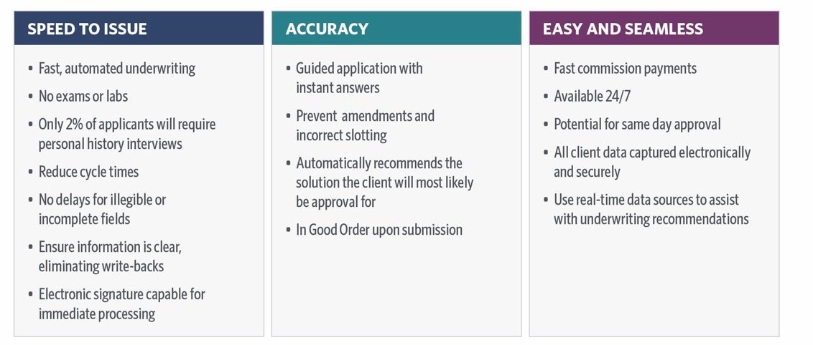
Transamerica offers the iGO® e-App with real time underwriting, making it easier to submit business with the potential for same-day coverage.
For Agent Use Only. Not for Use With the Public.
Notes:
[READ SLIDE]

Slide 15
Run a quote for your client at transamerica.com/quote-fe
Register for our mobile-friendly Agent + Advisor Portal
Apply using iGO® e-App
Evaluate the proposed insured — happens behind the scenes with real time underwriting
Get decision notification by email shortly after you submit the e-app
Check case requirements on Agent + Advisor Portal, if needed
Place the case
Manage your entire book of business and correspondence on Agent + Advisor Portal
For Agent Use Only. Not for Use With the Public.
15
Notes:
[READ SLIDE]
Remember to have your writing number and email associated with your Transamerica business
With FE becoming more automated and simplified, the underwriting decision on the final expense solutions products will be nonnegotiable.

Slide 16
Social Security billing authorization feature
Nursing Home Benefit Rider
Provides flexible benefits through riders
Children's and Grandchildren's Rider
For Agent Use Only. Not for Use With the Public.
Notes:
[READ SLIDE]

Slide 17
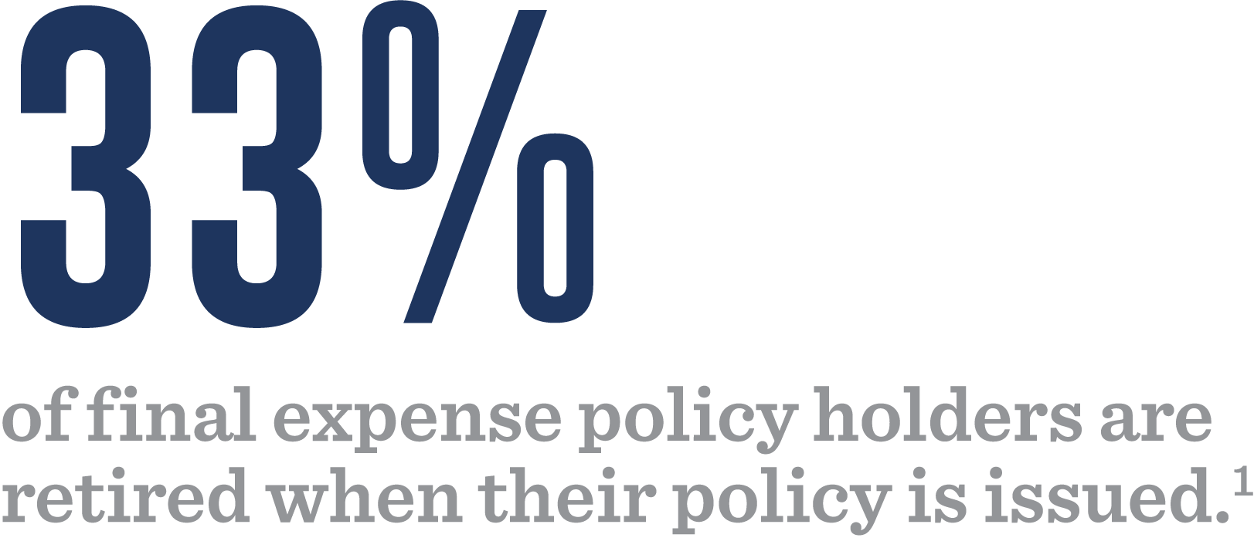
Utilize Social Security billing authorization feature for clients receiving Social Security benefits
Convenient for your clients
Good for your business
¹ Transamerica final expense policy data as of May 2, 2023
For Agent Use Only. Not for Use With the Public.
17
Notes:
Anyone receiving Social Security benefit payments can make premium payments from their checking accounts or through the Direct Express® MasterCard® when they receive their monthly benefits. In fact, Transamerica is one of the few carriers that accepts payment through the Direct Express MasterCard.
This is sure to be helpful to your business as 30% of final expense policyholders are already retired when their policy is issued.¹
Clients get peace of mind, knowing their premiums will always be paid automatically. ² For you, this premium payment feature also helps keep your business strong with fewer lapsed policies, higher persistency rates, and fewer commission chargebacks.
¹ Transamerica final expense policy data, 2017-2020

Slide 18
Nursing Home Benefit Rider³ available at no extra cost to those who qualify
The rider pays the face amount less interest discount, loans, administrative charge, and premiums that would be due in the next year.
Eligibility based on diagnosis of qualifying event or confinement in qualified nursing facility
¹ “How Much Care Will You Need?,” U.S. Department of Health and Human Services. accessed online, April 2023
² "Cost of Care Trends & Insights," Genworth Financial Inc., accessed online, April 2023
³ Not available in New York. Accelerated Death Benefit Rider available only in Florida; Terminal Illness Accelerated Death Benefit Rider available only in Florida
Riders are available at an additional cost. Riders and rider benefits have specific limitations and may not be available in all jurisdictions. Benefits paid under accelerated death benefit riders will reduce the life insurance policy’s death benefit and policy value. For complete details including the terms and conditions of each rider and exact coverage provided, please refer to the riders.
For Agent Use Only. Not for Use With the Public.
18
Notes:
Your clients are living longer and they need flexible life insurance strategies to build solid financial foundations for today and tomorrow. That especially applies to future healthcare expenses. Transamerica is one of a few carriers that offers an Accelerated Death Benefit Rider with a Nursing Home Benefit on our Final Expense Solutions Portfolio at no extra cost for clients who qualify. It provides early access to the death benefit, which can be used to help pay nursing home costs when the insured has a qualifying event or is confined to a nursing home.

Slide 19
2.6 million grandparents are raising their grandchildren.¹
Final expense is one solution for an entire family.¹
Children’s/Grandchildren’s Rider
Clients can add up to nine children and grandchildren to one policy.
No health questions
Rider can be converted to permanent policy.²
¹ U.S. Census Bureau, Selected Social Characteristics in the United States, accessed online April 2023
² The children/grandchildren must be insured for two years under the rider to convert. The rider terminates on the rider anniversary following the children’s/grandchildren’s 25th birthday.
For Agent Use Only. Not for Use With the Public.
Notes:
There are 2.6 million grandparents raising their grandchildren.
1. You may know some. Or you may know some who aren't the main caregivers, but they worry over whether their adult children have taken steps to protect their grandkids in case the worst happens. Transamerica's Final Expense Solutions Portfolio offers a competitively priced Children's/Grandchildren's Benefit Rider that lets clients add up to nine children and grandchildren to the policy — without having to answer any health questions. Few carriers will cover up to nine. It also allows the children and grandchildren to convert to a permanent policy at a later date.
2. It's one life insurance policy that can protect an entire family.

Slide 20
pages.transamerica.com/agent_consumer_kit
For Agent Use Only. Not for Use With the Public.
Notes:
Finding new customers is the lifeblood for any successful business. We want to see you and your business thrive, so we've created prospecting tools to help you succeed. We've done the work for you with pre-built marketing materials that you can customize with your name. Use the social media campaign, designed email templates, and ready-to-print direct mailers to reach more customers and land new business.

Slide 21
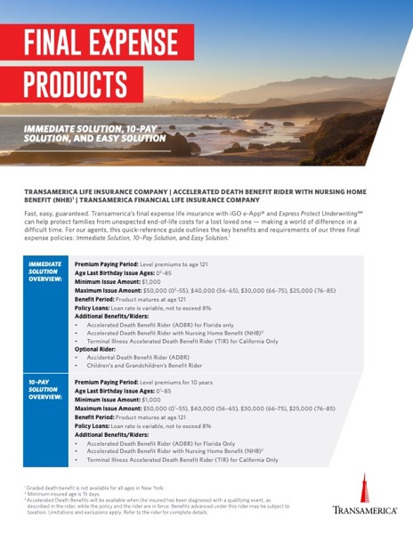
Final Expense Agent Product and Underwriting Guide
Final Expense Spec Sheet
For Agent Use Only. Not for Use With the Public.

Slide 22
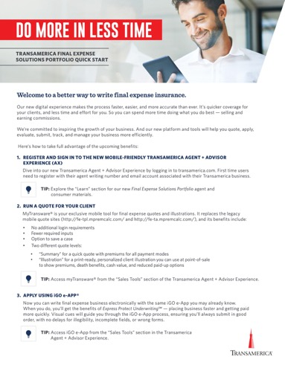
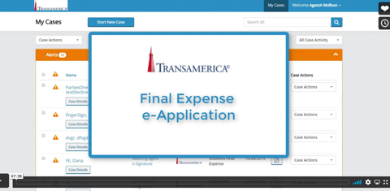
Final Expense Where We Win Competitive Comparison
Agent Activation Flyer
Agent iGO e-App Training Video

Slide 23
Social Security Billing Video
Social Security Billing Presentation
For Agent Use Only. Not for Use With the Public.

Slide 24
Final Expense Client Video
My Last Will Worksheet
Final Expense Consumer Brochure
For Agent Use Only. Not for Use With the Public.

Slide 25
Life insurance products are issued by Transamerica Life Insurance Company, Cedar Rapids, IA, or Transamerica Financial Life Insurance Company, Harrison, NY. Transamerica Financial Life Insurance Company is authorized to conduct business in New York. Transamerica Life Insurance Company is authorized to conduct business in all other states. All products may not be available in all jurisdictions.
For Agent Use Only. Not for Use With the Public.
133508R4
© 2023 Transamerica Corporation. All Rights Reserved.

