Slide 1
Notes:
Welcome to today’s webinar on Transamerica Life Illustrator.

Slide 2
Notes:
Our commitment to supporting others goes way back. Transamerica has stood for innovation since 1906, when a young entrepreneur named Amadeo P. Giannini founded a bank in San Francisco to make financial services available to everyone. Today, creating opportunities to help people live their best lives is at the heart of what we do, and as people’s needs and the financial landscape evolve, we want to help pave the way forward for everyone.

Slide 3
Notes:
Here’s a quick look at what we’ll cover today.
[Read slide]

Slide 4
Notes:
Our mission is to help your clients protect themselves and their loved ones and help individuals with their financial needs throughout their entire life. Just as we’ve done for more than 100 years. Our global CEO, Lard Friese, explained the significance of our commitment during Capital Markets Day in December of 2020.
[Review slide]

Slide 5
Notes:
As you've seen over the last two years, Transamerica has brought together top talent from across the industry to lead our strategic vision. We're committed to regaining our position as a market leader.
To do this we are going to:
• Tap into our industry-leading distribution to drive growth
• We are going to Own and deliver an all-weather product portfolio … One that will deliver solutions that meet the needs of you and your clients
• And Provide excellent service and focused execution
• Improving our agent and customer experience is high priority

Slide 6
Notes:
Our leadership is looking to add to our already impressive numbers.
[Read slide]

Slide 7
Notes:
As one of the first carriers to enter the IUL market, Transamerica has racked up quite a track record thanks to its flexibility and cash-accumulation potential. We’ve been on top for nine consecutive quarters now, and we keep evolving and pushing our FFIUL to make it even better.

Slide 8
Notes:
As an agent, your most effective sales tool is the illustration. That's why we're excited about the recent launch of our Transamerica Life Illustrator, available for all Transamerica life insurance products. It's not only easy to navigate and personalize, but it will help reinforce the purchase decision for your client through brand strength and policy overview sections. We’ve also made the illustration customizable, so you can build a more tailored representation of your client’s future policy. To help you sell more efficiently, the Transamerica Life Illustrator pushes data to pre-populate an electronic application on iGO® e-App when your client wishes to apply for IUL coverage.

Slide 9
Notes:
Our goal is always to make working with Transamerica easy.
[Review slide]

Slide 10
Notes:
Here you can see the customizable cover page. Select from a variety of images that best match your clients’ lifestyles.
[Review slide]

Slide 11
Notes:
Historical index look-back periods are now all on one page for quicker review.
[Review slide]

Slide 12
Notes:
The new projections page in Life Illustrator makes it easy to compare guaranteed and non-guaranteed projections versus the old myTransWare page.
[Review slide]

Slide 13
Notes:
Life Illustrator provides client-friendly policy summary and overview pages.
[Review slide]

Slide 14
Notes:
And it presents information in a very visual style with easy-to-read color graphics. This is a powerful sales tool for you to use.
[Review slide]

Slide 15
Notes:
Here you can see the policy benefit snapshot page and the brand strength page to help enforce Transamerica’s credibility and experience.
[Review slide]

Slide 16
Notes:
[Review slide]

Slide 17
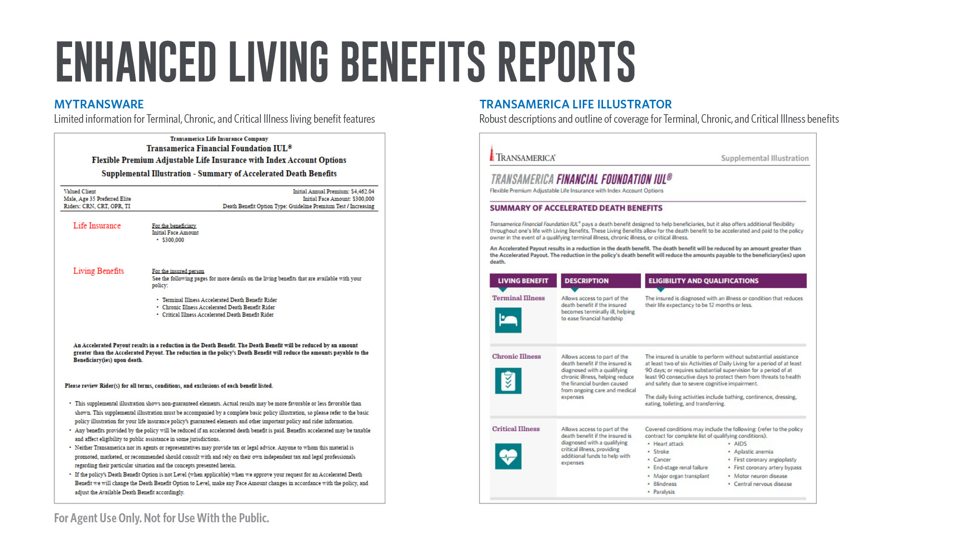
Notes:
Here you can see the difference between MyTransWare and the new Transamerica Life Illustrator for the living benefits reports.
[Review slide]

Slide 18
Notes:
Here you can see the difference between MyTransWare and the new Transamerica Life Illustrator for FFIUL and the Terminal Illness Accelerated Death Benefit Rider.
[Review slide]

Slide 19
Notes:
And a comparison of the two showing Critical Illness Accelerated Death Benefit payout examples based on life expectancy.
[Review slide]

Slide 20
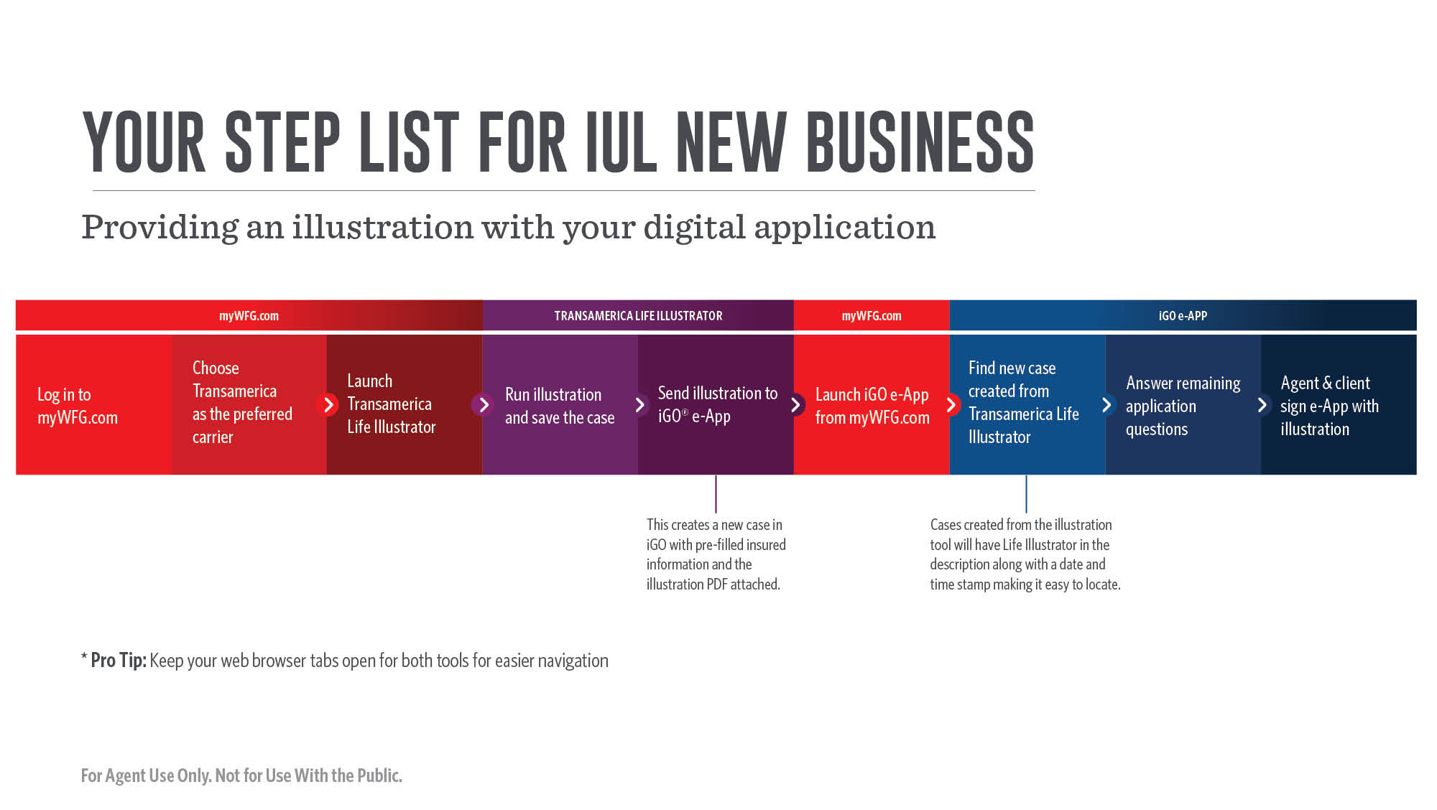
Notes:
Here is a quick step list for new business when providing an illustration with your digital application.
[Review slide]

Slide 21
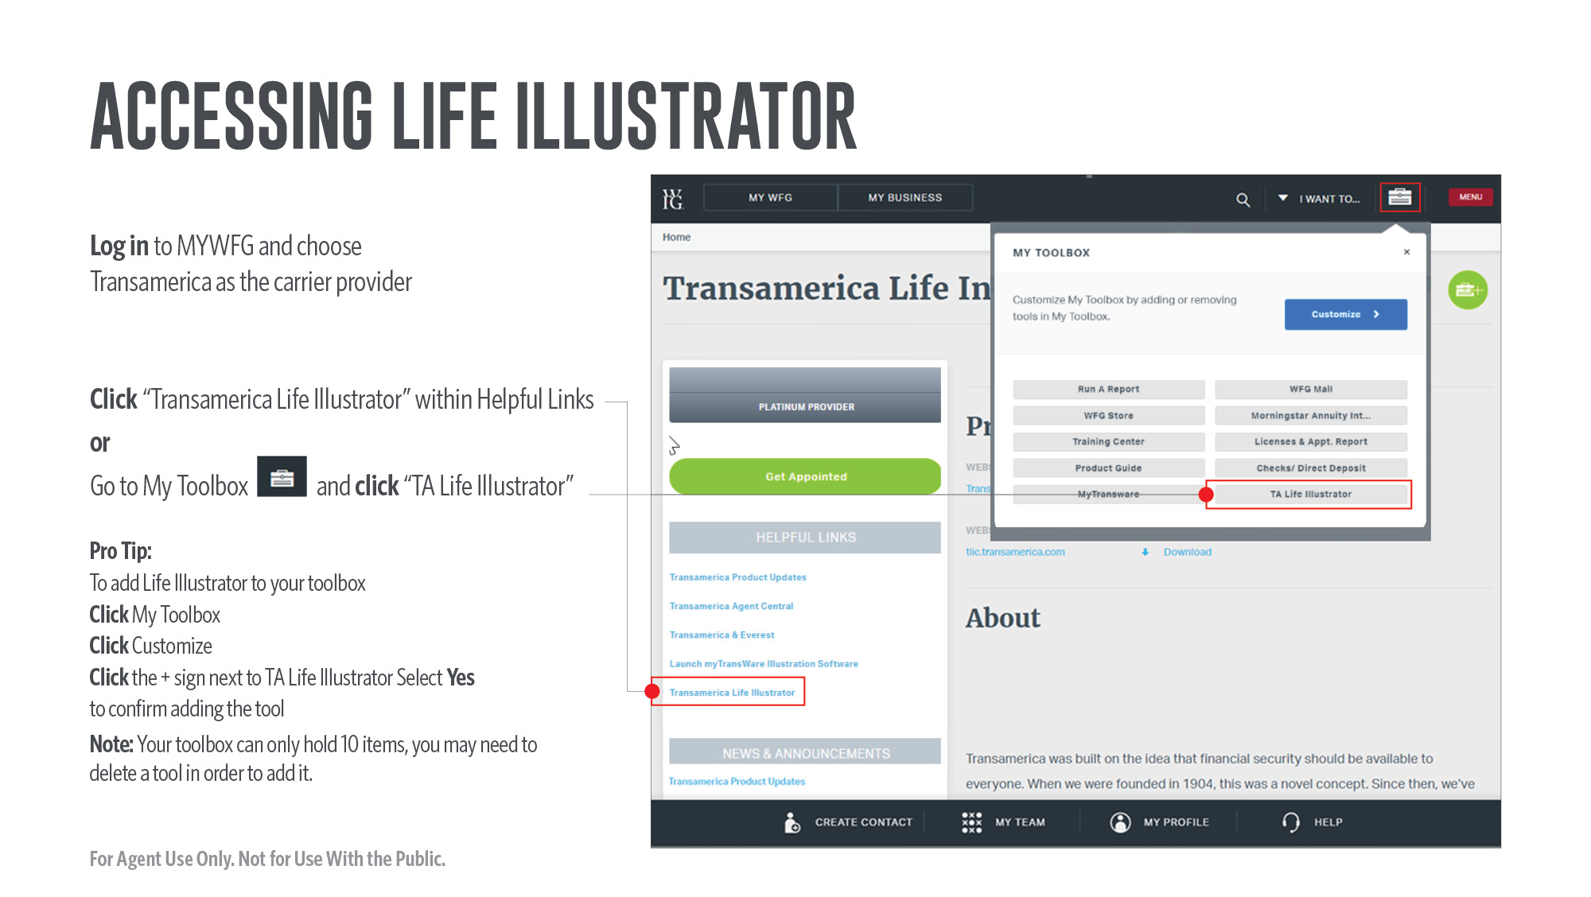
Notes:
Here is how to access Life Illustrator.

Slide 22
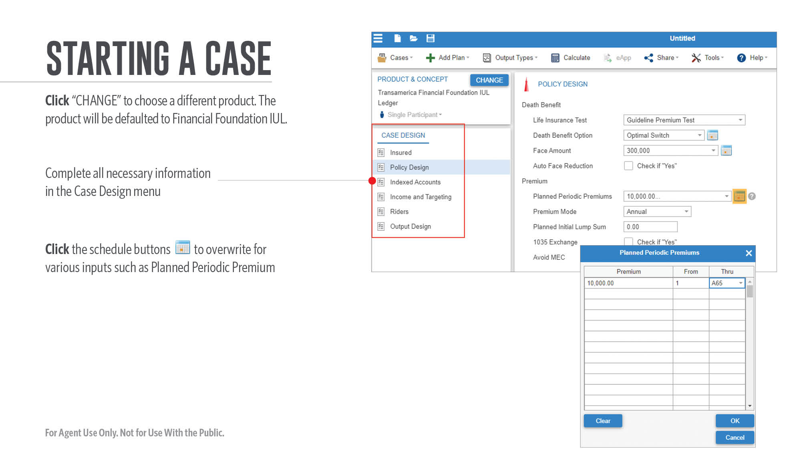
Notes:
Now let’s do a quick walk-through on how to start a case.
[Review slide]

Slide 23
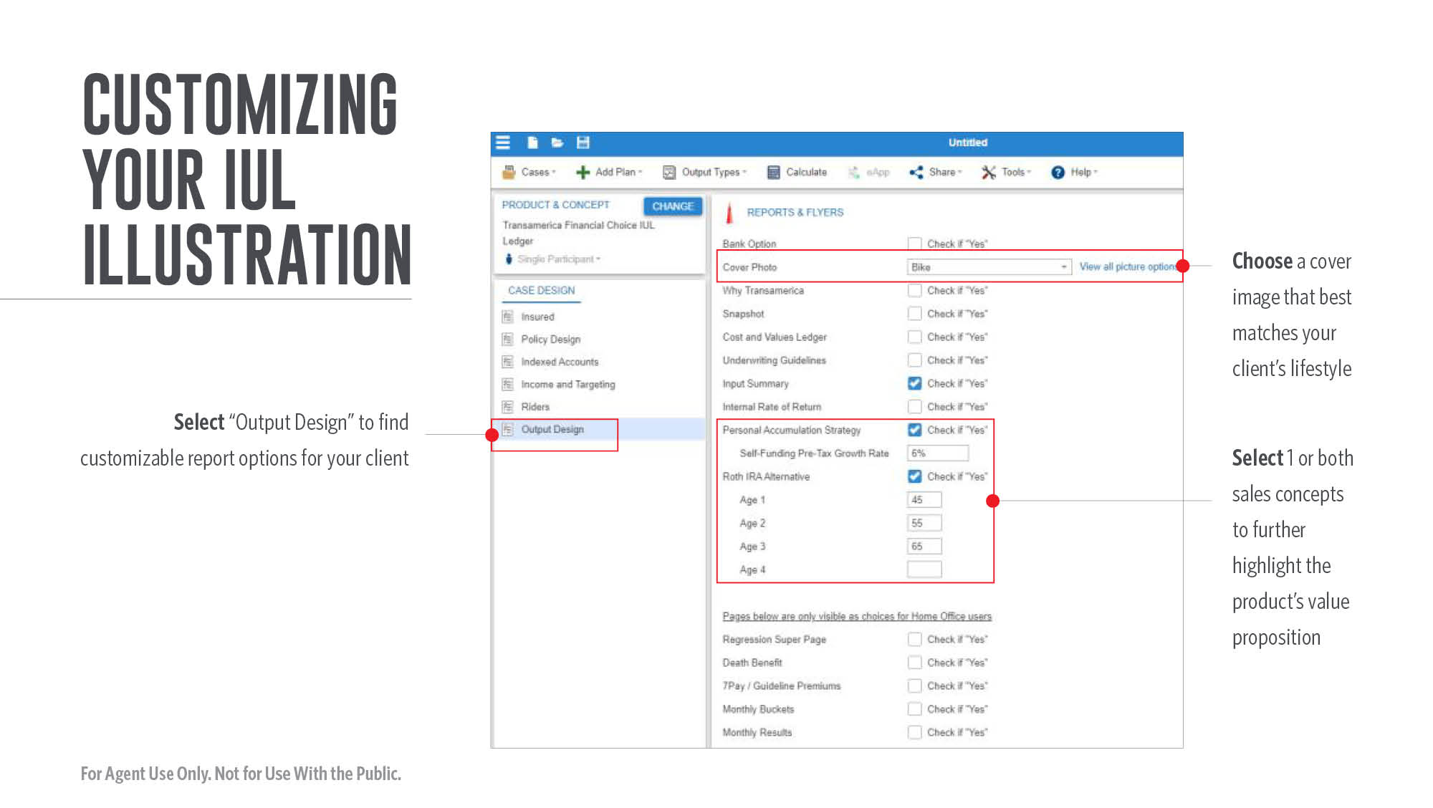
Notes:
Customize your Index Universal Life illustration by choosing a cover image and sales concept(s) to further highlight the product’s value proposition.
[Review slide]

Slide 24
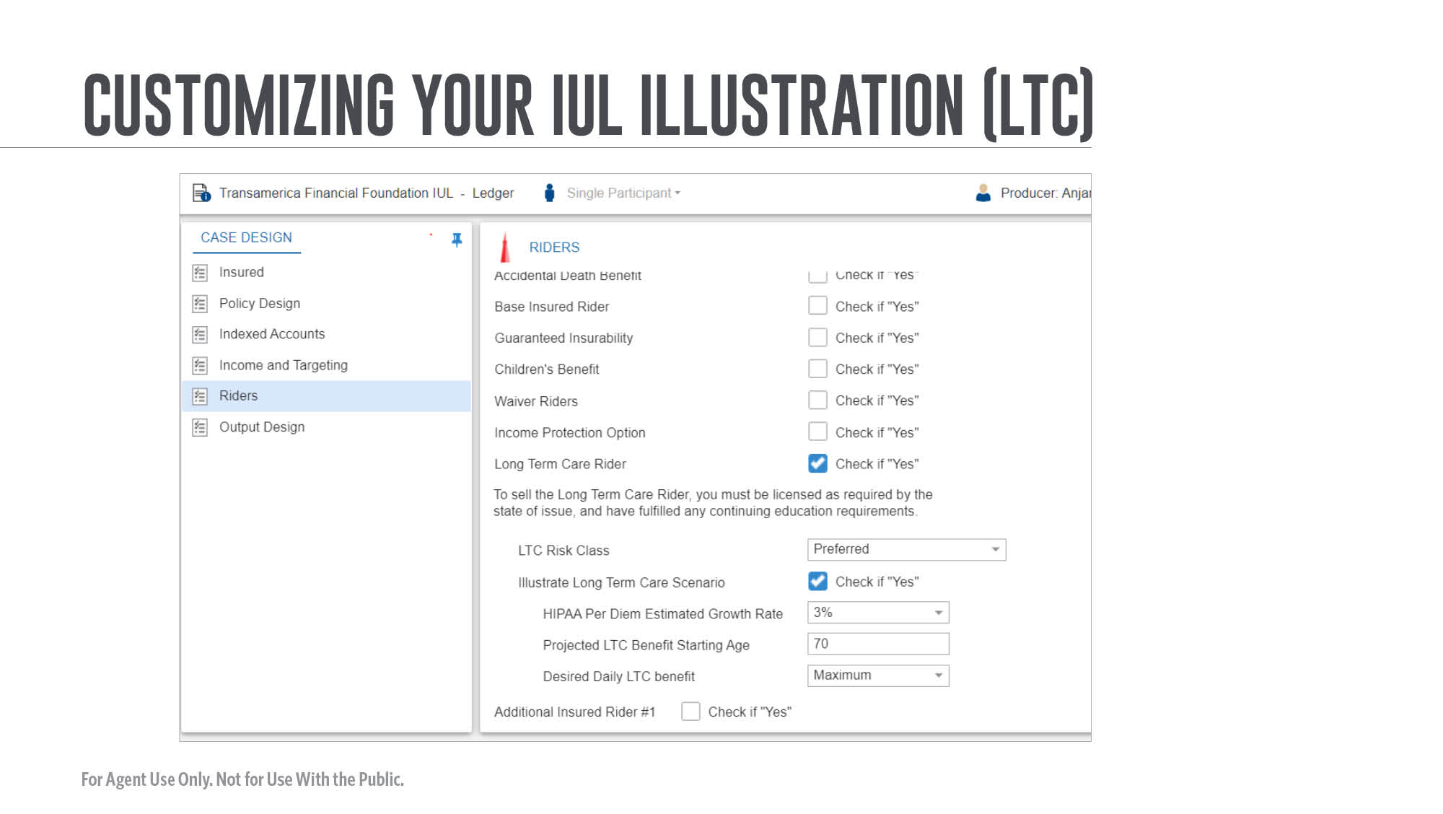
Notes:
Let's look at adding the Long Term Care Rider.

Slide 25
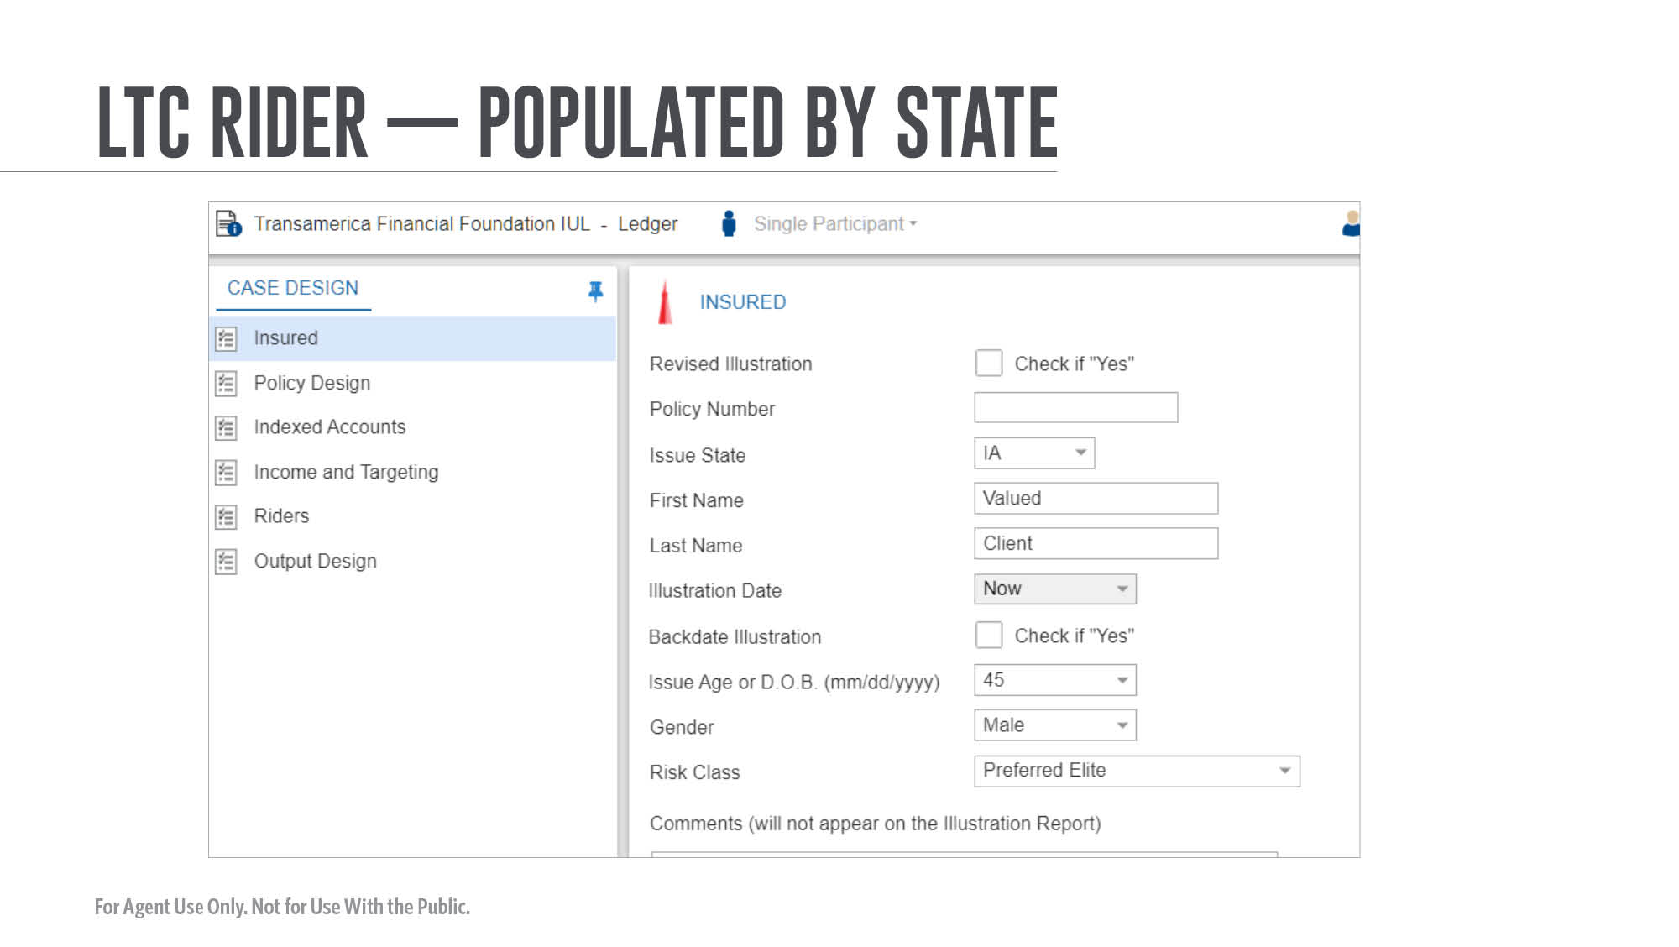
Notes:
[Review slide]

Slide 26
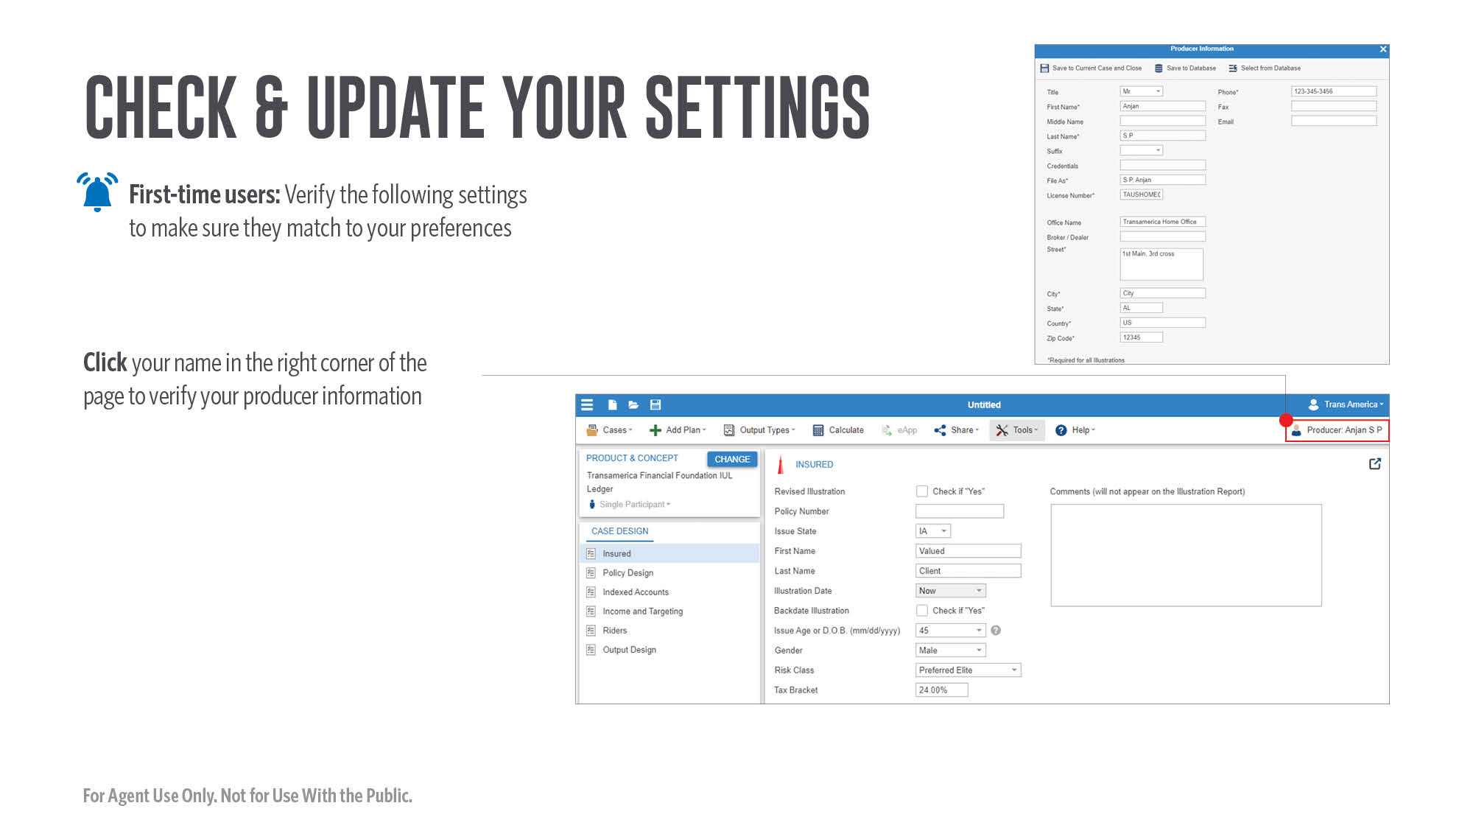
Notes:
Check and update your settings.
[Review slide]

Slide 27
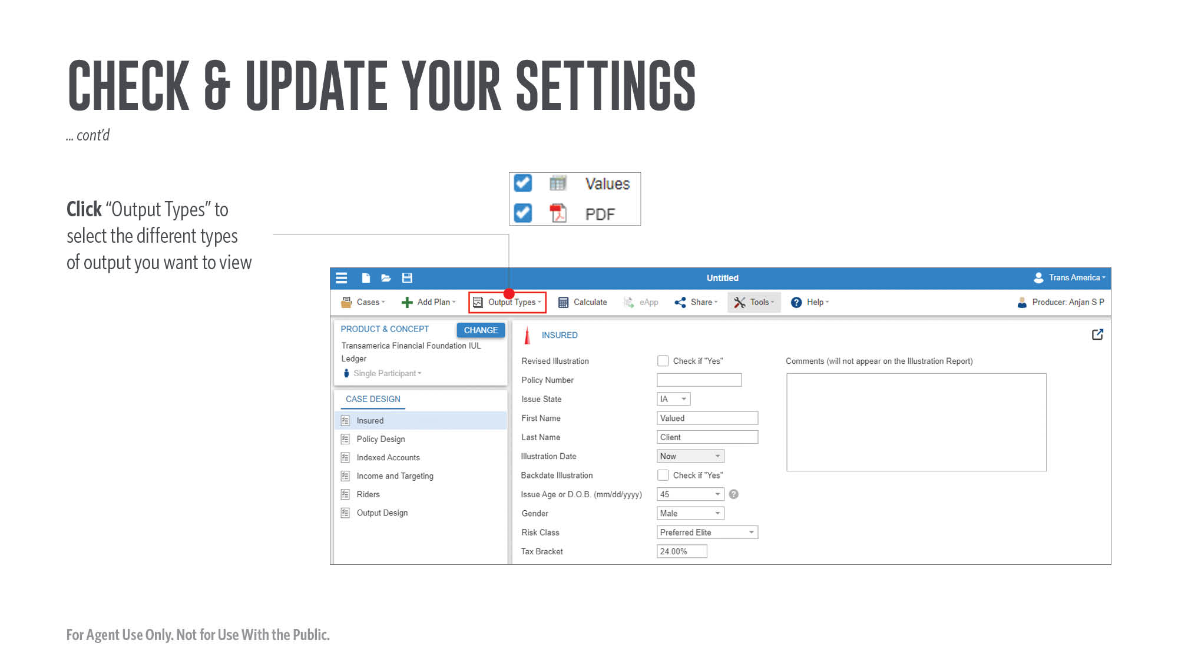
Notes:
[Review slide]

Slide 28
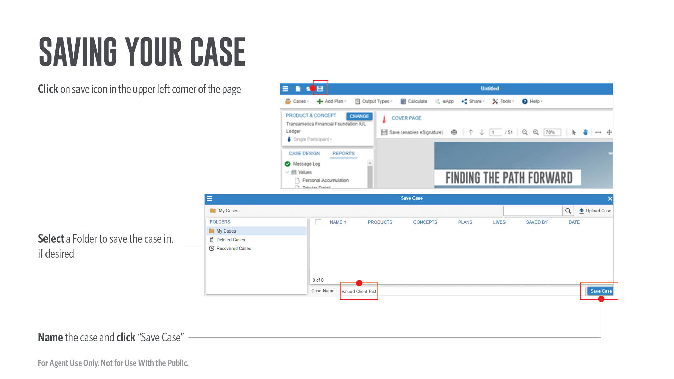
Notes:
Here’s how to save your case.
[Review slide]

Slide 29
Notes:
Now you’re ready to send the illustration to iGO.
[Review slide]

Slide 30
Notes:
To find your case from Life Illustrator in the e-App, simply click “View My Cases.”
[Review slide]

Slide 31
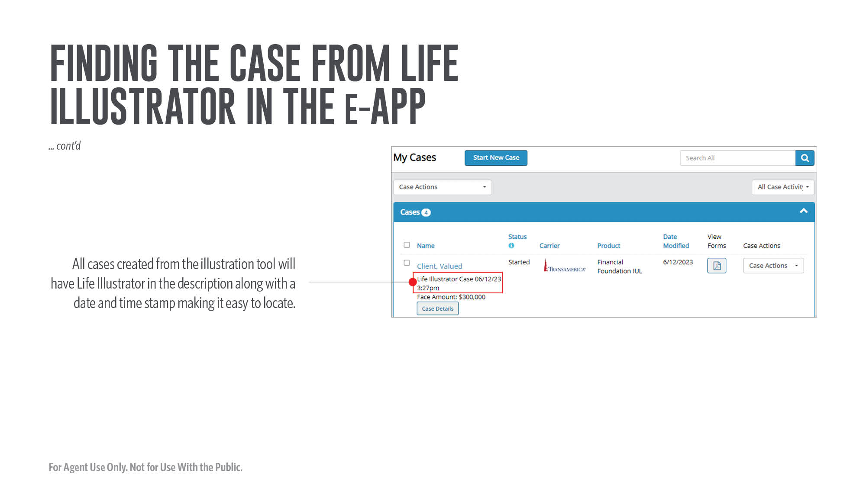
Notes:
[Review slide]

Slide 32
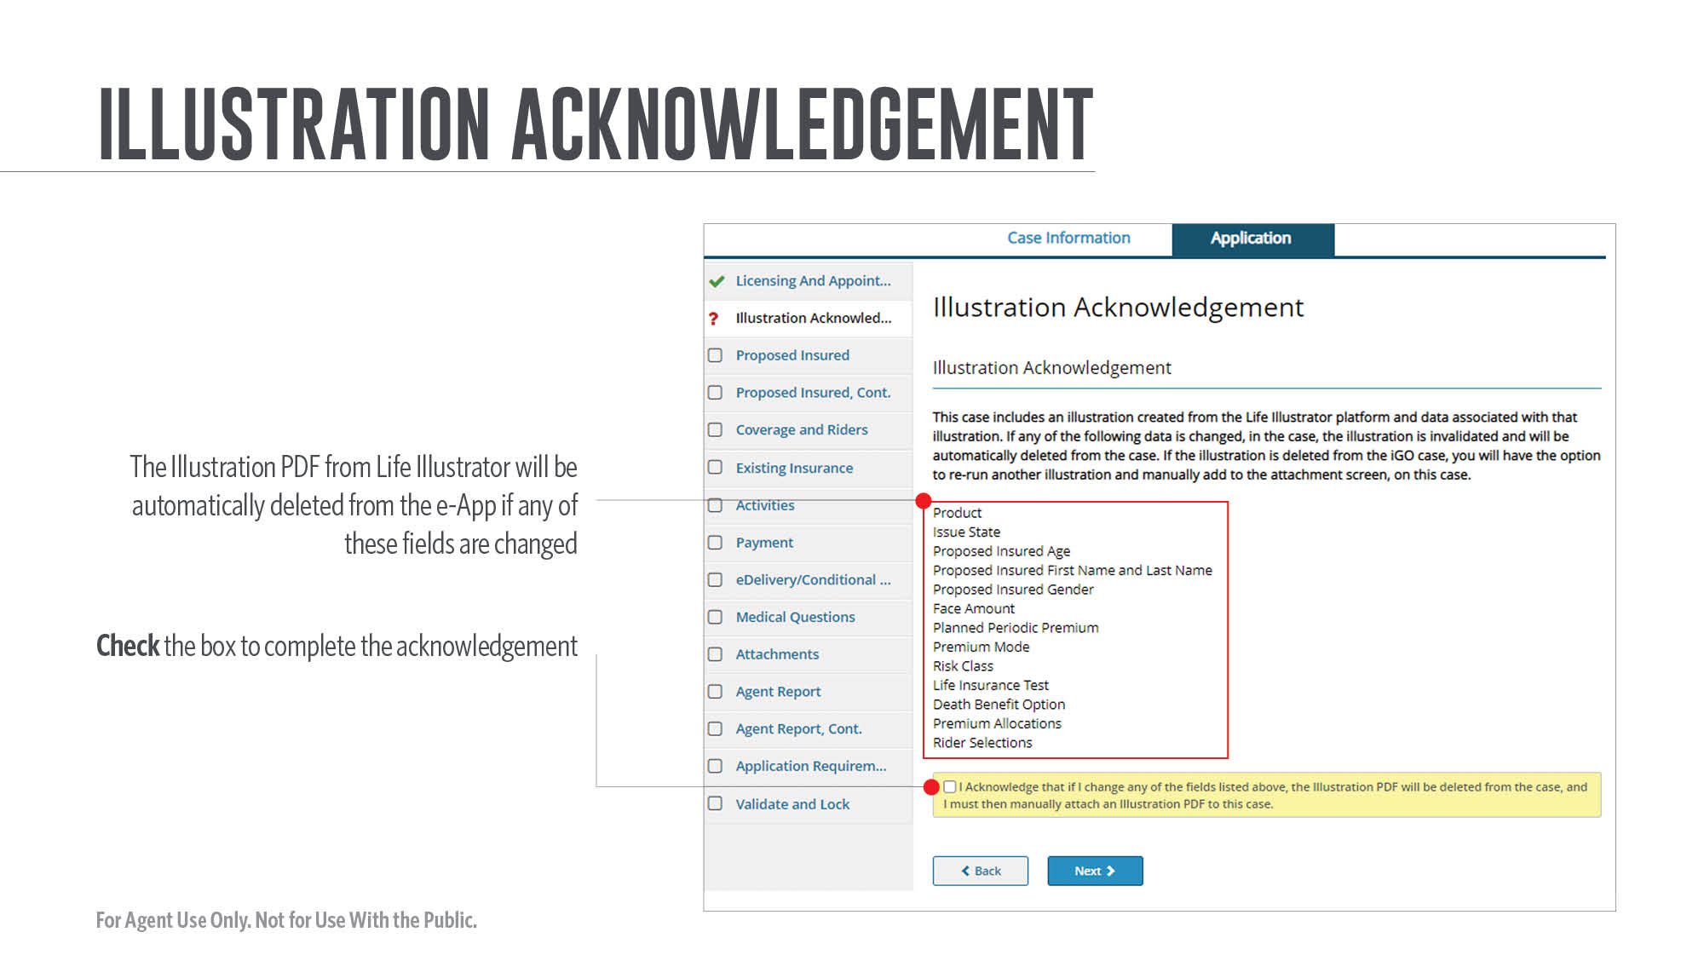
Notes:
[Review slide]

Slide 33
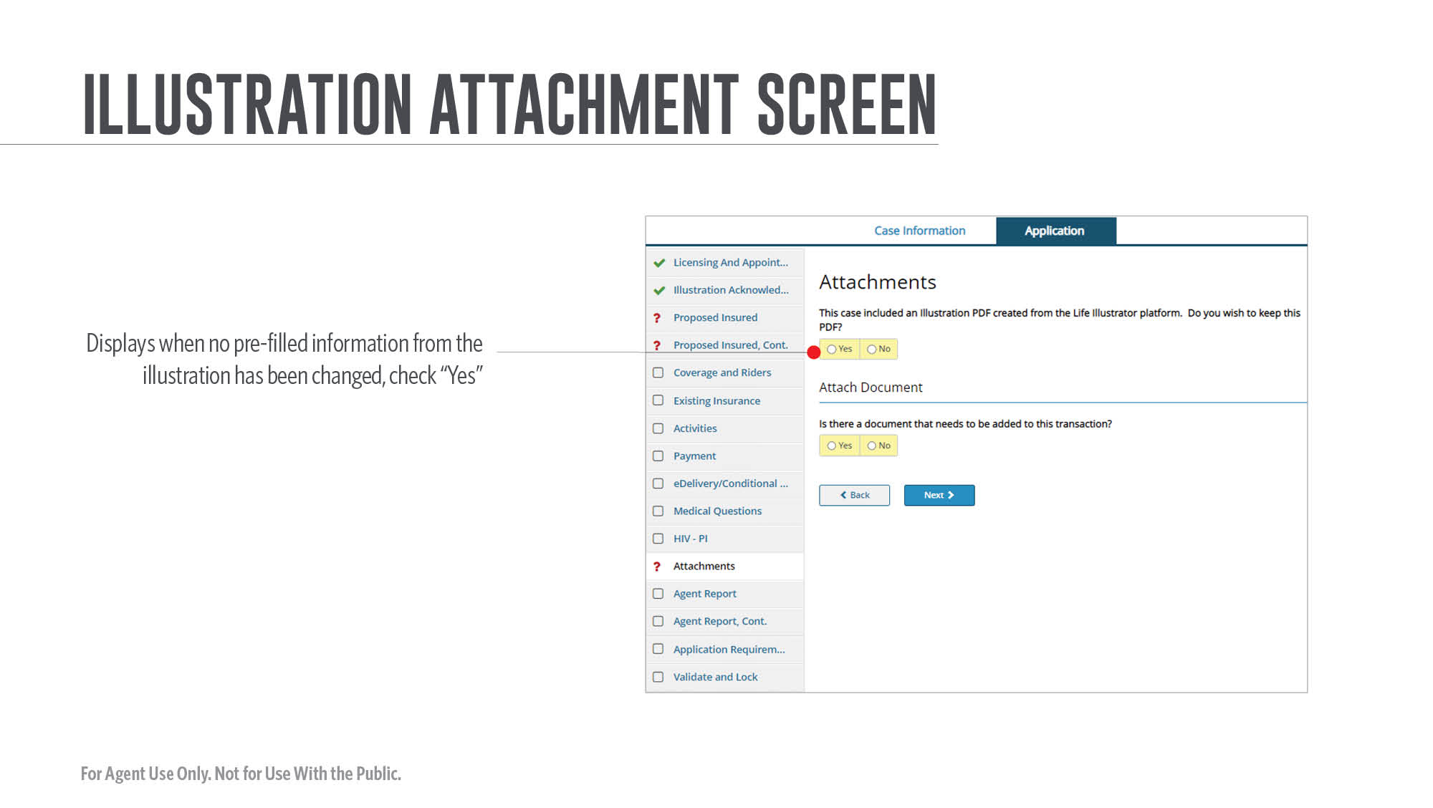
Notes:
[Review slide]

Slide 34
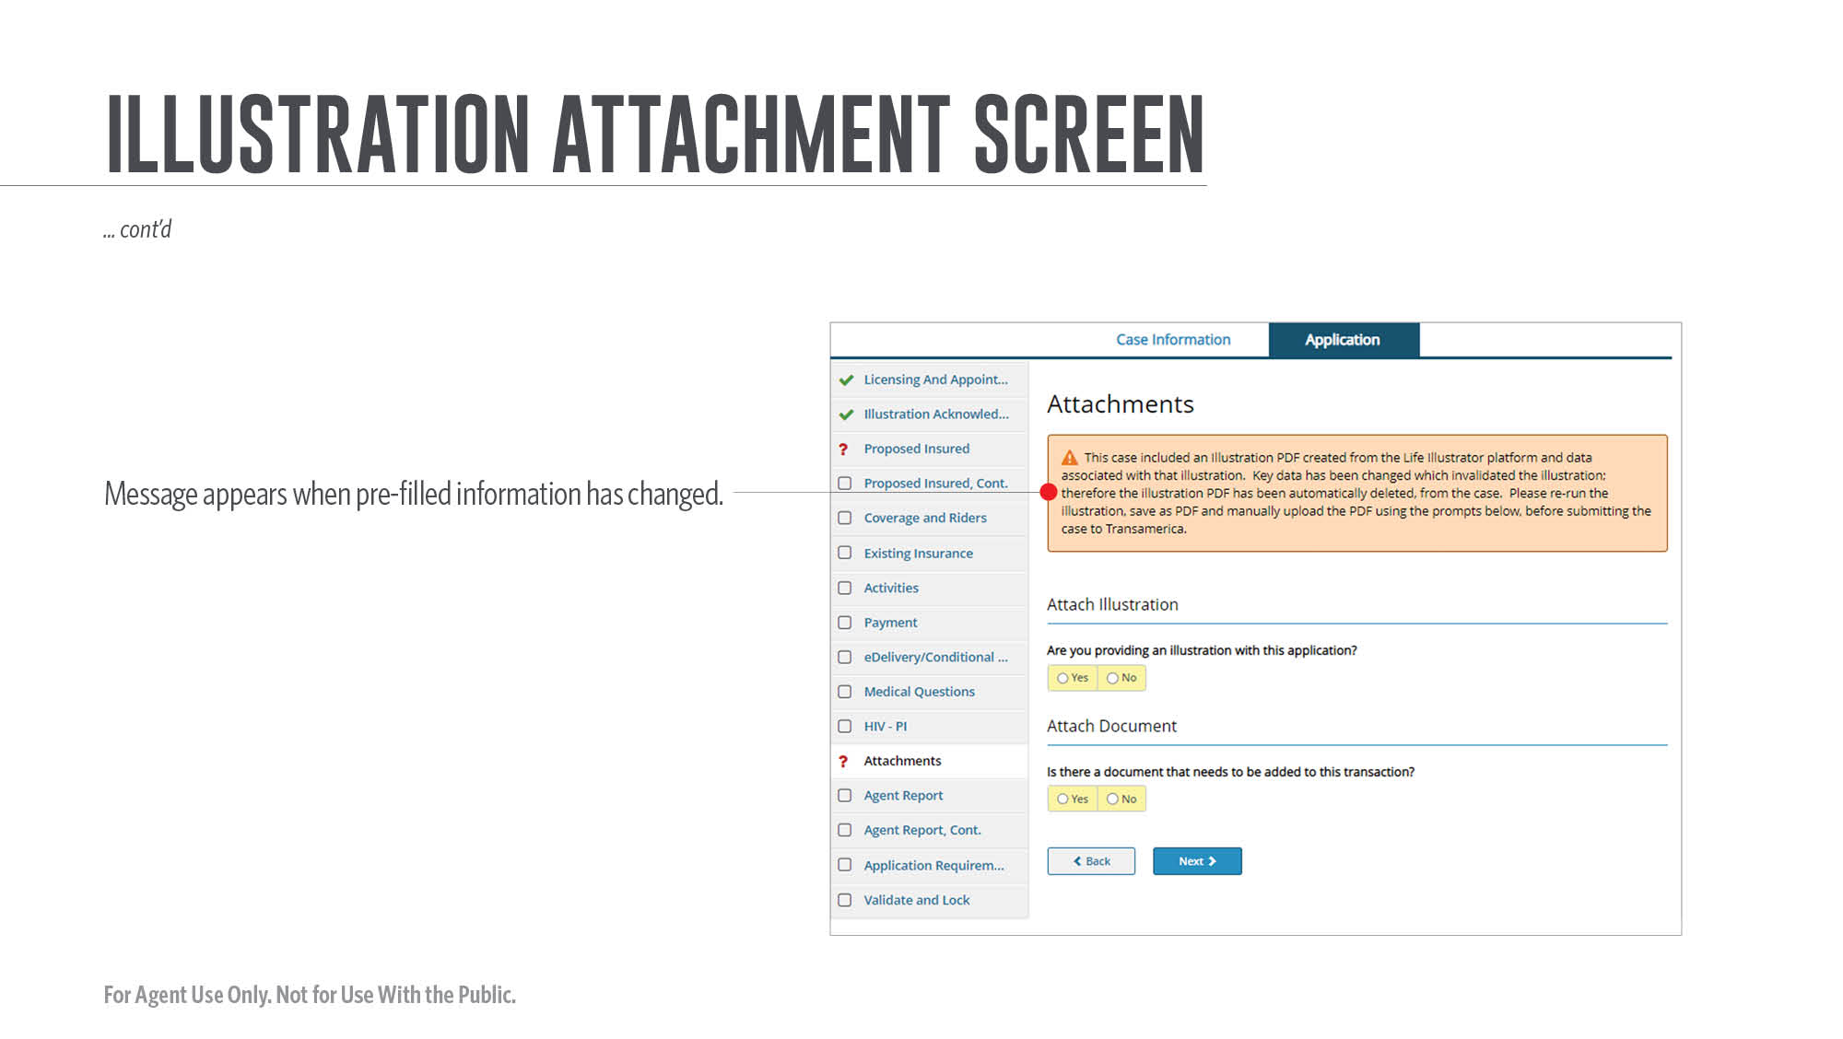
Notes:
[Review slide]

Slide 35
Notes:
[Review slide]

Slide 36
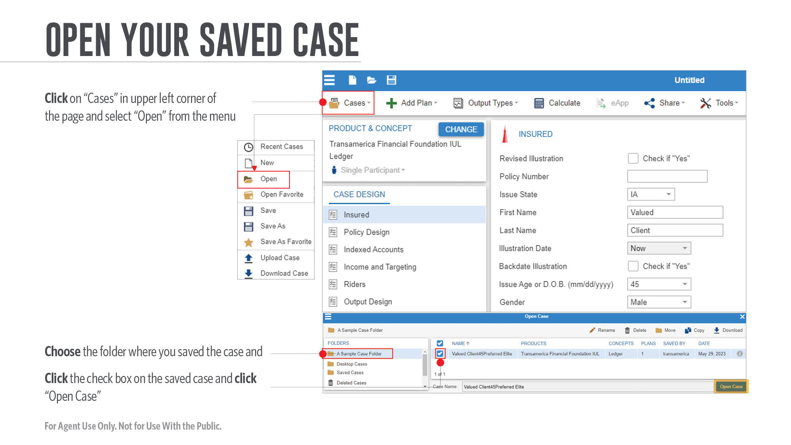
Notes:
Here’s how to open your saved case.
[Review slide]

Slide 37
Notes:
Be sure to click the save icon and not the print icon to save your illustration.
[Review slide]

Slide 38
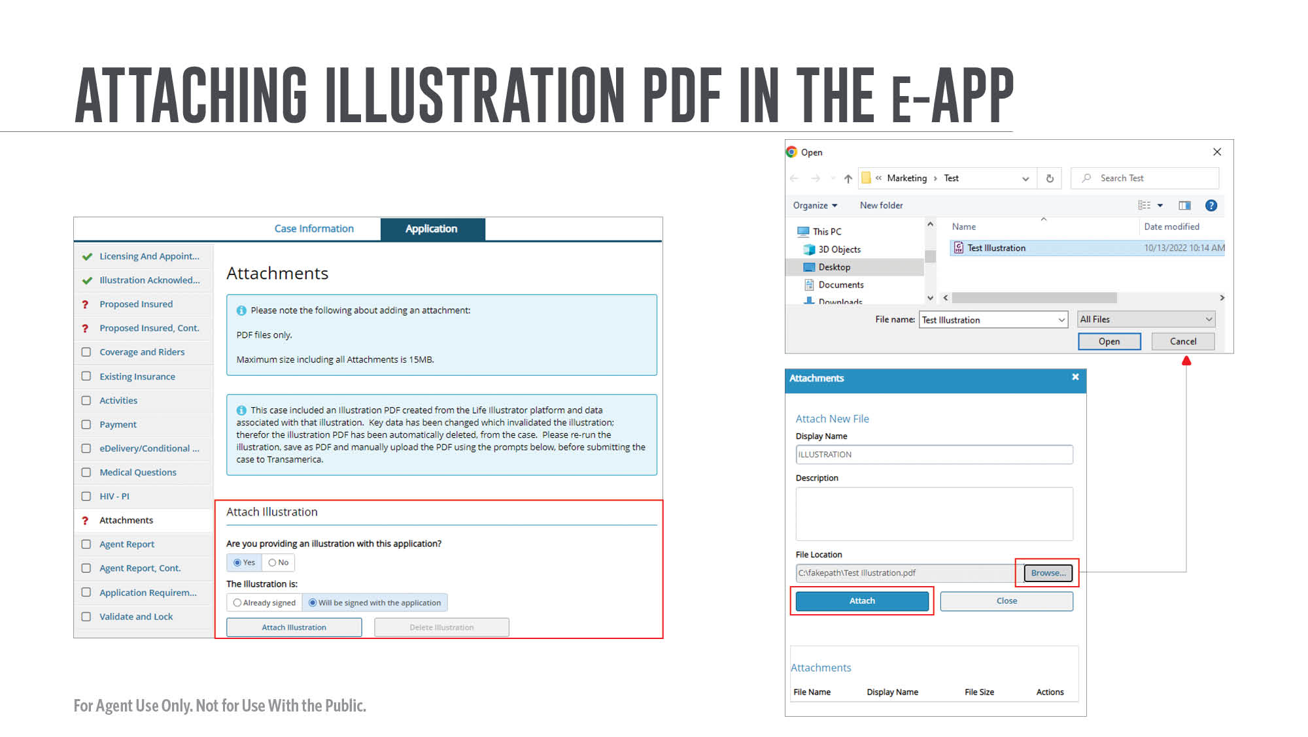
Notes:
Now we attached the illustration PDF in the e-App.
[Review slide]

Slide 39
Notes:
Here is how to revise an illustration.
[Review slide]

Slide 40
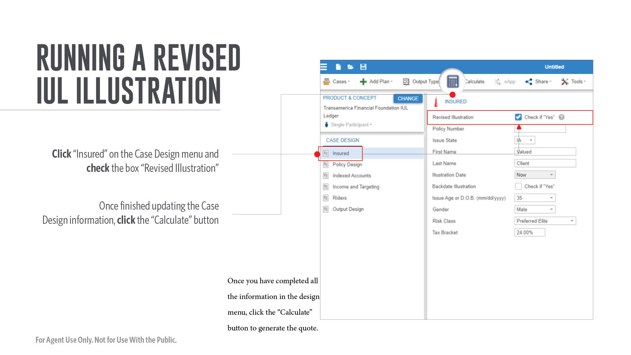
Notes:
[Review slide]

Slide 41
Notes:
Now let’s review the step list for all other products — including Term, Final Expense, and Whole Life.
[Review slide]

Slide 42
Notes:
[Review slide]

Slide 43
Notes:
[Review slide]

Slide 44
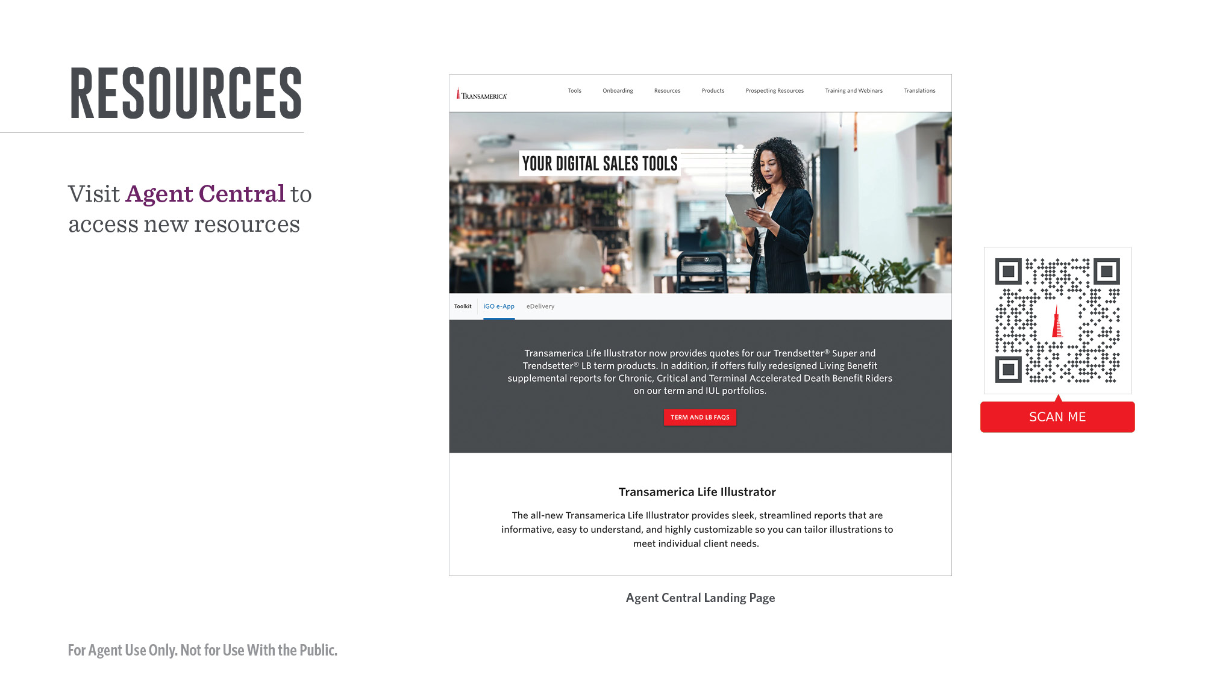
Notes:
Here is how to access more resources on the digital tools page of Agent Central.
[Review slide]

Slide 45
Notes:
Thank you for your time today. I hope you now have a better understanding of how Life Illustrator works and are excited about using it with your clients moving forward. Please let me know if I can answer any questions.

