Slide 1
[MONTH XX, XXXX]
Turning assets into income
A Guide to Retirement Income Planning
Presented to:
[Client Name Here]
This presentation may have been customized by the plan's financial advisor, who is not affiliated with Transamerica. Transamerica disclaims the accuracy of plan-specific information or any other information input into the presentation by such advisor
Notes:
Hello, and thank you for joining me today. My name is [Advisor name], and I’m with [Advisor firm].
We spend so many years trying to accumulate enough money to live comfortably in retirement. Which makes sense, right? You need to have enough set aside to retire when you want and how you want. But what about the day after you retire? How do you go about spending that money?
Today’s presentation will review the basics of creating a retirement income plan. At the end of the presentation, I hope you’ll have a better understanding of some key income planning concepts.

Slide 2
If you fail to plan,
you are planning to fail.
Notes:
I’d like to start off today’s presentation with a well-known proverb:
If you fail to plan, you are planning to fail.
Simple but true. I think all of us here have the same objective when we retire.

Slide 3
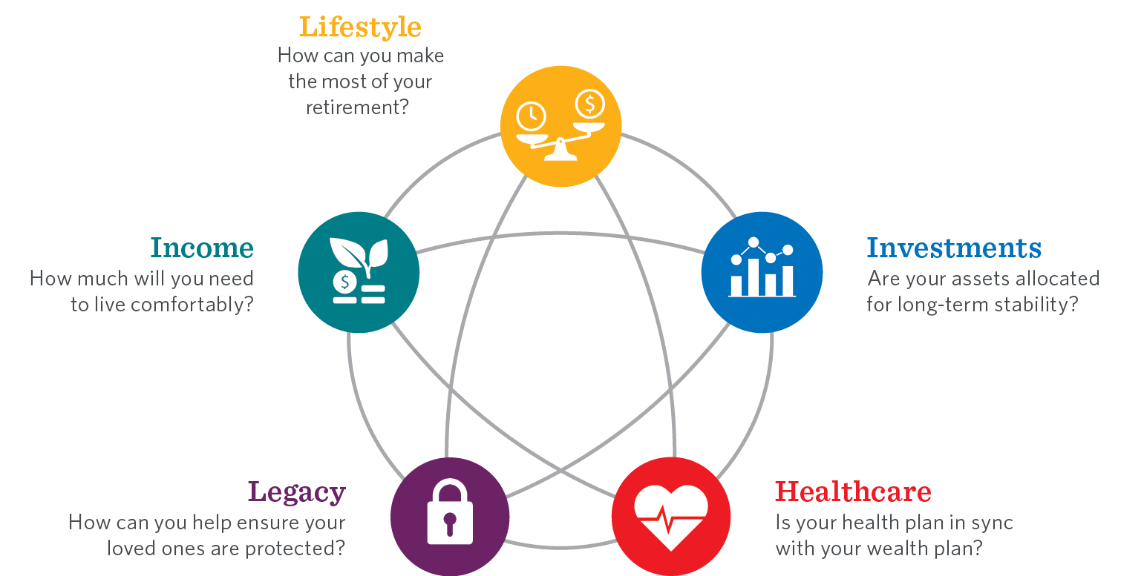
Five key areas for retirement planning
Notes:
As retirement approaches, there are five key areas to consider:
Lifestyle — what are you hoping to do in retirement?
Income — how much annual income do you think you’ll need to achieve that lifestyle?
Investments — what will be your different sources of income?
Healthcare — how will you obtain medical coverage to replace the health insurance provided by your former employer?
Legacy — how will you protect and organize your assets so they can be passed on to your loved ones smoothly?
That’s a lot to think about, but I’m here to help. Today, we’re going to focus on income, but you’ll see that creating a retirement income plan involves all five areas of retirement planning.

Slide 4
How do you visualize retirement?
Retirement aspirations have never been more active
How do you dream of spending your retirement?
65
All Workers (%)
59
51
Working – 51%
26
17
20
14
Traveling
Spending more time with family & friends
Pursuing hobbies
Doing volunteer work
Pursuing an encore career
Starting a business
Continue working in the same field
BASE: ALL QUALIFIED RESPONDENTS
Q1418. How do you dream of spending your retirement? Select all.
“21st Annual Transamerica Retirement Survey of Workers,” nonprofit Transamerica Center for Retirement Studies, November 2021
Notes:
First, let's think about the lifestyle you want to live in retirement.
Not only are Americans living longer, but they are also living more active years in retirement.
According to a nonprofit Transamerica Center for Retirement Studies' survey, two-thirds of workers dream of traveling in retirement. More than half stated they want to spend more time with family and friends, pursue hobbies, or continue working in some capacity.
How do you visualize your retirement?
Everyone has a different vision of what retirement looks like. That’s why it’s so important to create a retirement income plan that fits your vision — a plan that’s right for you.

Slide 5
PLANNING FOR RETIREMENT INCOME
Here’s what we want:
Here’s what we have:
Independence
Security
Freedom
Flexibility
Income
Expenses
Uncertainty
How do we close the gap between what we want and what we have?
Notes:
When it comes to retirement, here is what most people want:
Independence: Having enough money saved for retirement to enjoy the desired lifestyle you want
Security: Having income that will last as long as you do
Freedom: The ability to live retirement on your terms
And flexibility: The ability to adapt if something changes
We also know what people have:
Income: This includes Social Security, your workplace retirement plan, and personal savings you’ve set aside for retirement;
Expenses in retirement, which will largely depend upon the type of retirement you want to have and where you’d like to live; and
Uncertainty, like life, your retirement years are unpredictable. So, you’ll want to have a plan that’s flexible.
So how can we get closer to what we want, with what we have?

Slide 6
Having a plan is critical
Regardless of how much you have saved for retirement, everyone needs a retirement income plan.
Why?
Planning — while not perfect — can help you:
Address the risks inherent in any retirement income plan
Create a sustainable stream of income to meet your needs over the course of your retirement
Address the need for flexibility to accommodate uncertainty and changes in your life or income needs
Notes:
We have to create a plan that takes all of this into consideration.
Planning can help you:
Address the risks inherent in any retirement income plan
Create a sustainable stream of income to meet your needs over the course of your retirement
Address the need for flexibility to accommodate uncertainty and changes in your life or income needs

Slide 7
Today’s Goals
1.
Review the risks inherent in any retirement income plan
2.
Walk through the five key steps to building an income plan
3.
Provide clarity and confidence in building an income plan that’s right for you
Notes:
So here is what we’re going to accomplish today.
We’re going to:
Review the risks inherent in any retirement income plan
Walk through the five key steps to building an income plan
And provide clarity and confidence in building an income plan that’s right for you

Slide 8
Risks in retirement
Longevity
Inflation
Market volatility
Uncertainty
Notes:
So, let’s start with the risks in retirement. When it comes to a retirement income plan, we need to address and incorporate the risks inherent in any income strategy, namely:
(Read Slide)
Let’s look at each of these risks in more detail.

Slide 9
The longevity reality
Life expectancy at age 65
ONE OUT OF THREE 65-YEAR-OLDS TODAY WILL LIVE PAST 90
ONE OUT OF SEVEN 65-YEAR-OLDS TODAY WILL LIVE PAST 95
“When to Start Receiving Retirement Benefits,” Social Security Administration, January 2022
Notes:
Consider the first risk, longevity. Not only are retirees becoming more active in retirement, but they’re also looking at MORE retirement years. One-third of 65-year-olds today will live past age 90. This could mean a 25-year retirement. One in seven will live past 95. This could mean a 30-year retirement. How do you make sure you don’t run out of money before you run out of retirement?

Slide 10
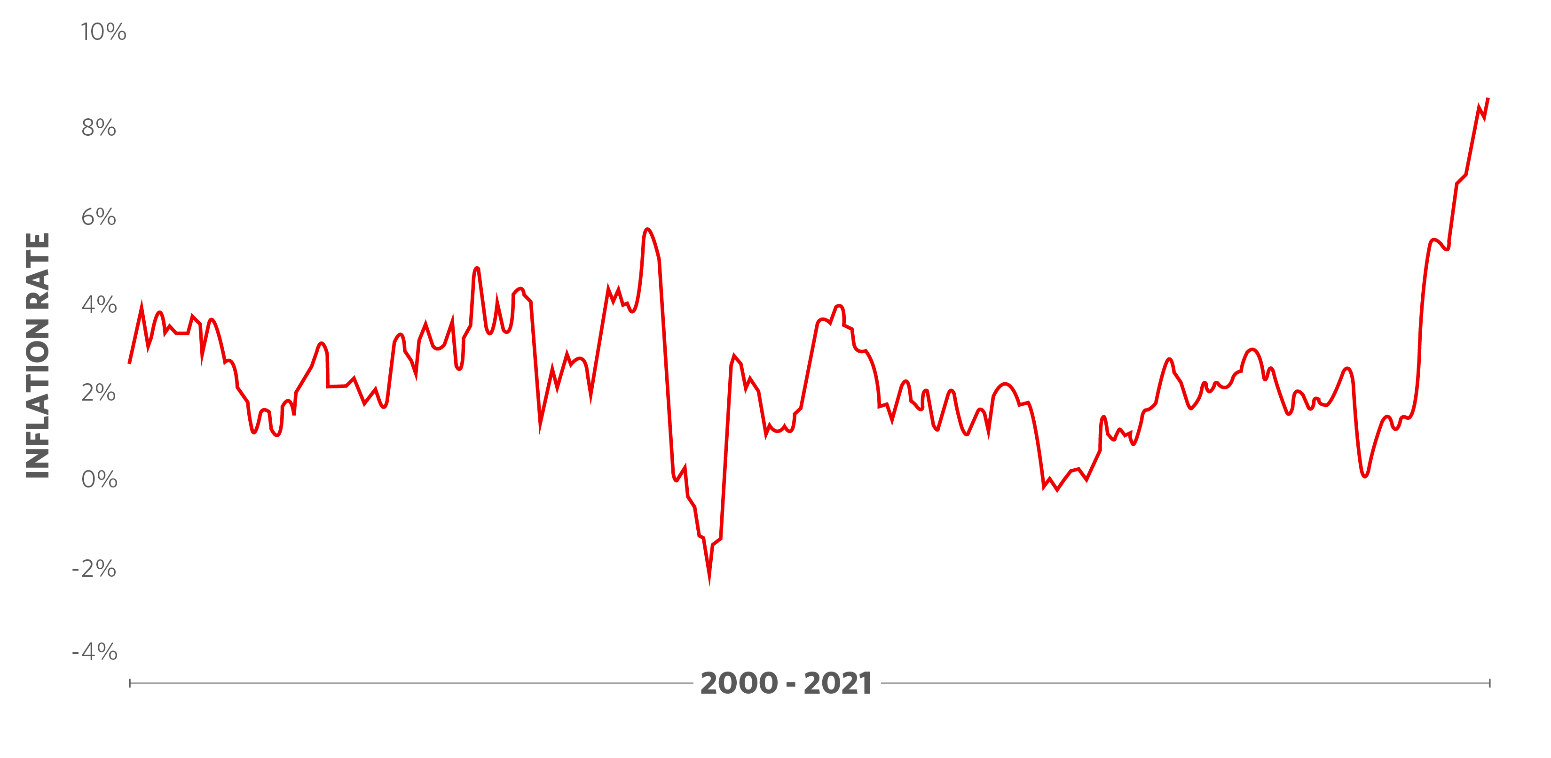
Inflation risk
Inflation erodes the value of savings and purchasing power
Notes:
And then there’s inflation. How many times have we seen charts and graphs that assume a 3 percent inflation rate when inflation historically has been considerably volatile? Inflation erodes the value of savings and purchasing power over time. Most people know that a dollar in 10 years will likely buy less than it does today. What impact could inflation have during your retirement?

Slide 11
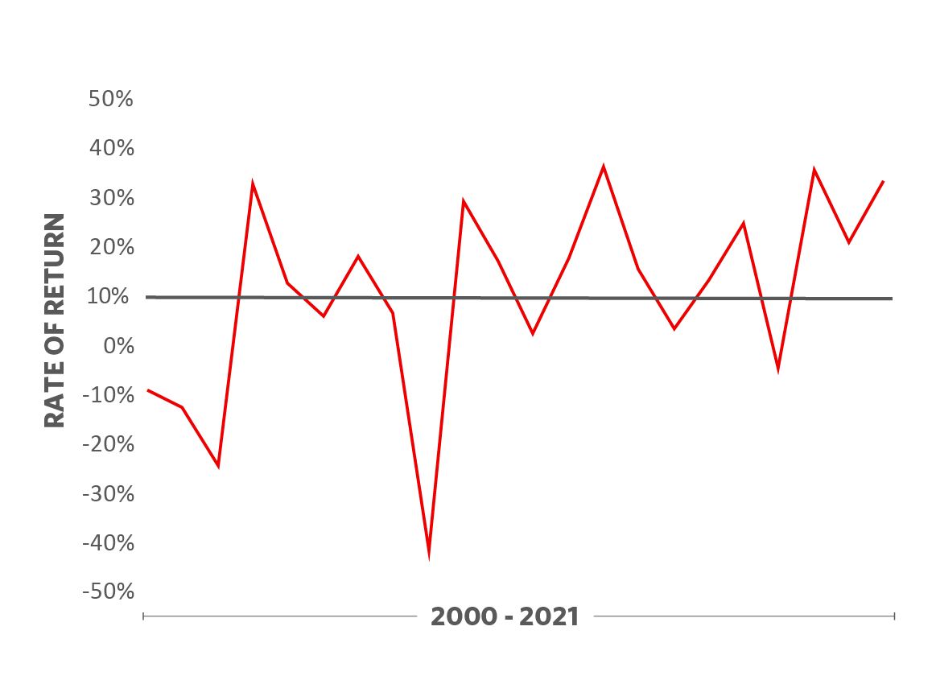
Market volatility risk
S&P 500® * Returns
Market volatility means unpredictable returns
Average Annual Rate of Return
*S&P 500® TR (USD,SPYZ)(IDX) Morningstar®
An index is unmanaged and does not take into account the fees and expenses associated with an actively managed fund, so performance may differ. It is not possible to invest directly in an index. Past performance is no guarantee of future results.
Notes:
The third risk in retirement is market volatility. Market volatility means unpredictable returns. When putting together a plan for the future, people typically use a historical average annual rate of return to estimate or project how their investments will perform, but as you can see, actual performance can vary significantly from the “average.” Are markets going to be favorable in retirement? Are you going to retire in an up market or a down market? How do you plan around unpredictable returns on your investments?
This chart shows that for the time period shown, 2000 to 2021, the average annual growth rate was 7.11%.

Slide 12
uncertainty
Things may not go according to your plan, or you may simply want to change your plan.
Varying income scenarios
Changes in expenses or taxes
Phased retirement
Timing of income
Loss of income
Inflation
Healthcare
Emergencies
Tax rates
Deductions
Notes:
And finally, uncertainty.
(Read slide)
With all these risks and uncertainties, what do we do?

Slide 13
Developing a plan
Notes:
It’s important to think carefully about how you manage and invest your assets throughout retirement. You should also understand the tools available to help provide the necessary retirement income based on your financial resources. That means creating a plan that takes these risks into consideration. Let’s talk about building that plan.

Slide 14
The five key steps
1.
Estimate your expected expenses in retirement
2.
Identify income sources and their reliability
3.
Calculate the income gap – and address it
4.
Consider the different approaches to filling the gap
5.
Monitor and update your plan periodically
Notes:
There are five key steps in developing a retirement income plan:
1. Estimate your expenses in retirement. It’s hard to develop a plan if you don’t have an idea of how much your expenses are going to be.
2. Identify your sources of income. Where is this income going to come from and how reliable is it?
3. Calculate your income gap. This is the gap between your reliable sources of income and your overall anticipated income needs.
4. Develop a plan to fill this gap. Keep in mind, there is no one-size-fits all solution for this.
5. And lastly, monitor your plan periodically. As you know, life changes and you may need to adapt.
[In addition to the information I’m going to share with you today, you can access tools and information on [your plan’s website] [Transamerica’s website], to help you get organized.]

Slide 15
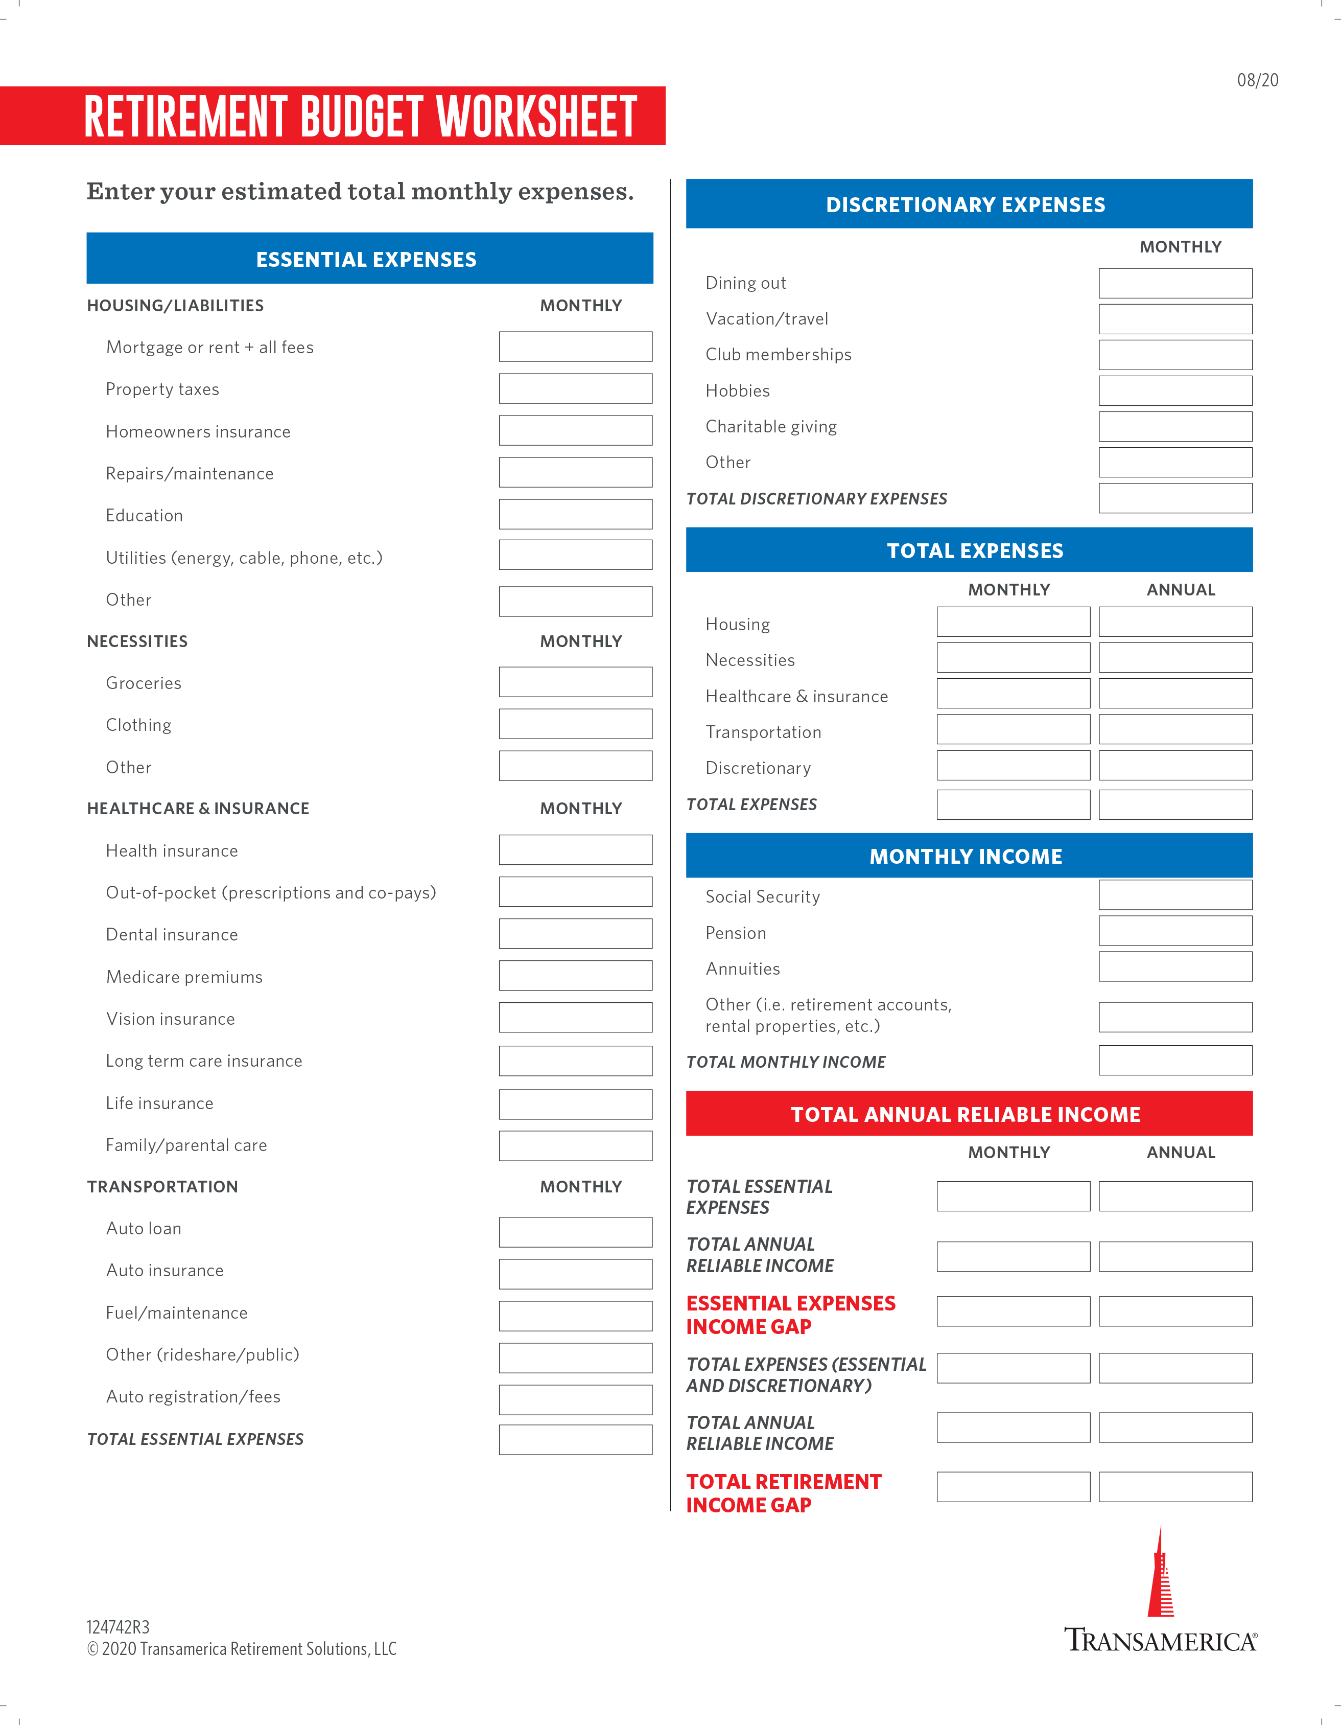
Step 1: estimating your expenses
Find Transamerica’s Retirement Budget Worksheet at: transamerica.com/lp/grtr
Notes:
[OPTIONAL SLIDE FOR FA]
The first step is estimating your expenses in retirement. Costs such as property taxes, utilities, groceries, and transportation are still going to be there when you retire, but they may change from what they are today.
You may want to start by compiling a budget based on your current expenses, and then consider how those expenses may change once you retire. Will you live in the same house, city, or state? Will you stop commuting but travel more? Will you have more time to spend doing the things you enjoy?
Some people find they will spend less in retirement, while others are surprised to learn they may actually spend more! Consider using a budget worksheet that’s available online at: transamerica.com/lp/grtr.

Slide 16
Don’t forget about healthcare
TYPICALLY, MEDICARE DOES NOT COVER ALL HEALTHCARE EXPENSES IN RETIREMENT
When do you need to enroll?
How much will premiums cost?
How much will supplemental insurance cost?
How much should you budget for out-of-pocket expenses?
For information, visit medicare.gov
Notes:
When estimating your expenses, be sure to set aside some time to think about healthcare. If your current employer provides healthcare coverage, you’ll want to understand how your healthcare costs will change in retirement and how Medicare will fit into your plan.
(Read slide)
If you’re getting close to retirement, visit the Medicare website to learn more about Medicare coverage, what it will cost, and what’s right for you.

Slide 17
Step 2: identify sources of income
EMPLOYMENT
DISCRETIONARY
INCOME
SOURCES
SAVINGS AND INVESTMENTS
RETIREMENT ACCOUNTS
PENSION
RELIABLE
INCOME
SOURCES
SOCIAL SECURITY
Notes:
Once you have a handle on spending needs and your expected budget in retirement, you can evaluate your sources of retirement income. Let’s briefly review these income sources, starting at the bottom, and how they’ll fit into your overall income plan.
Social Security is typically the first building block in your retirement income strategy, followed by pensions or other defined benefit arrangements you may have from an employer. Social Security and pensions are considered reliable sources of income because they’re guaranteed for life.
Moving up the chart, we have retirement accounts, such as your 401(k) or other workplace retirement plan or IRAs. These types of accounts are designed specifically to help you set money aside for retirement.
Some of you may have additional assets in a variety of other accounts — either invested in brokerage accounts or something as simple as a savings account in the bank. And finally, we list employment as a potential source of income. Working in retirement, such as a part-time job, may be part of your retirement strategy.
Retirement accounts, other savings and investments, and wages are considered discretionary income sources. Your account balances or employment income may change over time. For example, you may decide to quit your part-time job, or you may experience a decline in the value of your savings and investments due to market volatility. In other words, these sources tend to be less reliable than others, and it will be up to you to decide when and how to use them.

Slide 18
Reliable sources of retirement income
SOCIAL SECURITY
Eligibility
Primary insurance amount (PIA)
Claiming strategy
Impact of working in retirement
For more information: SSA.gov
PENSIONS
How much?
When is it available?
What are the payout options?
Notes:
Let’s take a few minutes to review income sources in more detail.
It’s important to find out if you’re eligible for Social Security benefits and what your full retirement benefit will be. Your full retirement benefit is also referred to as your primary insurance amount. Also, what are the claiming options available, and which one might be right for you based on your personal circumstances? Should you collect early, or should you wait? And if you’re married, how will your decision impact your spouse? And finally, how will working in retirement impact your benefits? For answers to these questions — and more — visit SSA.gov to get a better understanding of the benefits you’re entitled to and what may be best for you.
If you’re fortunate enough to have a pension through your current or former employer, it’s important to find out how much you’ll be entitled to, when you’ll be eligible to receive benefits, and what payout options are available. Many pension plans offer joint life options with a spouse and guaranteed periods. You should carefully review your options to determine what’s best for you.

Slide 19
Discretionary sources of retirement income
Employer-sponsored retirement plan (e.g., 401(k)/403(b))
IRAs
Personal investments
Savings
Wages
Notes:
Now let’s take a closer look at your discretionary income sources.
Retirement accounts such as 401(k)s, 403(b)s, and IRAs are designed to help you build your retirement savings, but it’s up to you to decide how you’ll use the money to generate a stream of income that’ll meet your retirement objectives. For many people, retirement accounts will help meet monthly income needs and provide a source of cash for discretionary expenses.
You may also have other personal investments and savings accounts that you’ll be able to use for income in retirement. But again, it will be up to you to decide how and when you will use these assets to meet your income needs in retirement.
Working in retirement can offer significant benefits. In addition to the income, many people like to work in retirement because they enjoy the challenge or just want to remain active. Other advantages of working include deferral of Social Security benefits, continued access to health insurance, and additional time for your retirement assets to potentially grow. “Phasing” into retirement through part-time work has become a growing trend.
The sources of income listed on this slide are discretionary for two reasons. The first is that you control when you’ll use them and how much you’ll use to meet your income needs. The second reason is that how you choose to invest these sources of income will determine their value over time.
How you invest your assets in retirement is an important topic that’s beyond the scope of today’s presentation. Generally speaking, people tend to invest more conservatively in retirement but it’s also important to invest in a way that can offset the effects of inflation. [You may want to take the time to speak with an investment professional to determine what investment strategy is best for you.]
In the next few slides, we’ll talk about how you can build a retirement plan using both your reliable and discretionary sources of income.

Slide 20
Matching sources of income with expenses
EMPLOYMENT
LEGACY
DISCRETIONARY
INCOME
SOURCES
SAVINGS AND INVESTMENTS
FREEDOM / FLEXIBILITY
RETIREMENT ACCOUNTS
DISCRETIONARY EXPENSES
PENSION
ESSENTIAL EXPENSES
RELIABLE
INCOME
SOURCES
SOCIAL SECURITY
HEALTHCARE
Notes:
To start, let’s consider a general framework for matching our sources of income with our income needs.
When it comes to expenses, we’ve created a general hierarchy based on need, starting at the bottom with the essentials, and building up to the things we’d like to be able to afford in retirement. As you examine your expenses in retirement, it may be beneficial to categorize them in the following way:
First, start with healthcare and essential expenses. For most people, the first step in creating a retirement income plan is to ensure they have enough income to cover their healthcare costs and other essential expenses, such as groceries, heat, electricity, and other basics.
Next, you’ll want to determine your discretionary expenses. These are the types of expenses associated with the things you would like in retirement, but you could reduce or eliminate if needed. Examples of discretionary expenses include dining out, traveling, golf club memberships, etc.
Once you’ve laid out your essential and discretionary expenses, you’ve probably covered the majority of your income needs in retirement. But some people also like to ensure they can have some freedom and flexibility in retirement by setting some of their income or retirement assets aside for special purposes. Some examples may include plans for a once-in-a-lifetime trip, traveling in an RV for a few years, or helping their children or grandchildren pay for a wedding or buy a new home.
And finally, some people who have saved a sufficient amount for retirement may want to set some money aside for legacy planning. Examples may include leaving money as an inheritance or making a significant financial contribution to a charity or other special interest.
Generally speaking, most people want to feel confident they’ll be able to cover their healthcare expenses and essential expenses in retirement, at a minimum. Ideally, it’d be great if you have enough income from reliable sources to cover health care, essential expenses and more! But that may not be the case. You may have to dip into your discretionary sources of income to cover some of your essential expenses in addition to your discretionary expenses.
By estimating your expenses in retirement and determining your sources of income to meet those expenses, you can get a sense of how much of your expenses will be covered by your reliable sources of income. Then consider how much of your discretionary sources of income will be needed to cover your remaining expenses. This is sometimes referred to as the “income gap.”

Slide 21
Step 3: calculating the income gap
The difference between your estimated expenses and your reliable income sources.
LEGACY
FREEDOM / FLEXIBILITY
DISCRETIONARY EXPENSES
ESSENTIAL EXPENSES
RELIABLE INCOME
HEALTH CARE
Example is hypothetical for illustrative purposes only.
Notes:
The retirement income gap is the difference between the income you’ll receive from your reliable sources of income, such as Social Security and pensions, and the amount of income you’ll need to meet your overall retirement income objectives.
In this hypothetical illustration, we have $5,500 of monthly expenses to cover and only $2,500 in reliable income, leaving an income gap of $3,000 a month. Multiply that by 12 months — and your annual income gap will be $36,000. Calculating this gap is critical for any retirement income strategy.
Arguably the biggest concern for most retirees is how to fill this income gap with a stream of income that is sustainable.

Slide 22
Step 4: filling the income gap
When it comes to retirement income, there are essentially two solutions
Traditional investments
(asset allocation)
Annuities*
*Guarantees are based on the claims-paying ability of the issuing company.
Notes:
Once you’ve calculated your retirement income gap, you need to find a way to fill it. There are different ways to accomplish this, but we’ll focus on two of the most popular. Each solution has its pros and cons, and there is a give and take when it comes to flexibility vs. sustainability. Many people use a combination of these solutions to meet their retirement income objectives.
First, let’s talk about flexibility vs. sustainability. Flexibility means you can withdraw as much as you want whenever you want. Sustainability refers to the likelihood that the income you receive will last as long as you do. As you’ll see, there’s a tradeoff between flexibility and sustainability depending on the source or tool you use to generate income in retirement.
A diversified portfolio of traditional investments, which most of you probably have today in your workplace plan or IRA, is usually going to offer the most flexibility. You can generally withdraw as much as you want, whenever you want in retirement. The tradeoff is that you’ll have to carefully monitor how much you spend each year to ensure you don’t run out of money too soon. In other words, a traditional investment offers a lot of flexibility, but it doesn’t provide a guaranteed source of income for life.
At the other end of the spectrum is an annuity. An annuity provides a guaranteed amount of income that you can’t outlive. You determine the amount of income you’ll receive by exchanging a lump-sum amount of your retirement assets for a specified amount of income each month or year. The terms of the annuity contract ensure a guaranteed lifetime income, but offer very little, if any, flexibility. If your desire is to have freedom and flexibility or leave a legacy, the story is very similar. Traditional investments would give you the most flexibility to leave a legacy, while annuities would offer very little, if any, legacy planning opportunities.
So, let’s examine them briefly in the context of what people want. I think we’d all agree that a guaranteed source of income is beneficial when it comes to meeting our essential expenses and even a portion of your discretionary expenses. But we may want to have flexibility when it comes to some of our discretionary expenses or desire to leave a legacy.
This diagram shows there is no clear winner or loser. Instead, there are pros and cons that should be weighed against your needs and desires. For most individuals, a combination of these options would probably be appropriate. Determining that combination is the challenge.
Let’s look at each of these strategies.

Slide 23
Traditional investments
How much can I withdraw each year and not run out of money?
4% rule
The 4% rule is not a rule at all.
It’s a common general recommendation introduced in 1994
Most commonly defined as withdrawing 4% of initial retirement account balance, and increasing that amount every year based on inflation
It historically offers a high probability that your assets will last as long as you do
Other financial professionals say 5% may be more realistic and allow for a more comfortable lifestyle while adding only a little more risk
Source: “Four Percent Rule,” Investopedia.com, January 2022
Notes:
Having a “big pot of money” when you retire sounds like a good thing, right? The challenge is figuring out how much you can withdraw each year without running out of money.
Over the course of your retirement, you’ll likely encounter many, if not all, of the risks we outlined earlier in the presentation: longevity risk, inflation risk, and market risk. Because things change over time, it’s impossible to know how long your assets will last with any degree of certainty.
Back in the 1990s, a financial planner named William Bengen published an article that addressed the question of sustainable withdrawals in the context of the risks inherent in any income strategy. His conclusion is what’s commonly referred to today as the four percent rule. The four percent rule is a common recommendation noting that a four percent annual withdrawal rate would have a high probability of success for a 60- to 65-year-old who wanted their assets to last 30 years. Over the years, this number has been debated and there’s still a lot of uncertainty around the general proposition that four percent is considered an optimal withdrawal rate for most retirement investors.

Slide 24
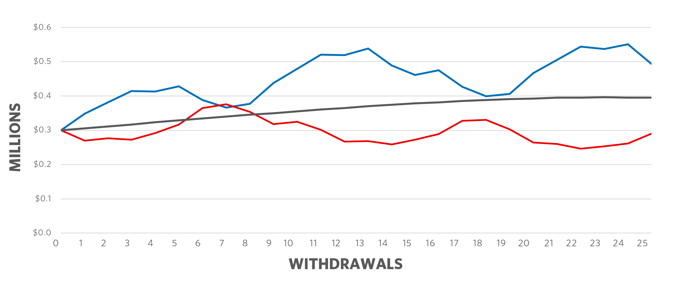
Withdrawal rate vs portfolio performance
 | YEAR 1 | YEAR 2 | YEAR 3 | YEAR 4 | YEAR 5
PORTFOLIO A | 20% | 13% | 12% | 3% | 7%
PORTFOLIO B | 5.93% | 5.93% | 5.93% | 5.93% | 5.93%
PORTFOLIO C | 6% | 7% | 3% | 12% | 13%
Hypothetical example used for illustrative purposes.
Notes:
A key factor in determining whether the four percent rule is an effective guideline for your retirement income plan has to do with your portfolio’s make-up and how you’re invested. If you’re more heavily invested in stocks, the chances of market risk negatively affecting your total account balance increases. On the other hand, if you’re more heavily invested in bonds, the chances of inflation risk increases as your investment returns may not match how much inflation is increasing by.
The best way to mitigate these types of risks is by finding an appropriate balance between stocks, bonds, and cash investments. For example, some investors may set aside cash in their portfolio so that those funds can be withdrawn first during times of a market downturn to avoid withdrawing from investments when they’re down.
In this example, look at how regular withdrawals can compound losses in retirement, making it harder to recover from a portfolio decline, especially one that happens early on in retirement. This example assumes that each portfolio started with $300,000 and there were annual withdrawals from each of $12,000, adjusted by 3% each year for inflation. While the average return of all three portfolios is the same at 5.93% over a five-year span, you can clearly see which portfolio was most affected by an early market decline.

Slide 25
Traditional investments
What if the 4% rule doesn’t work for me?
Consider a variable spending strategy: If the market is down, maybe work to only withdraw 3% that year. When the market recovers, try to increase your spending back to 4%, or even 5%.
Skip the inflation adjustment: Withdraw the same amount each year, despite increased inflation, and find ways to cut back on discretionary expenses.
Continue to review/adjust your plan: Things can change quickly with our market. Stay flexible and consistently review your spending strategy to ensure your plan stays aligned with your retirement goals.
Leverage fixed income sources: Be sure to factor in your Social Security and pension income when developing your spending plan. Consider other fixed income solutions to invest in, like annuities.
Notes:
So, what if the 4% rule doesn’t make sense for you? It does make assumptions that don’t apply to every investor. For example, it assumes you have a perfect 50/50 split between stock and bond investments in your portfolio and it assumes you have a 30-year time horizon, which may not line up with your situation.
If the 4% rule doesn’t seem feasible given your circumstances, there are other ways you can approach how to develop and maintain a sustainable spending strategy.
(Read Slide)

Slide 26
ANNUITIES
Offer sustainability protection
Tax-deferred annuity with an optional rider that provides guaranteed lifetime income
Limited flexibility
Typically, no access to cash
Can offer options allowing you to provide lifetime income to both you and your spouse
Guarantees are based on the claims-paying ability of the issuing company.
Annuity fees and charges include mortality and expense risk fee and administrative charge, surrender charges, annual fee, and investment option management fee.
Annuities are long-term, tax-deferred vehicles designed for retirement purposes and are subject to investment risk, including possible loss of principal.
Notes:
As you can see, creating a sustainable stream of income from traditional investments over the course of your retirement can be a challenge and there will always be some degree of uncertainty, which is why annuities are a great solution to provide sustainable income. Many people just like the idea of having a source of income that will last as long as they do.
You can typically pick from either fixed or variable annuity products, and they also offer options that allow you to provide lifetime income to both you and your spouse.
You’ll want to carefully review the options, terms, and fees to decide if an annuity makes sense for your retirement income plan.

Slide 27
income SOURCES in action
Flexibility
EMPLOYMENT
TRADITIONAL INVESTMENTS
LEGACY
SAVINGS AND INVESTMENTS
FREEDOM / FLEXIBILITY
RETIREMENT ACCOUNTS
DISCRETIONARY EXPENSES
ANNUITIES
PENSION
ESSENTIAL EXPENSES
RELIABLE
SOURCES
OF INCOME
SOCIAL SECURITY
HEALTH CARE
Sustainability
Notes:
Going back to the chart we discussed earlier, you can see annuities right in the center between traditional investments and reliable sources of income. You can rely on Social Security and a pension plan to provide a reliable and sustainable source of income to cover healthcare costs and most of their essential expenses.
You may have to access your retirement accounts to cover any remaining essential and discretionary expenses. For this example, let’s say you’d like all essential expenses and half of the discretionary expenses to be sustainable and reliable. This is accomplished by purchasing a guaranteed income product to provide a guaranteed floor of income you feel comfortable with.
For the remainder of your discretionary expenses, along with the money you plan to set aside to provide freedom, flexibility, and a possible legacy for your children, you might be comfortable [setting up a sustainable withdrawal plan with your financial advisor to provide the remaining income you’ll need in retirement] [speaking with a Transamerica advisor].
Of course, everyone has a unique set of circumstances when it comes to sources of income, expenses, and preference for sustainability vs. flexibility. But as you can see, there are a variety of solutions to meet those needs.

Slide 28
Creating an income plan that’s right for you
Three primary components
Income floor: An annuity is an example of how you can supplement your reliable sources of income
Sustainability: Manage the amount you withdraw from traditional income sources
Balance: Flexibility vs. sustainability
Notes:
So, some of you may be asking, which approach is right for me? It’s a good question because there is no one answer that’s right for everyone. It’s important to create an income plan tailored to your goals and objectives.
Here are three primary components to consider:
If you like the concept of an income floor to cover a minimum amount of expenses, consider guaranteed income solutions — like an annuity — to supplement your reliable sources of income
Manage the amount you withdraw from your traditional income sources with an eye toward sustainability.
Consider your preference or desired balance between flexibility and sustainability.
Guaranteed income products can add sustainability but may limit some flexibility. This is where people need the most help – finding the mix of products and investments to best address their needs.

Slide 29
Step 5: monitor your plan
As life changes, your retirement income plan may need to change as well
Change in retirement goals
Increase or decrease in expenses
Investment performance
Change in legacy desires
Impact of taxes
[Consider working with a financial professional / checking in on your retirement strategy with a Transamerica advisor]
Transamerica and its agents and representatives do not provide tax or legal advice. This material is for informational purposes and should not be construed as legal or tax advice. For legal or tax advice concerning your situation, please consult your attorney or tax professional.
Notes:
One of the only certainties in a plan is that it will change. That’s why it’s important to continue to monitor your plan and make changes when necessary. Consider what would happen if you changed your retirement goals. What if your expenses increase or decrease? What’s going to happen to the markets in the years ahead? What if your legacy desires change? The list could go on and on.
But let’s take a moment to discuss the impact of taxes. We’ve talked about establishing a retirement income plan that is right for you. But depending on the amount of income you receive and the sources of that income, taxes can have a significant impact on the amount you’ll be able to spend. So, once you establish an income plan that is right for you, you’ll want to also review the tax implications with a tax professional.
Continue to monitor your plan and make changes along the way to adapt your plan to your personal circumstances. Working with [a financial professional] [a Transamerica advisor] can help you navigate some of these changes over the course of your retirement journey.

Slide 30
Reviewing the five steps
1.
Estimate your expected expenses in retirement
2.
Identify income sources and their reliability
3.
Calculate the income gap – and address it
4.
Consider the different approaches to filling the gap
5.
Monitor and update your plan periodically
Notes:
To recap, here are the five steps to start developing your retirement income plan:
1. Evaluate your expected expenses in retirement
Essential expenses
Discretionary expenses
2. Identify income sources and their reliability
Social Security and pensions
Investments and retirement accounts
3. Calculate the income gap in order to address it
4. Consider the different approaches to filling the gap
5. Monitor and update your plan periodically
Remember, you don’t need to do any of this by yourself.

Slide 31
Your transamerica resources
Transamerica.com/portal/financial-wellness
Transamerica.com/webinars
ADDITIONAL resources
Medicare.gov
SSA.gov
[Speak to a financial professional about your annuity options]
Transamerica is sponsoring financial education programs developed by EVERFI, a third party unaffiliated with Transamerica that is responsible for the content of the financial education program.
Notes:
Transamerica offers online tools and services you can access at any time including live and recorded webinars, an expansive menu of quick and easy online lessons to help you understand the basics of fundamental financial principles, and then you can always speak with a Transamerica retirement specialist who can answer your questions or offer guidance on how to work toward any specific financial goals you’re trying to accomplish. I can help you connect with one of those specialists, if needed.

Slide 32
I can help
Make an appointment
Transamerica Resources
Get in touch
[ADVISOR NAME]
[Advisor email address]
[Advisor phone number]
[Onsite location if applicable]
Access your account: [transamerica.com/portal]
Market Outlook
Knowledge Place
Financial Wellness Center
[COPY IN QR CODE HERE]
Registered representative of [firm name & address]. Transamerica is not affiliated with [firm name] or its affiliates.
Notes:
Advisor: fill in whichever contact methods you prefer and delete sections you do not need.
My goal today was to address (and ease) your concerns, provide perspective, and encourage you to create a sound investment strategy for retirement — and to stick to it!
You don’t have to do it alone. I encourage you to schedule some time with me to review your retirement strategy. Here’s my email address [and phone number]. Please reach out if you’d like to make an appointment. [You can also make an appointment right now by scanning the QR code on the screen. If you have an iPhone, simply point your camera at it. If you have an Android device, use Google Lens or another scanning app.]
You can always access your account and find resources at [transamerica.com/portal/home].
Remember, try to be patient, pragmatic, and disciplined with your retirement strategy during any market crisis. Stay the course with your strategy using the tried-and-true principles of successful retirement planning that we discussed today. Try not to let emotions get the best of you and let the facts and proven principles guide you.
I’m hopeful I provided you with some information that will help reassure you as we work together to navigate investing for retirement.

Slide 33
disclosures
All investments involve risk, including loss of principal, and there is no guarantee of profits. Investors should carefully consider their objectives, risk tolerance, and time horizon before investing. There is no assurance that any fund will meet its stated objective.
A variable annuity is suitable for long-term investing, such as for retirement. There are no additional tax-deferral benefits when a variable annuity is offered inside a tax-deferred retirement plan. As with any early distribution from a tax-deferred retirement plan, a 10% tax penalty may apply for a withdrawal before age 59-1/2 unless an applicable exception is available. You should consider a variable annuity's investment objectives, risks, rates, charges and expenses carefully before signing a contract. More information can be found in the prospectus. You are encouraged to read it carefully.
Securities offered through Transamerica Investors Securities Corporation (TISC), member FINRA, 440 Mamaroneck Avenue, Harrison, NY 10528. Investment advisory services are offered through Transamerica Retirement Advisors, LLC (TRA), registered investment advisor.
Variable annuities issued by Transamerica Life Insurance Company (TLIC) in Cedar Rapids, Iowa and Transamerica Financial Life Insurance Company (TFLIC) in Harrison, New York (Transamerica). Variable annuities are underwritten and distributed by Transamerica Capital, Inc. (TCI), member FINRA, 1801 California Street, Denver, CO 80202. Securities are offered by TISC. All Transamerica companies identified are affiliated, but are not affiliated with your employer.
This material was prepared for general distribution. It is being provided for informational purposes only and should not be viewed as an investment recommendation. If you need advice regarding your particular investment needs, contact your financial professional.
Transamerica and its agents and representatives do not provide tax or legal advice. This material is for informational purposes and should not be construed as legal or tax advice. For legal or tax advice concerning your situation, please consult your attorney or professional tax advisor.
Notes:
As a reminder, this material is provided for educational purposes only and does not constitute investment, tax, or legal advice. The information contained herein is based on current tax laws, which may change in the future. Transamerica does not provide any tax, legal, or accounting advice. Please consult your attorney or tax professional for answers to your specific questions.

Slide 34
Thank you
08/22
2318820
© 2022 Transamerica Corporation
Notes:
Thank you for your time.

