Slide 1

Live to explore
Updated foreign national program
For Agent Use Only. Not for Use With the Public.

Slide 2
Agenda
1.
Why are we in this space?
2.
Why Transamerica?
3.
Individual Taxpayer Identification Number (ITIN) program
4.
Resident Foreign Nationals program
5.
High Net Worth Nonresident Foreign Nationals program
6.
Where do we go from here
For Agent Use Only. Not for Use With the Public.

Slide 3



Market opportunity
Major foreign buyer countries
China
Canada
Brazil
India
Mexico
132 million
The number of foreign
nationals granted admission
to the U.S. in 2023.¹
$42 billion
The amount of residential
property purchased by
foreign nationals from
April 2023 – March 2024.²
For Agent Use Only. Not for Use With the Public.

Slide 4
What’s the why?
Lifetime estate tax exemption
U.S. Resident
Foreign Nationals:
2023: $12.9 million
(RA exemption amount is equal to
that available for U.S. citizens.)
Non-U.S. Resident
Foreign Nationals:
$60,000 (equal to credit
amount of $13,000)
Client need: High net worth foreign nationals may be unaware of the potential tax exposure. U.S. dollar-denominated life insurance can be used to help pay estate taxes and protect the quality of life for their family.
For Agent Use Only. Not for Use With the Public.
4
For Agent Use Only. Not for Use With the Public.

Slide 5
“The only source of knowledge is experience.”
- Albert Einstein
For Agent Use Only. Not for Use With the Public.

Slide 6

Deep-rooted experience
Over 100 years in the insurance business,
25 of those in the foreign nationals market
Agency Rating
A.M. best: A is 3rd highest of 16 categories
(as of January 28, 2025)
Moody’s: A1 is 5th highest of 21 categories
(as of December 12, 2024)
S&P global: A+ is 5th highest of 21 categories
(as of March 28, 2025)
For Agent Use Only. Not for Use With the Public.

Slide 7

International underwriting team
Experience matters
First established in 1998
Current team boasts extensive medical underwriting expertise
Spanish translation capability
Thorough understanding of geopolitics, geography, immigration, and international finance
For Agent Use Only. Not for Use With the Public.

Slide 8
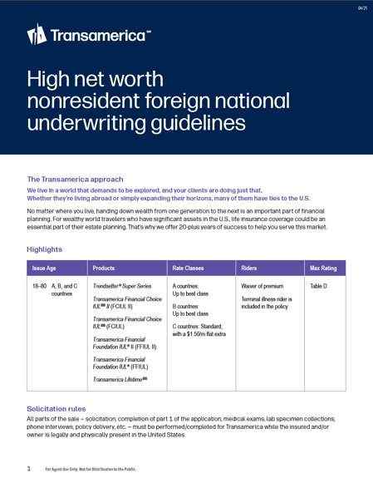
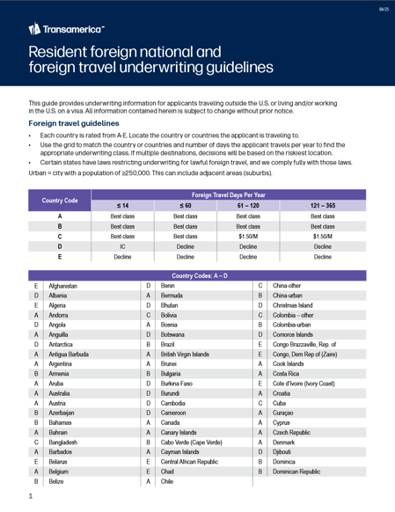
Foreign national support
Simplified marketing materials
Nonresident HNWFN Guidelines
Resident and Foreign Travel HNWFN Guidelines
Agent Guide to U.S. Estate and Gift Taxation
for Foreign Nationals
Foreign Nationals Consumer Guide
Foreign National landing page: transamerica.com/foreign-nationals/
Transamerica foreign national hotline: Dedicated sales desk resources
available to answer your calls 855-712-0561
Foreign national forms: Transamerica website > forms finder
For Agent Use Only. Not for Use With the Public.

Slide 9
Individual taxpayer identification number
What’s new:
C & D countries now available at standard class (no flat extras)
E countries can now be considered up to standard class when the client has been in the U.S. for two years or more
Maximum face amount increased to $2 million
Face amounts over $2 million considered on an individual case basis
Elimination of minimum face amounts eligible for expanded nonmedical underwriting with a medical footprint in the U.S.
Employment authorization card with categories C14 and C08 (pending asylum) now able to be considered
with ITIN guidelines
Consideration of
juveniles (<18) when parent/owner qualifies
For Agent Use Only. Not for Use With the Public.

Slide 10
Resident and nonresident programs
For underwriting purposes
U.S. Resident
Foreign Nationals
Work, academic, and humanitarian visas
Work and/or reside in the
U.S. for a set amount of
time based on visa
Non-U.S. Resident
Foreign Nationals
B visa or visa waiver program
Visits U.S. for business
or pleasure but maintains permanent residence
outside of the U.S.
10
For Agent Use Only. Not for Use With the Public.
For Agent Use Only. Not for Use With the Public.

Slide 11

U.S. resident foreign national program
11
For Agent Use Only. Not for Use With the Public.

Slide 12

U.S. resident foreign national program
Overview and highlights
Have to hold a visa that allows them to reside and work (or go to school) in the U.S.
Green card holders eligible for long term care, chronic, and critical riders
Many visa types eligible for long term care, chronic,
and critical riders
Similar underwriting process to U.S. citizens, many visa types eligible for best class
For Agent Use Only. Not for Use With the Public.

Slide 13
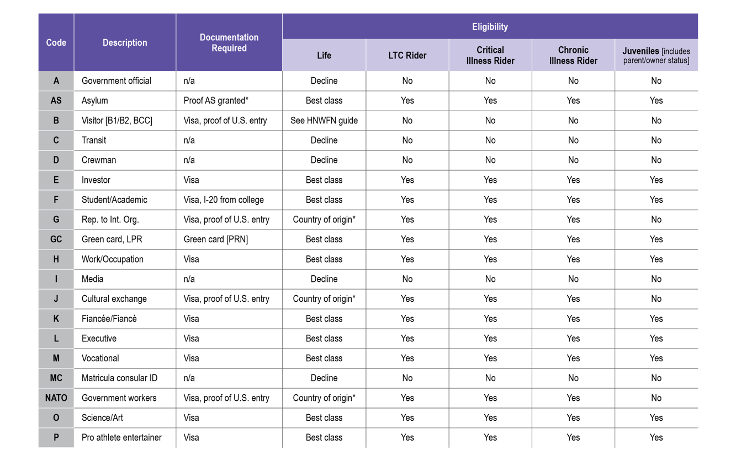
Visas
13
For Agent Use Only. Not for Use With the Public.

Slide 14
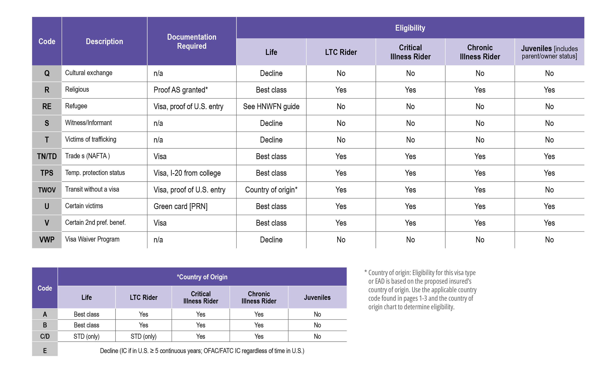
Visas continued
14
For Agent Use Only. Not for Use With the Public.

Slide 15
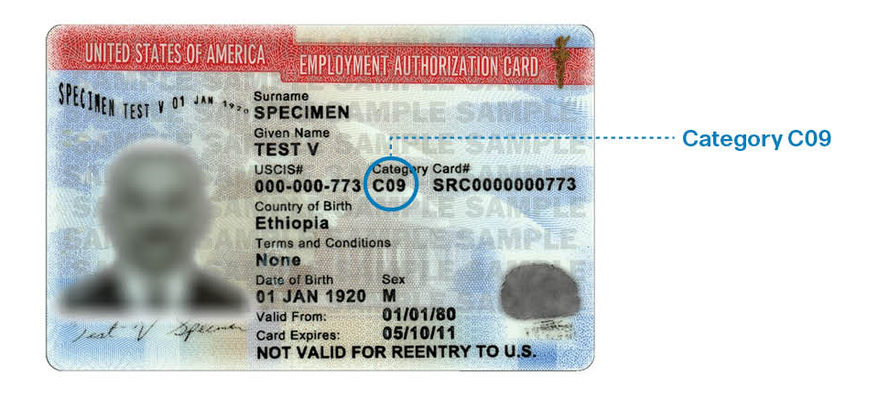
Employee authorization cards
Sample card
This card is a sample card from the U.S. citizenship and immigration services website.*
15
For Agent Use Only. Not for Use With the Public.
* Source: uscis.gov/i-9-central/acceptable-documents/list-documents/form-i-9-acceptable-documents

Slide 16
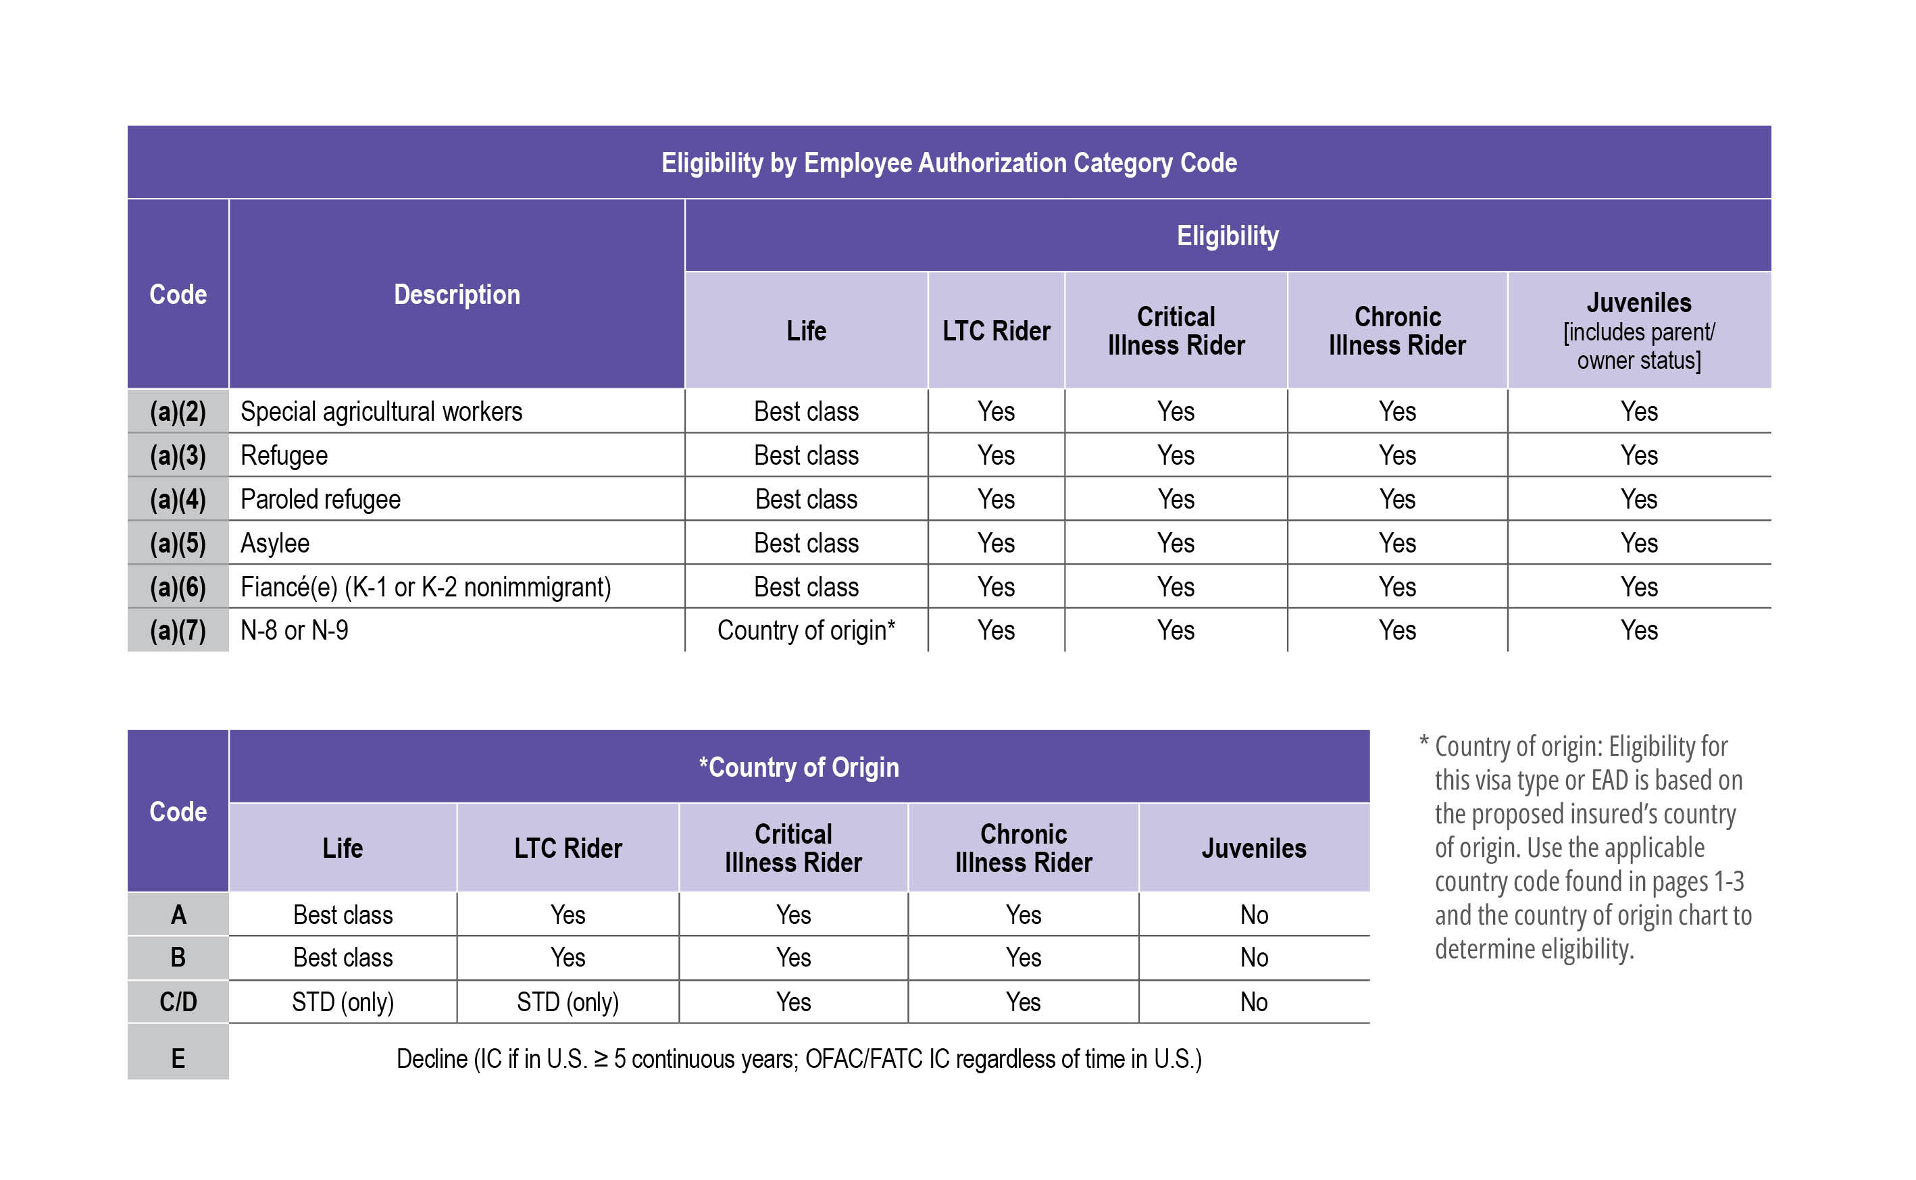
Employee authorization cards
16
For Agent Use Only. Not for Use With the Public.
¹ May be eligible for life coverage through ITIN program.

Slide 17

Resident foreign nationals
Asylum (granted or pending)
Transamerica underwrites pending asylum cases through our ITIN program. Acceptable evidence of asylum granted (or pending) includes one of the following:
A readable copy of the letter granting asylum.
The letter may be from USCIS or an immigration
court judge.
A copy of the EAD A05 (asylum granted)
For dependent family members, a copy of
USCIS Form I-730
A copy of the EAD with category C08 (pending asylum)
For Agent Use Only. Not for Use With the Public.

Slide 18

Resident foreign nationals
F visa: college students
Required documentation:
Copy of F visa
Copy of Form I-20 from the school
Financial underwriting:
Face amounts up to $2,000,000
$2,000,000+
Additional consideration may be given to professional
degrees such as law, engineering, medical school, or
advanced degrees (master’s, Ph.D.)
For Agent Use Only. Not for Use With the Public.

Slide 19

High Net Worth Non-Resident Foreign National Program
19
For Agent Use Only. Not for Use With the Public.

Slide 20
Nonresident foreign national program
Overview and highlights
Program:
Up to best class for
A and B countries
Available to qualified
residents of dozens
of countries
A clear definition of
required U.S. ties
Financials:
Minimum global
net worth ≥ $1M
Third-party financials
over $3M death benefit
Inspection reports
over $10M death benefit
Products:
Term and permanent
life insurance available
IUL: minimum
$250,000 face -or- ≥ $5,000 MNLP
Term: minimum
$1M face-or- ≥ $5,000 MNLP
LWL: minimum
$250,000 face-or- ≥ $5,000 MNLP
For Agent Use Only. Not for Use With the Public.

Slide 21
Nonresident foreign national program
Overview and highlights
Multi-applicant scenario:
The MNLP minimum can be met on multi-applicant “Eligible Group” scenarios (husband/wife;
immediate families; business partners, etc.) as long as at least one applicant in the Eligible Group
meets their basic Face or MNLP minimum.
The “eligible group” must:
Be clearly stated by the agent at time
of submission(s)
Demonstrate an obvious, common
relationship between/among the applicants
Ineligible groups include:
Multiple unrelated cases from same agent/agency
Friends or acquaintances
Coworkers from same company
Bulk submission of otherwise unrelated cases
For Agent Use Only. Not for Use With the Public.

Slide 22


Nonresident foreign national program
Multi-applicant scenario: Eligible
Husband
$750,000 FFIUL
$5,000 MNLP
Wife
$500,000 term
$2,100 annual premium
Eligibility examples
In this instance, the wife’s application is considered
part of an “eligible group” — despite the fact that if she submitted her app individually it would be disqualified based on her face and MNLP limits.
For Agent Use Only. Not for Use With the Public.

Slide 23


Nonresident foreign national program
Multi-applicant scenario: Noneligible
Husband
$240,000 FFIUL
$4,500 MNLP
Wife
$240,000 term
$3,900 annual premium
Friend 1
$240,000 term
$3,900 annual premium
Friend 2
$240,000 term
$3,900 annual premium
Eligibility examples
For Agent Use Only. Not for Use With the Public.

Slide 24

High net worth nonresident foreign nationals
Important program rules
All parts of the sale must be completed in the U.S.
This includes solicitation of Transamerica products, completion of forms and requirements
Policy delivery receipt signed in the U.S. is required
Money:
Do not collect money with the application
Conditional coverage is not available
Premiums must be paid from a U.S. financial account
For Agent Use Only. Not for Use With the Public.

Slide 25




Overview
Qualifying high net worth non resident foreign nationals
Home
U.S. connection
Wealth
Health
Domiciled in an eligible country outside the U.S.
Acceptable U.S. ties
Evidence of U.S. entry
Supporting the timeline
of the application
High income/net worth
Global net worth of ≥$1M
Qualifying occupation Technical, professional, business owner, or executive in nature
Issue ages 18–75
(A&B countries)
Access to Attending Physician Statement (APS) if required
Translated into English
max rating of Table D
For Agent Use Only. Not for Use With the Public.

Slide 26
High net worth nonresident foreign nationals
Program highlights:
Issue Age | Products | Rate Classes | Riders | Max Rating
18-75 A/B/C countries | Trendsetter® Super Series | A/B countries: up to best class | Waiver of premium | Table D
 | Transamerica Financial Choice IULSM (FCIUL)
 | Transamerica Financial Foundation IUL® (FFIUL) | C countries: standard, with $1.50/m flat extra | Terminal Illness Rider is included in the policy
26
For Agent Use Only. Not for Use With the Public.

Slide 27
High net worth nonresident foreign nationals
Occupation
Occupation should be technical, professional, business owner, or executive in nature.
Excluded occupations:
Politicians or government employees (including family and close business associates)
Judges
Journalists
Celebrities, prominent, famous, or public figures
Public or private police personnel
Missionaries or proselytizers
Military personnel
Private pilots and/or crew members
Professional athletes (NFL, NHL, NBA, or MLB)
Union
Additional people excluded:
Individuals on the treasury department’s office of foreign assets control (OFAC) lists
For Agent Use Only. Not for Use With the Public.

Slide 28
High net worth nonresident foreign nationals
Financial underwriting:
Min. Face Amount: Varies by Product
Min. Premium Amount: $5,000, will supersede Face Minimum
Min. Net Worth: $1,000,000 global net worth
Requirement | Face amount
Financial questionnaire: | All amounts
Third-party financials: | >$3,000,000
Inspection report: | >$10,000,000
For Agent Use Only. Not for Use With the Public.
28

Slide 29
High net worth nonresident foreign nationals
Maximum face amounts:
Country code | Retention | Autobind | Maximum (autobind + retention)
A | $10,000,000 | $15,000,000 | $25,000,000
B | $5,000,000 | $15,000,000 | $20,000,000
C | $2,000,000 | $5,000,000 | $7,000,000
Jumbo limit: $35,000,000
Amounts exceeding the above may be considered with facultative reinsurance.
Max face for TFLIC sales are limited to internal retention only.
For Agent Use Only. Not for Use With the Public.

Slide 30

High net worth nonresident foreign nationals
Medical underwriting:
Regular new business and underwriting requirements apply.
All Transamerica forms and medical requirements must be completed while the applicant is physically present in the U.S.
If a required APS is in a language other than English or Spanish, it must be translated into English by a certified translation service.
For Agent Use Only. Not for Use With the Public.

Slide 31
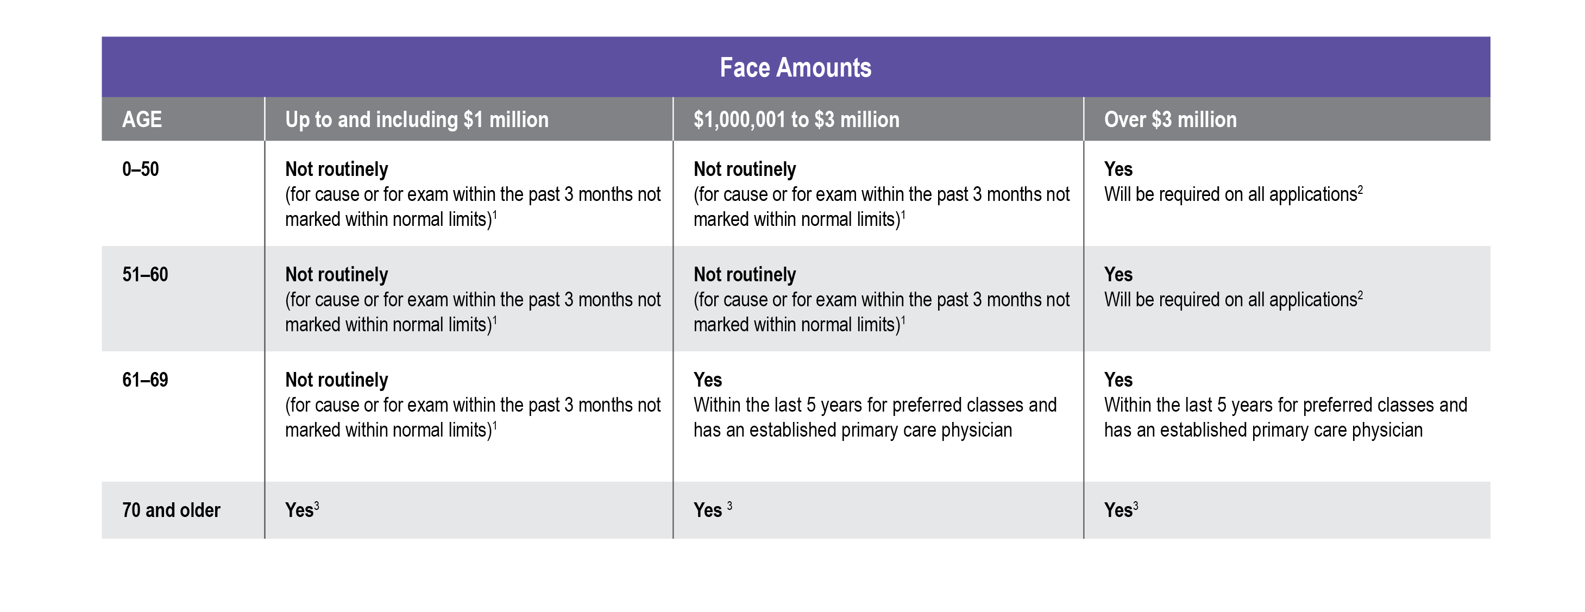
High net worth nonresident foreign nationals
Medical underwriting: APS guidelines
For Agent Use Only. Not for Use With the Public.

Slide 32
High net worth nonresident foreign nationals
Connection to the U.S.
Applicants in the U.S. for the sole purpose of purchasing insurance are not eligible.
Applicants must have at least one of the following connections to the U.S. to be eligible for coverage:
Travel pattern to the U.S. for business
and/or pleasure
Real estate
U.S. liquid assets (savings or investment account(s))
U.S. nonliquid assets (land, property, etc.)
Ownership of Transamerica coverage
Employed by a U.S. payroll
Immediate family permanently residing in the U.S.
Ownership on a U.S. legal entity (e.g., LLC):
A copy of EAD with category C08
  Trust
  Business
¹ APS are not needed on regular annual exams that are marked within normal limits or on annual female exams unless exam was noted as abnormal.
² Individual consideration up to and including $5 million (and under age 50) if applicant has not seen an M.D. for more than 3 years.
³ Age 70 to 79, normal underwriting guidelines if seen in the last 24 months by primary care physician. Age 80 should have seen an M.D. in the last 12 months for any consideration.
For Agent Use Only. Not for Use With the Public.
32

Slide 33
High net worth nonresident foreign nationals
Eligible countries:
Asia
Brunei
China (urban only)
Hong Kong
India (urban)
Indonesia (Java only)
Malaysia (Peninsula, Borneo, Kuching, Kota, Kinabalu, Miri only)
Philippines
Singapore
South Korea
Taiwan
Thailand
Vietnam
Europe
Greece
Italy
Malta
Germany
Belgium
Great Britain
(United Kingdom)
Ireland
Luxembourg
Poland
Oceania
Australia
New Zealand
Africa
Mauritius
Namibia
South Africa
Cameroon
Tanzania
Ghana
Middle East
Kuwait
Jordan
Oman
Qatar
Americas
Antigua and Barbuda
Bahamas
Belize
Bolivia
Canada
Chile
Colombia (urban only)
Costa Rica
Curacao
Dominican Republic
Ecuador
El Salvador
Guatemala
Jamaica
Mexico
Panama
Peru
Uruguay
For Agent Use Only. Not for Use With the Public.

Slide 34

High net worth nonresident foreign nationals
Roadblocks to success:
Required forms:
  Notice and Consent
  Producer Statement
  W-8BEN
  Financial Questionnaire Transamerica
  Life Insurance Company
  Copy of visa and proof of U.S. entry
Application addresses: Primary foreign
residence and a U.S. mailing address are required
Travel details: Incomplete travel
details (to the U.S. and other countries)
Medical information: Undisclosed
doctors and medical history outside the U.S.
Cover letter highlighting:
Connection to the U.S.
Business affairs
Financials
Delivery: Agent has not planned for delivery
in the U.S. (limited POA submitted during UW)
For Agent Use Only. Not for Use With the Public.

Slide 35
Producer checklist
For high net worth nonresident foreign nationals
Financial
Medical
Connection to the U.S.
Foreign residence and travel
For Agent Use Only. Not for Use With the Public.

Slide 36

Large case unit
Here to help you untangle the complexity of large and international cases
A dedicated team for all face amounts
$5 million or more
Personalized, collaborative case management and underwriting support from pre-sale to
policy placement
An outside-of-the-box approach to risk assessment
PLACEHOLDER
For Agent Use Only. Not for Use With the Public.

Slide 37

Proven foreign nationals experience
Decades of foreign
national experience
Industry-leading product
availability and guidelines
Constantly making it easer
to do business
Ongoing research to
continually optimize programs
37
For Agent Use Only. Not for Use With the Public.

Slide 38

Thank you
Life insurance products are issued by Transamerica Life Insurance Company, Cedar Rapids, IA, or Transamerica Financial Life Insurance Company, Harrison, NY. Transamerica Financial Life Insurance Company is authorized to conduct business in New York. Transamerica Life Insurance Company is authorized to conduct business in all other states. All products may not be available in all jurisdictions.
116351R9
©2025 Transamerica Corporation. All rights reserved.
38
For Agent Use Only. Not for Use With the Public.

