Slide 2
Notes:
First, I have to review some quick disclosure information with you.
[Read slide]

Slide 10
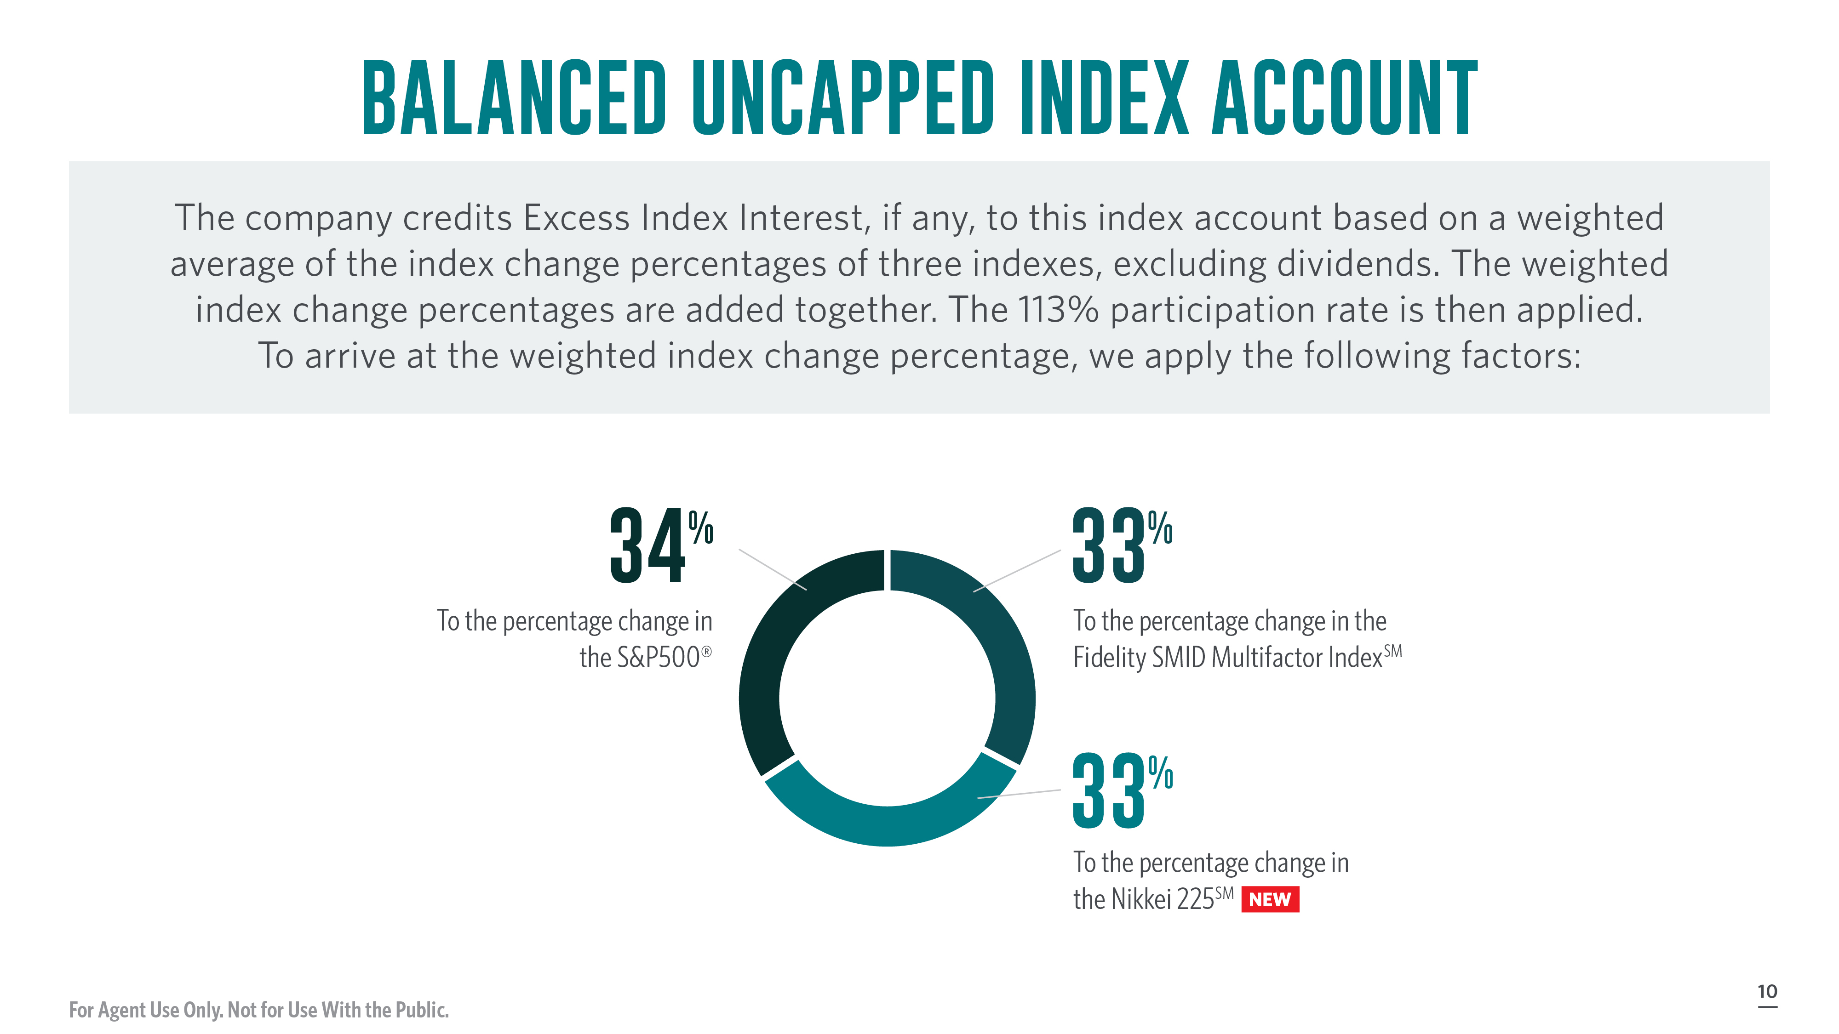

Slide 11
Notes:
A lower volatility can help with raising cap rates on index accounts.

Slide 12
Notes:
Here’s a closer look at the Fidelity Small-Mid Multifactor IndexSM.
[Read slide]

Slide 14
Notes:
Here’s a closer look at the Global Index Account:
[Review slide]

Slide 15
Notes:
Read slide

Slide 20
Notes:
Read slide

Slide 26
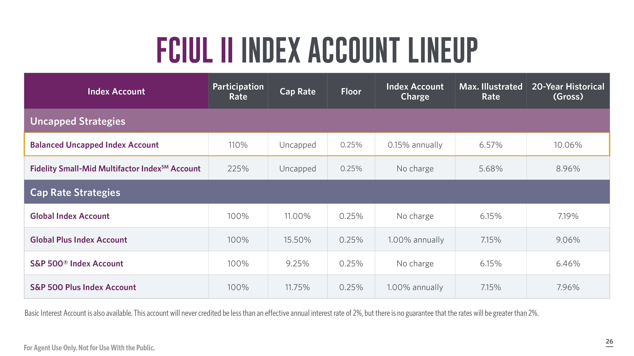

Slide 33
