Slide 1

Notes:
Read Slide

Slide 2
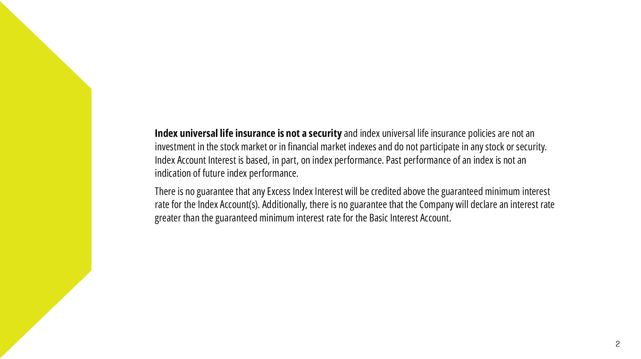
Notes:
Read Slide

Slide 3
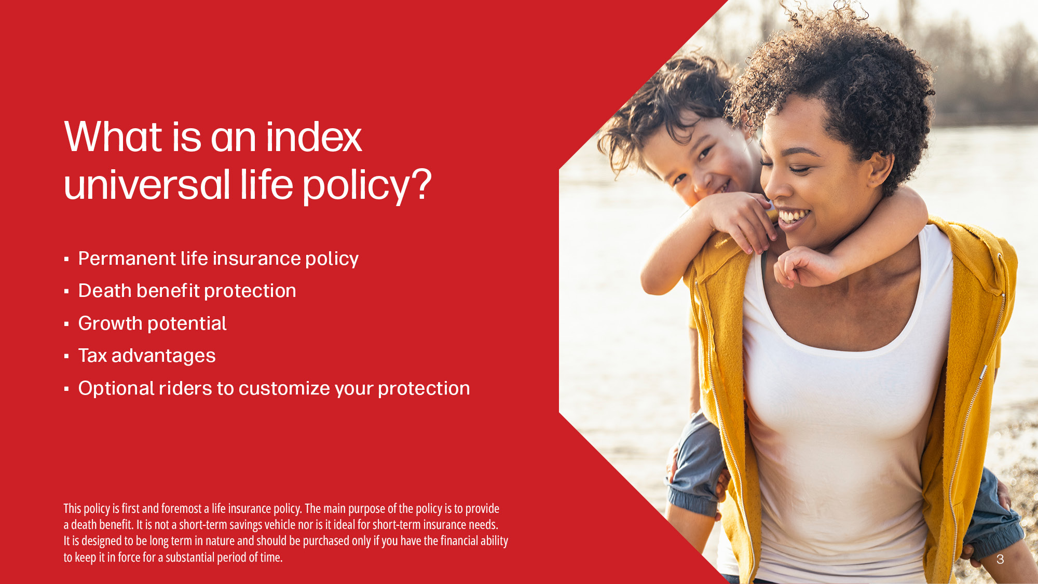
Notes:
Permanent life insurance provides coverage for your entire life instead of a certain number of years (like term insurance does)
It offers a death benefit — which is paid to your beneficiaries once you pass
IUL policies have the potential to build cash value as you pay premiums over time — more on that later
There are also associated tax advantages we’ll cover today as well as specific policy add-ons you may want to consider

Slide 4
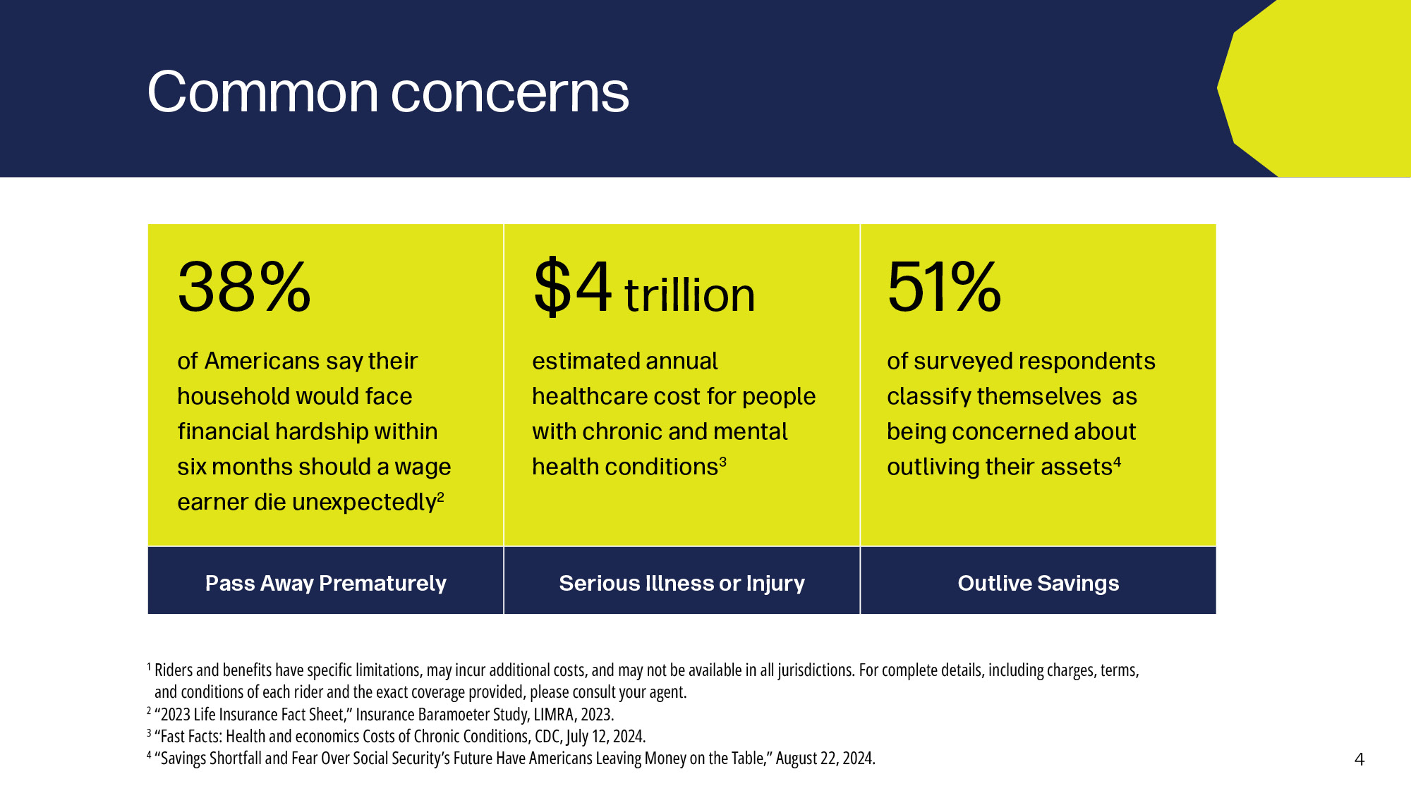
Notes:
American families share many hopes and concerns. Here are factors, among many for your consideration.

Slide 5
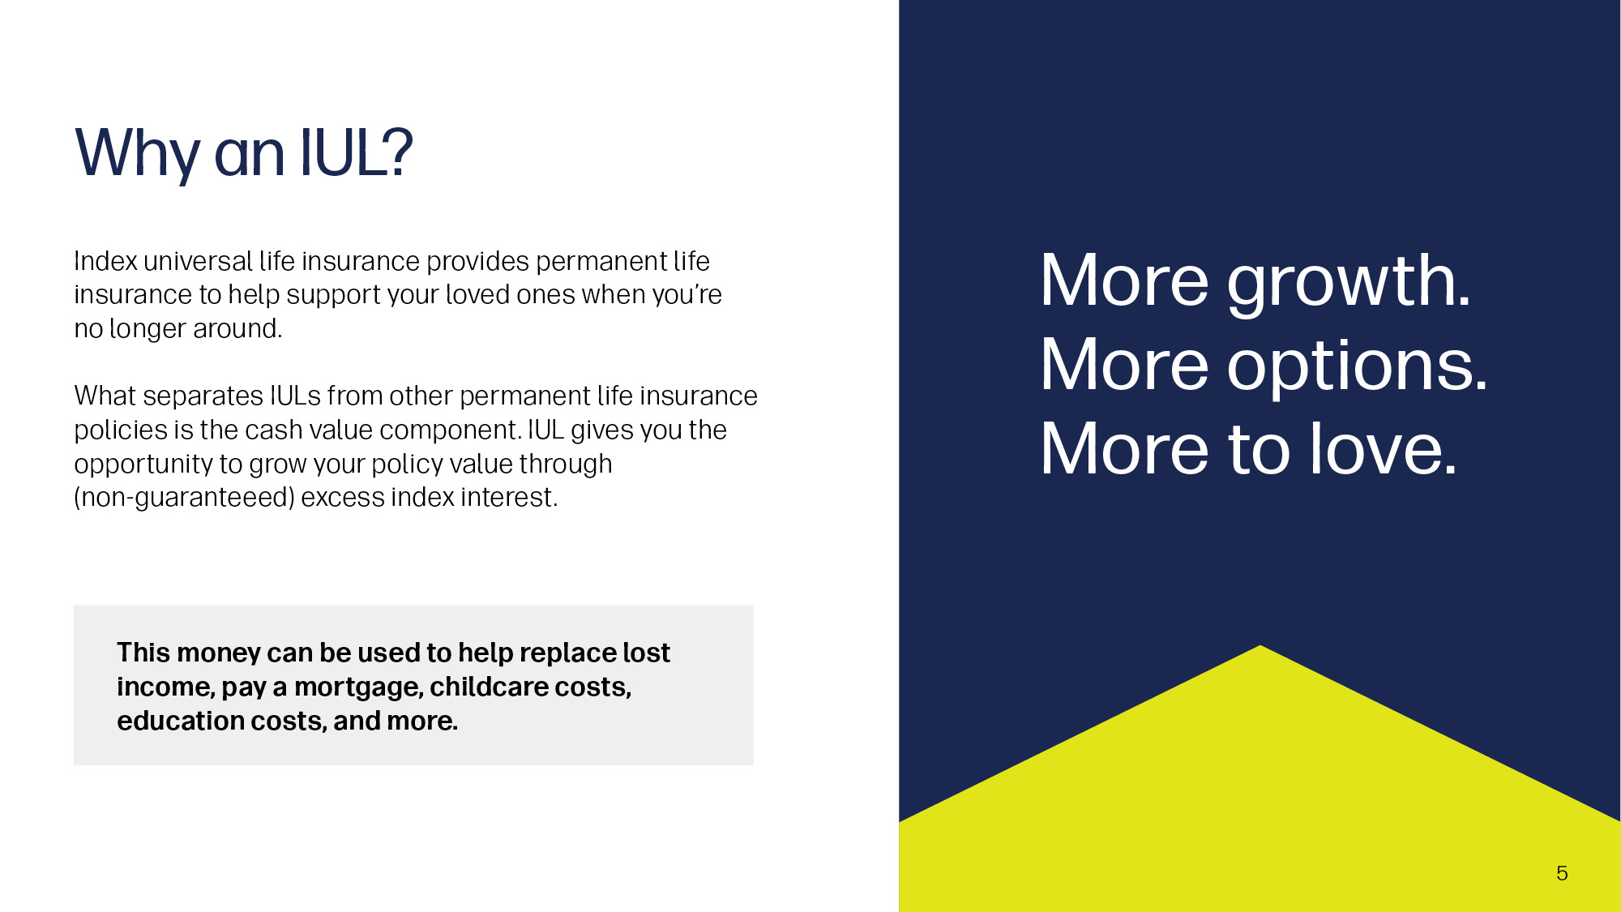
Notes:
What’s an IUL?
[read slide]

Slide 6
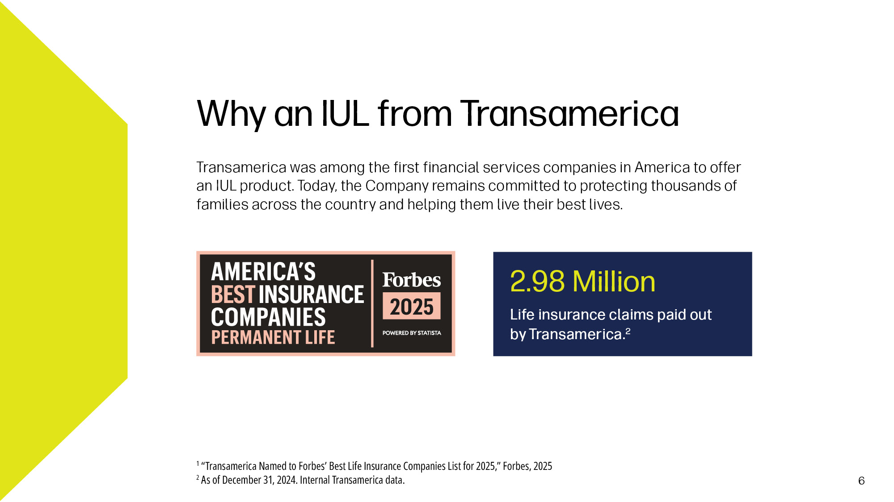
Notes:
Read Slide

Slide 7

Notes:
Read Slide

Slide 8
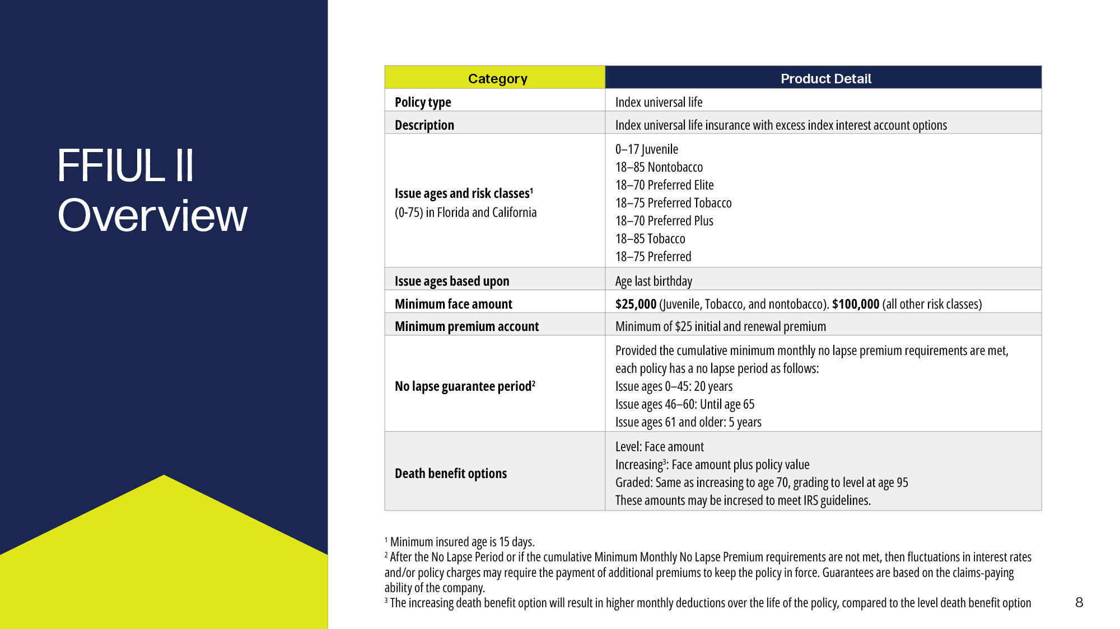
Notes:
Issue age: refers to the age of the insured person at the time the policy is issued. This is a critical factor because it directly affects: Premium Cost, Underwriting and policy projections or illustrations.
Risk class: is a classification assigned to the insured based on their health, lifestyle, and other risk factors. It plays a major role in determining the cost of insurance (COI) and overall premium rates.
Face Amount: is the initial death benefit that the insurance company agrees to pay to the beneficiary upon the death of the insured. On an IUL policy, the Face amount can be impacted by several factors. Not all will be covered in this deck.
No-Lapse Guarantee Period is a feature that ensures the policy won’t lapse (terminate) due to insufficient cash value, as long as certain conditions are met
Death benefit Options:
Level:
Death Benefit = Face Amount
The death benefit stays constant over time.
Increasing
Death Benefit = Face Amount + Cash Value
The total death benefit increases as the cash value grows.

Slide 9
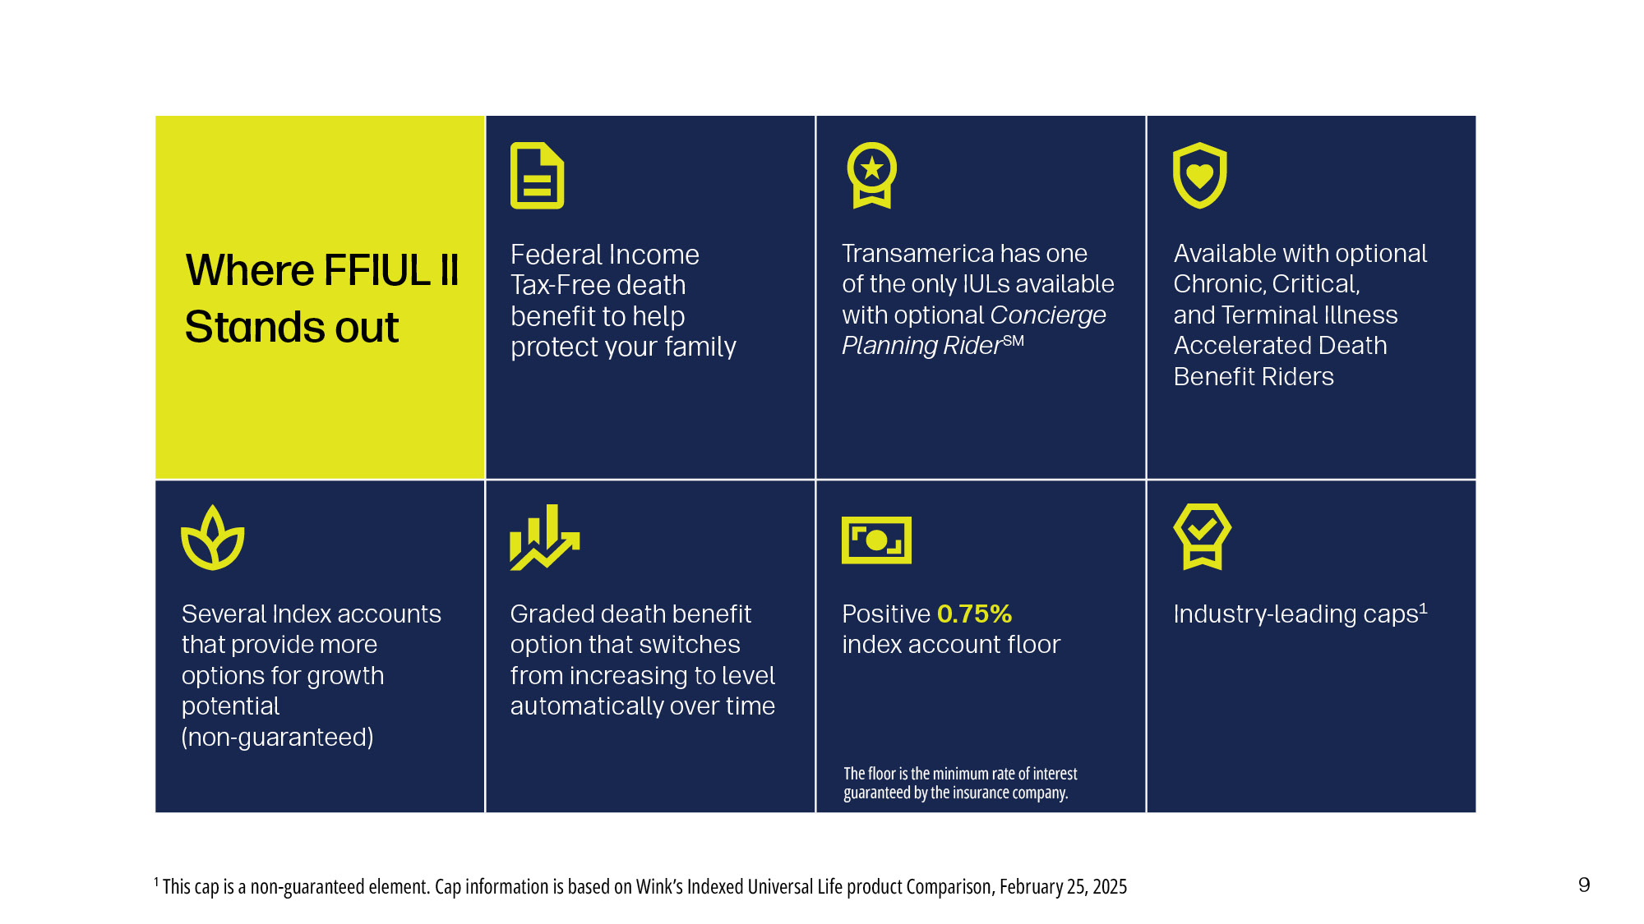
Notes:
Why is the Transamerica Financial Foundation IUL a product something you would beinterested in? Here are just a few reasons why this product is winning within the IUL industry.
Federal income tax-free death benefit: When the insured passes away, the death benefit paid to the beneficiary is generally not subject to federal income tax.
The CPR Rider is an optional rider, at no cost to you, on the FFIUL II policy which provides access to funeral concierge services. We will go over more details later in the presentation Additional Living benefit riders allow you to customize your policy further. We have several options to choose from, a couple of which we will go over later in this presentation.
The Index Accounts on the FFIUL II can provide you with additional opportunities for growth potential. As discussed previously, there are increasing, graded, and level death benefit options on the FFIUL II.
Even when the markets are down, your policy is protected by a guaranteed “floor”where the interest rate will not drop below 0.75%. Meaning, your policy will always be credited interest, even in a down market. This, along with the Caps, will be shown next.

Slide 10

Notes:
Read Slide

Slide 11
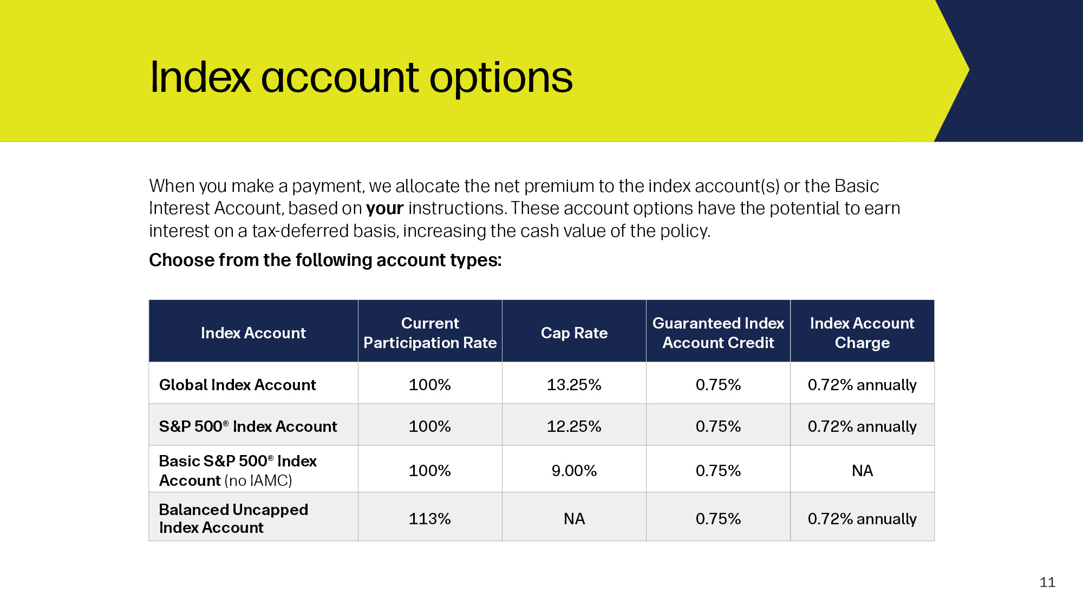
Notes:
The participation rate is a percentage used to determine the Excess Index Interest rate for index accounts. Each index account and segment may have a different participation rate. Participation rates are declared by Transamerica at the company’s discretion
The cap is the maximum percentage rate used to determine Excess Index Interest that can be credited to an index account segment for the 12-month segment period that just ended. At the end of each segment period, we compare the cap rate to the calculated index change percentage.
The Guaranteed Index Account Credit (Or Guaranteed Minimum Interest Rate or Floor) no matter how the indexes perform, the company will never credit less than the guaranteed minimum interest rate of 0.75%.
You may opt to use a cash accumulation strategy that allocates net premiums to more than one account option for the opportunity to earn different rates of interest.
FFIUL II gives you the opportunity to grow your policy value through Excess Index Interest (earnings above the guaranteed minimum interest rate) that may be credited to your policy based partly on changes in the indexes. There are limitations on when you can transfer policy value between account options, but since transfers are tax-free, any earnings are protected from the erosive effect of taxes.

Slide 12
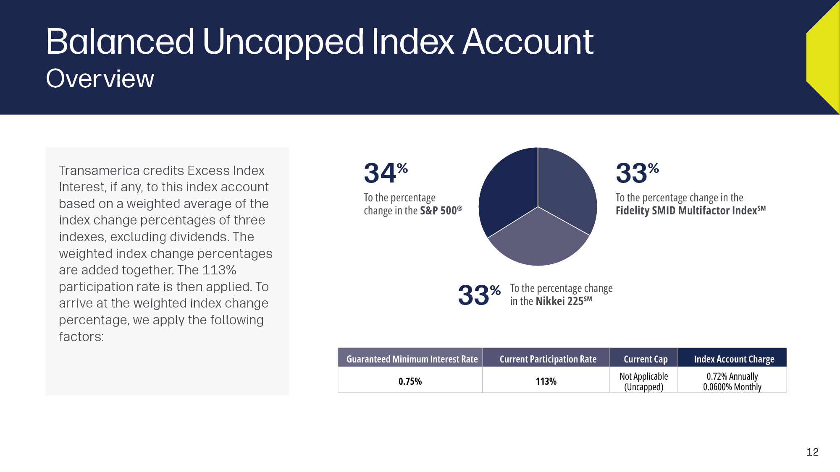
Notes:
Now let’s take a look at our new Balanced Uncapped Index Account.
[Review slide]

Slide 13
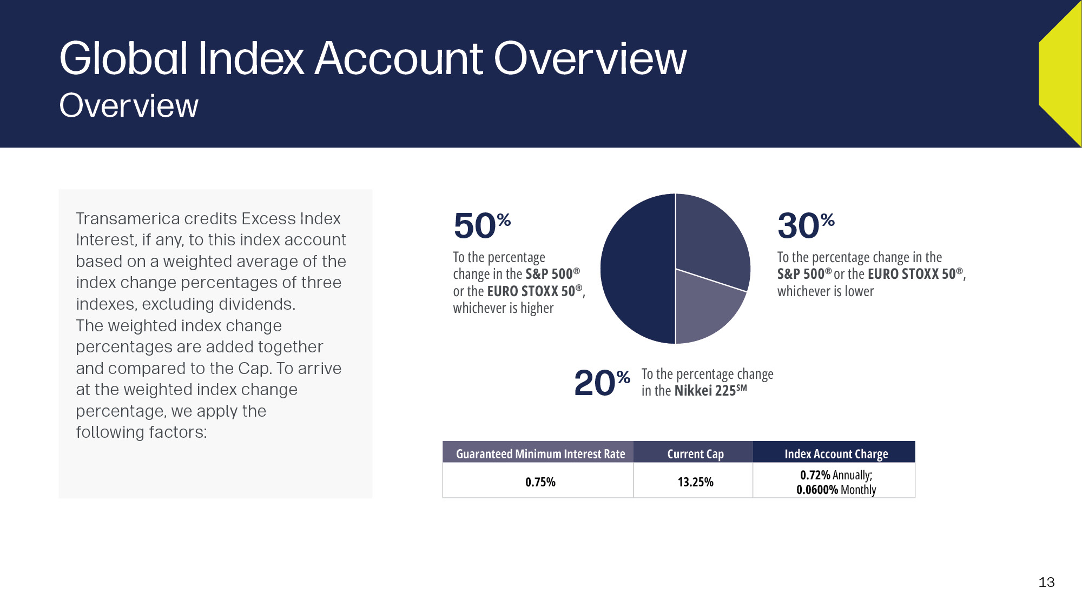
Notes:
Read Slide

Slide 14
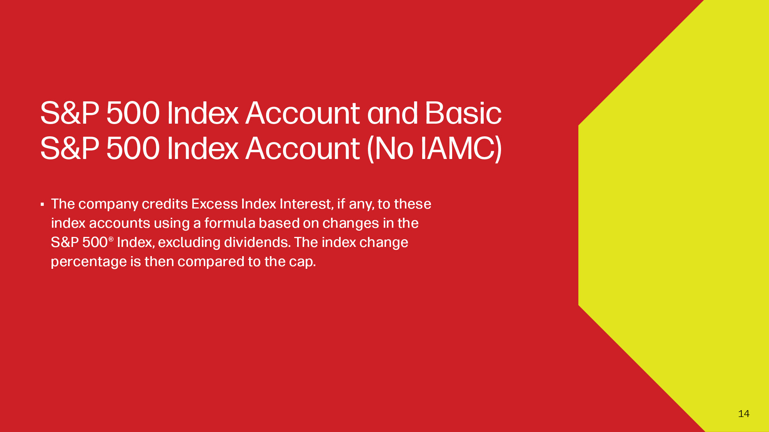
Notes:
Read Slide

Slide 15
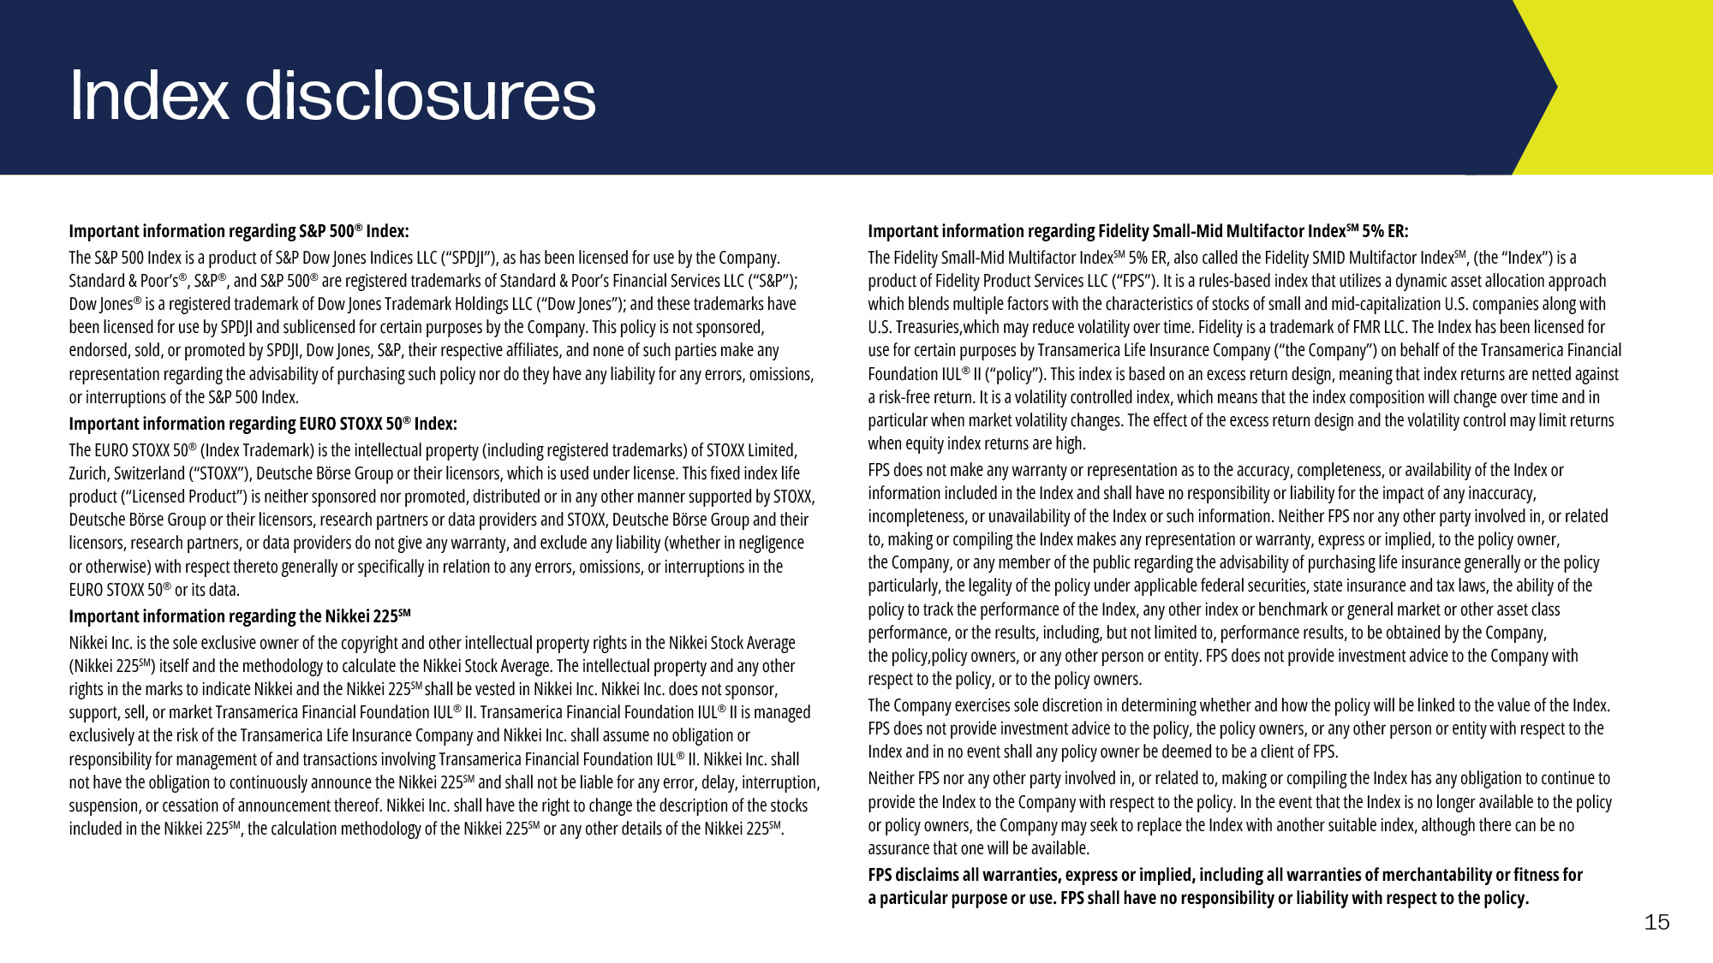

Slide 16

Notes:
Read Slide

Slide 17

Notes:
With a living benefit rider, you can access a portion of your death benefit early if you become stricken with a serious illness, such as a qualifying chronic, critical, or terminal illness.
Transamerica offers Transamerica Financial Foundation IUL II with optional chronic and critical illness accelerated death benefit riders for these situations.
Many worry about getting sick and how that would affect their family's finances, but they don't think there's anything they can do to prepare for it.

Slide 18
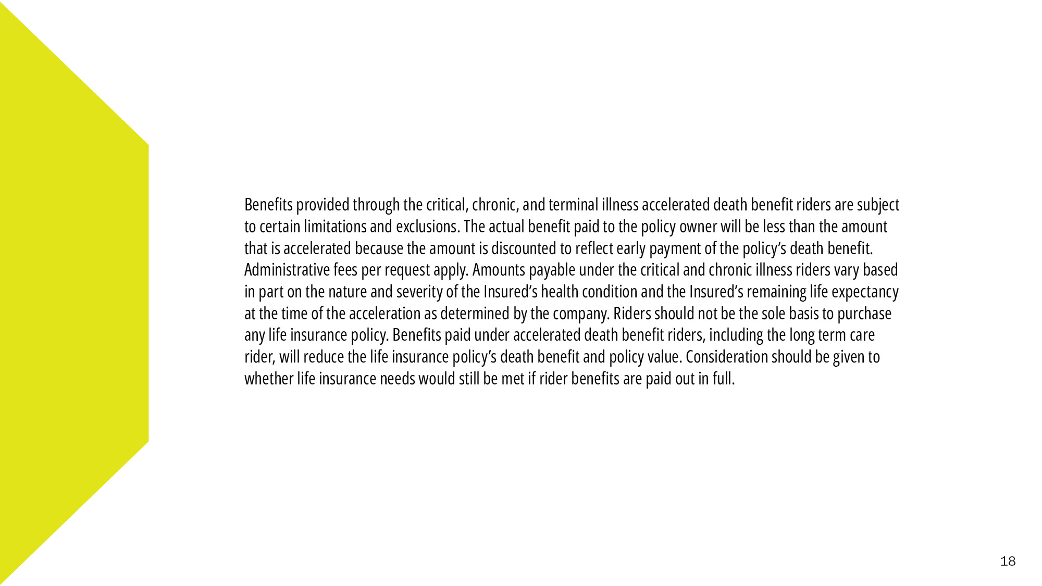
Notes:
Read slide

Slide 19
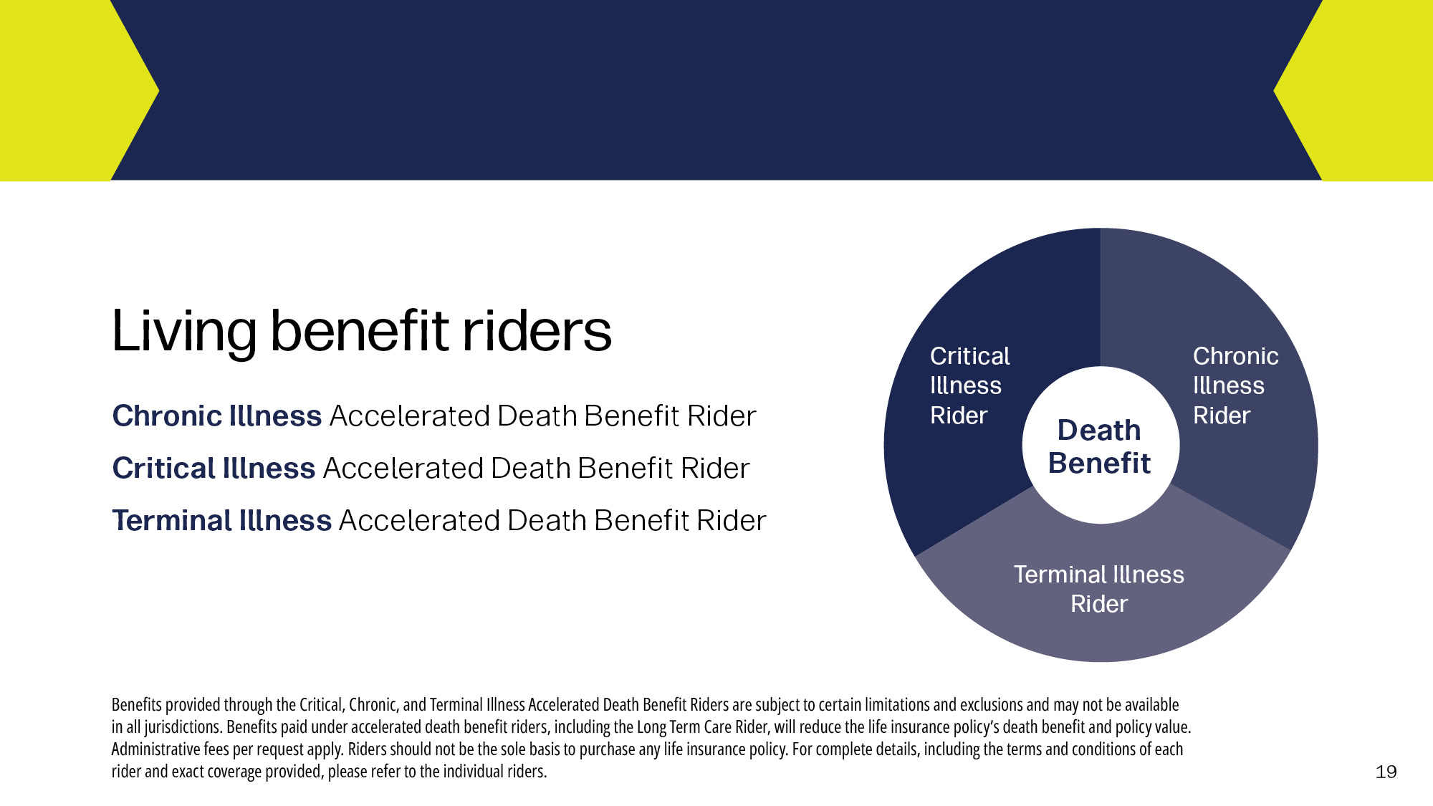
Notes:
Transamerica Financial Foundation IUL II has three optional living benefit options:
Chronic Illness Accelerated Death Benefit Rider
Critical Illness Accelerated Death Benefit Rider
Terminal Illness Accelerated Death Benefit Rider

Slide 20
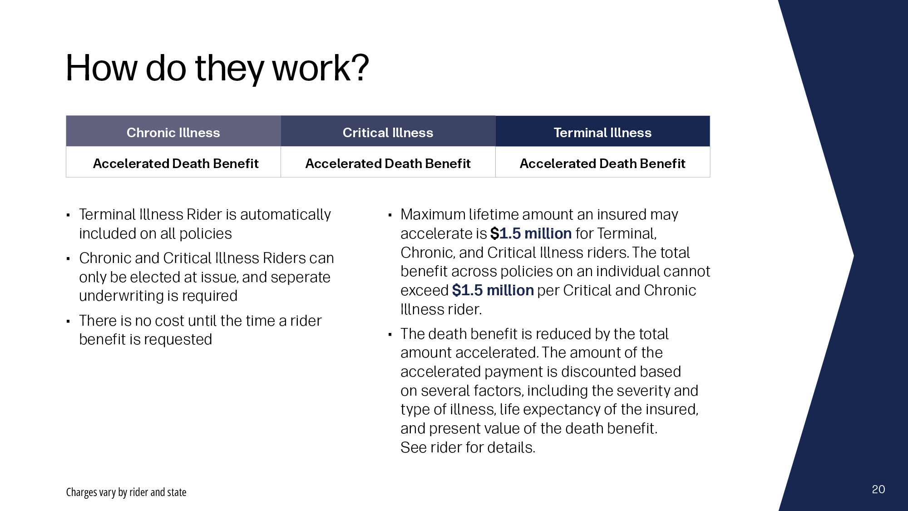
Notes:
The optional living benefit riders available with the FFIUL II policy may allow policyholders to accelerate their death benefits to provide funds that can be used to help pay for qualified expenses associated with chronic, critical, and terminal illnesses.

Slide 21
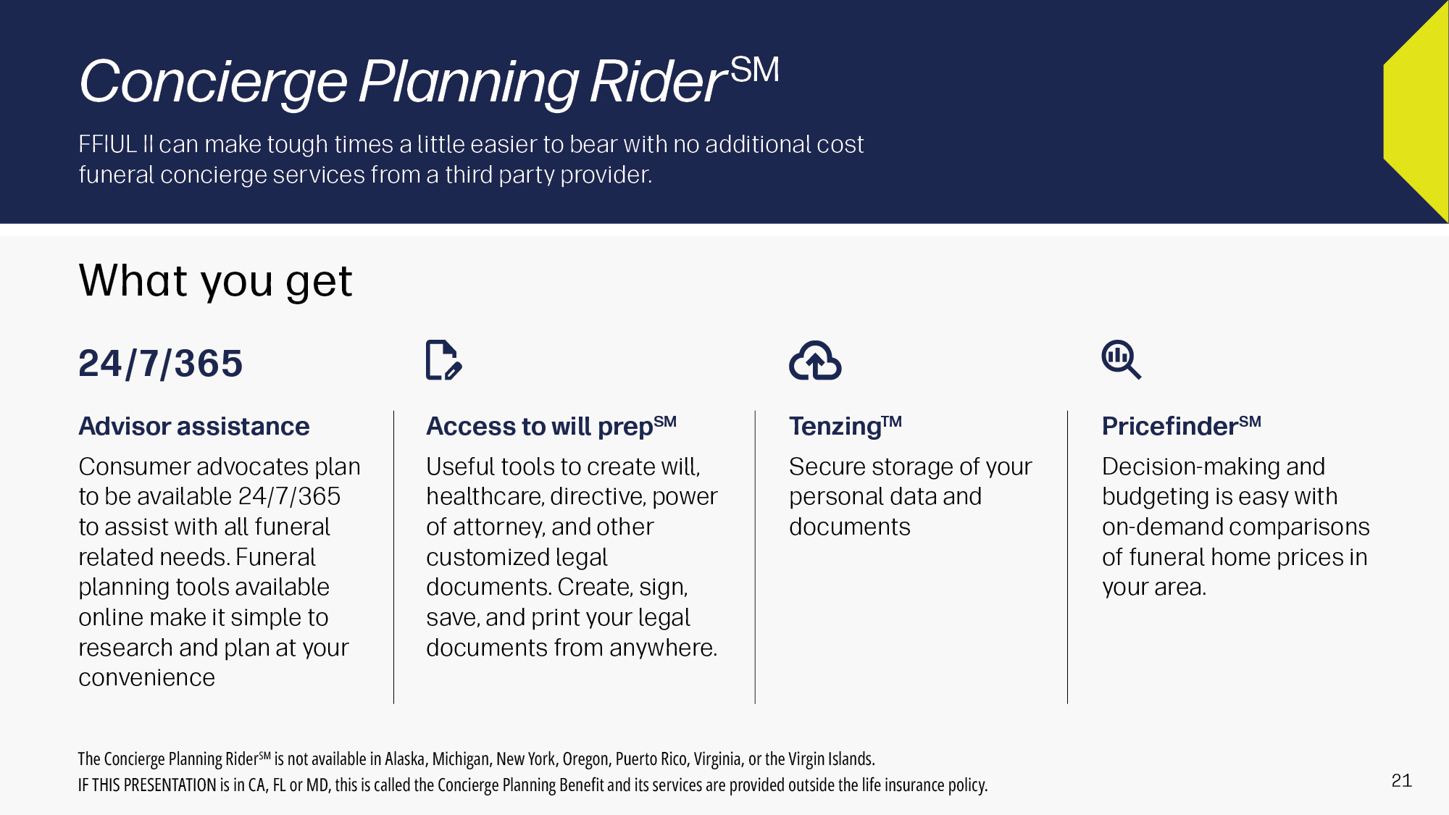
Notes:
Transamerica’s Concierge Planning Rider allows owners/insureds to take advantage of a full suite of services like will prep and funeral planning. Available on qualifying FFIUL II policies, you can protect your family with an IUL policy with death benefits and living benefits, as well as funeral preparation and planning benefits.
The Concierge Planning Rider offers 24/7 funeral planning and concierge services. Senior advisors are licensed funeral directors that provide personalized funeral plans and price negotiation assistance. Independent and not associated with any funeral home, burial, or cremation provider, they can work with any funeral home, anywhere in the world.

Slide 22
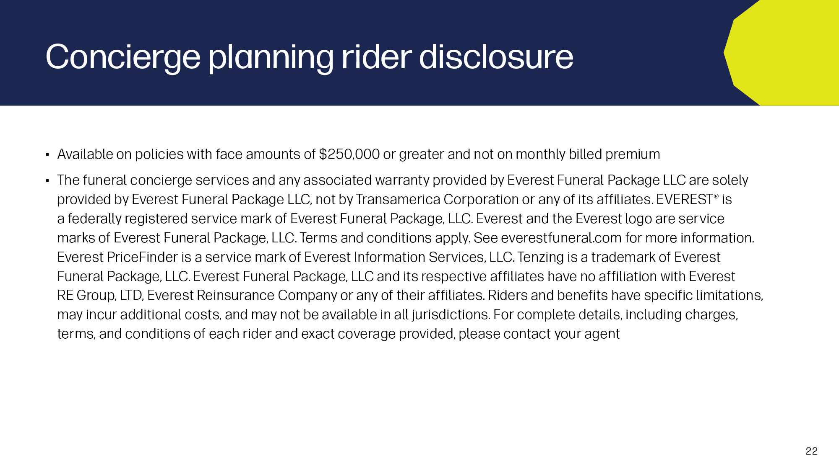
Notes:
Read slide.

Slide 23
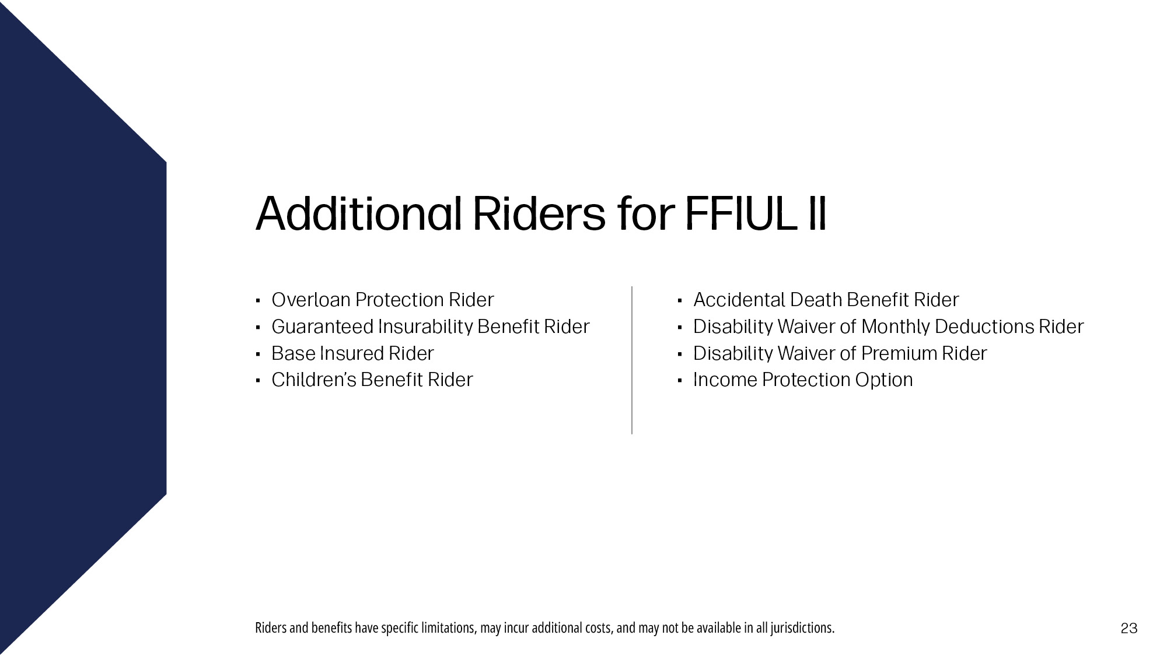
Notes:
Here are additional Riders that you can add to your FFIUL II policy. Information on these Riders can be looked up in the FFIUL II client guide seen on the next slide.

Slide 24

Notes:
Read Slide

Slide 25

Notes:
Read Slide

