Slide 1
Notes:
Welcome!

Slide 2
Notes:
Welcome!

Slide 3
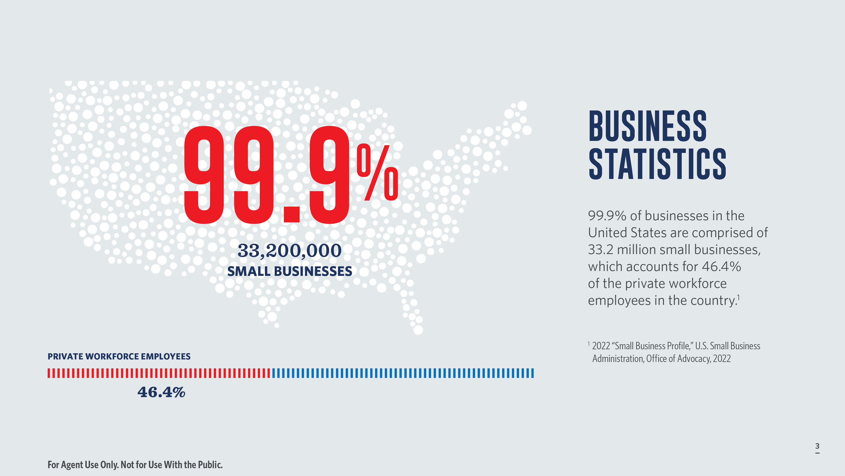
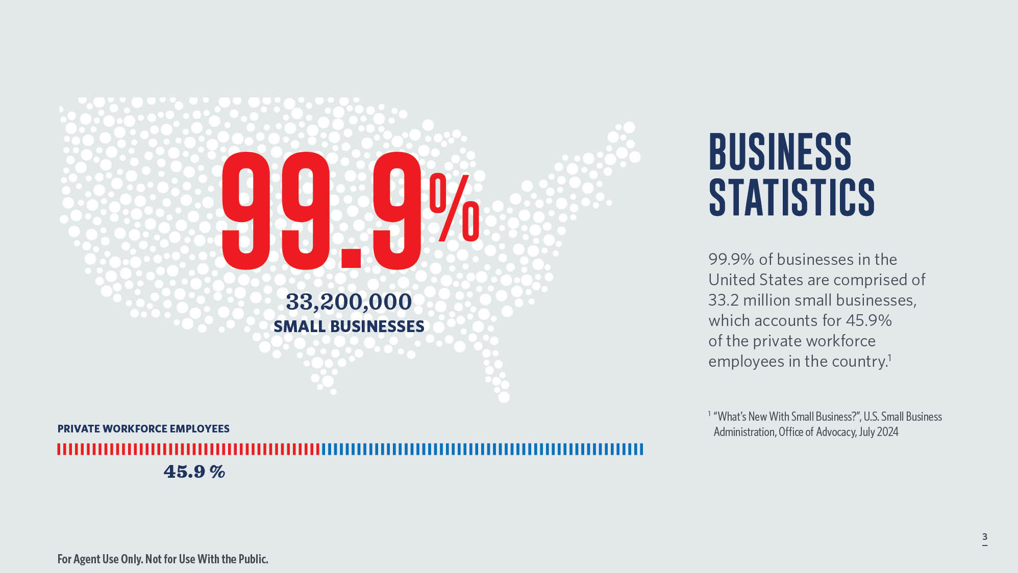
Notes:
The U.S. Small Business Administration defines a small business in the United States as an independent business with fewer than 500 employees. This threshold varies around the world. The European Union considers fewer than 50 employees, while Australia defines a small business as having fewer than 15 employees. Regardless of where you are in the world, small businesses are the backbone of the macroeconomy. Whether you have one employee or 500 employees, there are business planning strategies that should be considered, which are often overlooked by business owners.
2024: https://advocacy.sba.gov/wp-content/uploads/2024/07/Frequently-Asked-Questions-About-Small-Business_2024-508.pdf

Slide 4
Notes:
The financial costs to a business owner for hiring new employees can be staggering. A Gallup study discovered that 51% of U.S. employees are actively looking for a new job or watching for openings. It's estimated that $1 trillion annually is lost by U.S. businesses due to employee turnover and some estimates suggest it can cost three to four times the salary’s position to hire a new employee. To help attract and retain long-term employees it is essential to offer benefits and perks. Healthcare and retirement plans have become the norm in employee benefit packages.

Slide 5
Notes:
So, how can a business set themselves apart to attract those highly sought-after key employees? Executive benefits such as Executive Bonus Arrangements can be offered to employees on a case-by-case basis. The business can also protect itself against the loss of a key employee through key person life insurance or Buy-Sell Agreements. We will cover these uses of life insurance in business planning through the rest of the presentation.

Slide 7
Notes:
For many small- and mid-size businesses, qualified plans allow for their employees to save a significant amount for retirement while having either tax-deferred or tax-favored treatment on plan contributions.
However, limits on how much employers and employees may contribute to qualified plans may result in a savings gap for highly compensated employees, leaving them with insufficient assets to maintain their standard of living in retirement.
A Non-Qualified Executive Bonus Plan funded with permanent life insurance can complement an existing qualified plan by helping to recruit, retain, and reward key employees of the company while offering them valuable death benefit protection along with a potential source of supplemental retirement income.
An Executive Bonus Plan involves paying the premiums, through a series of bonuses, for a personal life insurance policy that is owned by the executive. Premiums may be bonuses to the executive or paid directly to the insurance company. Bonus amounts will be taxable to the employee and can be tax-deductible for the business.

Slide 8
Notes:
What are some of the benefits of a 162 bonus arrangement to the business?
(Read bullets)
What benefits would an executive get out of being offered an executive bonus plan?
(Read bullets)

Slide 9
Notes:
In some instances, an employer may wish to protect their interest and make sure the executive holds up their end of the agreement. In this case, a Restricted Executive Bonus Arrangement (REBA) may be useful.
(Read bullets)

Slide 10
Notes:
The REBA will usually stipulate when these restrictions will be lifted. It could be upon retirement or disability, at a certain age, or once a waiver and release has been signed by the employer. Typically, the business will enter into a separate agreement with the employee which outlines what would happen if the employee terminates their employment with the business before retirement. It may require the employee to pay back all, or a portion of the bonuses received. Once the restricted period has ended the business must send a written statement to the life insurance company to lift the special endorsement on the policy.

Slide 11
Notes:
This diagram shows how it works.
(Read Slide)

Slide 12
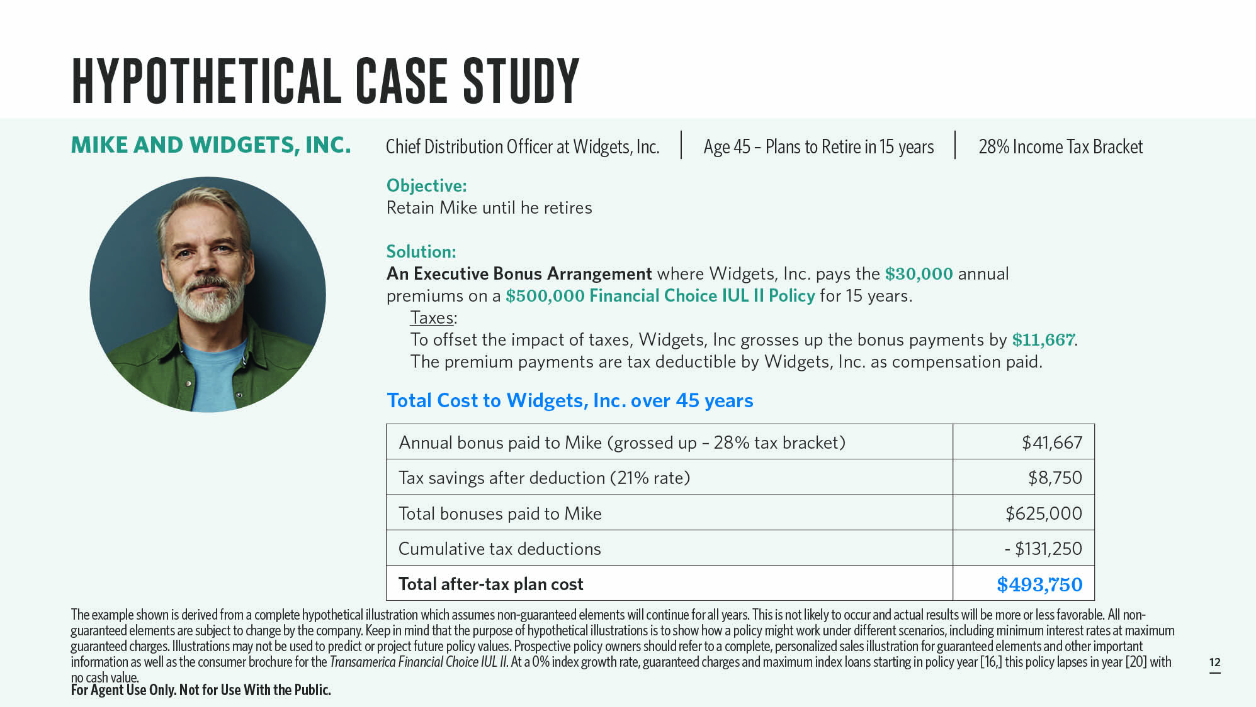
Notes:
Widgets, Inc. would like to reward Mike, their Chief Distribution Officer and one of their most valued executives, for his efforts in helping the company expand and grow. Mike is 45 years old and plans to retire once he reaches age 60. Widgets, Inc. would like to find a way to retain Mike until he retires, as his expertise is crucial to the company’s continued success.
The company chooses to implement an Executive Bonus Plan for Mike where the company agrees to pay premiums on a $500,000 Transamerica Financial Choice IUL II policy owned by Mike, that will provide death benefit protection along with tax-free access to cash surrender values to supplement his income in retirement.
Widgets, Inc. pays the annual premiums of $30,000 for 15 years on behalf of Mike, which constitutes a taxable bonus to him. The company chooses to pay an additional bonus of $8,750 to Mike to cover his tax expenses, known as a double bonus.
This chart shows the total cost to Widgets, Inc. to provide Mike with the Executive Bonus arrangement.

Slide 13
Notes:
Upon retiring at age 60, Mike chooses to access his policy’s cash surrender value for retirement income to supplement what he will withdraw from his qualified plans and other retirement assets.
When Mike retires, he can access the cash value proceeds of the life insurance policy through loans to supplement his retirement income. He decides he needs $50,304 annually in retirement income from the policy. The chart above shows the potential benefit to Mike and his family from the policy assuming he lives until age 90.

Slide 14
Notes:
Businesses must also be vigilant to protect against the loss of a key employee.

Slide 15
Notes:
Essentially, all businesses rely on employees for the success of the business. Some employees may provide a more critical role to contributing to the ongoing financial success of the business than others. The loss of one of these key employees could be detrimental to the business’s continuation. To help protect against the loss of a key employee’s contributions and expertise, a business can purchase insurance on the key employee’s life. This can be a form of EOLI subject to the IRC § 101(j). The employer retains all incidents of ownership, pays the premiums, and receives the death benefit proceeds as the beneficiary. The premiums are not tax-deductible to the employer, but as long as IRS rules are met, the death benefit proceeds are received income tax-free.

Slide 16
Notes:
A key employee could be considered as anyone who provides for the ongoing financial success of the business in a critical way. Characteristics that could be used to identify key employees are:
(Read Bullets)
It is important to note that it is at the business’s discretion to determine who is a key employee. This arbitrary determination is unique to every business and should not be conflated with the IRS of Key Employee definition. Code Section 101(j)(3)(A) defines an “employer-owned life insurance contract” to mean a life insurance contract owned by an employer that covers the life of an officer, director, or employee of the employer (determined as of the date the policy is issued) and under which the employer (or a related person) is a direct or indirect beneficiary.

Slide 17
Notes:
THE BENEFITS OF KEY PERSON COVERAGE
• A death benefit free of income tax can help to cover financial losses that could occur after key employee’s death and help to offset the cost of finding a suitable replacement.
• Cash value is a business asset that enhances your business’s creditworthiness.¹
• Flexibility to provide both business protection and serve as an employee retention tool, if desired.
¹ Loans and withdrawals will lower the policy value and net cash value and will lower the death benefit or cause the policy to lapse. Withdrawals or distributions, and various other transactions may have adverse tax consequences, so please consult your tax professional. Loans and withdrawals from MECs are taxed to the extent of income in the contract. There is a 10% tax on the amount of income borrowed or withdrawn from a MEC if the taxpayer is below age 59½. A corporation is always considered to be “younger” than 59½, so the 10% penalty applies. The 10% tax also applies upon the gain on full surrender of the policy. Withdrawals, loans, and assignments are considered distributions.

Slide 18
Notes:
Here’s how it works.
(Read Slide)

Slide 19
Notes:
AI Soft, Inc. is a software engineering company with 20 employees that generates $4 million in annual revenues. The company relies heavily on Anna, their director of business development, for both new sales and licensing renewals. The accounts Anna has brought in represent 25% of the company’s annual revenue.
Michael is concerned about the financial impact of losing a key contributor like Anna and decides to establish a key employee coverage plan funded with life insurance. The company chooses to purchase a $1 million Transamerica Financial Foundation IUL® II (FFIUL II) policy on Anna’s life with annual premiums of $24,000 to her age 65 with an increasing death benefit option. The increasing death benefit option will potentially enable the company to grow coverage on Anna’s life as the size of her accounts increases over time.

Slide 20
Notes:
If Anna were to leave for another employer or retire, Michael’s company may access the policy’s cash surrender values to recover their costs for maintaining coverage.
If something happened to Anna, the business would receive the death benefit proceeds, which are generally federal income tax-free. By purchasing Key Person coverage on Anna’s life, Michael can continue to focus on growing his business without worrying about what would happen to it with the loss of a key contributor like Anna.

Slide 21
Notes:
Why FFIUL II for key person coverage?
(Read Slide)

Slide 22
Notes:
Buy-sell agreements can be a powerful business succession tool. There are numerous types of buy-sell agreements offering flexible, customizable solutions that can provide certainty, mitigate conflict, and facilitate a smooth ownership transition.
For businesses with a small number of owners, a cross-purchase buy-sell agreement may be a good option to help make sure their business continues if something were to happen to them.
HOW DOES A CROSS-PURCHASE BUY-SELL AGREEMENT WORK?
In a cross-purchase buy-sell agreement, each business owner purchases a life insurance policy on the other business owner; each owner is the payer and beneficiary of the policy they own. This strategy is typically used for businesses with two owners but can be implemented for businesses that have more than two owners.
If one of the owners dies, the life insurance benefit received by the surviving business owner is used to purchase the business interests of a deceased owner per the buy-sell agreement.

Slide 24
Notes:
Often, you might start working with a business owner on one business planning solution and then be given the opportunity to address not only other business issues, such as key employee protection, retirement planning, succession planning, but you can also work with each individual owner on their own separate planning issues impacted by the business.

Slide 25
Notes:
We’ve covered a lot of information today and have only scratched the surface on some of these important business planning strategies using life insurance. My hope is that you’ll leave here with an appreciation of all the planning that can be done for business owners by incorporating life insurance coverage at various stages in their business as well as their personal life. It will take a team to accomplish all of the required planning, so it is important to build relationships with other professionals, like attorneys, tax professionals, and even business valuation firms. You can be the center of your client’s business planning needs and help them institute the proper life insurance coverage for all the strategies that will help protect and grow their business well into the future.

Slide 26
Notes:
We offer a number of resources you can use with your clients to help grow your business.
[Read Slide]

