Slide 1


Notes:
Hello. My name is ____________, ________ with Transamerica. November is long term care awareness month and today we’ll be discussing how to use our Long-Term Confidence strategy to help clients prepare with clarity and confidence for their financial future.
Today, I am going to share insights into:
• The opportunity that exists based on the current life insurance coverage gap
• The scope of the funding options available in the long-term care market
• What advantages of hybrid life insurance stand out
• Client considerations when identifying opportunities
• What makes hybrid life insurance may stand out to clients
• Best practices for presenting a benefit-based solution
• Finally, I will introduce our new Long Term Confidence marketing toolkit to help
you make a meaningful impact to your clients with Transamerica’s FFIUL with a LTC rider

Slide 2


Slide 3
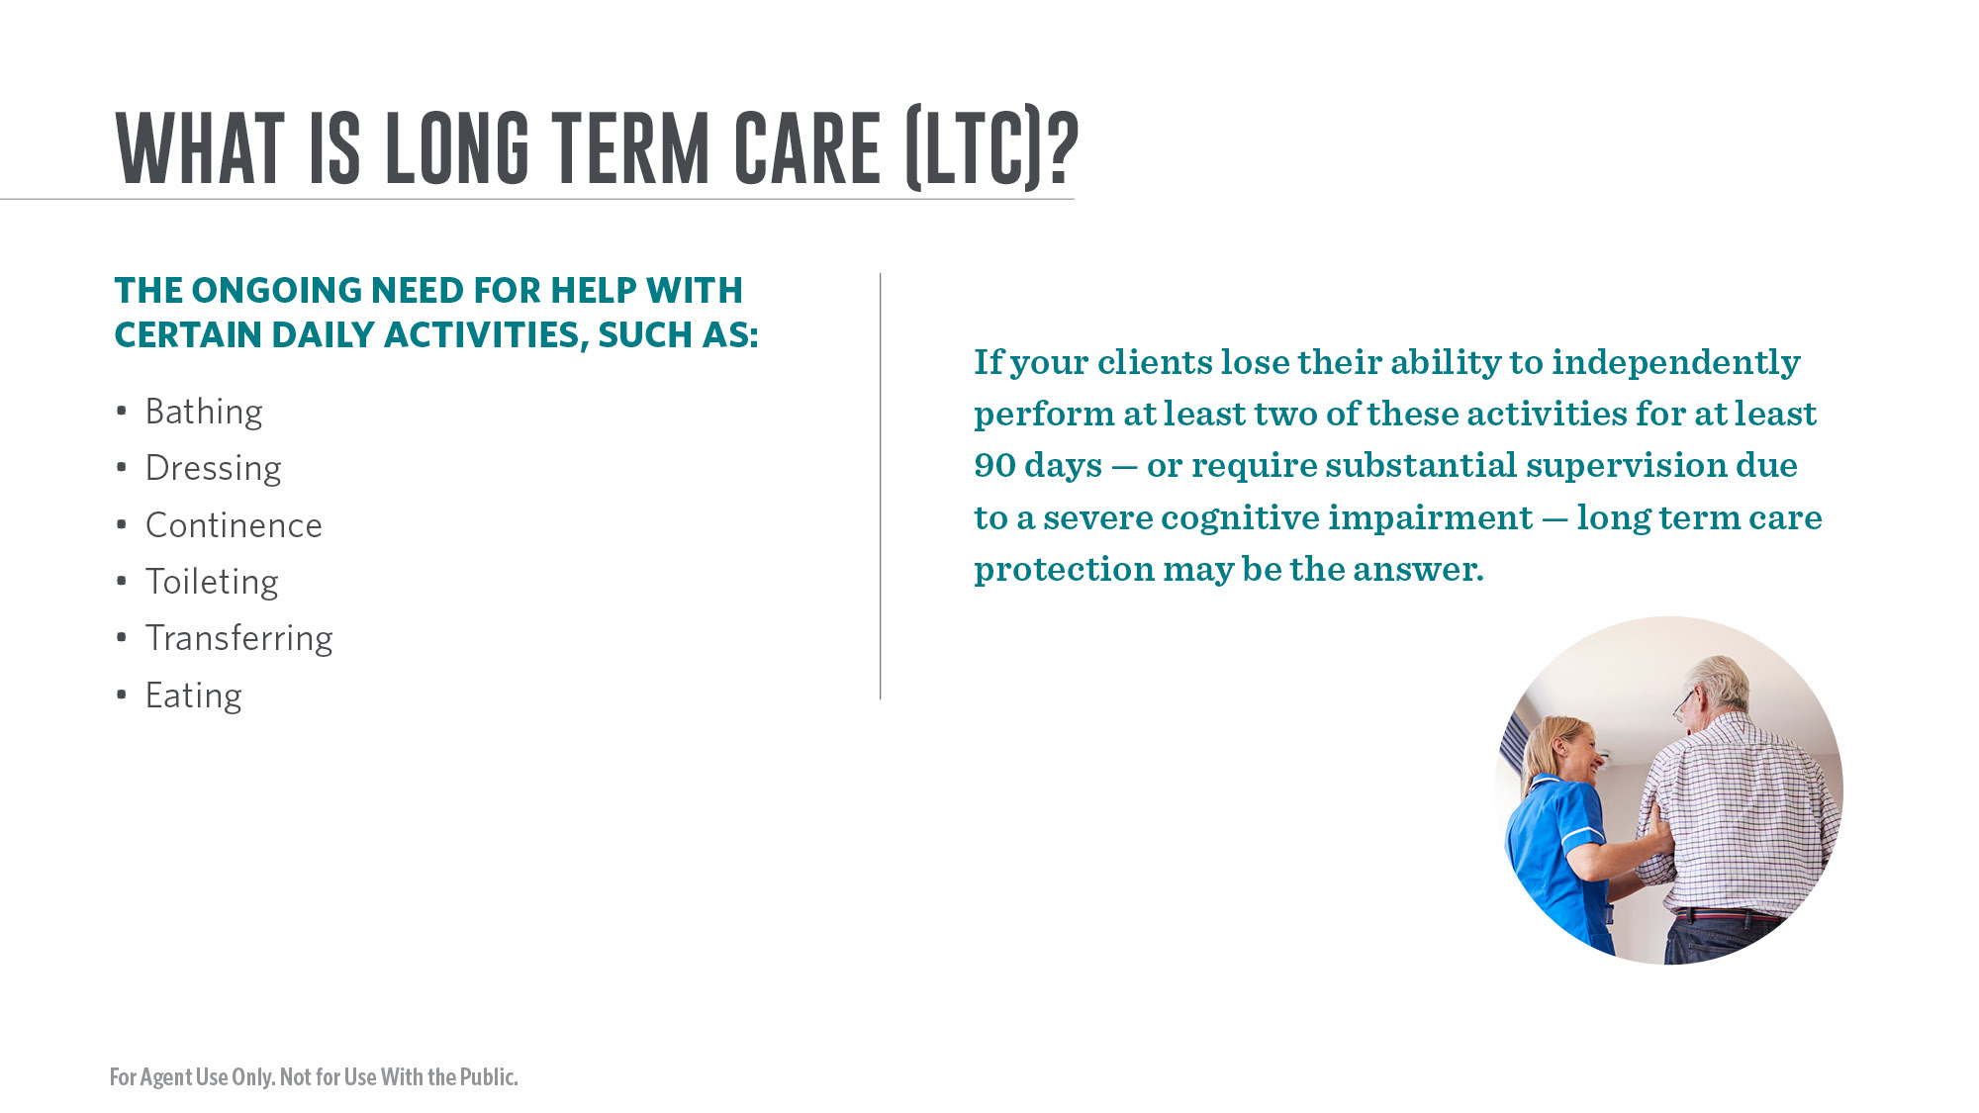
Notes:
What is long-term care?
It’s the ongoing help with daily activities. Most of the care needs do not relate to medical care aid, but rather to assistance with the Activities of Daily Living (ADL), such as: Bathing, Dressing, Continence, Toileting, Transferring, Eating.
What does a long-term care solution do?
It helps take the financial consequences of an extended healthcare event off your client’s portfolio and transfers that risk to an insurance company. It also provides a range of services to support your clients if they were to experience an extended care event. They help cover their expenses if they can no longer independently perform at least two ADL for at least 90 days, or if they require substantial supervision due to a severe cognitive impairment. Medicare will likely be insufficient and Medicaid does not account for their choices or preferences.
Why plan now?
It’s important to begin saving for long-term care needs when people are healthy and have more time to grow benefits. Planning is also about preparing loved ones for the tough emotional and financial decisions they may need to make.

Slide 4

Notes:
Now is the time to engage with clients regarding the need for long term care insurance. We have a challenge ahead of us. In the United states today, there is a massive coverage gap when it comes to long term care.
Nearly 70% of people turning 65 will need some form of long term care in their lives. Sadly, only 75,162 long-term care insurance policies were sold in 2021 (by all carriers) to help people pay for the cost of care.
But with every challenge comes opportunity — the opportunity to help clients prepare for a better future with clarity, long‐term confidence.

Slide 5
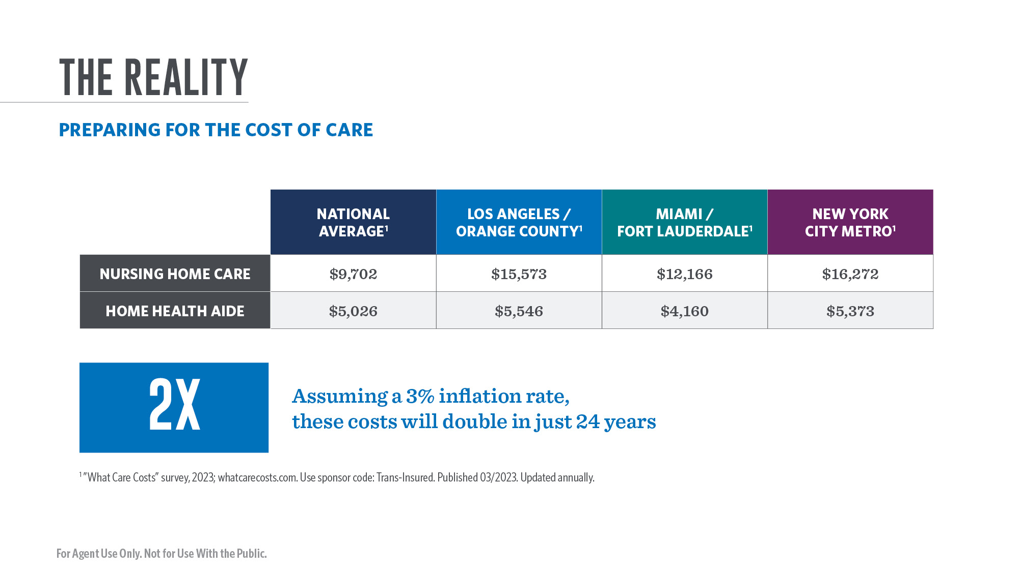
Notes:
Given the rising costs of healthcare, it’s never too early to start helping your clients prepare for long term care as part of their overall financial strategy
The national average cost of a home health aide is $5,026 per month and is $9,702 per month for skilled nursing care in a private room. The examples above for Los Angeles, Miami, and the New York City Metro areas show how much costs can vary depending on what part of the country you live in.
Assuming a hypothetical inflation rate of 3%, these costs will double in just 24 years.

Slide 6
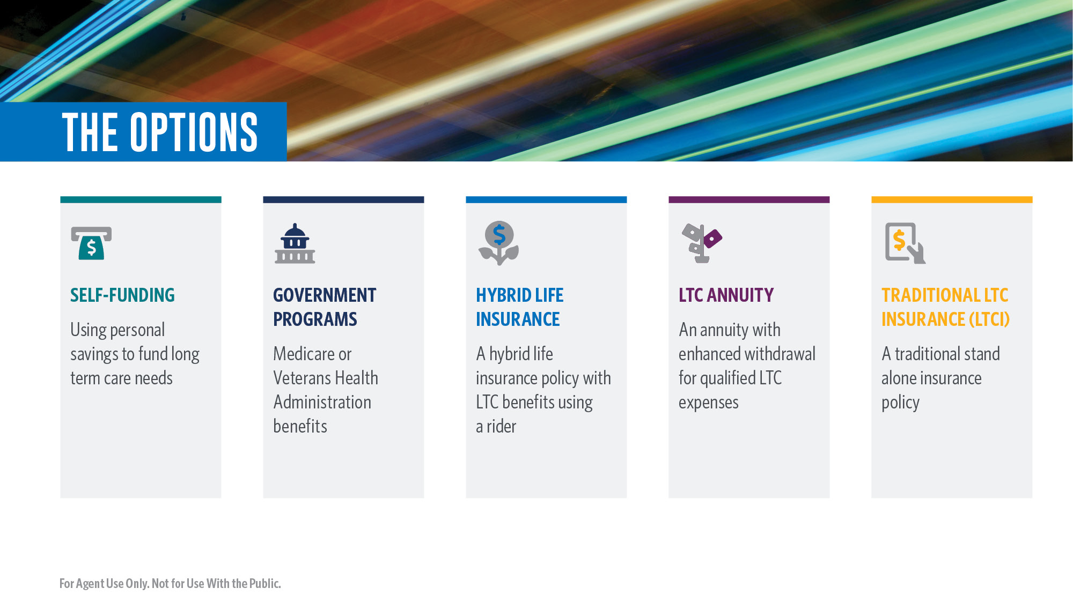
Notes:
Just as there are several ways to help clients prepare for the costs of long-term care, there are also important questions that need to be answered to determine which option may be right for them.
For example….
• Self‐funding – Using personal savings to fund long term care needs. With the uncertainty of the total amount of savings needed and competing priorities like saving for retirement, will a client be able to cover all potential costs on their own?
• Government programs – Programs like Medicare, Medicaid, or Veterans Health Administration Benefits are limited to certain qualifying recipients and what they actually cover. Does your client recognize the potential gaps or potential asset spend down provisions?
• Hybrid life insurance with LTC rider – Permanent life insurance with a LTC rider. Does your client have a need for
permanent life insurance as well as long term care coverage? Is your client healthy enough to qualify?
• LTC annuity – Generally an annuity contract with an enhanced income streams for LTC. Can your client
contribute enough funds to create the benefit needed to cover their LTC expenses?
• Traditional LTC insurance – Also known as stand‐alone long‐term care insurance. One of the original
LTC insurance options. Does the client have concerns about premium increases or limited benefits if care is never needed?

Slide 7


Slide 8
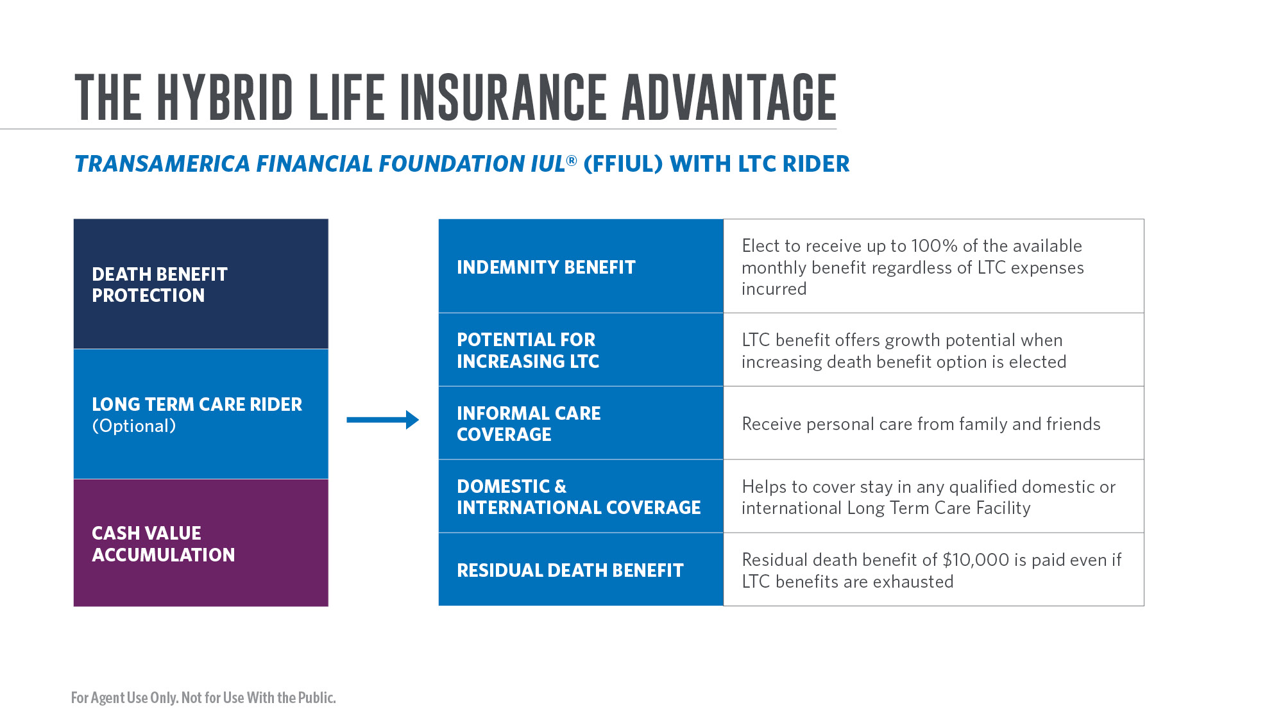
Notes:
Transamerica FFIUL is a multipurpose indexed universal life policy that has four key features that can help your clients and make the planning process easier:
Death benefit protection — the death benefit from the FFIUL may help a family replace the loss of income, assist with mortgage, childcare, education costs (or leave a financial legacy for children or grandchildren).
Tax-advantaged growth potential with downside protection — FFIUL gives clients the opportunity to grow their policy value through excess index interest (earnings above the guaranteed minimum rate) that may be credited to the policy based partly on changes in the major stock indexes.
Optional Long-Term Care Rider — The Long Term Care Rider allows for the acceleration of a portion of the policy’s death benefit to help pay for monthly expenses incurred for qualified long term care services. These benefits are generally income tax free* in accordance with the terms of the Long Term Care Rider. The Long Term Care Rider must be elected at the time the owner purchases a select permanent life insurance policy from Transamerica.
The Long Term Care Rider provides a range of features to help cover LTC needs when they’re needed most including Indemnity Benefits, an Index-Linked LTC Benefit Option, Informal Care Coverage, Domestic and International Coverage, and a Residual Death Benefit for loved ones.

Slide 9
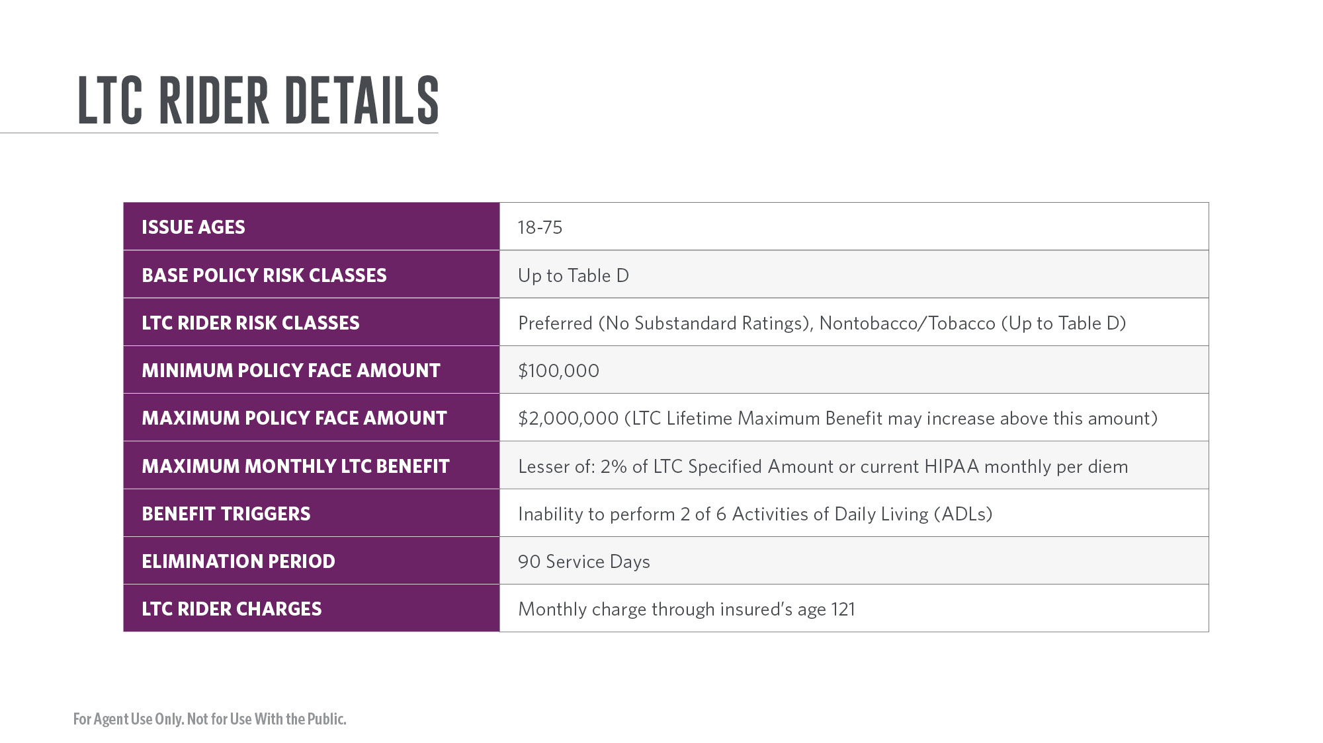
Notes:
The Long Term Care Rider is available to a wide range of insureds and risk classes up to Table D. With a maximum initial face amount available with the LTC Rider of $2 million, FFIUL may help clients to have enough protection to help offset the rising costs of care in the future.
Upon approval of a qualifying LTC claim, the policy owner may elect to receive up to their maximum monthly LTC benefit each month, which is the lesser of 2% of the LTC Specified Amount at the time of claim approval or the current HIPAA monthly per diem limit. If 2% of the LTC specified amount is received while on claim, the policy owner will receive a maximum of 50 months of LTC benefit payments. If less than the monthly maximum is accelerated, the Lifetime Maximum LTC Benefit will remain available for a longer period of time.

Slide 10
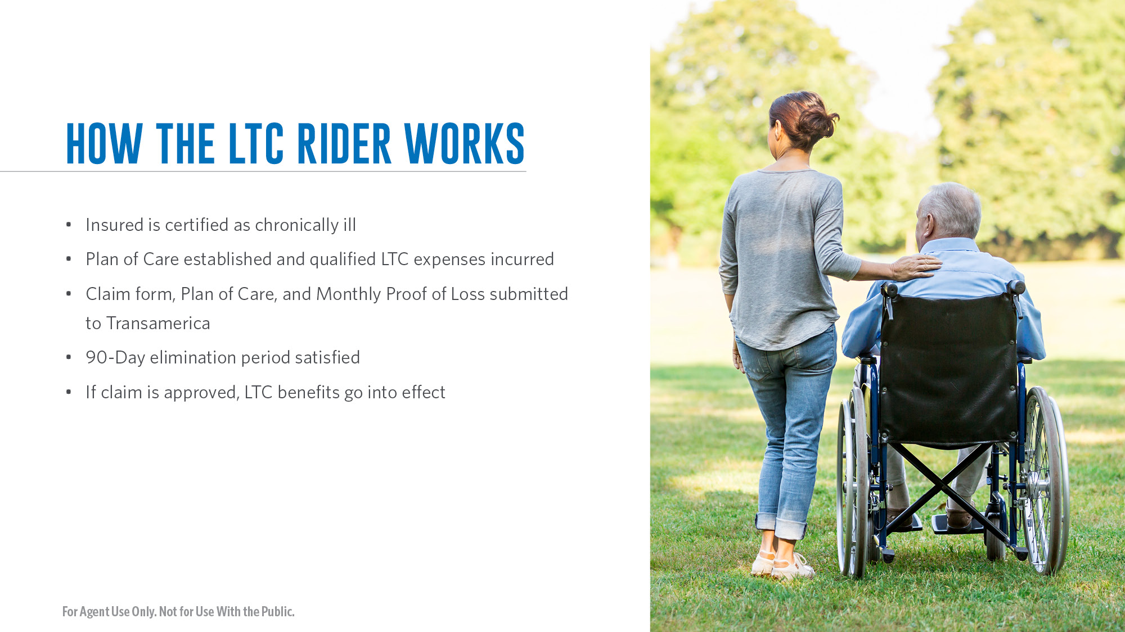
Notes:
How The Long Term Care Rider Works
To be eligible for monthly long term care benefits, the following conditions must be satisfied:
• The insured is certified as chronically ill by a licensed healthcare practitioner.
• A plan of care prescribed and approved by a licensed healthcare practitioner must be provided to Transamerica.
• Proof of loss documentation must be provided to Transamerica each month showing expenses incurred for qualified long term care services, in accordance with the plan of care.
• 90‐day elimination period must be met.

Slide 11
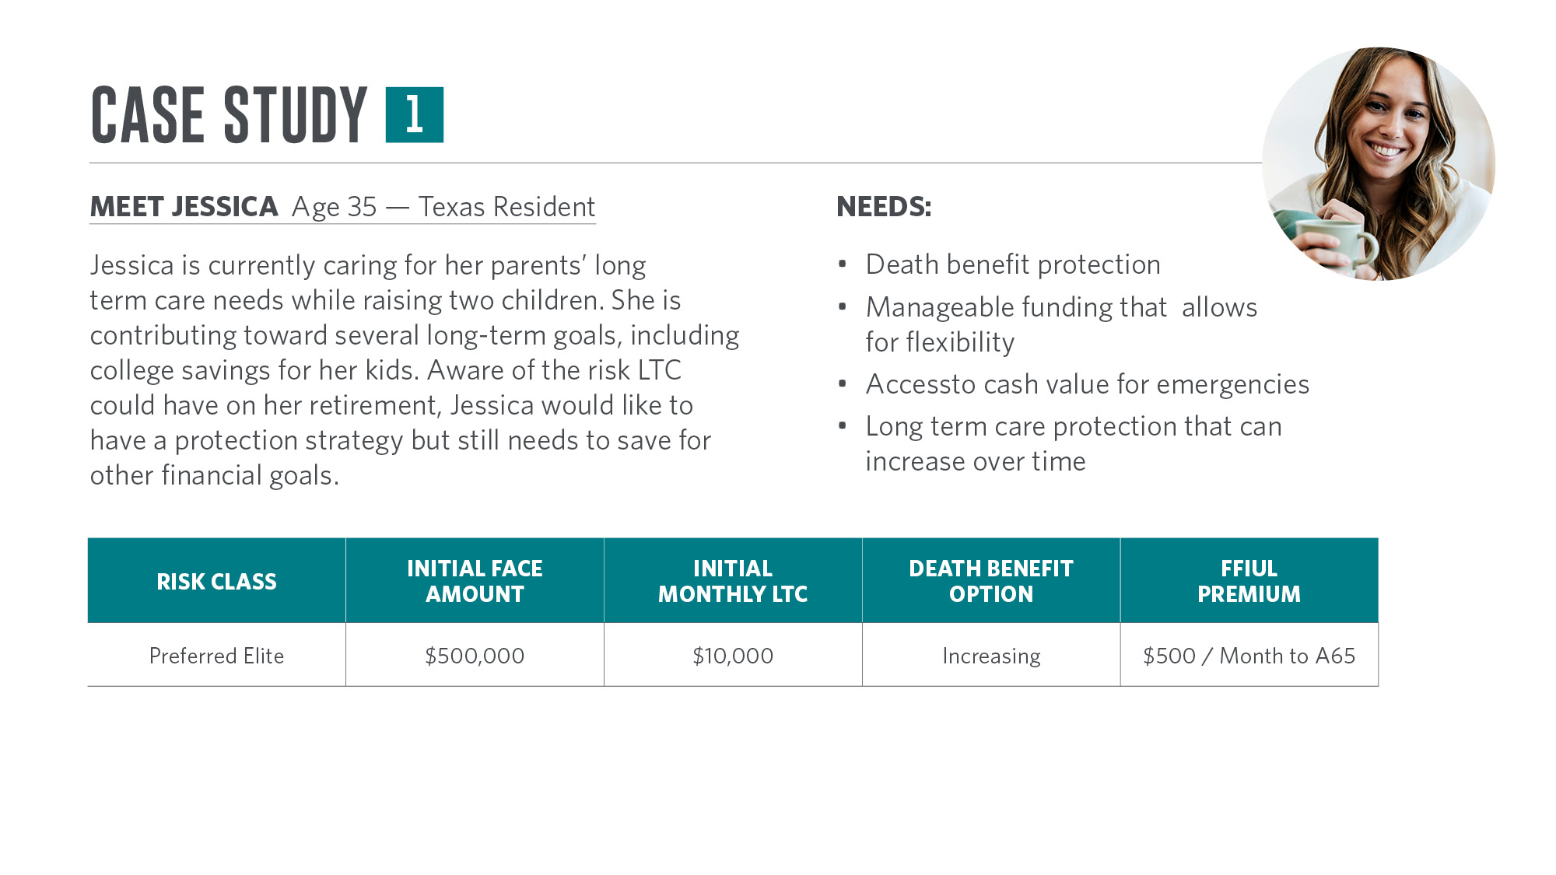
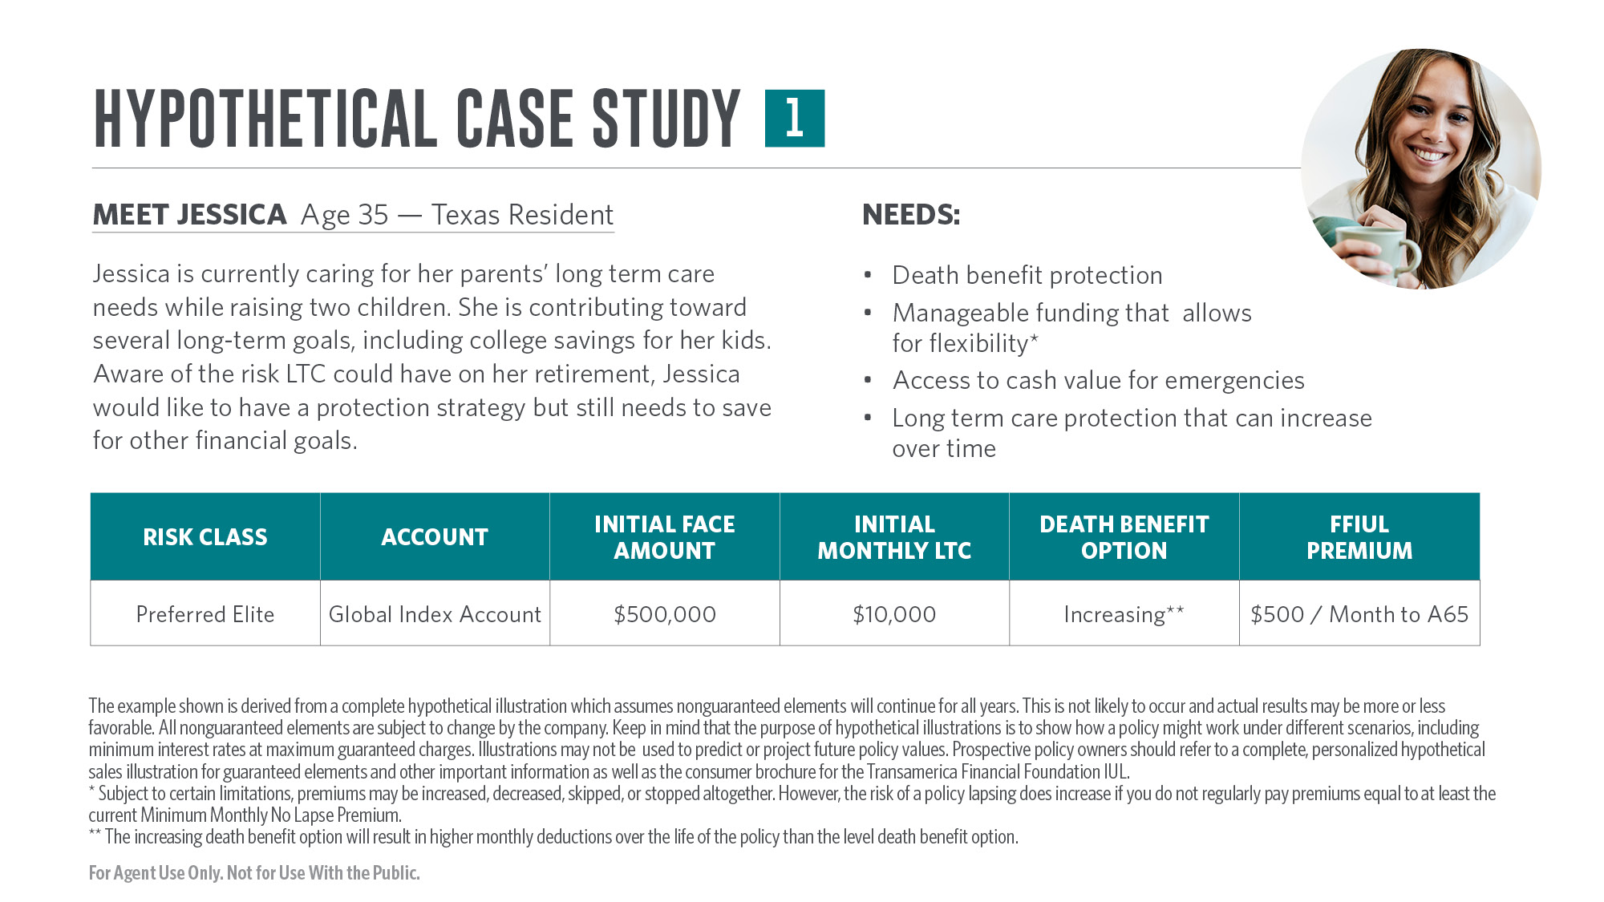
Notes:
This case study will help to show the benefits of the Long Term Care Rider and how it could help one of your clients protect against rising LTC costs.
Jessica is 35 years old and currently lives in Dallas, Texas, with her husband and two children. After helping care for her parents who needed nursing home care, she is aware of the impact LTC costs could have on her retirement. At the same time, Jessica would like to protect her family financially with a permanent life insurance policy that will enable her to also help save for her children’s college expenses in the future while having access to a source of cash for emergencies.
Jessica chooses to purchase a Transamerica FFIUL policy with an initial death benefit of $500,000. She elects to pay $500 per month and plans to pay it to age 65 but likes the flexibility of being able to skip a premium when needed.** Jessica elects to add the LTC Rider to her policy and chooses an increasing death benefit option that may allow the LTC benefits to increase over time in tandem with the death benefit.

Slide 12
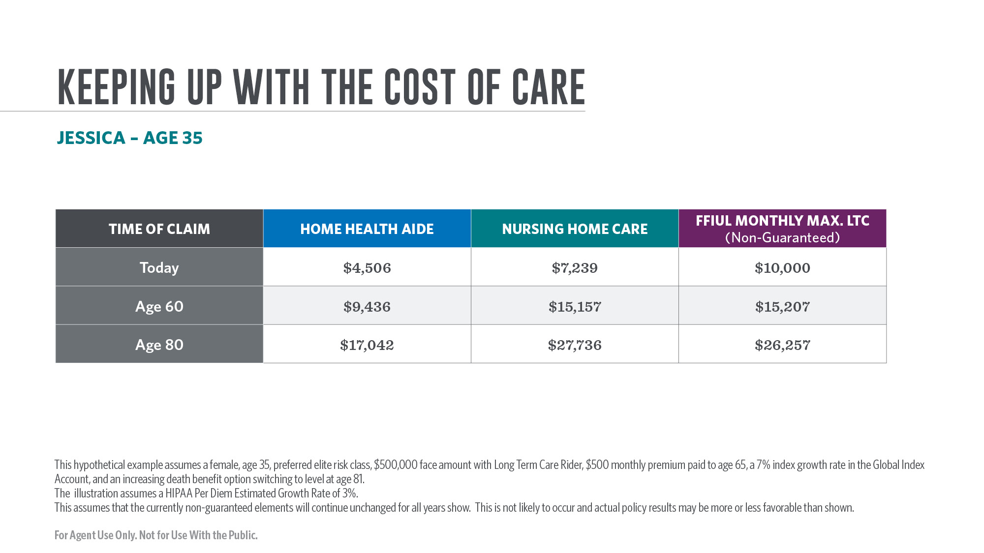
Notes:
Assuming non-guaranteed current policy charges and a 7% hypothetical annual growth rate, Jessica’s FFIUL death benefit is projected to increase from $500,000 at time of purchase to $760,000 by her attained age 60. If Jessica was no longer able to perform 2 of 6 activities of daily living or has severe cognitive impairment from a condition like early-onset dementia, she could elect to receive up to $15,207 per month from her policy while on claim.
Assuming a hypothetical 3% rate on inflation, a Home Health Aide is projected to cost $9,436 per month in Texas when Jessica is age 60 while Nursing Home Care is projected to Cost $15,157 per month by her age 60. Jessica may use her monthly LTC benefit to help pay for these costs without having a severe impact on her family’s finances.
By Jessica’s age 80, her FFIUL death benefit is projected to increase to roughly $1.3 million with a monthly max. LTC benefit of $26,257. This compares to the projected future cost of Nursing Home Care of $27,376 per month, assuming a 3% rate of inflation. A Home Health Aide’s services for 40 hours per week is projected to cost $17,042 per month by Jessica’s age 80.

Slide 13
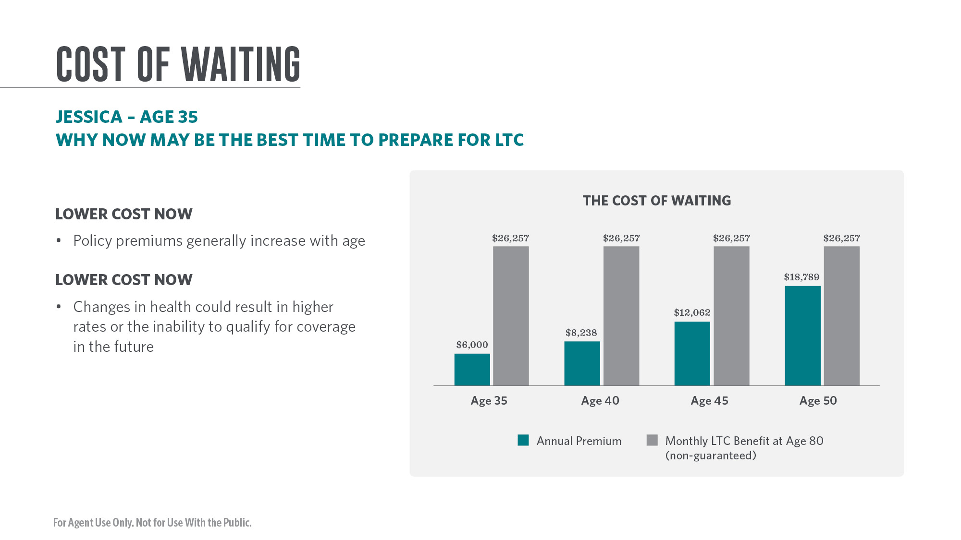
Notes:
Clients often wonder when the best time is to purchase protection for future long-term care needs. For clients who elect to cover that need with a permanent life insurance policy with LTC acceleration rider, such as Transamerica’s FFIUL, the best time to purchase protection may be now.
With life insurance policies, policy premiums generally increase with age due to an insured being closer to their life expectancy. As an example, the annual premium for $500,000 of coverage on a 40-year-old will be less than the same level of coverage purchased by a 65-year-old. If an insured has a negative change in their health in the future, this could also lead to higher rates or the inability to qualify for life insurance coverage.
In Jessica’s case, obtaining the same level of potential future LTC benefits may be substantially more expensive depending on how long she waits to purchase coverage. As a 35-year-old, her planned premium of $500 a month ($6,000 per year) to age 65 would result in a death benefit of $1,312,827 by her attained age 80. If she had a qualifying LTC claim at age 80, she could access up to $26,257 per month to help pay for her LTC expenses. By waiting just five more years to purchase coverage, Jessica would need to pay $687 a month ($8,238 per year) to age 65 to reach the same monthly LTC benefit at age 80.

Slide 14
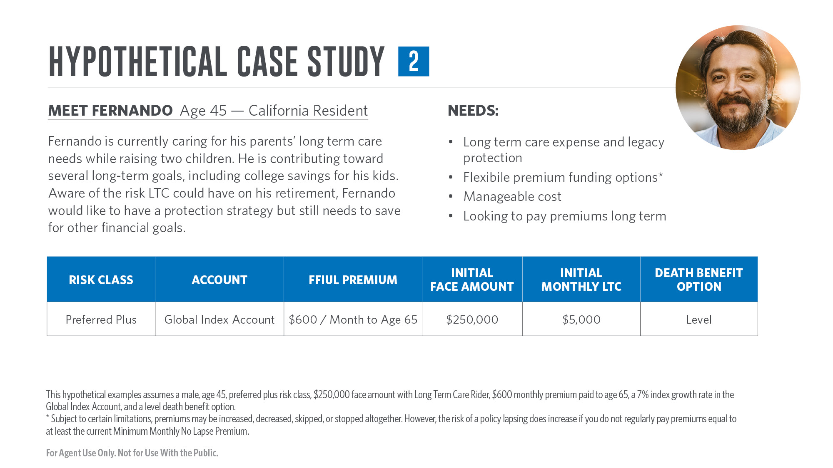
Notes:
This case study will help to show the benefits of the Long Term Care Rider and how it could help one of your clients protect against rising LTC costs.
Fernando is 45 years old and currently lives in California with his spouse and three children. Fernando and his spouse are currently acting as caregivers for his mother, who had a stroke and no longer can live independently. Fernando would like to protect his family financially with a permanent life insurance policy that would help replace his current income while also gaining access to LTC protection should he need long-term care in the future himself. Fernando would also like to leave a death benefit to his children even if he needs to use all of his available LTC benefit.
Fernando chooses to purchase a Transamerica FFIUL policy with an initial death benefit of $250,000. He has a budget of $600 per month for the policy and plans to pay it to age 65, but likes the flexibility of being able to skip a premium when needed. Fernando elects to add the LTC Rider to his policy and chooses the level death benefit option. If something happened to Fernando and he had an immediate long-term care need, his initial monthly maximum LTC benefit is $5,000.

Slide 15
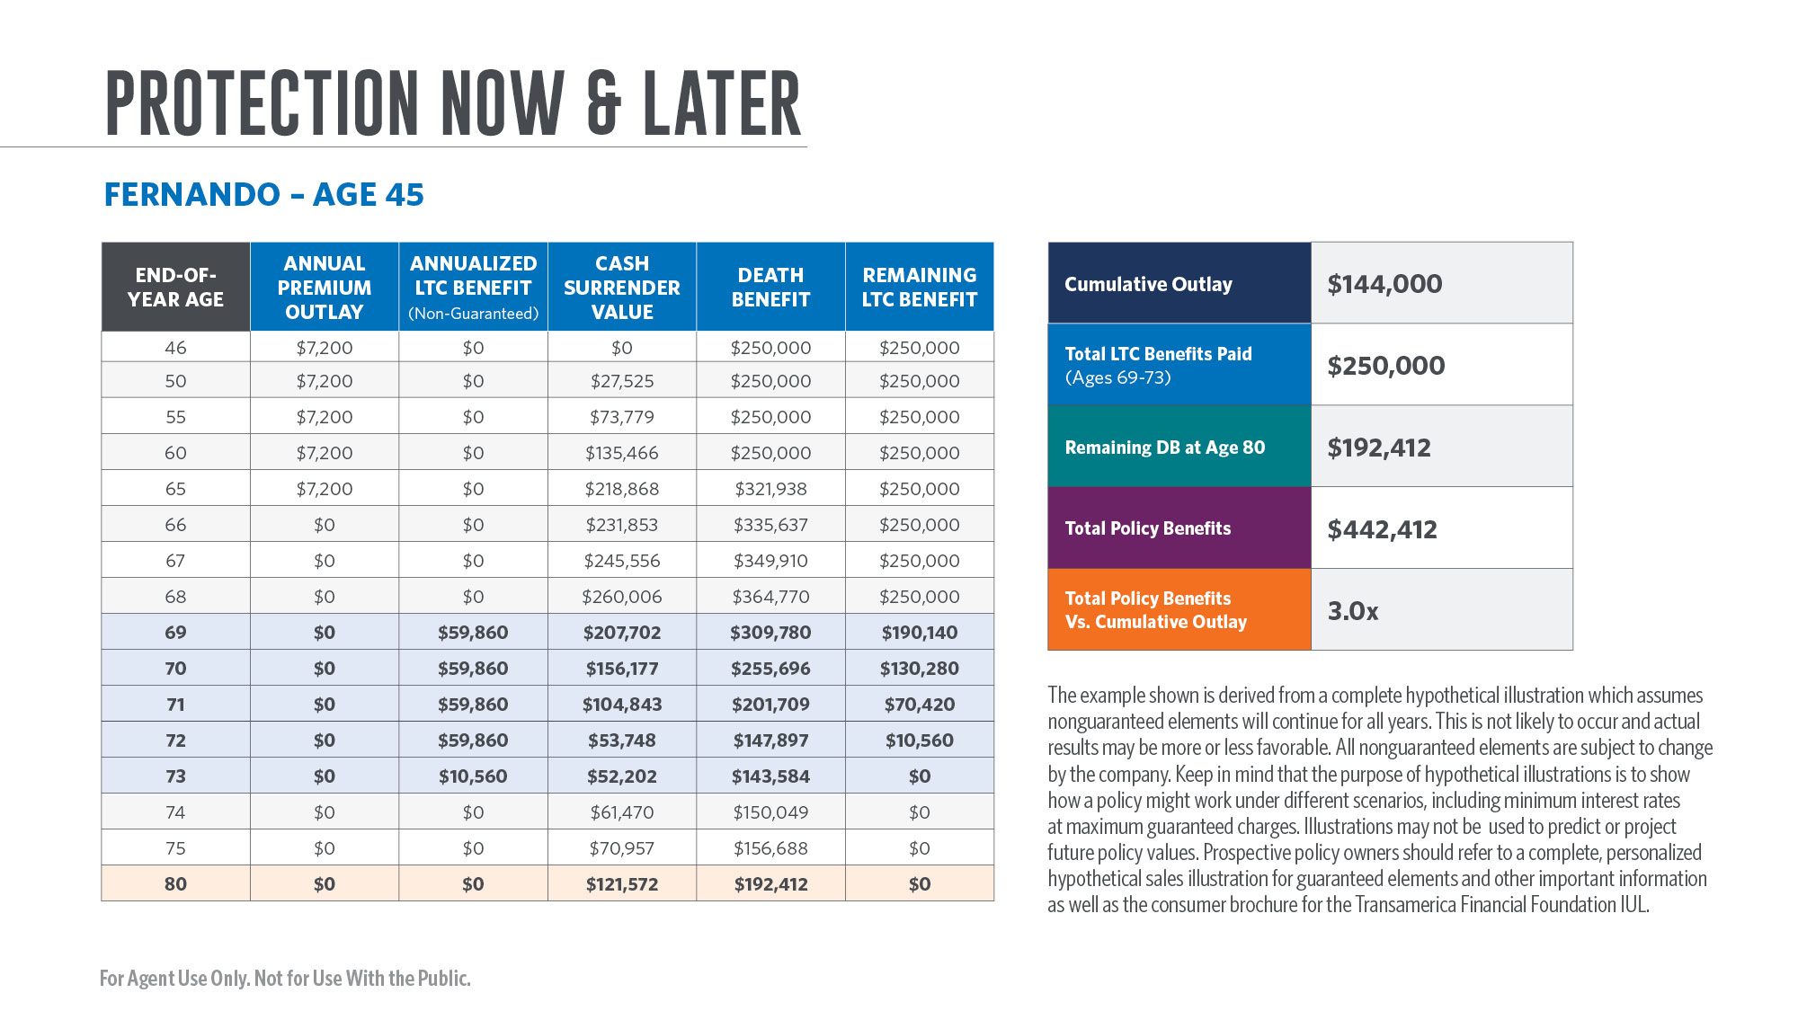
Notes:
Fernando funds his $250,000 FFIUL policy with $600 per month of premiums to age 65. Based on a non-guaranteed illustrated rate of 7% and current policy charges, Fernando’s initial death benefit of $250,000 is projected to grow to $321,938 by age 65. If something happened to Fernando between now and his retirement, he would leave his family a death benefit that could help them with ongoing living expenses or help pay down debt such as a mortgage.
Fernando finds out he has early-onset dementia at age 68 and requires substantial supervision due to having severe cognitive impairment. Fernando submits a claim on his FFIUL policy that is approved. He elects to receive the maximum monthly benefit of $5,000 from his policy each month he remains on claim. After his exhausting his Lifetime Maximum LTC Benefit after 50 months, Fernando is still projected to have a remaining death benefit of $143,584 at age 83. If Fernando lived for 12 years after the onset of his dementia, his remaining death benefit is projected to be $192,412.
In total, Fernando is scheduled to pay $144,000 in total premiums, is able to access $250,000 for his LTC needs, and still leave his family a death benefit of $192k upon his death at age 80. In total, Fernando and his family receive approximately 3x what he paid in total premiums.

Slide 16

Notes:
It’s important to truly understand what the client needs and what fits their unique situation. Taking the time to do so can turn you into a trusted resource for not only your clients’ future needs, but also their friends and family.

Slide 17

Notes:
Another way to introduce the subject of long-term care planning is to share a personal story from a client or from your own experience. Ask your client if they’ve known a friend or family member who suffered a serious illness or needed long term care. Find out how that individual planned (or didn’t plan) for it and really take a personal interest in their story. A client’s personal experience may help
motivate them to take the steps necessary to act on preparing to address their needs and take their future care more seriously.

Slide 18

Notes:
There are many reasons that drive clients to take action to protect themselves and their loved ones from the potentially devastating impacts of being unable to care for oneself. Listen for hot buttons such as wanting to:
• Help protect their hard‐earned retirement savings
• Leave a legacy for younger generations
• Ensure loved ones have resources for care
• Have choice and control when addressing their care

Slide 19


Slide 20
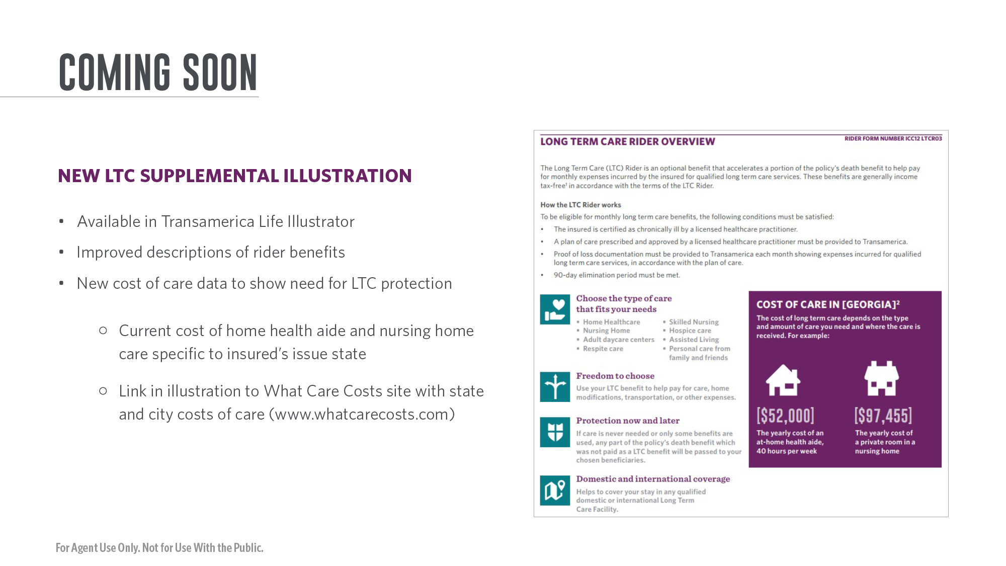
Notes:
See slide.

Slide 21
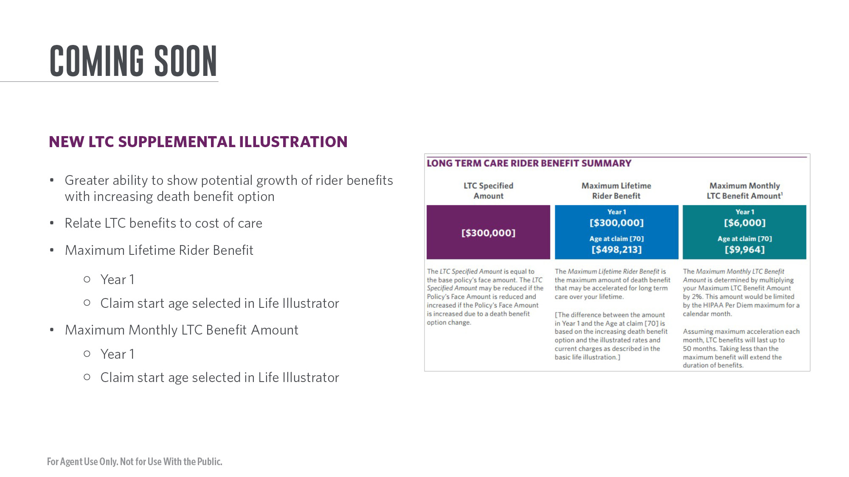
Notes:
See slide.

Slide 22
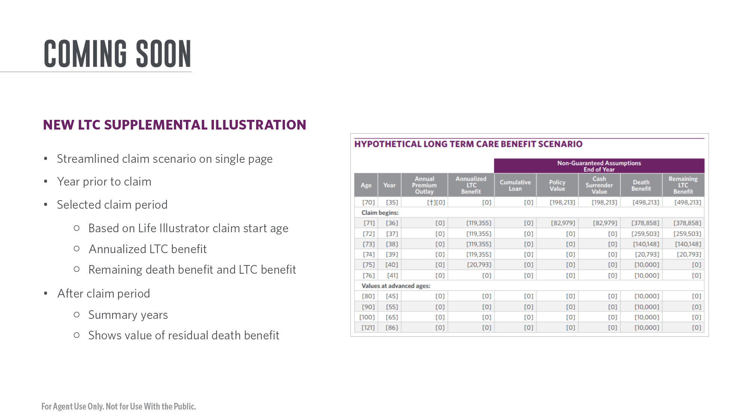
Notes:
See slide.

Slide 23

Notes:
See slide.

