Slide 1



Transamerica Financial Foundation IUL® II
Index Account Training
Februaury 2025
Jeremy Sims
Director, Life Product Solutions
Notes:
Read slide. Hi. Today we’re going to take a quick look at how we built the index accounts for Transamerica Financial Foundation II and the indexes currently available with this new product offering.

Slide 2
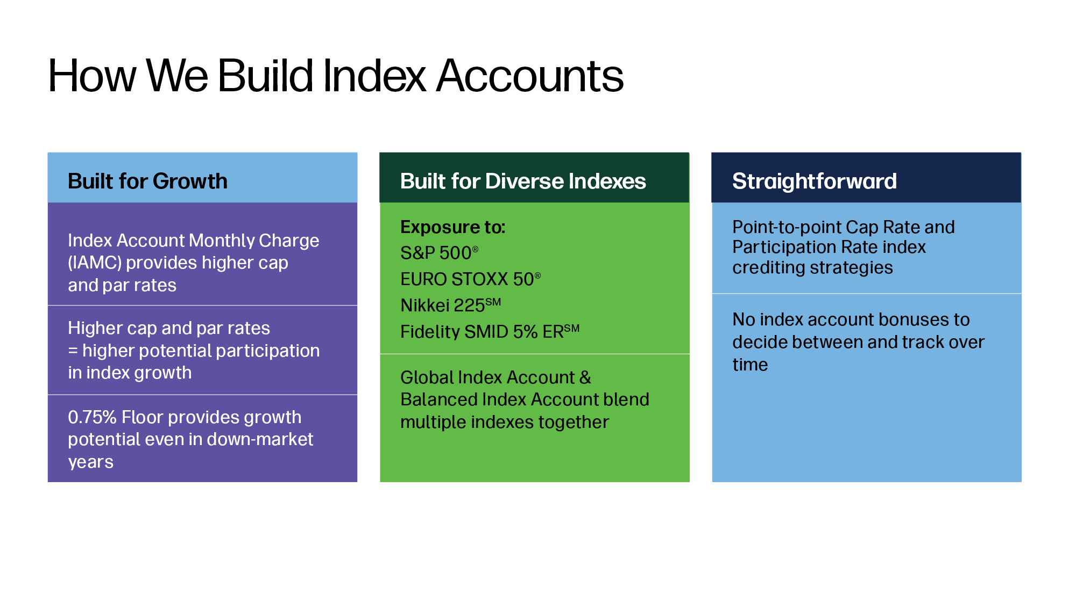
Notes:
When building our index accounts, we keep three things in mind. They are:
Built for Growth
Built for Diversification
Straightforward
[Review slide]

Slide 3
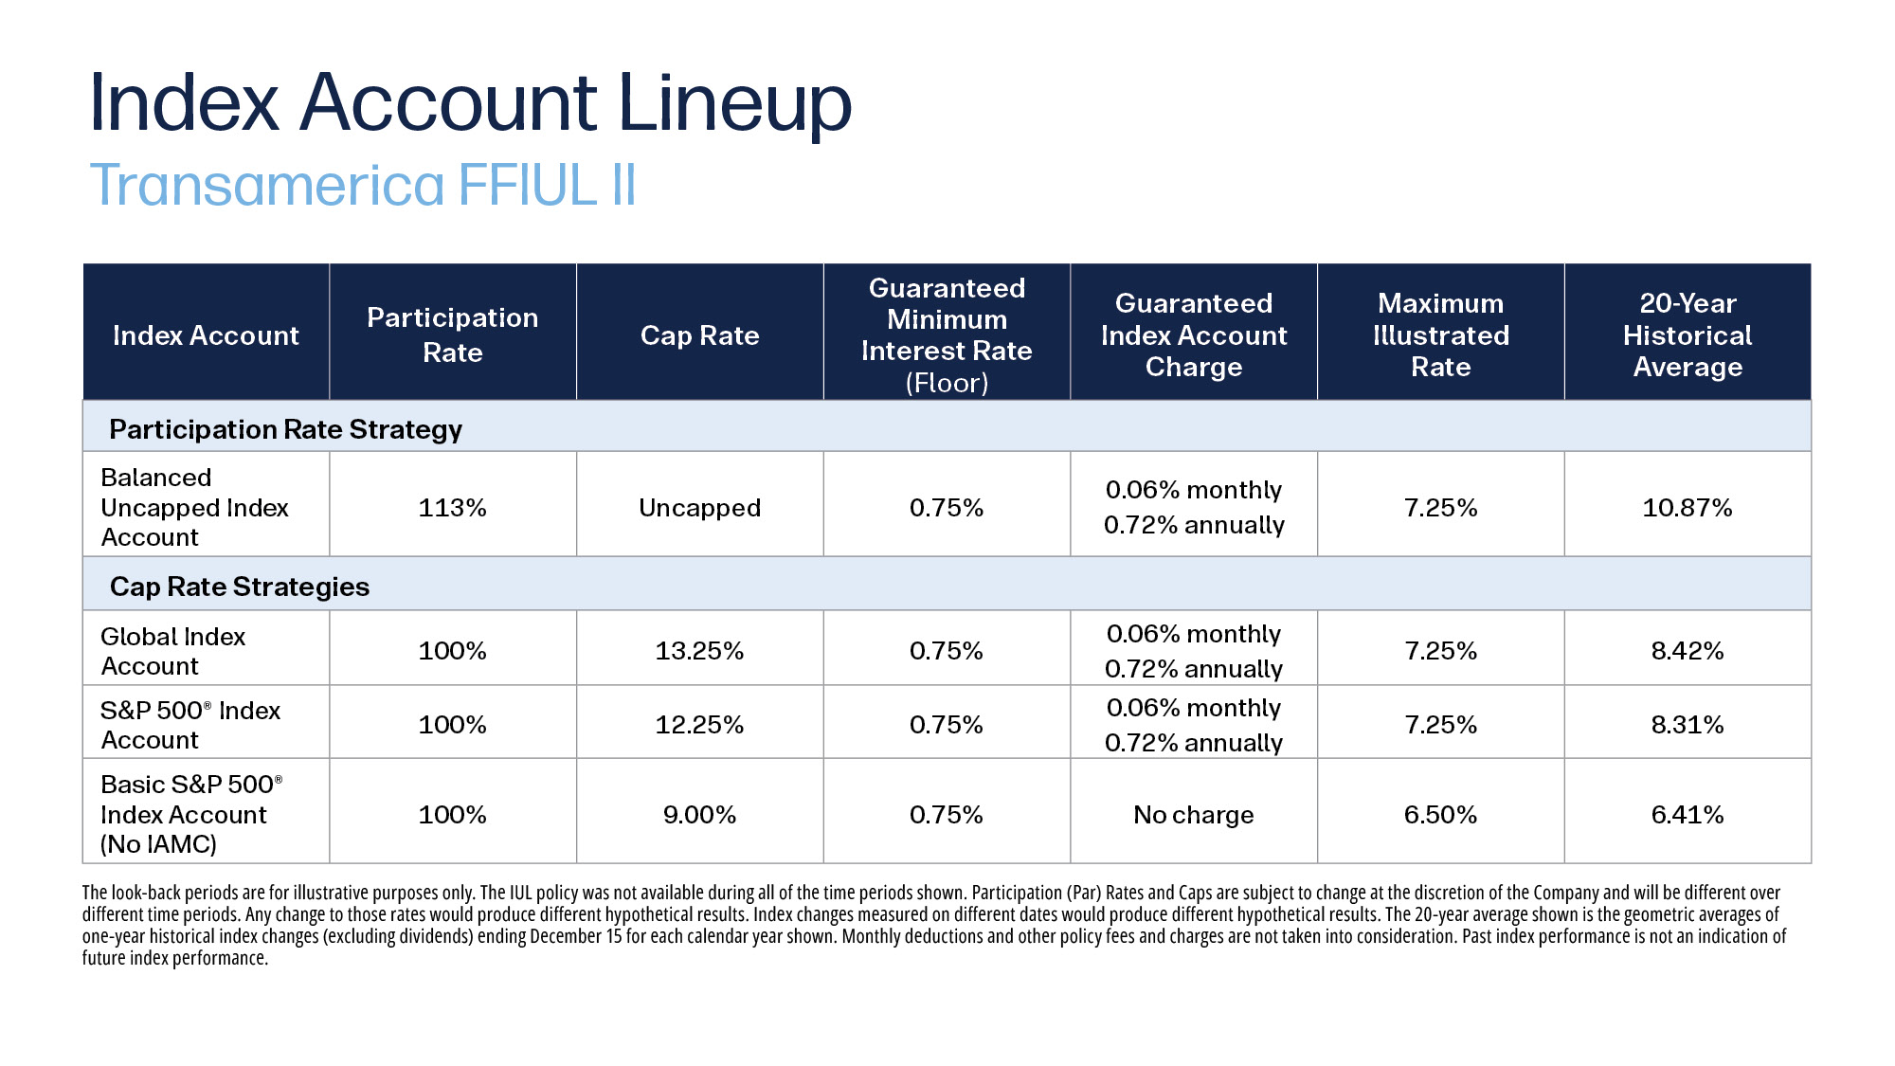
Notes:
Here’s a look at our index account lineup and the rates, caps, and averages associated with each one.
[Review slide]

Slide 4
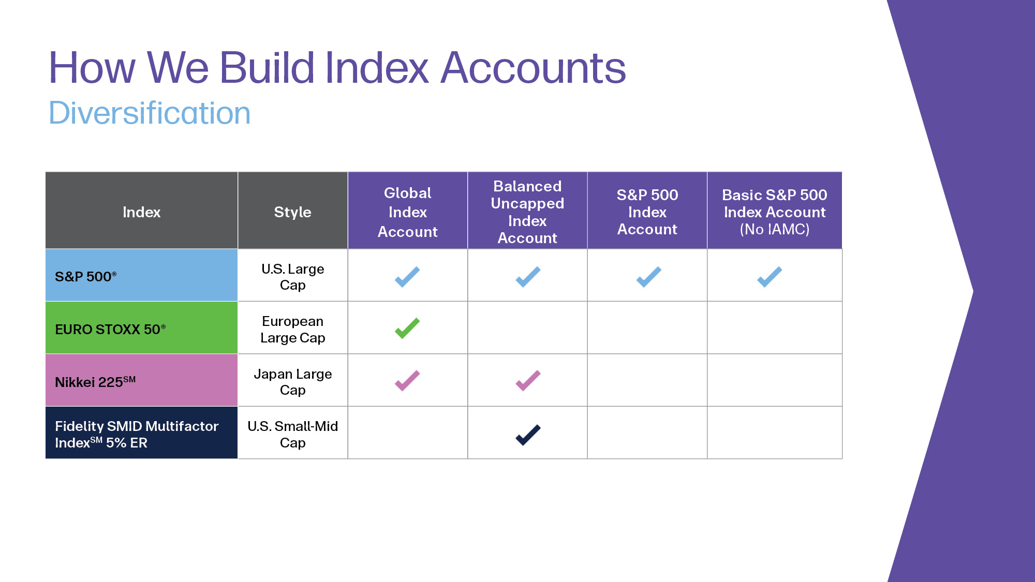
Notes:
Here is a comparison of our index accounts.
[Review slide]

Slide 5
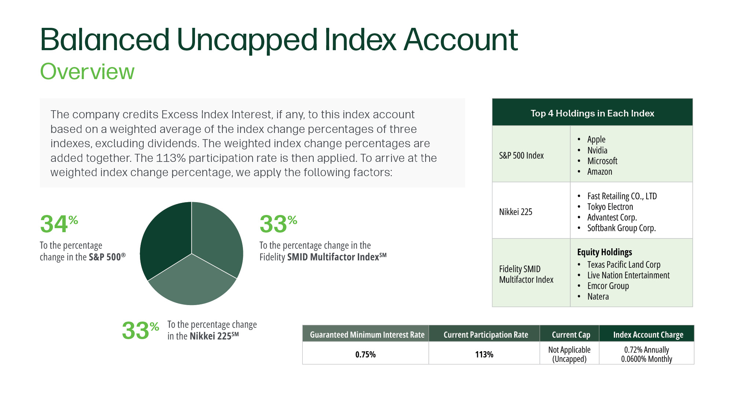
Notes:
Now let’s take a look at our new Balanced Uncapped Index Account.
[Review slide]

Slide 6
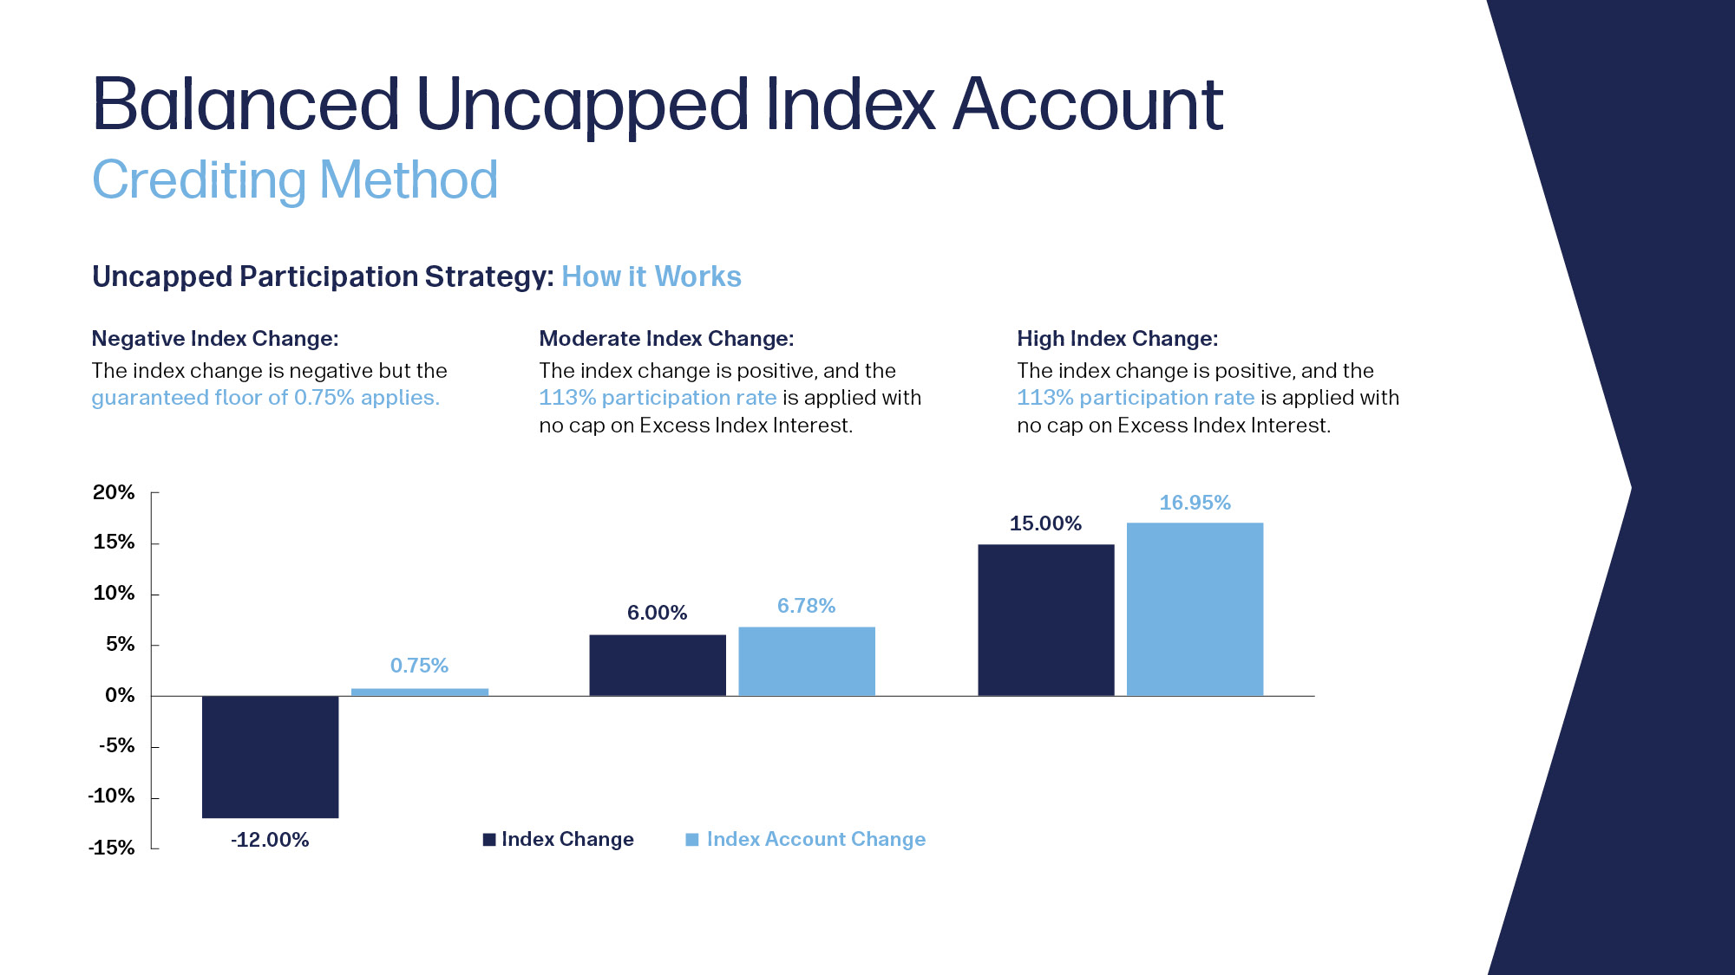
Notes:
Here is how the uncapped participation strategy works with our Balanced Uncapped Index Account.
[Review slide]

Slide 7
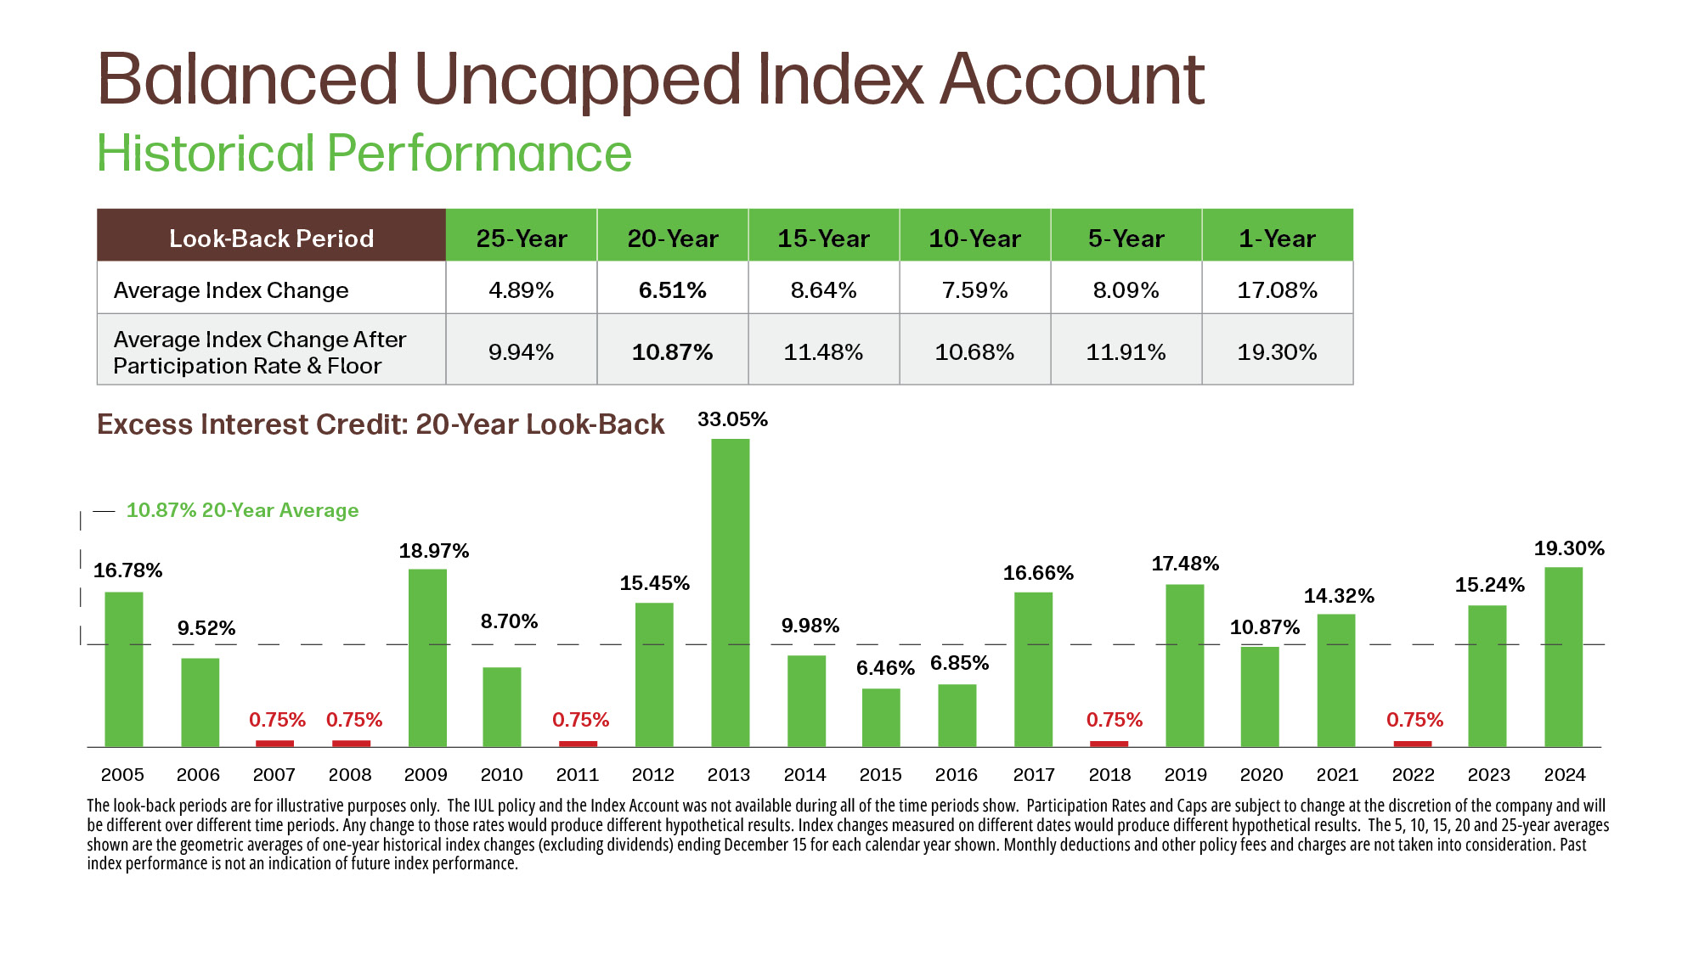
Notes:
Read slide.

Slide 8
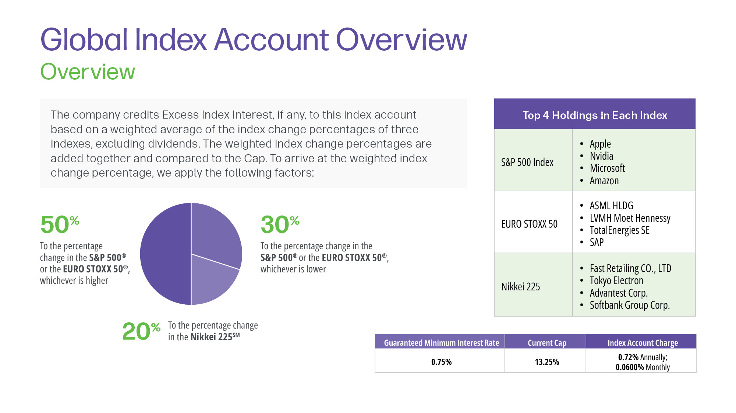
Notes:
Read slide.

Slide 9
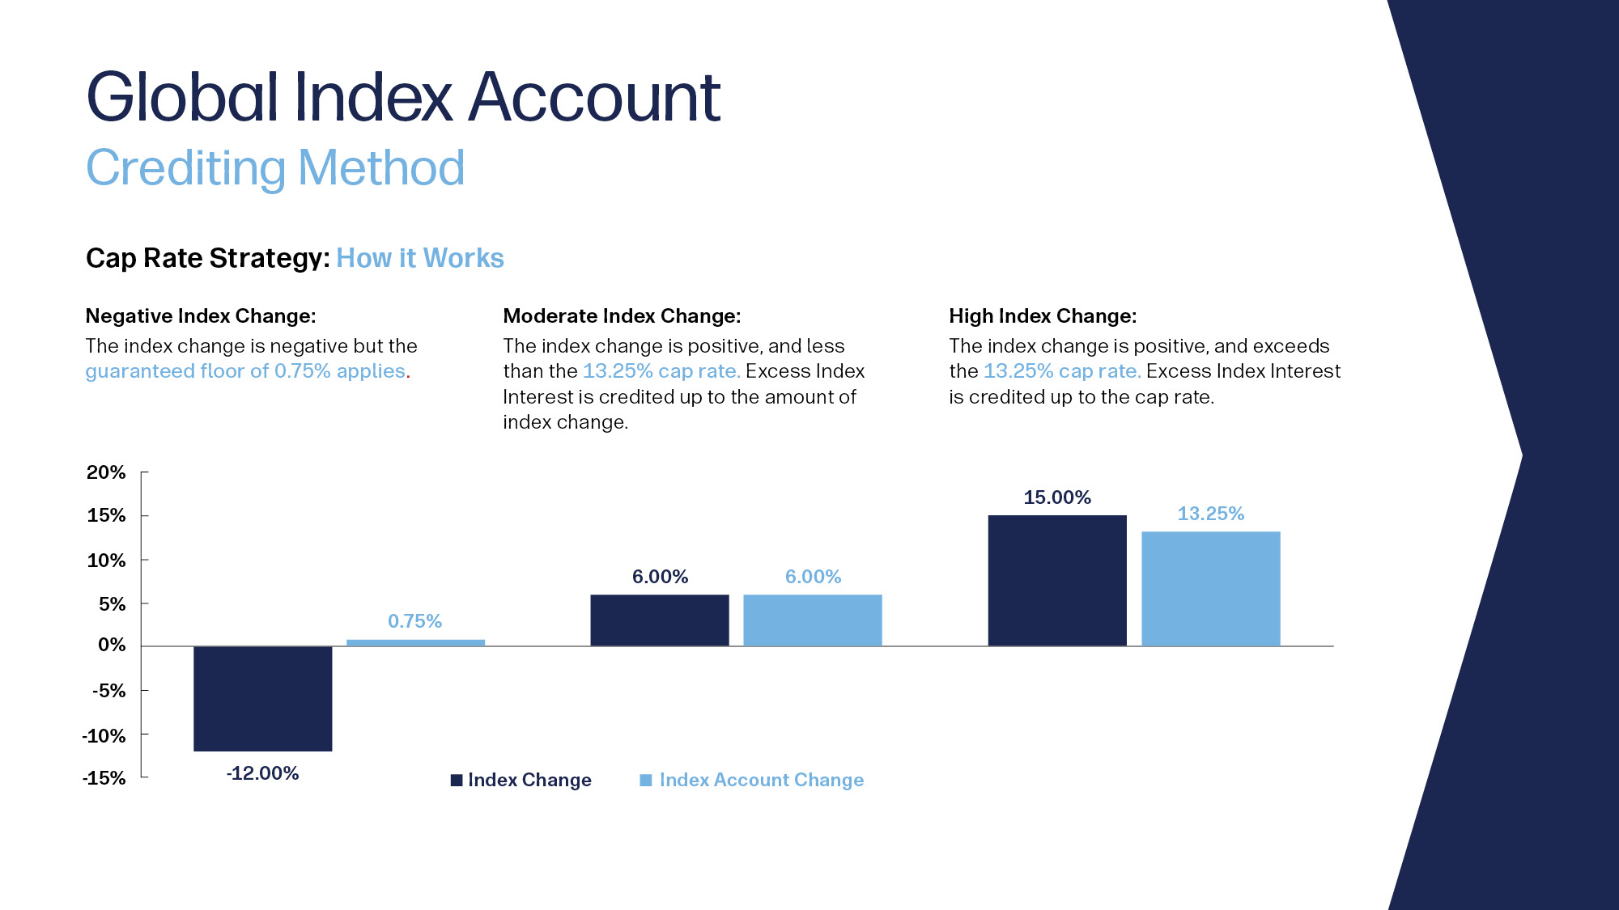
Notes:
Read slide.

Slide 10
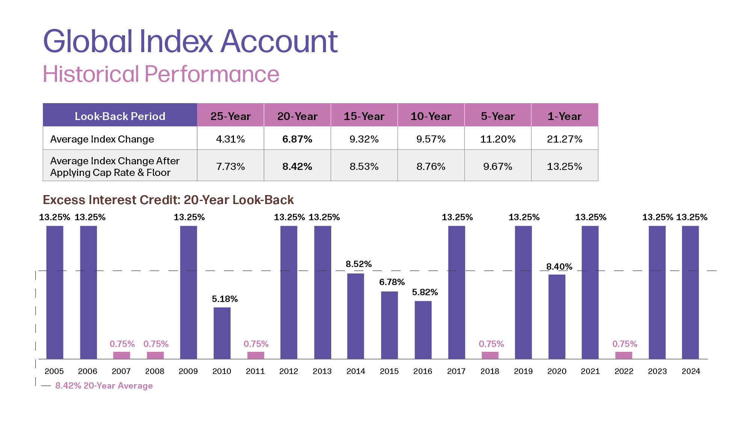
Notes:
Read slide.

Slide 11
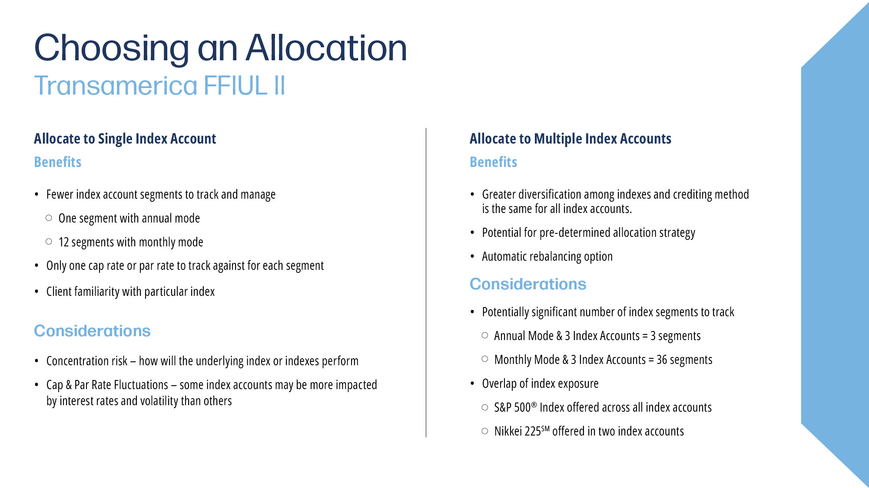
Notes:
Read slide.

Slide 12
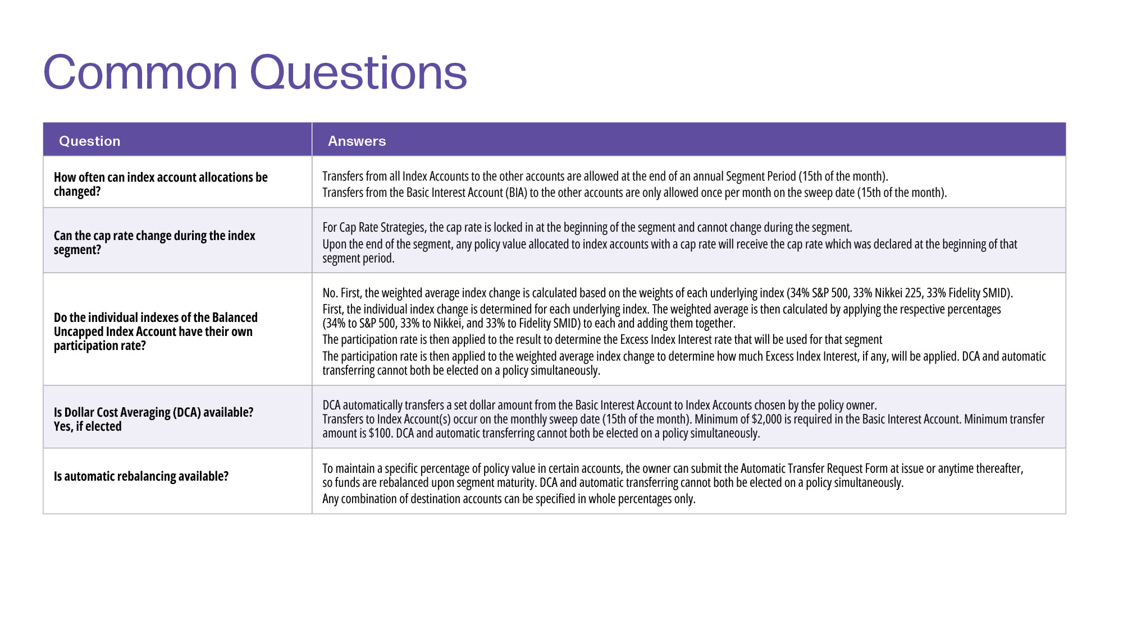
Notes:
Read slide.

Slide 13
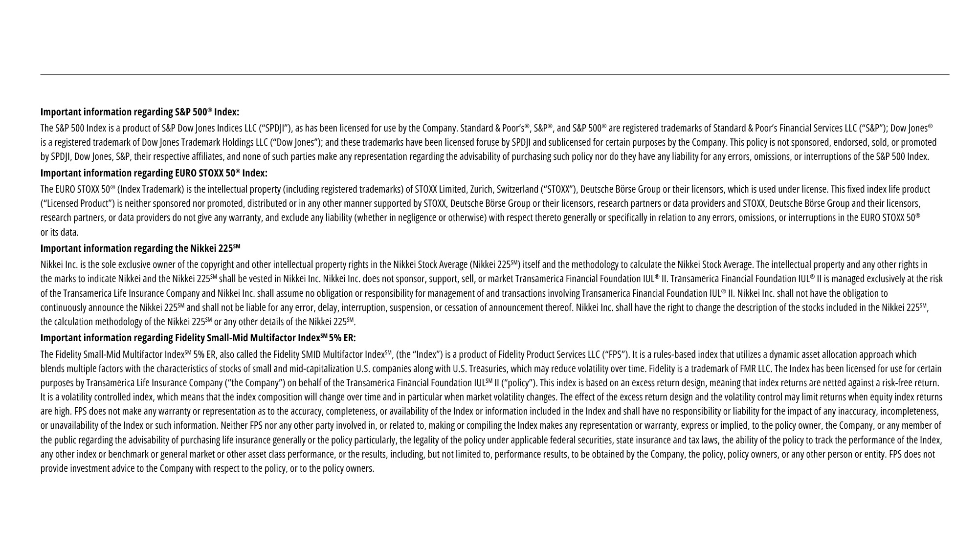
Notes:
Read slide.

Slide 14

Notes:
Read slide.

