Slide 1



SIMPLIFYING THE AUTHORIZATION FORM

Slide 2
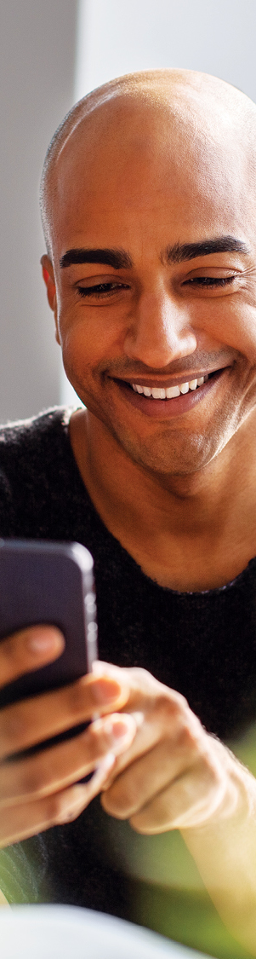
IMPORTANT INFORMATION FOR PRESENTER
This presentation is the property of Transamerica and its affiliates. By delivering the presentation, you acknowledge that it cannot be altered, edited, or reproduced in any way. You further understand you may not misrepresent the information in this presentation or deviate from its approved content.
For Agent Use Only. Not for Use With the Public.
Notes:
You deserve to work with a company that is responsive and strives to inspire the growth of your business in creative and innovative ways. Transamerica is committed to you and your success, and there are a few things that set us apart.
People are living longer lives, and the quality they expect from those years is making a big impact on their financial security. We’ve been helping people feel better about the future for more than 100 years. We’re proud of the trust we’ve earned from the families we’ve helped protect. One generation to the next.
We’re a highly rated carrier.
We also offer a wide portfolio of offerings to meet customers’ needs, including the lifetime permanent protection of the Final Expense Solutions Portfolio. It can help provide clients with a sense of security that comes from knowing their loved ones will have one less thing to worry about.

Slide 3


    Share the benefits of Social Security Payment Option for you and your clients
    Understand the schedule of Social Security benefit payments
    Review the 3-day rule to determine deposit/withdrawal date
    Walk through how to accurately set up Social Security Billing Option
For Agent Use Only. Not for Public Distribution.
Notes:
[Read slide]

Slide 4


Increased Persistency
Premiums can be withdrawn as soon as Social Security benefits are paid.
Timing the withdrawal with the deposit of the client’s Social Security benefits
will ensure premiums are collected prior to clients withdrawing funds.
Increased Sales Opportunities
We are able to withdraw premium payments on corresponding Social
Security benefit deposit dates for checking accounts and the Direct Express® card program.
We are one of a few carriers that accept the Direct Express® card as a mode
of payment.
For Agent Use Only. Not for Public Distribution.
Notes:
AGENT BENEFITS
Increased Persistency
Premiums can be withdrawn as soon as Social Security benefits are paid. Timing the withdrawal with the deposit of the client’s Social Security benefits will ensure premiums are collected prior to clients withdrawing funds.
Increased Sales Opportunities
We are able to withdraw on corresponding Social Security benefit deposit dates for both checking accounts and the Direct Express® card program. We are one of a few carriers that accept the Direct Express® card program as a mode of payment.

Slide 5


Social Security Deposit Dates Matched
Clients should have peace of mind knowing their premiums will be withdrawn as soon as their Social Security benefits are deposited.
Direct Express® MasterCard® Accepted
Clients can have their withdraw correspond to Social Security benefit deposit dates for bank accounts and the Direct Express card program.
We are one of a few carriers that accept the Direct Express card
as a mode of payment.
For Agent Use Only. Not for Public Distribution.
Notes:
CLIENT BENEFITS
Social Security Deposit Dates Matched
Clients can have the peace of mind knowing their premiums will be withdrawn as soon as their Social Security benefits are deposited.
Direct Express MasterCard Accepted
Clients can have their withdraw correspond to Social Security Benefit deposit dates for bank accounts and the Direct Express card program. We are one of a few carriers that accept the Direct Express card as a mode of payment.

Slide 6

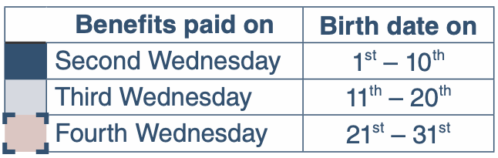
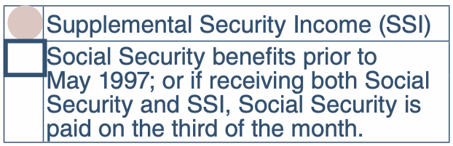
For Agent Use Only. Not for Public Distribution.
Notes:
This is only a monthly payment EFT payment mode — quarterly and annual payment modes are not available using the Transamerica Authorization Form.

Slide 7


Please ensure the Social Security benefit deposit date does not occur within 3 business days of the application date.
If it does occur within 3 business days of the application date, the initial draft date must be moved to the following month. Initial draft month cannot exceed one benefit payment cycle past application date.
For Agent Use Only. Not for Public Distribution.
Notes:
Please ensure the Social Security benefit deposit date does not occur within 3 business days of the application date.
If the Social Security benefit deposit date occurs within 3 business days of the application date, the initial draft date would need to be moved to the following month. Initial draft month cannot exceed one benefit payment cycle past application date.

Slide 8

(CONT)
EXAMPLE
If the application date is June 3 and the client’s Social Security benefits are deposited on the second Wednesday of the month, June 10, this would not meet the rule of 3 business days.
The next draft date (July 8) would need to be selected.
For Agent Use Only. Not for Public Distribution.
Notes:
Example:
If the application date is June 3 and the client’s Social Security benefits are deposited on the second Wednesday of the month, June 10, this would not meet the 3-day business rule. The next draft date (July 8) would need to be selected.

Slide 9

SOCIAL SECURITY PAYMENT OPTION
For Agent Use Only. Not for Public Distribution.

Slide 10
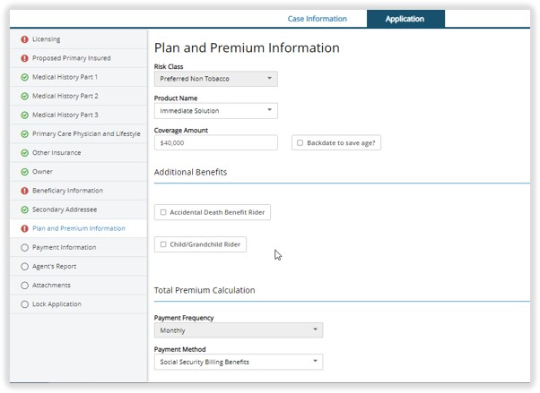
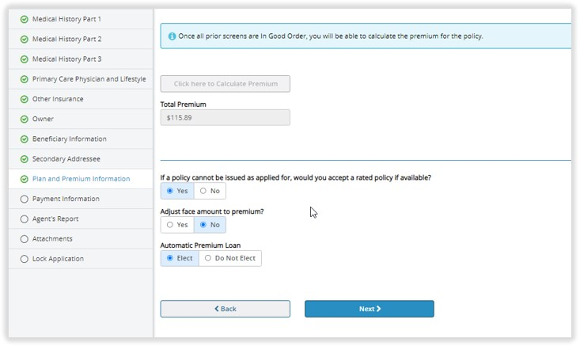
This is only a monthly EFT payment mode. Quarterly, semiannual, and annual are not available when your client elects to pay via Social Security billing.
For Agent Use Only. Not for Public Distribution.
Notes:
[Read slide]

Slide 11
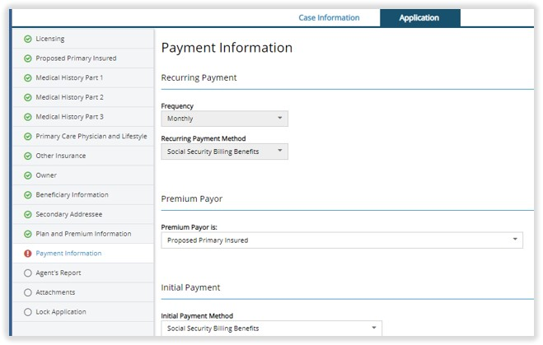
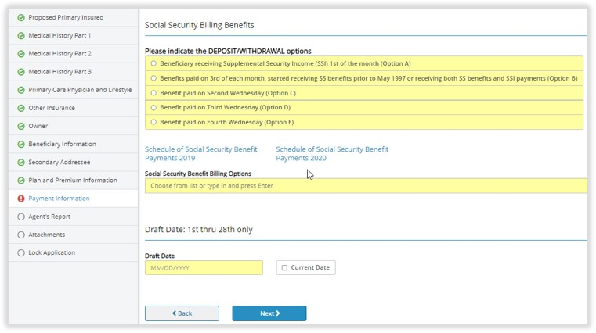
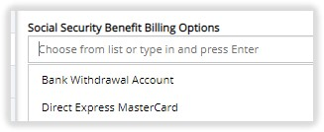
Select one of the five payment date options using the Schedule of Social Security Benefit Payments. After the client picks the payment date, use the drop down under the Social Security Benefit Billing option to elect whether they want to withdraw from the bank account or use Direct Express MasterCard.
For Agent Use Only. Not for Public Distribution.
Notes:
[Read slide]

Slide 12
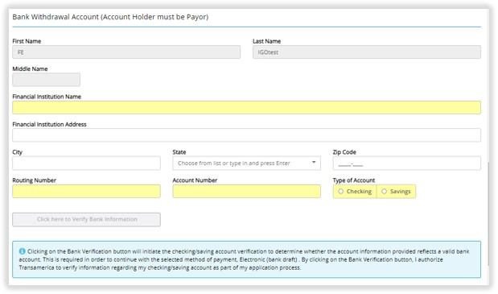
If your client wishes to pay with their bank account, complete the Bank Withdrawal Account
section on iGO® e-App.
For Agent Use Only. Not for Public Distribution.
Notes:
[Read slide]

Slide 13
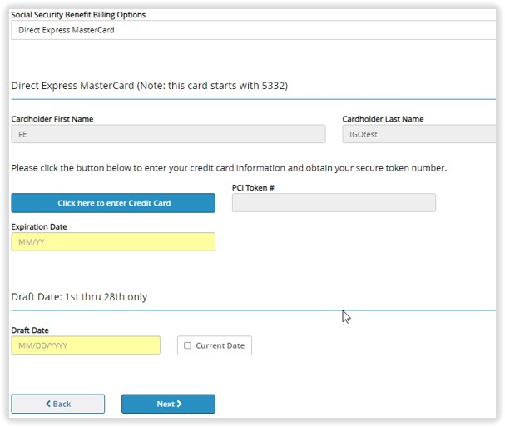
You and your client’s privacy and security are our top priority. That’s why we have a process that secures all card numbers, including Direct Express Debit Master Card numbers that begin with 5332. The card numbers are converted to a token when you click on CLICK HERE TO ENTER CREDIT CARD. The token number is used in place of the card number in all our systems.
For Agent Use Only. Not for Public Distribution.
Notes:
[Read slide]

Slide 14

SOCIAL SECURITY PAYMENT OPTION
For Agent Use Only. Not for Public Distribution.

Slide 15

You may access the Transamerica Payment Authorization Form on your agent portal..
NOTE: The Payment Authorization Form is required with every paper application.
For Agent Use Only. Not for Public Distribution.
Notes:
The Transamerica Payment Authorization Form must accompany every paper application. If the client wants their premium withdrawal to match their Social Security benefit deposit, they must complete the Social Security Benefits Billing portion of the Payment Authorization Form.

Slide 16


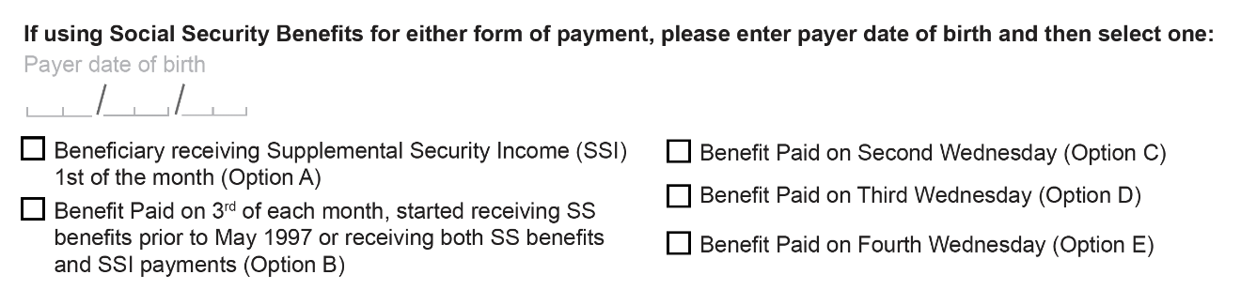
Select one of the five options using the Schedule of Social Security Benefit Payments.
Complete the Initial Draft Month.
NOTE: If the Social Security benefit deposit date is within 10 business days of the application date, go to the next month for the initial draft month.
We must have the birthdate of the insured and the payor to process. The birthdate of the payor is validated by checking it against the Schedule of Social Security Benefit Payments to ensure we have the correct payment date. If one or both of the birthdates are not provided, placement of the policy and commissions may be delayed.
For Agent Use Only. Not for Public Distribution.
Notes:
Select one of the five payment date options using the Schedule of Social Security Benefit Payments.
We must have the birthdate of the insured and the payor to process. The birthdate of the payor is validated by checking it against the Schedule of Social Security Benefit Payments to ensure we have the correct payment date. If one or both of the birthdates are not provided, placement of the policy and commissions could be delayed.

Slide 17

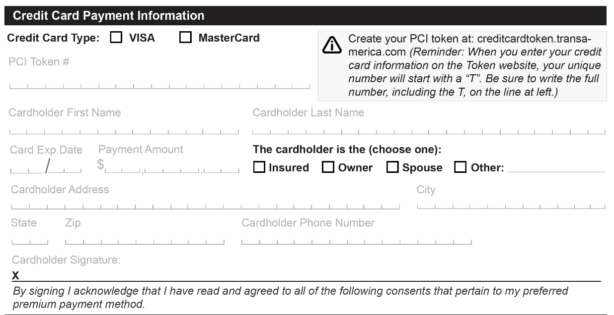
Direct Express® Debit MasterCard® account numbers begin with 5332.
NOTE: Card numbers must be converted to a token number using our website. The token number is then placed on the application.
For Agent Use Only. Not for Public Distribution.
Notes:
Complete this section for clients who wish to use their Direct Express® Debit Master Card®.

Slide 18

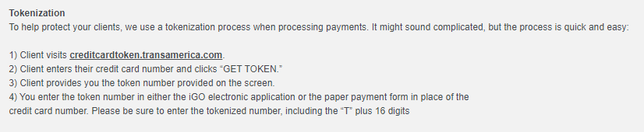
For Agent Use Only. Not for Public Distribution.
Notes:
[Read slide]

Slide 19

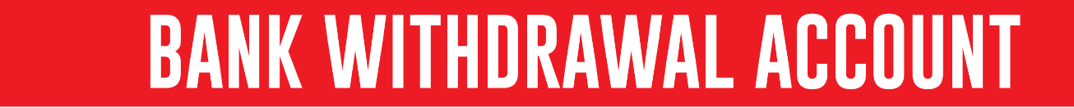
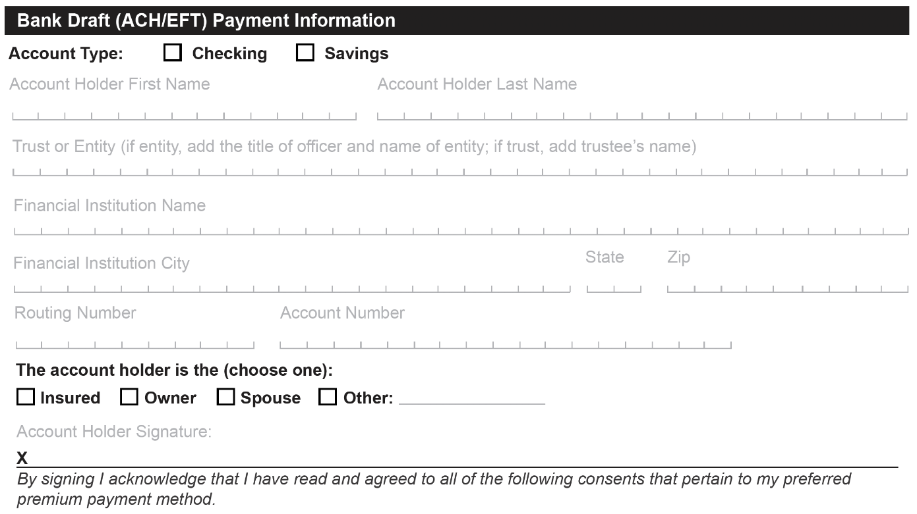
For Agent Use Only. Not for Public Distribution.
Notes:
If your client wishes to pay with their bank account, complete the bank draft section of the Payment Form.

Slide 20

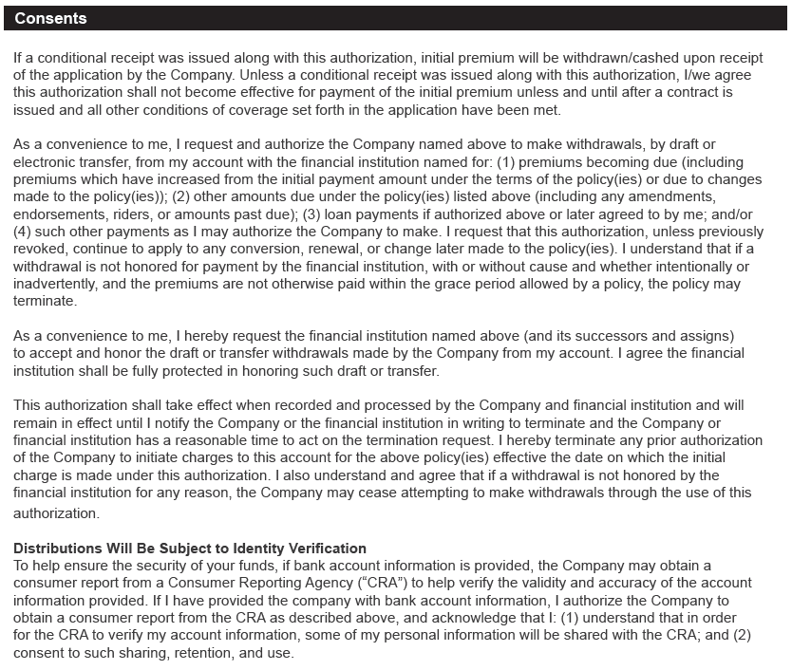
For Agent Use Only. Not for Public Distribution.
Notes:
Have the account holder check the applicable box and sign the form.

Slide 21

01/23
A brighter future starts with knowing today.
Visit: transamerica.com for more financial education resources.
258554R3
© 2022 Transamerica Corporation. All Rights Reserved.
Notes:
Return Completed Form To:
Transamerica Life Insurance Company
Transamerica Financial Life Insurance Company
6400 C St. SW
Cedar Rapids, IA 52499
Or fax it to us at:
800-235-4782
Questions? Call us at:
800-pyramid
Visit us at:
transamerica.com

