Slide 1
Transamerica FE Express Solution℠
Feature Releases and Enhancements
Agent Use Only. Not for public use.
Notes:
For Agent Use Only. Not For Public Use.

Slide 2
Transamerica FE Express Solution℠ Face amount increase
Effective January 21, 2026
Agent Use Only. Not for Public Use.
Notes:
For Agent Use Only. Not For Public Use.

Slide 3

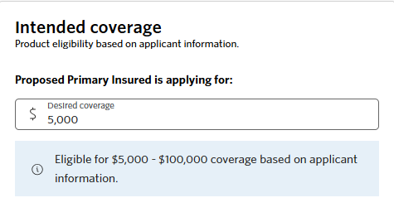
Transamerica FE Express Solution℠
Face amount increase
Effective January 21, 2026, Transamerica’s FE Express Solution℠ maximum face amount will be increased from $50,000 to $100,000.
Transamerica’s Graded FE Express Solution℠ maximum face amount remains $25,000.
Coverage Availability
$5,000 – $100,000 in coverage
Issue Ages 18–75 $100,000
Issue Ages 76+ or Graded Risk Approval $25,000
Please Note: For complete issue age and coverage eligibility guidelines, please view the Transamerica FE Express℠ Agent and Underwriting Guide.
Agent Use Only. Not for public use.
Notes:
Agent Use Only. Not for public use.

Slide 4
Transamerica FE Express Solution℠ Additional documents now available
Effective December 2025
Agent Use Only. Not for Public Use.
Notes:
For Agent Use Only. Not For Public Use.

Slide 5
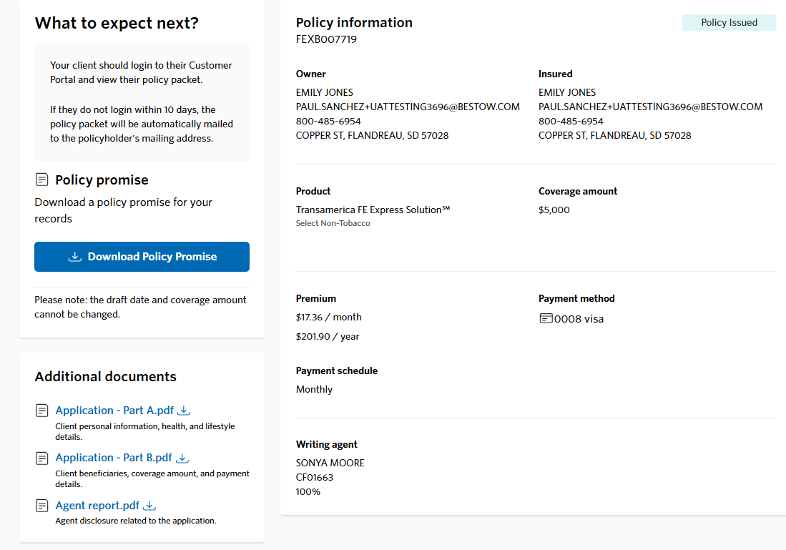
Transamerica FE Express Solution℠
Additional documents are now available from the Policy Promise page
In addition to the Policy Promise, agents can now download additional documents for their records.
Additional documents available
Application- Part A
Application- Part B
Agent Report
Agent Use Only. Not for public use.
Notes:
Agent Use Only. Not for public use.

Slide 6
Transamerica FE Express Solution℠ Third-Party Payor
Effective October 16, 2025
Agent Use Only. Not for Public Use.
Notes:
For Agent Use Only. Not For Public Use.

Slide 7
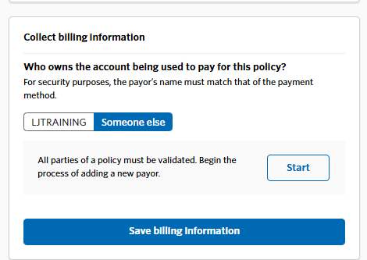
Transamerica FE Express Solution℠
Third-Party Payor
Third-party payors, anyone outside of the owner or the insured, will follow the PIN-to-Sign signature process for payor forms.
Agent Use Only. Not for public use.
Notes:
All third-party payors, including those outside of the owner or the insured, must adhere to the PIN-to-Sign signature process for payor forms, regardless of the method of interaction with the payor, whether virtual or in-person.
After setting up the payment schedule, to add a third-party payor to the application, select “someone else” and then click “Start”.
For Agent Use Only. Not For Public Use.

Slide 8
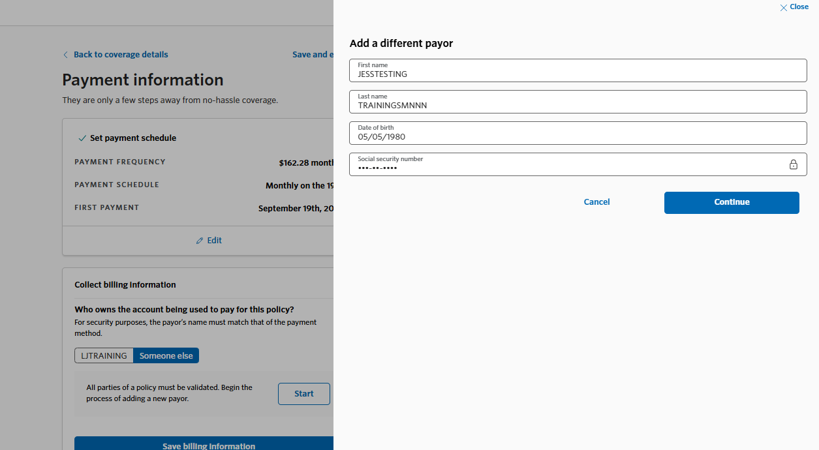
Transamerica FE Express Solution℠
Third-Party Payor
The third-party payor questionnaire will populate in a secondary window for completion.
Agent Use Only. Not for public use.
Notes:
The 3rd-party payor questionnaire will populate in a secondary window for completion.
For Agent Use Only. Not For Public Use.

Slide 9
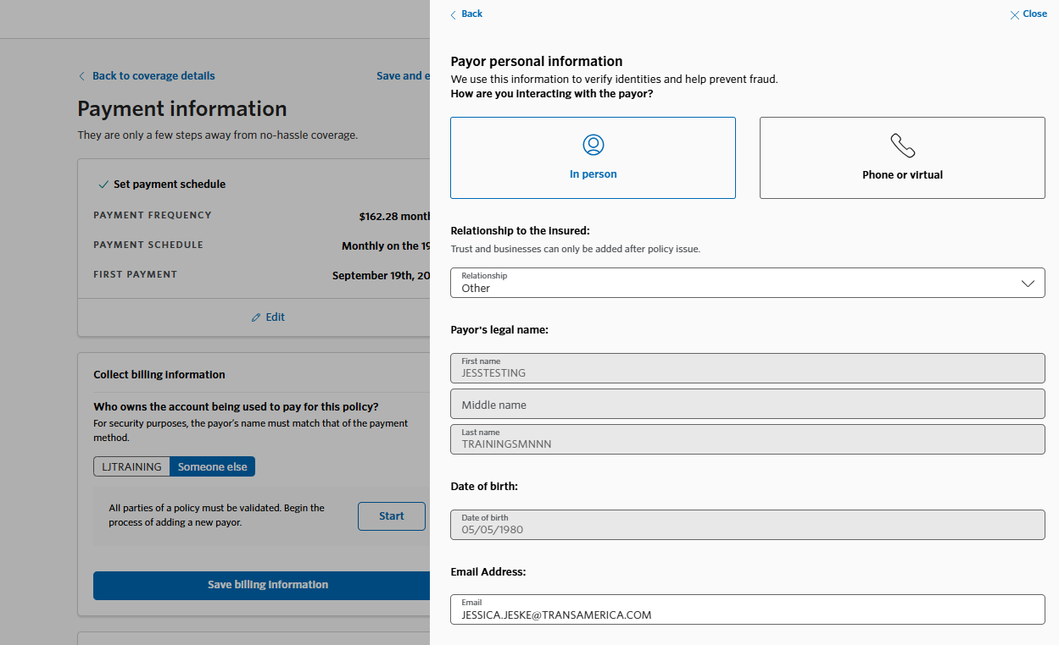
Transamerica FE Express Solution℠
Third-Party Payor
Next, you’ll be asked to specify how you are interacting with the third-party payor, then fill out the remaining questions.
Third-party payors, anyone outside of the owner or the insured, will follow the PIN-to-Sign signature process for payor forms.
Agent Use Only. Not for public use.
Notes:
Next, you’ll be asked to specify how you are interacting with the third-party payor, then fill out the remaining questions.
Please note: This question does not reflect the signature process that the third-party payor is required to follow. All third-party payors, including those outside of the owner or insured, must adhere to the PIN-to-Sign signature process for the payor forms.
For Agent Use Only. Not For Public Use.

Slide 10
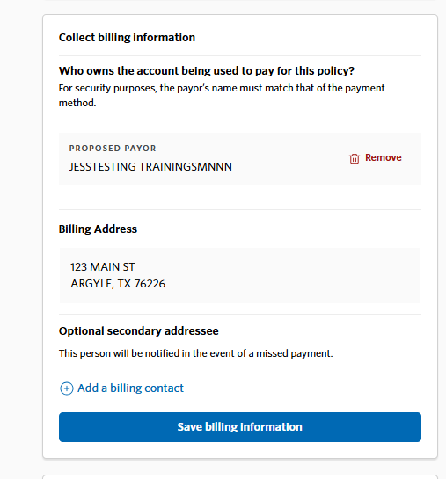
Transamerica FE Express Solution℠
Third-Party Payor
After completing the questionnaire, select Save billing information.
Agent Use Only. Not for public use.
Notes:
After completing the 3rd party payor questionnaire, select save billing information
For Agent Use Only. Not For Public Use.

Slide 11
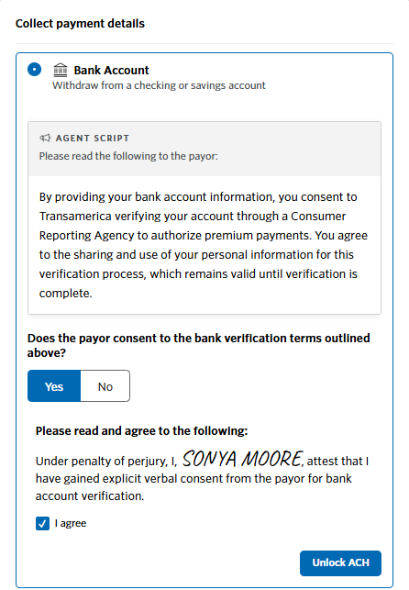
Transamerica FE Express Solution℠
Third-Party Payor
If the third-party payor is using bank account information for payment, they’ll need to agree to the bank verification terms outlined here.
Otherwise, you’ll be prompted to use a debit or credit card for payment.
Agent Use Only. Not for public use.
Notes:
If the 3rd party payor is using bank account information for payment, they’ll need to agree to the bank verification terms outlined here. Otherwise, you’ll be prompted to use a debit or credit card for payment.
For Agent Use Only. Not For Public Use.

Slide 12
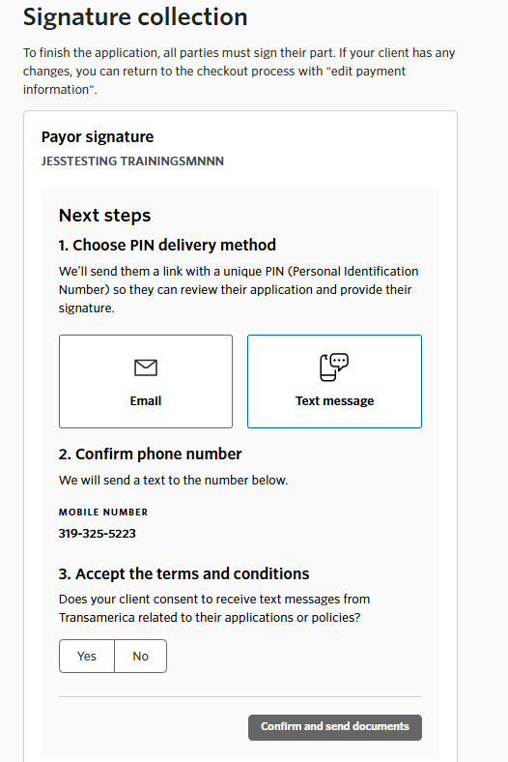
Transamerica FE Express Solution℠
Third-Party Payor
First, select the delivery method the payor prefers (email or text message), confirm the phone number, and accept the terms and conditions.
The payor can review the electronic business consent, premium payor supplement, and privacy notice before providing the PIN by clicking on the link provided in the text messages.
Agent Use Only. Not for public use.
Notes:
First, select the delivery method the payor prefers (email or text message), confirm the phone number, and accept the terms and conditions. In this example, we will choose a text message.
The payor will receive a series of back-to-back text messages from a (469) area code. The payor can review the electronic business consent, premium payor supplement, and privacy notice before providing the PIN by clicking on the link provided in the text messages.
For Agent Use Only. Not For Public Use.

Slide 13
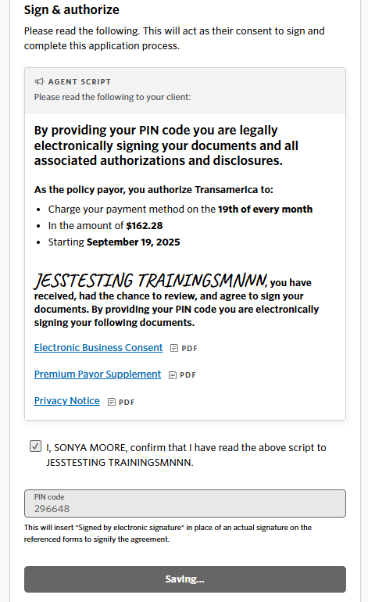
Transamerica FE Express Solution℠
Third-Party Payor
Before requesting the PIN code, you’ll need to verbally read an authorization script on the screen and click the box to confirm this action was completed. ​
Once the script has been read, the payor can provide the PIN code.
​
.
Agent Use Only. Not for public use.
Notes:
Before requesting the PIN code, you’ll need to verbally read an authorization script on the screen and click the box to confirm this action was completed. ​
​
Once the script has been read, the payor can provide you with the PIN Code.
For Agent Use Only. Not For Public Use.

Slide 14
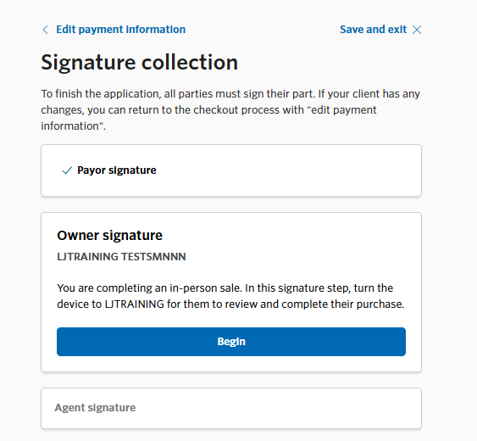
Transamerica FE Express Solution℠
Third-Party Payor
After collecting the third-party payor’s signature, you can proceed and finalize the process with the insured.
Agent Use Only. Not for public use.
Notes:
After collecting the third-party payor’s signature, you can proceed and finalize the process with the insured.
For Agent Use Only. Not For Public Use.

Slide 15
Transamerica FE Express Solution℠ Multi-Policies
Effective October 16, 2025
Internal Use Only. Not for Public Use.
Notes:
For Agent Use Only. Not For Public Use.

Slide 16
Transamerica FE Express Solution℠
Multi-Policy Functionality
Effective October 16, 2025
Clients will be able to purchase multiple “express” policies.
Face Amount Limitations
Multi-policies are subject to a combined max of the face amount per product.
FE Express = $100,000 max.
FFIUL II Express = $500,000 max.
Max face amounts are subject to issue ages as outlined in the product guide(s).
Example:
A client can have two FE Express policies; however, the combined total face amount of the two policies cannot exceed the maximum face amount of $100,000, as specified in the product guide(s).
16
Agent Use Only. Not for public use.
Notes:
Review slide.
For Agent Use Only. Not For Public Use.

Slide 17
Transamerica FE Express Solution℠ Initial Draft Date Changes ACH Retry Email Enhancements
Effective December 2025
Agent Use Only. Not for Public Use.
Notes:
For Agent Use Only. Not For Public Use.

Slide 18
Transamerica FE Express Solution℠
Initial Draft Date Changes, ACH Retry, Email Enhancements
Initial Draft Date Changes
In some cases, your client might need to change the date of the initial draft.
To reschedule the initial draft date after buying the policy, the agent or client can contact Customer Service at (800) 453-1448.
ACH Retry
ACH payment failures will now be retried automatically once, five days after the failure occurs.
Payment failure emails will be sent to the client and agent every 7 days until:
Policy Binds
Manual Retry (Client goes online to make the payment)
Policy Stales (60 days)
Email Enhancements
Initial payment failure emails will now include:
Client’s last name
Last four digits of the policy number
Decline/Failure reason
Retry process (if applicable)
Incomplete purchase emails will be sent to the agent every 7 days until:
A payment method is applied
Policy Stales (60 days)
Agent Use Only. Not for public use.
Notes:
Review slide.
ACH retry note: Currently, when an ACH payment fails, an email is sent to the client and agent indicating the payment failure, but there is no automatic retry.
Incomplete purchase note: An incomplete purchase would include a completed application that has not yet been submitted or purchased.
For Agent Use Only. Not For Public Use.

Slide 19
Transamerica FE Express Solution℠ PIN-to-Sign
Internal Use Only. Not for Public Use.
Notes:
For Agent Use Only. Not For Public Use.

Slide 20

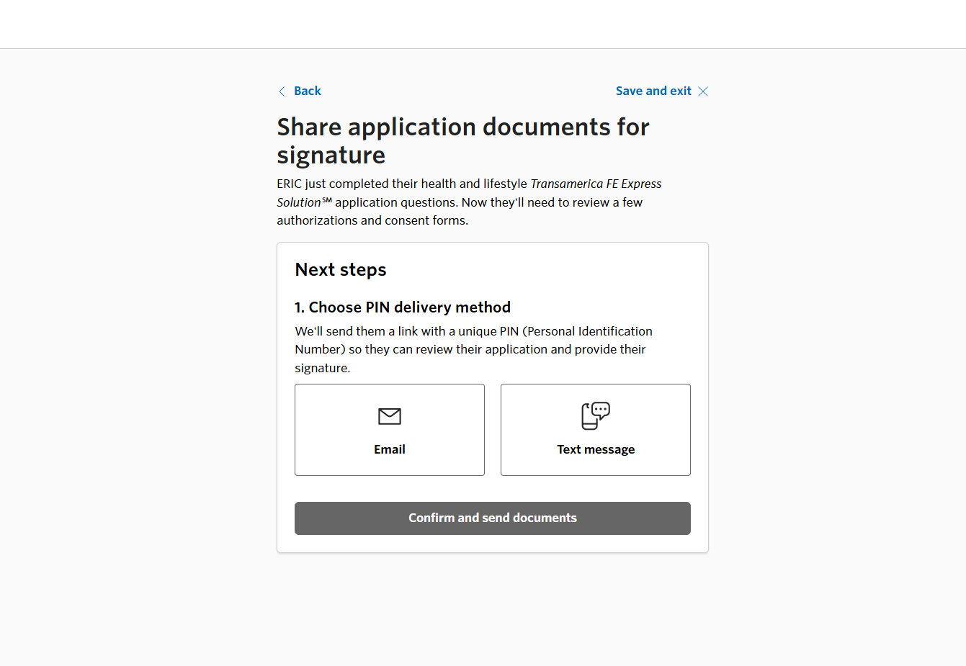
Transamerica FE Express Solution℠
PIN-to-Sign
The PIN-to-Sign remote signature experience works the same way for both Parts 1 and 2 of the application.
First, select the delivery method your client prefers: email or text message.
Agent Use Only. Not For Public Use.
Notes:
The PIN-to-Sign remote signature experience works the same way for both Parts 1 and 2 of the application.
First, select the delivery method your client prefers: email or text message. For this demonstration, we will choose a text message.
For Agent Use Only. Not For Public Use.

Slide 21
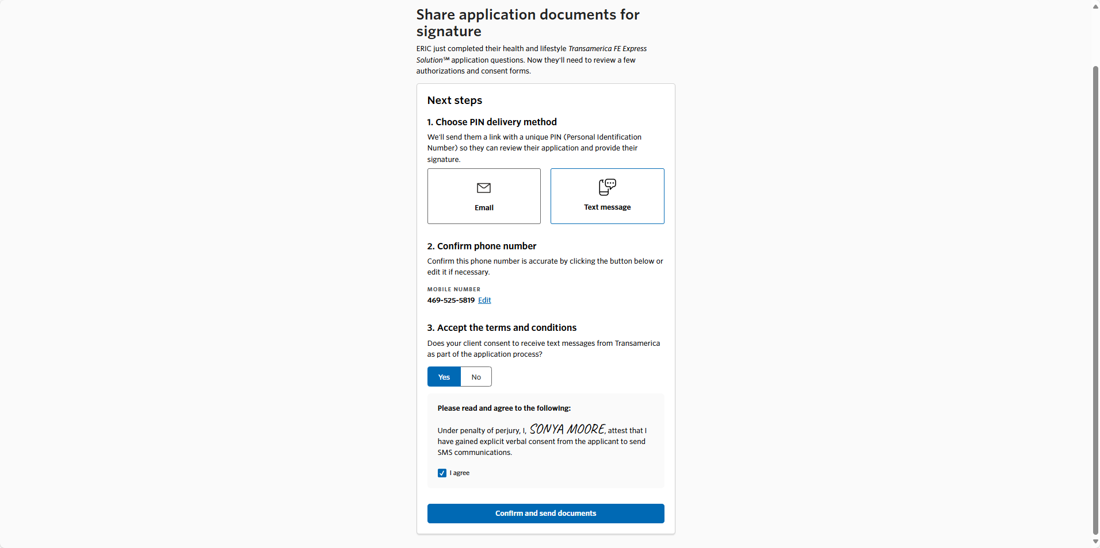
Transamerica FE Express Solution℠
PIN-to-Sign
Next, confirm the phone number, click to accept the terms and conditions, then click the blue button to send a text to your client.
Agent Use Only. Not For Public Use.
Notes:
Next, confirm the phone number, click to accept the terms and conditions, then click the blue button to send a text to your client.
For Agent Use Only. Not For Public Use.

Slide 22

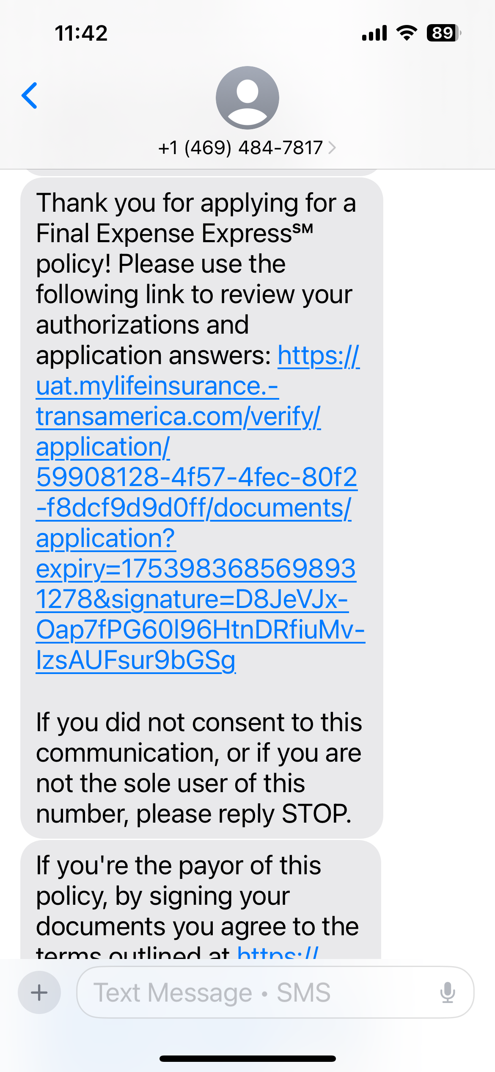
Transamerica FE Express Solution℠
PIN-to-Sign
The client will receive a series of back-to-back text messages from a (469) area code.
To review the forms before providing the PIN, the client will click the link provided in the text.
Agent Use Only. Not For Public Use.
Notes:
The client will receive a series of back-to-back text messages from a (469) area code. To review the forms before providing the PIN, the client will click the link provided in the text.
For Agent Use Only. Not For Public Use.

Slide 23
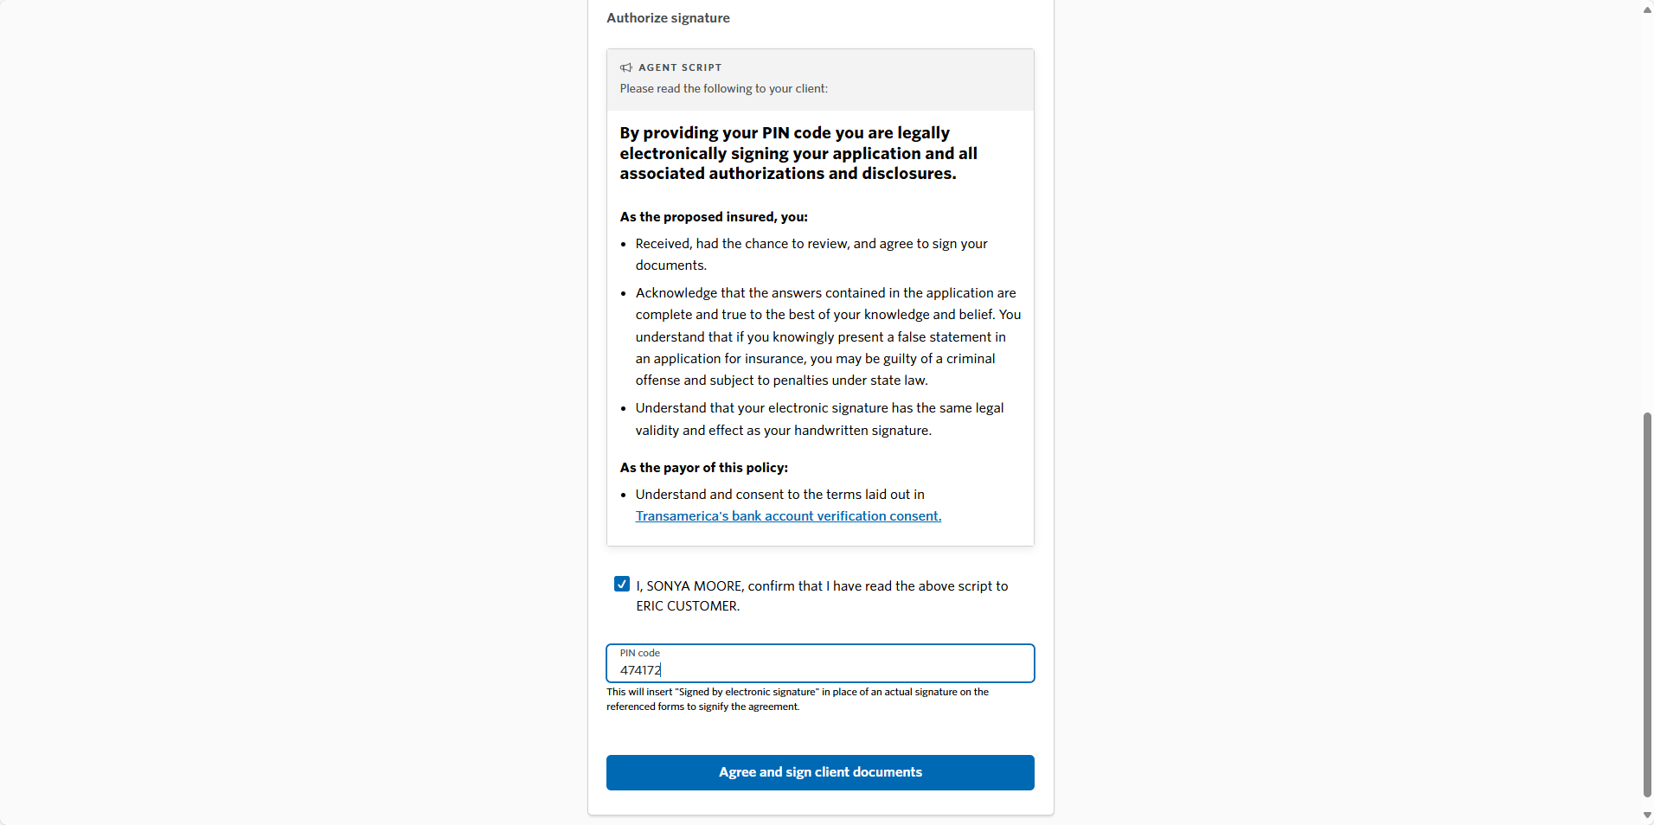
Transamerica FE Express Solution℠
PIN-to-Sign
Next, select the box confirming you’ve read the script to the client, then ask the client to provide you with the PIN they received via text message.
Finally, click the blue 'Agree and sign client documents' button and proceed with part B of the application.
Agent Use Only. Not For Public Use.
Notes:
Next, select the box confirming you’ve read the script to the client, then ask the client to provide you with the PIN they received via text message.
Finally, click the blue 'Agree and sign client documents' button and proceed with part B of the application.
For Agent Use Only. Not For Public Use.

Slide 24
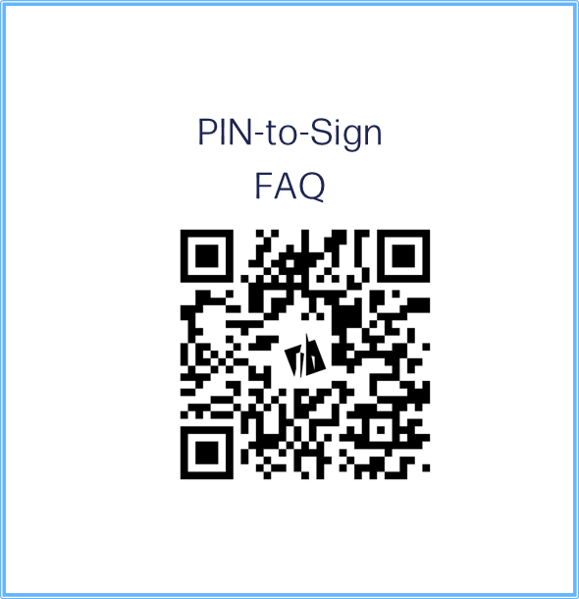
Transamerica FE Express Solution℠
PIN-to-Sign FAQ
Need Help?
Scan the QR to review PIN-to-Sign Frequently Asked Questions.
Agent Use Only. Not For Public Use.
Notes:
For Agent Use Only. Not For Public Use.

Slide 25
Transamerica FE Express Solution℠ Policy Promise
Internal Use Only. Not for Public Use.
Notes:
For Agent Use Only. Not For Public Use.

Slide 26
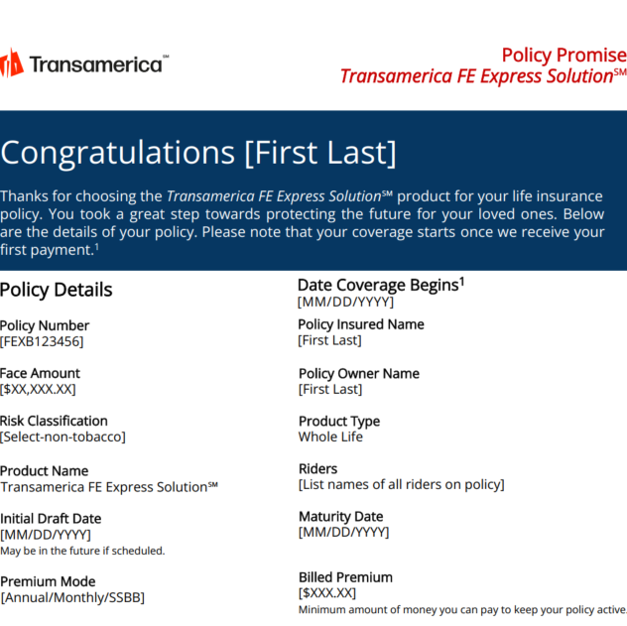
Policy Promise
After a policy has been approved and payment has been scheduled, agents can download a policy promise for their records or send it to their clients.
New Sales Only
Available immediately at the time of sale via the Policy Page
Available for up to 90 days via the FE Express Agent Dashboard
Everest messaging included on applicable policies
Agent Use Only. Not For Public Use.
Notes:
For Agent Use Only. Not For Public Use.

Slide 27
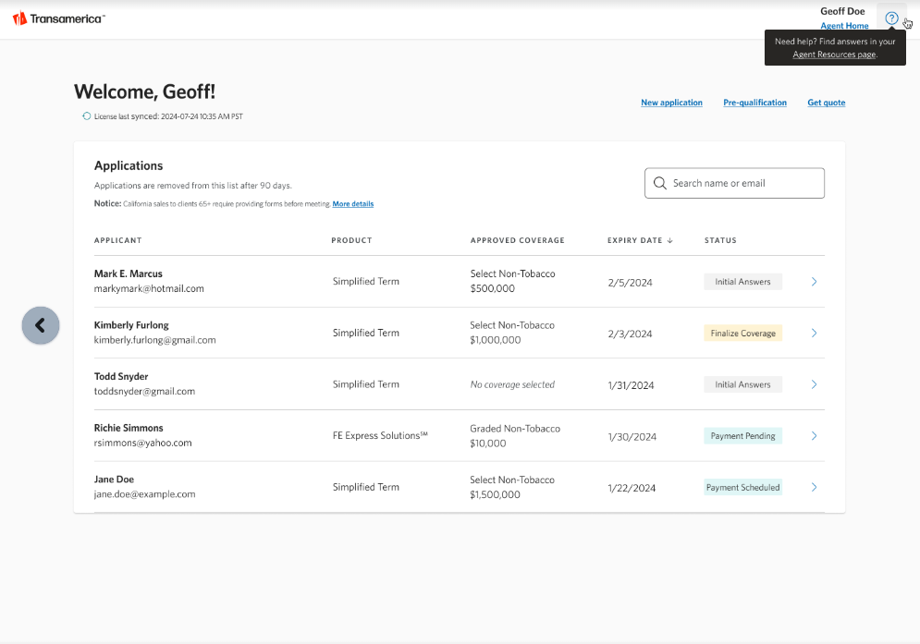
Policy Promise Availability
The Policy Promise is available for up to 90 days via the Agent Dashboard.
The Policy Promise is only available for policies sold that show one of the following statuses:
Payment Pending
Payment Scheduled
Policy Issued
Click the “>” symbol next to the applicable policy status to be taken to the Policy Page, where you can access the policy promise.
Agent Use Only. Not For Public Use.
Notes:
For Agent Use Only. Not For Public Use.

Slide 28
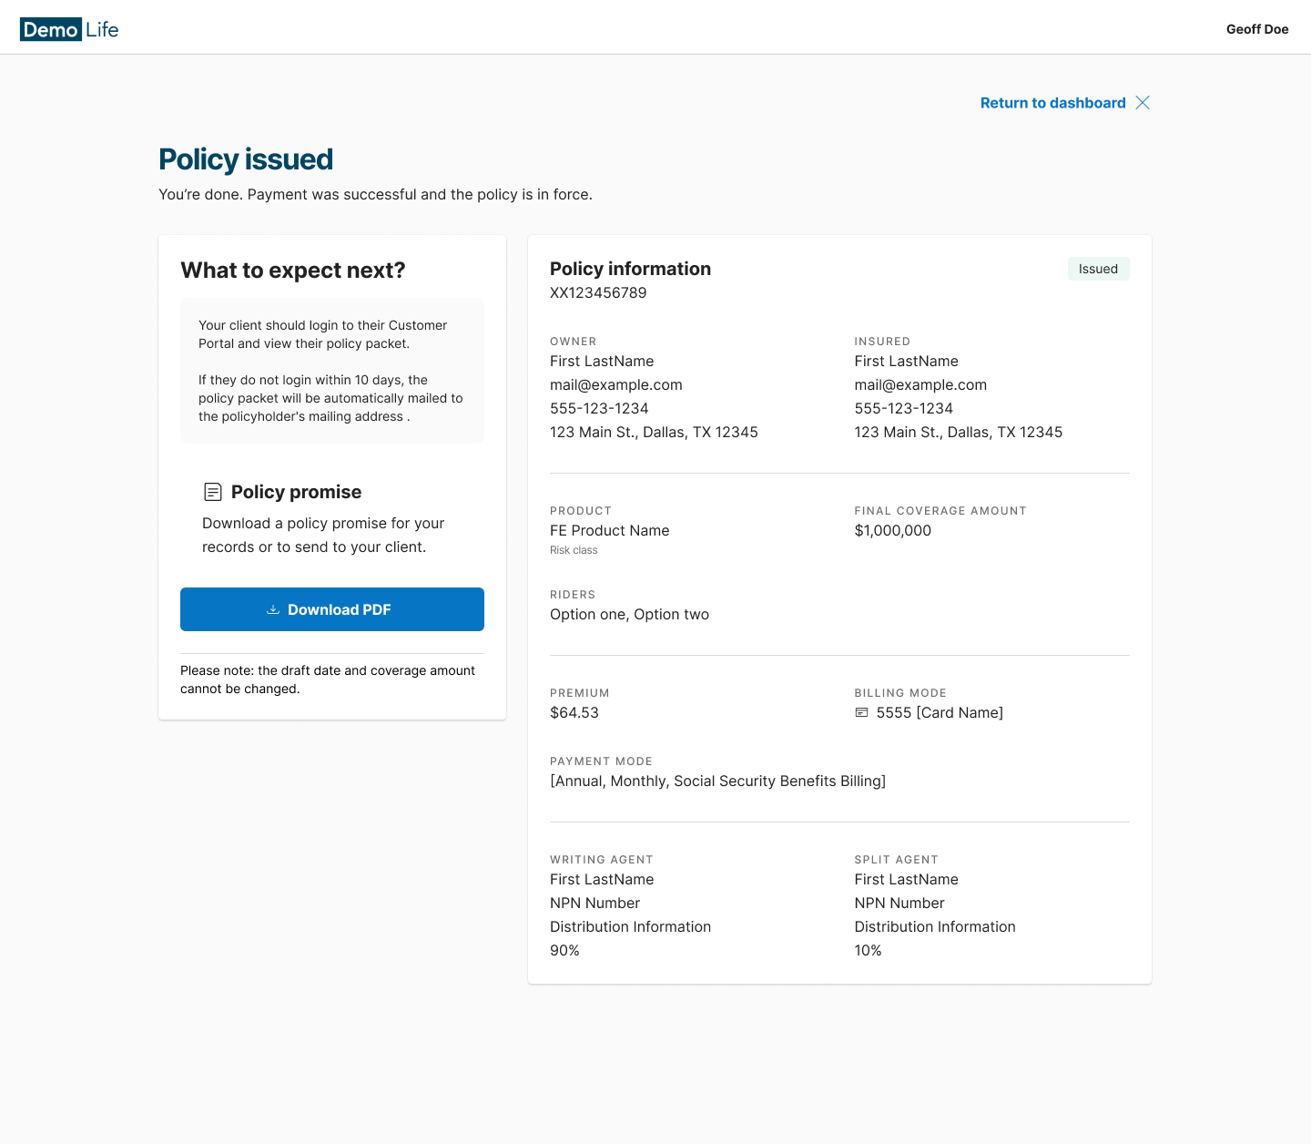
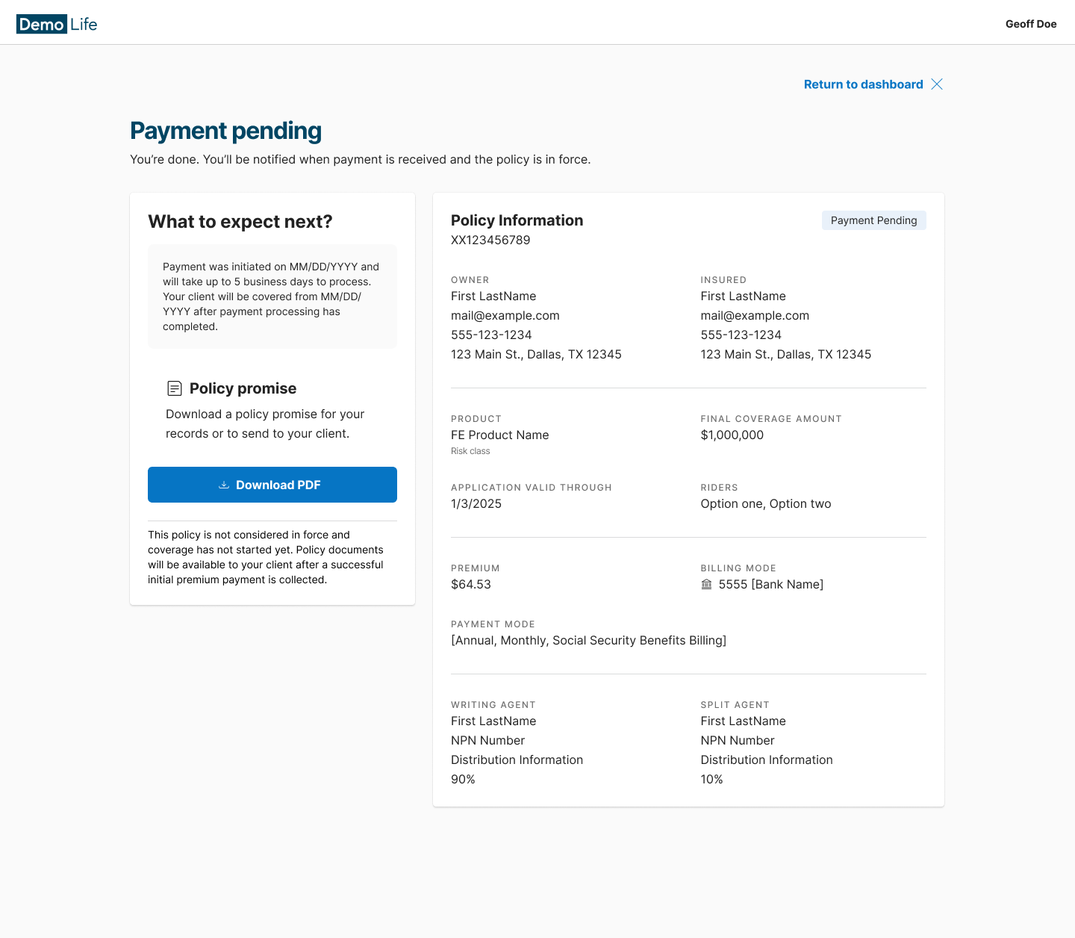
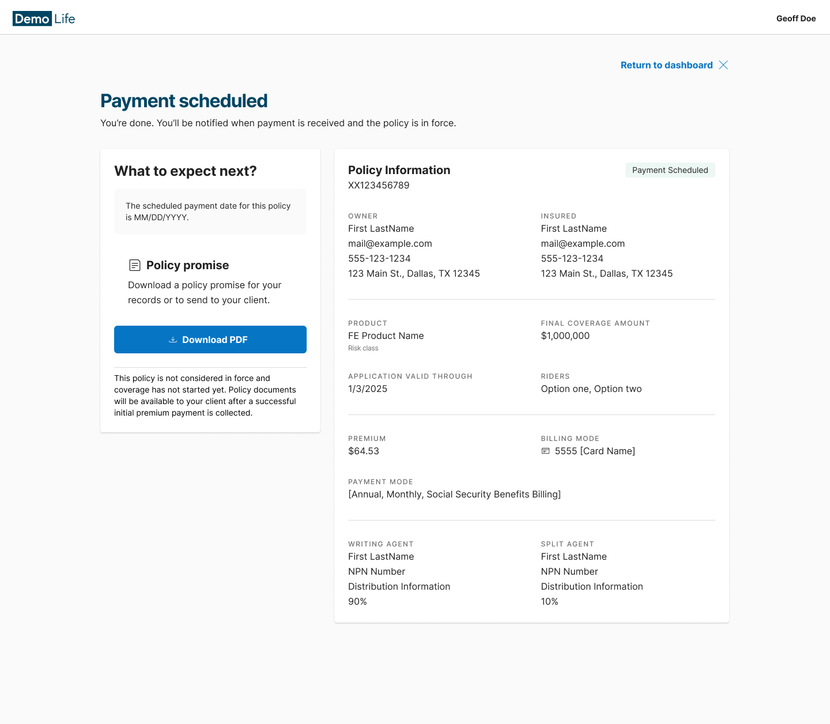
Accessing the Policy Promise
The Policy Promise is accessed by clicking “Download PDF” from the left-hand side of the Policy Page.
At the time of the sale, the below Policy Promise screen(s) will immediately populate for agent download and will remain available for up to 90 days post-sale.
Note: This page may vary slightly depending on the payment status.
Agent Use Only. Not For Public Use.
Notes:
For Agent Use Only. Not For Public Use.

Slide 29
Policy Promise Example(s)
Click to view both examples of the Policy Promise.
Policy Promise - Everest Opt In
Policy Promise - Everest Opt Out
Note: Messaging about Everest will only be displayed for policies that include Everest.
Agent Use Only. Not For Public Use.
Notes:
For Agent Use Only. Not For Public Use.

Slide 30
Transamerica FE Express Solution℠ Payment Improvements
Internal Use Only. Not for Public Use.
Notes:
For Agent Use Only. Not For Public Use.

Slide 31
Payment Improvements
The following payment improvements are effective 03/28/2025:
Confirm Bank Account Number
An additional field to confirm the bank account number is now required.
Account Not Found
Additional review for the customer and agent if the bank account cannot be verified.
Enhanced Social Security Billing Recommendations
An additional question to narrow down and assist in selecting the most likely Social Security payment schedule.
Agent Use Only. Not For Public Use.
Notes:
For Agent Use Only. Not For Public Use.

Slide 32
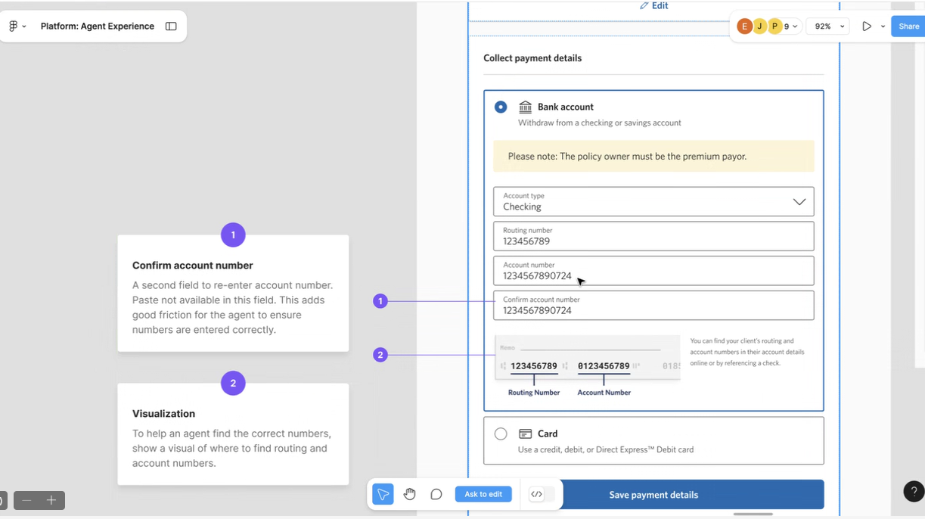
Payment Improvements
Confirm Bank Account Number
For confirmation and accuracy purposes, you will be required to enter the account number twice.
To ensure accuracy, copy/paste is not available when confirming the account number.
A visual representation of the typical routing location and account numbers is depicted.
Agent Use Only. Not For Public Use.
Notes:
For Agent Use Only. Not For Public Use.

Slide 33
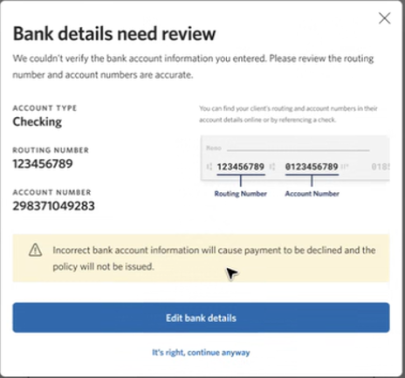
Payment Improvements
Account Not Found
If the client’s bank account information cannot be verified, an additional review will be required.
You’ll be prompted to verify the routing and account number(s) with your client.
If edits are needed, click “Edit bank details” to make the necessary corrections.
If the information is determined to be correct, simply click “It’s right; continue anyway.”
Agent Use Only. Not For Public Use.
Notes:
For Agent Use Only. Not For Public Use.

Slide 34
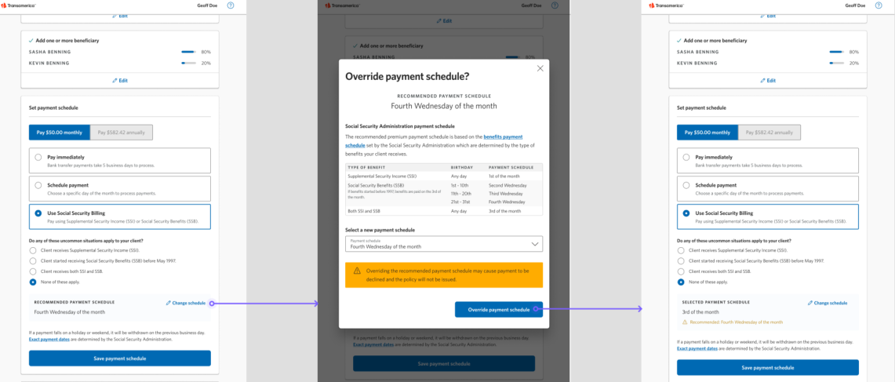
Payment Improvements
Enhanced Social Security Billing Recommendations
To assist in the determination and selection of a client’s appropriate Social Security payment schedule, an additional question, “Do any of these uncommon situations apply to your client?” will be asked.
Based on the client’s response to the question, a recommended payment schedule will be presented.
You and your client can choose to accept or override the recommended payment schedule.
Agent Use Only. Not For Public Use.
Notes:
For Agent Use Only. Not For Public Use.

Slide 35
Transamerica FE Express Solution℠ Agent Sync and Resources Page
Internal Use Only. Not for Public Use.
Notes:
For Agent Use Only. Not For Public Use.

Slide 36
Agent Sync and Resources Page
Agent Sync
The National Insurance Producer Registry, NIPR, is a third party that provides Transamerica, via Agent Sync, with daily license and agent appointment updates.
Resources Page
Easily navigate to on-demand training material directly from the Agent Dashboard.
Agent Use Only. Not For Public Use.
Notes:
For Agent Use Only. Not For Public Use.

Slide 37
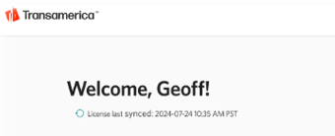
Agent Sync
Agent Sync allows Transamerica to update agent license and appointment information automatically, thus allowing agents and clients to benefit from real-time policy decisions and eliminate delays caused by false or outdated holds due to licensing and appointment issues.
The Agent Dashboard provides the date and time of the most recent License sync directly under the agent’s name.
Eliminates the need for agents to directly notify the Transamerica Commissions and Licensing team when adding or updating licenses.
Reduces agent holds and delays due to outdated licensing and appointment data by an estimated 50%, allowing these policies to be placed without delay.
Enables FE Express Solution applications and future instant issue products to process without delay.
Agent Use Only. Not For Public Use.
Notes:
For Agent Use Only. Not For Public Use.

Slide 38
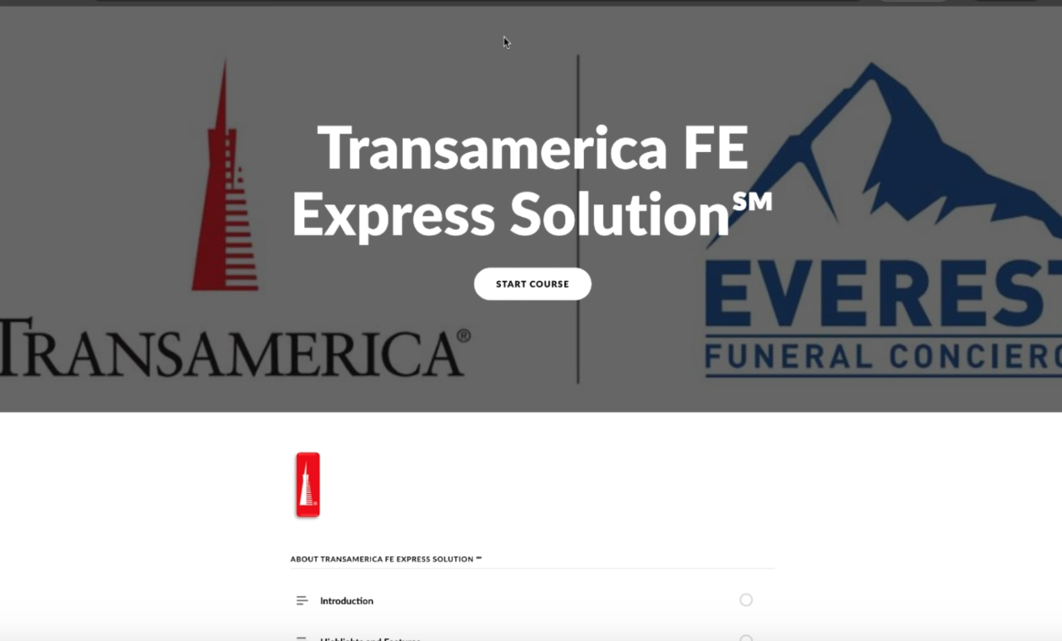
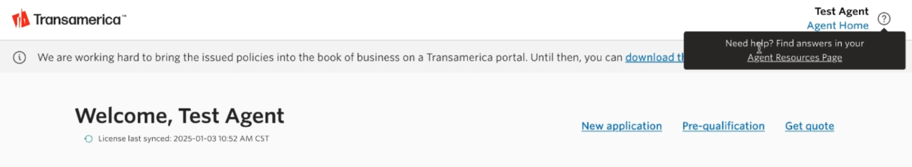
Agent Resources Page
Need Help?
Easily navigate to on-demand product and learning materials directly from the Agent Dashboard by hovering over the “?” symbol and clicking “Agent Resources Page.”
Agent Use Only. Not For Public Use.
Notes:
For Agent Use Only. Not For Public Use.

Slide 39
Transamerica FE Express Solution℠ Underwriting Enhancements
Internal Use Only. Not for Public Use.
Notes:
For Agent Use Only. Not For Public Use.

Slide 40
Comorbids
Our underwriting philosophy on comorbids is relaxing.
What’s Changing?
We will remove independent comorbids (Ex. Diabetes and Kidney Failure)
Removing irregular heartbeat, chest pain, and CAD as a comorbid.
What Does This Mean?
Instead of 2 conditions, we will now only consider comorbid risk cases that have 3 or more comorbidities.
Ex. Irregular heartbeat, CHF, and stroke are no longer considered comorbidity.
Because Irregular heartbeat is no longer considered a condition classified as a comorbid, and a comorbid requires 3 conditions.
Ex. Stroke & CHF is now Select instead of Decline.
Production Date:
02/19/2025
Agent Use Only. Not For Public Use.
Notes:
For Agent Use Only. Not For Public Use.

Slide 41
Hospitalization
Our underwriting philosophy around hospitalizations is changing.
What’s Changing?
Currently, we do not allow individuals who have spent two or more consecutive nights in a hospital to continue. Now, we will allow "yes" responses to continue, but we will verify against the overall risk score to ensure they are acceptable.
What Does This Mean?
We are now utilizing two decision points instead of declining after only one indicator.
Production Date:
02/18/2025
Agent Use Only. Not For Public Use.
Notes:
For Agent Use Only. Not For Public Use.

Slide 42
Memory Loss
Our underwriting philosophy around memory loss is changing.
What’s Changing?
We will only decline for chronic memory or memory loss within the last 2 years.
What Does This Mean?
We will no longer decline for memory loss diagnosed “ever”, only within the last 2 years.
Production Date:
02/04/2025
Agent Use Only. Not For Public Use.
Notes:
For Agent Use Only. Not For Public Use.

Slide 43
Milliman
Our underwriting philosophy around declining for a single Milliman code is changing.
What’s Changing?
We will only decline a policy for a single Milliman condition or prescription that also has a higher overall risk score.
What Does This Mean?
We will no longer decline a single Milliman condition by itself.
Ex. If a Milliman condition or prescription would result in a decline on its own, we will then review the overall risk score to determine if we can offer a policy.
Production Date:
03/07/2025
Agent Use Only. Not For Public Use.
Notes:
For Agent Use Only. Not For Public Use.

Slide 44
In Summary
4 Very impactful changes that will contribute to an overall reduction in declines by 5-10%.
Agent Use Only. Not For Public Use.
Notes:
For Agent Use Only. Not For Public Use.

Slide 45
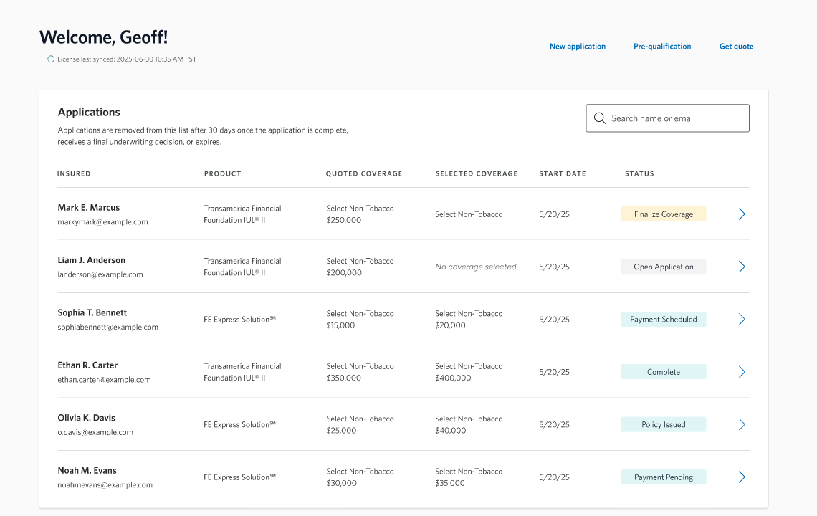
Self Guided Demonstration Tool
Want to try it out?
Click anywhere on the
image to open the self-guided
demonstration tool.
Notes:
Click anywhere on the image to open the self-guided demonstration tool.

Slide 46

Thank you
Transamerica FE Express Solution, Policy Form # ICC23 TPWL14IC-0123 and Transamerica Graded FE Express Solution, Policy Form # ICC23 TPWL15IC-0123 are whole
life insurance policies issued by Transamerica Life Insurance Company, Cedar Rapids, IA 52499.
Not available in New York.
4865974R2
©2025 Transamerica Corporation. All Rights Reserved.
Agent Use Only. Not For Public Use.
01/25
Notes:
For Agent Use Only. Not For Public Use.

