Slide 1

Presenter’s Name | Presenter’s Title
Notes:
(Presenter Introduction)

Slide 2

Notes:
First, I have to review some quick disclosure information with you.
[Read slide]

Slide 3

Notes:
Families need help addressing a number of issues. It is no longer just, “What happens to my family if I were to pass prematurely?” They also have to plan for how to pay for retirement-related expenses and other concerns. But perhaps a more urgent concern is how are they going to help pay for expenses related to chronic, critical, and terminal illnesses?

Slide 4
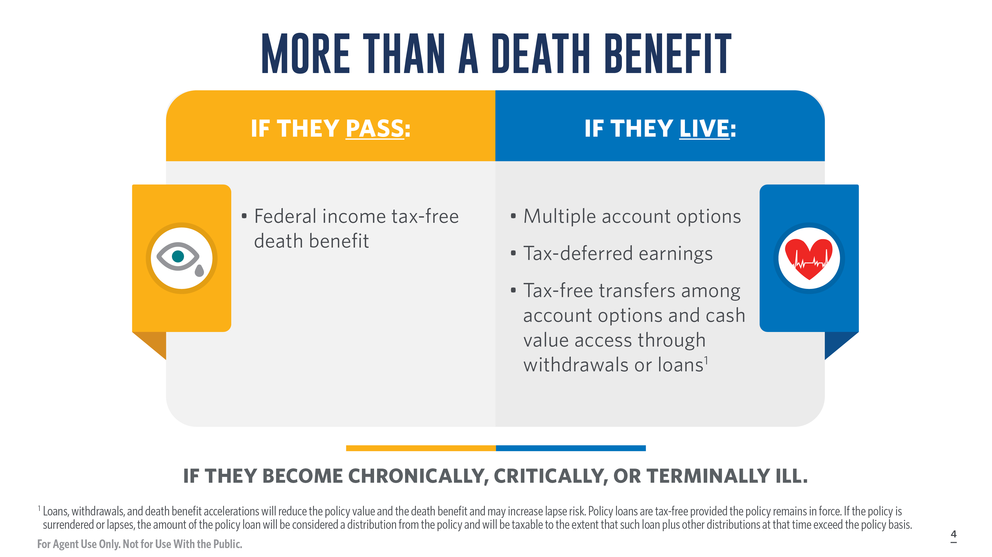
Notes:
Many families need help addressing a number of issues. It is no longer just, “What do I do if I were to die prematurely?” They also have to plan for how to pay for retirement-related expenses and other concerns. But perhaps a growing, more urgent concern is how are they going to help pay for expenses related to chronic, critical, and terminal illnesses.

Slide 5
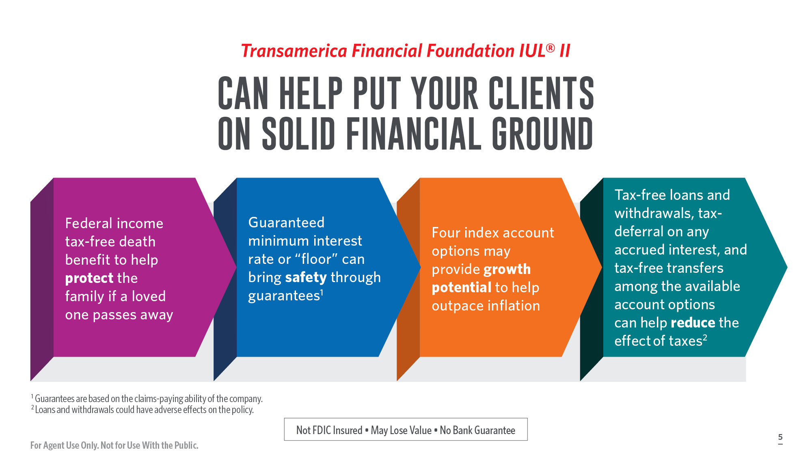
Notes:
Transamerica Life offers the Transamerica Financial Foundation IUL II. It is one option that incorporates four key characteristics that can give a client a starting point to work toward more solid financial ground and the opportunity to help achieve financial well-being.
Greater policy value growth potential than traditional universal life insurance, with four index account options and a Basic Interest Account
Guaranteed minimum interest rates or floor
Access to tax-free loans and withdrawals, earnings, and transfers, and
Most importantly, protecting loved ones in the event of an untimely death through a federal income tax-free death benefit
As you can see, the Transamerica Financial Foundation IUL II is flexible and can help clients plan for tomorrow in an uncertain world.
Let’s look at the index accounts and how they can work for clients.

Slide 6
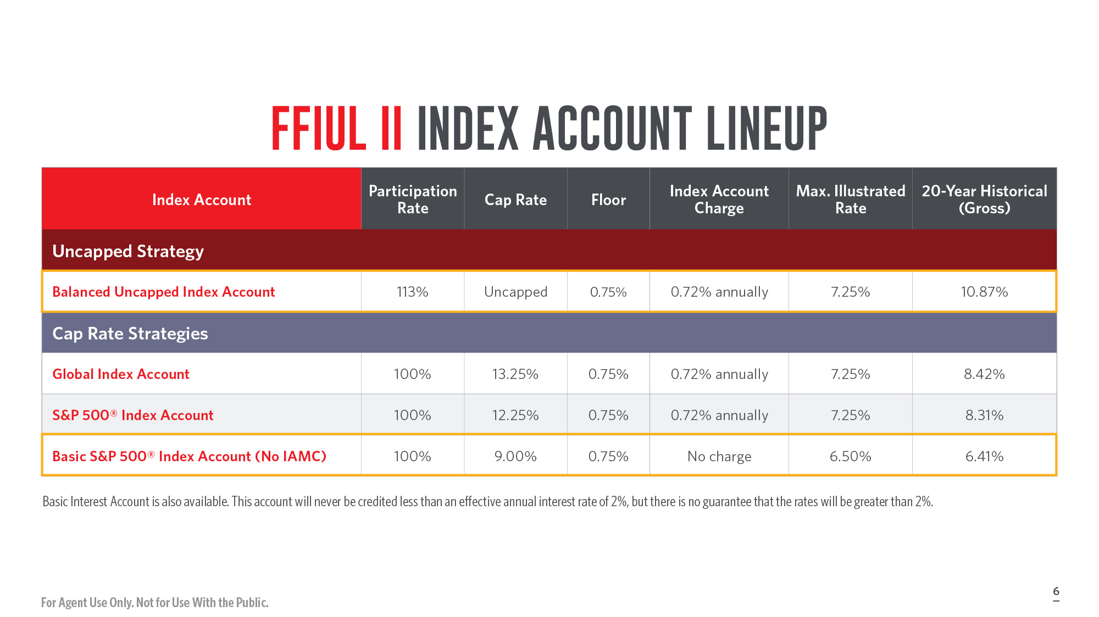
Notes:
FFIUL II policy owners can choose any combination of four index accounts, all with a 0.75% floor and varying cap rates, as well as a Basic Interest Account.

Slide 7
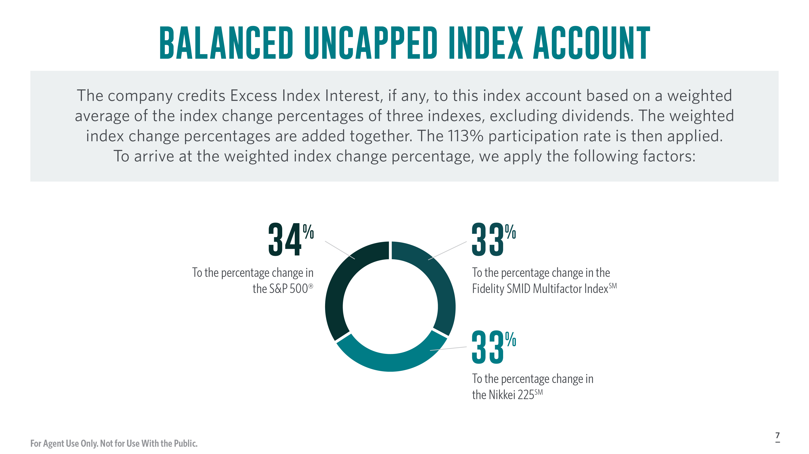
Notes:
Here’s a closer look at the Balanced Uncapped Index Account.
[Review slide]

Slide 8
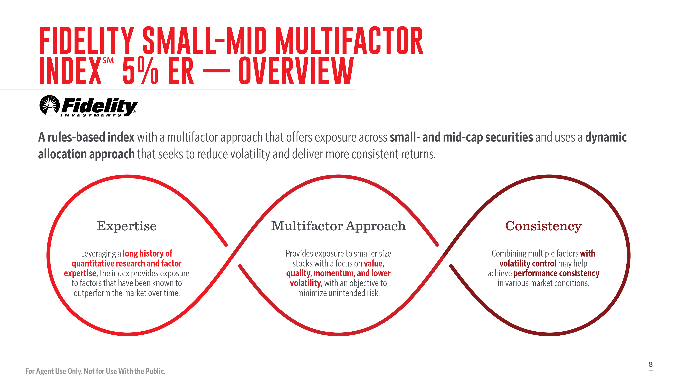
Notes:
Here’s a closer look at the Fidelity Small-Mid Multifactor IndexSM.
[Read slide]

Slide 9

Notes:
A lower volatility can help with raising cap rates on index accounts.

Slide 10
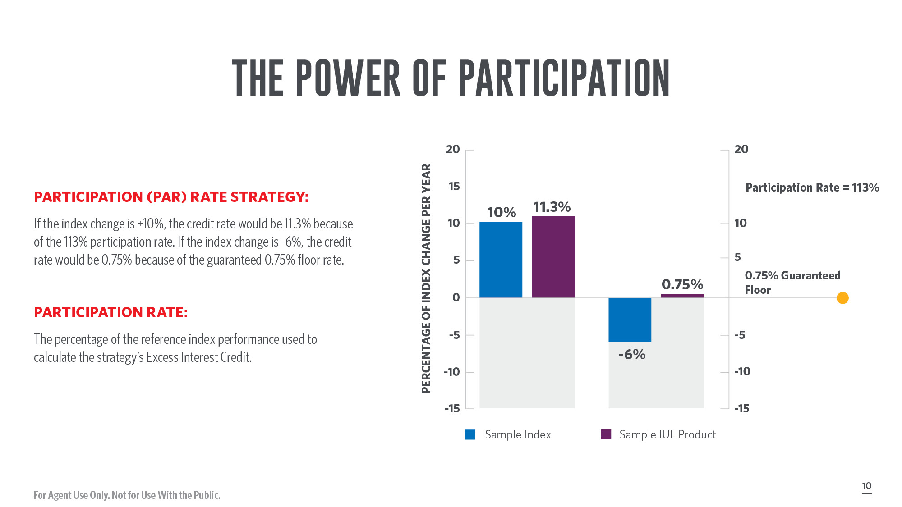
Notes:
[Review slide]

Slide 11
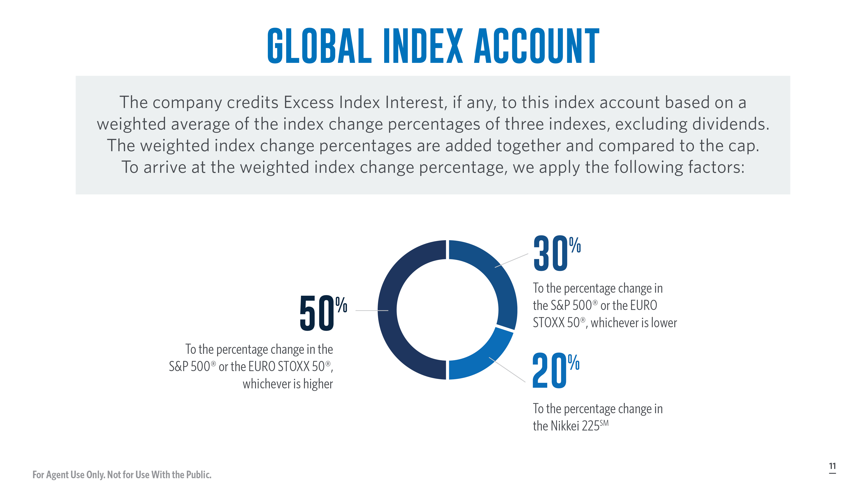
Notes:
Here’s a closer look at the Global Index Account:
[Review slide]

Slide 12
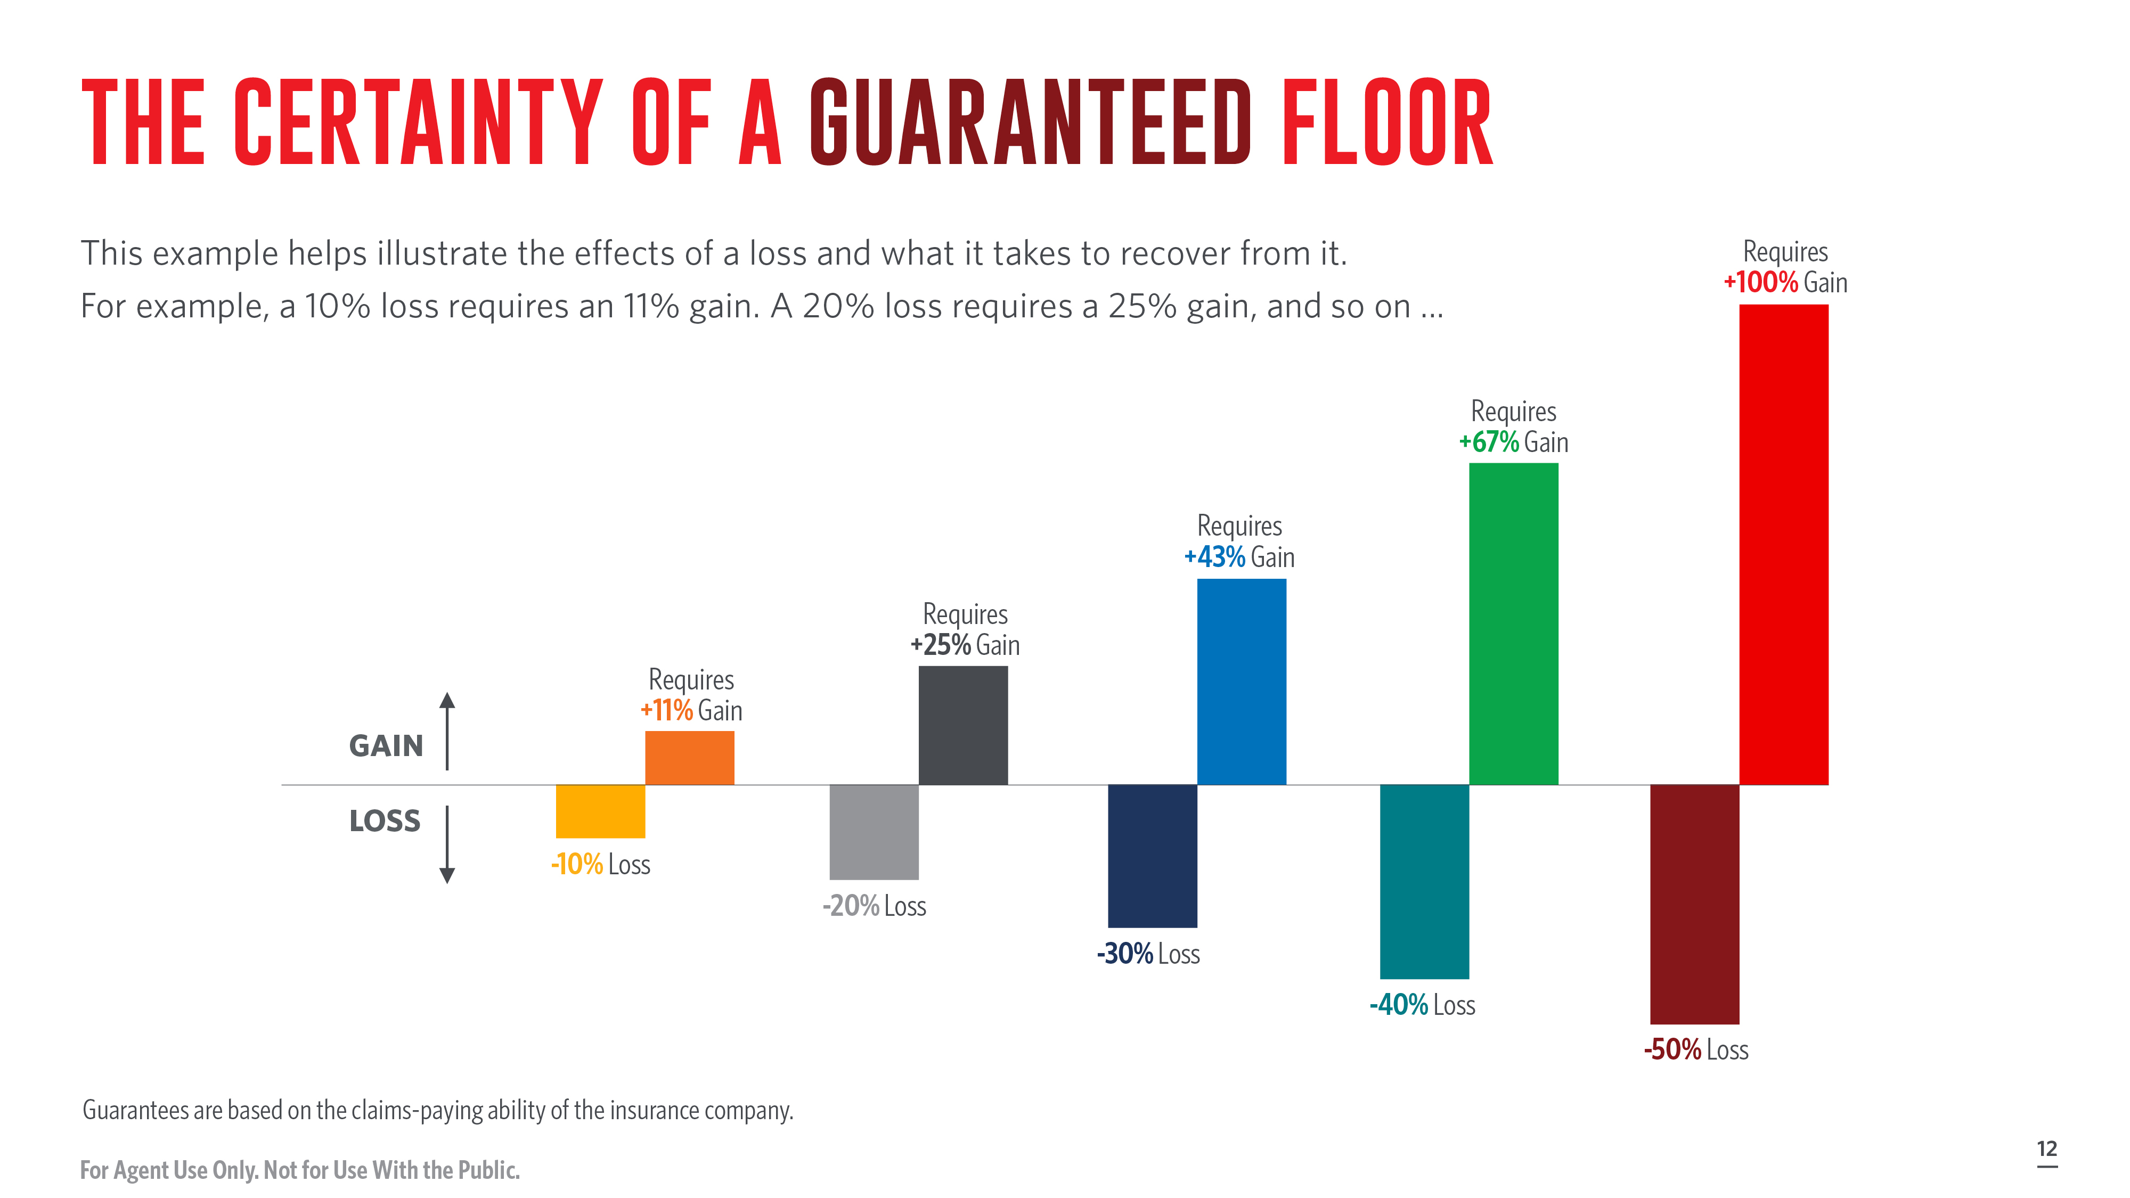
Notes:
[Read Slide]

Slide 13

Notes:
With a living benefit rider, you are able to present clients with the ability to access a portion of their death benefit early if they become stricken with a serious illness, such as a qualifying chronic, critical, or terminal illness.
We offer Transamerica Financial Foundation IUL II with optional chronic and critical illness accelerated death benefit riders for these situations.
Many worry about getting sick and how that would affect their family's finances, but they don't think there's anything they can do to prepare for it.
FFIUL II may allow agents to reach new markets:
Those that don’t know about (or don’t know they need) additional insurance features like chronic/critical ADB

Slide 14
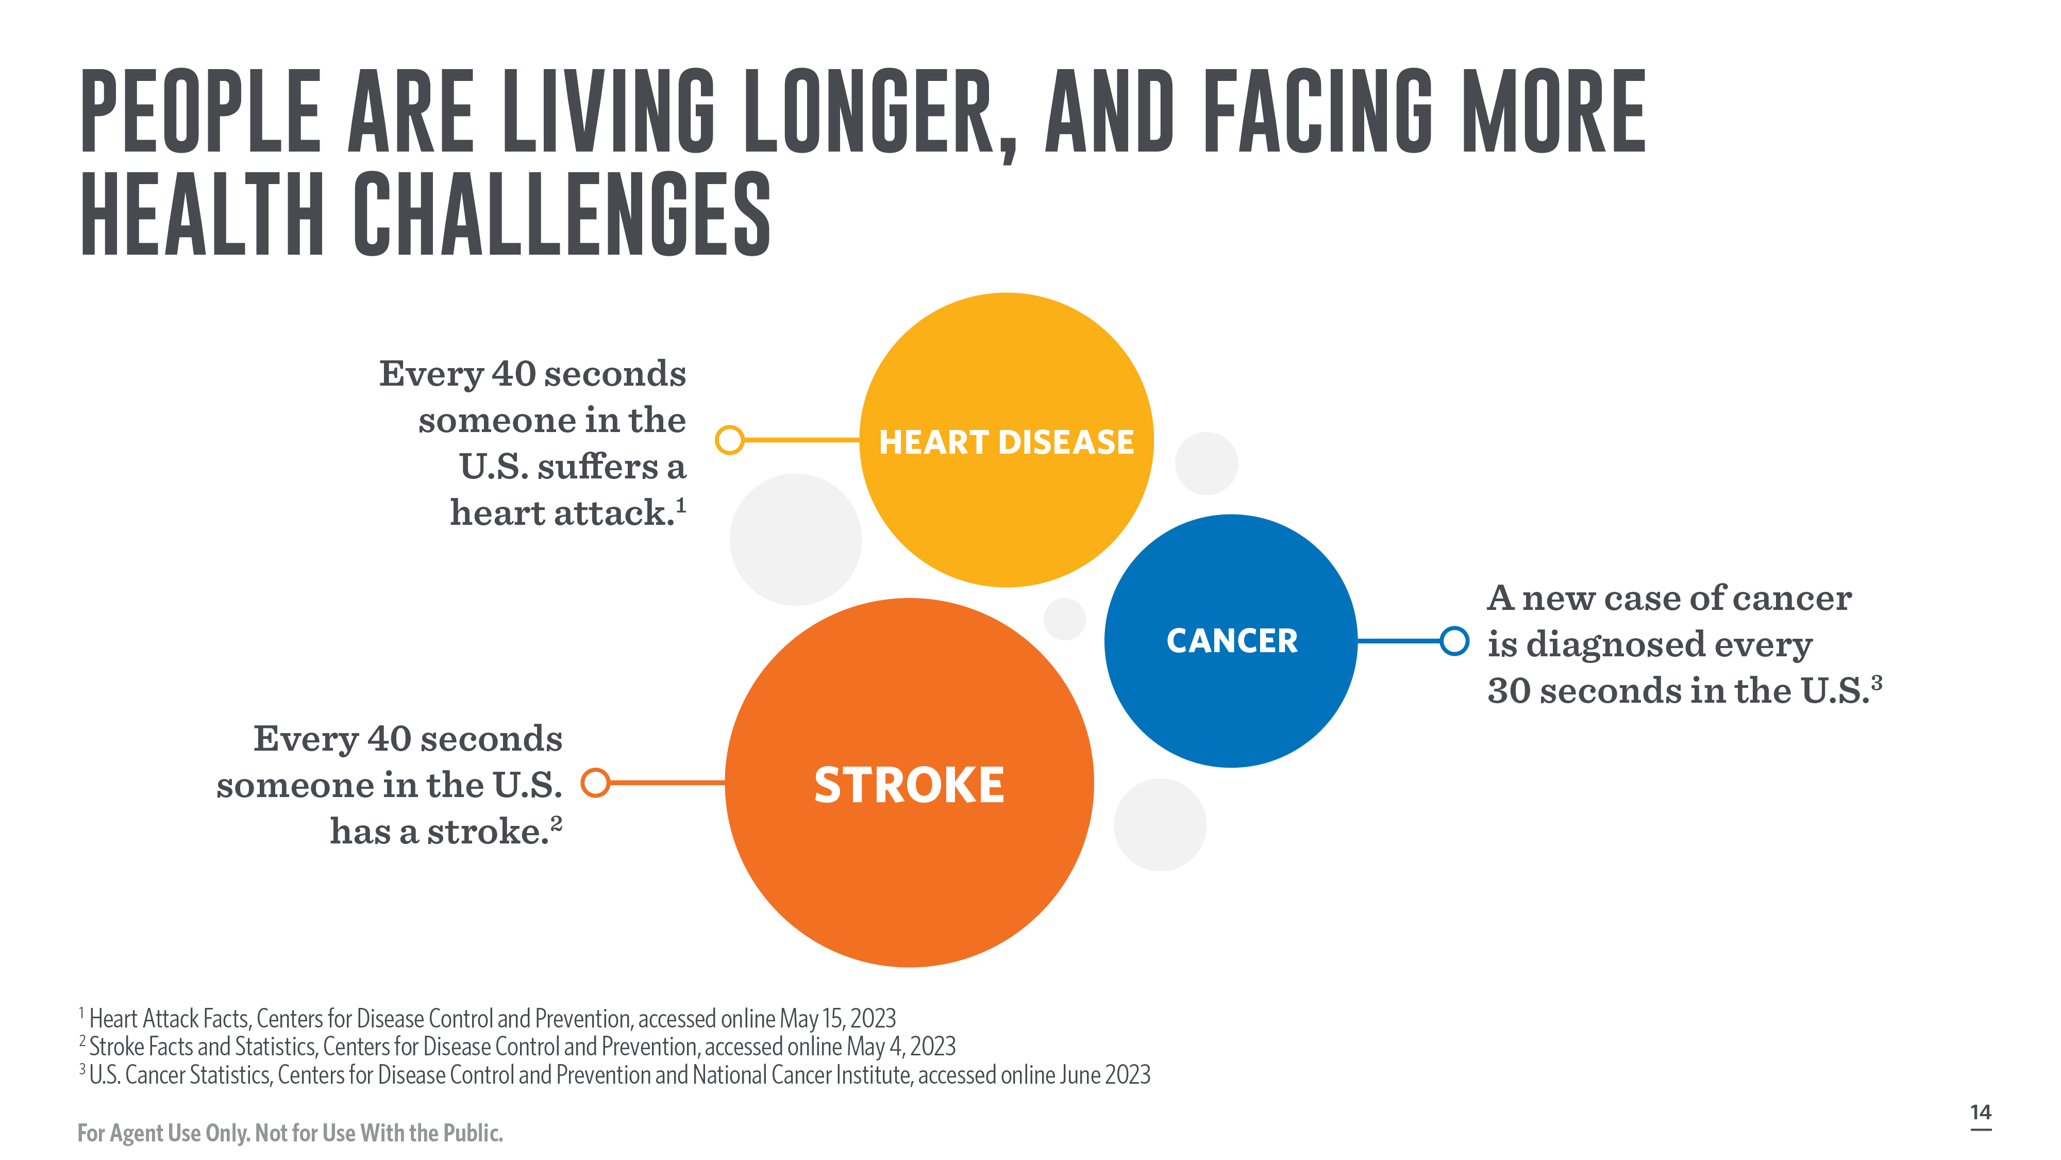
Notes:
The reason living benefit riders are gaining popularity is because, statistically, illness is likely to affect most of us at some point in our lifetime.
U.S. trends show our aging population continues to face health problems.

Slide 15

Notes:
Only 19% of respondents were very confident they will have enough money to take care of their medical expenses during retirement.
- Employee Benefit Research Institute Retirement Confidence Survey 2023

Slide 16

Notes:
Let’s talk about the first living benefit: the Long Term Care Rider.
Consider the fact that 70% of people turning age 65 today can expect to have a need for some form of long term care during their remaining years.
Are your clients planning for this important part of their lives?
Source: How Much Care Will You Need?, U.S. Department of Health and Human Services, accessed online September 2023

Slide 17
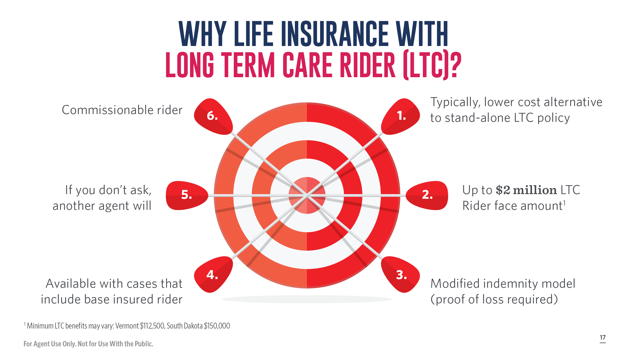
Notes:
So, why sell life insurance with the LTC Rider?
Typically, it is a lower cost alternative to stand-alone LTC policies
Maximum LTC face amount: $2,000,000
Modified Indemnity Model – Client receives elected benefit amount regardless of the amount of expenses incurred subject to the minimum and maximum amounts Proof of Loss documentation (receipts showing expenses incurred for cost of services) must be provided to Transamerica each month showing expenses incurred for qualified long term care services, in accordance with the Plan of Care
Available with Base Insured Rider – only other riders that may be selected if LTC Rider is selected are BIR, Terminal Illness, and Critical Illness IPO is also available
If you don’t ask, another agent will
Also, the rider is commissionable
Minimum LTC benefits may vary: Vermont $112,500, South Dakota $150,000
Underwriting for the LTC Rider is separate from the base policy.

Slide 18
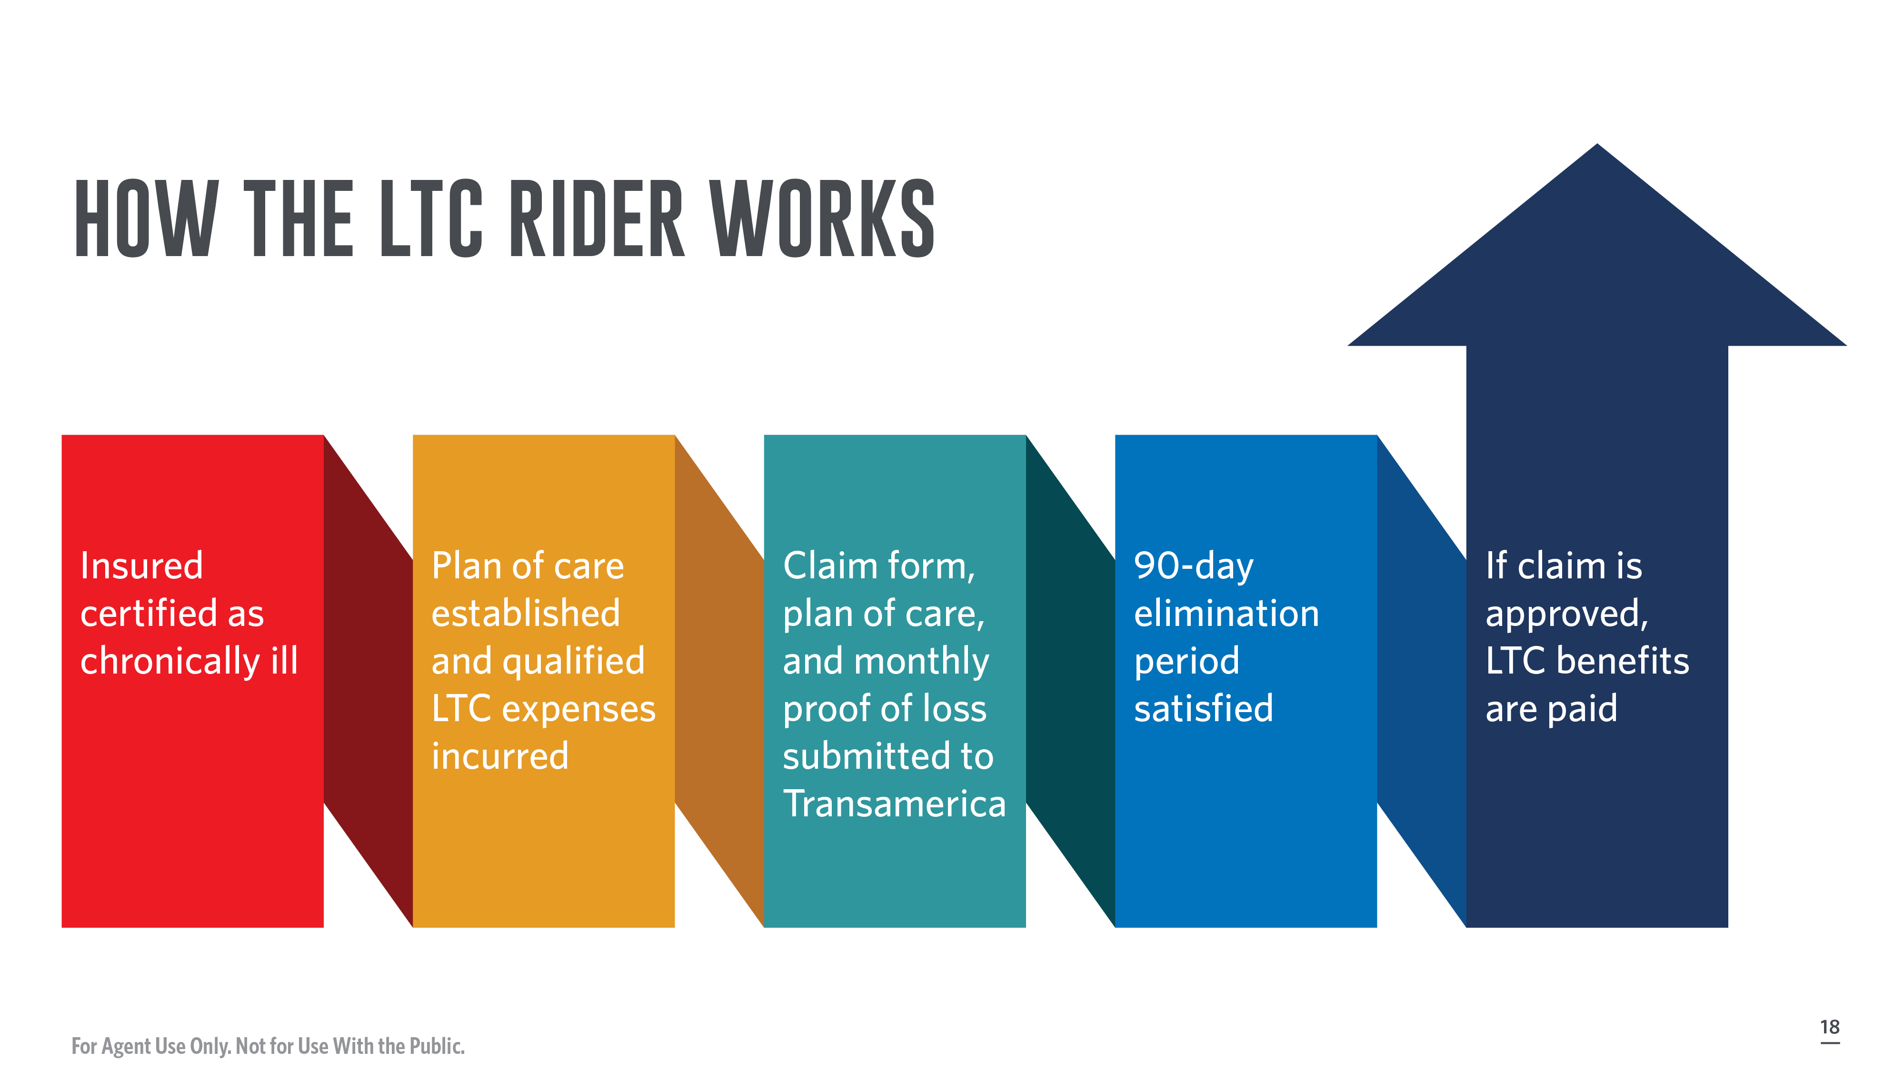
Notes:
To be eligible for monthly LTC benefits, the following conditions must be satisfied:
Insured is certified as a Chronically Ill individual by a licensed healthcare practitioner.
A Plan of Care prescribed and approved by a licensed healthcare practitioner and must be provided to Transamerica.
Proof of Loss documentation (receipts showing expenses incurred for cost of services) must be provided to Transamerica each month showing expenses incurred for qualified long term care services, in accordance with the Plan of Care.
90-day elimination period must be met.
Also:
Qualified long term care services must begin while the rider is in force.
All LTC expenses must be incurred for services rendered or goods provided while the rider is in force.
All care and services must be in accordance with accepted medical and nursing standards of practice and be consistent with the insured's current Plan of Care, and, if required, an assessment of the insured's functional and cognitive abilities must be completed at our expense. If an assessment is performed and the licensed healthcare practitioner cannot certify that the individual is chronically ill and is expected to remain so for a period of at least 90 days, then the claim will not be approved.

Slide 19

Notes:
As long as the insured continues to qualify to receive LTC Rider benefits:
LTC Rider charges waived (other policy charges will continue to be assessed).
The policy will not lapse while the insured is receiving benefits.

Slide 20
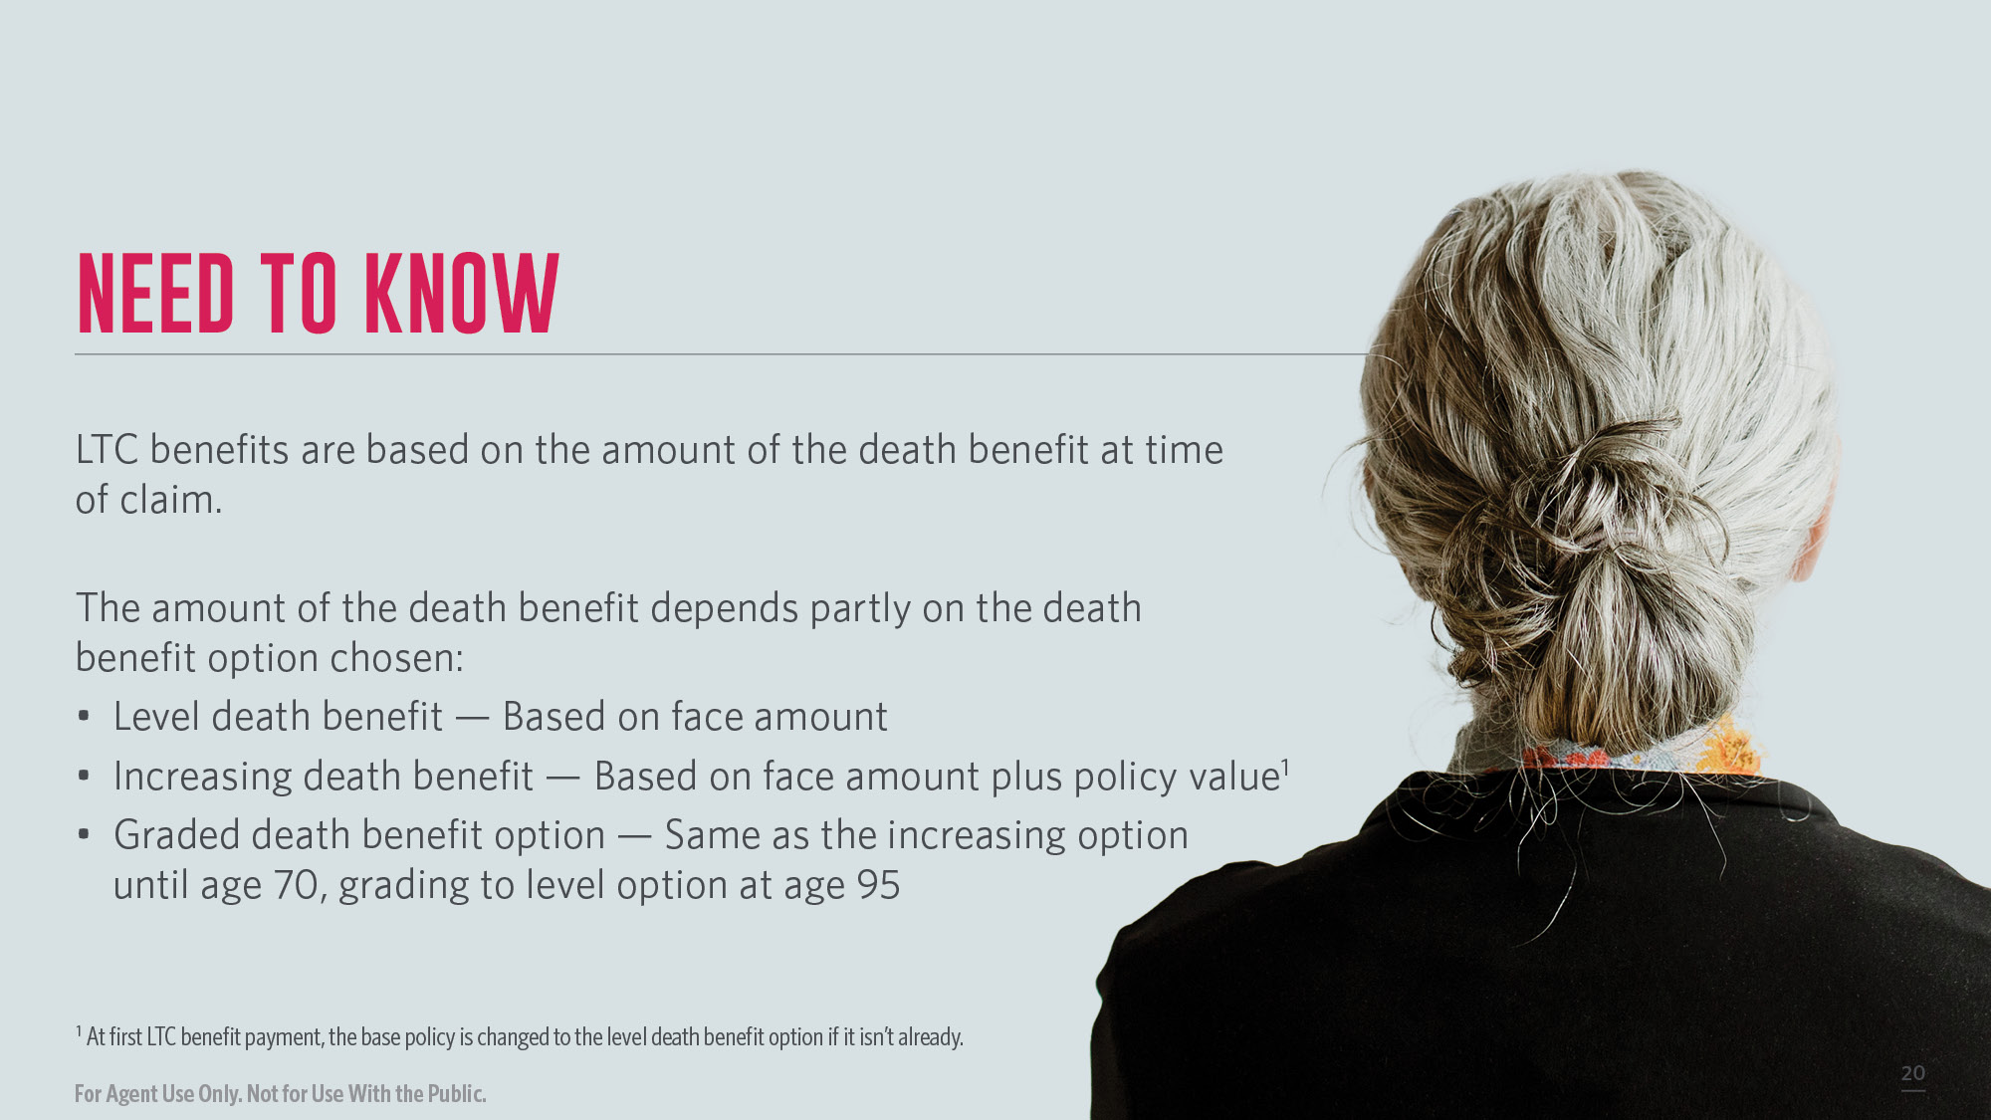
Notes:
LTC benefits are based on the amount of the death benefit at time of claim.
The amount of the death benefit depends partly on the death benefit option chosen:
Level death benefit - Based on face amount
Increasing death benefit - Based on face amount plus policy value
Graded death benefit option - Same as the increasing option until age 70, grading to level option at age 95

Slide 21

Notes:
Whether the policy owner has used some, none, or all the LTC benefits, there is potential to receive life insurance benefits under the policy.
What if there are no LTC benefits paid to the policy owner?
The beneficiaries will receive the full death benefit, minus any outstanding loans or withdrawals.
What if the policy owner receives some LTC benefits?
The beneficiaries will receive the death benefit, minus any paid LTC benefits, outstanding loans, or withdrawals.
What if LTC benefits are exhausted?
The base life insurance policy will provide the beneficiaries with a residual death benefit. The residual death benefit is equal to the lesser of: (a) 10% of the lowest face amount of the base policy since inception, less any outstanding policy loans or (b) $10,000.

Slide 22
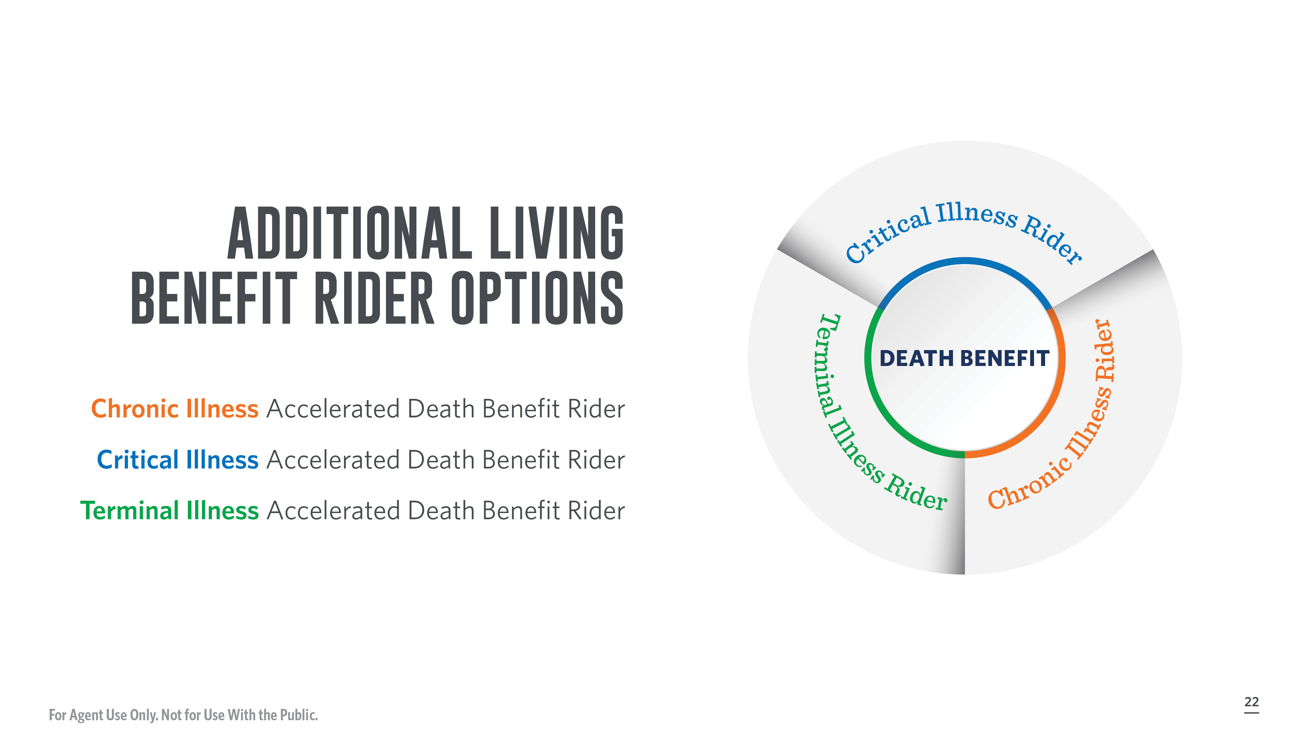
Notes:
Transamerica Financial Foundation IUL II has three additional living benefit options for your clients to choose from:
Chronic Illness Accelerated Death Benefit Rider
Critical Illness Accelerated Death Benefit Rider
Terminal Illness Accelerated Death Benefit Rider
Please note that the Chronic Illness Accelerated Death Benefit is not available of the Long Term Care Rider is elected.

Slide 23

Notes:
Benefits provided through the Critical, Chronic, and Terminal Illness Accelerated Death Benefit Riders are subject to certain limitations and exclusions. Amounts payable under the riders vary based in part on the nature and severity of the insured's health condition and the insured's remaining life expectancy at the time of the acceleration as determined by the company. The actual benefit paid to the policy owner will be less than the amount that is accelerated because the amount is discounted to reflect early payment of the policy's death benefit. Administrative fees per request apply.
Riders should not be the sole basis to purchase any life insurance policy. Benefits paid under accelerated death benefit riders, including the Long Term Care Rider, will reduce the life insurance policy’s death benefit and policy value. Consideration should be given to whether life insurance needs would still be met if rider benefits are paid out in full.
Riders and benefits have specific limitations, may incur additional costs, and may not be available in all jurisdictions. The maximum base policy face amount may be limited by the addition of certain riders. For complete details, including charges, terms and conditions of each rider and exact coverage provided, please see the rider forms.

Slide 24
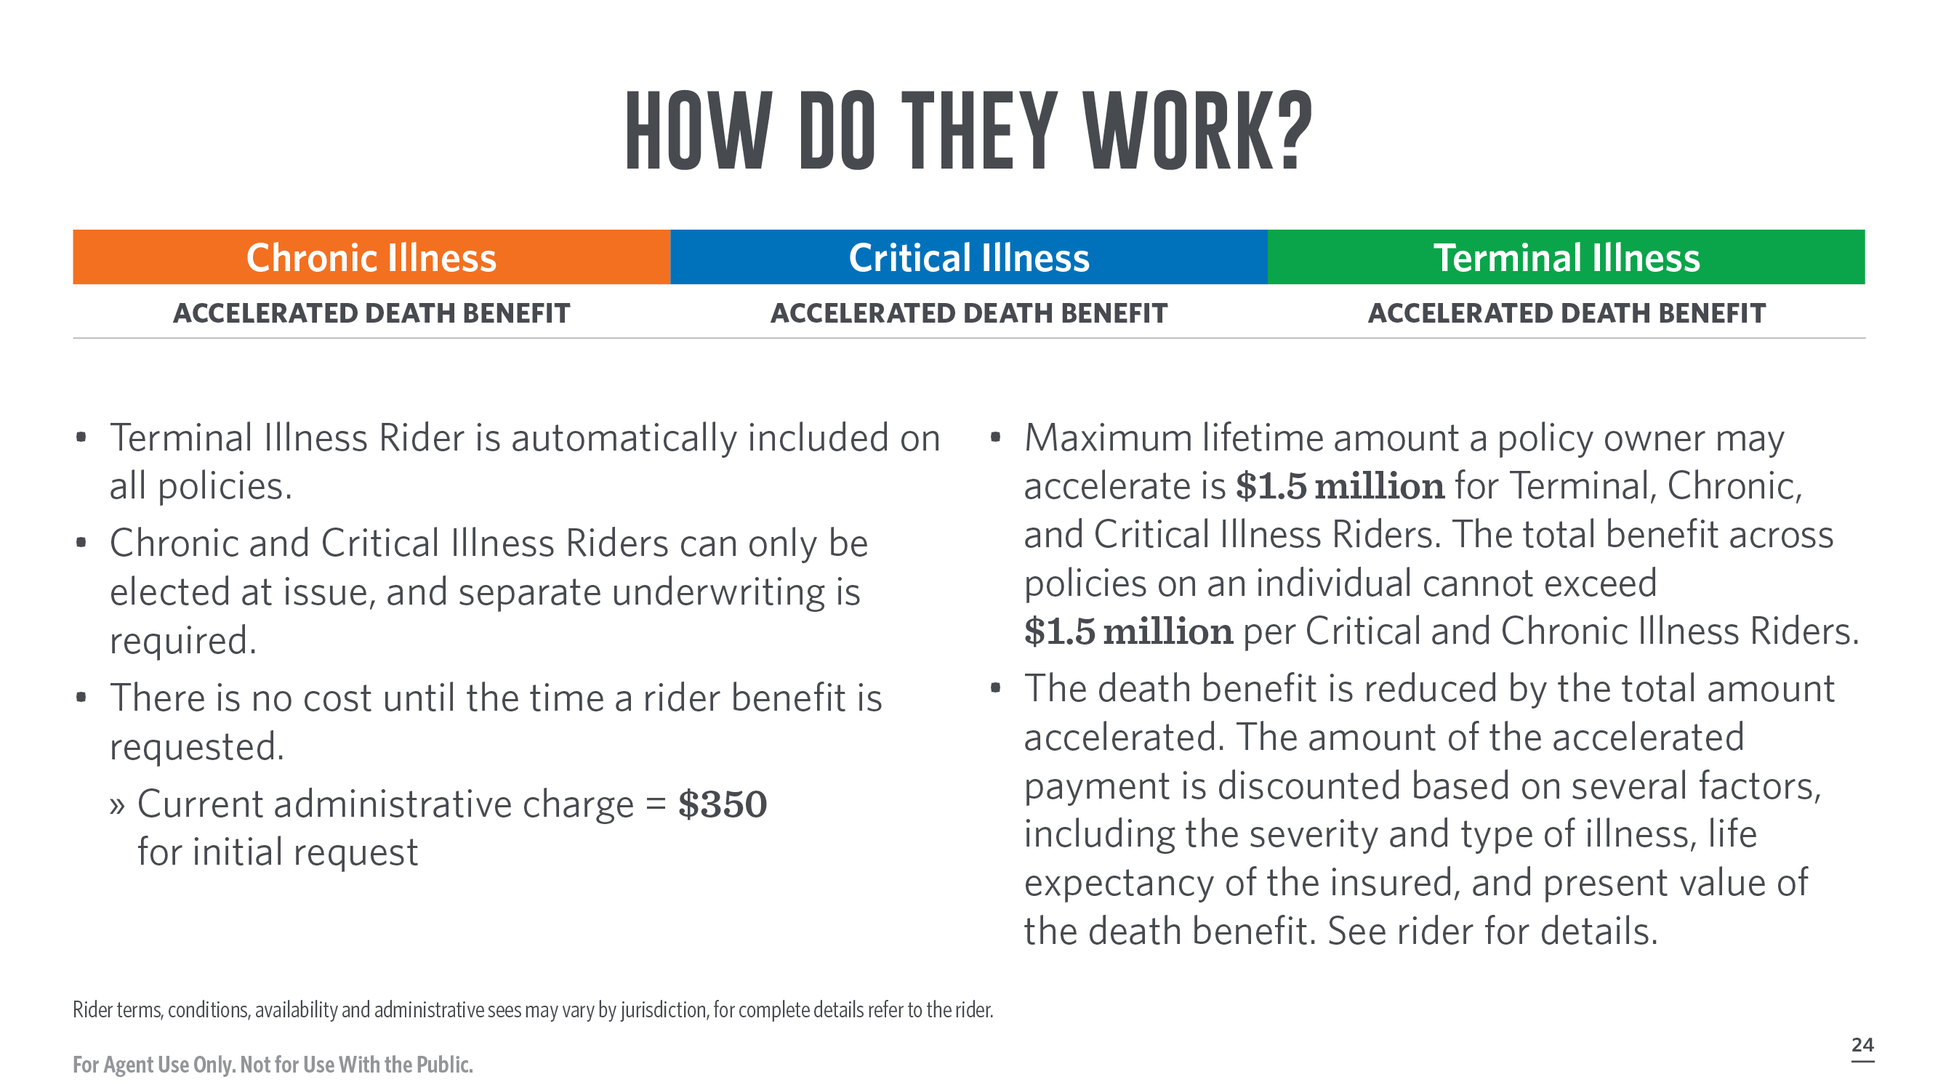
Notes:
The living benefits available with the FFIUL II policy may allow policyholders to accelerate their death benefits to provide dollars that can be used to help pay for expenses associated with chronic, critical, and terminal illnesses.

Slide 25
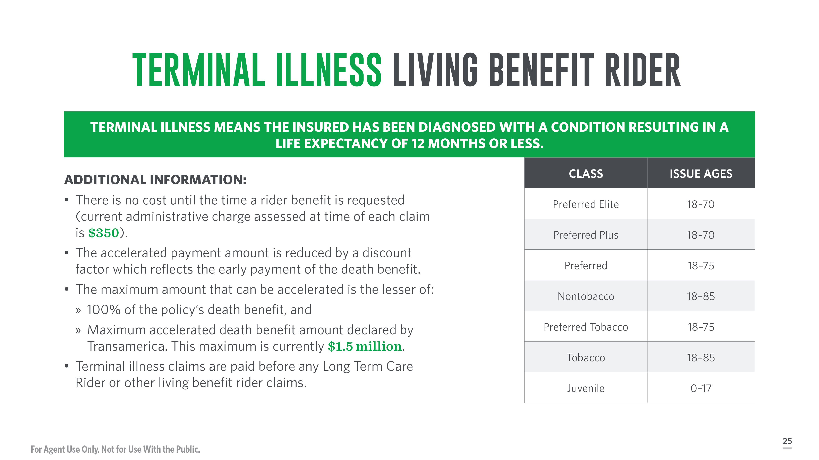
Notes:
If the insured is diagnosed with a terminal illness, benefits can be accelerated and paid to the policy owner. Terminally ill means that the insured has a medical condition, resulting from bodily injury or disease, or both, which is expected to result in the death of the insured within 12 months of diagnosis. Please see the rider form for complete details.
If the insured is diagnosed as terminally ill, 100% of the available death benefit (up to $1,500,000) can be requested for acceleration. The actual amount paid to the policy owner will be less because it is discounted to reflect early payment of the policy's death benefit.
ADDITIONAL INFORMATION:
There is no cost until the time a rider benefit is requested (current administrative charge assessed at time of each claim is $350).
The accelerated payment amount is reduced by a discount factor which reflects the early payment of the death benefit.
The maximum amount that can be accelerated is the lesser of:
100% of the policy's death benefit, and
The maximum accelerated death benefit amount that is declared by Transamerica. This maximum is subject to change but will never be lower than $500,000. This maximum is currently $1.5 million.
Terminal Illness claims are paid before Long Term Care Rider or any other living benefit rider claims.

Slide 26
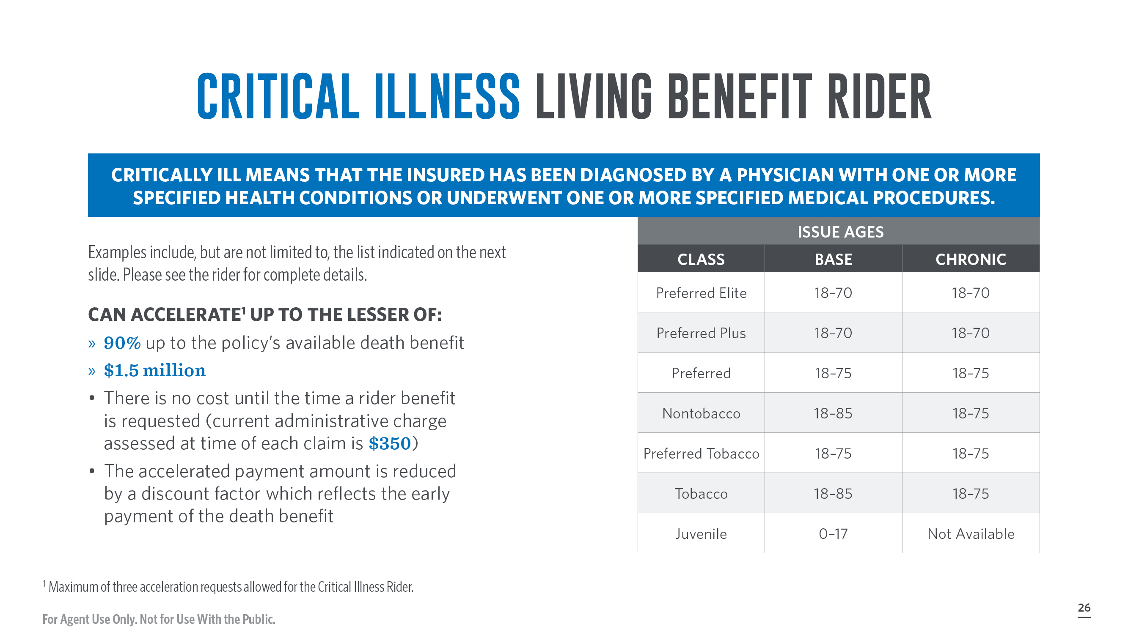
Notes:
Critically ill means that the insured has been diagnosed by a physician with one or more specified health conditions or underwent one or more specified medical procedures. Examples include, but are not limited to, the list indicated on the next slide. Please see the rider for complete details.
If the insured is diagnosed with a qualifying critical illness, up to 90% of the available death benefit (up to $1,500,000) can be requested for acceleration. The actual amount paid to the policy owner will be less because it is discounted to reflect early payment of the policy's death benefit.

Slide 27

Notes:
Here are examples of critical illness:
Heart attack Stroke (does not include TIAs)
Cancer End-stage renal failure
Major organ transplant Blindness
Paralysis Aids
Aplastic anemia First coronary angioplasty
First coronary artery bypass Motor neuron disease
Central nervous disease

Slide 28
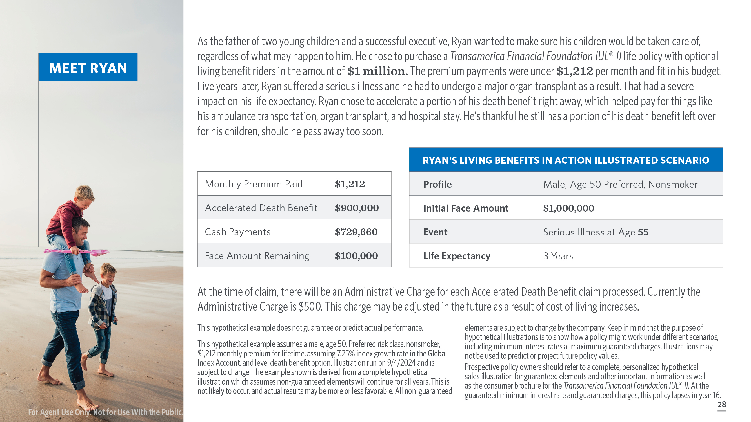
Notes:
[Read Slide]

Slide 29
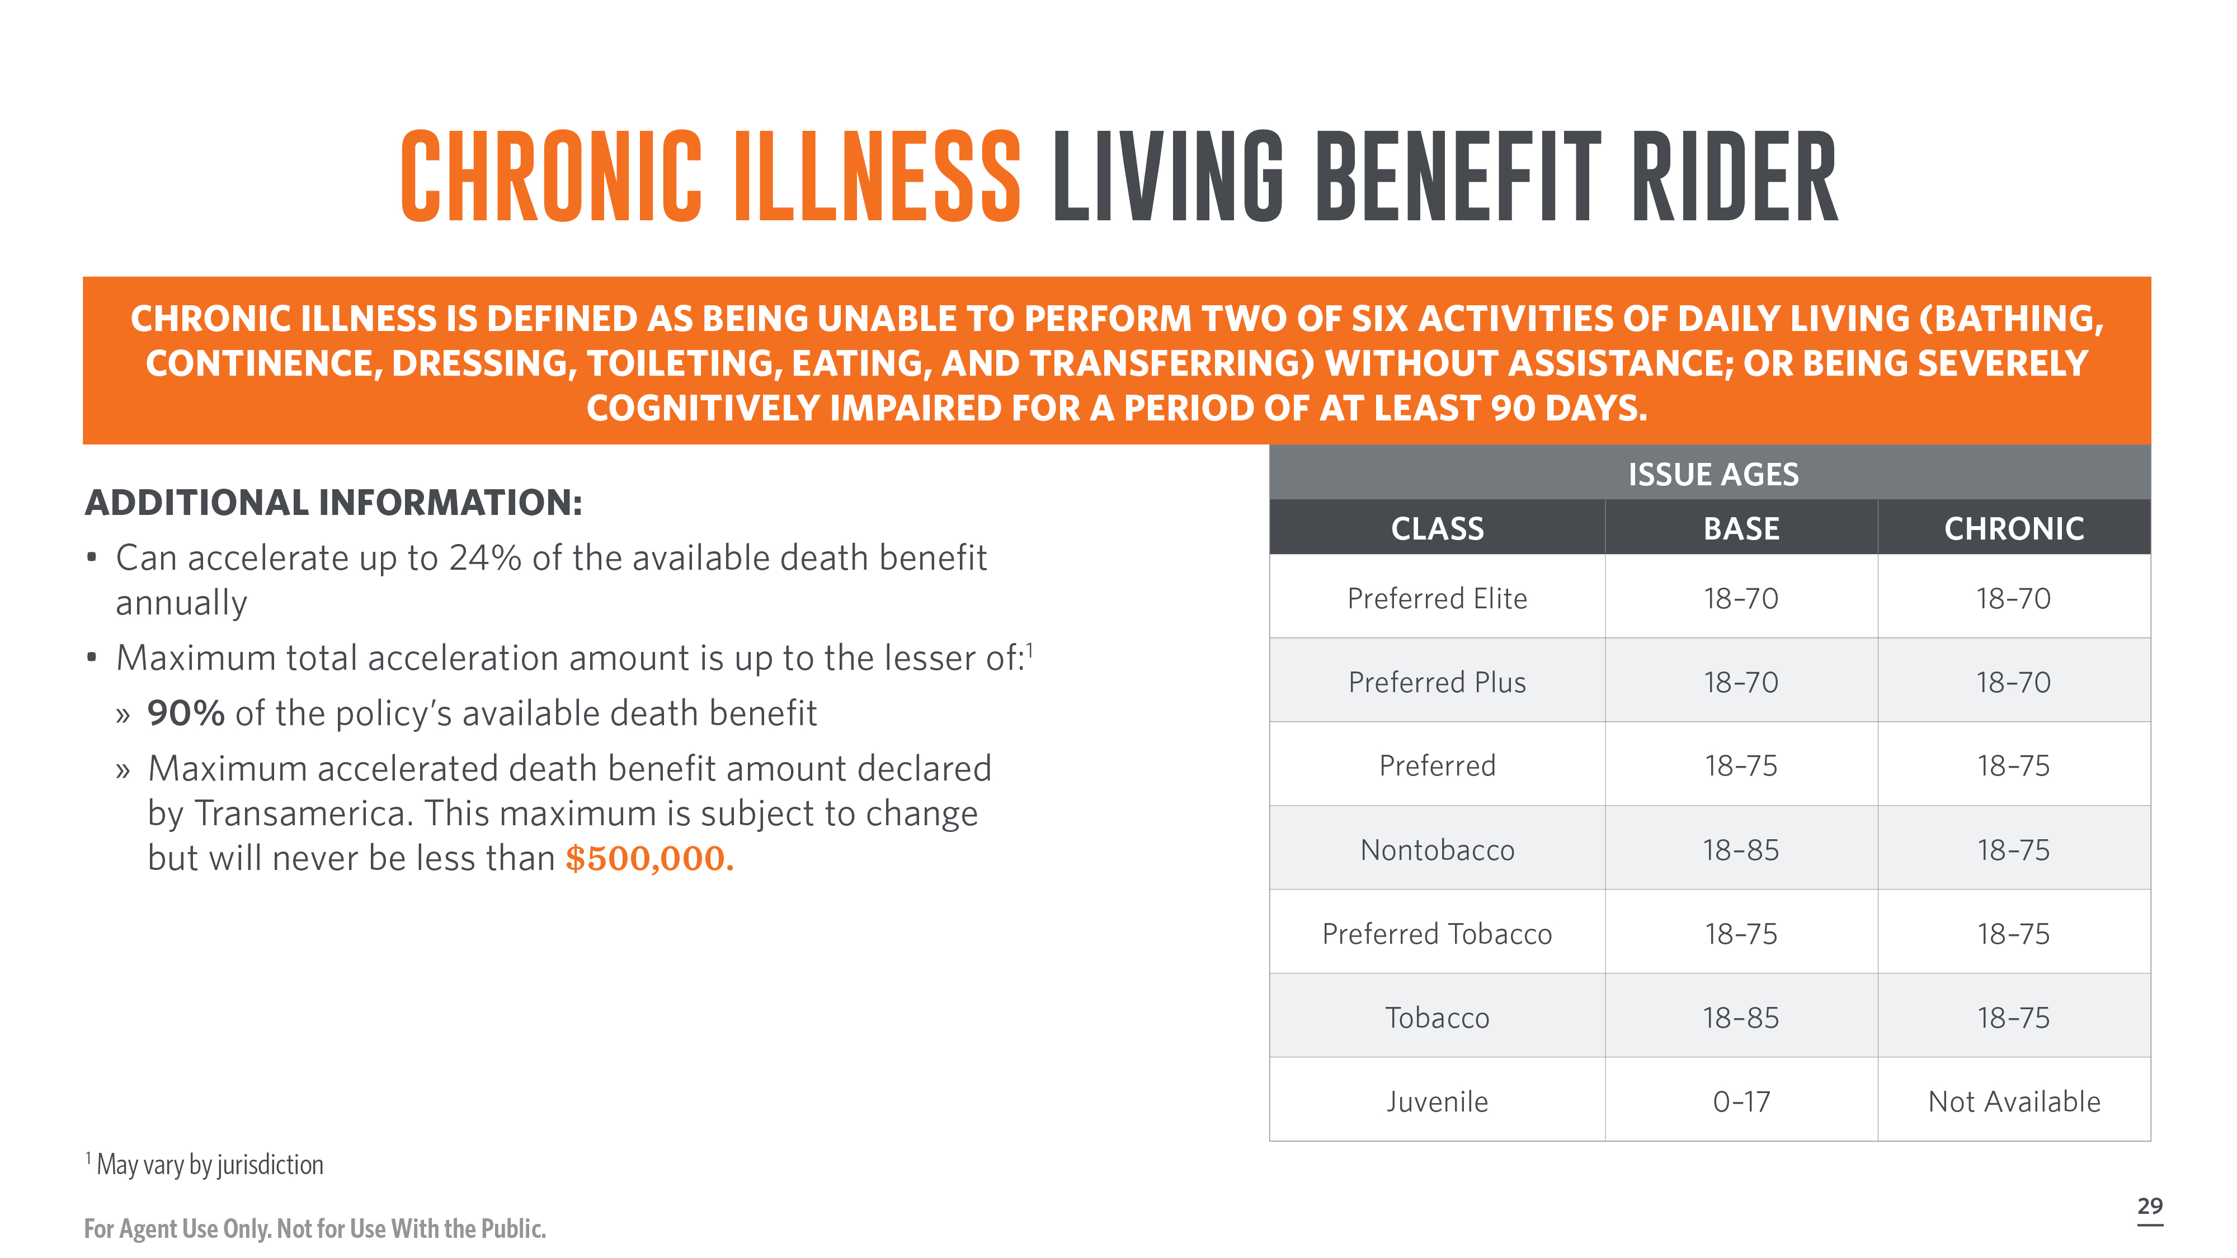

Notes:
Chronic illnesses can prevent people from performing basic activities of daily living (ADLs), like bathing, continence, dressing, toileting, eating, and transferring. If an insured is unable to perform two of these six activities without help, or is severely cognitively impaired for at least 90 days, the policy owner can accelerate up to 24% of the available death benefit of their policy annually, up to the lesser of 90% of the policy's death benefit, or $1,500,000. The actual amount paid to the policy owner will be less because it is discounted to reflect early payment of the policy's death benefit. Please see the rider form for complete details.
The Chronic Illness Rider is not allowed with the Long Term Care Rider and is the last to be paid when multiple living benefit requests are made.

Slide 30
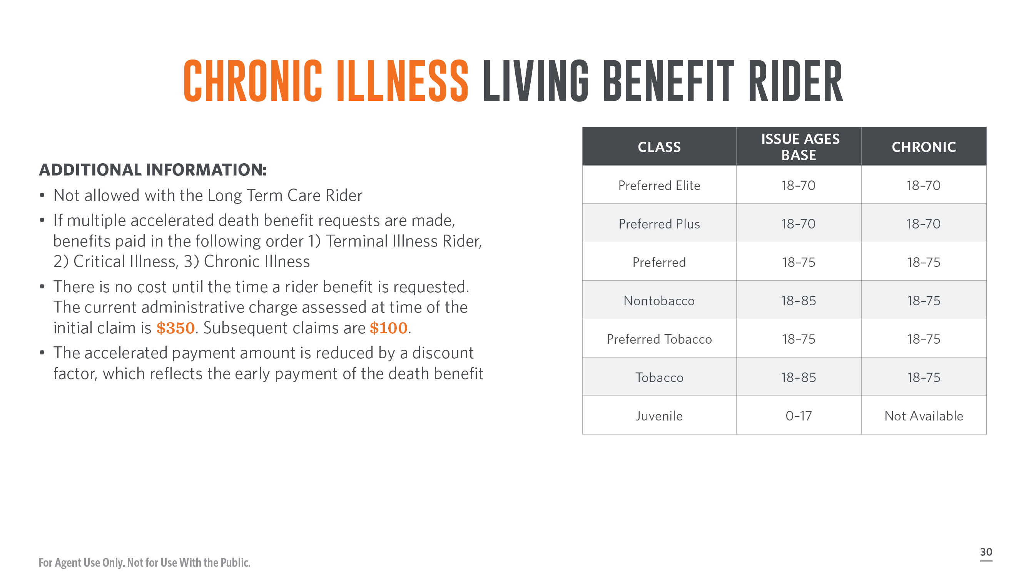
Notes:
Not allowed with the Long Term Care Rider
If multiple accelerated death benefit requests are made, benefits paid in the following order 1) Terminal Illness Rider, 2) Critical Illness, 3) Chronic Illness
There is no cost until the time a rider benefit is requested. The current administrative charge assessed at time of the initial claim is $350. Subsequent claims are $100.
The accelerated payment amount is reduced by a discount factor, which reflects the early payment of the death benefit

Slide 31

Notes:
[Read Slide]

Slide 32
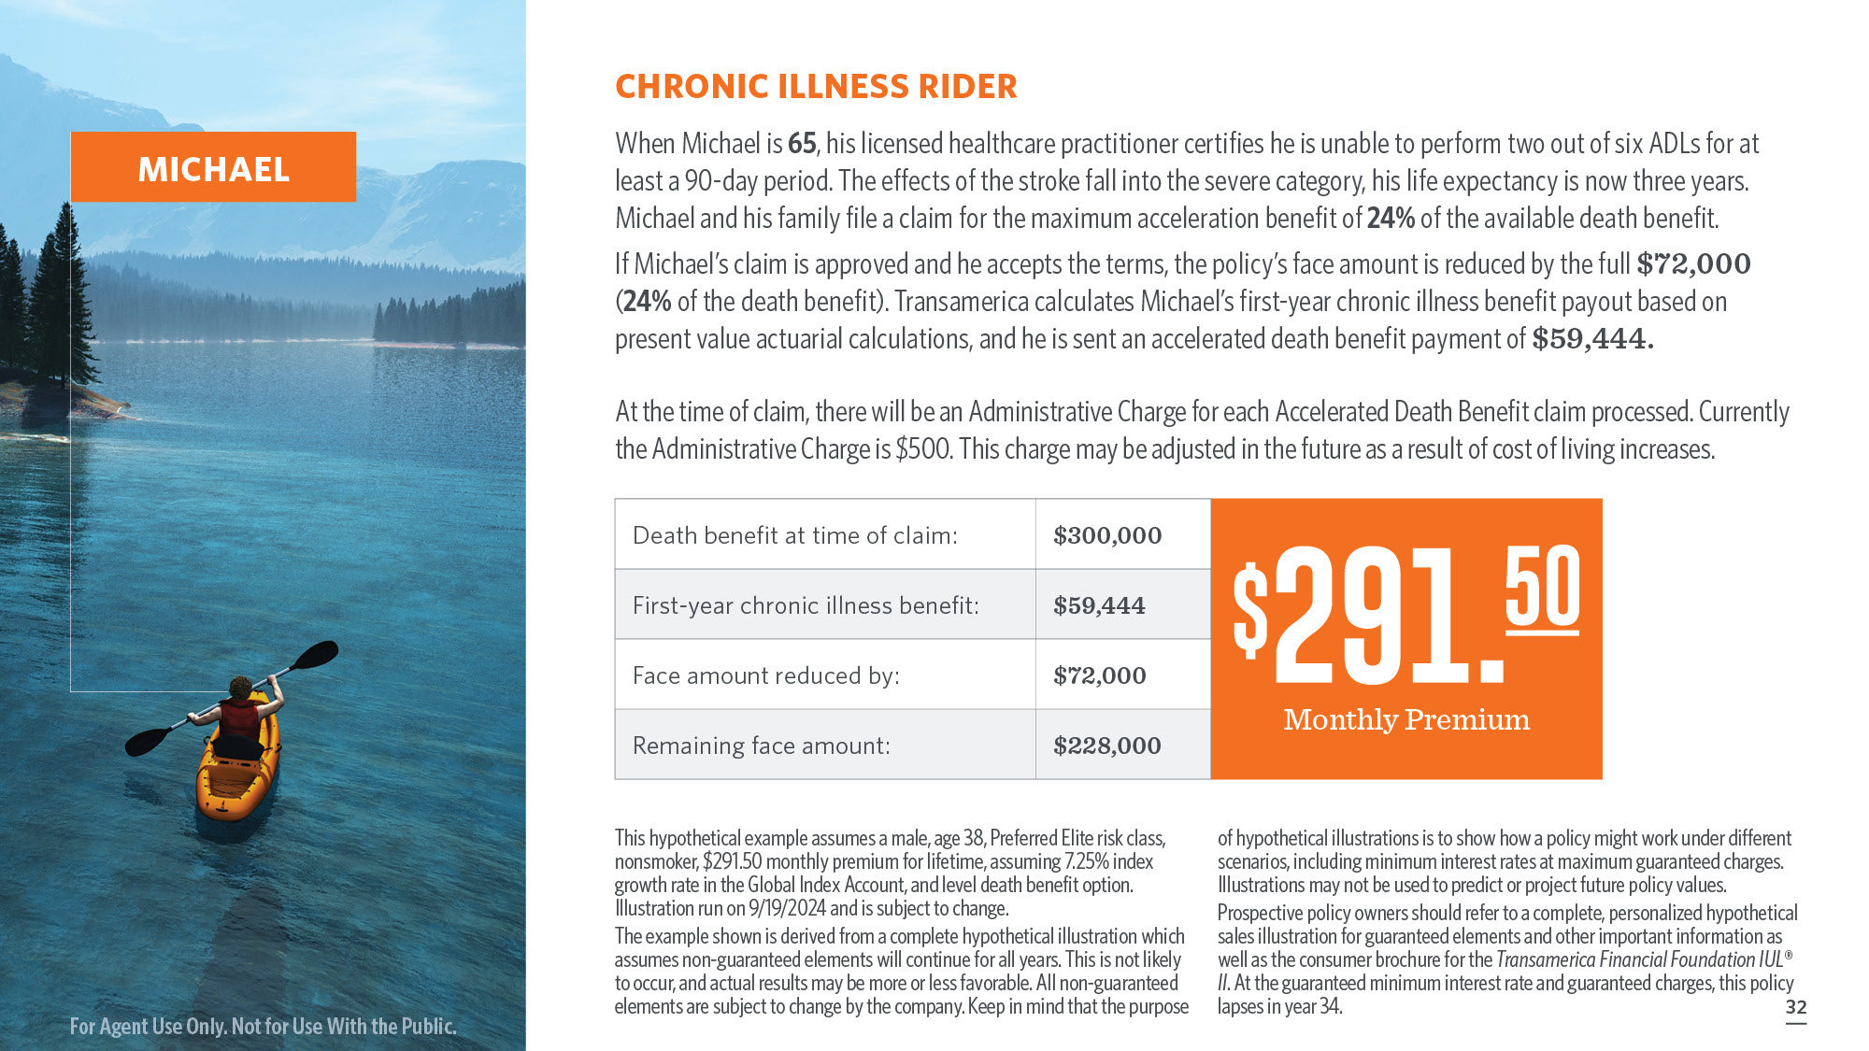
Notes:
[Read Slide]

Slide 33
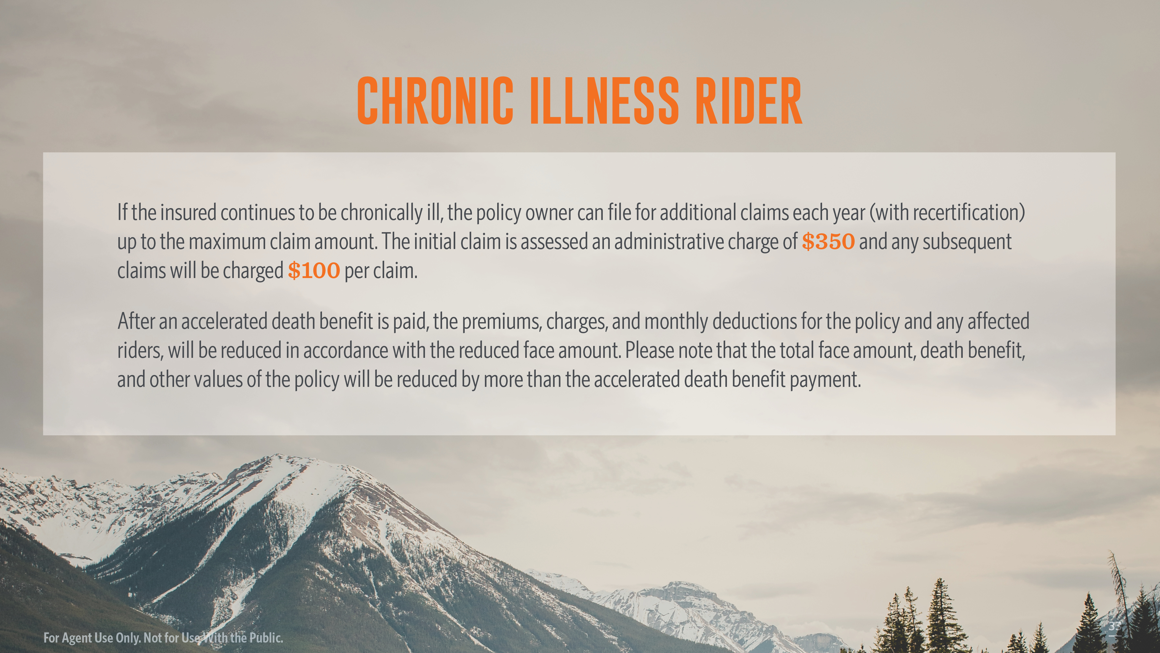
Notes:
[Read Slide]

Slide 34
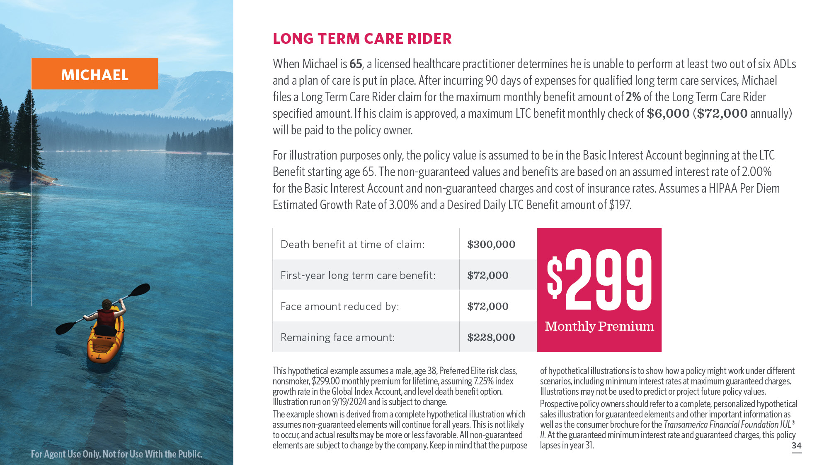
Notes:
[Read Slide]

Slide 35
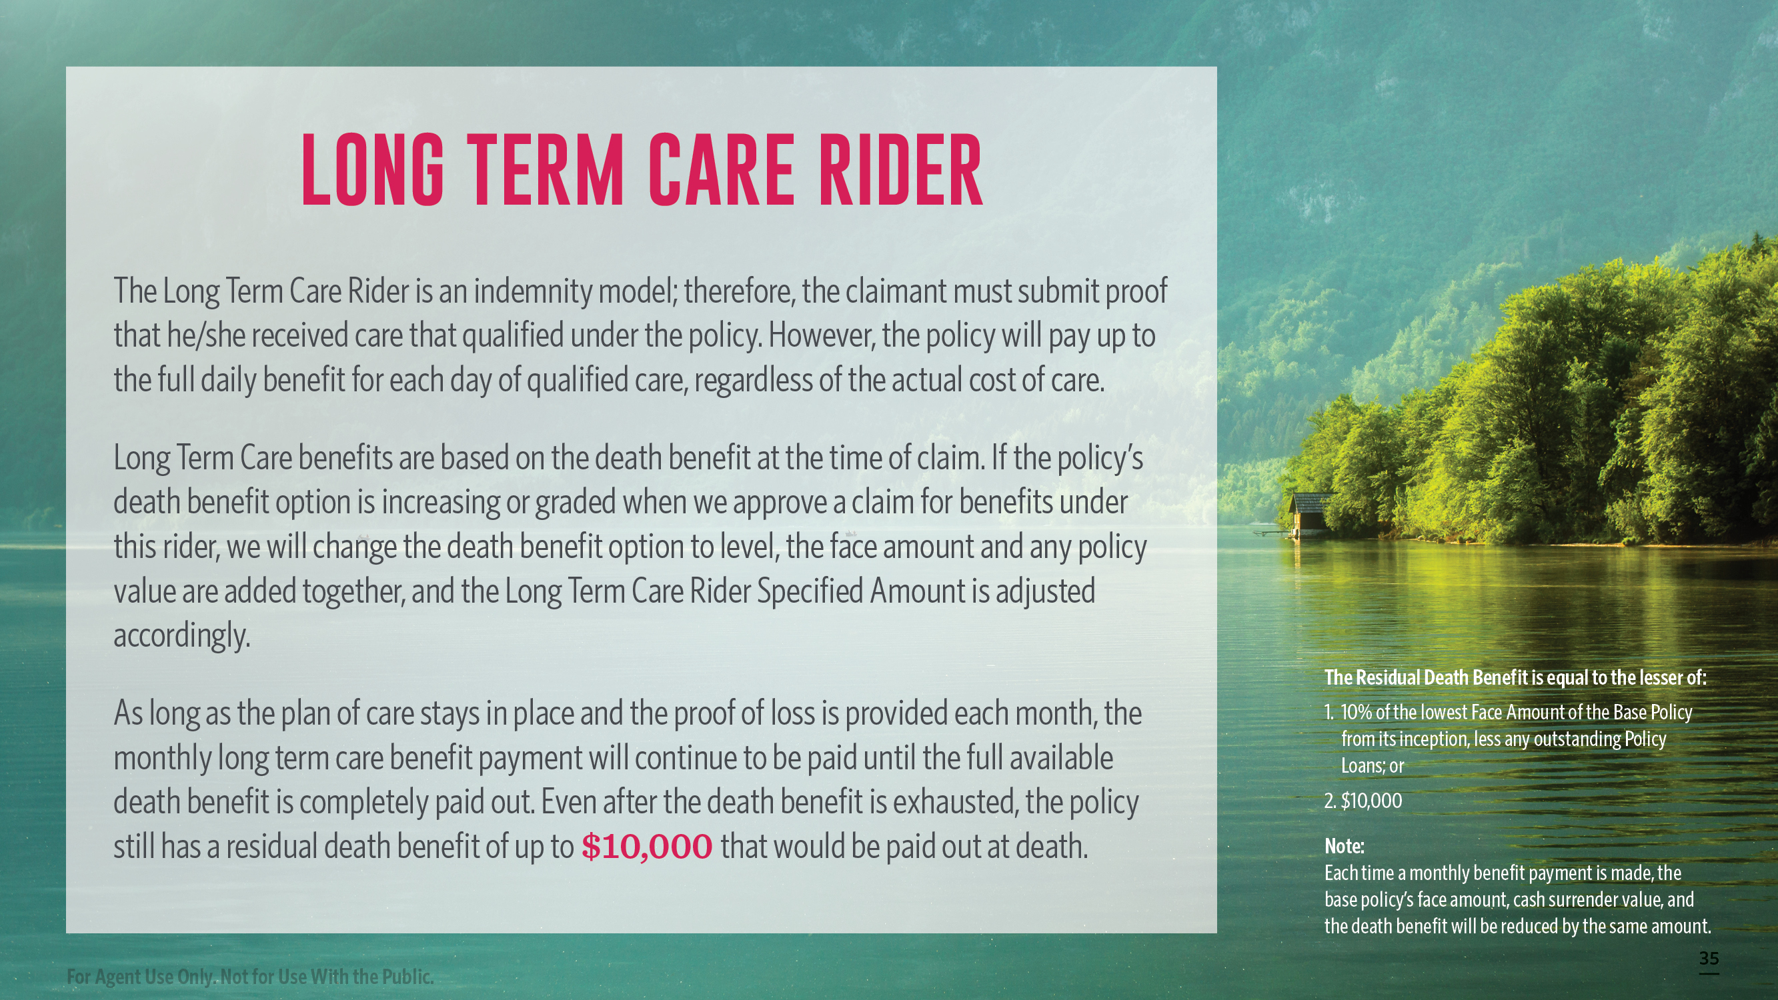
Notes:
[Read Slide]

Slide 36

Notes:
[Read Slide]

Slide 37

Notes:
[Read Slide]

Slide 38

Notes:
When it comes to preparing for your future, there’s no time like the present.
Call your national sales desk for more information on helping your clients live their best life with the Transamerica Financial Foundation IUL II policy.

