Slide 1
Notes:
Welcome to the Life Access webinar live demo. My name is ________, and today I will be guiding you through our new, more convenient portal Transamerica Life AccessSM.

Slide 2
Notes:
Here’s a quick overview of what we’ll be covering, and you’ll see some screenshots of the system to learn how to navigate your way around.
[Read slide]

Slide 3
Notes:
Now I know what you’re already thinking ... yet another portal and password to remember? But Transamerica Life Access is actually part of our effort to simplify your life and begin consolidating portals into one convenient location for all your business needs. You’ll be able to see your life policies such as final expense, term, whole, and index universal life products. Life Access features:
[Review bullet points on slide]

Slide 4
Notes:
Let’s get started on how to log in.

Slide 5
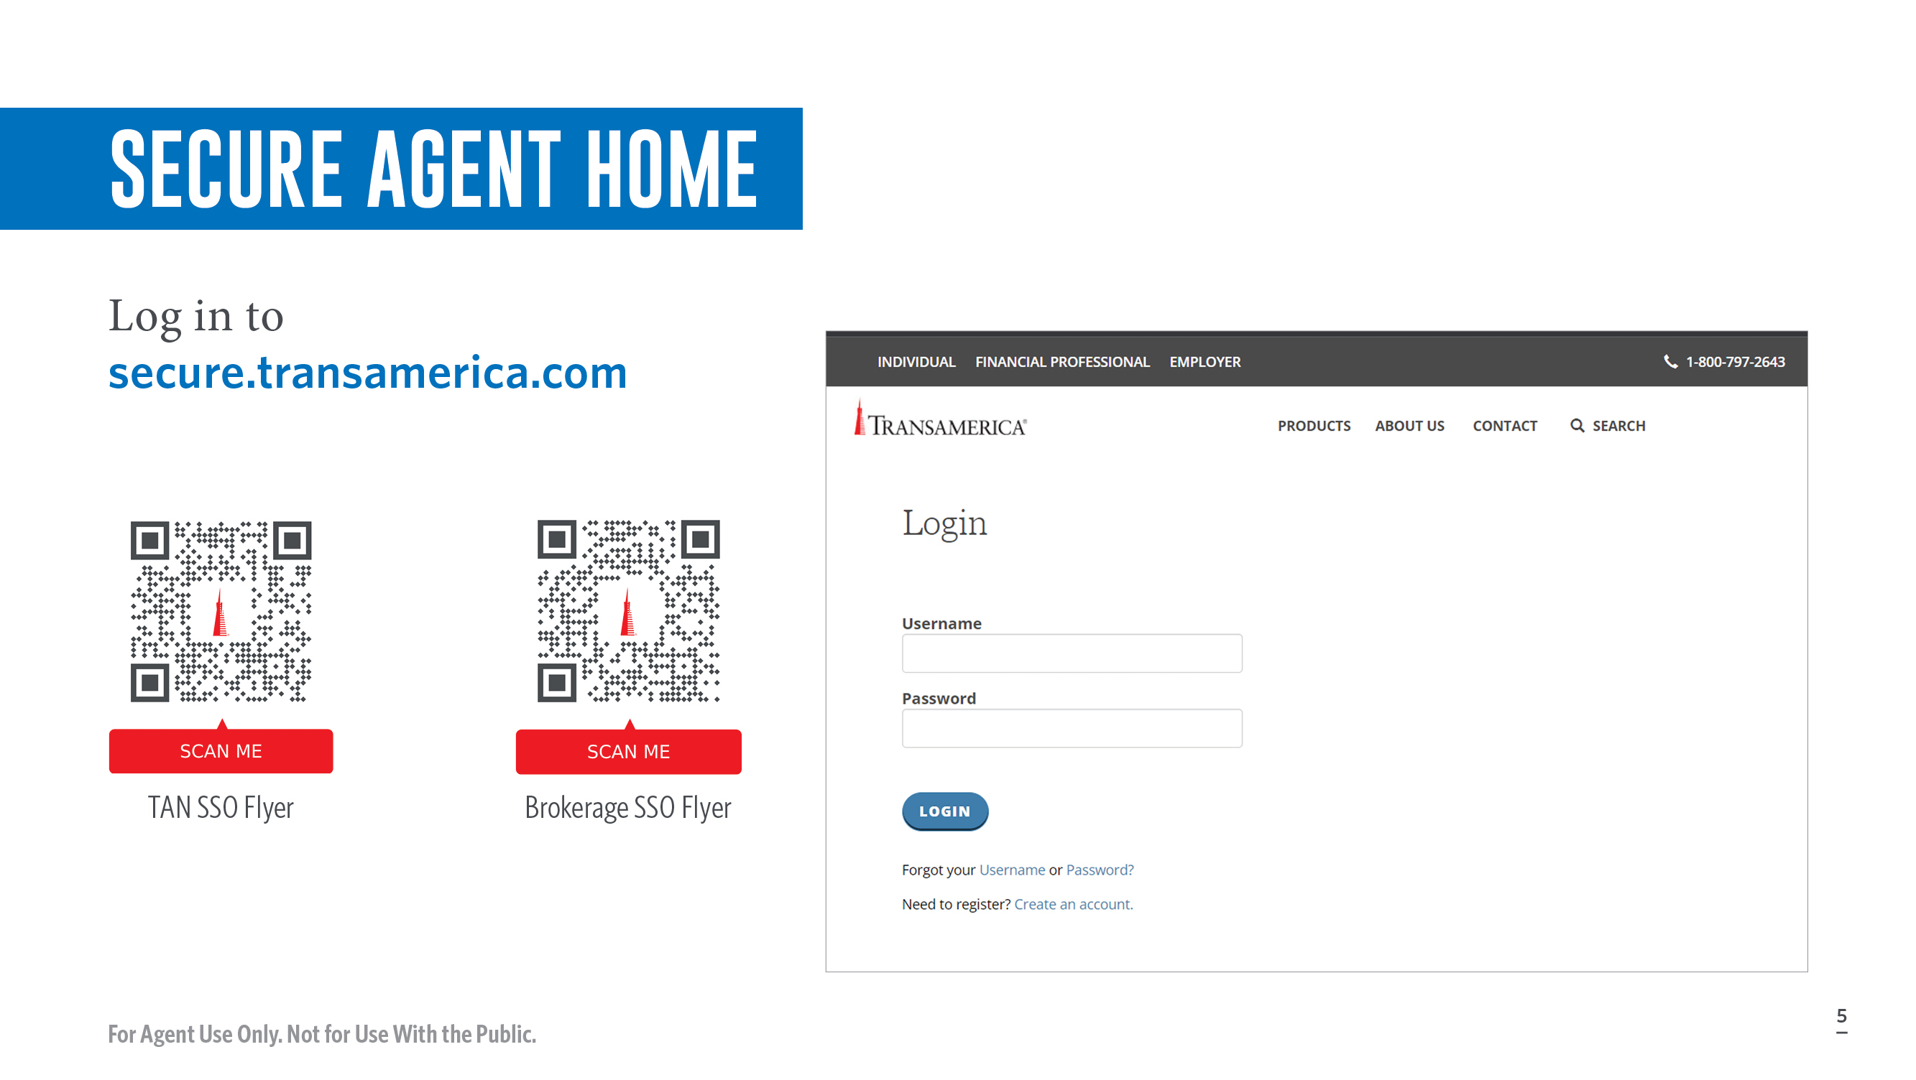
Notes:
Here is the login screen you should see when you visit the secure Agent Home page. This is how to get into Life Access. If you’re already registered on the Agent + Advisor portal, you can use the same login by navigating to secure.transamerica.com. If you have not registered with either secure Agent Home or the Agent + Producer portal, here are two QR codes depending on your channel (TAN and Brokerage) on how to do so.

Slide 6
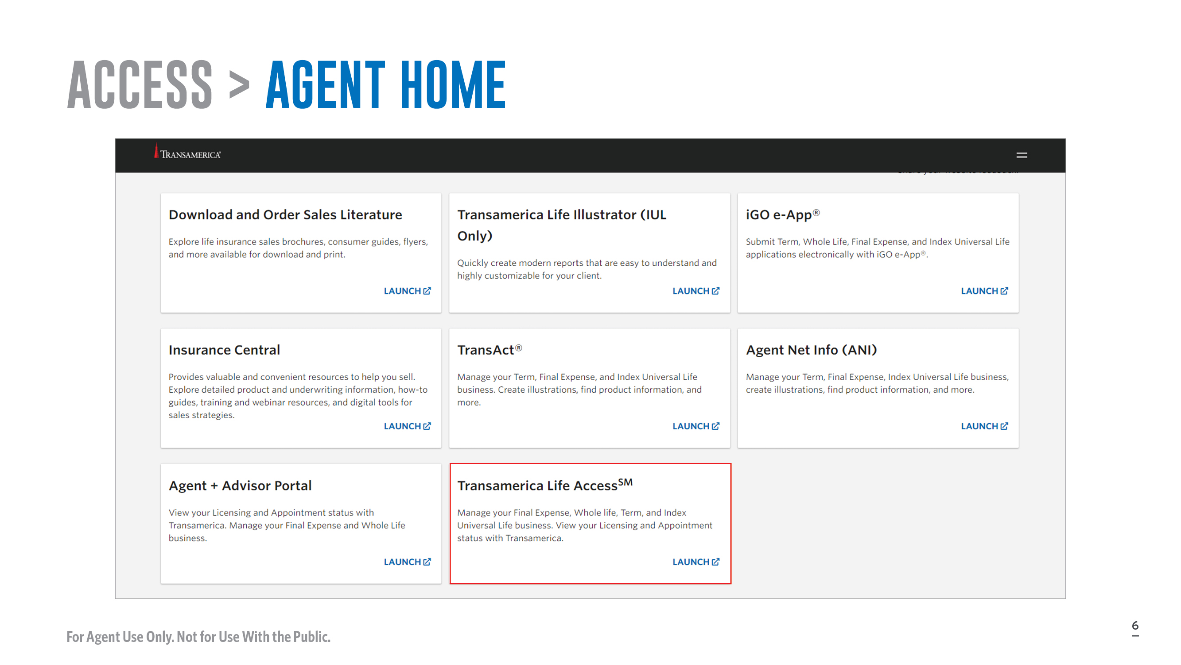
Notes:
[Read slide]
Here you can see the secure Agent Home log in dashboard. You will notice a new tile near the bottom called Transamerica Life Access. You’ll want to click on “Launch” in that tile to get started.

Slide 7
Notes:
Let’s take a deeper dive into some of the features that will make your life and doing business with Transamerica easier than ever.

Slide 8
Notes:
Let’s start with navigation and the dashboard.

Slide 9
Notes:
Here you’ll see the top-level navigation menu that contains:
Home
My Book
Tools (Report a Claim)
Profile
[Review slide]

Slide 10
Notes:
Click on “My Book” in the dashboard and, on the right, you’ll see a quick, colorful overview of your pending and in force policies represented by these charts.
[Review slide]

Slide 11
Notes:
On the left, you’ll see important announcements and upcoming calendar events.
[Review slide]

Slide 12
Notes:
Under ”My Profile,” you can update personal information such as contact info so you’re always up to date.

Slide 13
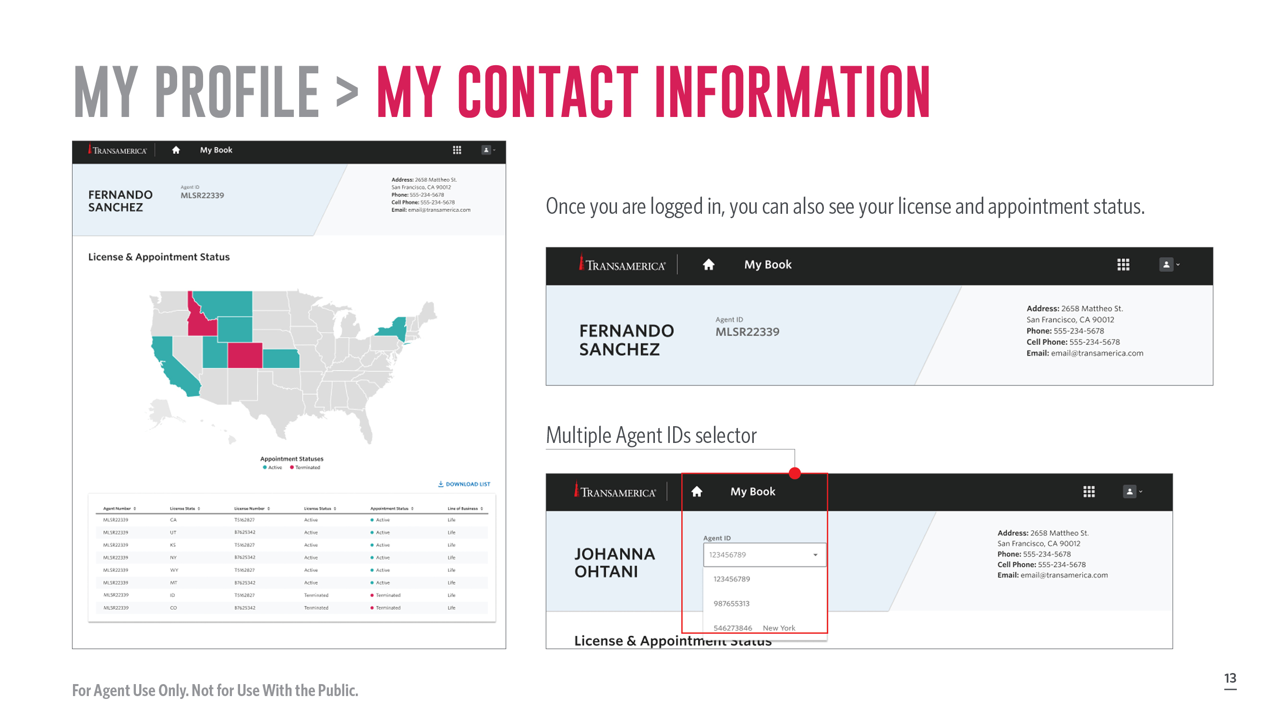
Notes:
Once you are logged in, you can also see your license and appointment status.
[Review slide]

Slide 14
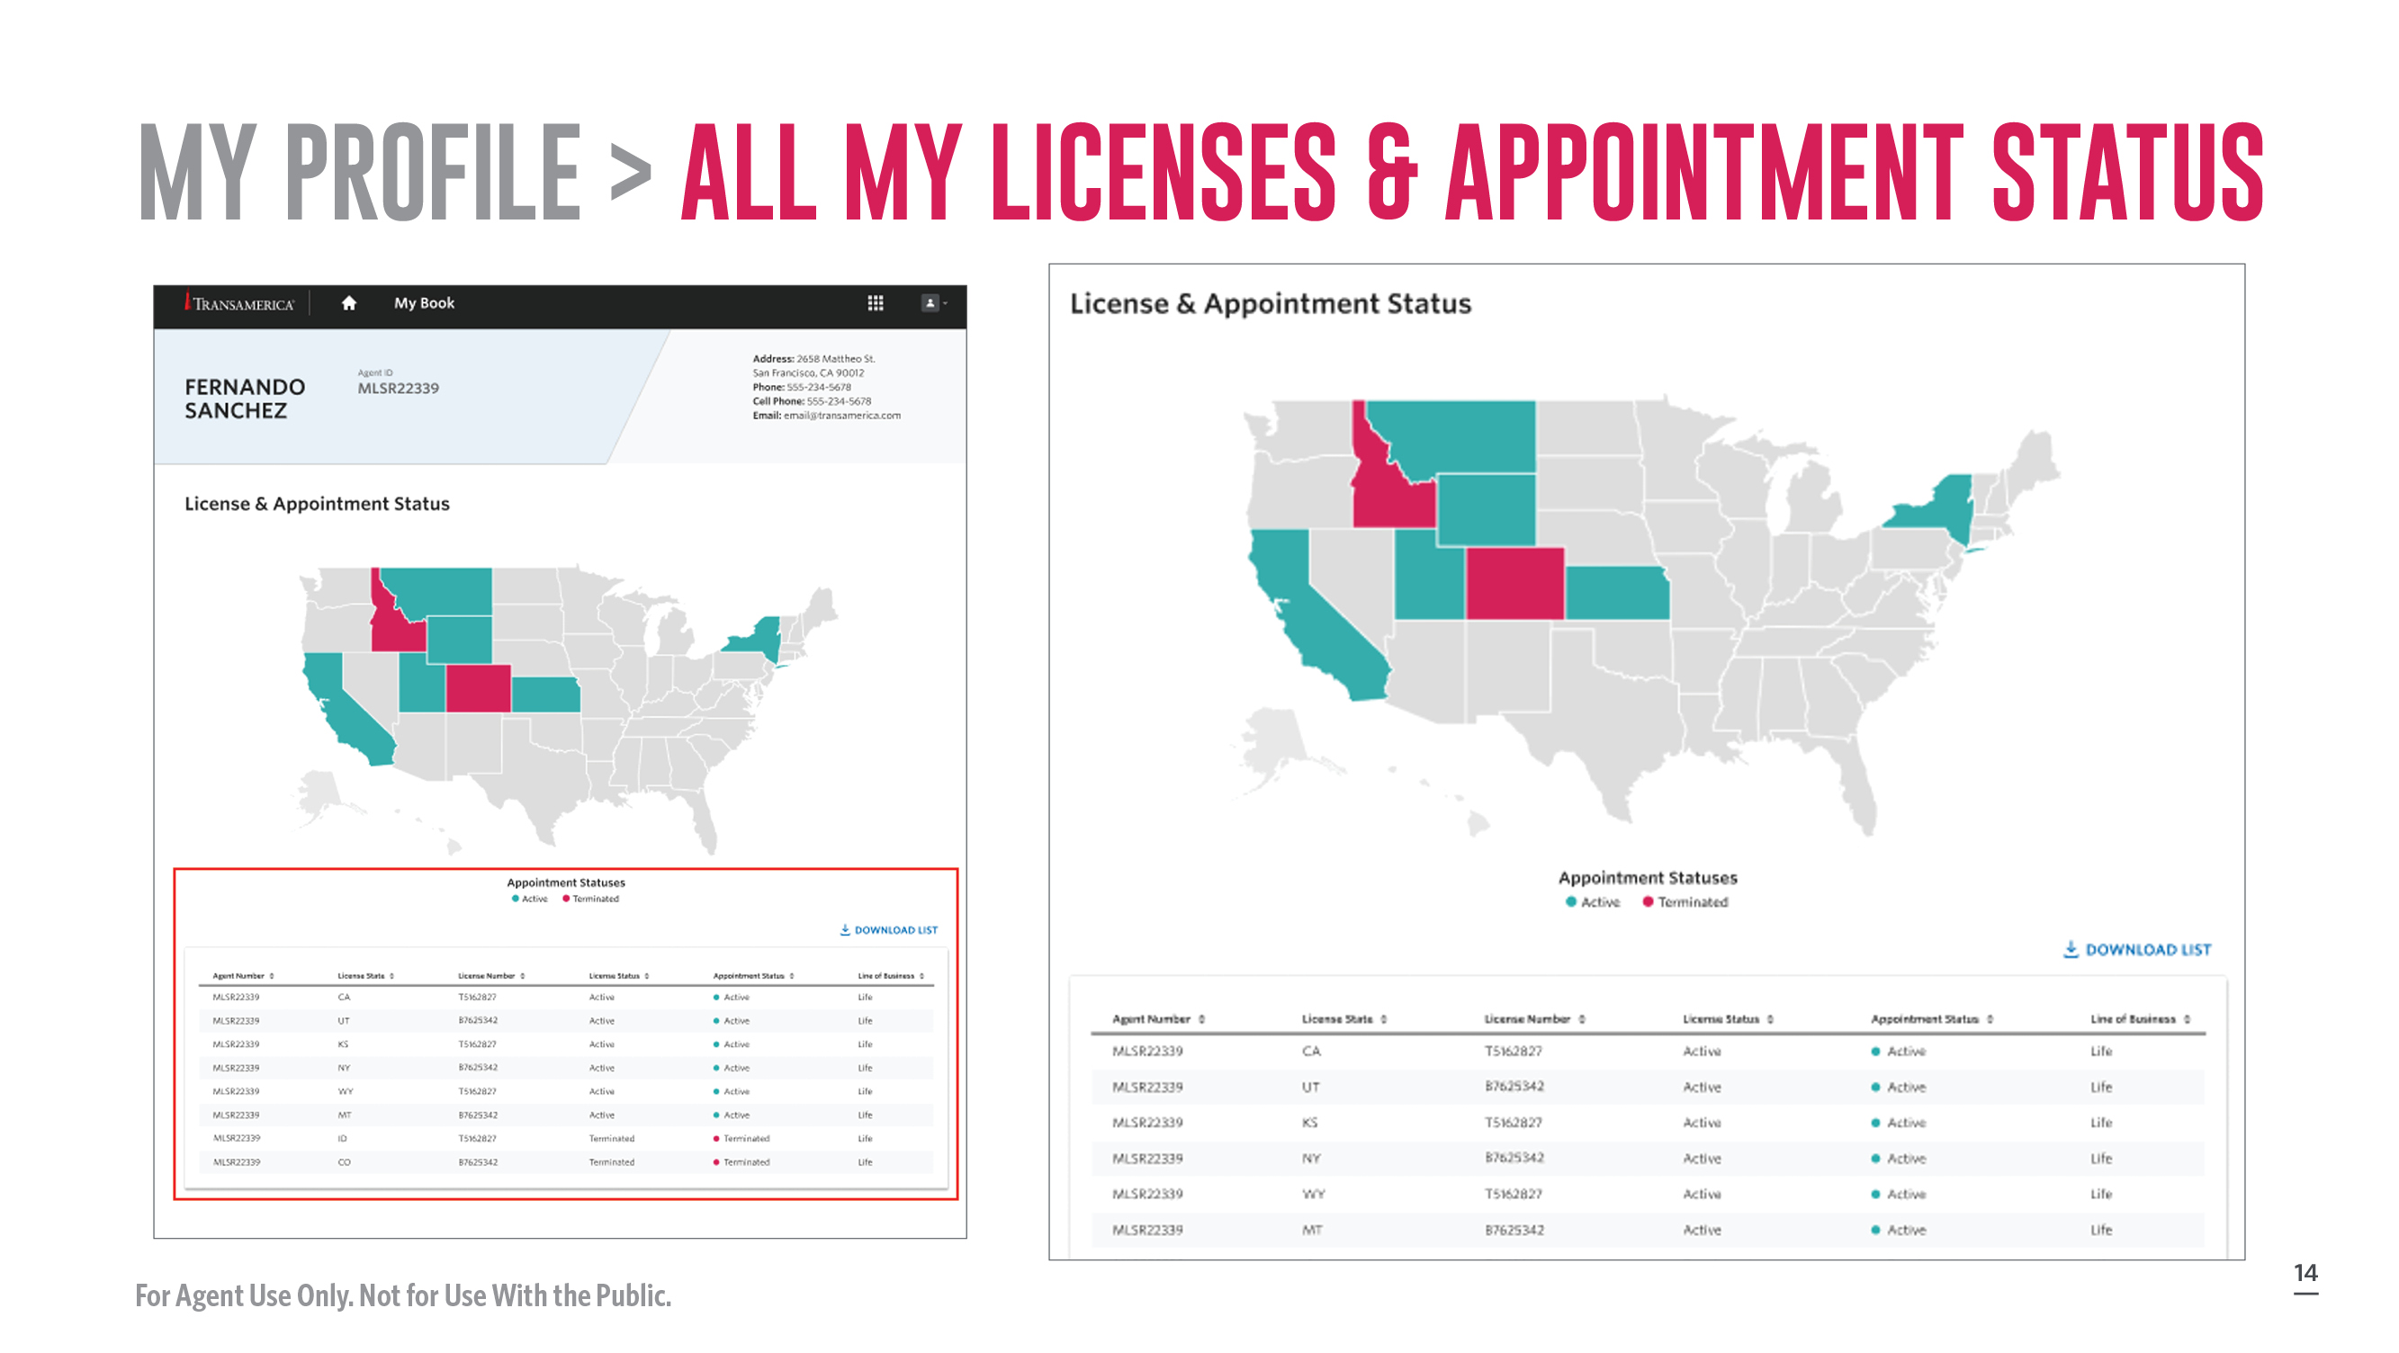
Notes:
[Review slide]

Slide 16
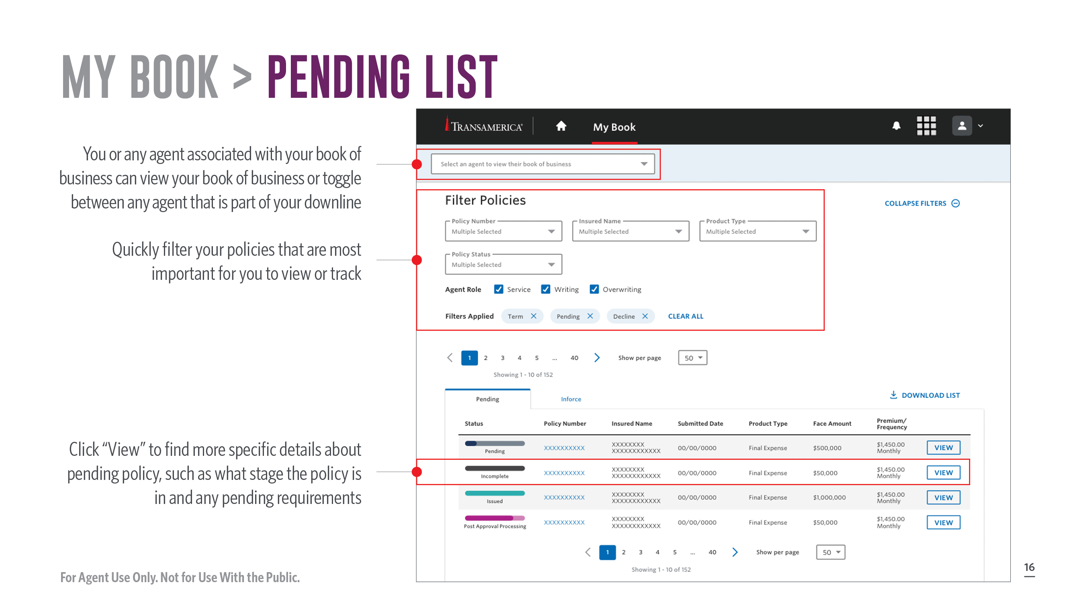
Notes:
Here you can:
You, or any agent associated with your book of business, can view your book of business or toggle between any agent that is part of your downline
Quickly filter your policies that are most important for you to view or track
Click “View” to find more specific details about pending policy, such as what stage the policy is in and any pending requirements
[Review slide]

Slide 17
Notes:
In the Status Tracker you can:
Track your policy with real-time updates on pending requirements, underwriting decisions, and policy delivery
See your required actions versus activity Transamerica is taking for pending requirements
Easily upload documents to fulfill any pending requirements
[Review slide]

Slide 18
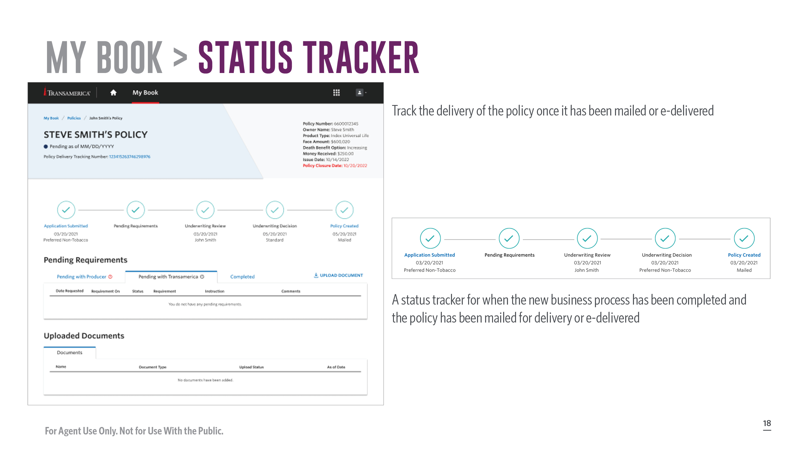
Notes:
You can track when your new business process has been completed and if the policy has been mailed for delivery. You can even track the delivery of the policy after it’s been mailed.
[Review slide]

Slide 19
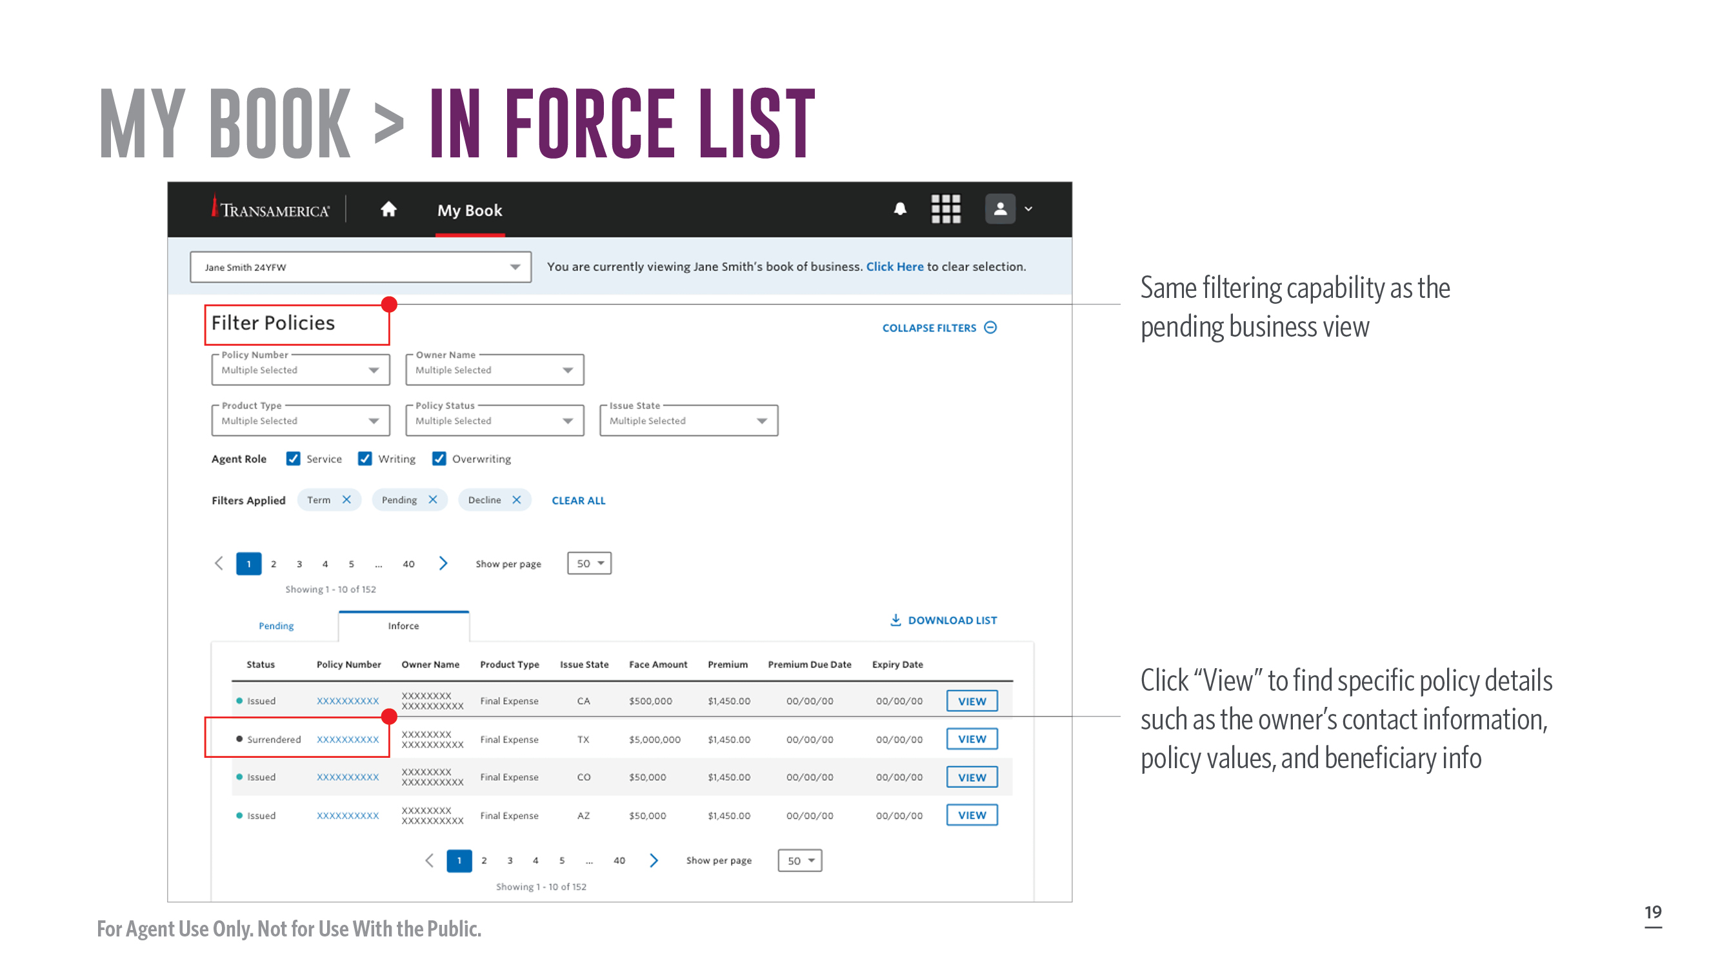
Notes:
For in force policies, you have the same filtering capability as the pending business view. Simply click “View” to find specific details about the policy such as the owner’s contact information, policy values, and beneficiary information.
[Review slide]

Slide 20
Notes:
Now let’s look at In Force Policies found under “My Book.”

Slide 21
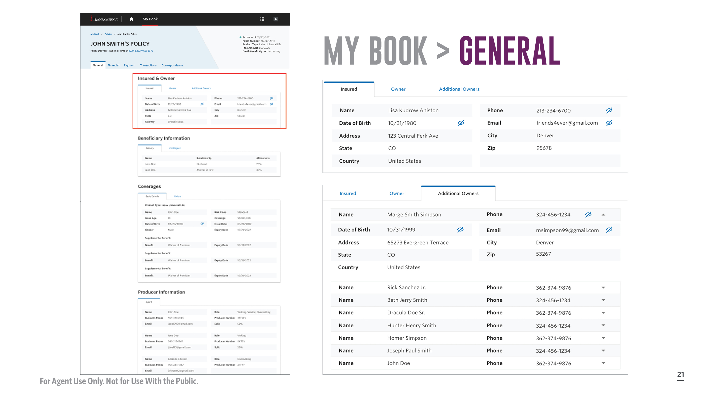
Notes:
Opening up a client’s policy reveals all the information you’d ever likely need such as who the insured and owner is, beneficiaries, coverages, and more.
[Review slide]

Slide 23
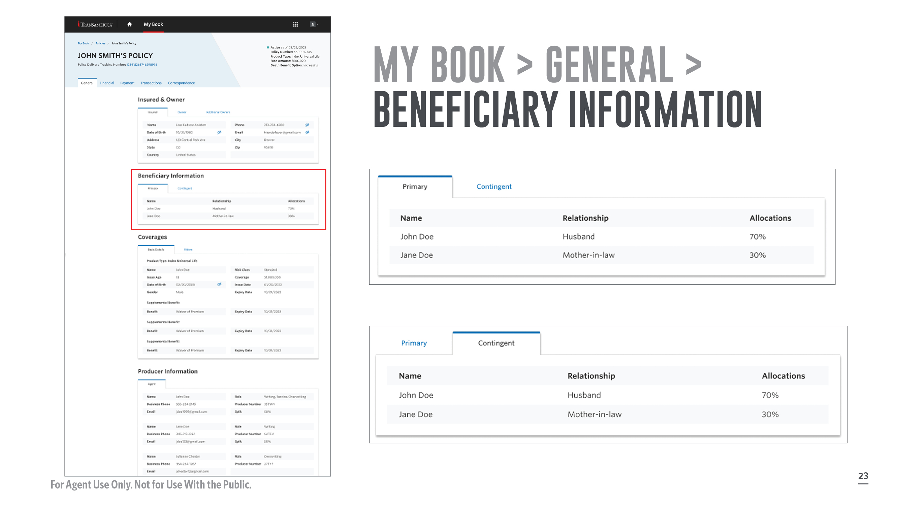
Notes:
Here is the beneficiary information.
[Review slide]

Slide 24
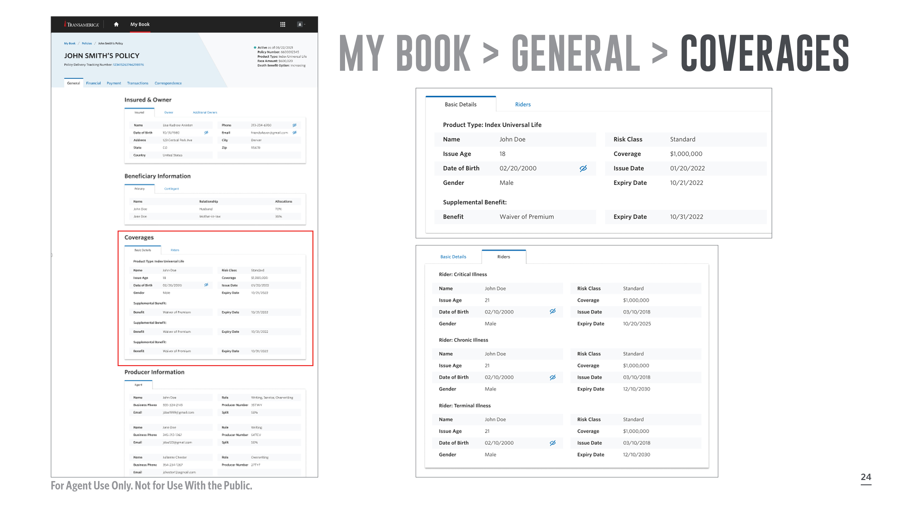

Slide 25
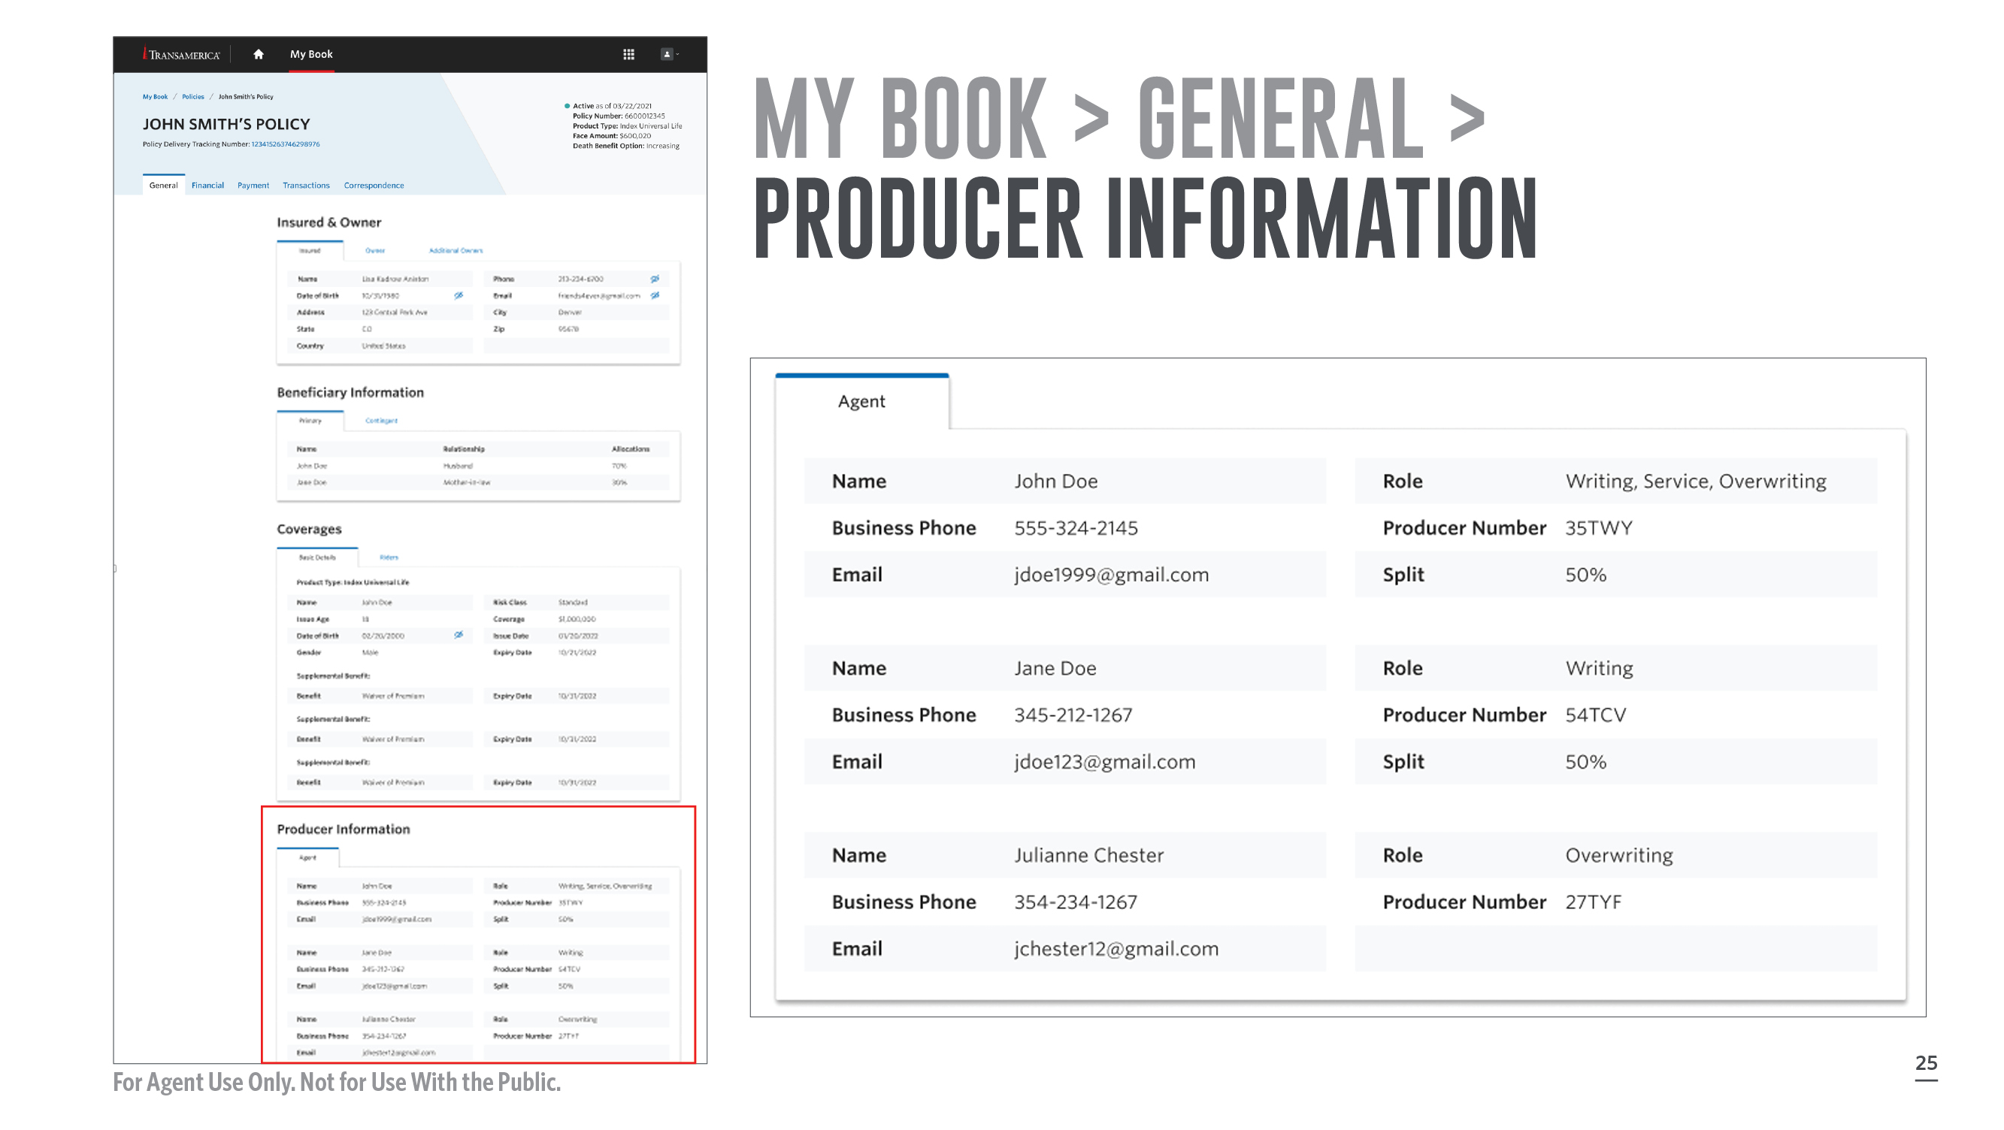
Notes:
And you’ll find producer information at the bottom.
[Review slide]

Slide 27
Notes:
Now let’s look at the wealth of financial information that’s available with Transamerica Life Access.

Slide 28
Notes:
Take a quick look at important policy values, such as available cash value and loan/withdrawal amounts.
[Review slide]

Slide 29
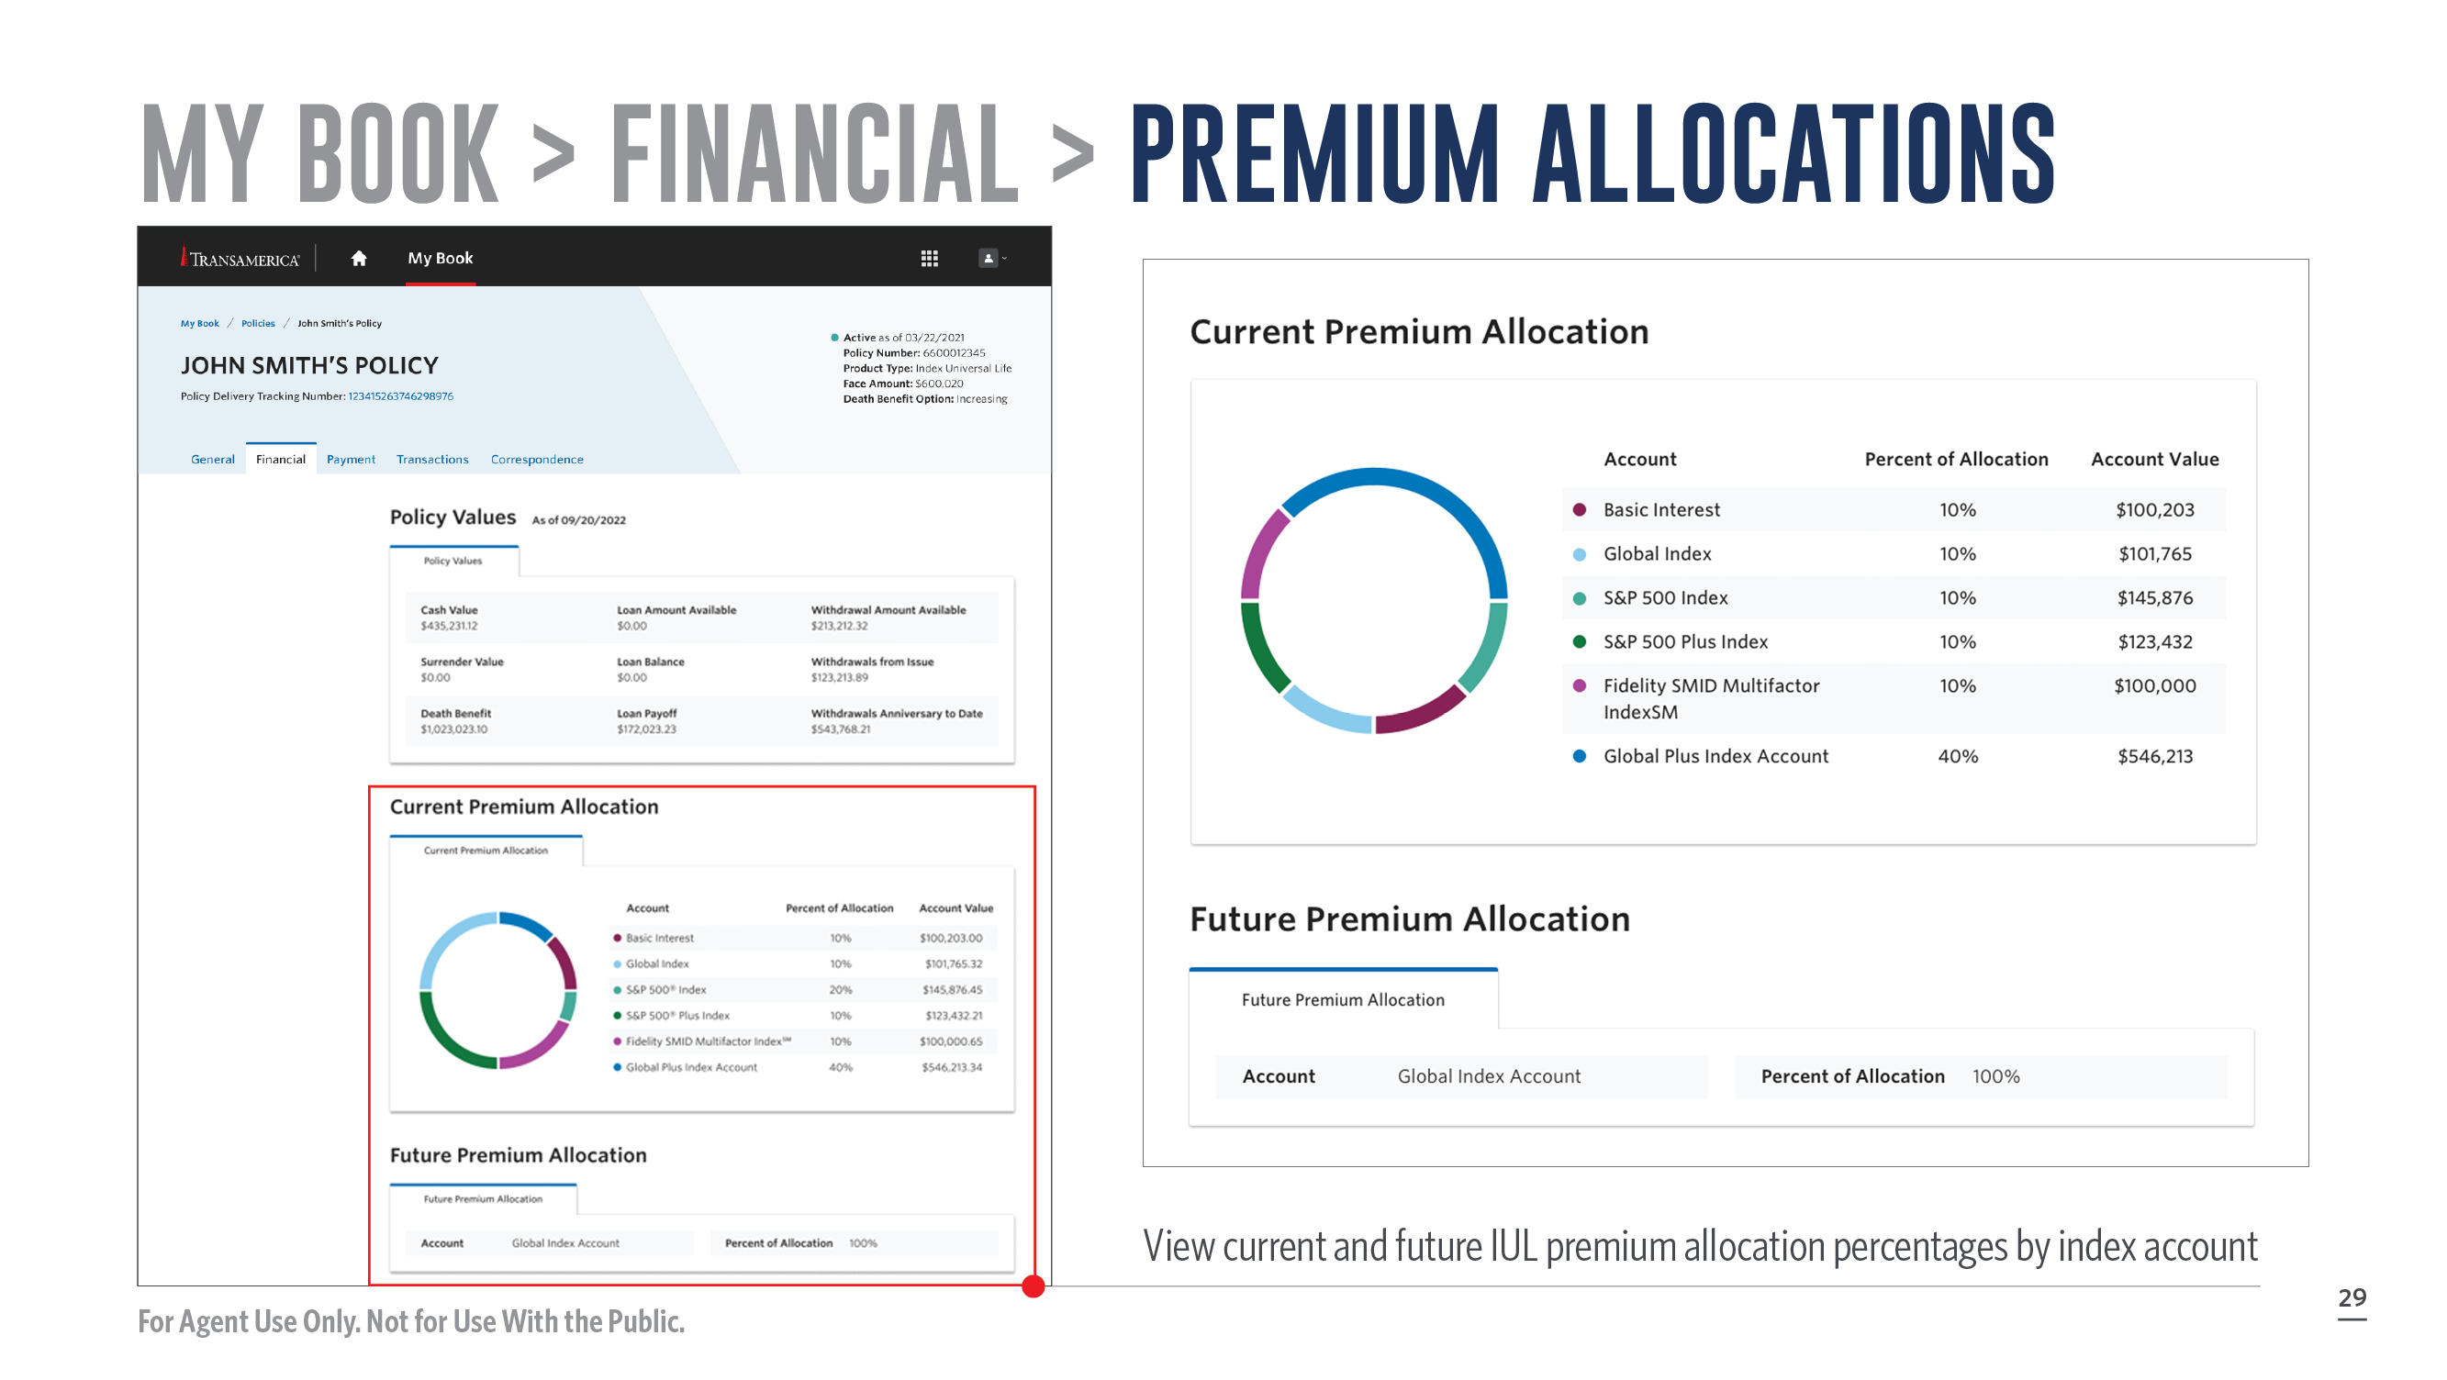
Notes:
Below that you can see the current premium allocation.
[Review slide]

Slide 30
Notes:
Also under My Book, you’ll find the payment information.

Slide 31
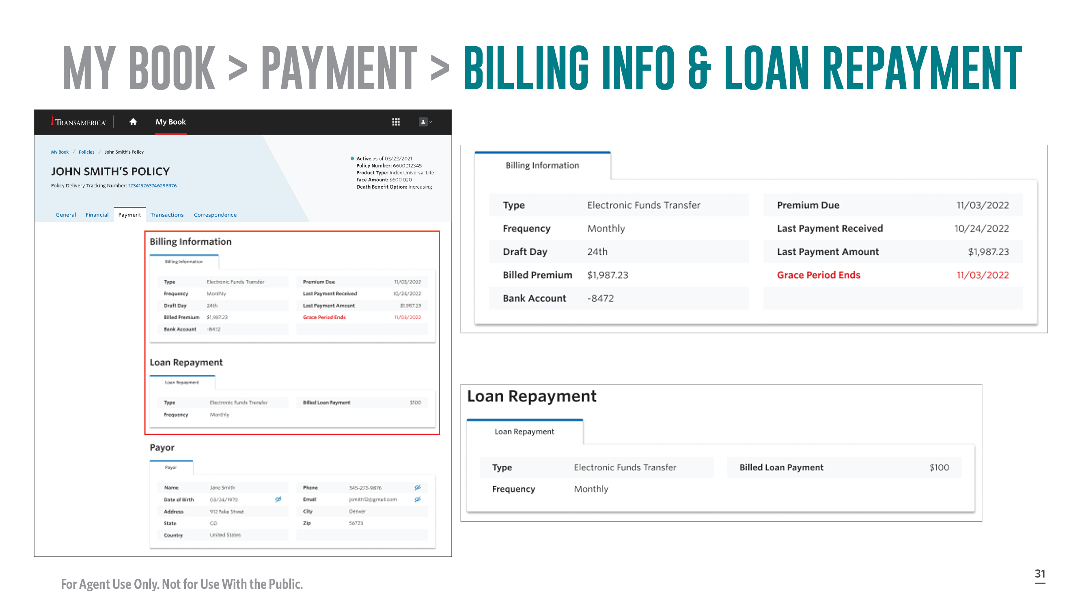
Notes:
View the details of billing information such as premium, frequency, or draft day.
[Review slide]

Slide 32
Notes:
Navigate to the bottom to view payer details.
[Review slide]

Slide 33
Notes:
Additionally, you have the ability to view transactions.

Slide 34
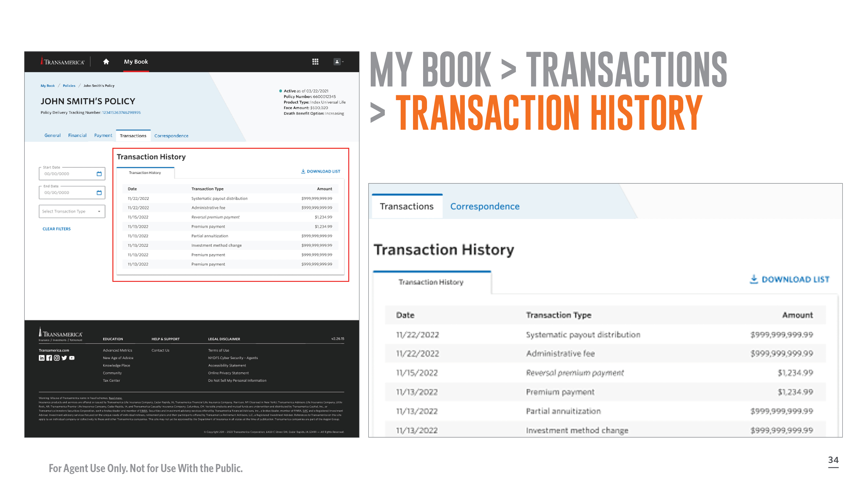
Notes:
Review the transaction history from the last two years.
[Review slide]

Slide 35
Notes:
You can view any correspondence that has taken place as well.

Slide 36
Notes:
[Review slide]

Slide 37
Notes:
Need more info? We have a number of resources to help you utilize Life Access to the fullest.

Slide 38
Notes:
Feel free to take a minute to download any of these resources using your device’s camera.

Slide 39
Notes:
Thank you for your time today. I hope you’re excited about using Transamerica Life Access to make your life and your business easier. I’m now happy to answer any questions you may have.

