Slide 1


Slide 2
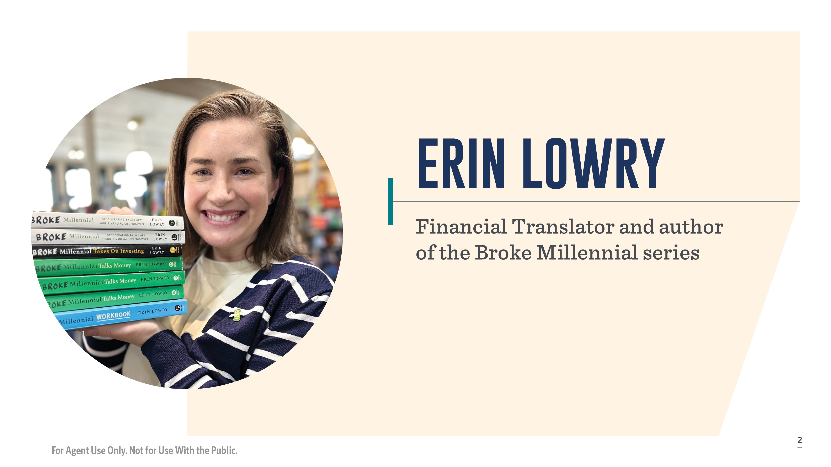
Notes:
I'm Erin Lowry, a proud 34-year-old Millennial, which really does put me smackdab in the middle of the generation.
I created Broke Millennial in January of 2013 and it all started as a blog. I wanted to create a space to write about my own adventures with money as well as help my fellow broke millennials figure out how to get their financial lives together.
As the blog grew, so too did opportunities to expand my work. I started getting media and writing opportunities and eventually ended up writing a series of three books and one workbook.
These days, I consider myself a financial translator. My job is to interview and talk with experienced, educated financial professionals and distill their knowledge into something that's digestible and relatable to your average millennial.
Most of the books reference life insurance in some way, especially because I see it as a critical, but often overlooked or disregarded part of someone’s financial plan. Life insurance is not my area of expertise, but helping people navigate tough money talks certainly is.
As a financial translator, author, and speaker – I love difficult conversations. There are few topics more awkward for people than talking about the intersection of death and money. Now, before we get into becoming fluent in Speaking Millennial (with a side of conversational Gen Z), let’s have a quick refresher on the generations…

Slide 3
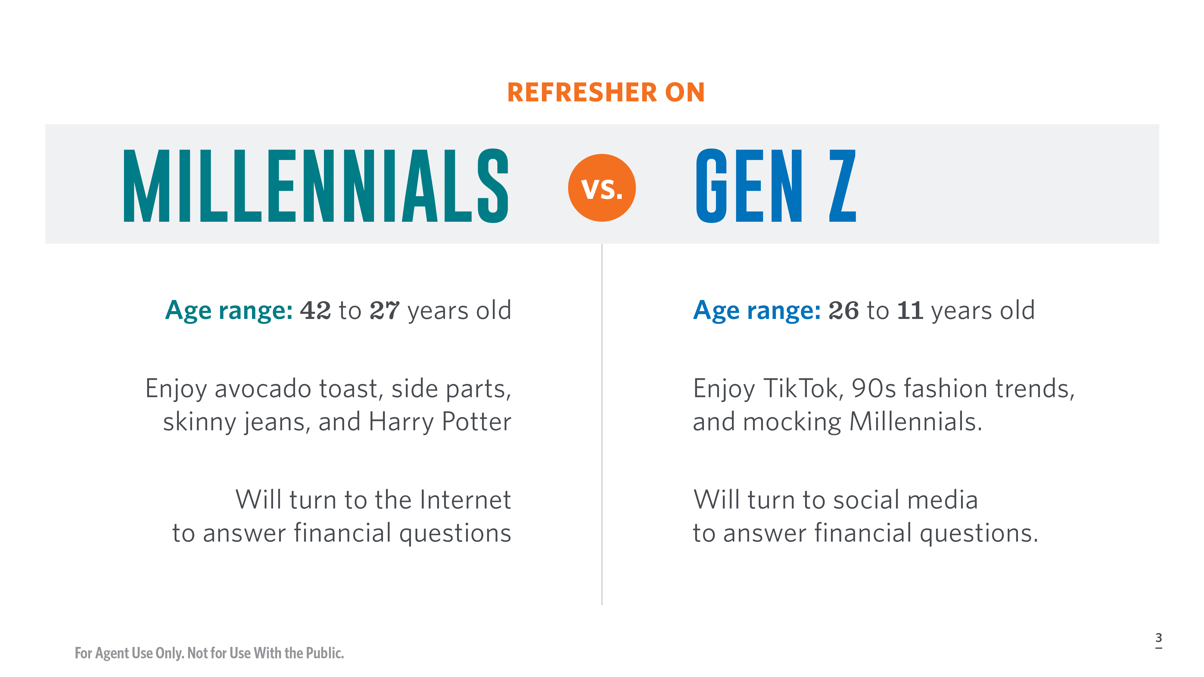
Notes:
Millennials still seem to draw a lot of ire from older generations, especially Boomers, but it’s important to remember that we’re not the youthful generation anymore. We’re the ones adding retinol to our nighttime skincare routines, stressing about how to balance the cost of raising children, funding our retirements, and wondering if our parents are going to be okay. Heck, the oldest millennials can sue for workplace age discrimination!
[Overview table on difference between the generations.]
53 million Millennials and Gen-Zers in the U.S. today need, or need more, life insurance, according to the 2023 LIMRA Barometer Study. I was one of them until about two months ago.

Slide 4
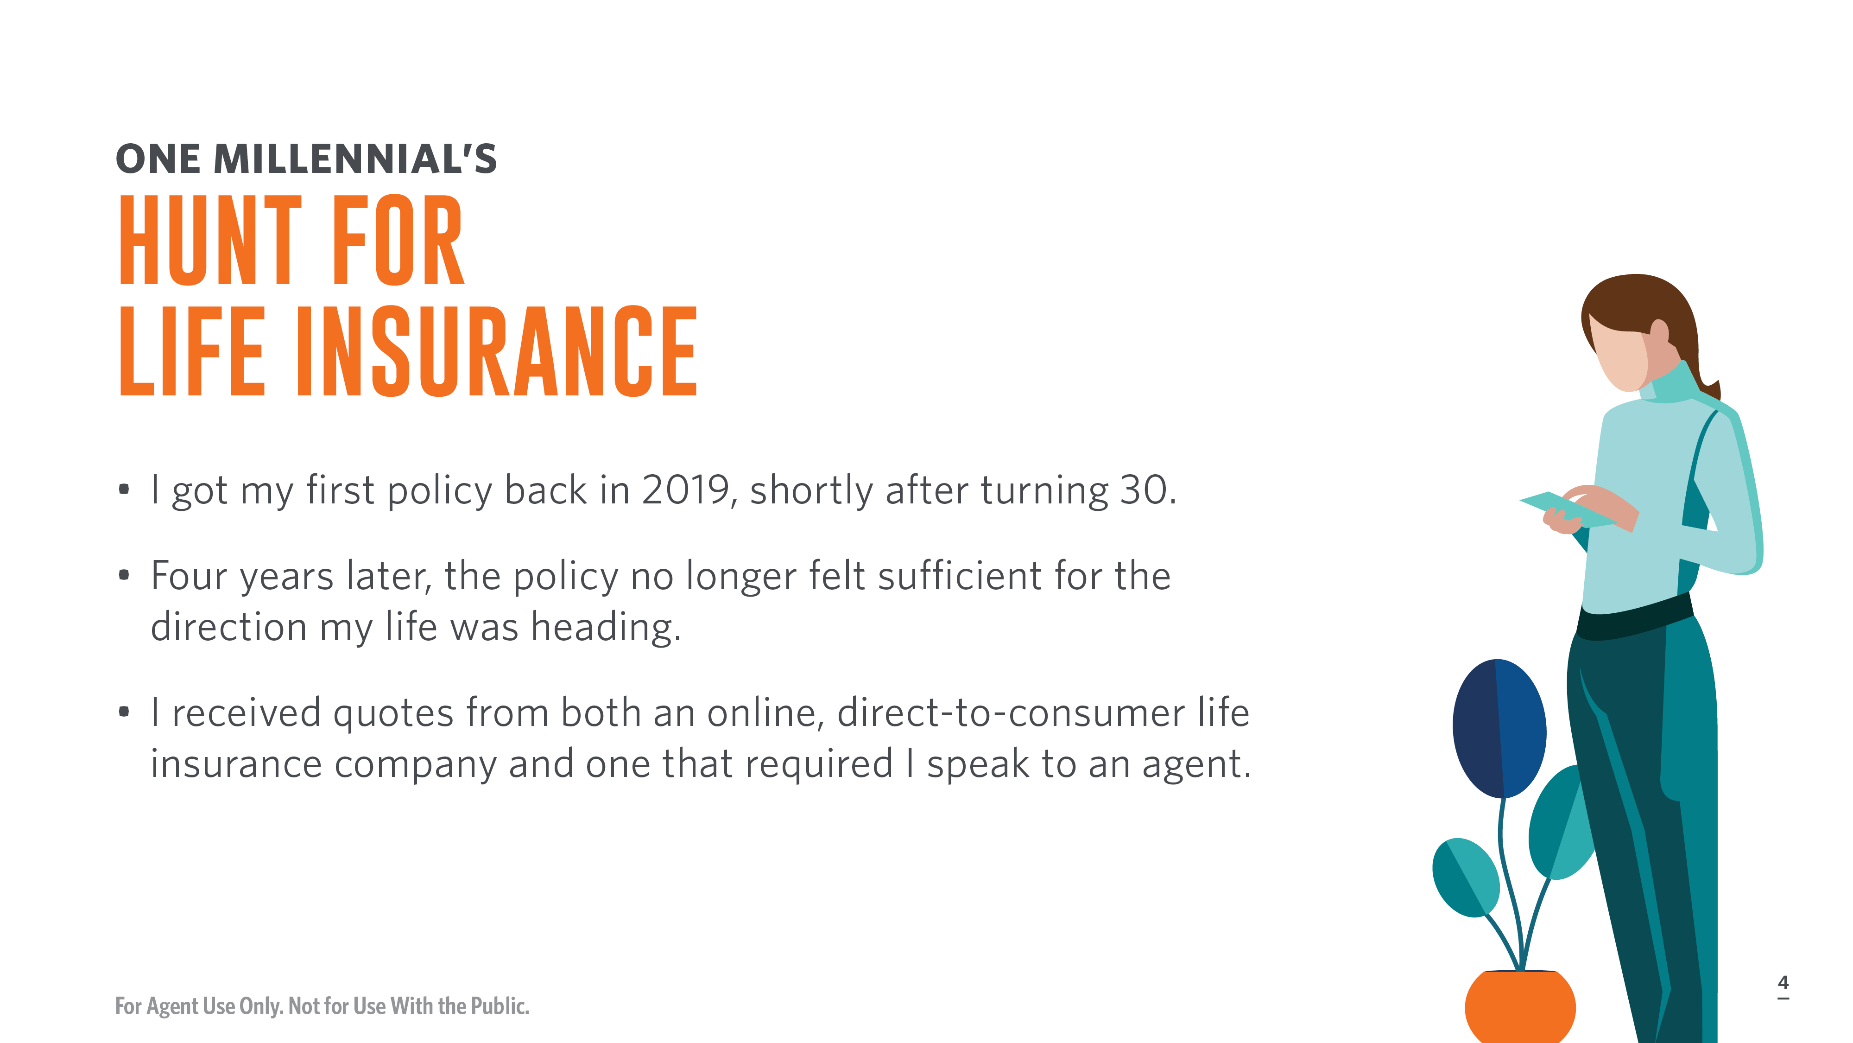
Notes:
I got my first life insurance policy back in 2019. It was a year after I got married and, unfortunately for my monthly payment, a couple months after I turned 30. It was a 30-year term life insurance policy for $500,000. At the time I owned no property, had no debt, and while I was the breadwinner, my husband had a stable job that would provide him enough security if I died.
The process for securing my first policy was simple. I used a direct-to-consumer life insurance company. I didn’t need a medical exam and the entire process happened online. Approval was quick, I accepted the policy, and I set up my automatic monthly payments within about 48 hours of applying. For years, I rested easy knowing that my husband would be financially secure if something were to happen to me.
Then, as it tends to do, my life changed. My husband and I decided to buy our first home together and began having conversations about expanding our family. While most people would probably start creating filters on Zillow or dreaming about baby names, I immediately focused on the state of our finances. One vulnerability was both of our life insurance policies. My policy was enough for the life we currently led but adding a home and/or children to the equation would immediately make it insufficient.
My 34th birthday was on the horizon, so I knew that acting fast would lock in a better premium. I started doing my research and decided to do some price comparison shopping. I ended up returning to the company that held my existing policy and applied for an entirely new policy. I also reached out to another company that didn’t provide an online option and instead required I speak to an agent. An agent who told me that it was good I’d called a week before my 34th birthday because it meant I could lock in an offer at the age of 33 instead of 34. Then I promptly freaked her out with my directness in answering, “What made you decide to contact us about a life insurance policy?”
I told her that I was considering getting pregnant and that I knew I’d likely receive a better rate pre-pregnancy, but that given the maternal mortality rate in the United States, it made me feel more comfortable to have adequate life insurance before trying to conceive. There was a pregnant pause after that line…
This time I didn’t get to escape the medical exam and instead had a fun-filled morning of fasting, no coffee, and blood draws. However, the fact that the medical exams came to me, and one even granted me online access to my results, made an unpleasant process simple.
A week or so later I received approvals from both companies and made my decision.

Slide 5
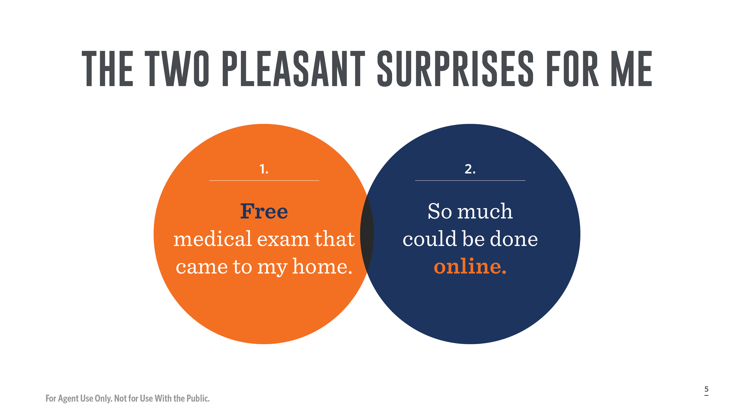
Notes:
Even as a person who talks and writes about money professionally, I definitely kicked the can down the road for a while when it came to increasing my life insurance coverage. I knew I needed to increase it for at least six months before I initiated the process. And I’m someone who is far more comfortable discussing death and focused on my personal finances than the average 30-something. It’s hard to determine exactly what made me stall for so long.
One part was just the unknown of how long it would take and setting aside the handful of hours to simply get the task done. The other was stressing about whether or not I would need a medical exam. If only I’d known just how smooth the medical exam process was, then I maybe could’ve gotten an even lower rate by getting a new policy six months prior! You know that paramed exams are free to clients, but your client might not know that it’s free and a smooth process. There are life insurance options that don’t require medical exams and that’s a major selling point in their sales pitch, so it can confuse a consumer who is unfamiliar with the process into thinking the medical exam is a cumbersome part of the process. Cost is another concern. Healthcare is so expensive in the United States and frankly we’re conditioned to think any medical visit will result in a surprise bill. Why would the average consumer believe that a medical exam would be free and not bundled into the cost of sign-up or result in a bill if you don’t take the policy?
I knew that medical exams were often a part of the underwriting process, but I had no idea that someone was sent to your home and everything could be easily done on your schedule. I assumed the medical exam process would include me having to trek to some far-flung corner of New York City to go sit in a waiting room for hours at a doctor’s office, even with a scheduled appointment, and eat up half my day.
The fact that one of the companies even gave me direct access to my results with no strings attached felt like finding a healthcare cheat code. I could get a free medical exam and bloodwork results?! That's actually a fantastic marketing tool and can be particularly appealing to people who are coming to life insurance before a big life change like trying to conceive or just someone who hasn’t been to see their primary care physician for an annual physical in awhile! Would your average Millennial prefer an option with nonmedical underwriting? Of course. But understandably coverage amount or family medical history may necessitate a medical exam. Make it clear immediately that the exam comes to the client on their schedule. Send a one-sheet with information about the best way to prep for the exam, like don’t drink coffee and don’t do a rigorous workout prior. Anything to make the process as painless as possible, minus the fasting, which you can’t control, is critical. Plus, if the client can be granted access to the lab results, that’s truly another marketing tool to add to your belt.
The second appeal was that so much could be done online. Even the process that required connecting me to an agent was largely online and didn’t require going to meeting anyone face-to-face. And, I’ll admit, that when I accepted the policy, it was nice to be talking to someone on the phone about all of the particulars.

Slide 6
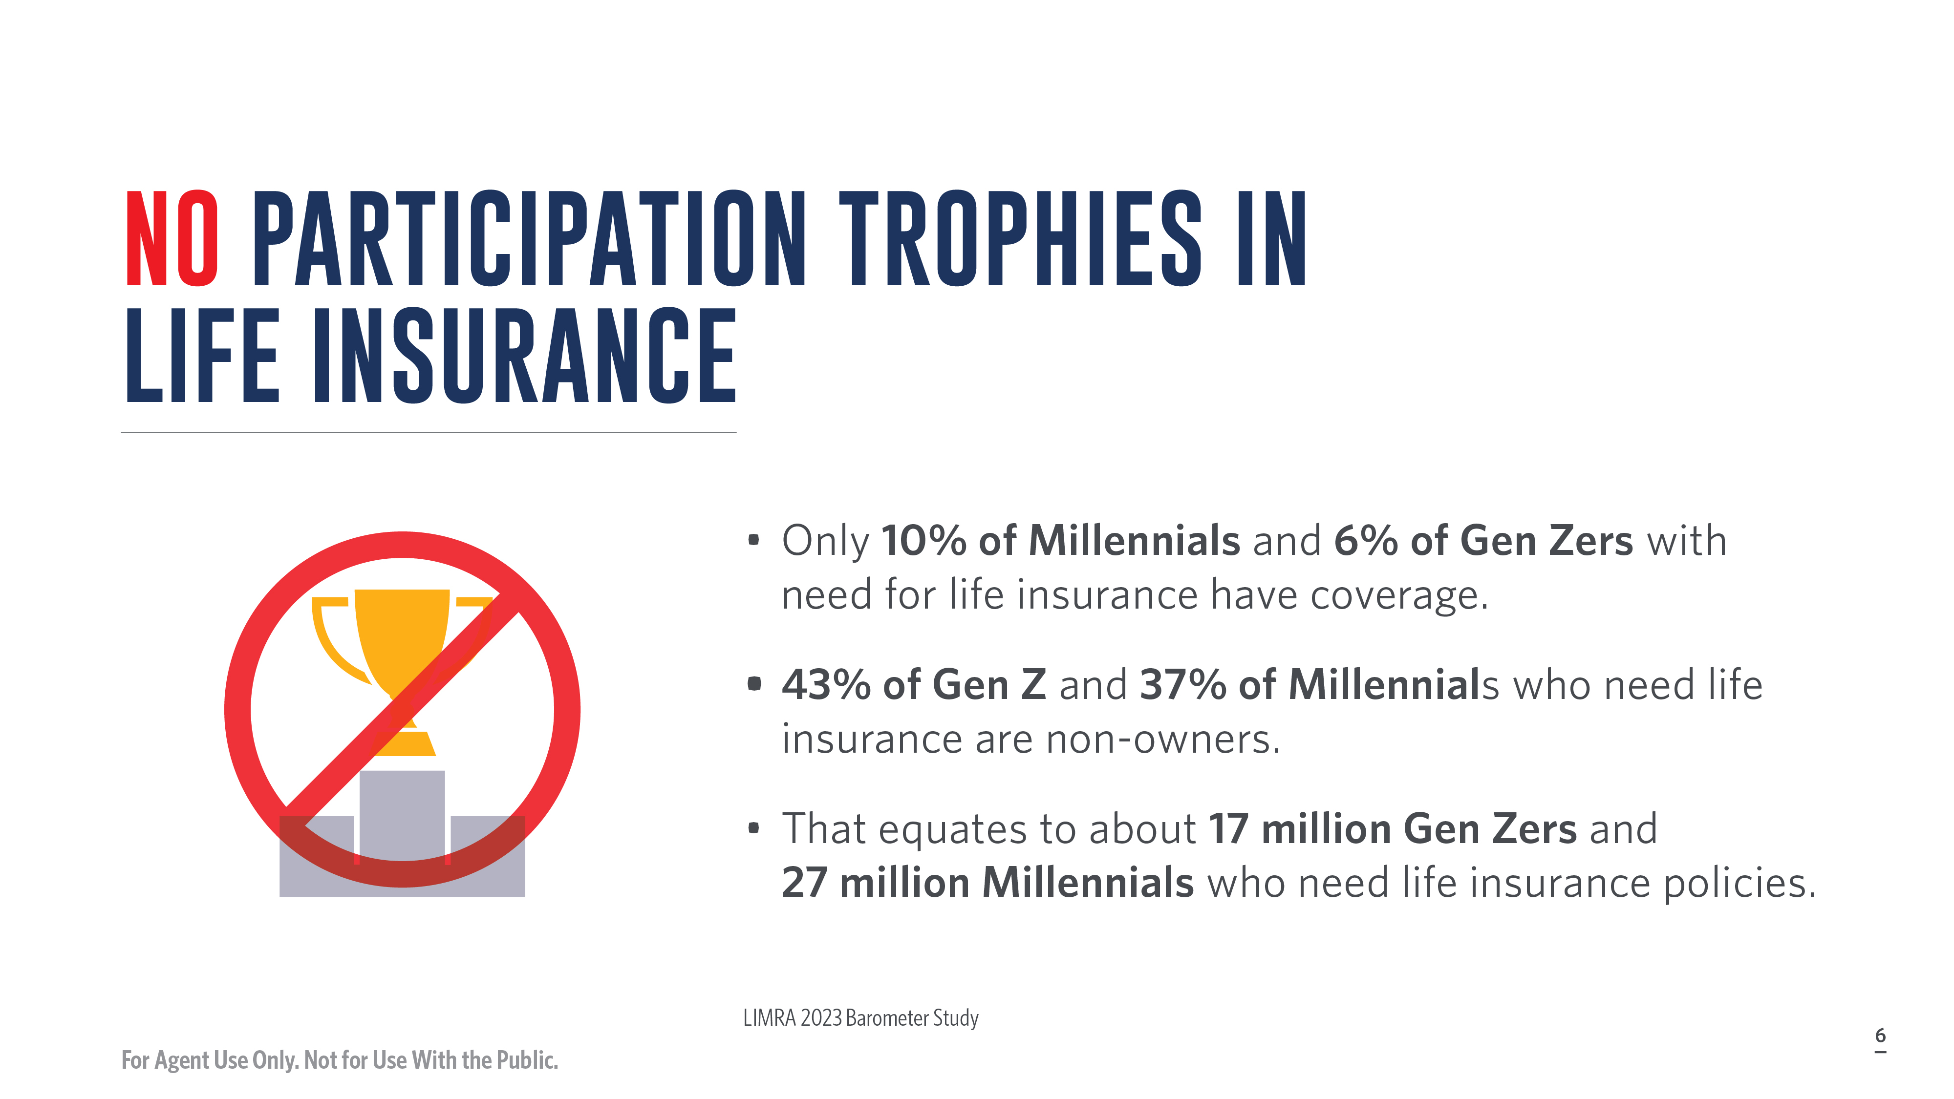
Notes:
A major problem is just how many millennials keep pushing off getting an initial policy or expanding their coverage, much like I did.
Only 10% of millennials and 6% of Gen Zs with a need for life insurance coverage are getting gold stars.
There are 27 million Millennials and 17 million Gen Zs who need life insurance policies and are non-owners.
As we all know, there are no participation trophies for acknowledging you need a policy. You either have coverage or you don’t.
So, what’s stopping people from taking the next step to get coverage?

Slide 7
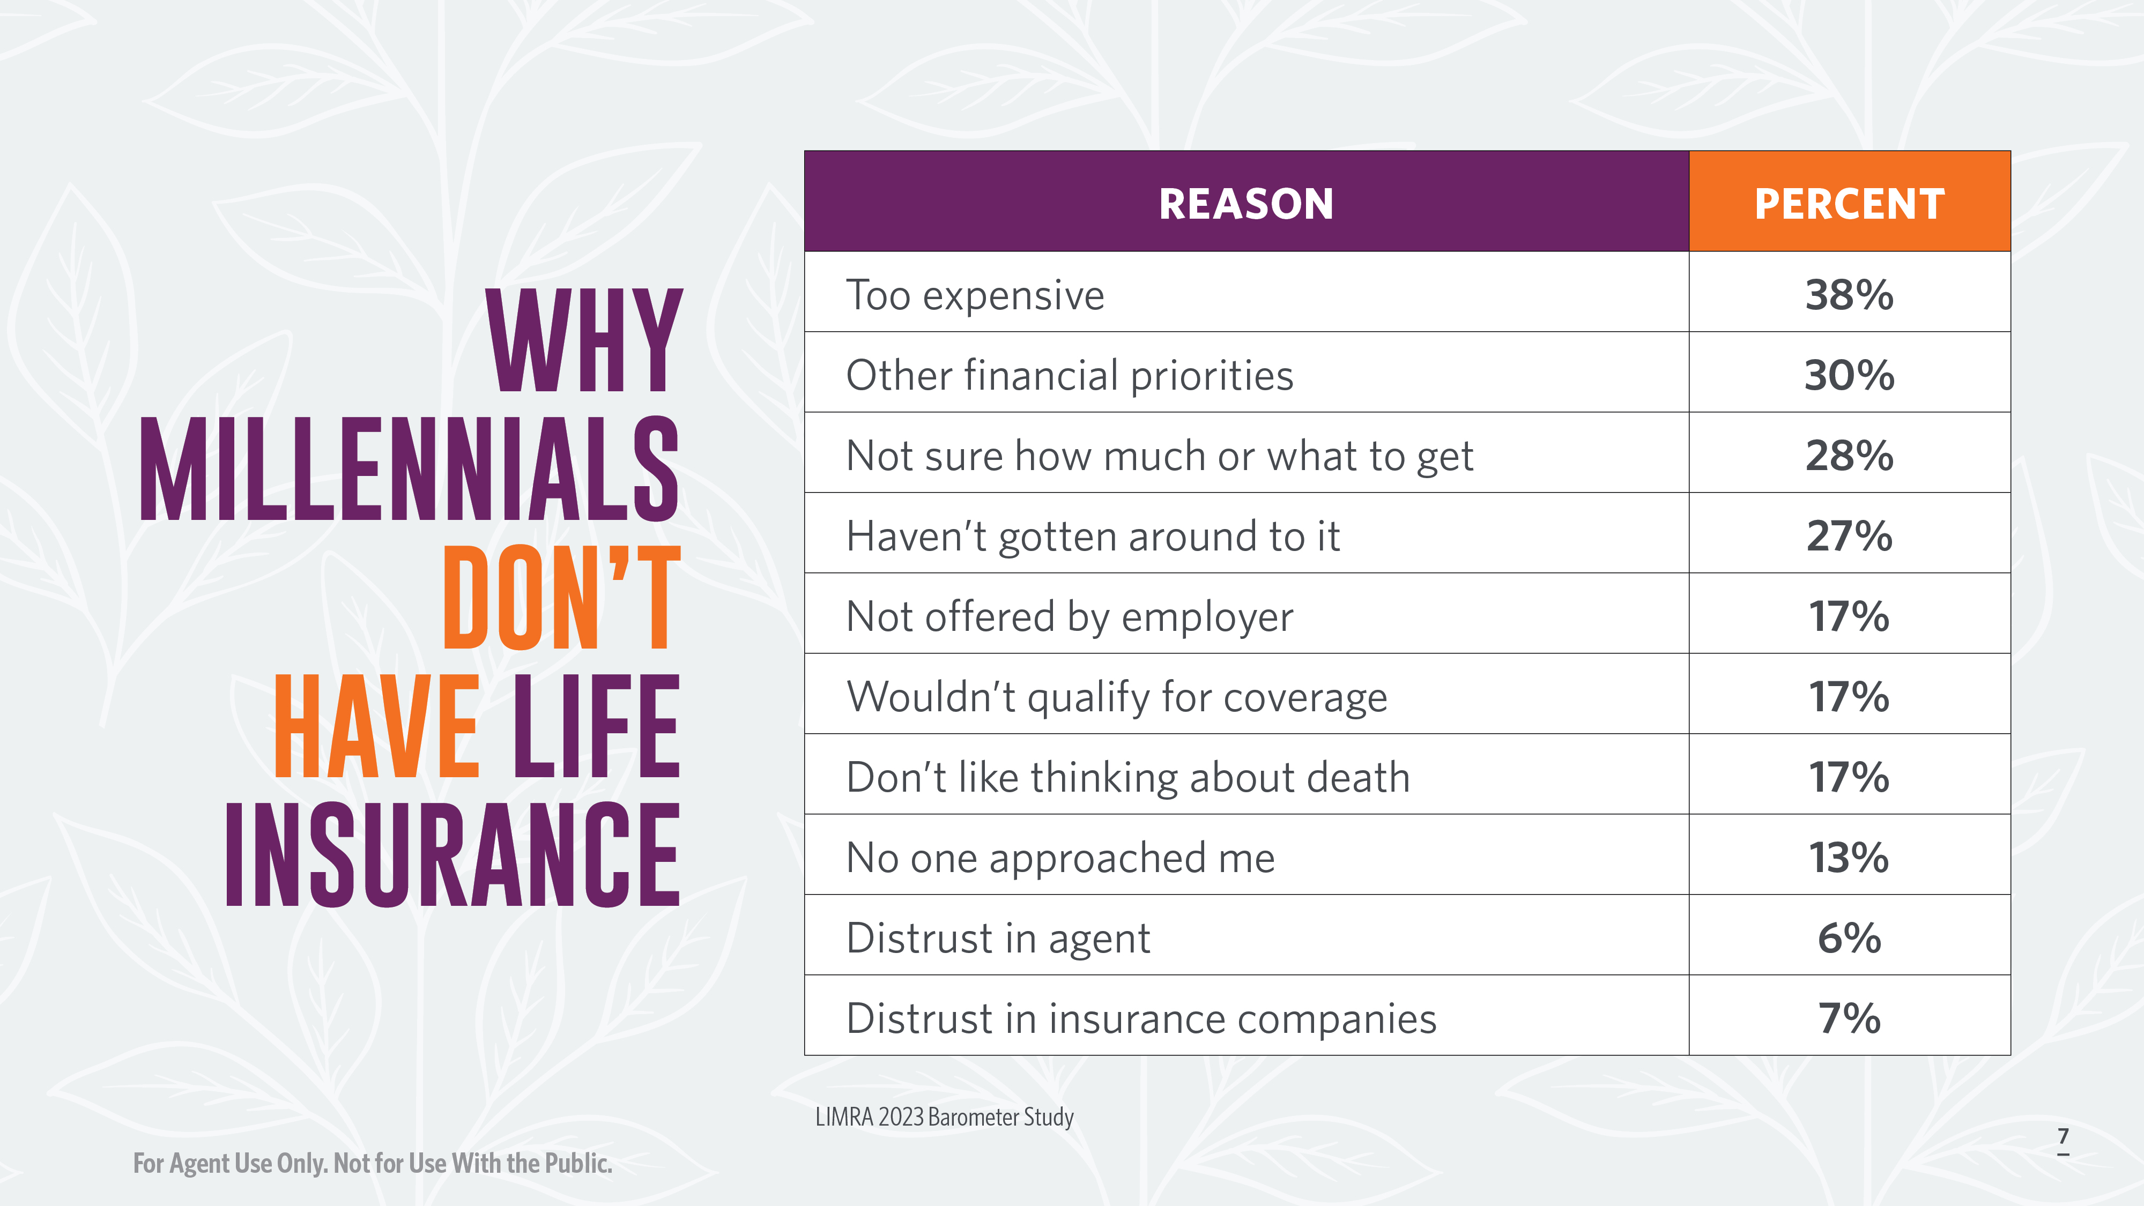
Notes:
The dominant reasons Millennials, and Gen Z, are under insured are:
1. Because it’s too expensive (or so they think)
2. They have competing financial priorities
3. They’re not sure how much or what kind of policy to get
and 4. They simply haven’t gotten around to it.
As you can see, there are plenty more reasons, but those are the dominate factors.
Three of these reasons are fairly easy for a life insurance agent to either debunk or contextualize in a way that motivates a potential client to get a policy. But competing financial priorities can be a doozy to go up against, especially as Millennials and Gen Z face the fact that federal student loan payments will resume in October. While life insurance is far more cost effective than plenty of people realize, elder Millennials, who are 38 to 42, may not have room in their budget for the cost of a policy with adequate coverage. Proper insurance could cost over $100 a month and that might be too much to stomach on top of student loan payments, a mortgage, contributing to a retirement fund, saving up an emergency fund, healthcare costs, auto loans, and possibly credit card debt.
While the 2023 Insurance Barometer study is helpful, I did decide to go straight to the source myself.

Slide 8
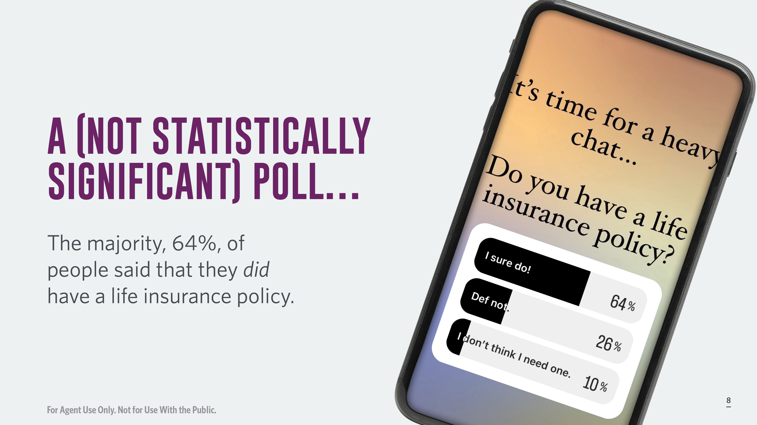
Notes:
I put this poll up in my Instagram stories at the end of August. Over 1,200 people responded and as you can see, the majority of my followers, who arguably may be more interested in financial literacy than your average millennial, did respond that they have a life insurance policy.
36% of respondents saying they don’t have a life insurance policy is 11% off from the LIMRA 2023 Barometer study. What concerns me most of that 36% are the 10% who say they don’t think they need one. It’s so common for people to believe they only need a policy if someone depends on their income. A major concern that we’ll discuss later.
Because first, I did have an important clarifying question for the 64% of people who have a policy.

Slide 9
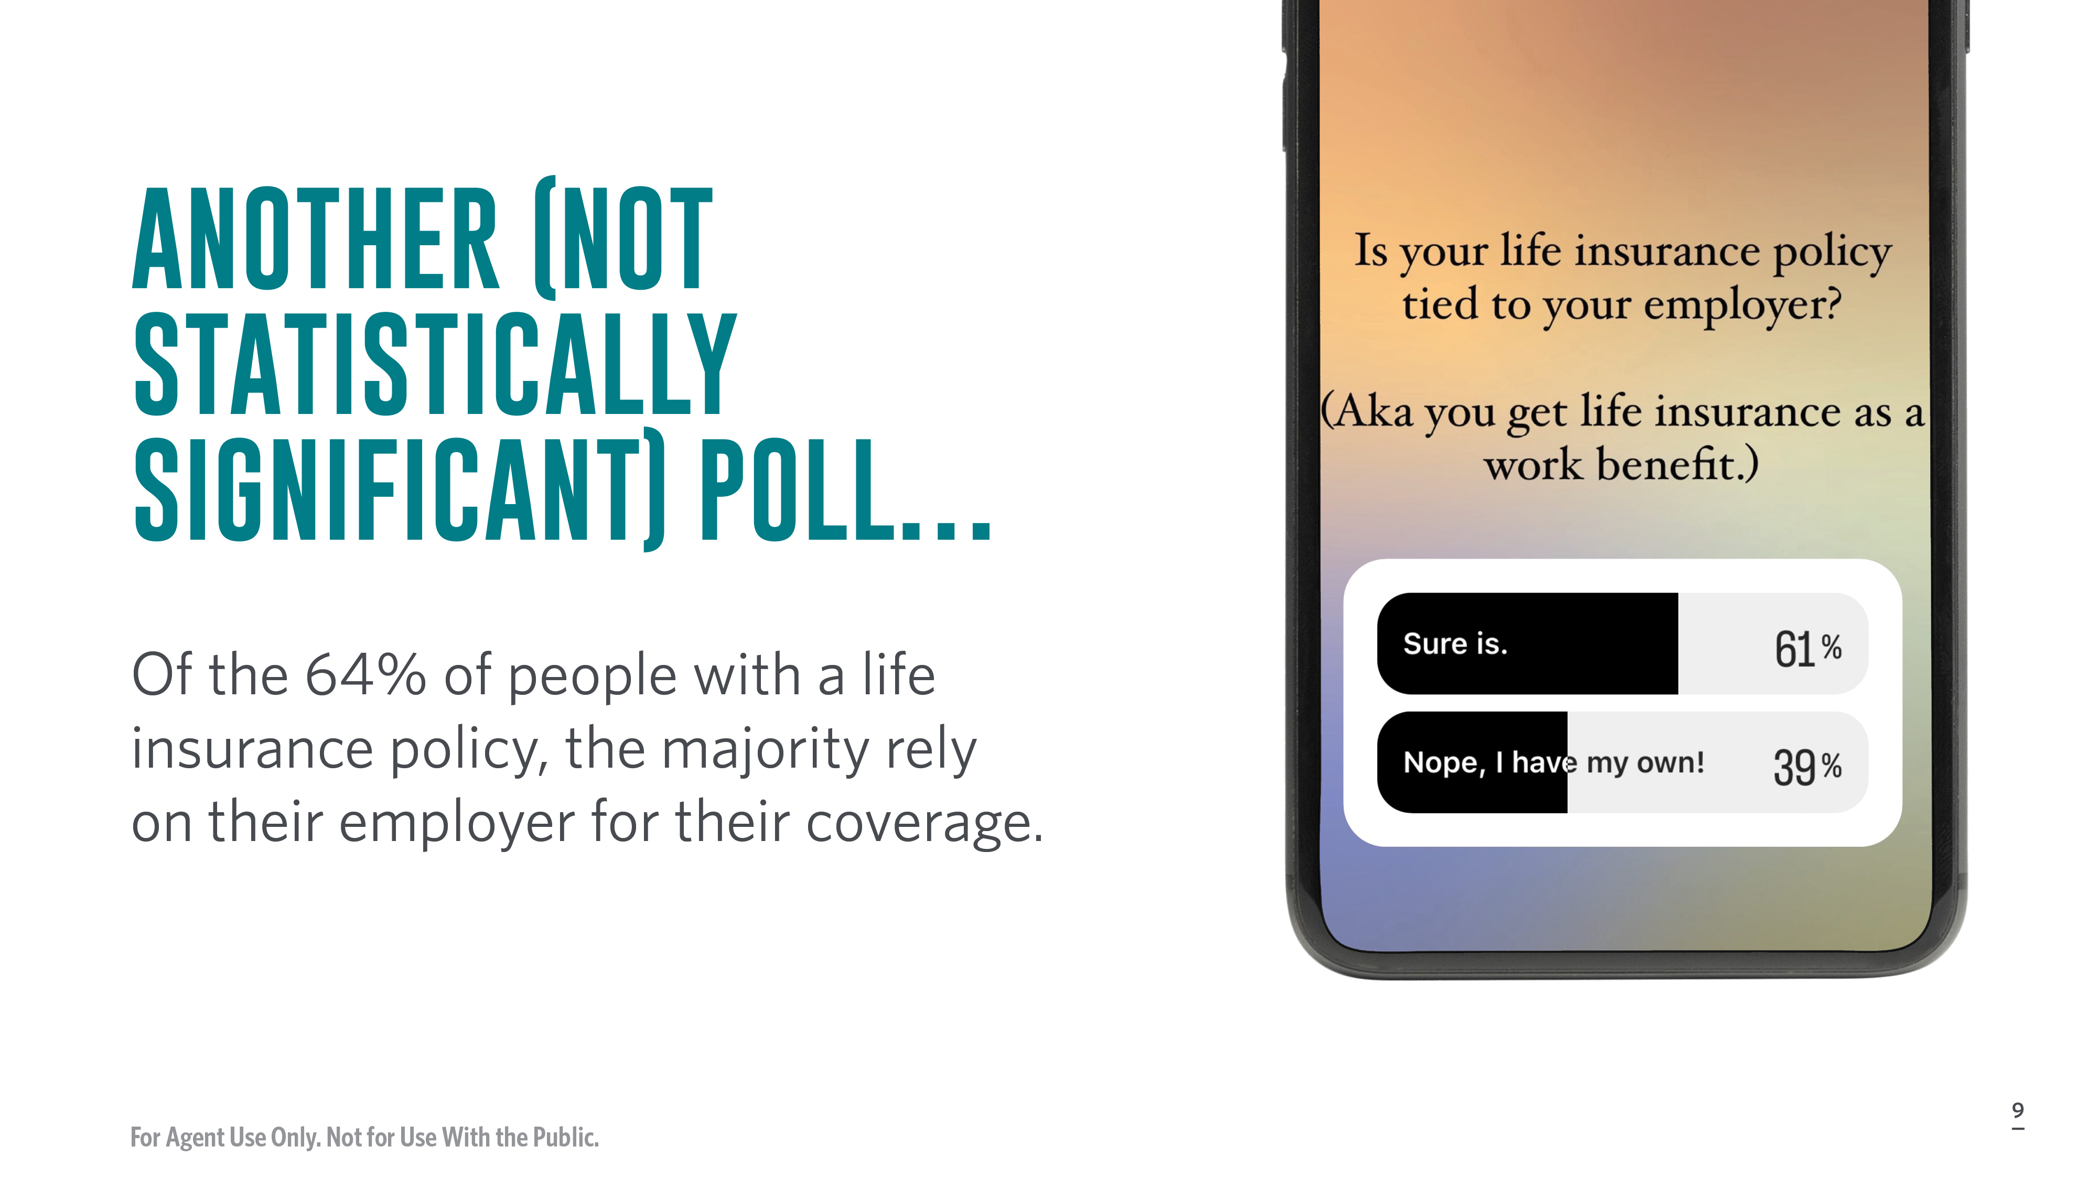
Notes:
Next, I asked if those with a life insurance policy had one that was tied to their employer. 1,166 people responded and the answer was about what I expected. That yes, 61% of people, have a life insurance policy as a workplace benefit. Only 39% reported having their own policy.
This is a problem.

Slide 10
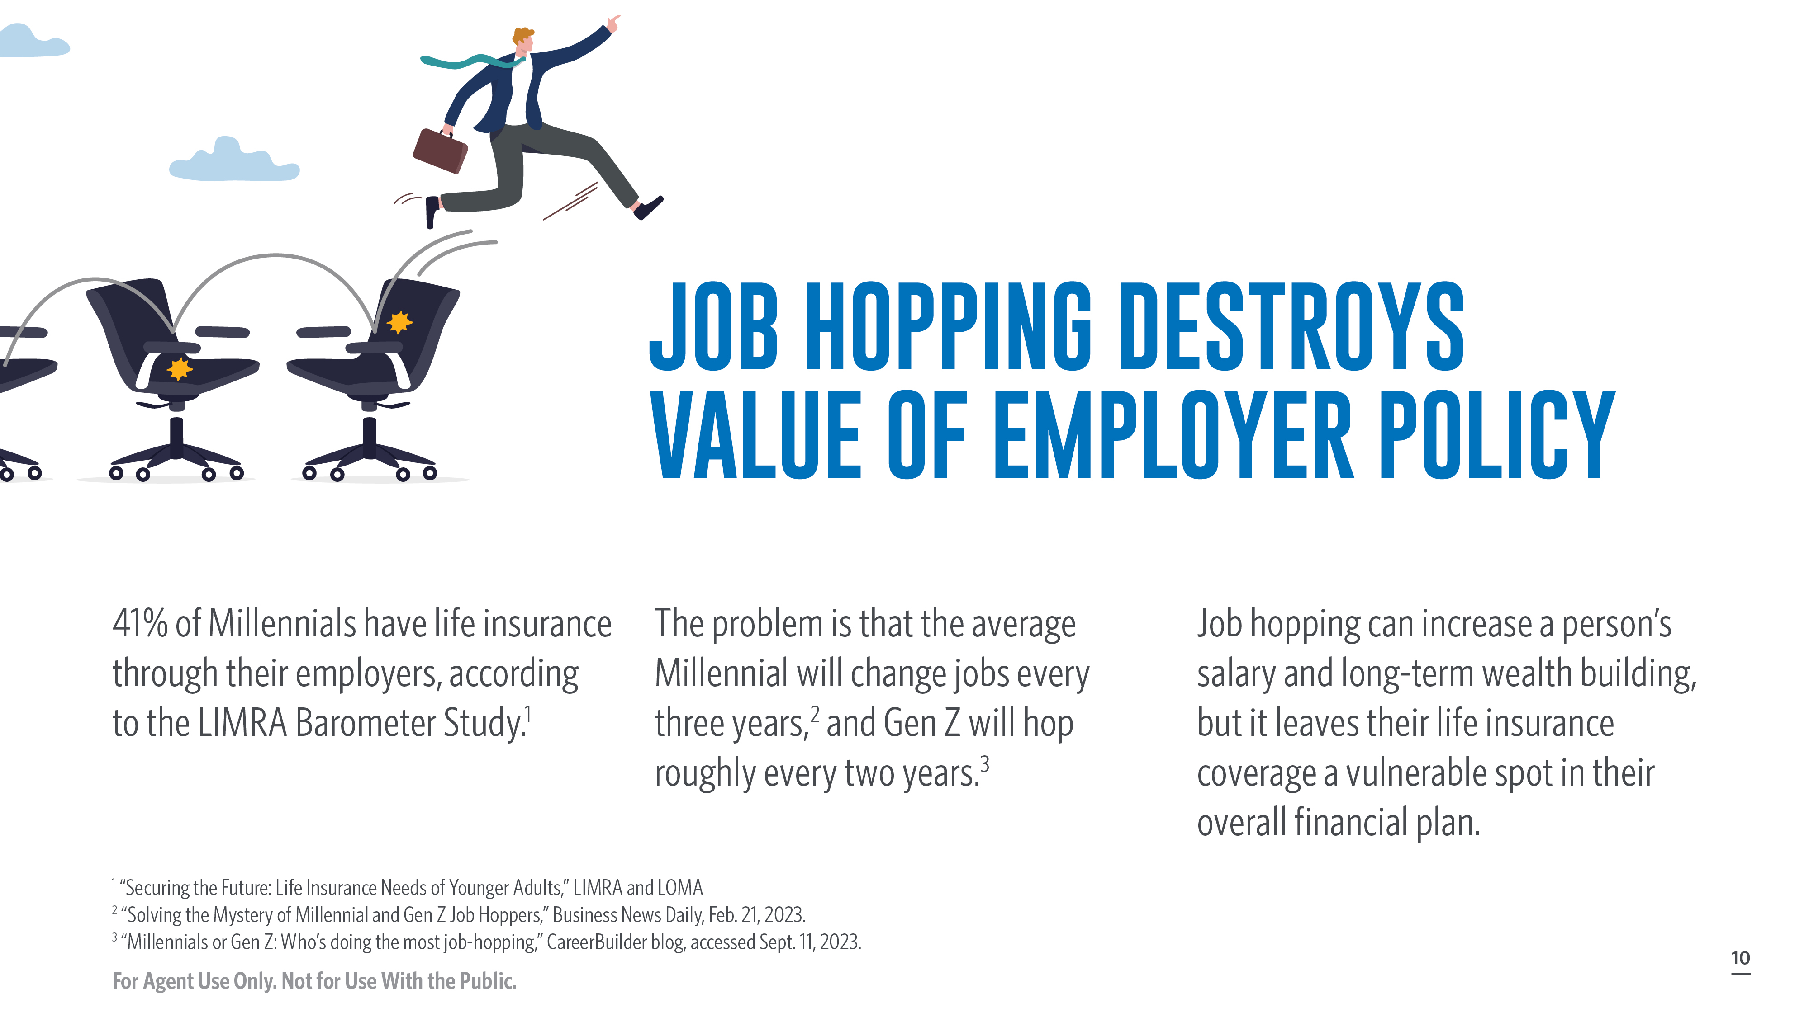
Notes:
Now, my not statistically significant Instagram poll found that 61% of people who had life insurance got it from their employers, which is…not my favorite way for someone to have life insurance. But and it’s not uncommon. 41% of Millennials have life insurance through their employers, according to the LIMRA Barometer Study. It’s unclear how many people have an additional life insurance policy on top of what their employer provides, but the reality is that most Millennials will not stay with their current employer through retirement.
In fact, Millennials change jobs roughly every three years, according a survey by CareerBuilder. Gen Z hops about every two years. Gen Xers tend to stick around for more than five years before finding a new job.
Job hopping has been proven time and time again to yield higher salaries than sticking with one employer for years and years. While this trend can lead to better long-term wealth building, it does leave a major vulnerability in people’s overall financial plan.
It’s understandable why people don’t subsidize their workplace benefit with an additional life insurance policy. The policy offered through an employer probably doesn’t require a medical exam and it’s just one less thing on a person’s never-ending to-do list. However, relying on an employer for life insurance is leaving Millennials vulnerable. The policy typically cannot move with you once you terminate your employment and while you might get life insurance coverage at your new job, there’s no guarantee that it will be provided. The longer Millennials delay securing their own policies the more expensive it will be.
This does provide an opportunity when speaking with Millennials about the importance of life insurance.
https://www.careerbuilder.com/advice/blog/how-long-should-you-stay-in-a-job

Slide 11
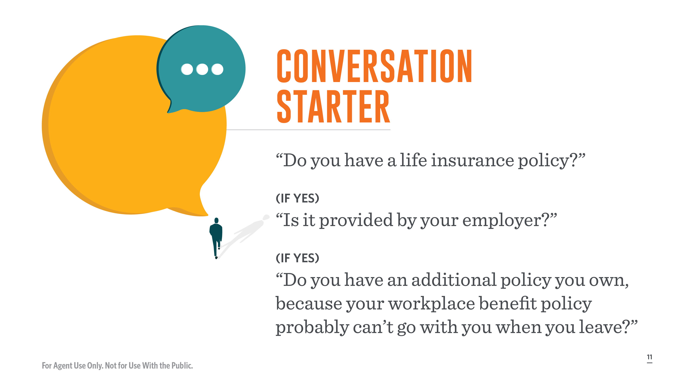
Notes:
Financial advisors and insurance agents can use an employer offered life insurance policy as a way to initiate a conversation and educate millennial clients about the importance of purchasing their own policy separate from their employer. It’s a nice added benefit to have a workplace policy, but it’s far more critical to purchase their own that will not only stay with them, but provide adequate coverage.
A simple script is to say: “Do you have a life insurance policy?”
(If yes) “Is it provided by your employer?”
(If yes) “Do you have an additional policy you own because your workplace benefit policy probably can’t go with you when you leave.”
Be sure to make it clear that getting their own policy won’t void their employer benefit, but instead provide protection as their career grows, and they probably change employers, throughout their career. You can provide a reminder that the younger and healthier you are, the better your rates will be with an individual policy, so it’s better to lock in earlier. Listen, at this point Millennials love any reference to our rapidly fading youth.

Slide 12
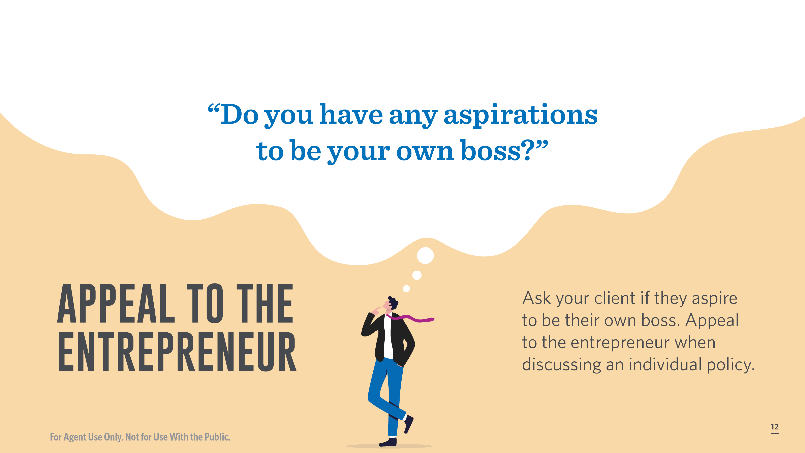
Notes:
Plenty of people aspire to be their own boss. Appeal to the entrepreneur when discussing an individual policy.
“Do you have any aspirations to be your own boss? Having a policy that you own, and isn’t tied to your employer, means one less golden handcuff keeping you tied to your job. Buying a policy when you’re younger means a lower premium, and you lock in your insurability. Plus, it’s one less piece of your own benefits package that you’ll have to create when you start your own business.

Slide 13
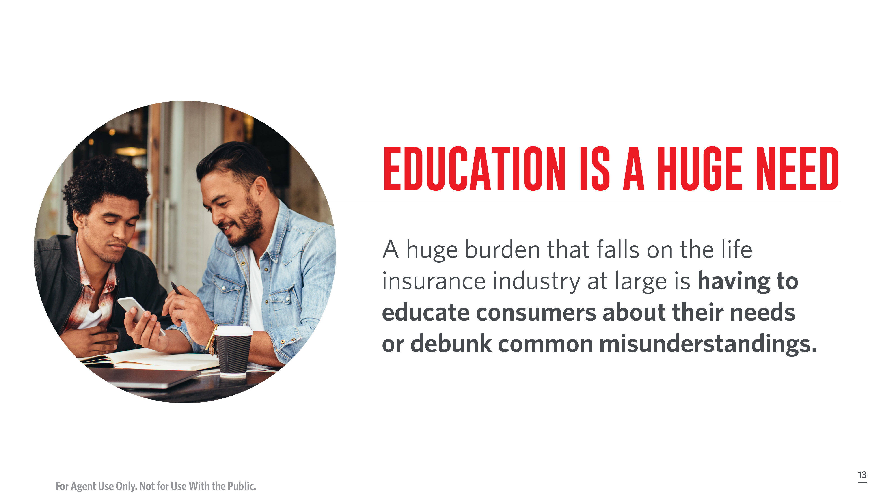
Notes:
Ultimately, educating millennials and gen z is a huge need and the burden largely falls on the life insurance industry at large to educate consumers about their needs.
The fact that having a life insurance policy tied to an employer should be a supplemental policy and not the cornerstone of your life insurance plan is just one example.
One of the prevailing myths is about cost.

Slide 14
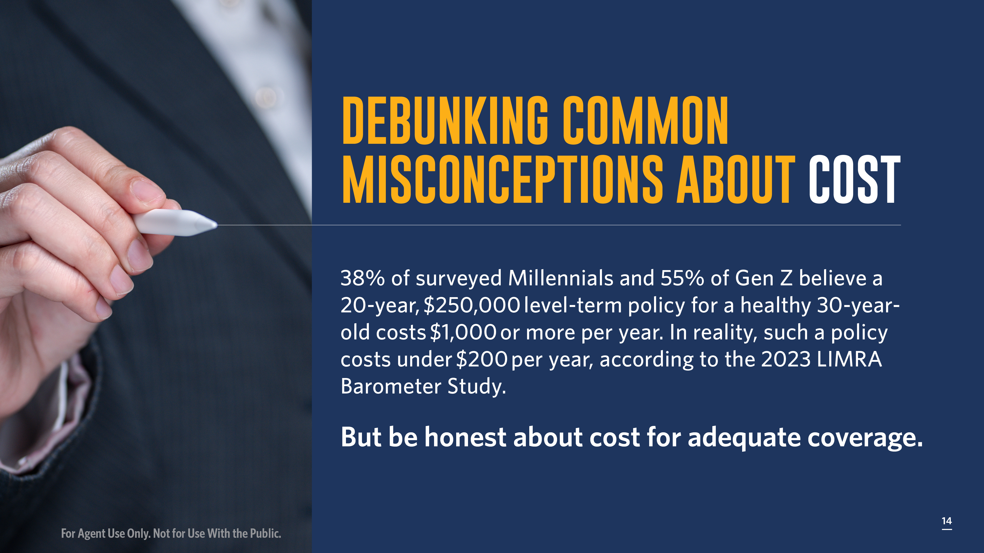
Notes:
One of the most common misconceptions, but probably the easiest to correct, is the belief about cost.
38% of surveyed Millennials and 55% of Gen Z believe a 20-year, $250,000 level-term policy for a healthy 30-year-old costs $1,000 or more per year. In reality, such a policy costs under $200 per year, according to 2023 LIMRA Barometer Study.
Now, the issue with this stat is that while a 20-year, $250,000 level-term policy for a healthy 30-year-old might cost less than $200 a year – it’s highly likely that a 30-year-old who is planning to expand a family or care for anyone else would need more than $250,000 to have adequate coverage. It’s a good starting point to use this stat, but you should contextualize cost for your clients based on what they’ll need.
Help them understand how much life insurance they need based on factors like their potential lifetime earning, debts like student loans and a mortgage, average cost of burial expenses in their area, the cost of covering household expenses if they’re a primary earner, or the cost of outsourcing household labor if they’re a primary caregiver. Honestly, having a worksheet to work through with clients or average figures filled in that’s relevant to your area can really help contextualize the reality. Unless your client has personally had settle an estate or help cover the cost of a burial, it’s unlikely they have a realistic sense of how much it costs to be buried. Or they may have never thought just how much it would cost their spouse if they died and their spouse had to get new health insurance on top of all the household bills.
Go through a variety of solutions for them with monthly prices. It’s incredibly helpful to demonstrate the monthly cost to someone’s budget compared to the annual in order to mitigate the potential for sticker shock. It also feels more doable when financial obligations are in bite-sized chunks.
If your client says that a certain price point isn’t doable for their monthly budget, then try reducing coverage to a price point that fits but be sure to clarify that it won’t provide as much coverage for your loved ones if something happens to you and if you decide you need more coverage in the future, it’ll end up costing more because you’ll be older. But that having some coverage is better than none. It certainly wouldn’t hurt to show average costs for the same policy if the client waits 2 years, 5 years, 10 years, etc.
Another important lesson is effectively demonstrating to people that they even need life insurance.

Slide 15
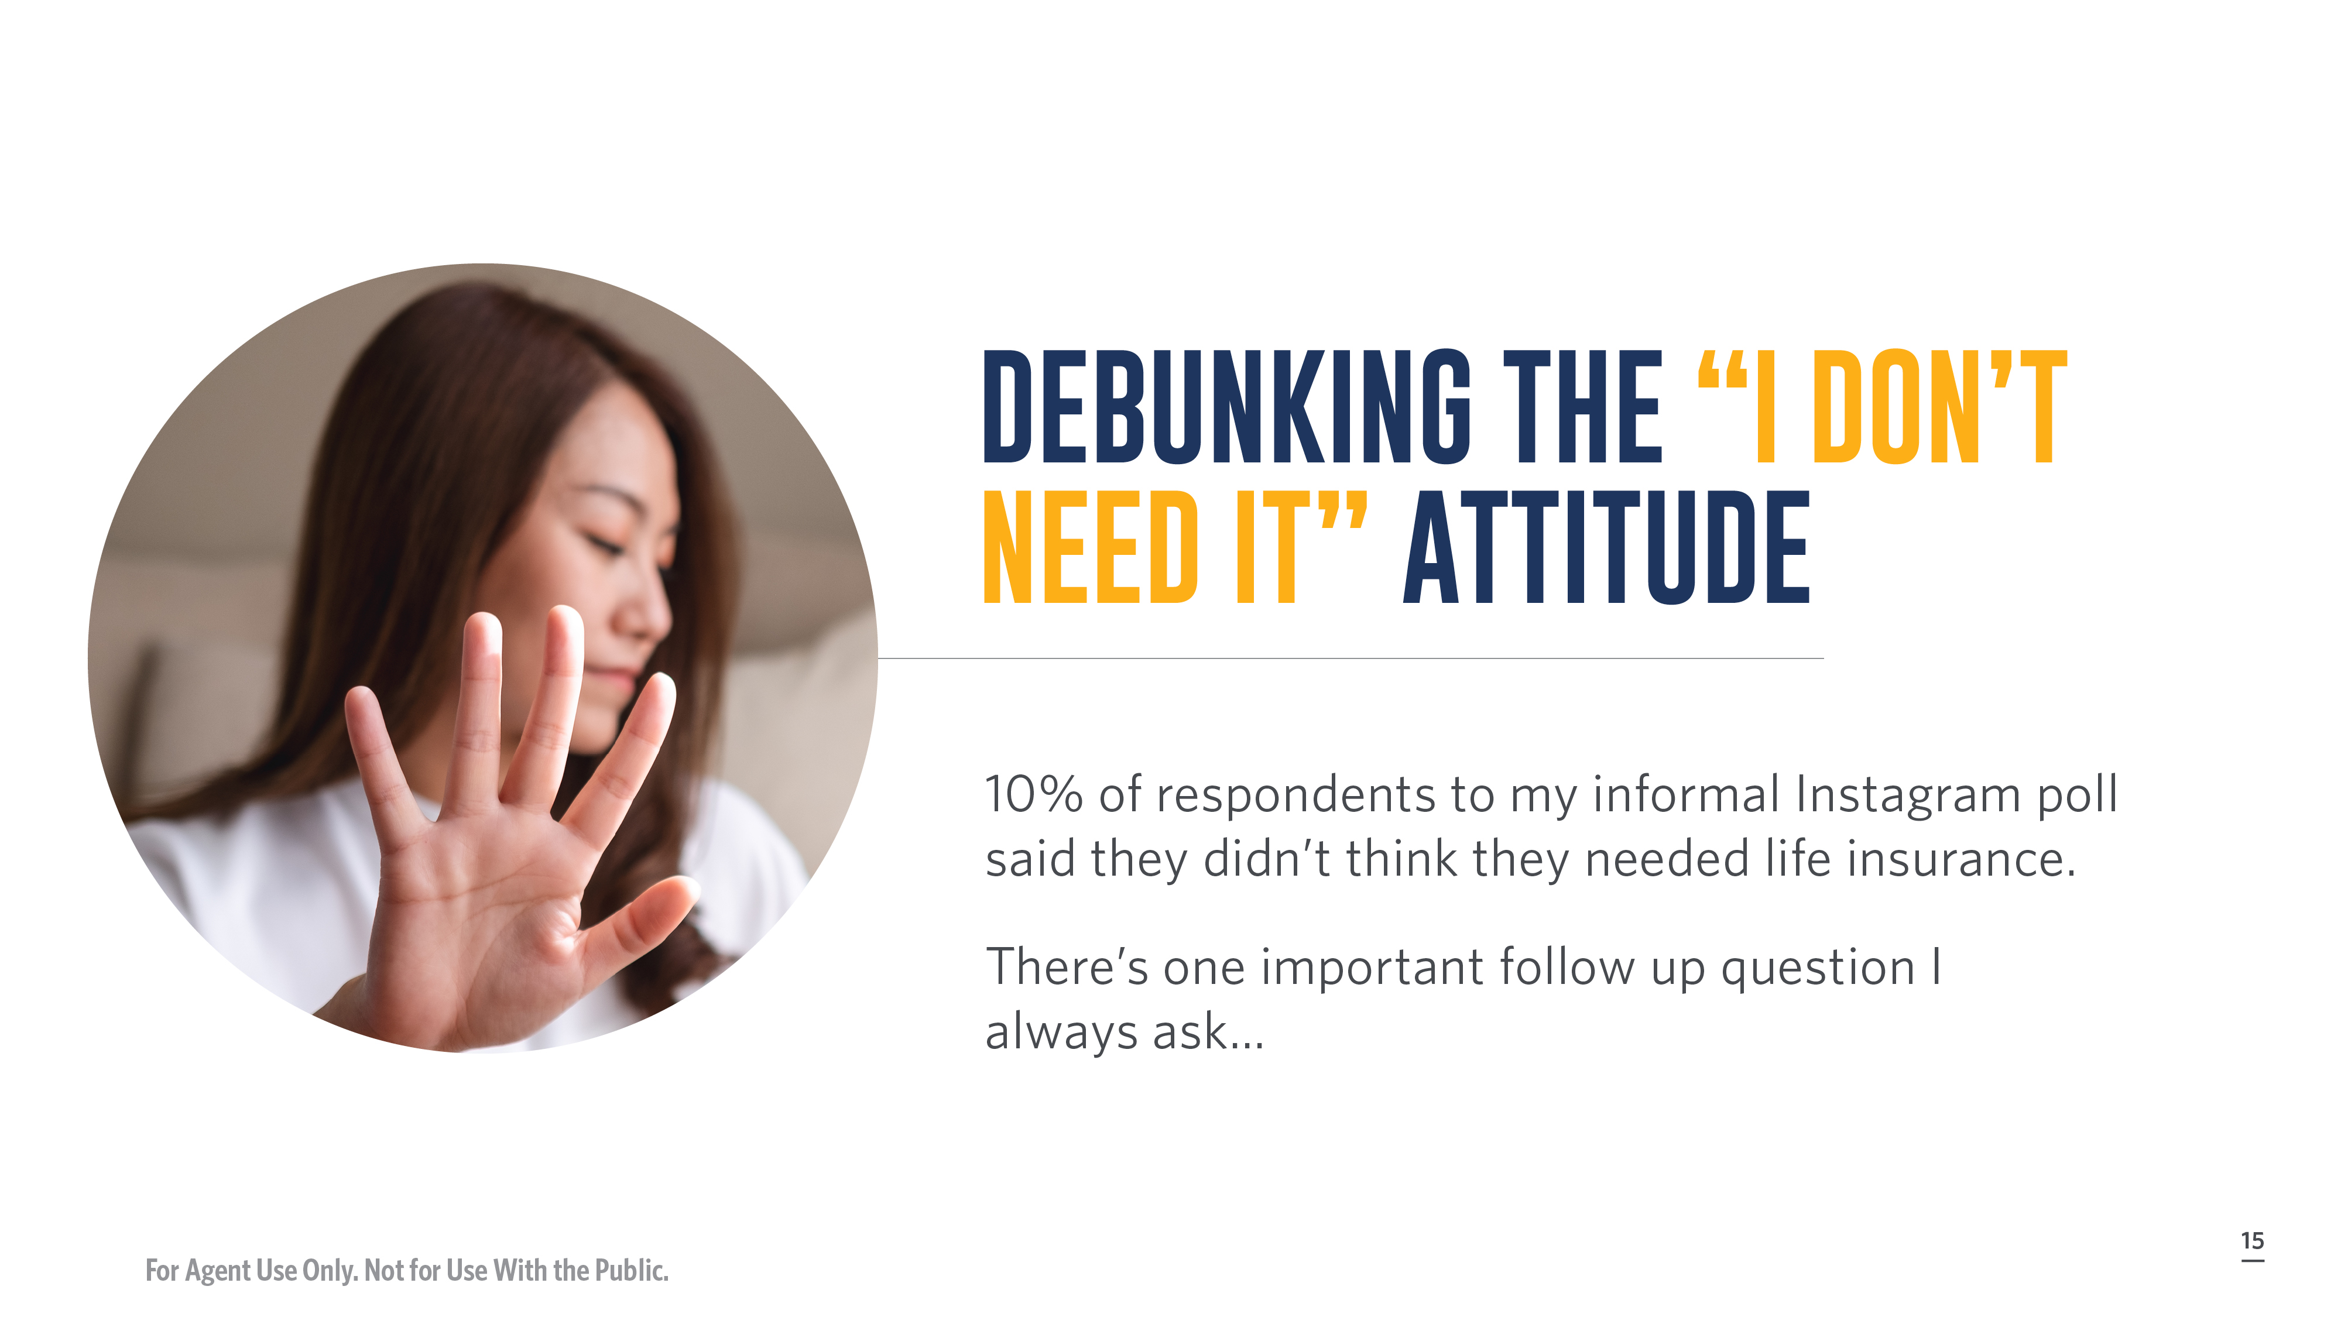
Notes:
One of the most common retorts I hear when I ask folks about life insurance is that they don’t need it because no one depends on their income. They don’t have kids or a spouse or own property.
I even one time asked a friend of mine, who recently turned 40, if she had a life insurance policy and a will. (I promise there was context for me asking and I didn’t do it out of the blue.) She waved her hand dismissively and said, “No, I don’t need to either. No one depends on me.”
My response was to point out that a policy could still be useful if her life changed in the future and that it also could help offset the costs of a funeral and any other costs of settling an estate. Her flippant response was, “What do I care? I’m dead anyway.” After I picked my jaw up off the floor, I did bring up some points about how estate planning and having adequate life insurance to cover the costs of burial and perhaps provide some generational wealth is one of the kindest acts of love we can give our family members…and then I dropped it.
Unfortunately, her stance is not uncommon. There are a lot of people who either get so uncomfortable at the topic of death – or feel that it’s some sort of jinx to discuss – that they’ll dismiss absolutely any attempt at initiating a conversation around topics like life insurance and estate planning. Others dismiss the idea of owning a life insurance policy because they’re unmarried and have no children. Life insurance is so often positioned as a solution to dying early and leaving loved ones behind without a financial safety net – that they fail to recognize other reasons it’s important and may not know about other options that could result in tax-deferred growth, tax-free income, or a tax-free death benefit..

Slide 16
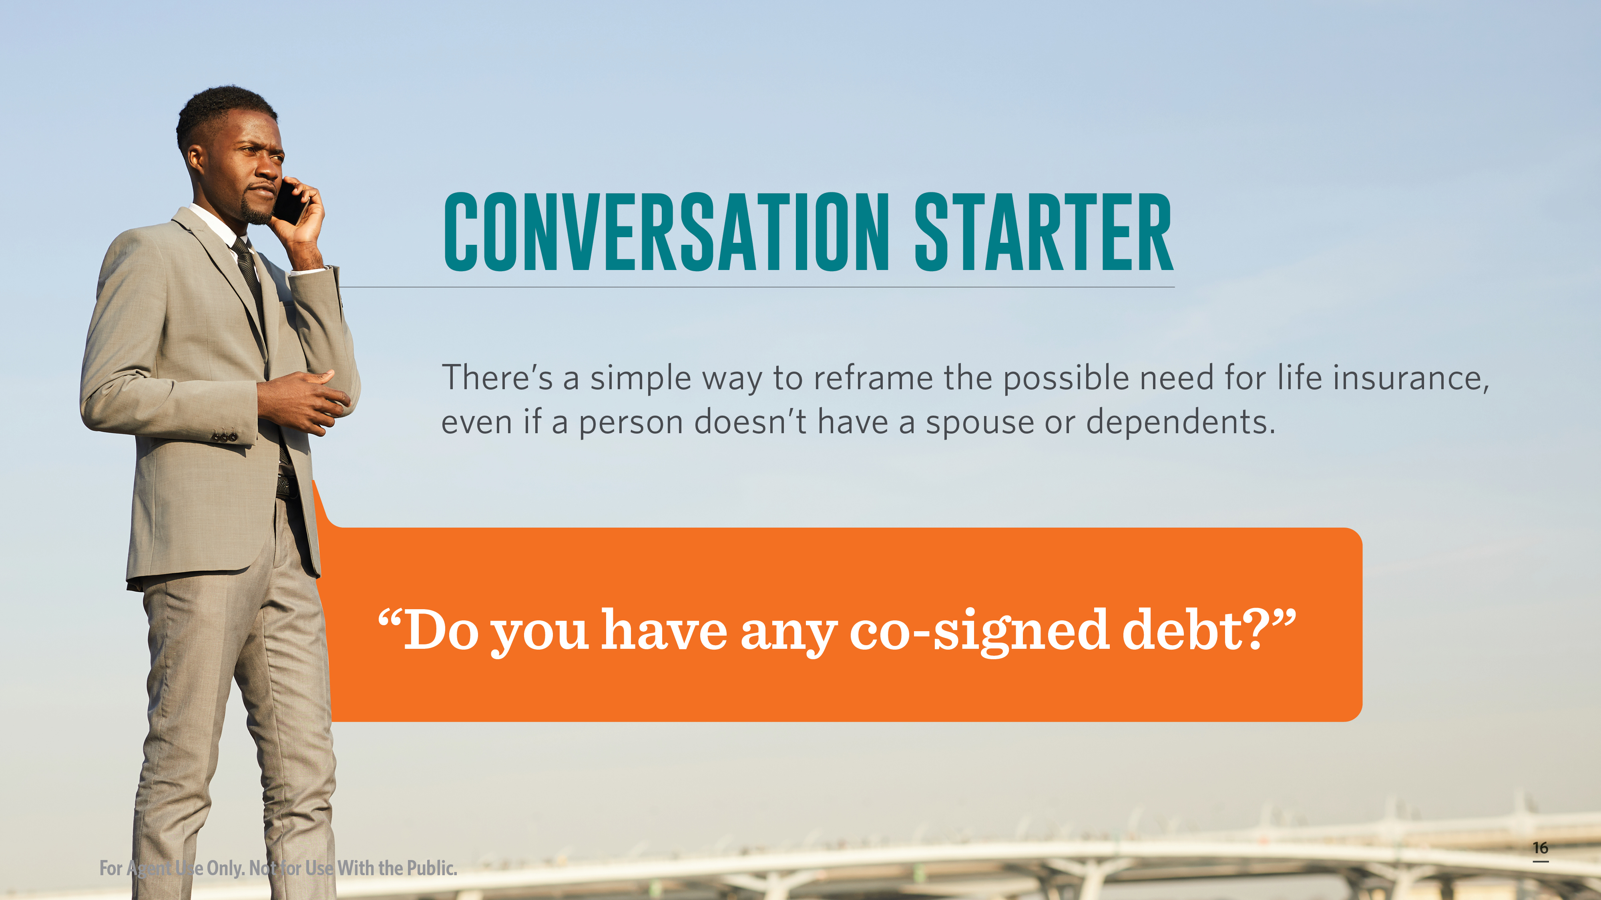
Notes:
Many people don’t realize that a co-signed debt, even some student loans, can result in your co-signer being responsible for the remaining debt after your death. Asking a client about their debt burden and whether or not it could impact a loved one is a good start to reframe the need for life insurance. Simply ask, "Do you have any co-signed debt?"
Federal student loans are generally discharged in the case of death, but this isn’t always the case for private student loans. Roughly one-tenth of student loan borrowers have private loans of some sort. It’s not uncommon for an undergraduate taking on a private student loan to need a parent co-signer.
Part of the reason my husband got his first life insurance policy was specifically because his parents were co-signers on his private student loan. If anything happened to him, his parents would’ve been on the hook for over $20,000. At the time, in his mid-twenties, his estate certainly would not have covered that bill – so his parents would’ve had to pay for a funeral and the price tag on student loans that could’ve harmed their own financial futures. This was all before we were married and I encouraged him to get a life insurance policy large enough to cover his student loan liability and funeral expenses. Even after we got married, I insisted he keep his parents as the beneficiaries of that policy until the two of us paid off those private loans. Despite us being married, it wasn’t until after those loans were completely paid off that he updated me to his beneficiary.
It's important to explain to clients that no matter if someone co-signed on their auto loan, was a guarantor on their lease, put them as an authorized user on a credit card, or are financially associated other debt that may not be discharged in death– it’s critical to have enough life insurance to cover their potential liability.
Another important consideration are the adult children who are – or will – be caring for aging parents.
https://www.bankrate.com/loans/student-loans/student-loan-debt-statistics/#federal

Slide 17
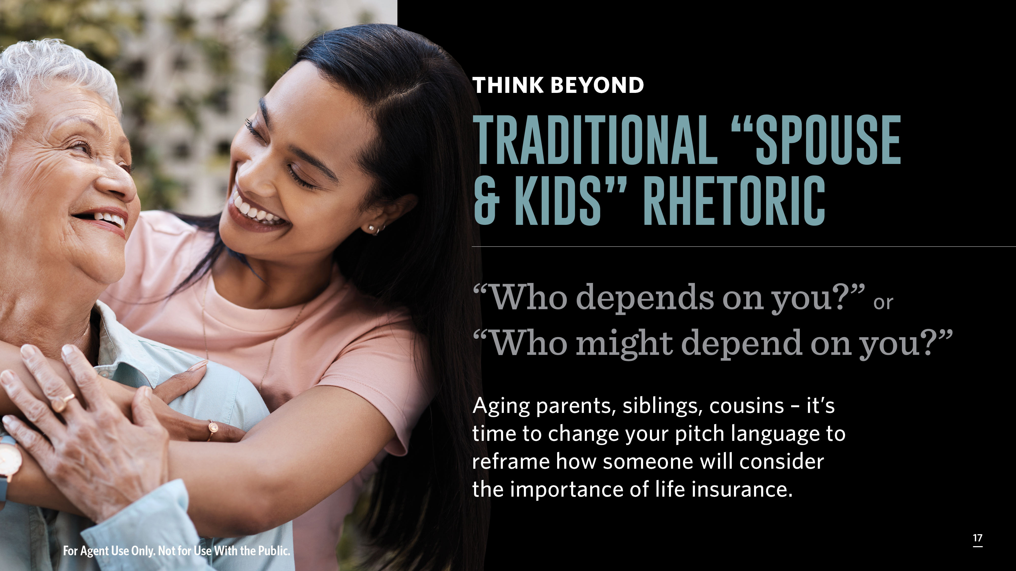
Notes:
Another important question is to broadly ask, “Who depends on you?” or “Who might depend on you?”
Aging parents, aunts, uncles, siblings, cousins, family friends – there are all sorts of people to whom an adult might provide unpaid care. It’s time to change your language to frame the question to include people beyond a spouse and children. Should a client respond with, “I’m not married and don’t have kids,” then you should bring up the question of any other family members or friends that may need care in the future?
Gen Xers are truly at the forefront of the sandwich generation struggle, but Millennials are not far behind. According to the 2023 AARP report entitled “Valuing the Invaluable” the estimated economic value of family caregivers’ unpaid contributions was approximately $600 billion in 2021. That figure is based on about 38 million caregivers providing an average of 18 hours of care per week for a total of 36 billion hours of care, at an average value of $16.59 per hour.
So, the tough question is, what would happen to the person receiving unpaid care if their caregiver were to die unexpectedly? A life insurance policy could help cover the need to hire an in-home aid or cover the cost of a care facility.
51.2% of caregivers did not prepare for the cost of giving care, according to an MIT AgeLab survey, which probably means at least half of the population doesn’t have the person to whom they’re providing care adequately covered in their estate plan or a beneficiary on a life insurance policy. This is likely even more true if an adult child has a spouse and or children of their own and is providing care to an aging parent. The adult child would probably have their spouse and children as beneficiaries on a life insurance policy, but not necessarily their aging parent that they expect to outlive. Long-term care or living benefits insurance solutions are other important solutions to present to families in these situations or to clients who may be interested in securing a policy early to ensure their children don’t have to financially care for them in the future.
It’s also critical to make sure more than just wage earners are covered.

Slide 18
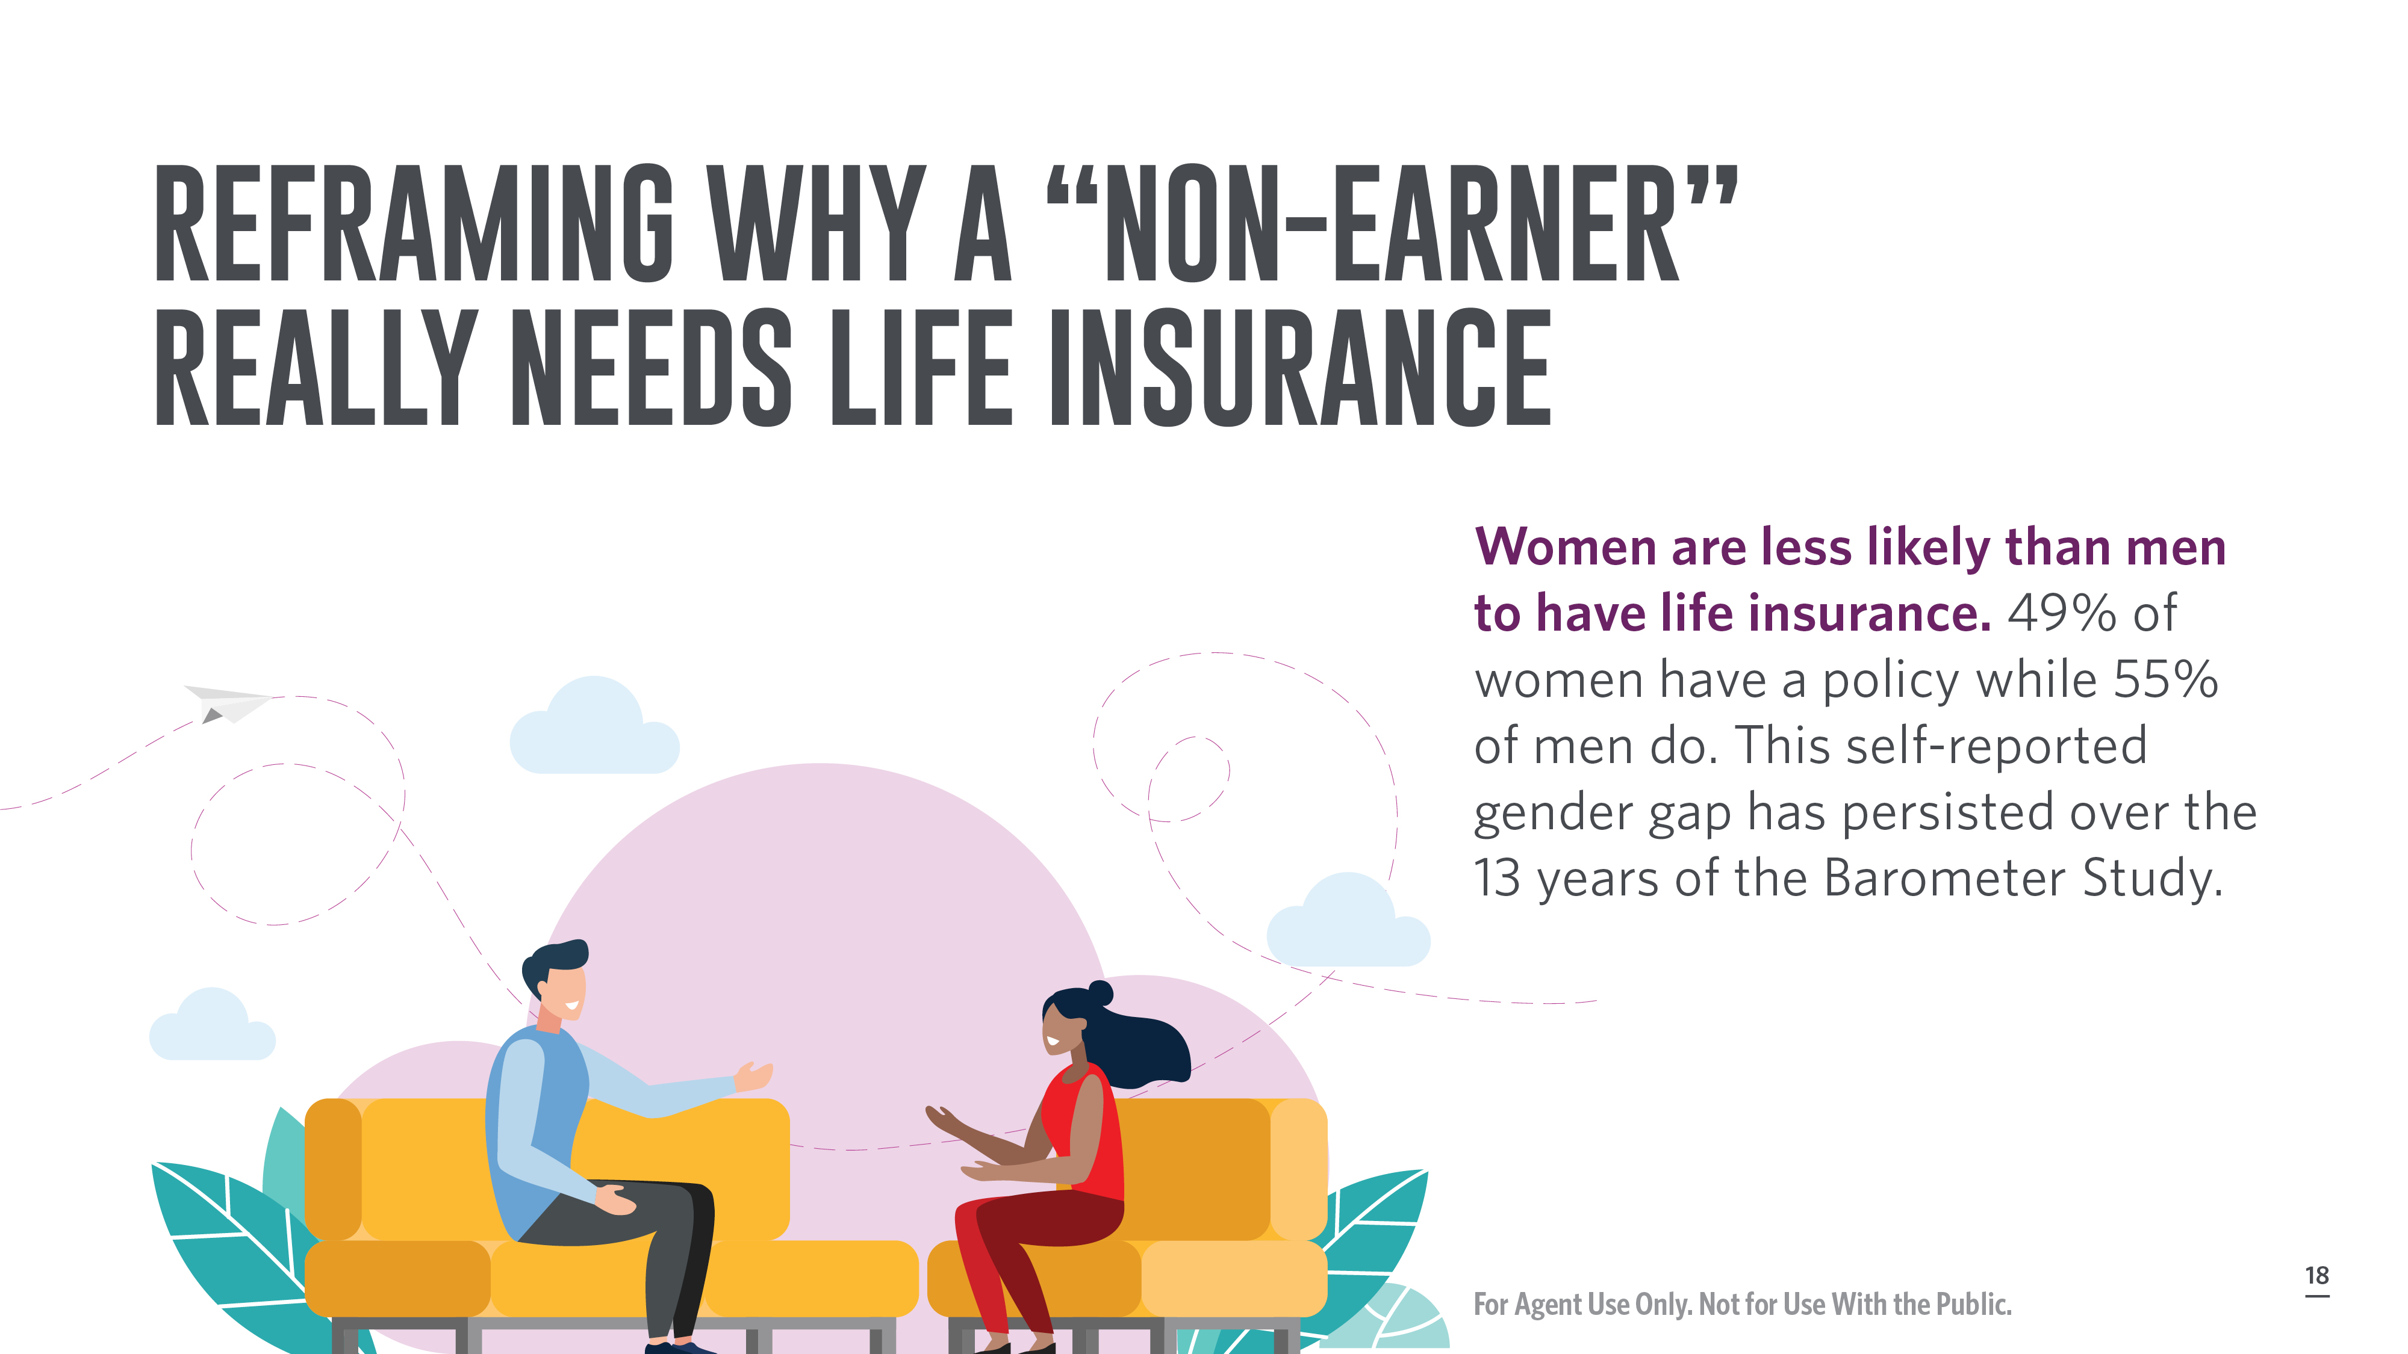
Notes:
Women are less likely than men to have life insurance. 49% of women have a policy while 55% of men do. This self-reported gender gap has persisted over the 13 years of the Barometer Study.
A major concern of mine looking at this stat, is wondering how many of these women, who still are more likely to be the stay-at-home parent, don’t believe they “need” life insurance because they don’t earn an income or don't earn as much as their spouse. This couldn’t be further from the truth. It’s imperative a stay-at-home parent is properly insured because the loss of their labor would have major financial implications on the family. It sounds blunt to put it in financial perspectives, but suddenly having to pay for all the services a stay-at-home parent provides would be incredibly expensive, particularly the cost of childcare.
One issue a family may be up against is securing an adequate amount of coverage to supplement the stay-at-home parents’ contributions. My dad told me the tale of trying to increase my mom’s life insurance coverage after I was born. My mom had left the workforce shortly after I was born. She had a $100,000 policy and he called to increase it to $500,000. The request was denied, so my dad called the company and spoke directly to an underwriter to explain his logic. He factored in the cost of funeral arrangements, full-time childcare costs local to the area, and that we lived across the country from all our family, so he had no safety net of local support to help. Ultimately, the underwriter agreed and approved the request.
Granted, this anecdote is 34 years old, but it stands to reason that plenty of stay-at-home parents are also underinsured when you look at the full scope of a family's needs. And, just a reminder, Millennials may have delayed starting families compared to previous generations, but the generation has aged into being parents. Many families have two-working parents, but it’s important to ask clients if both parents are in the workforce (and don’t just look at the woman when you say this). You can also mention that if either parent were needed to leave the workforce to be a caregiver, whether it was to children or another relative, then it’s important they still have an individual policy.
The estimates of how much a stay-at-home parent should get paid varies, but a 2021 study by Salary.com found the total to be around $185,000. Sharing information like this could help reframe the need for a policy for both parents, regardless of traditional job status. The cost of childcare varies wildly by city and state, but it could easily cost tens-of-thousands of dollars annually to secure childcare for two kids.
Having numbers that are local to your area and your clients helps contextualize how much it would cost the family if the stay-at-home parent’s contributions were no longer available. This can better reframe the importance of both parents having a life insurance policy. You can also point out that a life insurance policy could be used to help fund a child’s future in addition to providing relief to the cost of childcare, this can be true for various types of policies including properly funded growth-oriented permanent policies. Other suggestions could include the life insurance policy covering funeral costs and any additional costs to settling an estate. It could help pay for outsourcing of errands and household tasks like hiring cleaners, or a laundry service, or ordering groceries and meal kits for delivery. These may seem like luxuries to many families, but outsourcing commonplace household tasks could be one less thing a grieving partner needs to handle in the short-term.

Slide 19
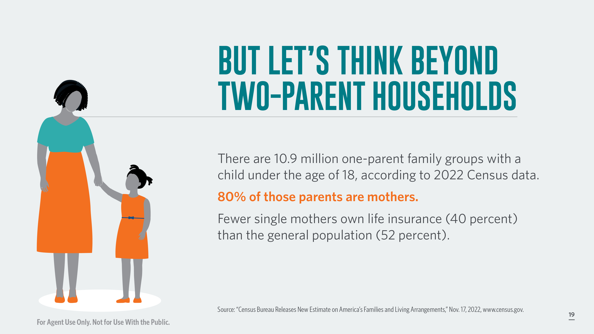
Notes:
Too often, the conversation around life insurance comes with a “what will happen to your loved ones” pitch. It’s fair, of course, but much of the conversation is tinged with a mom and dad with 2.5 kids and a white picket fence cliché. Single parents make up a large contingent of parents in the United States. There are 10.9 million one-parent family groups with a child under the age of 18, according to 2022 Census data. 80% of those parents are mothers.
By and large, this is an underinsured population.
Only 40% of single mothers own life insurance compared to 52% of the general population, according to the LIMRA barometer study. This is also a demographic that has largely expressed a heightened sense of financial concern and want to ensure their death doesn’t create a bill that their children have to pay out of pocket.
While covering the cost of burial is an important reason to have life insurance, it’s also important to gently ask single parents about who would look after their child in the case of their death and if there is financial coverage to raise the child until at least 18. Even two-parent households should be answering those questions.
https://www.census.gov/newsroom/press-releases/2022/americas-families-and-living-arrangements.html

Slide 20
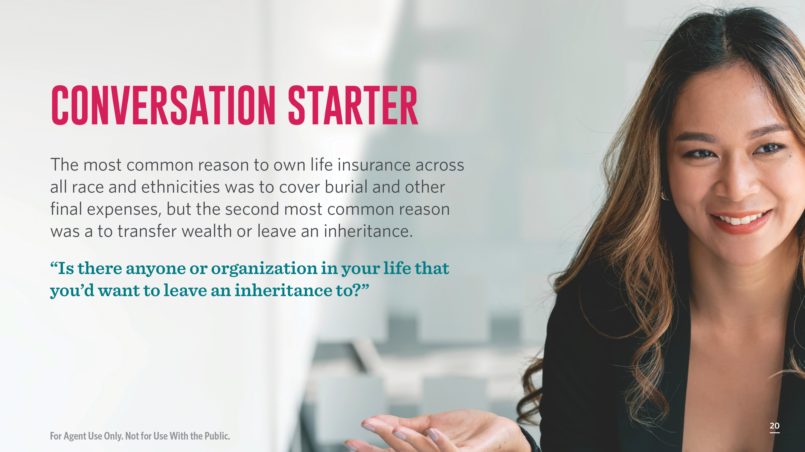
Notes:
The most common reason to own life insurance across all race and ethnicities was to cover burial and other final expenses, but the second most common reason was a to transfer wealth or leave an inheritance, according to the 2023 LIMRA barometer study.
38% of respondents said transferring wealth or leaving an inheritance was the most important reason to have life insurance, compared to 28% who cited replacing lost income of a wage earner.
This, to me, is a critical indicator about the rise in conversations concerning generational wealth.
Generational wealth is often thought of in terms of a family dynasty. Mom and Dad or Grandma and Grandpa amass wealth and pass it on to the next generation or two. We too often think of generational wealth in terms of a TV show like Succession. Billionaire families with massive wealth. But generational wealth is so much more than the top 1% and it can go beyond making an impact on your relatives.
It’s important to be careful about the language you use here, because you want to broaden out the scope of generational wealth beyond children or grandchildren. You also want to be careful not to say things along the lines of, “when you have children in the future” or “there’s still time to have children.” Instead, ask, "Is there anyone or organization in your life that you'd want to leave an inheritance to?"
The child free population is a growing one. In 2021, Pew Research found that 23% of non-parents aged 18 to 49 said it is not at all likely they’ll have children and 21% said it’s not too likely. This is up 7% from responses in 2018.
The reason? 56% of those respondents said because they don’t want to have kids. 19% said medical reasons and 17% said financial reason.
You’ll have clients who don’t have children and won’t want to have children, but may have a beloved niece, nephew or best friend’s kid or community foundation to which they’d like to leave a financial gift. They may also be inclined to leave a financial gift to a charitable organization close to their heart. You can use this opportunity to discuss tax benefits like the possibility for life insurance premium payments to be tax deductible if the charity is a beneficiary on their policy and the death benefit contribution will be tax-free.
https://www.pewresearch.org/short-reads/2021/11/19/growing-share-of-childless-adults-in-u-s-dont-expect-to-ever-have-children/

Slide 21
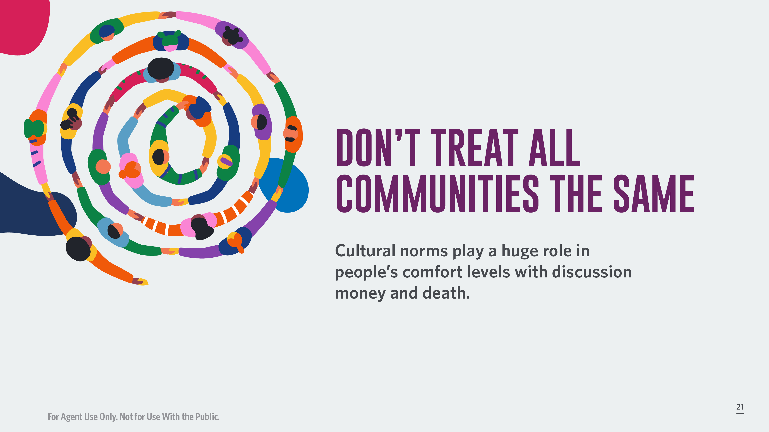
Notes:
Just as we discuss the need to treat each generation differently, it’s important not to try and market to all communities in the same way either.
Cultural norms play a huge role in people’s comfort levels with discussing money and death.
It’s critical to be sensitive to the ways in which clients of different backgrounds may react to the need for life insurance or feel anxious about which product to choose. Don’t be dismissive of how a client reacts or relates to life insurance just because it’s not your relationship to the product or your lived experience. Trying the tough love approach or educating in a way that veers into paternalism or being condescending is a quick way to lose a client. Your client needs to trust you and feel respected by you.

Slide 22

Notes:
Communicating with Millennials and Gen Z doesn’t mean you need to use slang, especially if it’s unnatural for you to do so. Even millennials are starting to feel our own youth slip away as we hear sentences like, “He had mad rizz, no cap.” Or finding out that saying “bet” as an answer to a question means yes.
The focus should be on asking a millennial or Gen Z about their vision of the future and explaining how the right products can help them reach their goals.
It wouldn’t hurt to tell a millennial they’re still young, while also slipping in a reference that premiums increase with each birthday. Older Gen Zers are on the wrong side of 25, which means they’re barreling towards the dreaded 30 and would probably love to hear that they’ve still got time to lock in a significant discount on their premiums if they get a policy before their 30th birthday.
Talk to clients in a straightforward manner. That means cutting the industry jargon – even if it doesn’t seem like jargon to you – and don’t use acronyms without first explaining them.
No one likes to feel stupid, so people won’t always ask for clarification. Instead, they’ll just smile and nod because they feel they’re supposed to know what “level-term” or “IUL” means. It wouldn’t hurt to provide a glossary of terms to clients, much like me going to Urban Dictionary to learn that rizz means charisma and that cap means to lie, so no cap means “no lie.”

Slide 23
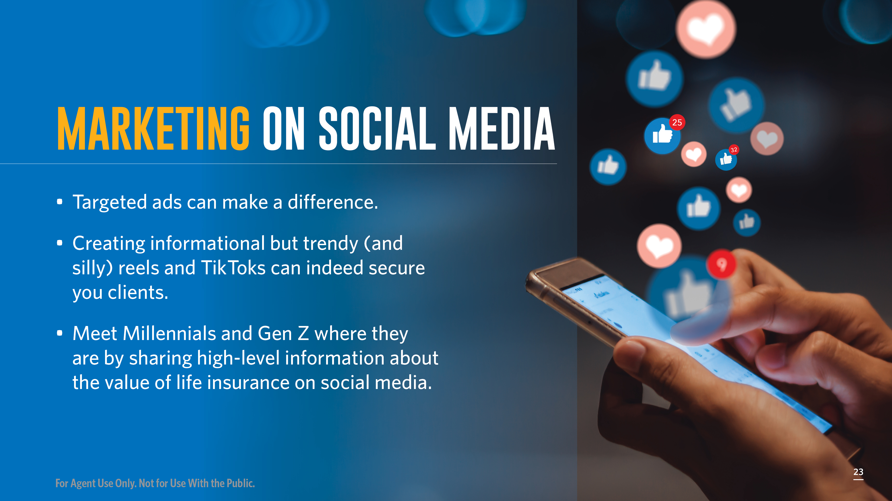
Notes:
If you’re trying to educate, or sell, to Millennials and Gen Z, then you have to meet them where they are. People are deeply influenced by social media and often make purchases, even ones as big as life insurance, from their phones.
Targeted ads make a difference. I have to confess that a targeted ad on Instagram is actually what reminded me to apply for life insurance before my 34th birthday. After Googling for some potential companies to use, I started getting targeted ads in my Instagram scroll. The information was quick and the captions were short, like “We’ve upped our coverage to $1 million, and there’s still no medical exam. So, if you’re looking for a sign to complete your application – this is it!”
Creating informational, but trendy (and silly) reels and TikToks can indeed secure you clients. You can build a pretty large social following talking about life insurance, especially if you use current trends on TikToks and Instagram Reels. I know this sounds abhorrent to some of you, and it’s okay if you don’t want to do this, but those who are social media savvy – or at least interested – can get educational information across while doing a silly dance or cringy activity in the background.
It's a good idea to check on your firms social media policies, if it's permitted.

Slide 24
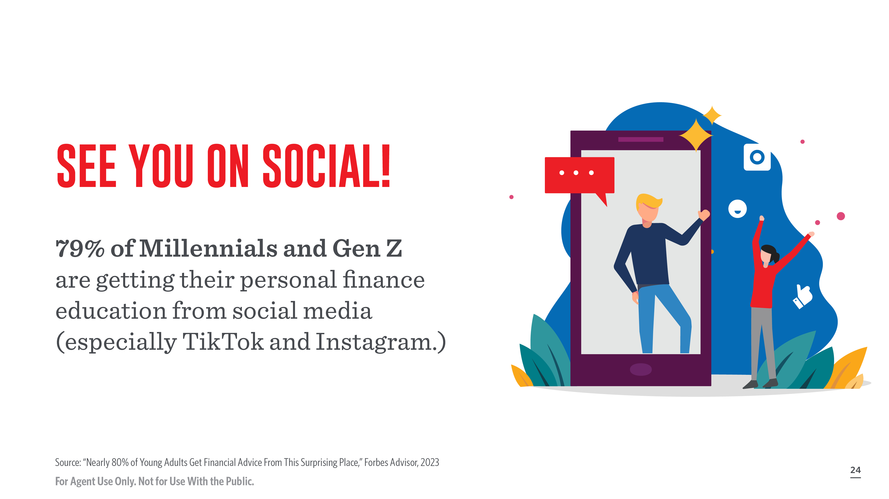
Notes:
Speaking of marketing, social media might be your compliance department’s worst nightmare – but it is how a lot of people are getting their financial information. 79% of Millennials and Gen-Zers seek out financial advice from social media, according to a 2023 survey by Forbes Advisor.
Millennials and Gen Z alike will search for information on social media, much like you might use Google to find an answer to your question.
You might not want (or have the compliance flexibility) to promote yourself, your work or products on social, but you should be watching.
Financial influencers aka Finfluencers are amassing massive followings on social media, especially TikTok and Instagram, – I’m talking millions of followers – advising their communities about how to spend, save, and invest. This also includes advice about life insurance policies like who needs it, how much, and what type of policies.
Even the old guard of personal finance personalities like Dave Ramsey and Suze Orman have been giving life insurance advice for years – which general fall into the “get a term life insurance policy large enough to cover your family’s needs and invest the difference” camp.
You should know what is being said/shared on social because this is how your potential clients are being educated and it’s the perspective from which they’re likely to ask you questions.
You can also learn more from Transamerica’s Social Media University.

Slide 25
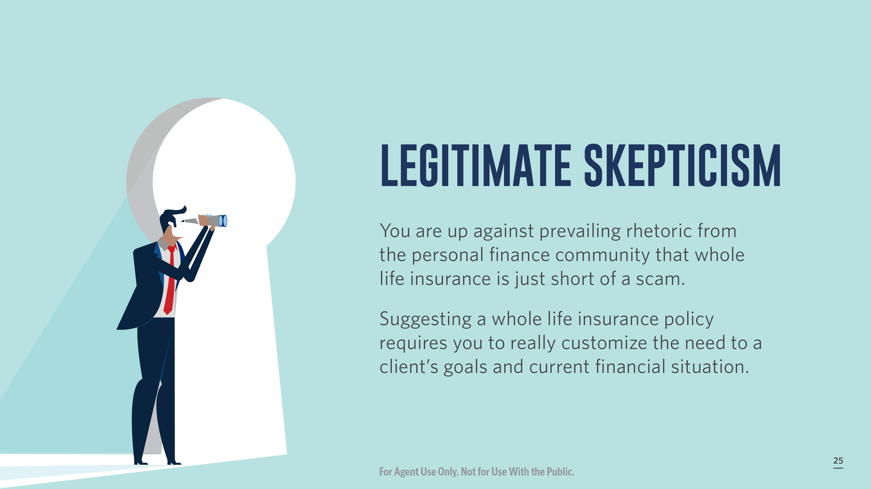
Notes:
Clients are being educated in various ways before reaching you. It’s possible a client will have an aversion to whole life insurance, even if that’s what is the right fit for their situation, thanks in part to finfluencers and other personal finance experts. The personal finance community does tend to have a healthy (and sometimes legitimate) skepticism around permanent life and final expense insurance products. Admittedly, I’m part of this cohort.
When my then boyfriend, now husband got his aforementioned life insurance policy, I didn’t micromanage the process. I simply told him that he should consider getting a life insurance policy large enough to cover his private student loans and burial experiences and make his parents the beneficiary. It wasn’t until months later when I asked him about his monthly payment that something smelled amiss to me.
It turns out that when he explained his needs to the insurance agent, he was given a pitch about whole life insurance. The pitch sounded good to him and he got a policy that cost him over $500 a year. A cost that pulled money away from other necessary financial goals at that stage of his life.
Once I realized what had happened, I encouraged him to switch to a term policy that was half the cost with adequate coverage for his needs. He wasn’t an ideal customer for whole life insurance but had been sold a policy anyway. It certainly didn’t strike me as someone adhering to a fiduciary responsibility.
It’s situations like his that leaves a negative taste in people’s mouths.
Of course, there are many important reasons why permanent policies that are more than death benefit and offer tax-diversification or potential access to cash through tax-deferred growth makes sense for some clients.
It’s your responsibility to explain benefits in a way that is highly personalized to them, doesn’t sound like an attempt to upsell for a commission, and is stripped of jargon. You have to translate and demystify products.
You need to be able to explain exactly how they’re funded, when they're accessible, and why it makes the most sense for a client’s goals and current financial situation.
But it’s much easier for finfluencers and personal finance experts to advise against whole life in favor of term because it fits a majority of people and is more affordable during the level term period. Ultimately, your client needs to feel heard, trust you, and fully understand which solutions you’re recommending and why it’s the right fit for today and into the future. The relationship should be a dynamic one that involves making changes and adjustments as the client’s life evolves.

Slide 26

Notes:
No matter the product, we all love to get a deal.
Life insurance premiums don’t adhere to the Black Friday or Labor Day or Fourth of July discounts – but age matters – a lot. It’s critical to make this clear to clients, especially if they’re inching towards big birthdays like 30 or 40 or 50 – but everything in between matters too.
Despite it feeling obvious that the younger you are, the better the rate, it’s not necessarily a given to young clients. Afterall, 30 still seems young and people are hitting life milestones later and later. People are going to ask why it matters if you lock in a policy at 29 before you’re married with kids compared to 35 when it seems like more of a need?
Show people exactly how much a they could save by locking in a policy young, even before it might feel completely necessary, compared to waiting until it’s absolutely a need.
If buying a policy at 29 will save hundreds -- or even thousands -- compared to waiting until mid-thirties, then people will consider buying before reaching that life milestones that would've been a triggering event. You can even mention why half-birthdays matter again for some insurance carriers! We used to make such a fuss over being 6-and-a-half years old compared, but no one says, I’m 31-and-a-half. It’s worth mentioning if your insurance products are priced using “Age Last Birthday Method” and explain to your client that some carriers use “Age Nearest Birthday Method,” meaning that a half birthday makes their insurance more expensive.
A healthy financial future involves more than just saving and investing, but it’s too common for people to wait five or 10 years too long to reach out to a financial advisor because they believe they aren’t ready or wealthy enough. Education in an accessible way and meeting people where they are are key parts to making sure millennials and Gen Z aren't waiting a year or five or 10 too long to have proper life insurance coverage.

Slide 27

Notes:
Thank you!

