Slide 1
Notes:
Hi, and thanks for attending today’s presentation.

Slide 3
Notes:
First, I have to review some quick disclosure information with you.
[Read slide]

Slide 4
Notes:
Here’s a quick look at what we’ll be covering in the next 30 minutes …
[Read slide]

Slide 5
Notes:
Transamerica welcomed our new president and CEO, Will Fuller, in March of 2021. Prior to Transamerica, Will served as Executive Vice President of Lincoln Group and President, Annuities, Lincoln Financial Distributors and Lincoln Financial Network.
Over the course of his almost 30 years in financial services, Will has worked in life insurance, annuities, retirement plans, and wealth management. His track record in strategic change makes him an excellent fit to lead Transamerica into the next phase of our transformation.
He is committed to regaining Transamerica’s position as a market leader, one that earns trust by delivering on our promises and serving the needs of our customers.
[Read slide]

Slide 6
Notes:
Our leadership is looking to add to our already impressive numbers.
[Read slide]

Slide 7
Notes:
December 2021: FFIUL Reprice and LTC Rider enhancements
December 2021: Increased maximum term conversion amount to Transamerica LifetimeSM
March 2022: Trendsetter® Super Reprice
April 2022: Term policy PDFs on TransACT®
June 2022: FFIUL policy PDFs on TransACT®
June 2022: Trendsetter® Super Reprice
July 2022: FFIUL launch on iGO® e-App
August 2022: Simplified rules for 1035 Exchanges to FFIUL
September 2022: FFIUL LTC Rider Enhancements (CA/FL), removal of withdrawal fee, adjusted loan charges, and cap change
December 2022: Integrated FFIUL e-App with illustration upload for streamlined policy eDelivery
January 2023: FCIUL Launch

Slide 8
Notes:
This increase in affluent individuals in the U.S. has different needs and face different risks than the typical client.
Did you know the top 5% of taxpayers account for 35.9% of all adjusted gross income and pay 59.4% of all income taxes paid?
You also may be surprised to know that a market correction occurs on average roughly once every two years. A market correction is defined as a broad decline in major market indexes of 10% to 20%.

Slide 9
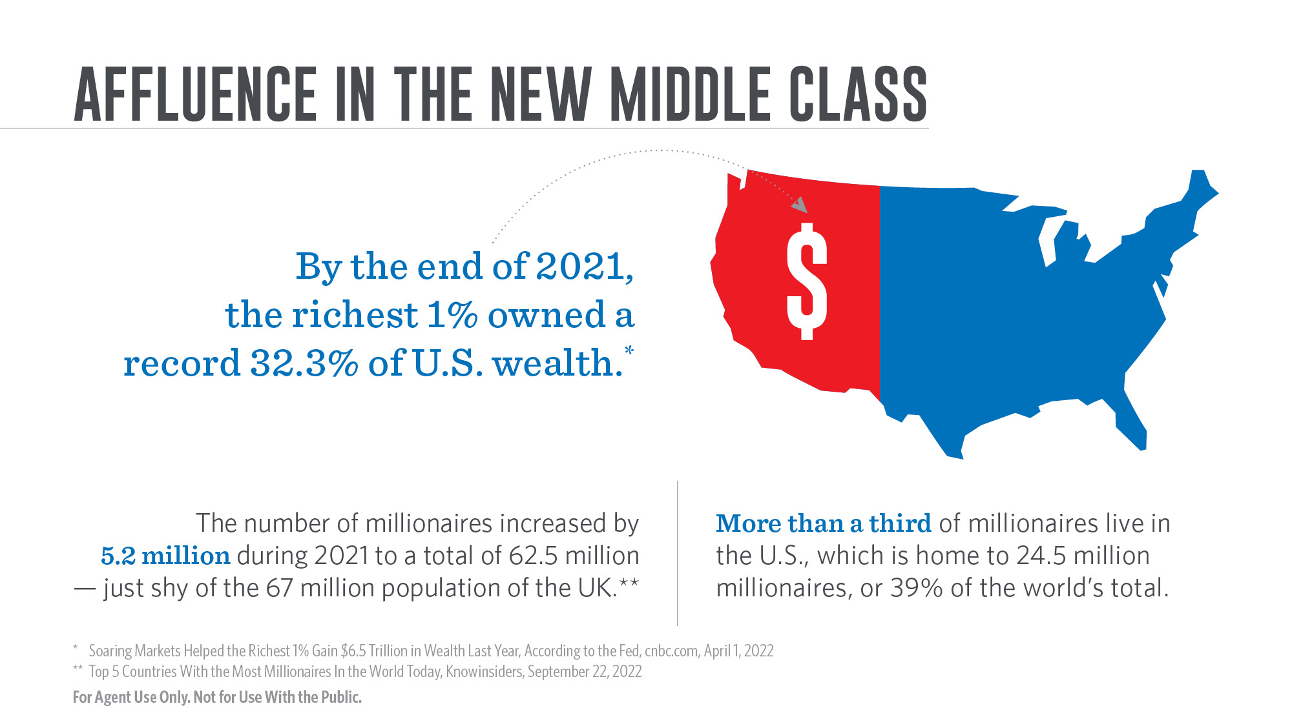
Notes:
Recent years have seen an increase in millionaires and wealth, especially here in the U.S.
[Read slide]
* “Soaring Markets Helped the Richest 1% Gain $6.5 Trillion in Wealth Last Year, According to the Fed,” cnbc.com, April 1, 2022
** “Top 5 Countries With the Most Millionaires In the World Today,” Knowinsiders, September 22, 2022

Slide 10
Notes:
[Review slide]

Slide 11
Notes:
Who is the target market for FCIUL?
[Read slide]

Slide 12
This slide was not in the original presentation but it made sense to include it
Notes:
Transamerica Financial Choice IUL determines an insured’s age based on their age last birthday. As an example, a 65-year-old who is within six months of their next birthday will still have an issue age of 65 rather than an age-nearest birthday resulting in an issue age of 66.
The product also offers a $1,000,000 face amount band that offers lower per thousand charges for policies issued at that face amount or higher.
[Read slide]
(Product features sourced internally)

Slide 13
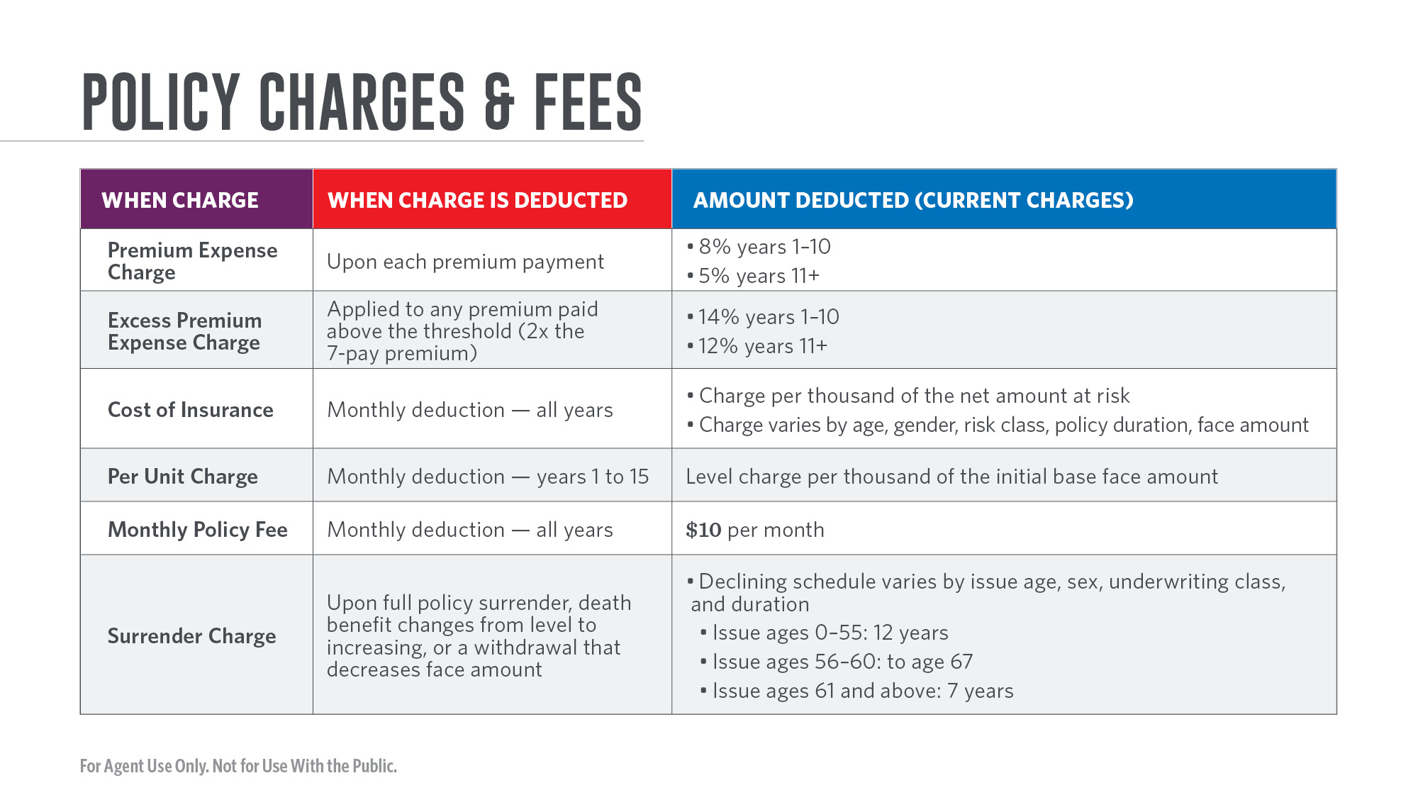
Notes:
Here is an overview of the different policy charges and fees.
[Read slide]
(Sourced internally)

Slide 14
Notes:
Here is a list of optional riders and living benefits available with FCIUL to help customize a client’s policy.
[Read slide]
(Sourced internally)

Slide 15
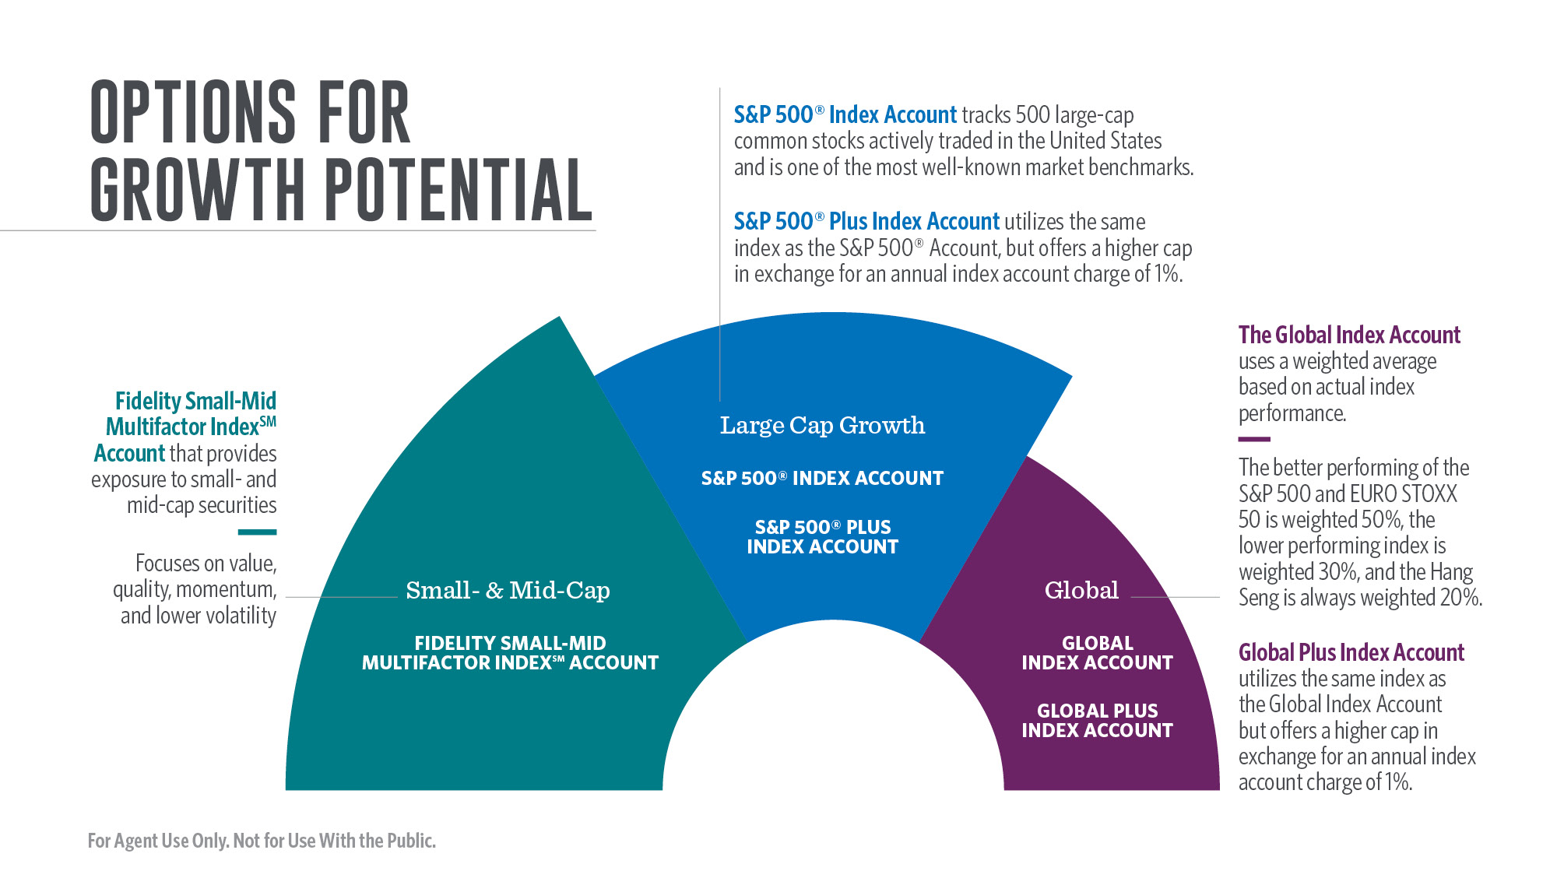
Notes:
FCIUL offers a variety of index accounts with small- ,mid-, and large-cap domestic and international exposure with the potential for growth.
[Read slide]

Slide 16
Notes:
[Read slide]

Slide 17
Notes:
Here’s a look at the various crediting strategies.
[Read slide]

Slide 18
Notes:
Here’s a closer look at the Fidelity Small-Mid Multifactor IndexSM.
[Read slide]

Slide 19
Notes:
An uncapped participation strategy, available on the Fidelity Small-Mid Multifactor IndexSM account, allows for participation in index growth up to the stated participation rate.
As an example, an uncapped participation strategy with a 200% participation rate would use 200% of the actual index performance in calculating the policy’s Excess Interest Credit. In the chart on the slide, a 2% index change would result in a 4% Excess Interest Credit due to participating in 200% of the actual index performance.
If the underlying index return is negative, a floor rate of 0.25% is applied to the policy’s cash value, providing protection in down market scenarios. Cash values may still decline in years where the floor rate of 0.25% is applied as FCIUL policy charges are deducted regardless of index performance.

Slide 20
Notes:
The Fidelity numbers are purely hypothetical and based on back-tested methodology because the index was not available in any of the years shown.

Slide 21
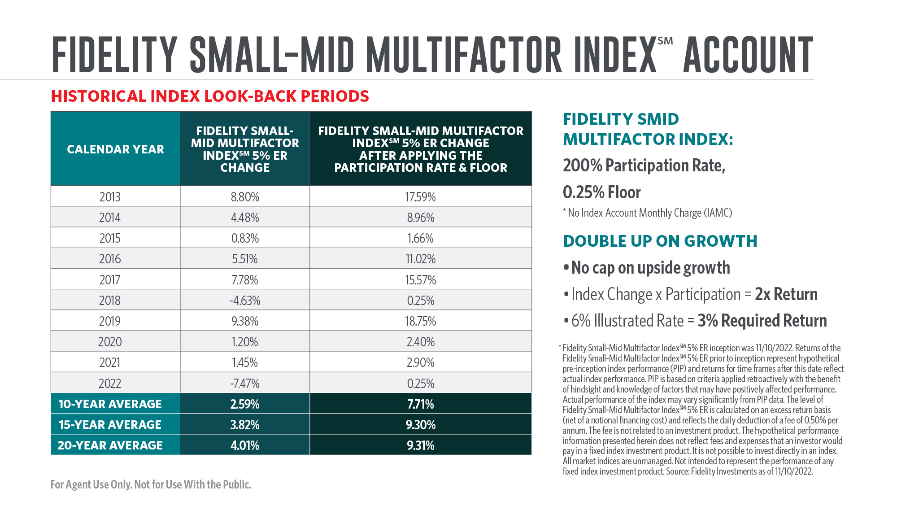
Notes:
Fidelity Small-Mid Multifactor IndexSM 5% ER inception was 11/10/2022. Returns of the Fidelity Small-Mid Multifactor IndexSM 5% ER prior to inception represent hypothetical pre-inception index performance (PIP) and returns for time frames after this date reflect actual index performance. PIP is based on criteria applied retroactively with the benefit of hindsight and knowledge of factors that may have positively affected performance. Actual performance of the index may vary significantly from PIP data. The level of Fidelity Small-Mid Multifactor IndexSM 5% ER is calculated on an excess return basis (net of a notional financing cost) and reflects the daily deduction of a fee of 0.50% per annum. The fee is not related to an investment product. The hypothetical performance information presented herein does not reflect fees and expenses that an investor would pay in a fixed index investment product. It is not possible to invest directly in an index. All market indices are unmanaged. Not intended to represent the performance of any fixed index investment product. Source: Fidelity Investments as of 11/10/2022.
Please note: the 0.50% per annum referenced in above disclosure is not a charge but is a reduction in returns that is passed back to the policy holder through a higher participation rate.”
The look-back periods are for illustrative purposes only. The IUL policy was not available during all of the time periods shown. Participation Rates and Caps are subject to change at the discretion of the Company and will be different over different time periods. Any change to those rates would produce different hypothetical results. Index changes measured on different dates would produce different hypothetical results. The “Average Index Change” shows the geometric averages of one-year historical index changes (excluding dividends) ending December 15 for each year during the time period shown. “Average Index Change After Participation Rate & Floor” shows the averages that would have resulted from applying the participation rate and then the floor. Monthly deductions and other policy fees and charges are not taken into consideration. Past index performance is not an indication of future index performance.

Slide 22
Notes:
The S&P 500® Index Account will never be credited less than the guaranteed minimum interest rate or floor and has the potential to be credited with Excess Index Interest up to the current Cap. The “Credit Net of 1% Fee” does not take into account policy charges deducted from the cash value.
The look-back periods are for illustrative purposes only. The IUL policy was not available during all of the time periods shown. The Caps are subject to change at the discretion of the Company and will be different over different time periods. A lower or higher Cap would produce different hypothetical results. Index changes measured on different dates would produce different hypothetical results. The “Average Index Change” shows the geometric averages of one-year historical index changes (excluding dividends) ending December 15 for each year during the time period shown. “Average Index Change Using Cap & Floor” shows the averages that would have resulted from applying the policy’s current Cap and floor to the index changes for the same time periods. Monthly deductions and other policy fees and charges are not taken into consideration. Past index performance is not an indication of future index performance.

Slide 23
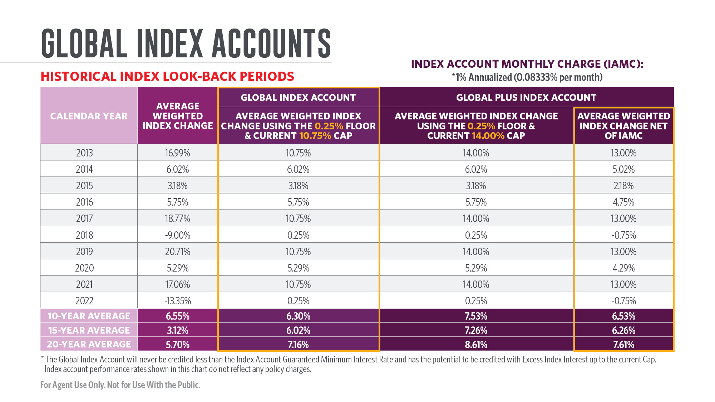
Notes:
The Global Index Account will never be credited less than the guaranteed minimum interest rate or floor and has the potential to be credited with Excess Index Interest up to the current Cap. The “Credit Net of 1% Fee” does not take into account policy charges deducted from the cash value.
The look-back periods are for illustrative purposes only. The IUL policy was not available during all the time periods shown. The Caps are subject to change at the discretion of the Company and will be different over different time periods. A lower or higher Cap would produce different hypothetical results. Index changes measured on different dates would produce different hypothetical results. The “Average Index Weighted Change” shows the geometric averages of one-year historical index changes (excluding dividends) ending December 15 for each year during the time period shown. “Average Weighted Index Change Using Cap & Floor” shows the averages that would have resulted from applying the policy’s current Cap and floor to the index changes for the same time periods. Monthly deductions and other policy fees and charges are not taken into consideration. Past index performance is not an indication of future index performance.

Slide 24
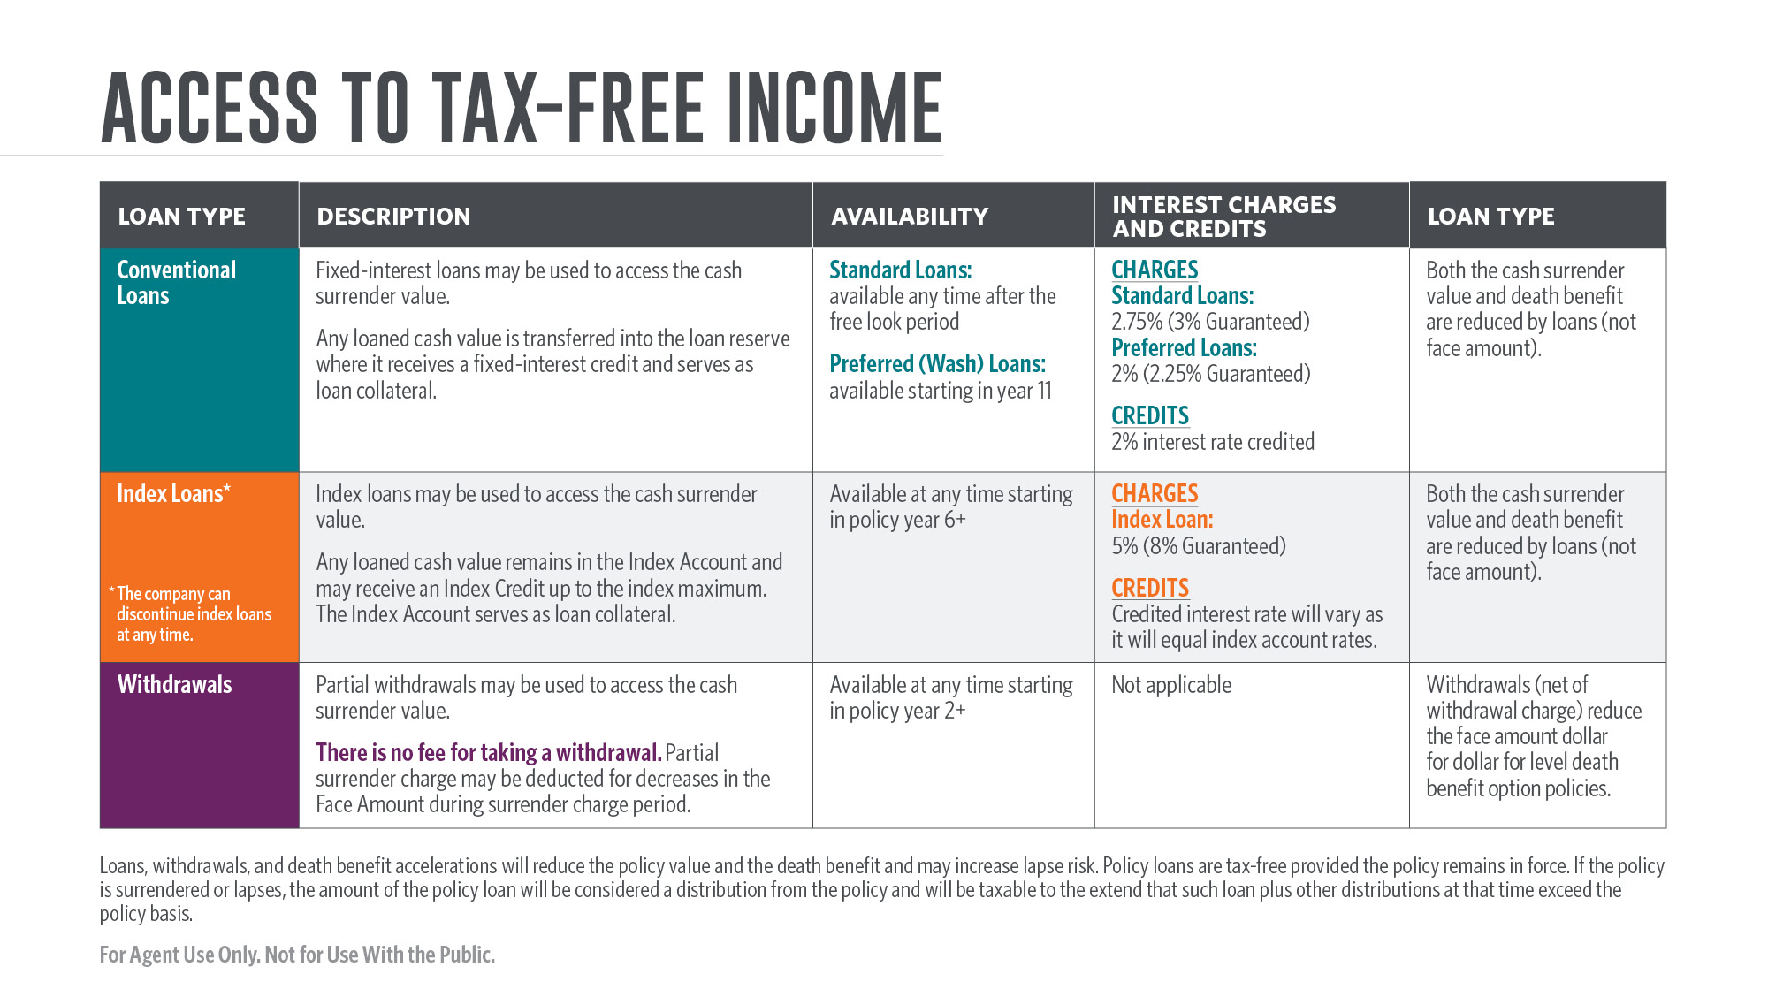
Notes:
There are three ways a policyholder can access income.
[Read slide]
(Use illustration disclosure)

Slide 25
Notes:
Clients purchasing an FCIUL policy may be eligible for expanded nonmed underwriting.
With nonmed face amounts up to $2,000,000 available for ages 18–45 and up to $1,000,000 for ages 46–55, the policy owner may be able to fund the policy with a significant level of premiums without the requirement for exams or labs. As an example, a 45-year-old male (Preferred Elite) could pay a maximum non-MEC annual premium of $123,938 for 10 years at a face amount of $2,000,000 with an increasing death benefit option and GPT. That is a total of $1.26 million of premium over 10 years. A 55-year-old male (Preferred Elite) could pay a maximum non-MEC annual premium of $86,369 for 10 years at an initial face amount of $1,000,000 with an increasing death benefit option and GPT. That is a total of $863,690 of premium over 10 years.
Note: Not all applicants will qualify for nonmedical underwriting. It is not guaranteed issue and the underwriter reserves the right to request additional medical exams and data.

Slide 26
Notes:
Let’s take a look at two case studies to get a better idea of how an FCIUL policy could benefit a client in different scenarios.

Slide 27
Notes:
For clients seeking permanent death benefit protection and the potential for cash value growth, FCIUL may be able to help them save additional funds for retirement. Let’s look at the first case study on a hypothetical client, a 45-year-old male in good health (Preferred Elite), who is married with three children and is earning $275,000 per year at his job as a physician. He is currently contributing the maximum amount to his 401(k) and would like to save more for retirement while providing financial protection for his family.
The client chooses to supplement his existing term insurance coverage and purchases a Transamerica Financial Choice IUL with an initial face amount of $312,000 and an annual premium of $20,000 that will be funded to his attained age 65. At attained age 65, the policy has a nonguaranteed cash value of $678,238 based on a hypothetical 6% Excess Interest Crediting rate. The client chooses to begin accessing his policy’s cash value starting at age 66 to supplement his retirement income. Using withdrawals to basis and then switching to conventional loans, the client could receive distributions of $58,272 per year for 20 years. That is a total of roughly $1.2 million at attained age 85.

Slide 28
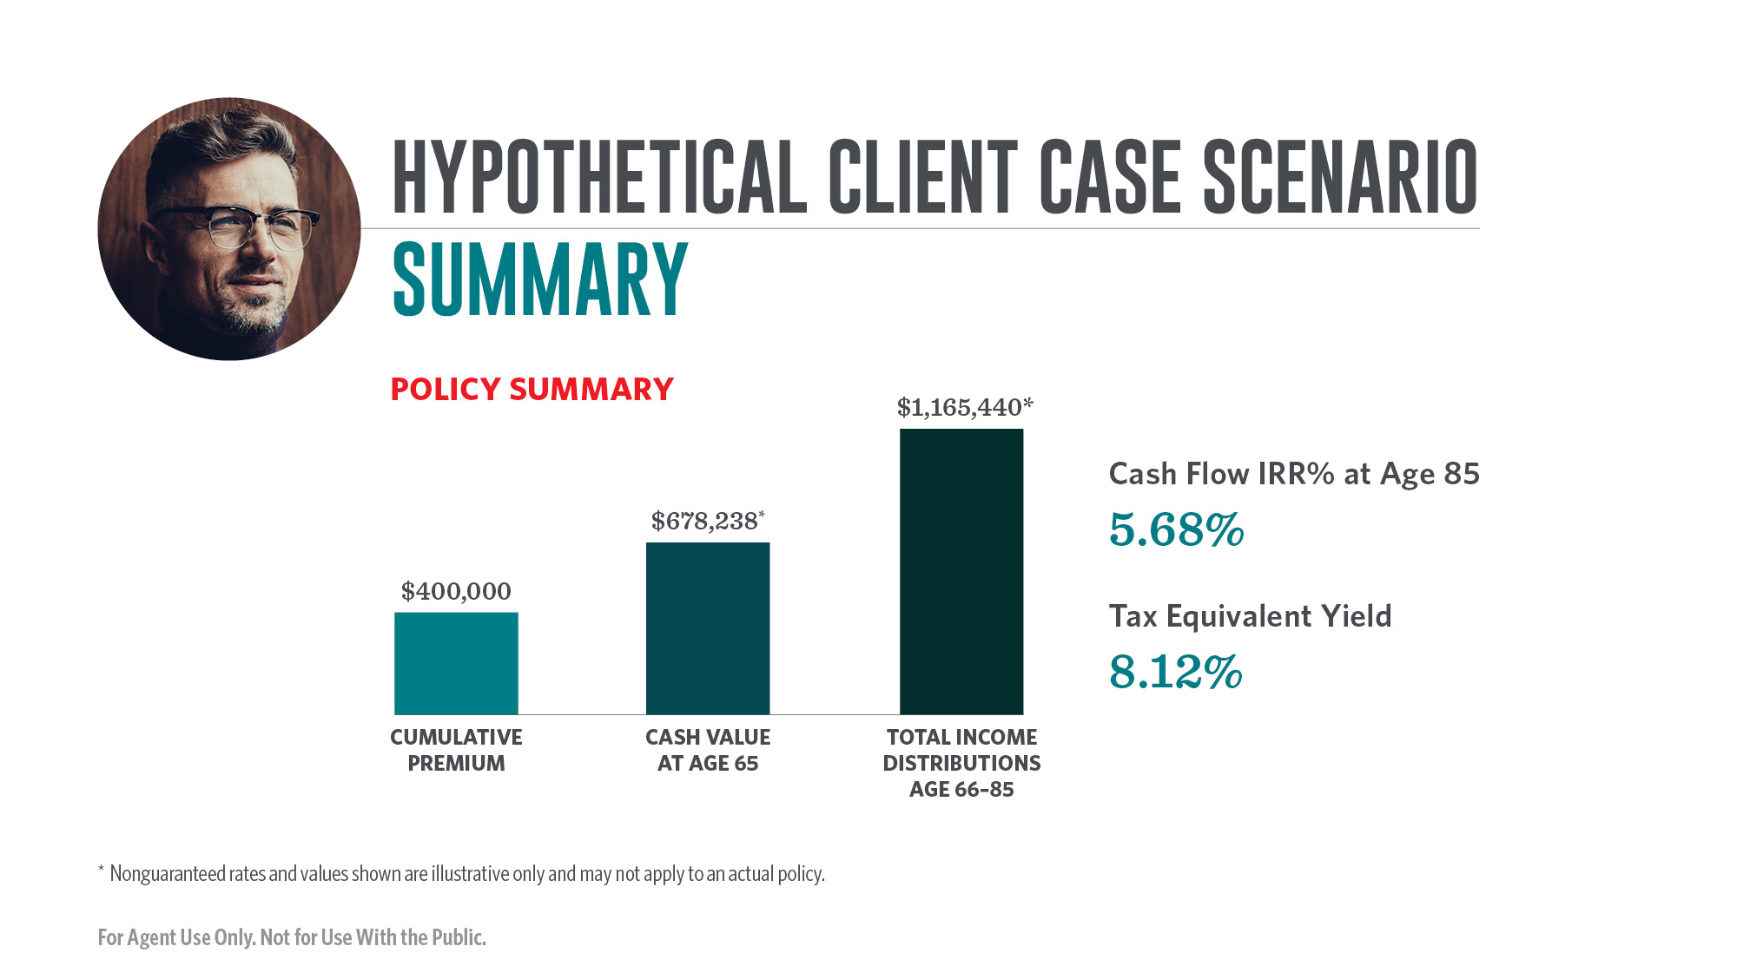
Notes:
The summary above illustrates the cumulative scheduled premiums of $20,000 per year over 20 years, a total of $400,000. After paying all scheduled premiums, the policy could have a nonguaranteed cash surrender value at attained age 65 (year 20) of $678,238.
The client chooses to begin accessing his policy’s cash value starting at age 66 to supplement his retirement income. Using withdrawals to basis and then switching to conventional loans, the client could [potentially] receive distributions of $58,272 per year for 20 years. That is a total of nearly $1.2 million at attained age 85.
Comparing the premiums paid to the income received results in a Cash Flow Internal Rate of Return (IRR%) of 5.68%. Assuming the client had a combined federal and state tax bracket of 35%, this results in a tax-equivalent yield of 8.12%.

Slide 29
Notes:
Many clients saving for retirement like the tax advantages of a Roth IRA, including tax-free accumulation, tax-free distributions, and the ability to avoid having required minimum distributions (RMDs) that Traditional IRAs require.
The current maximum Roth IRA contribution for 2023 is $6,500 per year for clients below age 50 and $7,500 per year for ages 50 and above. For high-earning clients who are already maximizing their 401(k) contributions and contributing to a Roth IRA, another financial vehicle may be desirable to supplement their retirement savings.
Other clients may earn too much to be able to contribute to a Roth IRA. For 2022, clients who file as single may not contribute to a Roth IRA if they earn $153,000 or more in Modified Adjusted Gross Income. For clients who file as Married Filing Jointly and earn $228,000 or more, they are also prohibited from contributing any funds to a Roth IRA.
For clients who would like to contribute more than a Roth IRA allows or those who cannot contribute to a Roth IRA, permanent cash value life insurance such as Transamerica Financial Choice IUL may be an ideal way for clients to supplement their retirement savings while gaining needed financial protection for their families in the event of a premature death.

Slide 30
Notes:
Cash value life insurance offers similar tax advantages as a Roth IRA while also providing death benefit protection. When properly structured, cash value life insurance allows for tax-free accumulation, tax-free distributions via withdrawals to basis and loans, and an income tax-free death benefit. Additionally, there are no required minimum distributions and no contribution limits with a cash value life insurance policy (subject to face amount and premium limitations). Finally, there is no tax penalty for taking distributions prior to age 59½ on a cash value life insurance policy assuming the policy is not a modified endowment contract (MEC).

Slide 31
Notes:
Transamerica’s foreign national and international underwriting has a number of competitive advantages in the market, including: a minimum face amount requirement of just $250,000, the counting of a client’s global net worth in the determination of assets to qualify for underwriting, broadly considering the U.S. presence of applicants, and using creative solutions to facilitate policy delivery to clients.

Slide 32
Notes:
[Read slide]

Slide 34
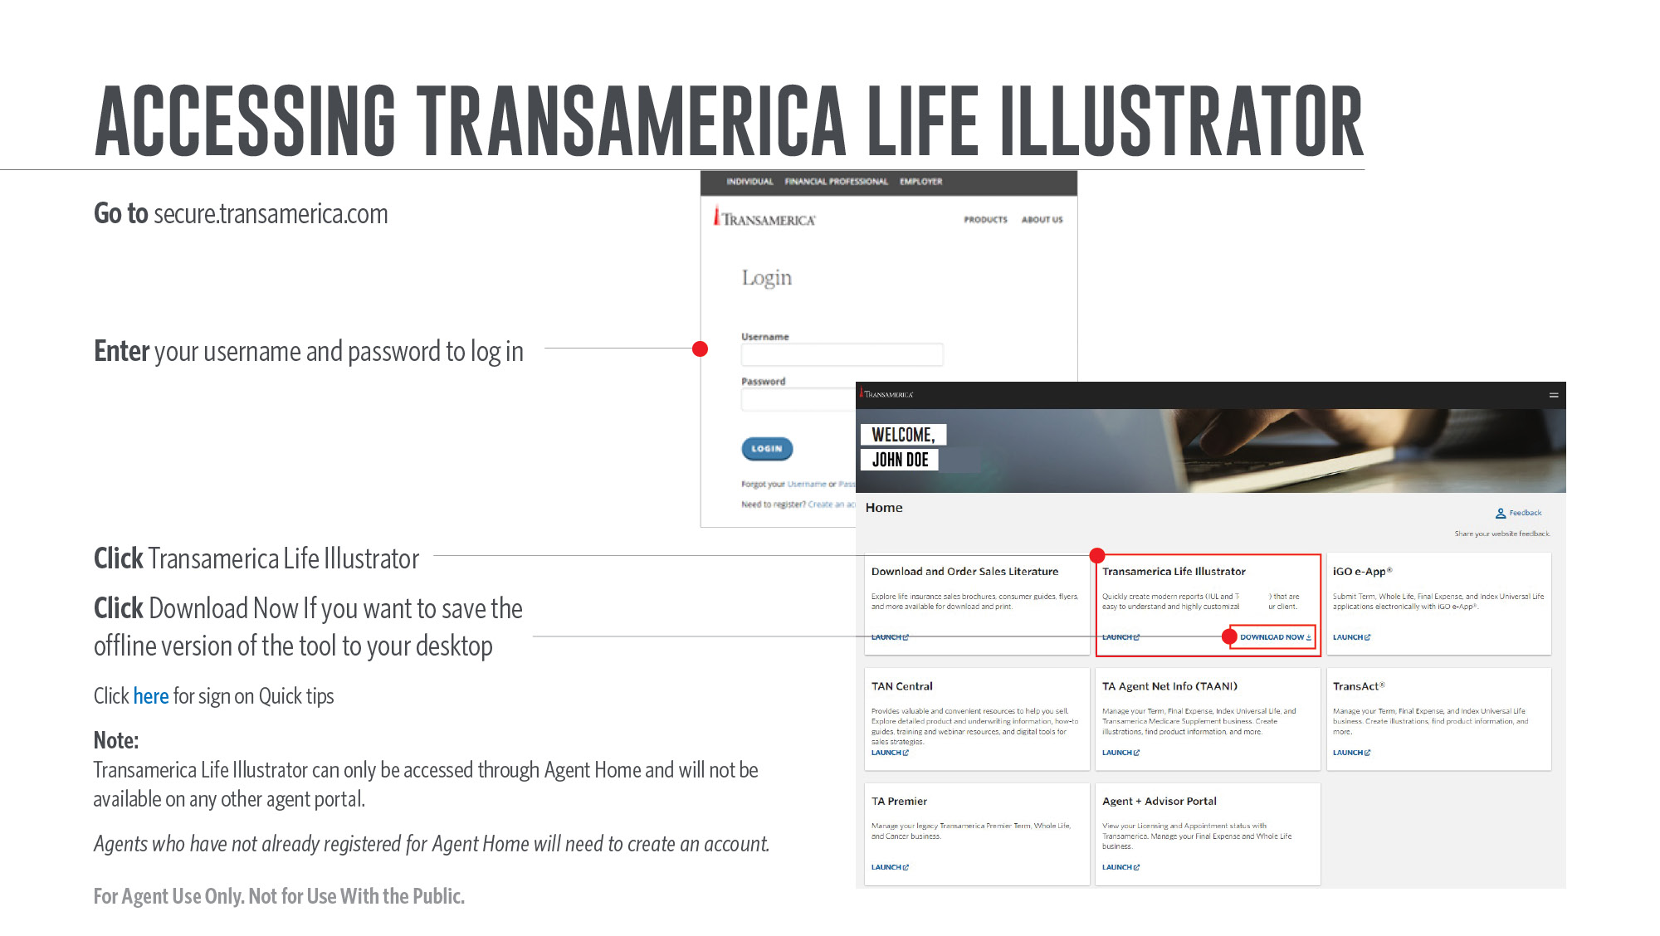
Notes:
[Review slide]

Slide 35
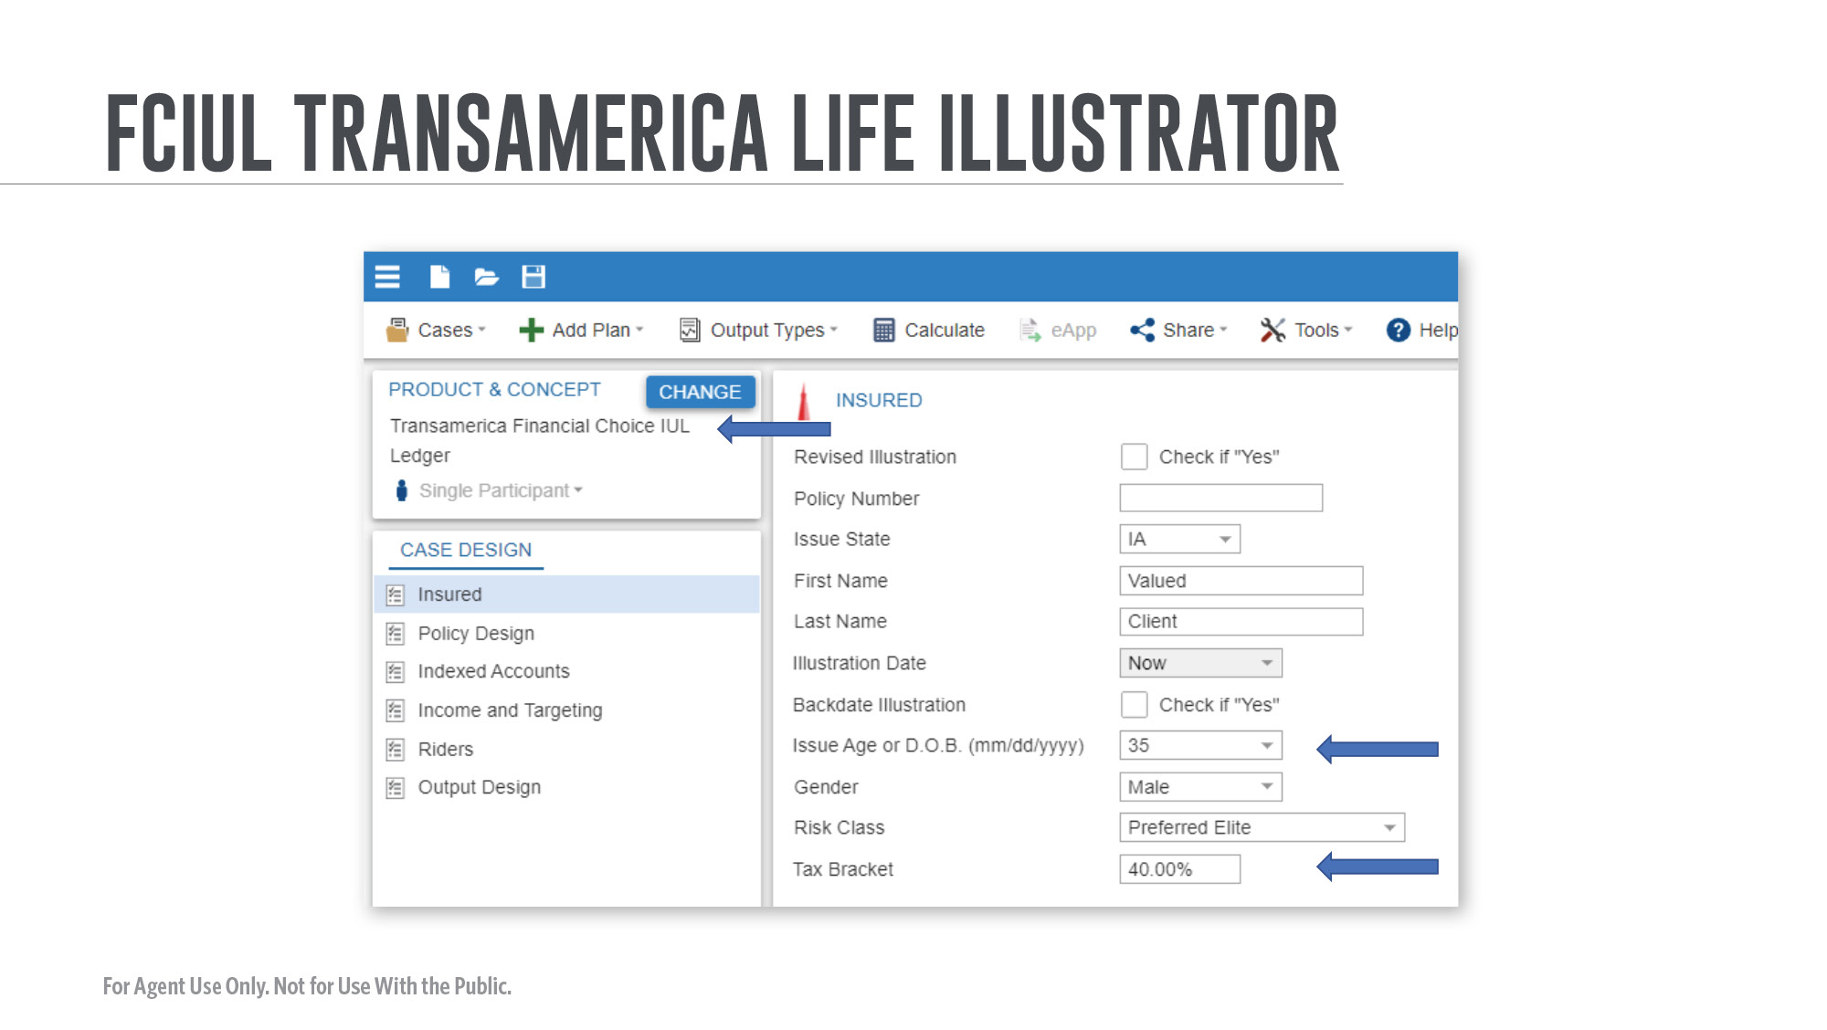
Notes:
[Review slide]

Slide 36
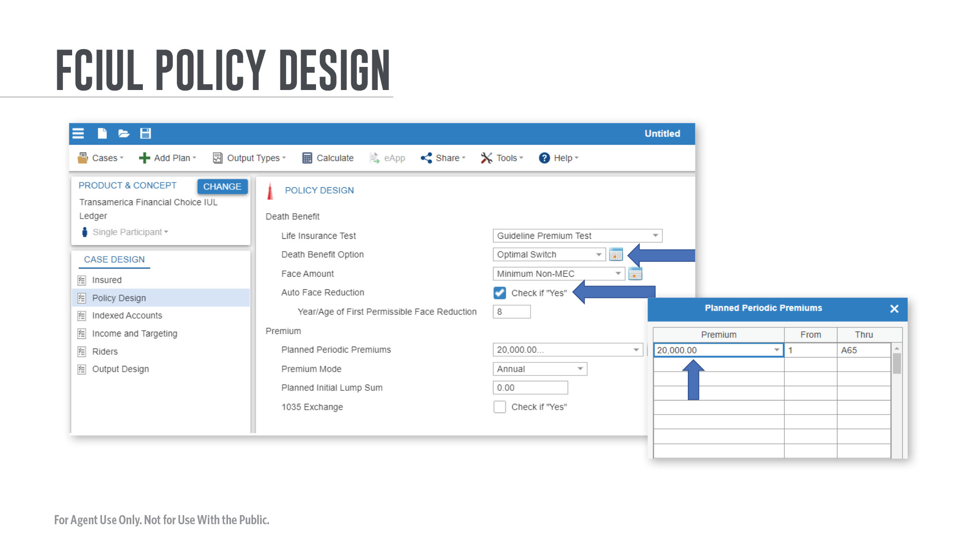
Notes:
[Review slide]

Slide 37
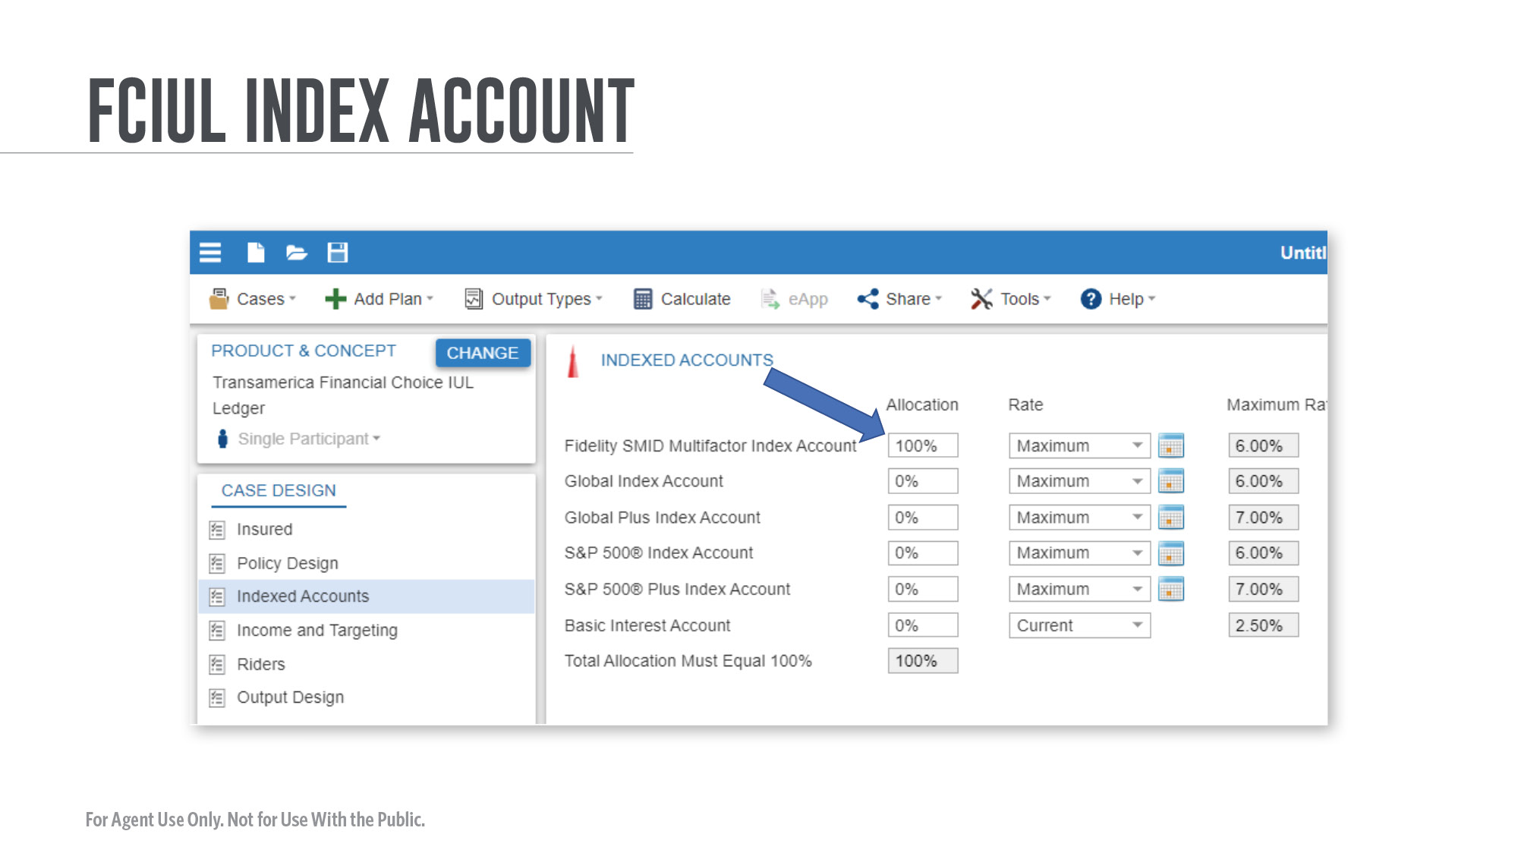
Notes:
[Review slide]

Slide 38
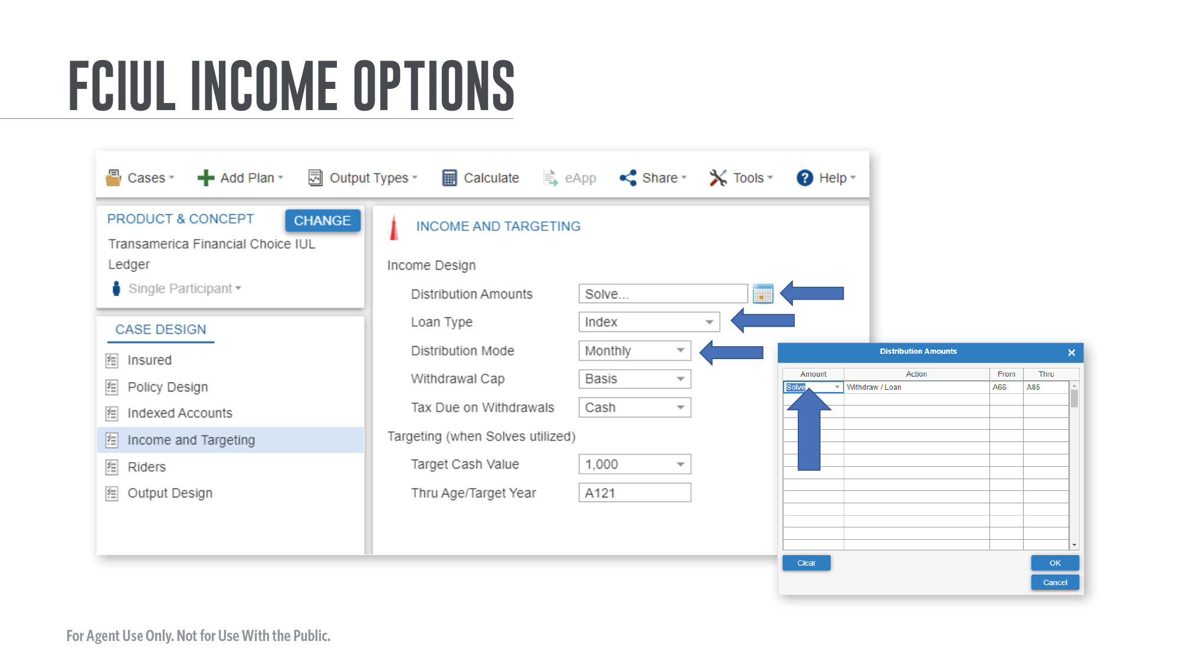
Notes:
[Review slide]

Slide 39
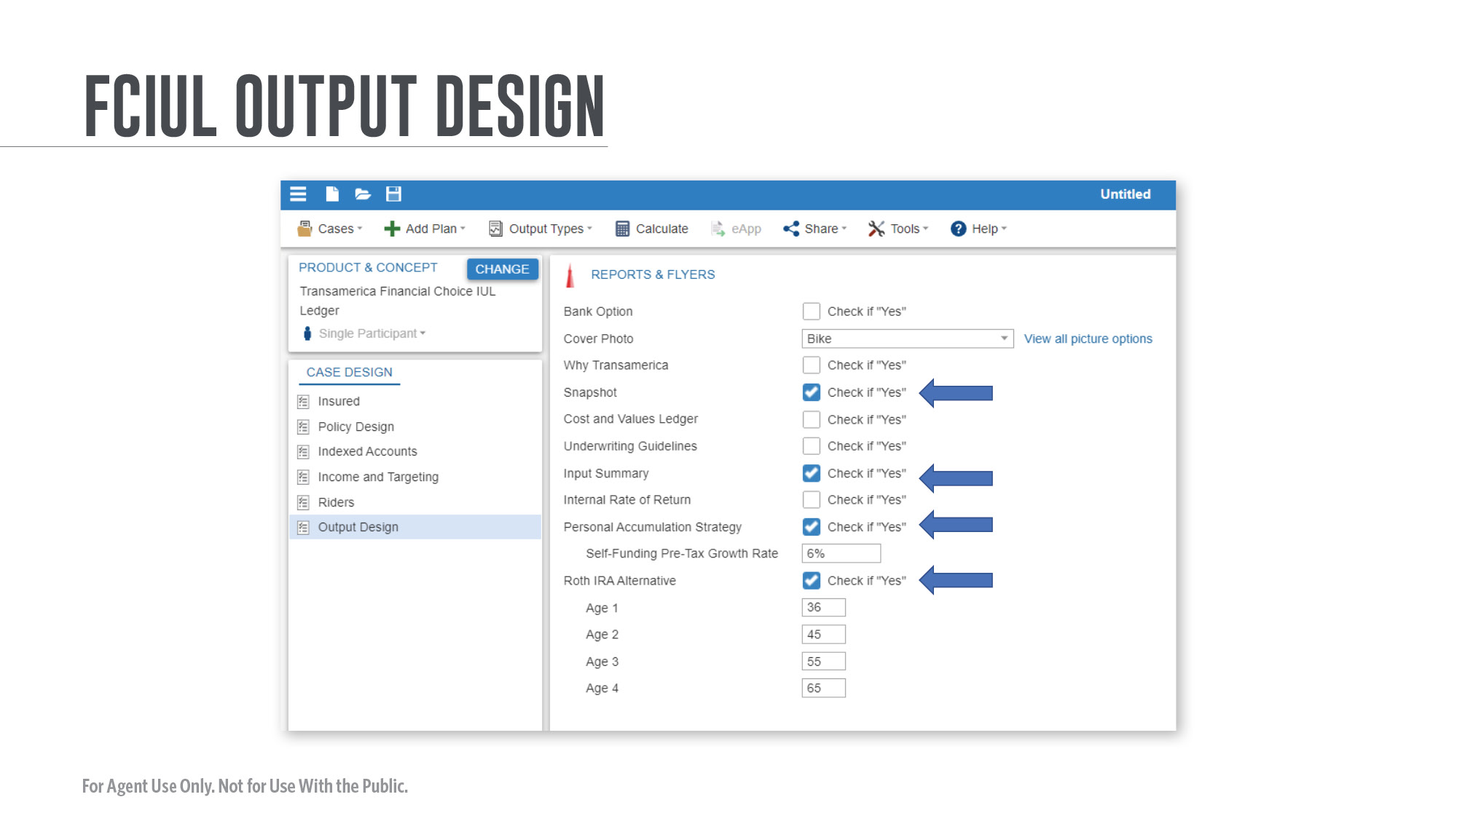
Notes:
[Review slide]

Slide 40
Notes:
[Review slide]

Slide 41
Notes:
The new projections page in Life Illustrator makes it easy to compare guaranteed and non-guaranteed projections versus the old myTransware page.
[Review slide]

Slide 42
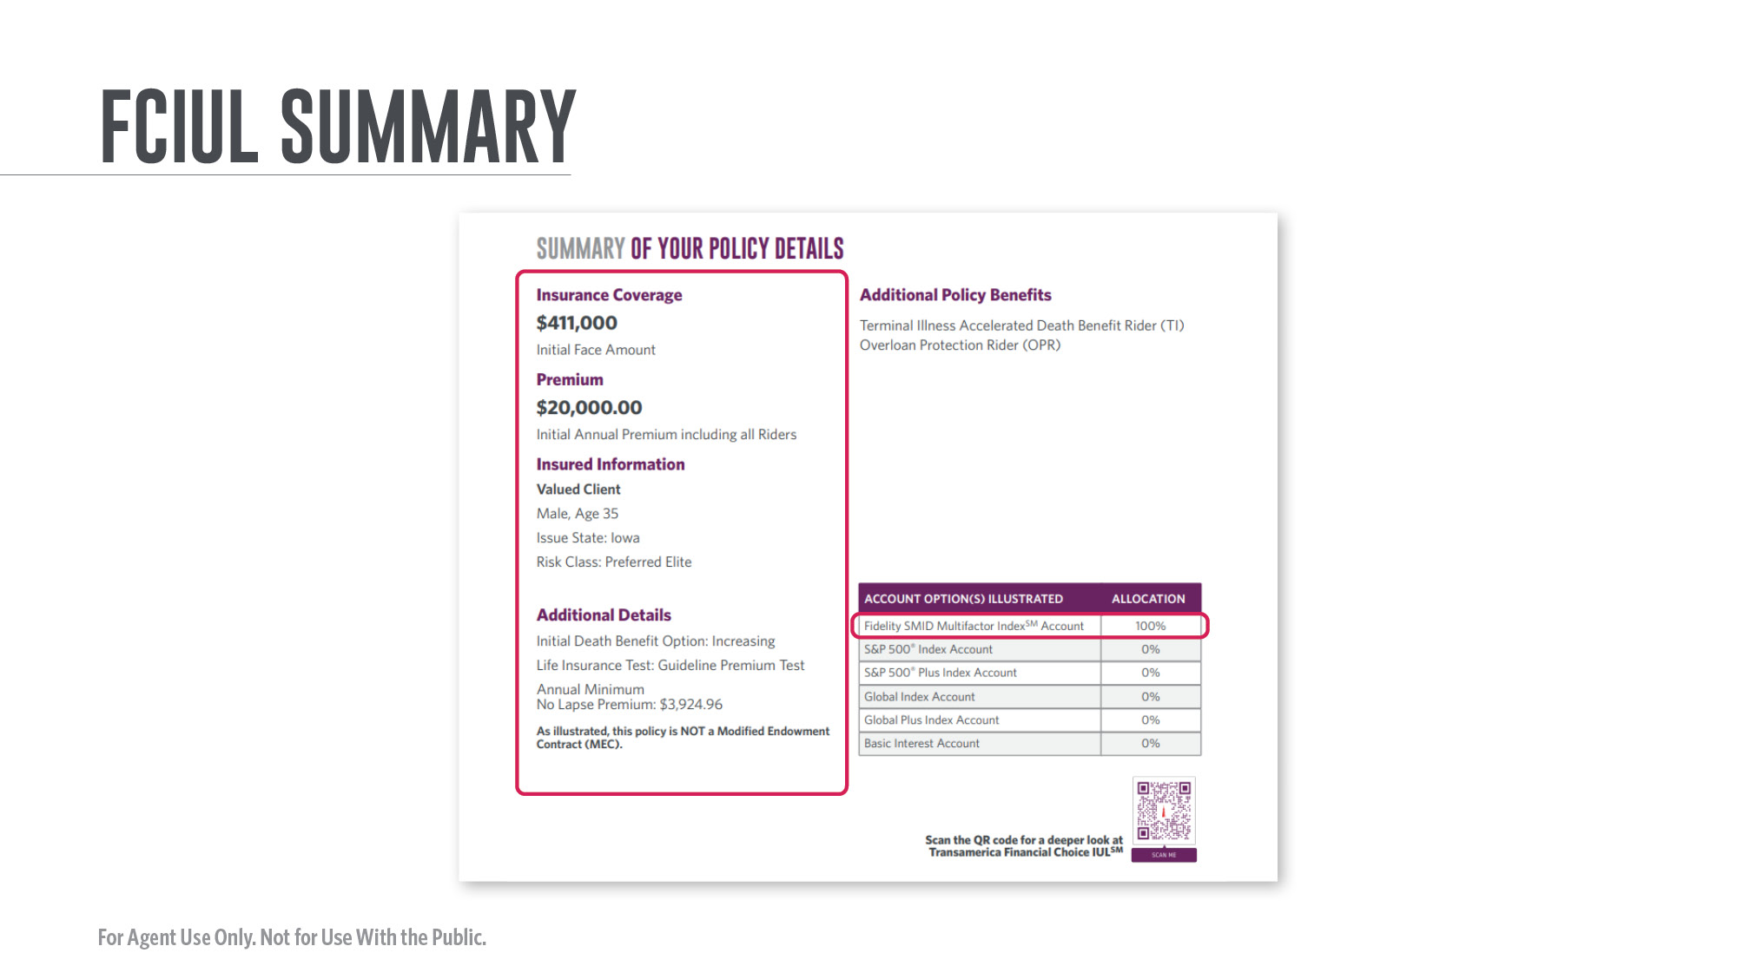
Notes:
[Review slide]

Slide 43
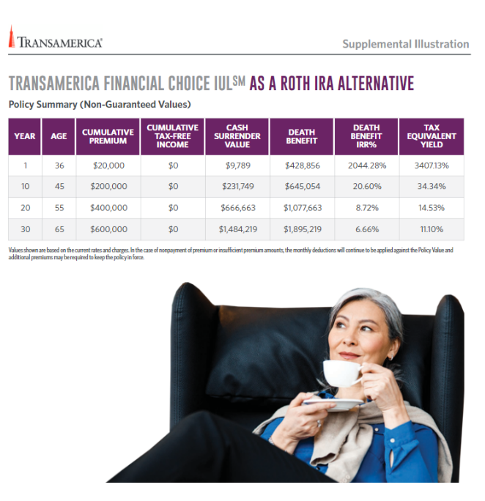
Notes:
And it presents information in a very visual style with easy-to-read color graphics. This is a powerful sales tool for you to use.
[Review slide]

Slide 44
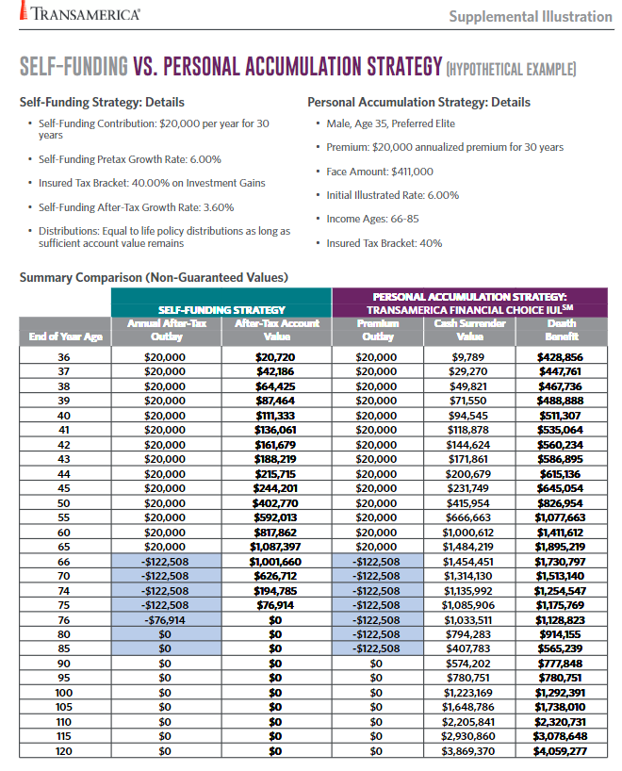
Notes:
[Review slide]

Slide 45
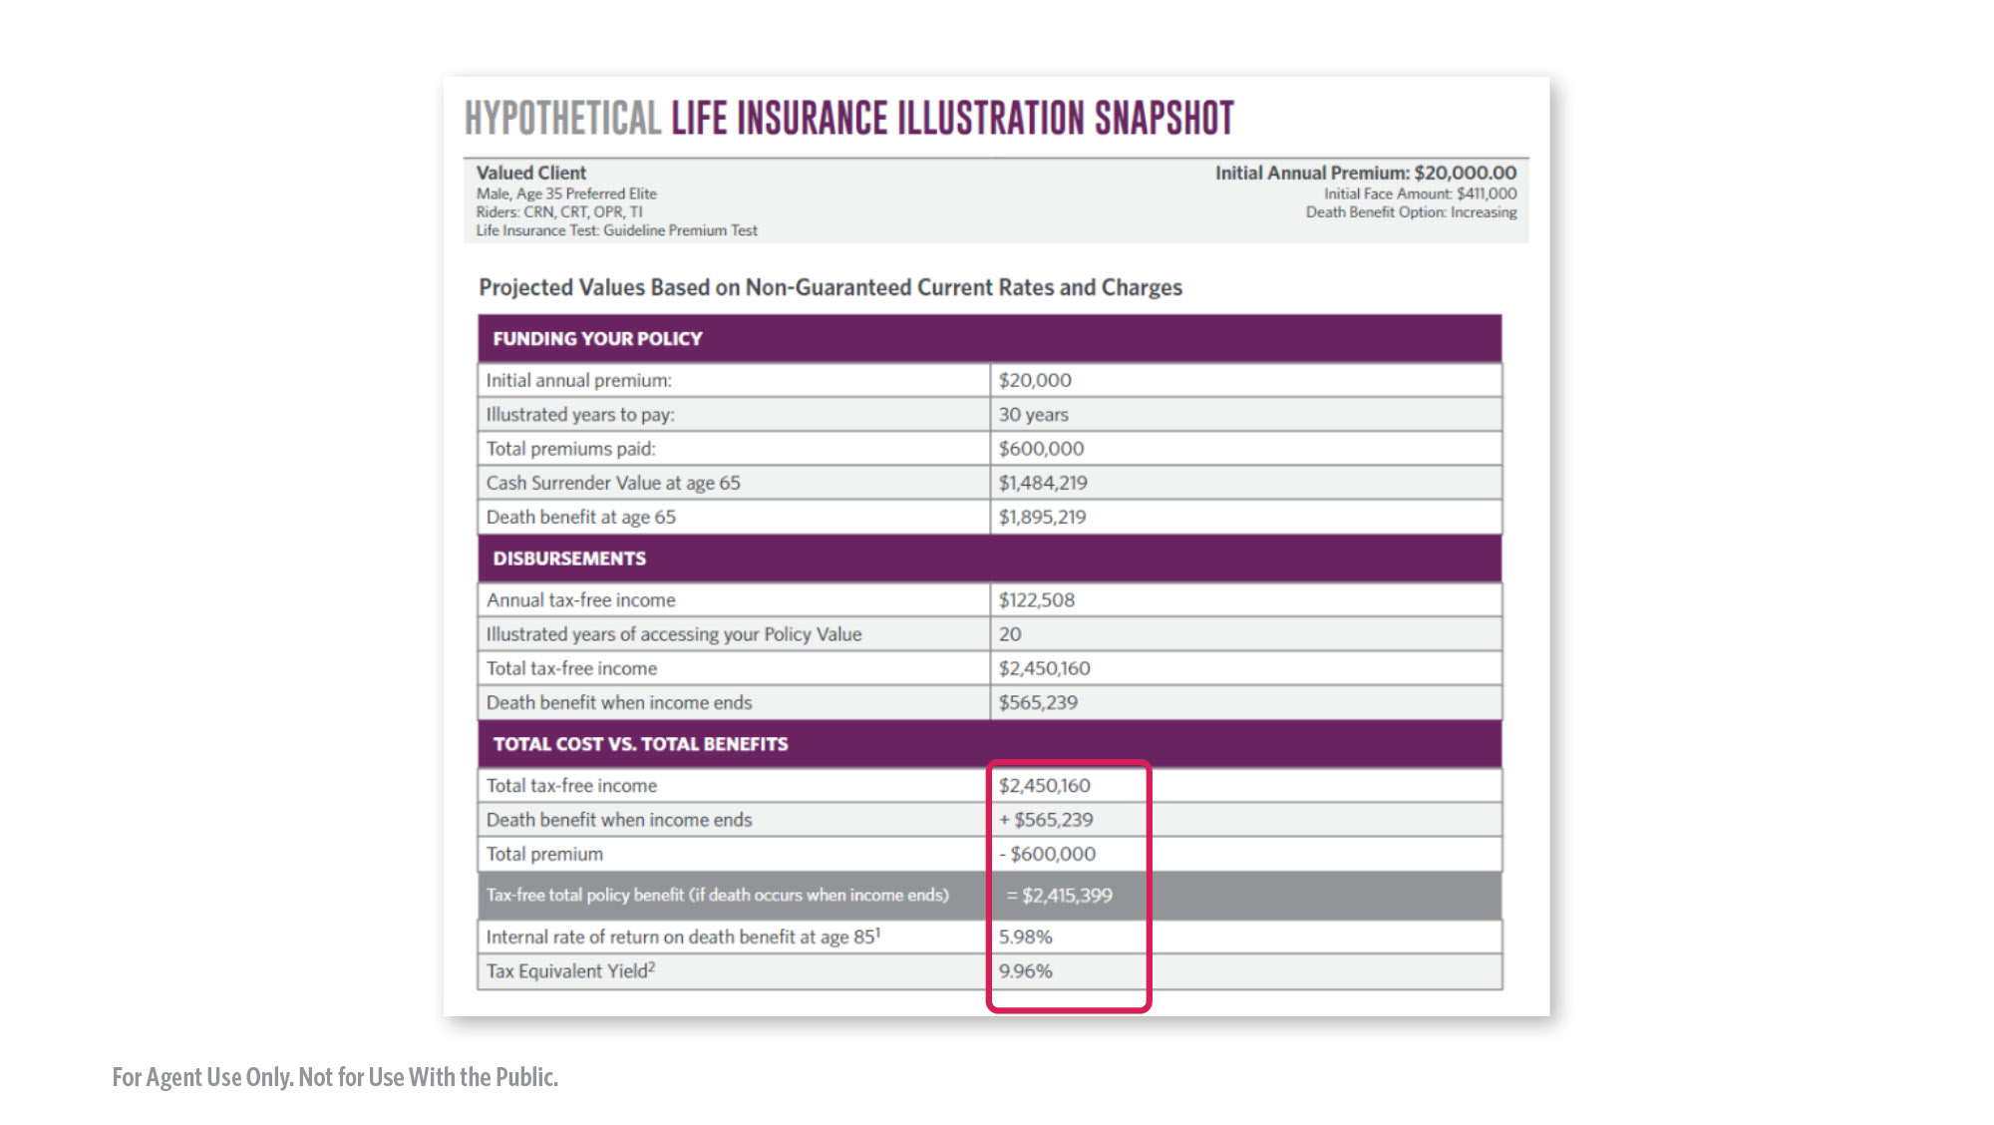
Notes:
[Review slide]

Slide 46
Notes:
[Review slide]

Slide 47
Notes:
With the introduction of FCIUL, we've created a list of resources to explore. Take a moment here and capture the QR code to review these additional resources.

Slide 48
Notes:
[Review slide]

Slide 49
Notes:
[Review slide]

Slide 50
Notes:
Please review these important disclosures.

Slide 51
Notes:
Thank you for your time today. I’m now happy to answer any questions you may have.

