Slide 1
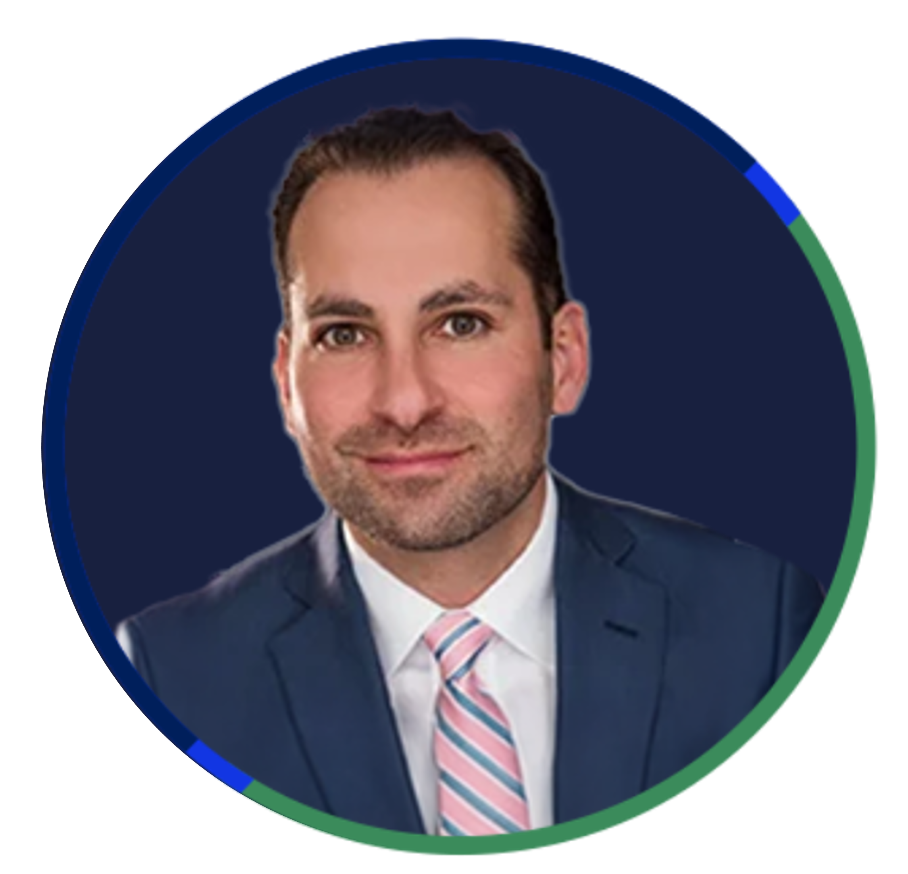
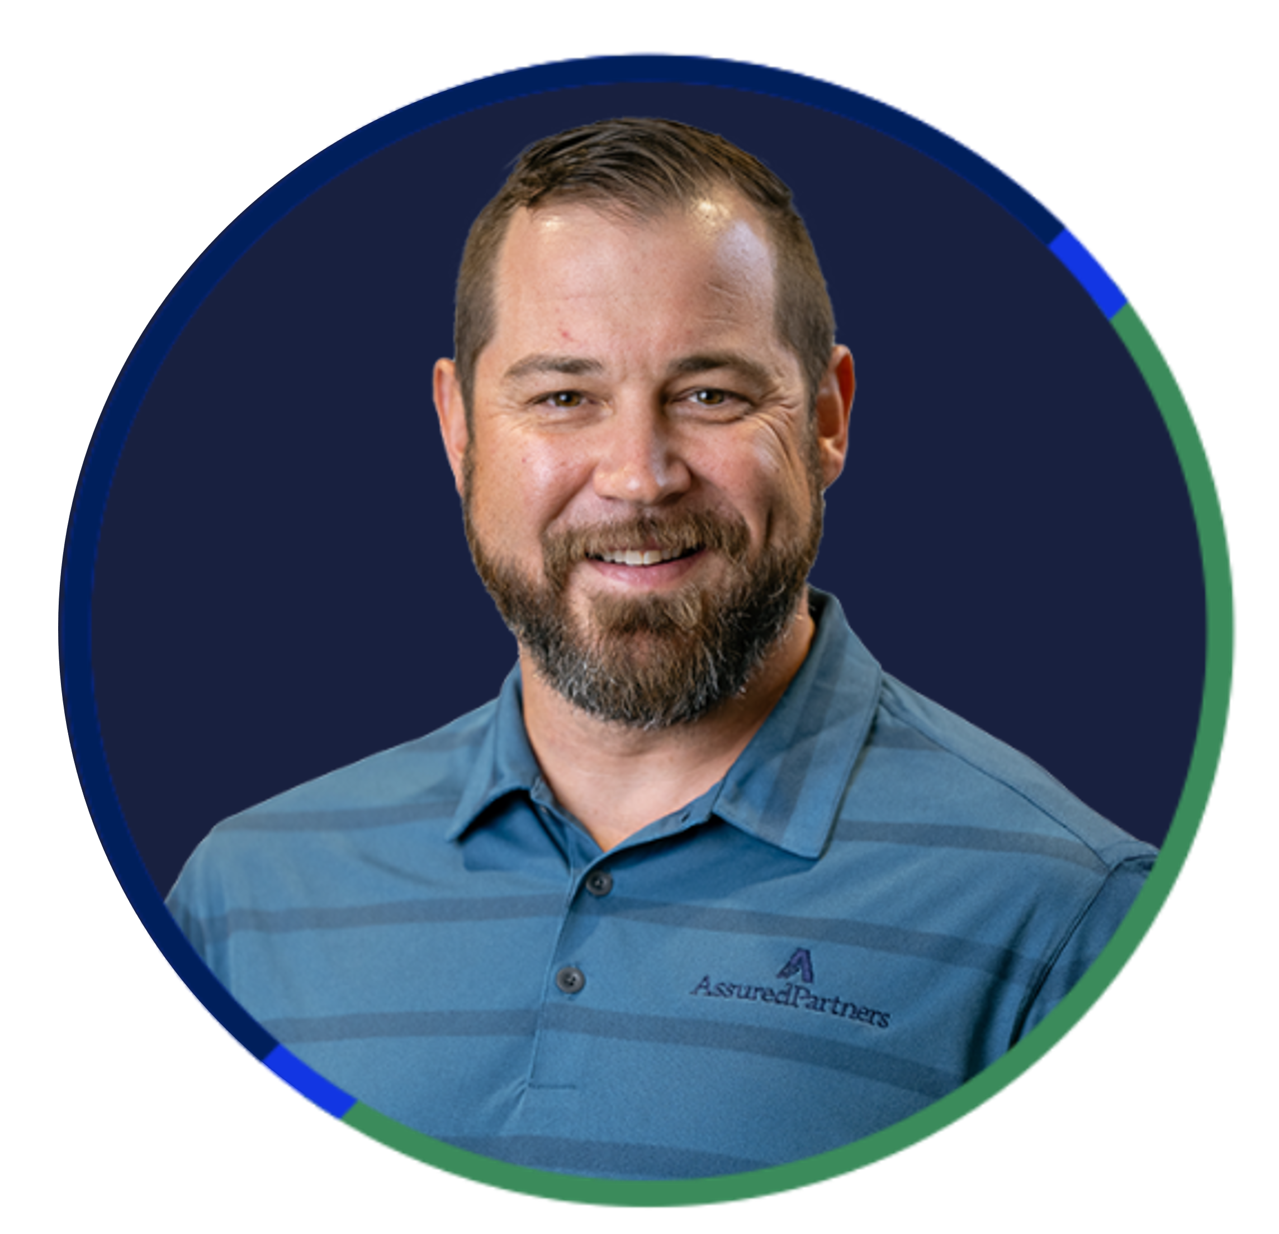
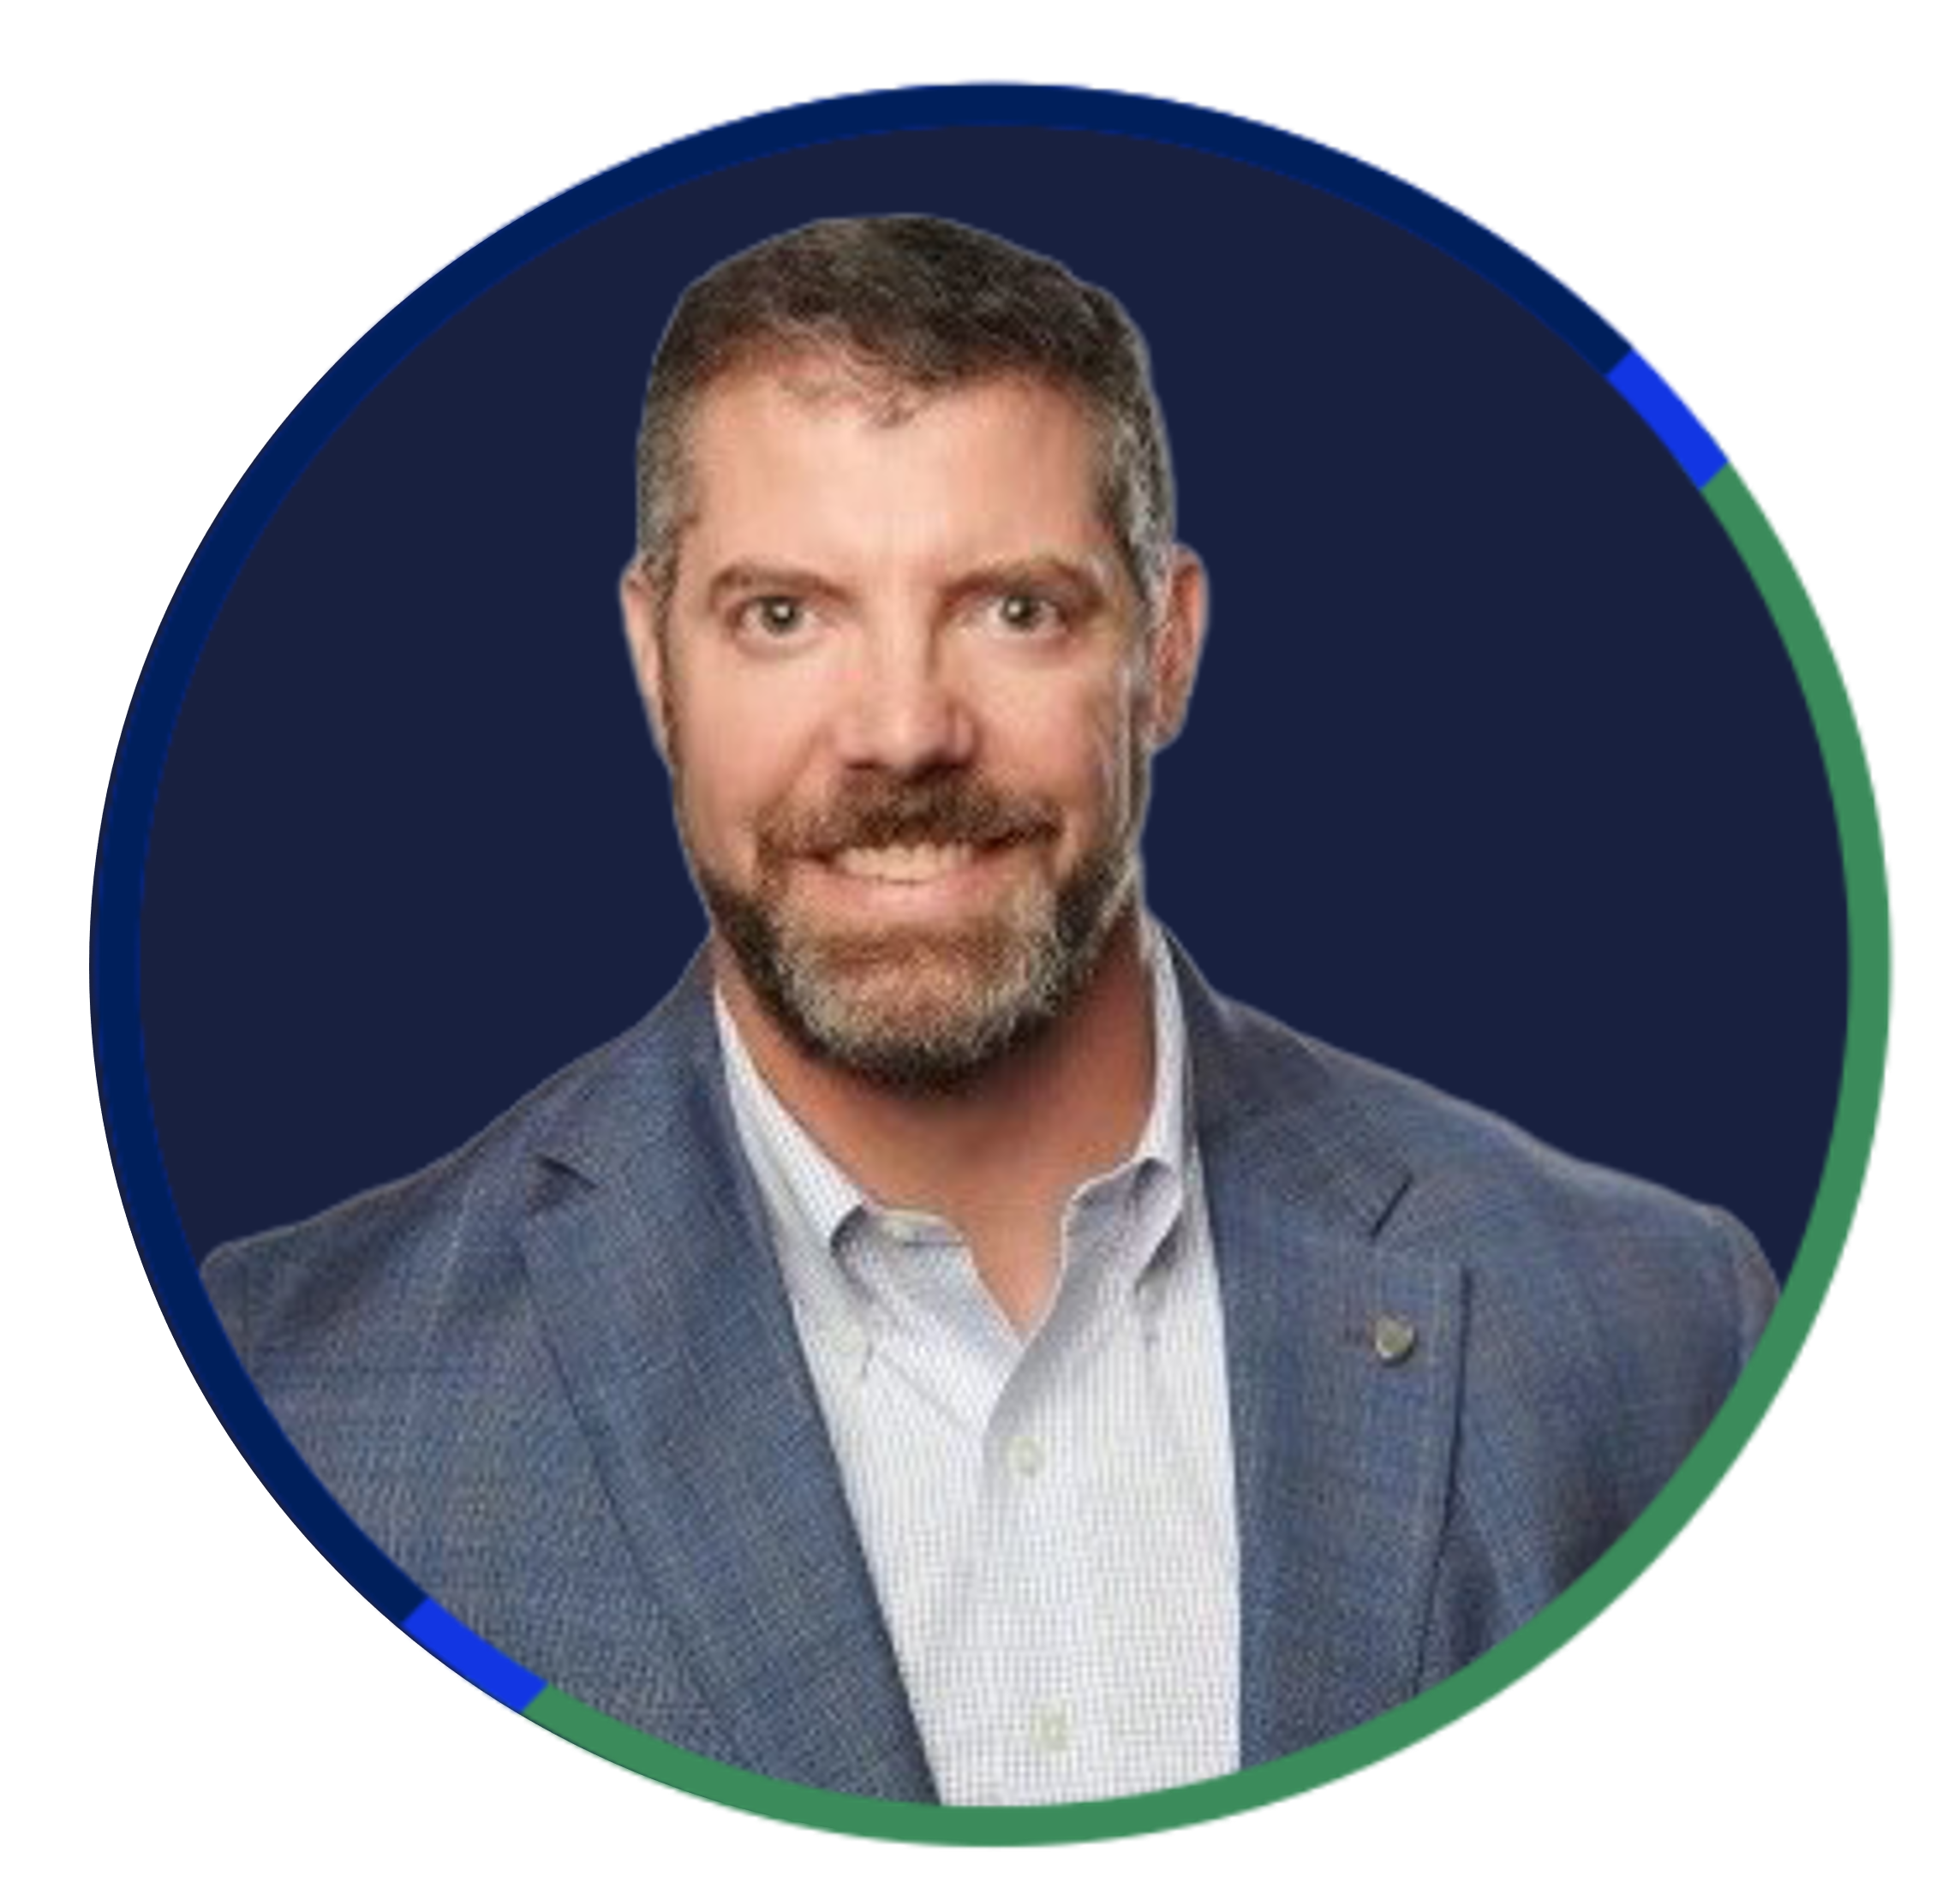
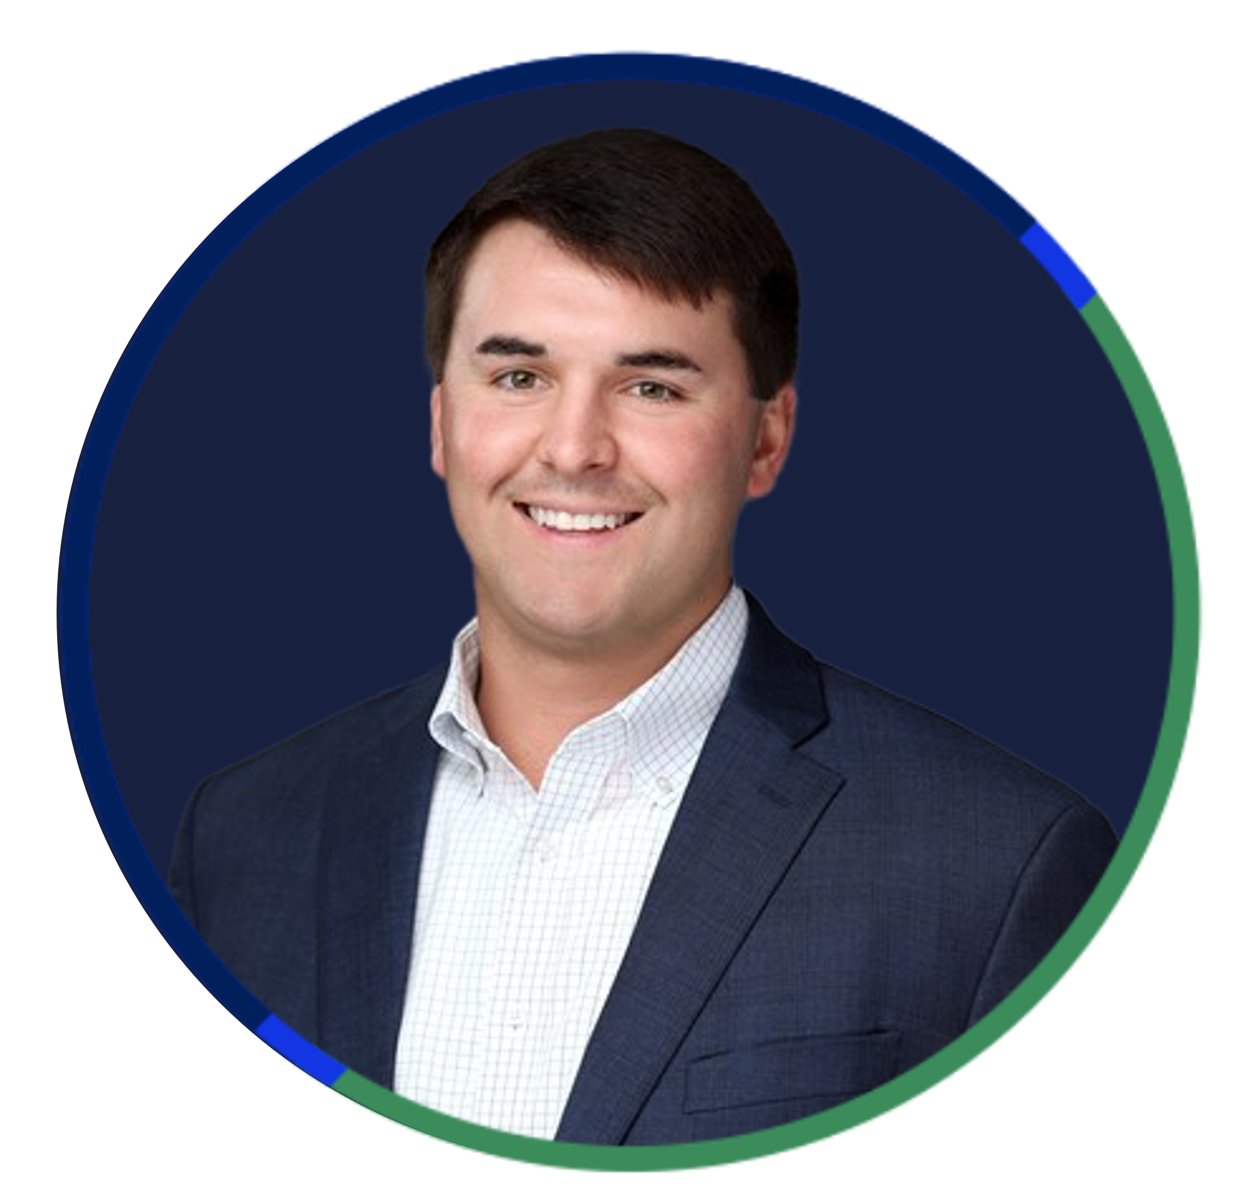
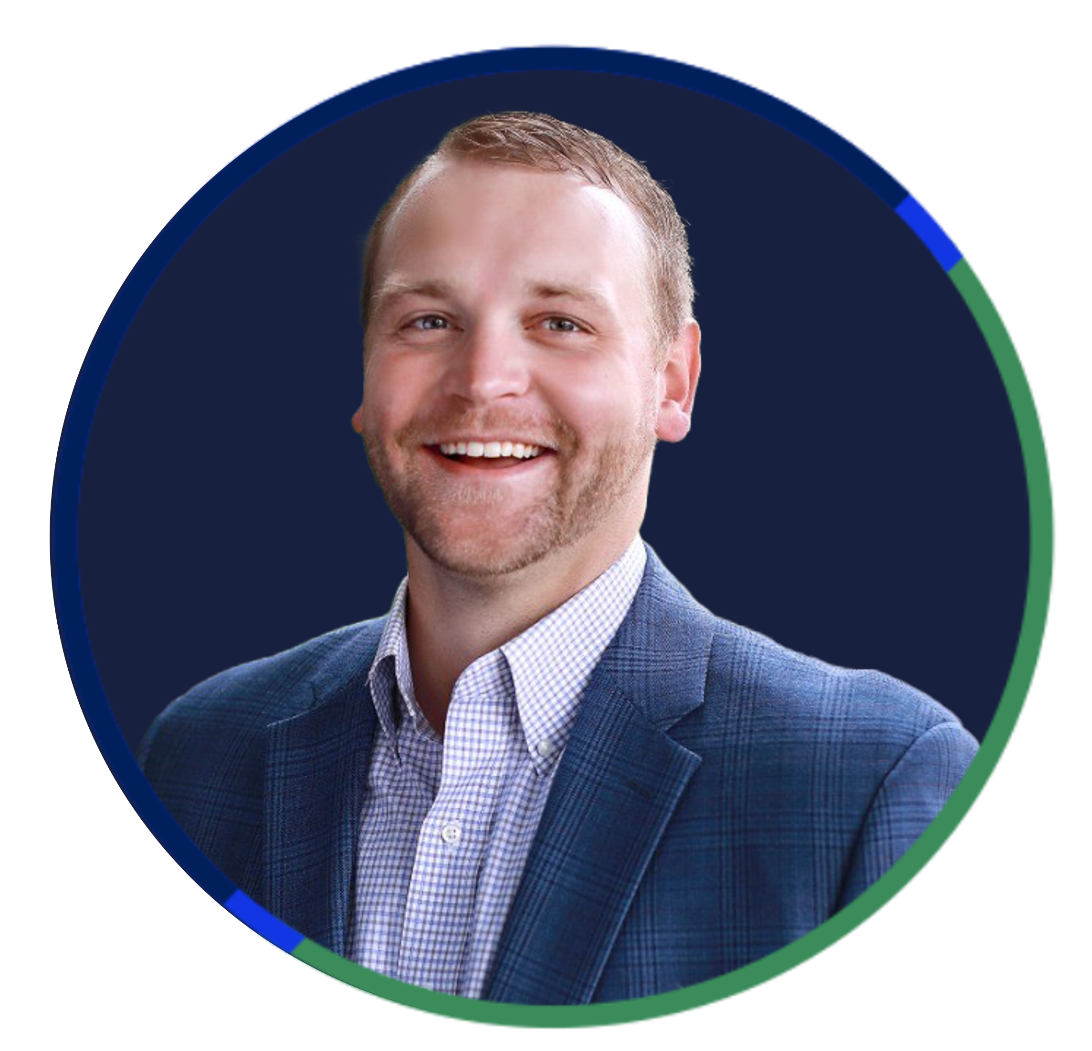
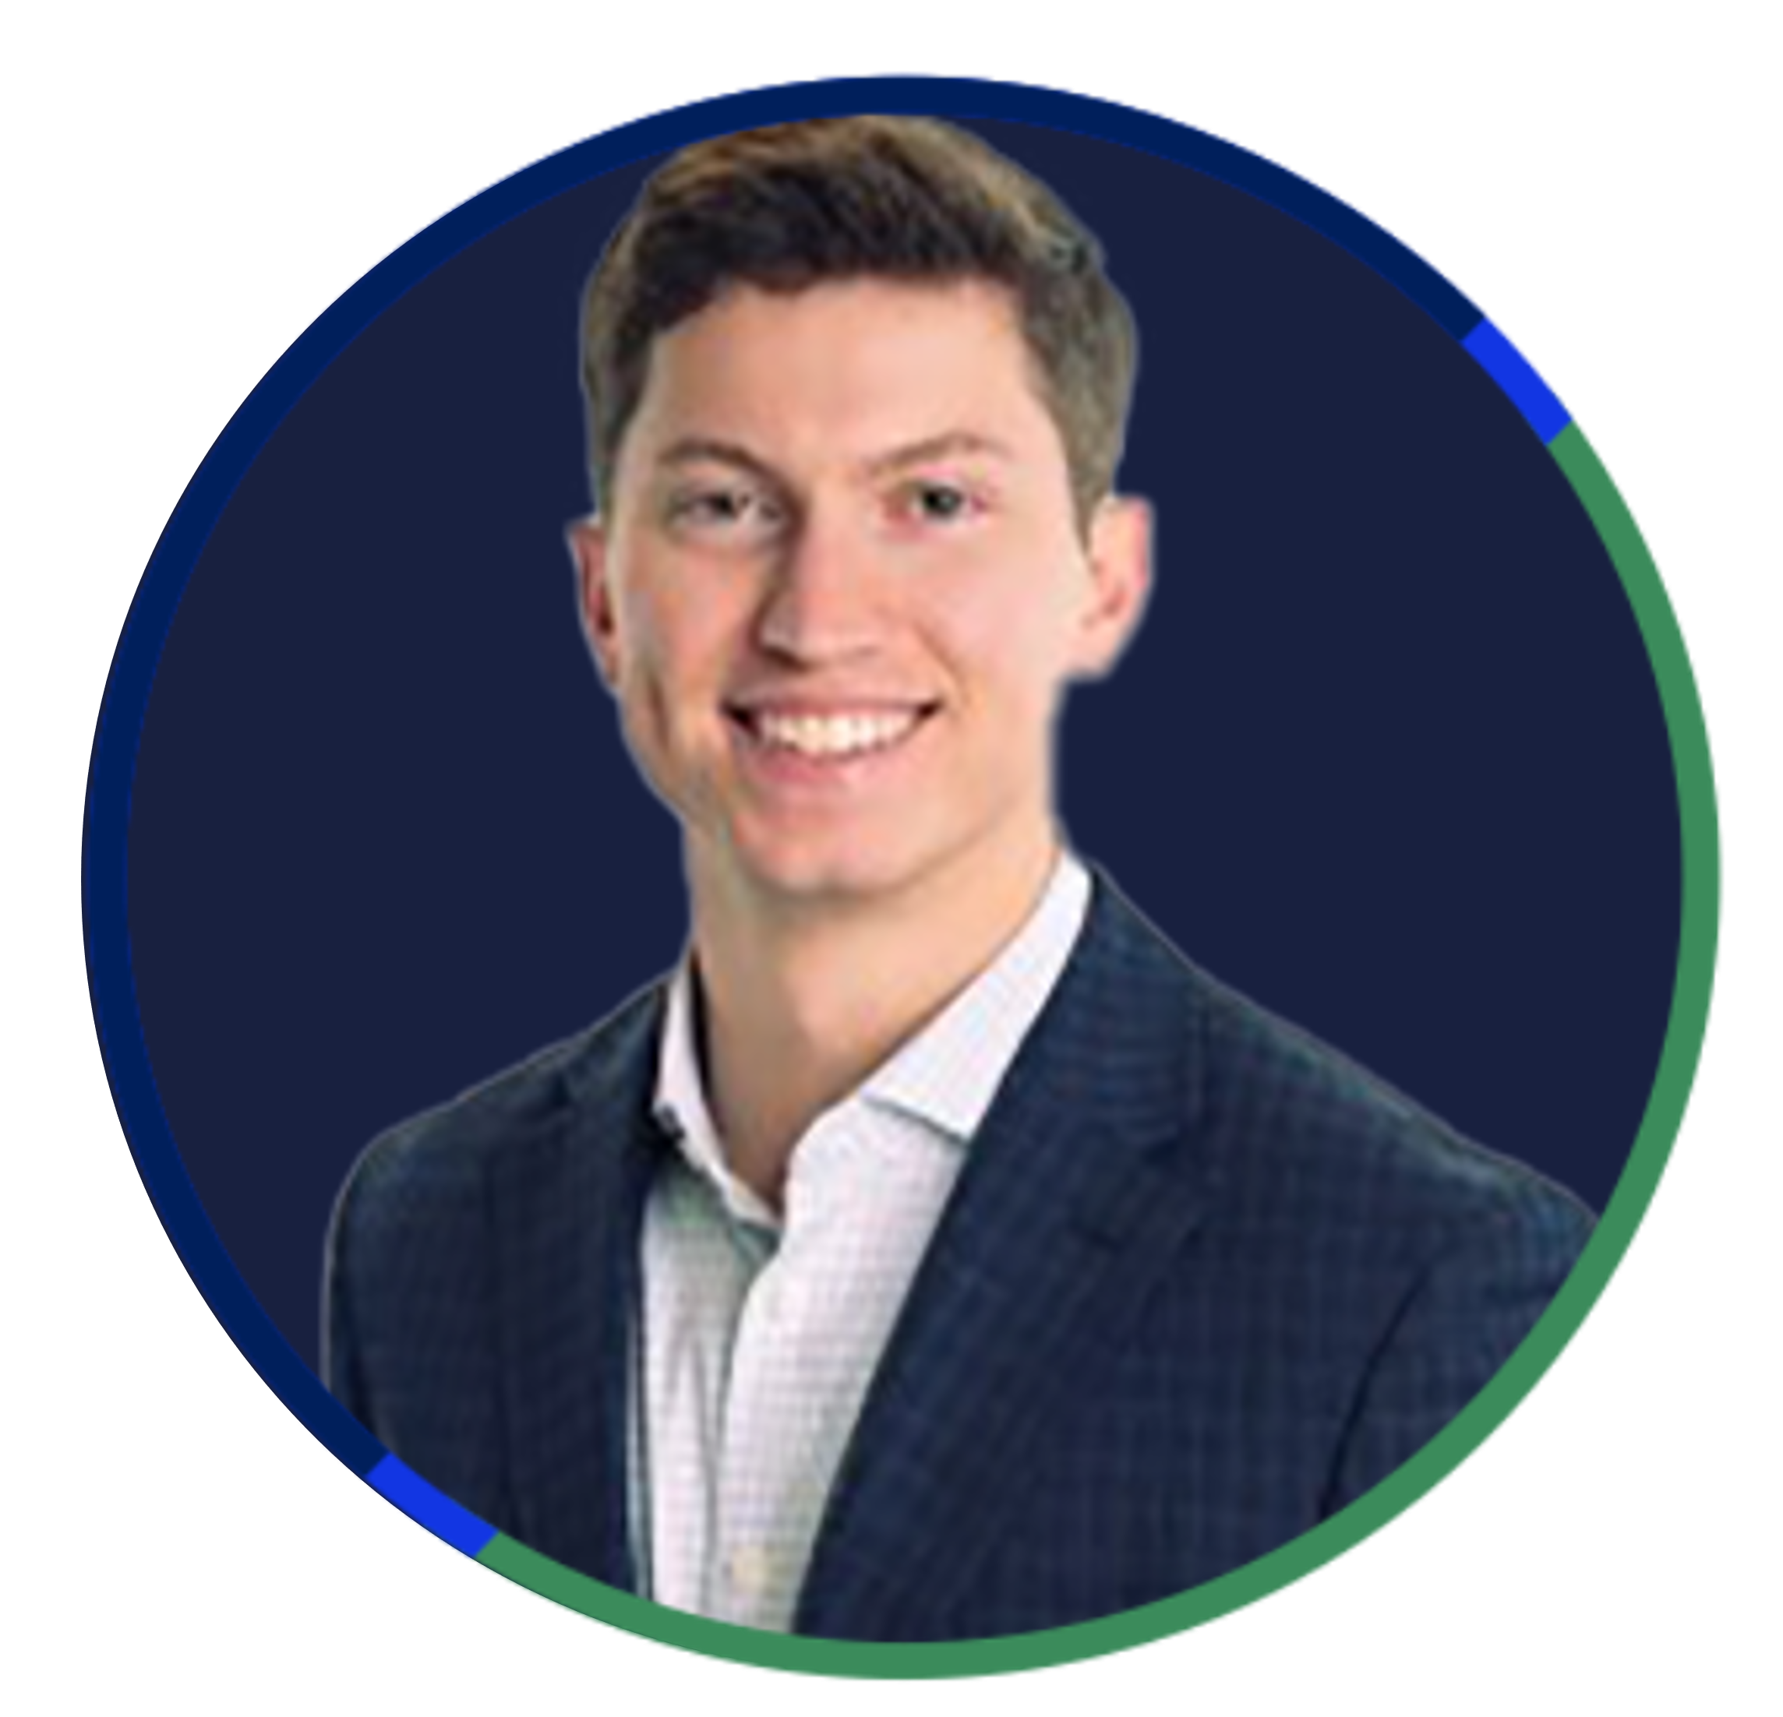
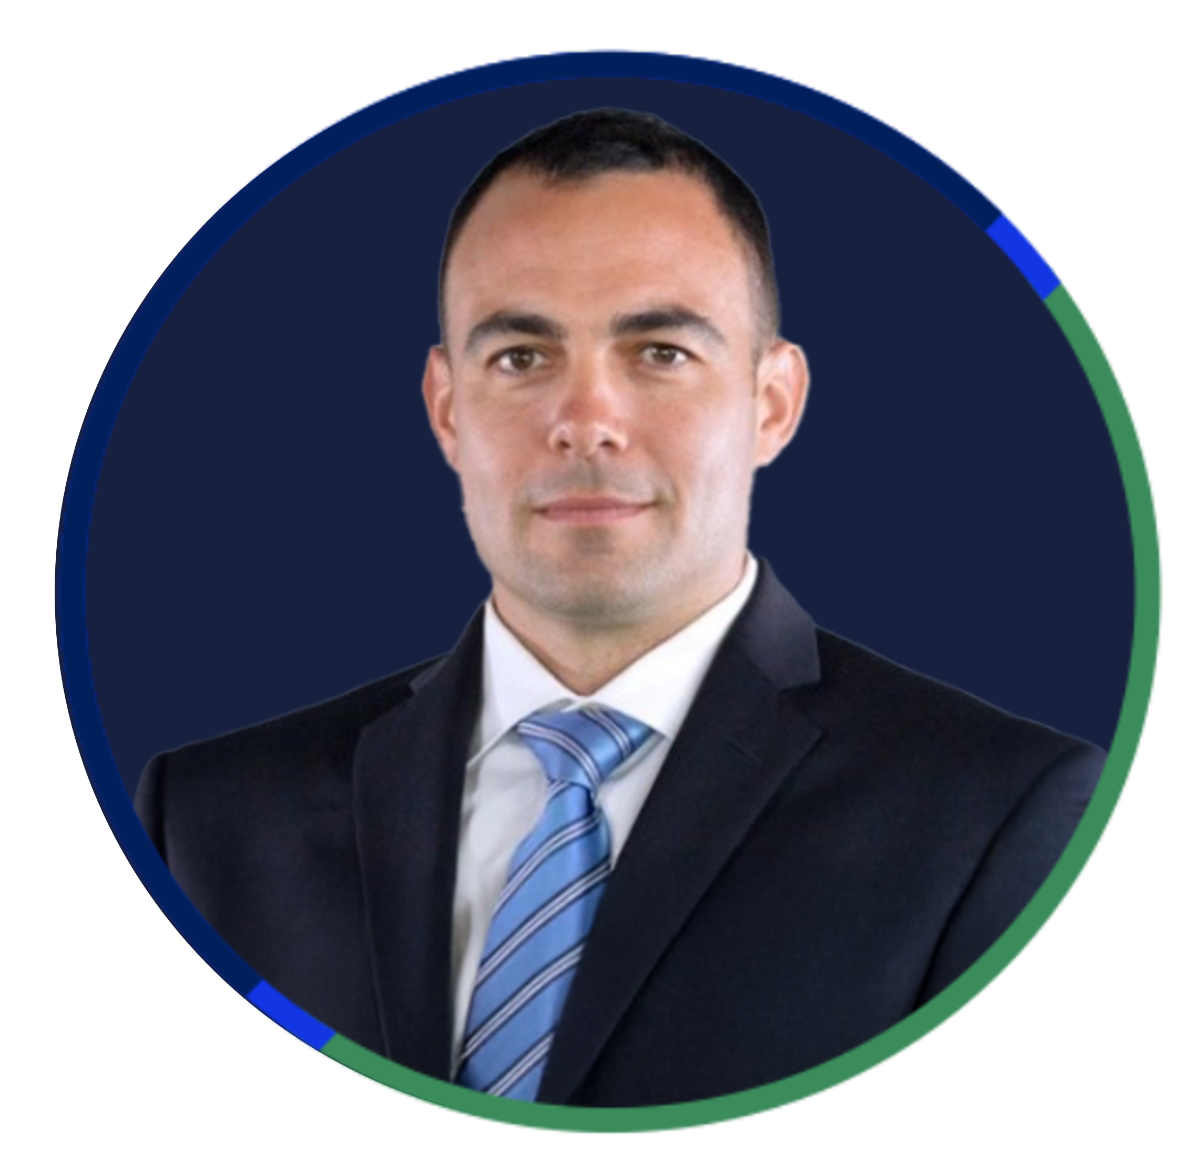
MENTORSHIP PIT CREW
Powering Growth from Within
Jeff
Beck
Regional EVP Sales
Mike
Randall
Executive Vice President of Vertical Strategies
Jeff
Steinberg
Sales Development Executive, CL
Ed
Williams
Sales Executive, CL
Seth
Thompson
SVP Sales CL
David
Hicks
Sales Development Executive, CL
Alush
Garzon
National Manufacturing Vertical Leader

