Slide 1
M&A/PRIVATE EQUITY:
DEAL-DRIVEN COVERAGE
NICK TULIEBITZ

Slide 2
Services Overview
  REPRESENTATION AND
  WARRANTIES INSURANCE
  LIABILITY INSURANCE
  P&C DUE DILIGENCE
      Tax Liability Insurance (Tax Insurance)
      Contingent Liability Insurance (Contingent Risk Insurance or Litigation Buyout Insurance)
      Insurance Program Review​
      Purchase Agreement Review​
      Post-closing Pricing Estimates​
      Loss Summaries Analysis​
      Closing Checklist Process
      Best-in-Class Brokers / M&A Advisory​
      No Additional Fees Beyond Commission​
      Deal Negotiations with Legal Advisors​
      Thoughtful Process Through Seasoned Expertise​
  PORTFOLIO CONSULTING SERVICES
  CLAIMS MANAGEMENT
  BENEFITS DUE DILIGENCE
      Employee Benefits Program Analysis​
      P&C Program Review​
      401(k) Strategy Analysis​
      Risk Management Cost Optimization​
      Reporting Assistance​
      Carrier Negotiations​
      Efficient Facilitation
      Synergies Analysis​
      Coverage Review​
      Cost Assessment

Slide 3
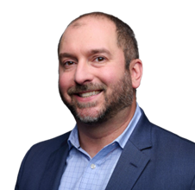

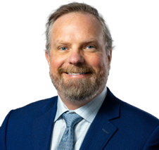
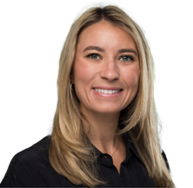
Our Team
  The M&A vertical is strategically guided by Nick Tuliebitz and Darlyn Heckman. Each brings nearly a decade of experience as practicing M&A attorneys, possessing a comprehensive understanding of the legal complexities and nuances inherent in these transactions. Their combined expertise encompasses deal structuring, negotiation, due diligence, and risk mitigation, providing invaluable counsel to our clients throughout the transaction lifecycle. With experience spanning diverse deal types and industries, they are adept at crafting tailored solutions to meet the unique needs of each client.
  Nick Tuliebitz
  National M&A Vertical Co-Leader
  nick.tuliebitz@assuredpartners.com | 914-220-6920
  Darlyn Heckman
  National M&A Vertical Co-Leader
  darlyn.heckman@assuredpartners.com | 917-284-1482
  Matt McFall
  M&A Vertical Due Diligence Practice Leader
  Having previously directed M&A due diligence at a major international insurance brokerage, Matt brings extensive experience in providing strategic advisory services. He collaborates closely with Nick and Darlyn to ensure a holistic and integrated approach to M&A transactions.
  matthew.mcfall@assuredpartners.com | 914-220-6931
  Olivia Detato
  Vice President
  Olivia works closely with Nick and Darlyn on RWI initiatives. She is anticipated to assume a managerial role upon graduation this spring from the Tuck School of Business at Dartmouth College.
  olivia.detato@assuredpartners.com | 914-220-6924

