Slide 2


CROSS-SELL & UPSELL:
DRIVING SUCCESS
Notes:
Welcome Introduction

Slide 3

Toree Hughes
Service Operations Trainer

Slide 4
OBJECTIVES
01.
Shift to identify key client touch points and the most effective strategies for cross-sell or upsell based on the client’s unique needs.
02.
Demonstrate how to conduct a needs assessment in a client conversation.
03.
Confidently address client questions and demonstrate your understanding of the product/service benefits.
Notes:
Let's dive into the objectives of our strategy.
First, it's crucial to shift our focus toward identifying key client touch points. These touch points are the moments where we can really make an impact by tailoring our cross-sell or upsell strategies to fit the unique needs of each client.
Moving on, we'll explore how to conduct an effective needs assessment during client conversations. The goal here is to truly understand what the client values and how our offerings can meet those needs.
Finally, we'll address how to confidently respond to client questions. This involves demonstrating a deep understanding of the benefits of our products or services. Remember, it's not just about answering questions—it's about building trust and showcasing our expertise.
By focusing on these areas, we're setting the stage for successful client interactions and paving the way for effective cross-selling and upselling.

Slide 5

UNLOCKING THE CROSS-SELL FORMULA
CS
N
+
E
+
Q
+
R
+
V
+
S
=
Quoting
Vision:
Paint the picture of not improving protection.
Educating about Risk Exposure
Making the Sale: Obtaining the Signed Application
Needs Assessment
Reviewing
Quote/Answering Questions
Notes:
For our Cross-Sell formula, we have CS = N + E + Q + R, multiplied by the V symbol. And finally, + S.
If you're not a math lover, you may be thinking to yourself, what happened, I thought I was in Cross-Sell: Beyond the Basics, not Advanced Formulas with Einstein.
I know, I know - but I promise it'll all come together and then you'll be printing out this slide to hang at your desk.
Let's talk about what each piece of this formula means.
CS stands for Cross-Sell, easy peasy so far.
N stands for Needs Assessment. This is where we start and this is a fundamental aspect of cross-selling. We must understand our clients' unique needs. To do that, we can use open-ended questions to identify gaps in their current coverage and recognize areas where additional insurance products could be advantageous.
Next we add in E for Educating on Risk Exposures. Once we understand their needs, we can proceed to educate them about their exposures. What areas are they leaving themselves open to financial injury?
ASK - How can we effectively educate clients about their exposures and potential financial risks?
Next we add in Q for Quoting: Here we quote the coverage they are interested in and share it with the client.
The last add in for this piece is R for Review & Respond: We follow up with the client to review the quote and answer any questions they may have.
ASK - How should we follow up with clients to review quotes and address their questions?
POSS ANSWERS: In person, Phone Call, Emails - emails should follow up a phone call or in-person attempt.
We're walked through the first piece of this formula: Completing the Needs Assessment, Educating on Exposures, Quoting Coverage, then Reviewing & Responding.
Now, we take all that and multiple by that V which, again, paints a picture of the potential lack of protection.
This is where you pose to the client, what is the cost to them of not securing the coverage. Is the client OK with taking the financial responsibility of the risk exposure?
And our last piece of the formula is to add in that S which stands for Sealing the Deal. Make the sale by obtaining the signed application, binding coverage, and documenting everything thoroughly.
ASK - We talked earlier about why documentation is crucial - who can tell me what thorough documentation looks like?
POSS ANSWERS: Who, What, When, Where, Why.
By following these steps, you ensure a comprehensive and client-centric approach to cross-selling insurance products.
Breakdown of the Formula:
N: Needs - Identifying the client's specific needs.
E: Engagement - Building a strong relationship through effective communication.
Q: Quality - Ensuring high-quality products and services.
R: Risk - Assessing and mitigating the client's risk exposure.
V: Universal applicability - Applying the formula universally to all clients.
S: Satisfaction - Achieving client satisfaction through tailored solutions.
Each component contributes to a holistic approach to client relationships, ensuring that clients receive the best possible coverage and service.

Slide 6

UNLOCKING THE CROSS-SELL FORMULA
CS
N
+
E
+
Q
+
R
+
V
+
S
=
Quoting
Vision:
Paint the picture of not improving protection.
Educating about Risk Exposure
Making the Sale: Obtaining the Signed Application
Needs Assessment
Reviewing
Quote/Answering Questions
Notes:
Today, we’re diving into a crucial aspect of our client interactions: educating about risk exposure. Think of this as laying the groundwork for a solid relationship. It’s not just about identifying risks but understanding how they impact our clients.
When we move into needs assessment, it’s vital to ask the right questions. This helps us tailor our approach to each client’s unique situation and seamlessly transition into making the sale. Obtaining that signed application is more than a transaction—it’s a commitment to fulfilling their needs.
This is our moment to reinforce their confidence in our service. Remember, our vision here is to illustrate the cost of not improving protection. It’s all about unlocking the cross-sell formula.
Let’s make sure we’re not just selling a product but offering peace of mind.

Slide 7






CROSS/UPSELL WORKFLOW
Email client and
follow-up with a call based on recommendations
Create recommendation and document file
Analyze Current Coverage vs New Risks exposure
Review Renewal Questionnaire
Notes:
Let's explore the cross/upsell workflow. This step is crucial for understanding our client's current needs and identifying any new risk exposures.
First, we'll review the renewal questionnaire. This helps us ensure that we have all the necessary information about the client's current coverage.
Now, let's move on to analyzing the current coverage against any new risks. This comparison is vital for identifying gaps or areas where the client may need more protection.
Then, we create a recommendation document. This is tailored to each client, ensuring that we address their specific needs and concerns.
Once the document is prepared, we'll email it to the client and follow up with a call. This follow-up call is key to discussing our recommendations and answering any questions they may have.
Finally, remember that this process is part of our broader cross/up-sell workflow. By understanding and addressing our client's needs, we can offer additional solutions that truly benefit them.
Let's continue to explore how understanding the client's buying process can enhance our client-centric approach.

Slide 8
UNLOCKING THE CROSS-SELL FORMULA
CS
N
+
E
+
Q
+
R
+
V
+
S
=
Quoting
Vision:
Paint the picture of not improving protection.
Educating about Risk Exposure
Making the Sale: Obtaining the Signed Application
Needs Assessment
Reviewing
Quote/Answering Questions
Notes:
Let's delve into the concept of risk exposure and how it plays a crucial role in our needs assessment process.
First, we emphasize the importance of educating clients about potential risks they face. This is not just about selling but ensuring they understand the implications of not improving their protection.
Next, reviewing quotes and answering questions, we unlock what we call the cross-sell formula. This formula isn't just about numbers; it’s about creating a vision for the client—a vision where they feel secure and well-protected.
As we continue, remember the key: it's about painting a picture of security, ensuring the client sees the value in what we offer. This isn't just about policies; it's about peace of mind.

Slide 9

IDENTIFY CROSS-SELL APPROACHES
  Understand the client’s buying process & recognize when they need new or better insurance.
  Foster a client-centric approach by being responsive & actively listening to client experiences.
Notes:
When cross selling it is important to identify the client's buying process. Take the time to actively listen to their stories to be able to identify when new or better insurances are needed.
For example if in the course of a conversation a client mentions they like to host parties and you know this client is liability conscious, you may then offer an umbrella policy.
or if a landscaper mentions transitioning his detached garage to a storage/ office for the business, it is an opportunity to discuss that the building may not be covered under his homeowners policy, but we may be able to write a commercial property policy.
Being responsive, and actively listening to their experiences in order to understand when a client will need new or better insurance is a key aspect of fostering a client centric relationship.

Slide 10










INTRODUCING THE CROSS-SELL
STRATEGY FOR SUCCESS
Receive
Introduce
Gaps
Receive & review renewal questionnaire.
Introduce yourself & the meeting’s purpose:
  Set clear expectations for review duration.
Cover gaps in coverage to provide protection.
  Provide transparency in coverage detail, fees, and risks.
Send
Review
Send an email to schedule a meeting with the client.
Review Findings:
  Risk Exposures
  Educate Meaning

Slide 11
UNLOCKING THE CROSS-SELL FORMULA
CS
N
+
E
+
Q
+
R
+
V
+
S
=
Quoting
Vision:
Paint the picture of not improving protection.
Educating about Risk Exposure
Making the Sale: Obtaining the Signed Application
Needs Assessment
Reviewing
Quote/Answering Questions
Notes:
Let's dive into the heart of our discussion today: Educating about Risk Exposure.
Our vision is to paint a clear picture of the consequences of not improving protection. We want the client to see the value we bring, not just in terms of cost, but also the peace of mind and security our solutions offer.
Finally, remember, unlocking the cross-sell formula is not just about selling more but about providing comprehensive protection that aligns with each client's specific needs. This approach fosters trust and long-term client relationships.

Slide 12
CLIENT OBJECTIONS COMMON OBJECTIONS
Type of Consumer
What They Mean
What Clients Say
“I don’t see the value vs. the cost in the coverage you are proposing.”
Economic
“The price is too high.”
Humanistic
“This coverage doesn’t align with my needs specifically.”
“I don’t think this would help me.”
Behaviorist
“I don’t trust what my agent has to say.”
“You are just trying to get more premium from me.”
“I think I already have coverage on the policy I currently pay for.”
Cognitive
“My other policies cover that.”
Psychodynamic
”I need more time to think about it.”
“I don’t have the time I’ll call back.
Notes:
Often, what clients say and what they mean can be two different things. Consumers may object when they are seeking to procrastinate a buying decision. Our goal is to decode their messages to gather additional information, address their concerns, and determine their priorities based on the type of consumer they identify as.
Questions:
Do we see a difference in what they say versus what they mean or might be feeling?
Why do we think they may be saying one thing while meaning another?
How does fear influence consumer behavior?
By understanding the difference between what clients say and what they mean, we can better address their concerns, provide relevant information, and guide them towards a confident buying decision.
Transition: When receiving objections from clients it is important that we fully listen to their concerns.

Slide 13
CLIENT OBJECTIONS LEVELS OF LISTENING
PROACTIVE
ACTIVE
SELECTIVE
PRETEND
IGNORE
What level of listening do you often find yourself at?
Notes:
Active listening is crucial in the cross-selling process. Every piece of information we receive from our clients helps us build solutions that fit their needs perfectly. Let's explore the five levels of listening:
Levels of Listening:
Ignore:
At this level, we are completely disengaged from the conversation. We have tuned out our client and are not receiving any information.
Pretend:
Pretending to listen gives the client the impression that we are focused on them. However, they soon realize that we haven't gathered any meaningful information from the interaction.
Selective:
We hear parts of the information the client provides but only focus on what we choose to hear. This selective hearing is often used to formulate a response rather than truly understanding the client's needs.
Active Listening:
We are fully engaged in the conversation, absorbing the information. This level of listening helps us assist the client effectively while demonstrating engagement and empathy.
Proactive Listening:
The highest level of listening, incorporating elements of active listening. Here, we use the information gathered to proactively create solutions tailored to the client's specific needs.
Question: What level of listening do you often find yourself at?

Slide 14





CLIENT OBJECTIONS: IRS
01
  ISOLATE
01
Identify the true root cause and concerns by asking thoughtful questions.
  RESPOND
02
02
Tailor response to show your understanding and explain the rationale and reasoning behind your suggestion.
03
  SUPPORT
Provide objective facts to help the client see the data and reinforce your position as consulting to benefit their interests.
03
Notes:
As we dive into the topic of overcoming objections, let's focus on three key strategies: Isolate, Respond, and Support.
First, Isolate. This means identifying the true root cause of concerns by asking thoughtful questions.
Think about how powerful a simple question can be. It opens the door to understanding the client's perspective and allows us to address their specific worries.
Next is Respond. Tailor your response to show you truly understand their concerns. This is where your rationale and reasoning come into play.
Make it clear that you are not just presenting information but rather engaging in a dialogue that respects their viewpoint.
Lastly, Support. It’s crucial to provide objective facts that help clients see the data, reinforcing your position as a consultant who genuinely wants to benefit their interests.
By following these steps, we can create a more productive conversation and foster a deeper connection with our clients.
Let's remember that effective communication hinges on our ability to listen, empathize, and ask the right questions.

Slide 15


CLIENT OBJECTIONS: SUPPORT
Facts
Analogies
Statistics
Demonstrations
E
A
T
F
S
E
D
Exhibits
Testimonies
Examples
EVIDENCE DEFEATS DOUBT
Notes:
As we explore how to effectively support client objections, it’s important to consider the different types of evidence that can help us overcome doubt.
Let's look at the acronym DEFEATS, where each letter represents a powerful tool in our toolkit: Demonstrations, Examples, Facts, Exhibits, Analogies, Testimonies, and Statistics.
These elements work together to build credibility and trust. By providing clear demonstrations and relevant examples, we can make abstract concepts more tangible. Facts and exhibits lend authority to our claims. Analogies can simplify complex ideas, while testimonies and statistics offer additional validation from real-world experiences.
Remember, the goal here is to support our claims effectively. By thoughtfully selecting the right type of evidence for each situation, we can address client concerns, helping them feel more confident in their decisions.

Slide 16

FINAL ACTIVITY
PIT STOP PARTNER UP
OBJECTIVE:
Learners will use a deck of cards to identify partners, rotate among groups, and engage in collaborative discussions to deepen their understanding of cross-sell and upsell strategies.
QUESTIONS:
1st Circuit: Which element of a client needs assessment do you find most valuable? How do you usually uncover that information when working with clients?
2nd Circuit: What type of consumer do you identify as—are you driven by price, quality, convenience, or something else? How do these traits influence the buying decision?
3rd Circuit: What common objections do you encounter from clients? What strategies have worked best for you in overcoming those challenges?
Notes:
Now, let's move on to our final activity, which is all about engaging collaboratively to deepen your understanding of cross-sell and upsell strategies.
You'll be using a deck of cards to help you identify partners and rotate among groups. This is a fun and interactive way to share insights and learn from each other.
First, you'll "Pair" up. Use the card given to you to find a partner with the same suit. This duo will be your discussion partner for the first round.
Next, we'll "Rotate & Regroup." After 3 minutes of discussion, shuffle and rotate. Find new partners based on different card traits.
Finally, in "Share & Reflect," each group will discuss the given topic and share key takeaways with everyone. Remember, the goal is to build on each other's ideas and enhance your strategies.
Let’s get started with our Pit Stop Partner Up!

Slide 17

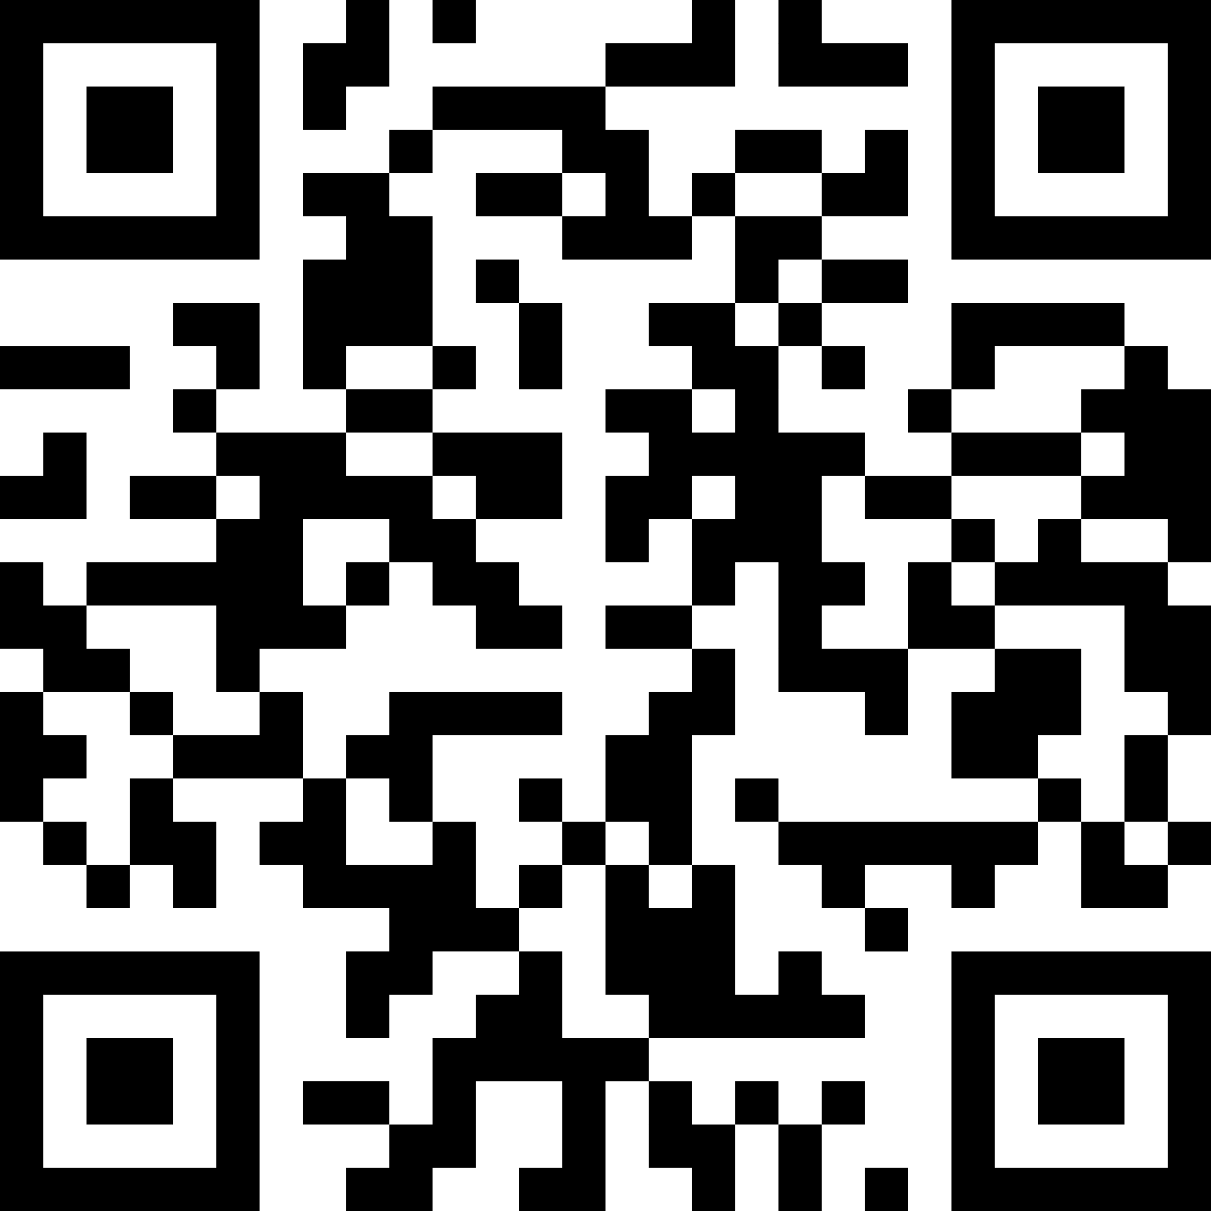
ENROLLMENT MADE EASY
Start Your Engines
& Enroll!
Ready to kick your learning into high gear? Just scan the QR code to zoom straight into the course registration pit lane. Whether you're looking to accelerate your career or take a victory lap through new business skills, this QR code is your fast track.
Notes:
Alright, everyone, let’s get ready to put the pedal to the metal!
Today, we're offering you the chance to turbocharge your learning journey. By simply scanning the QR code, you'll be taken directly to the course registration pit lane. It's designed to be as seamless as possible, so you're not stuck idling—you’re ready to roll!
Think of it as your fast track to new opportunities—whether you're looking to accelerate your career or enjoy a victory lap with some fresh business skills, this is your opportunity to start your engines and enroll.
Remember, enrollment is made easy—just a scan away. So, who’s ready to take the lead and hit the ground running?

