Slide 1
AEROSPACE: ALTITUDE
STEVE WHITLOCK, ISAAC HATHAWAY

Slide 2


Why AssuredPartners Aerospace
Whether companies own or rent an aircraft, operate a flight school, or provide other essential services to the aviation industry, they are exposed to a variety of critical risks. AssuredPartners has a professional Aerospace team who provides wholistic insurance and risk management solutions from light aircraft to large aircraft and everything in between that keeps them all flying into the future.
AP Aerospace provides protection and peace of mind to more than 40,000 aviation clients who share our passion with the art and science of flight. Our aim is to help you manage risk while also saving time, money, and resources so you can better run your business and enjoy that passion.

Slide 3


Knowledge & Relationships
When it comes to aviation insurance, often you must know as much about the industry as you know about insurance.
Our Aerospace vertical combines both. Our team features FAA-licensed pilots, mechanics, former military aviators, and others with diverse aviation operational backgrounds. Many are graduates of leading university aviation programs and have insurance designations.
The aviation insurance market is very small and requires expert knowledge from people with the relationships required to get things done.
We represent every domestic and international aviation insurance market. In the ~$1B+ general aviation insurance market, AP Aerospace represents over 20% of that premium.
    AssuredPartners Aerospace
      145 aviation insurance professionals
      10 U.S. office locations plus London

Slide 4
Why use the Aerospace Resource Center?
Team of aviation insurance professionals that know how to sell, service and support a wide range of aviation accounts from one central location.
Complete domestic market access as well as access to Lloyds of London for quota-share placements
Market appointments in all 50 states
AP Aerospace invests over $1M annually in aerospace marketing, industry support and goodwill
Aviation is a high-visibility, high-stakes industry. The expertise of the AP Aerospace team helps to mitigate both reputational risk and potential E&O

Slide 5
Nationwide Offices
Chaska, MN
Hillsboro, OR
Denver, CO
Wichita, KS
Aerospace Resource Center
(800) 721-6733
Frederick, MD
Columbia, SC
Carlsbad, CA
Phoenix, AZ
Stuart, FL
Dallas, TX

Slide 6
Strategy, Marketing and Deployment
Renewal Strategy
120 days in advance to discuss outcomes and long-term goals
Determine analytical strategy
Discuss retention analysis and self insurance strategy
Marketing
Creation of full underwriting submission, tailored to each individual market (based on their specific premium and loss activity)
Plan to visit with all US, UK and EU underwriters
Deploying a strategy based on client discussions to extract best overall outcome.
Captive feasibility
Bursary for safety services
Limit expansion
Finance optimization

Slide 7
Client Mix
AP Aerospace handles all lines of aviation coverage and is well-versed in complex risk environments. We speak the language of aviators, are familiar with industry best practices, and can readily identify coverage gaps that are unique to the aviation industry.
      Corporate Aircraft
      Helicopters
      Air Ambulance
      Air Freight
      Airports
      Agricultural Aircraft
      Alaska Operations
      Charter & Management Companies
      Fixed Base Operators (FBOs)
      Flight Schools & Universities
      Government Contracting / Special Mission Aircraft
      Maintenance, Repair & Overhaul (MRO) Facilities
      Owner-Flown Turbines
      Recreational Aircraft
      Regional Airlines
      Sports Team Transportation
      Warbirds
      Worldwide Operations

Slide 8


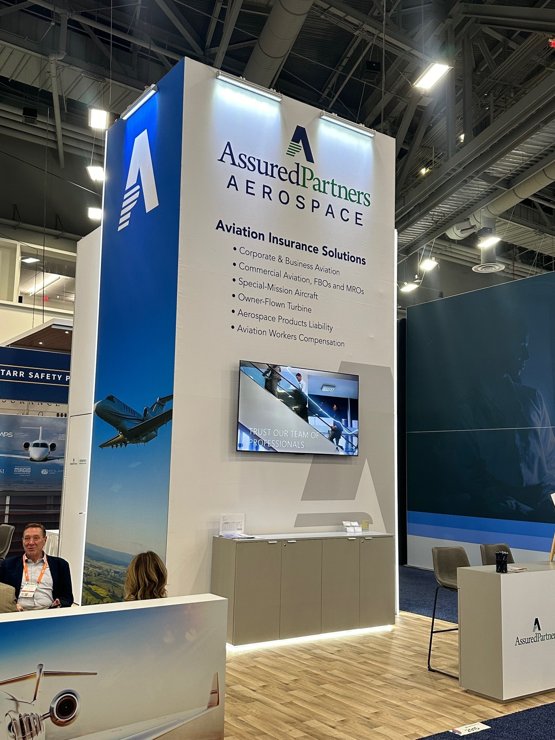
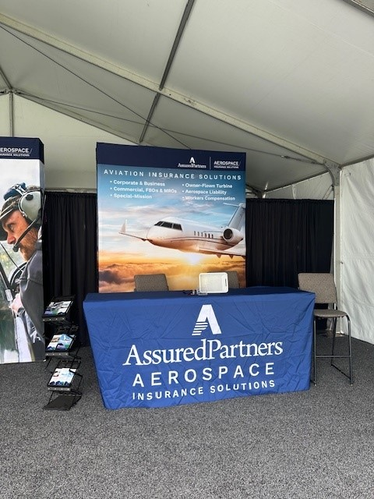

Associations & Industry Involvement
Aerospace team members are active in the aviation industry, with many having held key leadership positions throughout their careers.
      Aircraft Owners & Pilots Association (AOPA)
      National Business Aviation Association (NBAA)
      Vertical Aviation International (VAU)
      National Air Transportation Association (NATA)
      National Agricultural Aviation Association (NAAA)
      Regional Air Cargo Carriers Association (RACCA)
      Internation Society of Transport Aircraft Trading (ISTAT)
      Flight School Association of North America (FSANA)
      Embry-Riddle Aeronautical University (ERAU)
      Aviation Insurance Association (AIA)

Slide 9

Risk Management Resources
Contract Reviews
Certificate Management
Emergency Response Planning
Industry Education
Safety Surveys

Slide 10
AP AEROSPACE STRUCTURE
AssuredPartners Aerospace Insurance & Risk Management
Passionately taking care of clients and each other with respect, integrity, diligence, and expertise.

Slide 11
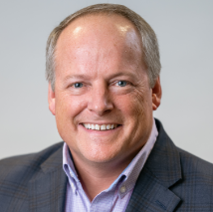
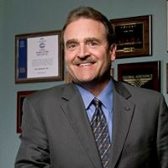
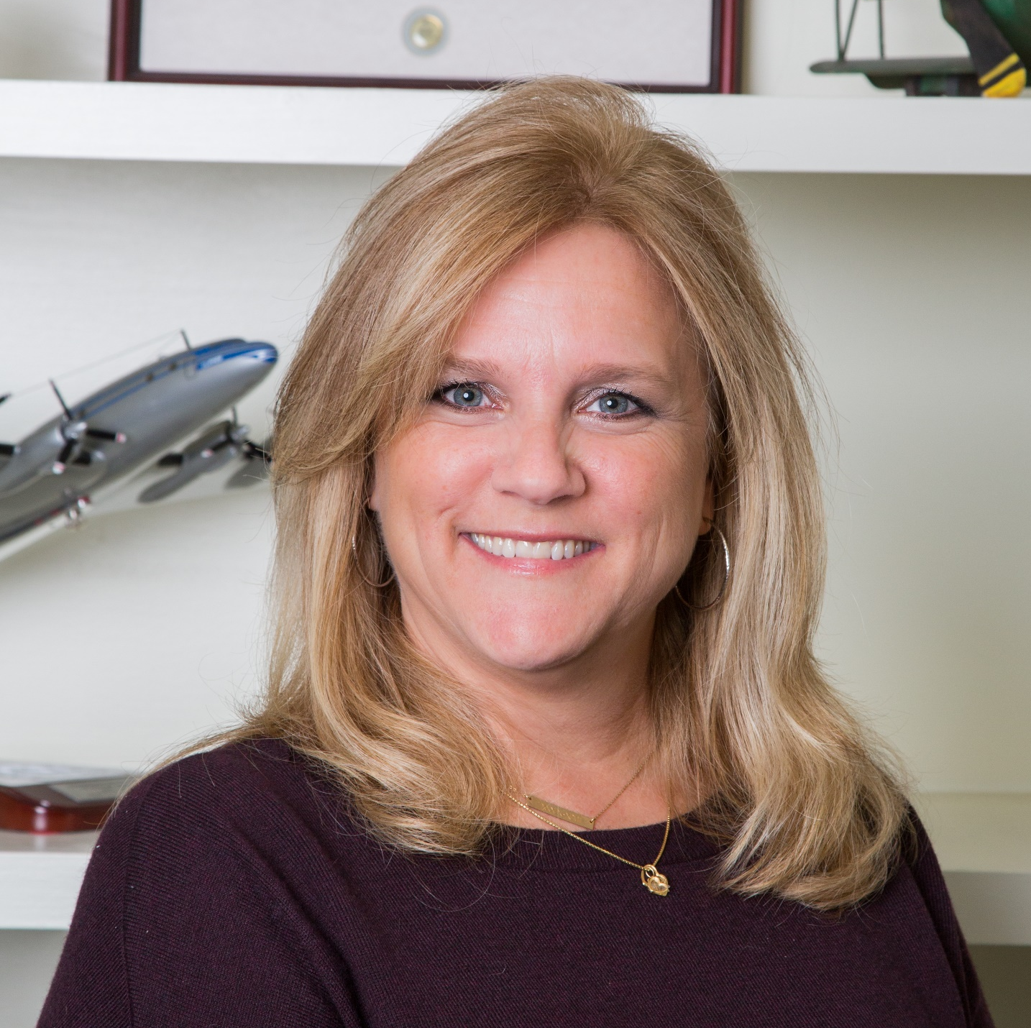
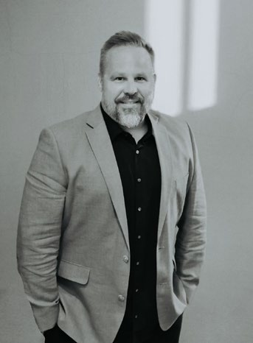
Aerospace Leadership
  Eric Barfield, President
Dallas, TX
Since 1998, Eric has served as a broker with Hope Aviation Insurance which was acquired by AssuredPartners in 2017, whereupon he took on the role as COO before becoming President of AP Aerospace. Eric received a Bachelor of Science in Aviation Business Administration from Embry-Riddle Aeronautical University and holds the Certified Aviation Insurance Professional (CAIP) and Associate in Risk Management (ARM) designations. He is a former chairman of the Aviation Insurance Association’s Education Committee and the National Business Aviation Association’s Safety Committee. In addition, Eric is an FAA Commercial Pilot and former Flight Instructor.
  Steve Whitlock, SVP Aerospace Vertical Director
Dallas, TX
A dual degree graduate of Embry-Riddle Aeronautical University, Steve's aviation insurance career began in 1978 as an aviation insurance underwriter specializing in FBOs & flight schools. After two years as a broker with Bayly, Martin & Fay (now AON) in the early ’80s, he served as Director of Insurance / Risk Manager for the Miami-based airline, Air Florida. After the demise of Air Florida, Steve returned to the brokerage ranks for over 13 years with Fred. S. James & Co. / Sedgwick Aerospace (now Marsh), followed by Willis Corroon. He joined AirSure in early 1997. AirSure was acquired by AssuredPartners in 2014. Steve is a Certified Insurance Counselor, a Certified (and licensed) Risk Manager, a Certified Aviation Insurance Professional, and a licensed pilot.
  Bernadette Manglaris, Managing Director – Aerospace East
  Wichita, KS
  Bernadette began her career in aviation insurance in 1990 as an Account Manager. She joined Hope Aviation in 2015 as Senior Account Executive until they were acquired by AssuredPartners in 2017. Bernadette specializes in complex aviation account management including fixed based operators, charter and management firms, aerial applicators, helicopter operators and more. Additionally, Bernadette leads the AssuredPartners Vertical Resource Center.
  Isaac Hathaway, CLCS, Aerospace Vertical Specialist Team Leader
Wichita, KS
Isaac joined AP Aerospace in 2021. He has extensive experience in managing insurance programs that include Commercial Aviation, General Liability, Aviation Products Liability, Aviation Workers Comp, D&O, Cyber Liability, and additional coverages within Aviation Operations. Isaac oversees the Aerospace Resource Center which was established to assist non-aviation AssuredPartners offices with the clients who required the expertise of Aviation Risk Management and Insurance.

Slide 12

Claims Advocacy
Nate Cobb
Senior Claims Representative
Educated at Embry-Riddle Aeronautical University with over 25 years of aviation claims experience, our licensed aviation adjuster is ready to assist clients with complex claims. The overarching goal of claims advocacy is to mitigate and expedite the claim, and ultimately, reach a successful resolution for the client.
FAA Commercial Pilot
M. S. Safety Management Systems, Embry-Riddle Aeronautical University
Airport management experience (DEN and SAN)
Aircraft accident investigation experience

Slide 13
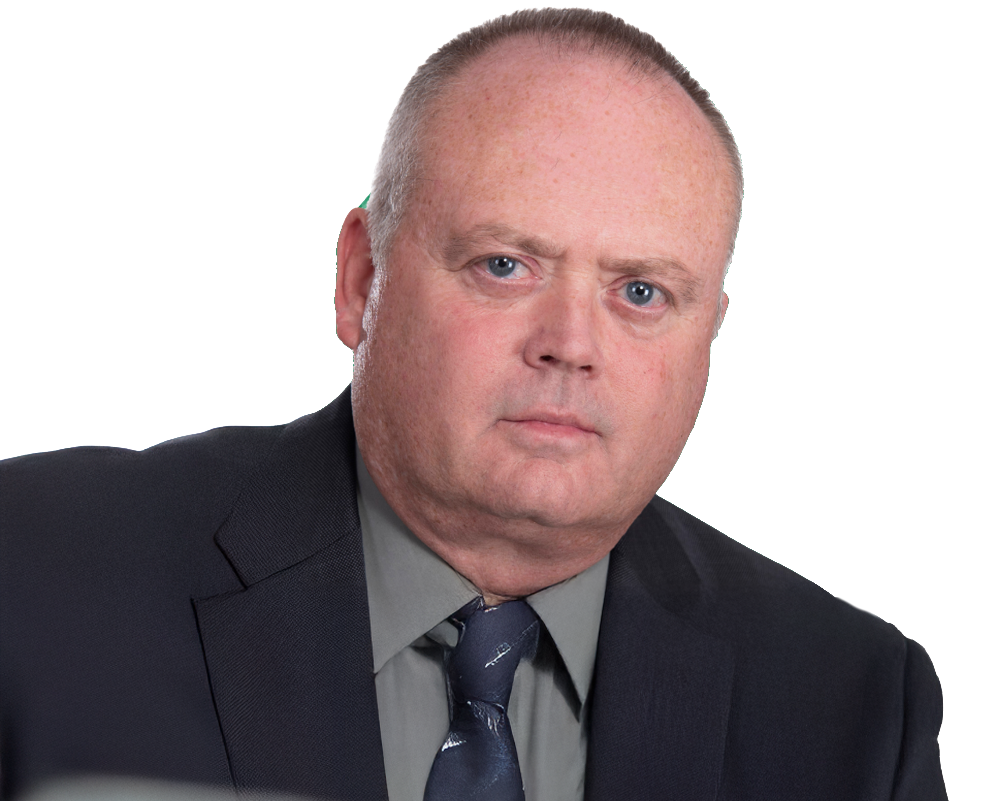
Loss Prevention
Mike Bradley
Senior Loss Advisor
With an illustrious career spanning 27 years of military service and a diverse background in aviation leadership roles during his 32 years in civilian aviation, Mike Bradley stands as a seasoned professional committed to enhancing safety and operational excellence. He brings unique insights derived from his diverse background, covering Military, MRO, Air Carrier, Corporate, and General aviation. His tangible experience in accident recovery and investigation further enriches his understanding of safety nuances.
Areas of expertise: Mike specializes in a range of critical areas, including Safety Management Systems (SMS), root cause analysis, risk management, mentorship, problem-solving, manual writing, and the development of policies and procedures. His focus on creating meaningful, measurable metrics and promoting transparent communication underscores his dedication to safety and operational excellence.
Strategic Vision and Methodologies: Mike's strategic vision revolves around transparent communication, active listening, and proactive and predictive methodologies. His approach includes mentorship, a commitment to continued education, and the provision of valuable resources and experience.
Client engagement and strategic opportunities: In client engagement, Mike is passionate about creating a Just Culture. He conducts comprehensive visits, actively participating in safety assessments and ERP drills. He promotes safety as a non-punitive culture, utilizing data-driven insights and customized options based on the size and scope of operations. Mike actively seeks to engage with current clients, contribute to new business opportunities, and plug into areas identified by the team or client for continuous improvement.
In conclusion, Mike Bradley is poised to bring his wealth of experience, strategic vision, and commitment to safety to your organization. His comprehensive skill set, and dedication make him an ideal partner in advancing your aviation safety objectives.

