Slide 1

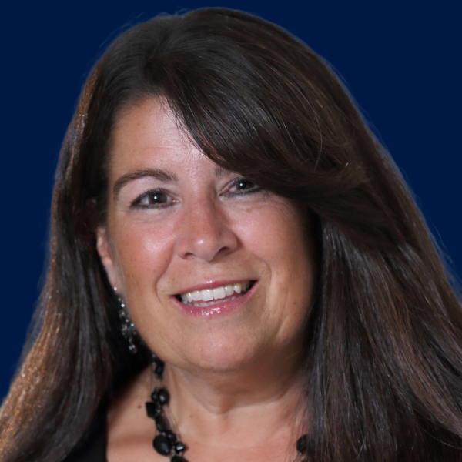

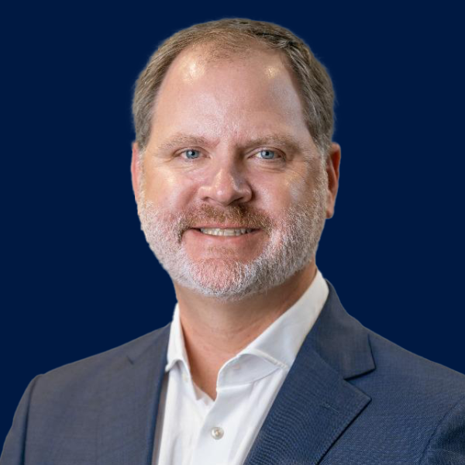
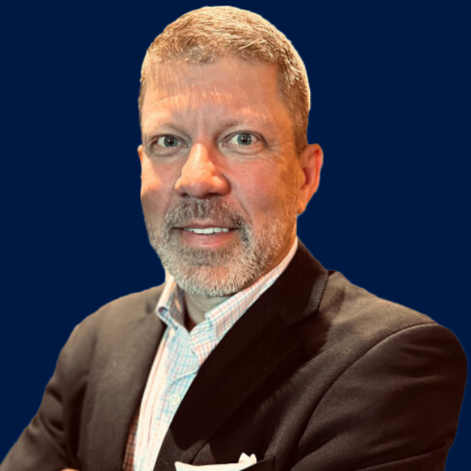
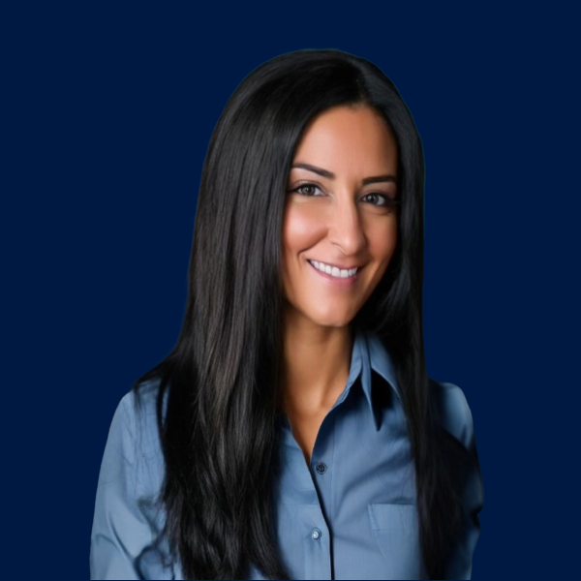
RISK AT SPEED
Alternative Strategies in Motion
Nick
Napolitano
National Captives Vertical Leader
Lori
Harris
Director, Captives
Jack
Foley
P&C Captives Practice Leader
Geoff
Christian
EB Captives Leader
Jeff
Kurz
SVP, Director-Alternative Risk Strategies
Sarah
Creighton
VP, Alternative Risk Strategies

